Slide 1
Telling Time Two
Quarter to, half past

Slide 2
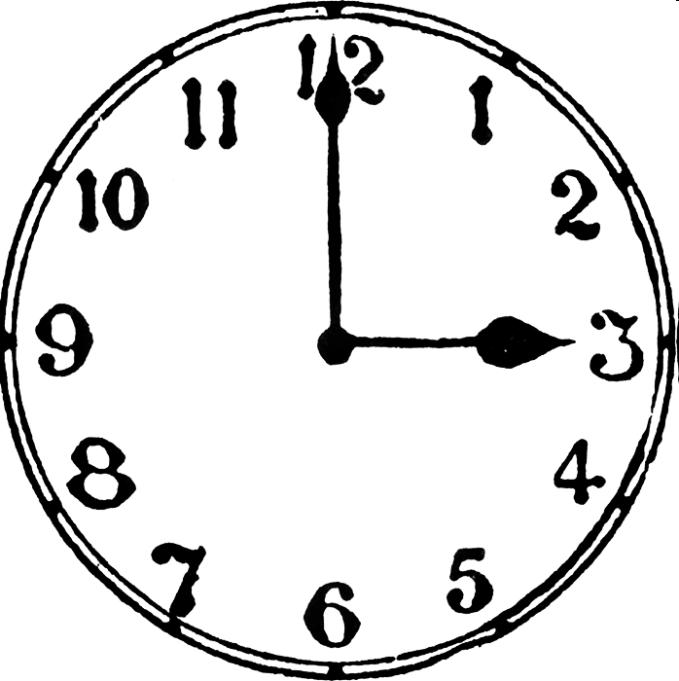
O'clock

Slide 3
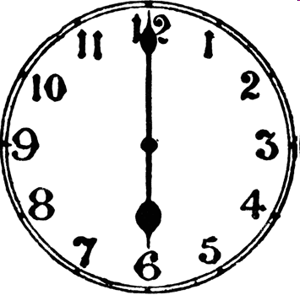

Slide 4
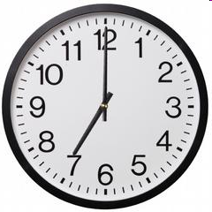

Slide 5
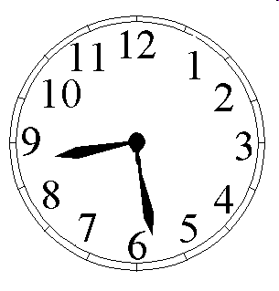
8:28 Eight, Twenty-eight

Slide 6
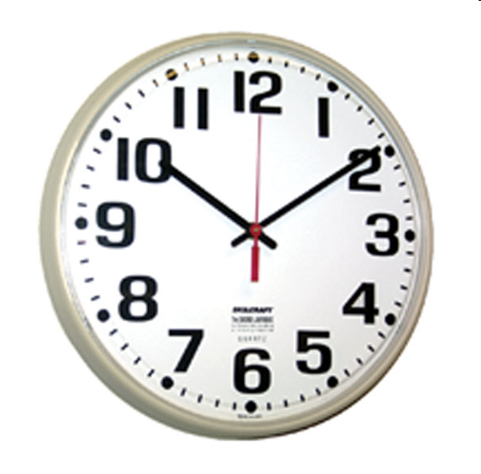

Slide 7
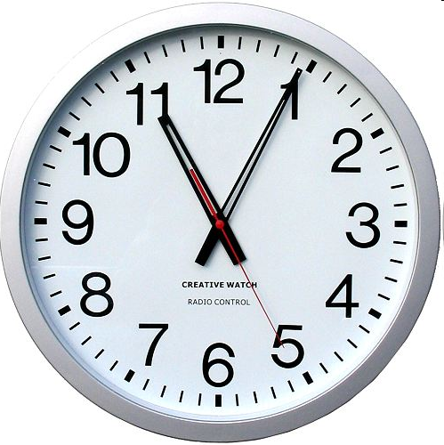

Slide 8
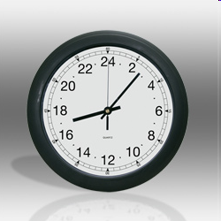

Slide 9
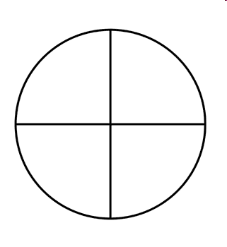
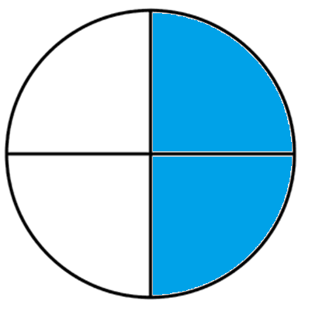

1/4
Quarter =
Half =
1/2

Slide 10
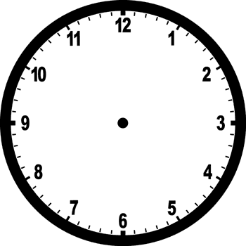
TIME
Quarter past _______
Half past _______
Quarter to _______
It’s five to eight. It’s ten past three.

Slide 11
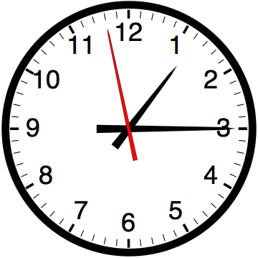

Slide 12


Slide 13
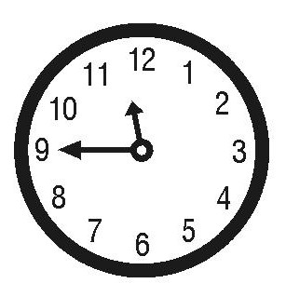

Slide 14
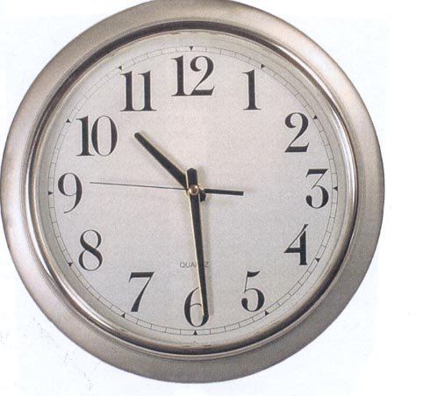

Slide 15
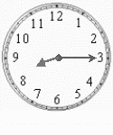

Slide 16
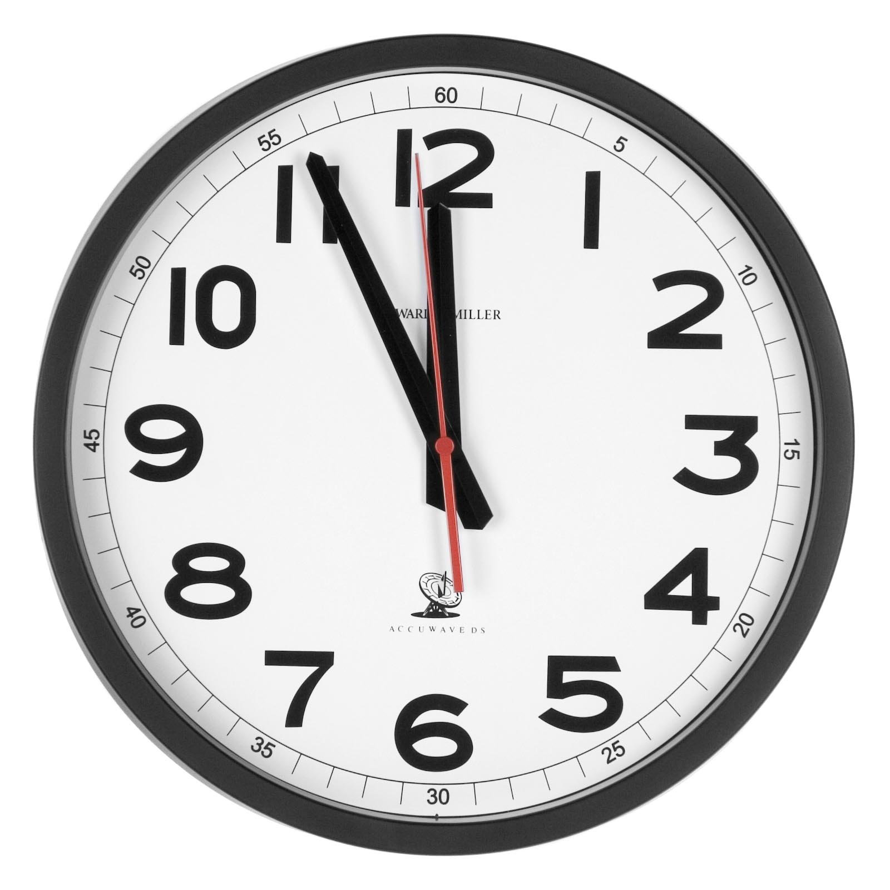

Slide 17
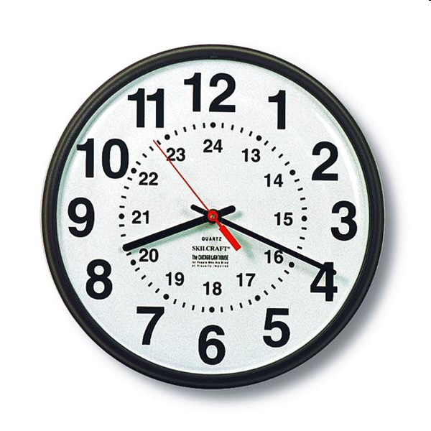

Slide 18
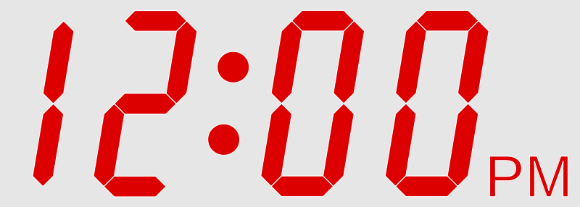
Noon

Slide 19

Midnight

Slide 20
What time is it now?
When does class start?
When is class over?

Slide 21
Create the Time
One student will come to the front.
Another student will say a time.
The first Student will produce the time on the clock.
http://www.classtools.net/random-name-picker/

Slide 22
Time Stop
http://www.teachingtime.co.uk/clock2/clockwordsres.html
http://www.teachingtime.co.uk/draggames/sthec3.html

Slide 23
TIME Race
You can use two broken clocks, draw some on the board, or make your own.
Have two students come to the front.
Use the random selector and that student will say a time
  http://www.classtools.net/random-name-picker/
The fastest student to create the correct time is the winner

