Slide 1


Time Ninjas

Slide 2
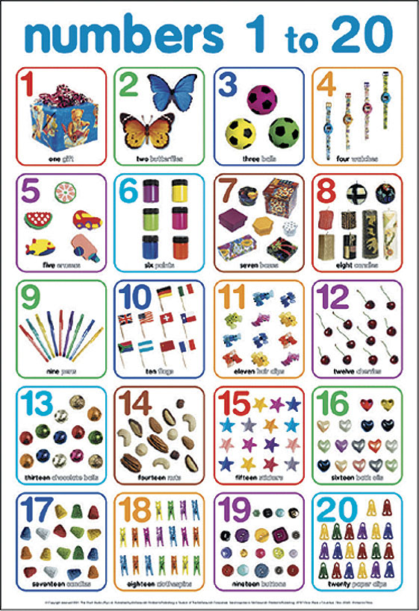
REVIEW

Slide 3
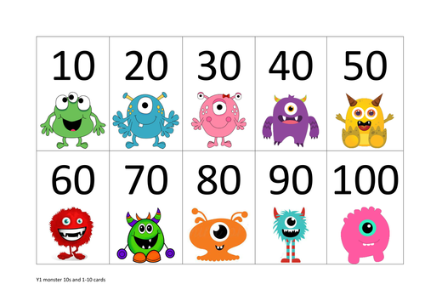
REVIEW

Slide 4
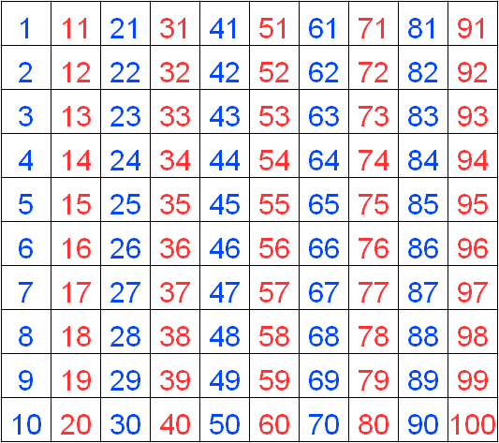
REVIEW

Slide 5
Find the Ninja
Time | :00 | :05 | :10 | :15 | :20 | :25 | :30 | :35 | :40 | :45 | :50 | :55
1:00
2:00
3:00
4:00
5:00
6:00
7:00
8:00
9:00
10:00
11:00
12:00
How to read the clock
6:15
3:45
12:00

Slide 6
Find the Ninja
Time | :00 | :05 | :10 | :15 | :20 | :25 | :30 | :35 | :40 | :45 | :50 | :55
1:00
2:00
3:00
4:00
5:00
6:00
7:00
8:00
9:00
10:00
11:00
12:00
Step 1
  Hide your ninjas
  Secretly make 20 circles

Slide 7
Find the Ninja
Time | :00 | :05 | :10 | :15 | :20 | :25 | :30 | :35 | :40 | :45 | :50 | :55
1:00
2:00
3:00
4:00
5:00
6:00
7:00
8:00
9:00
10:00
11:00
12:00
Step 2
  Guess where the ninjas are hiding
  “It’s 10 o’clock”

Slide 8
Find the Ninja
Time | :00 | :05 | :10 | :15 | :20 | :25 | :30 | :35 | :40 | :45 | :50 | :55
1:00
2:00
3:00
4:00
5:00
6:00
7:00
8:00
9:00
10:00
11:00
12:00
Step 2
  If you are correct, you get one point.
  If you are wrong, mark an ‘X’ on your paper to remember.
I
I

Slide 9
Find the Ninja
Time | :00 | :05 | :10 | :15 | :20 | :25 | :30 | :35 | :40 | :45 | :50 | :55
1:00
2:00
3:00
4:00
5:00
6:00
7:00
8:00
9:00
10:00
11:00
12:00
Take turns guessing where the ninjas are until someone wins or time is up

