Slide 1
Time’s Up Game

Slide 2
Rules:
Click the correct answer before the time runs out.
If time runs out, choose a new student and start over.

Slide 3
Start

Slide 4
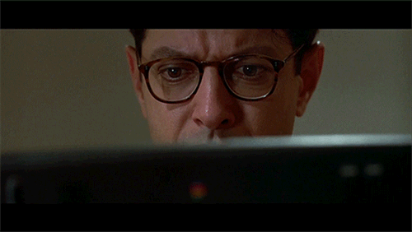
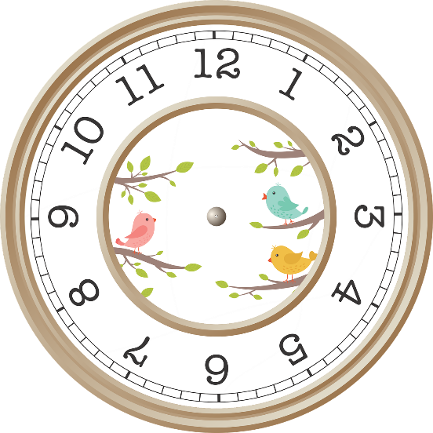
Two O’clock
2:00
12:00
20:00
22:00

Slide 5
6:00
Six O’click
Six O’clock
Six Zero
Clock O’Six

Slide 6
it is time what
It is what time?
What is time it?
What time is it?
Time is it what?

Slide 7
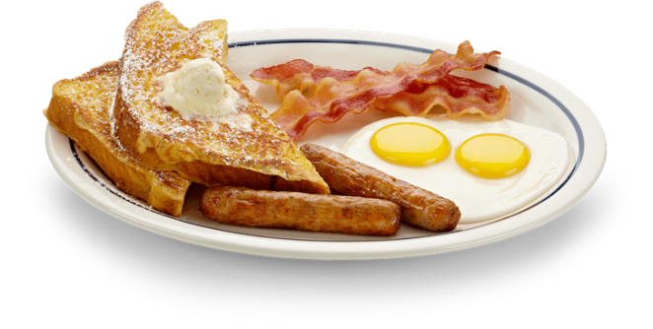
8:30 .
It’s breakfast. It’s eight thirty.
It’s twelve ten. It’s time for breakfast.
Breakfast is eight thirty.
It’s eight thirty. It’s time for breakfast.

Slide 8
4:30
Forteen three
For thirteen
Forty three
Four thirty

Slide 9
Eleven- eleven
11:10
11:11
10:01
10:11

Slide 10
12:45
Twelve forty-five
Twelve fifteen
Twenty o’clock
Twenty forty-five

Slide 11
Twelve twenty
21:20
10:22
20:12
12:20

Slide 12
1:33
One – three - three
Thirty-one three
One thirty-three
Thirteen three

Slide 13
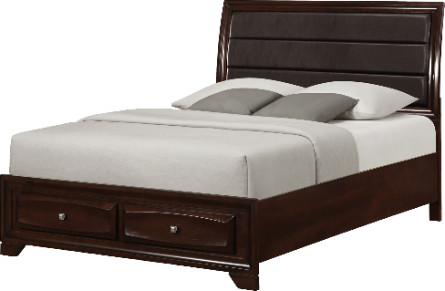
9:40 .
It’s nine forty. It’s time for bed.
Nine forty bed
It’s nine fourteen. It’s time for bed.
It’s bed time.

Slide 14
It’s eight twenty.
It’s time for school.
It’s time for lunch.
Happy birthday.
It’s time for bed.

Slide 15
LUNCH TIME IT’S FOR
Lunch for it’s time.
It’s for time lunch.
It’s lunch time.
It’s time for lunch.

Slide 16
It’s time for lunch.
6:00
12:10
8:30
7:40

Slide 17
It’s 5:30.
It’s time for breakfast.
It’s time for lunch.
It’s time for dinner.
It’s time for bed.

Slide 18
6:50 .
It’s six fifty. It’s time for school.
It’s six fifty. It’s time for lunch.
It’s sixty five. It’s time for dinner.
It’s six fifty. It’s time for dinner.

Slide 19
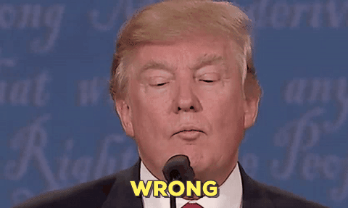
Click Anywhere

Slide 20
Winner!

