Slide 1
Time’s Up Game

Slide 2
Rules:
Click the correct answer before the time runs out.
If time runs out, choose a new student and start over.

Slide 3
Start

Slide 4
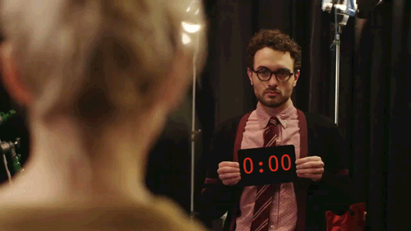
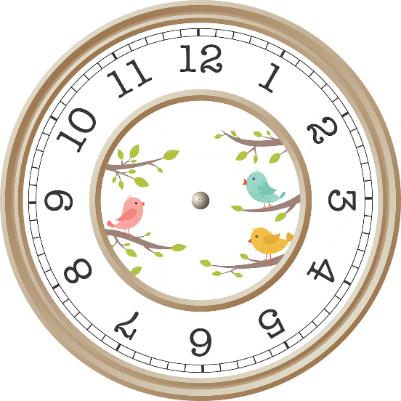
Seven o’clock
5:00
11:00
7:00
4:00

Slide 5
10:00
Ten O’clock
Ten zero zero
One o’clock
Clocks ten

Slide 6
ftbasaerk
School
What time it is?
breakfast
fastball

Slide 7
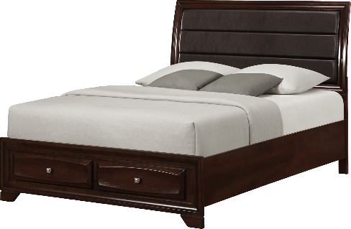
9:00 .
It’s bed. It’s nine.
It’s nine o’clock. It’s time for lunch.
Dinner is nine o’clock.
It’s nine o’clock. It’s time for bed.

Slide 8
1:30
thirteen
Thirty one
One thirty
One o’clock thirty

Slide 9
Eleven- ten
11:10
11:11
10:01
10:11

Slide 10
6:45
Six forty-five
Six fifteen
Sixty o’clock
Sixty forty-five

Slide 11
Four twenty
14:20
14:22
4:12
4:20

Slide 12
5:22
Five twenty-two
Five two two
Fifty-two two
Twenty to five

Slide 13

8:20 .
I ate school twenty.
School is eight twenty.
It’s eight twenty. It’s time for school.
I go to school at eight o’clock.

Slide 14
It’s twelve ten.
It’s time for school.
It’s time for lunch.
Happy birthday.
It’s time for bed.

Slide 15
FOR IT’S SCHOOL TIME
School for it’s time.
It’s for time school.
It’s school time.
It’s time for school.

Slide 16
It’s time for bed.
It’s 3:00.
It’s 12:10.
It’s 9:20.
It’s 1:30.

Slide 17
It’s 7:20.
It’s time for breakfast.
It’s time for lunch.
It’s time for dinner.
It’s time for bed.

Slide 18

12:10 .
It’s twenty ten. It’s time for school.
It’s twelve ten. It’s time for lunch.
It’s twenty ten. It’s time for dinner.
It’s twelve ten. It’s time for dinner.

Slide 19
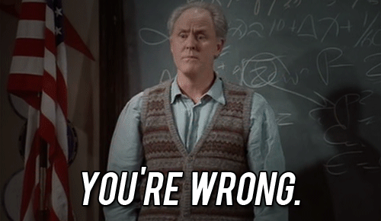
Click Anywhere

Slide 20
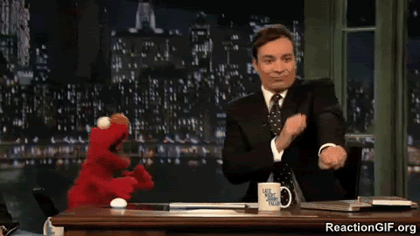
Winner !!!

