Slide 1
Time’s Up Game

Slide 2
Rules:
Click the correct answer before the time runs out.
If time runs out, choose a new student and start over.

Slide 3
Start

Slide 4
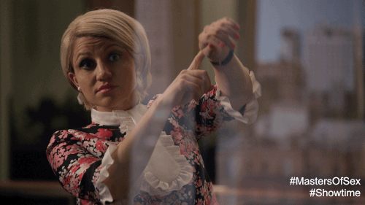
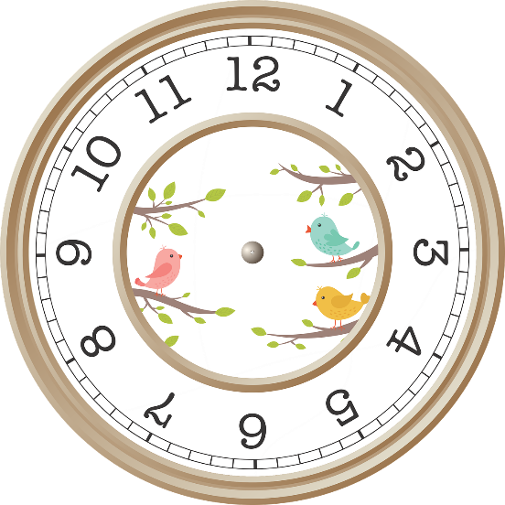
It’s five o’clock.
10:00
9:00
5:00
1:00
Time’s Up!

Slide 5
4:00
For O’clock
Four O’click
Four O’Clock
Four Clocks
Time’s Up!

Slide 6
HOSOCL
Class
Clock
Dinner
School
Time’s Up!

Slide 7
8:30 .
It’s lunch. It’s eight thirty.
It’s ten thirty. It’s time for breakfast.
Homework is eight thirty.
It’s eight thirty. It’s time for school.
Time’s Up!

Slide 8
2:50
It’s too fifty.
It’s two fifty.
It’s to fiddy.
It’s two fifteen.
Time’s Up!

Slide 9
Seven- eleven
11:07
7:00
7:11
11:00
Time’s Up!

Slide 10
12:15
Twelve fifteen
Twelve thirty
Twenty forty
Twenty fifteen
Time’s Up!

Slide 11
It’s eight ten.
18
800
8:00
8:10
Time’s Up!

Slide 12
3:21
Three – two - one
Twenty - one three
Three twenty one
Thirteen twenty
Time’s Up!

Slide 13
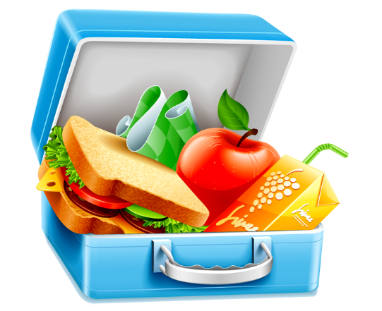
1:00 .
There is one o’clock. It’s lunch time.
Lunch at one clock.
This is a lunch. There is one o’clock.
It’s one o’clock. It’s time for lunch.
Time’s Up!

Slide 14
It’s six fifty.
It’s time for school.
It’s time for dinner.
Happy birthday.
It’s time for bed.
Time’s Up!

Slide 15
TIS MITE FOR LNCHU
What time is it?
It’s time for lunch.
It’s lunch time.
Pikachu
Time’s Up!

Slide 16
It’s time for bed.
5:00
12:10
6:50
9:30
Time’s Up!

Slide 17
It’s 8:30.
It’s time for breakfast.
It’s time for lunch.
It’s time for dinner.
It’s time for bed.
Time’s Up!

Slide 18
12:10 .
It’s twenty ten. It’s time for school.
It’s ten twenty. It’s time for lunch.
It’s twelve ten. It’s time for lunch.
It’s twelve ten. It’s time for dinner.
Time’s Up!

Slide 19
Click Anywhere

Slide 20
Winner!!

