Slide 1
Weather Forecast Cutouts

Slide 2
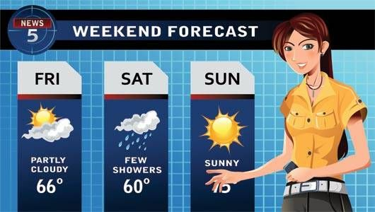

Slide 3
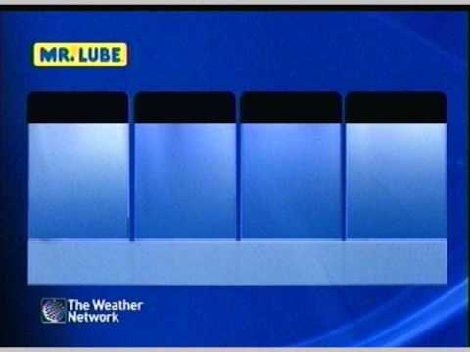
Prepare:
Print, Laminate, and affix Velcro tape to the following weather symbols.
Obtain a large felt board and draw a weather forecast chart on it.
  I did Monday to Friday
Cut out roles:
  Meteorologist
  Monday
  Tuesday
  etc.

Slide 4
Make a forecast:
First, hand out the role cards to volunteers.
The meteorologist will come to the front.
Starting with Monday, the days of the week will make a statement. “It’s Sunny.”, “It’s rainy.”
The meteorologist must memorize the forecast and reproduce it correctly. The days of the week will check the answers.

Slide 5
Get Harder
After a few round like this, you can make things a bit more difficult.
  Change the order of the days.
  Allow students to make more than one statement.
  Do not allow repeat statements.

Slide 6


Slide 7



Slide 8


Slide 9



Slide 10


Slide 11


Slide 12


Slide 14
Meteorologist
Monday

Slide 15
Tuesday
Wednesday

Slide 16
Thursday
Friday

Slide 17
Saturday
Sunday

