Slide 1
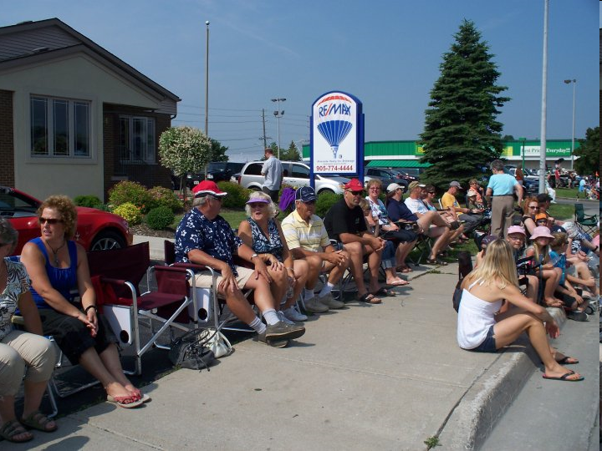
Family

Slide 3
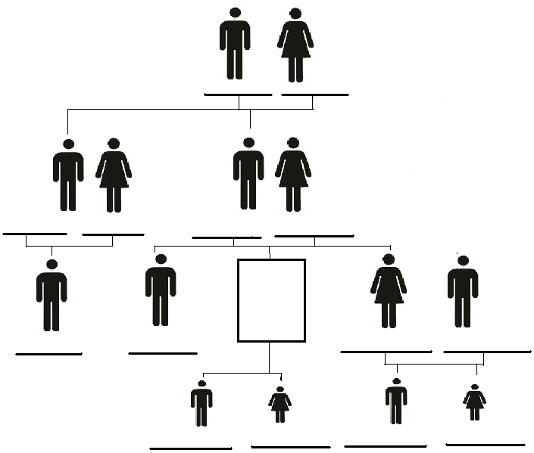
Name

Slide 4
You →

Slide 5
You →

Slide 6
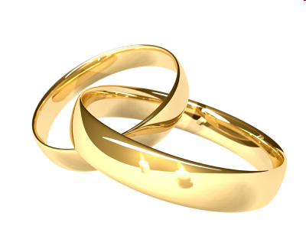
In-laws
After YOU get married…
Spouse = partner
Man =
Woman =
husband
wife
Mother in-law
Spouse's mother =
Spouse’s sister =
Sister in-law

Slide 7
Step – parents
Divorce = when marriage ends.
New mother =
New father =
New Brother =
Step-mother
Step-father
Step-brother

Slide 8
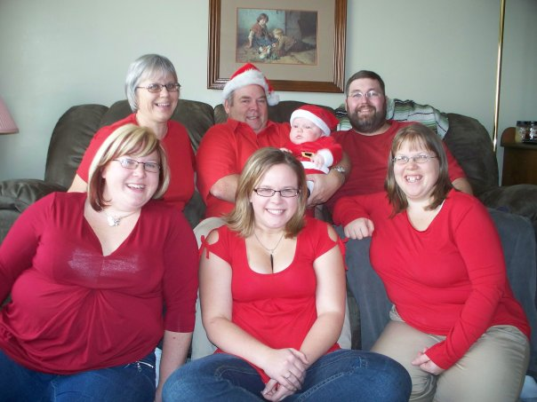
Family
In my family, I have …
In my family, I have three sisters a mother and a father. I also have a brother-in-law and a nephew.

Slide 9
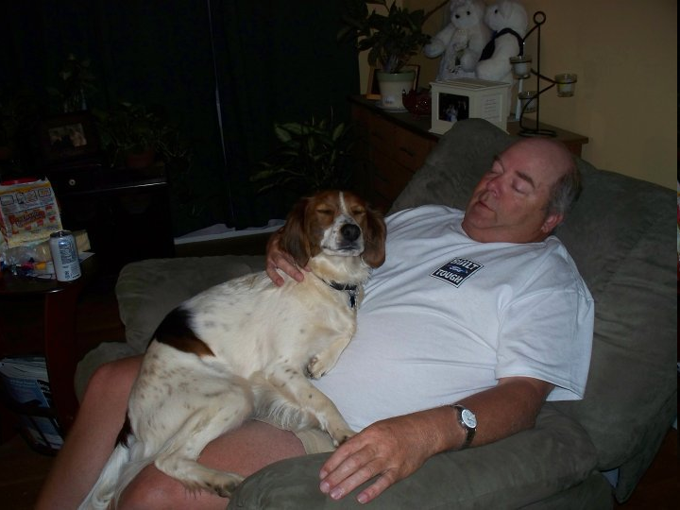
Family
My father’s name is Harold.

Slide 10
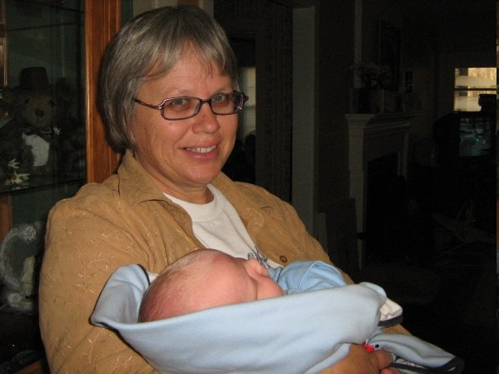
Family
My mother’s name is Nelly.

Slide 11
Family
My youngest sister’s name is Melissa.
.

Slide 12
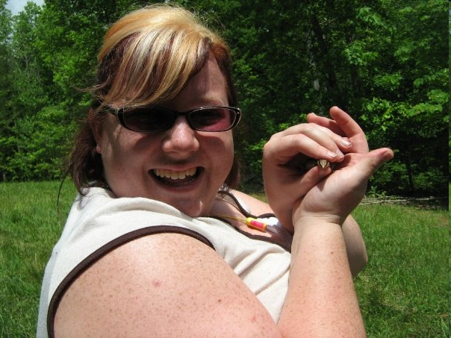
Family
My next youngest sister’s name is Amanda.

Slide 13
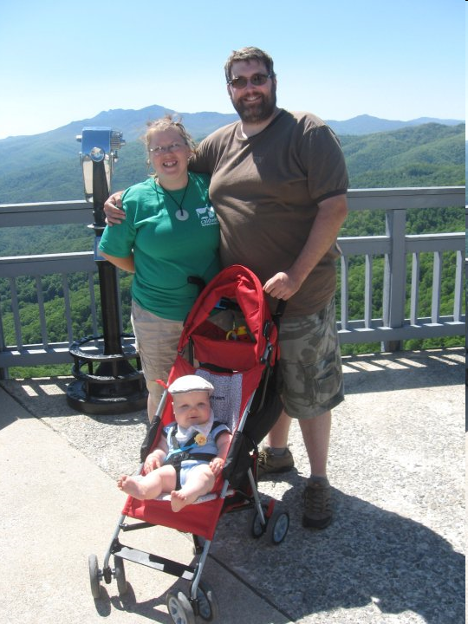
Family
Names
My oldest sister’s name is Debbie.
She is married to my brother-in-law.
My brother-in-law’s name is Dave.

Slide 14
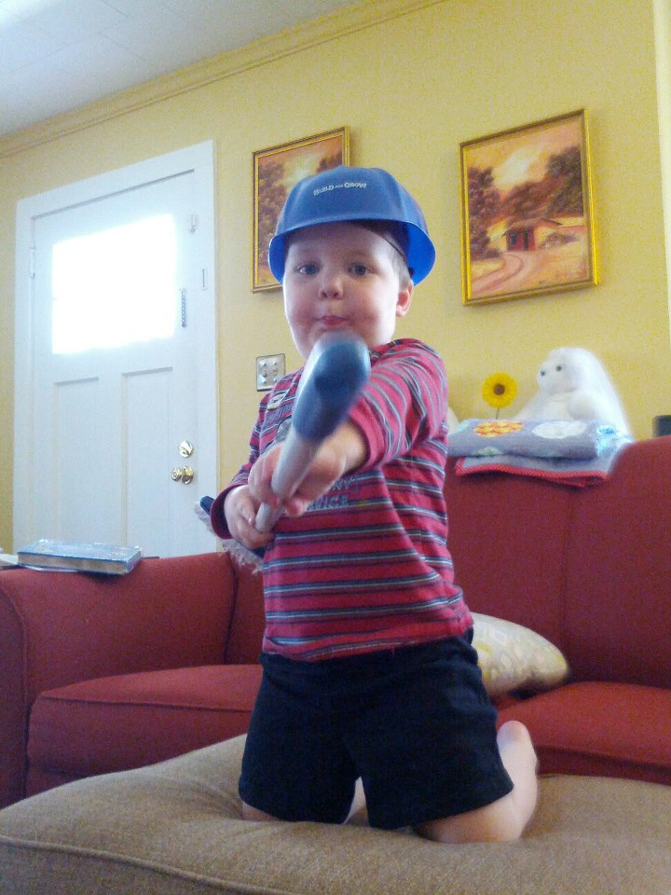
Family
My nephew’s name is Zeke.

Slide 15
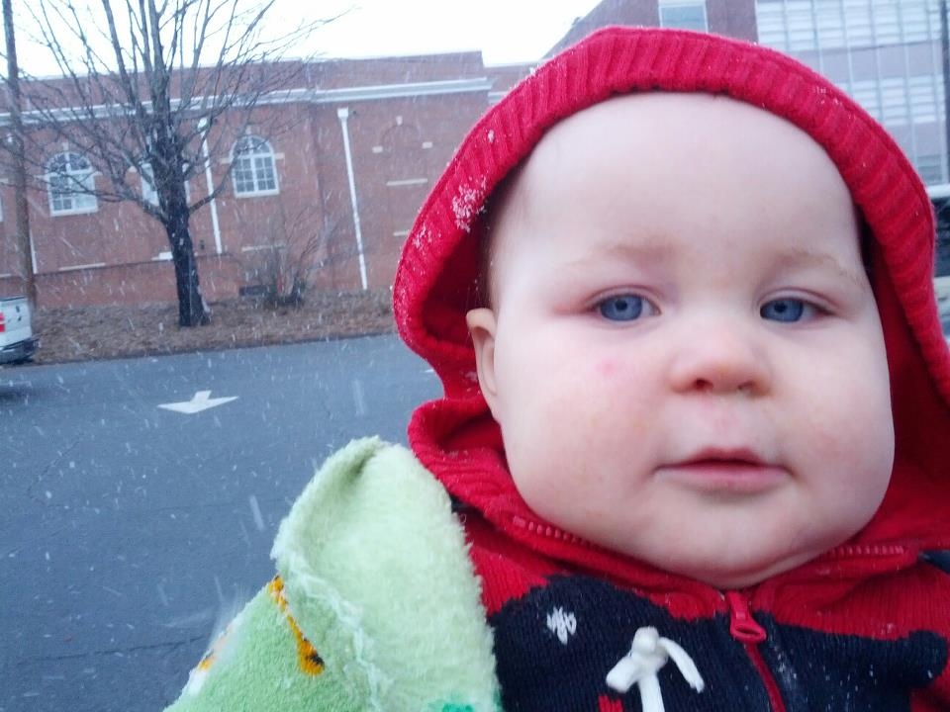
Family
My niece’s name is Abigail.

Slide 16
My oldest sister is named Debbie.
She is married to my brother-in-law, Dave.
My next oldest sister is named Amanda.
My youngest sister is named Melissa.
My father’s name is Harold.
My mother’s name is Nelly.
My nephew’s name is Zeke.

Slide 17
Jack
Tina
Cornelius
Jacoba
David
Andrew
Richard
Lawrence
Mariam
Wilma
Jackie
Joyce
Walt
Harold
Nelly
Debbie
Mr.S
Amanda
Melissa

Slide 18
Jeremy Lawrence
Laura Karen
Braden
Jack Jason
Melissa
Kimberley Richard
Corey Julie
Brittany
Dylan
Stephanie Andrew Jack
Emily Elizabeth Tina
Calvin
Summer David
Jordan Sheila
Noah
Zeke Debbie
Dave
Mr.S Harold
Amanda Nelly
Melissa
Eric Mariam
Matt Harley
Skyler Wilma
Sterling Dragon Cornelius
Tom Jackie Jacoba
Niki Mark
Curtis
James Joyce
Walt

Slide 19
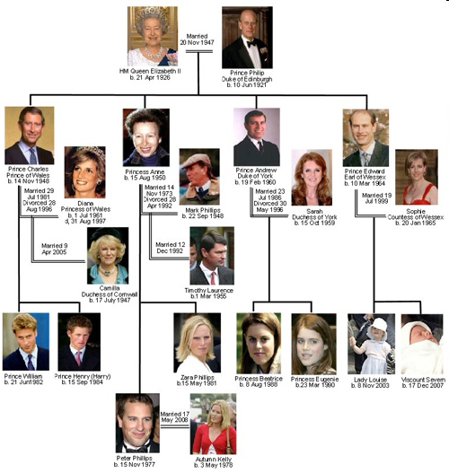

Slide 20
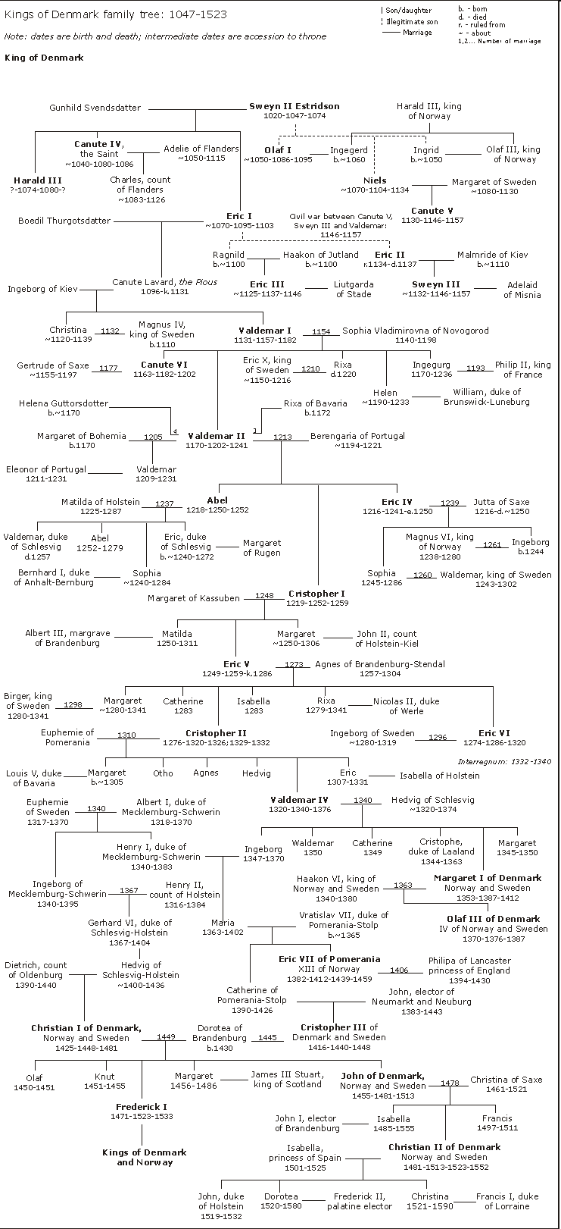
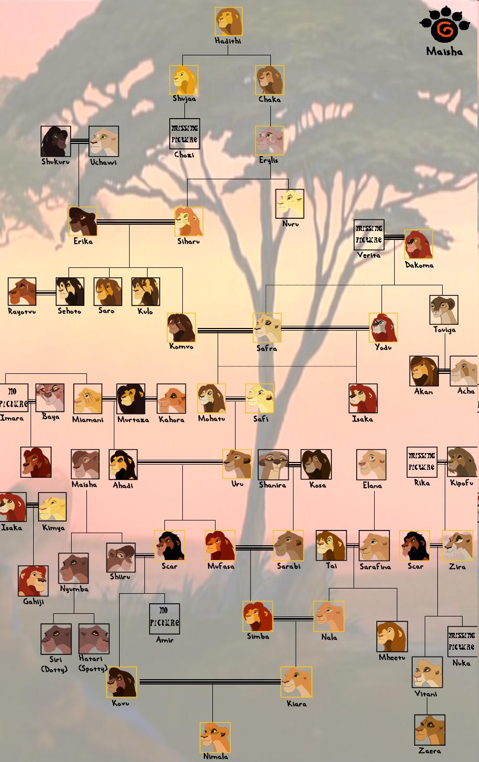

Slide 21
Family Tree
Make your own family tree

