Slide 2
Fine
How are you feeling?
Bad
Good

Slide 3
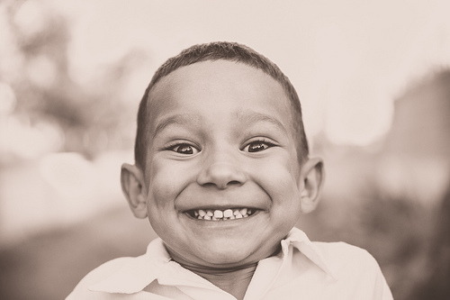

Slide 4
Happy
Fine
How are you feeling?
Bad
Good

Slide 5
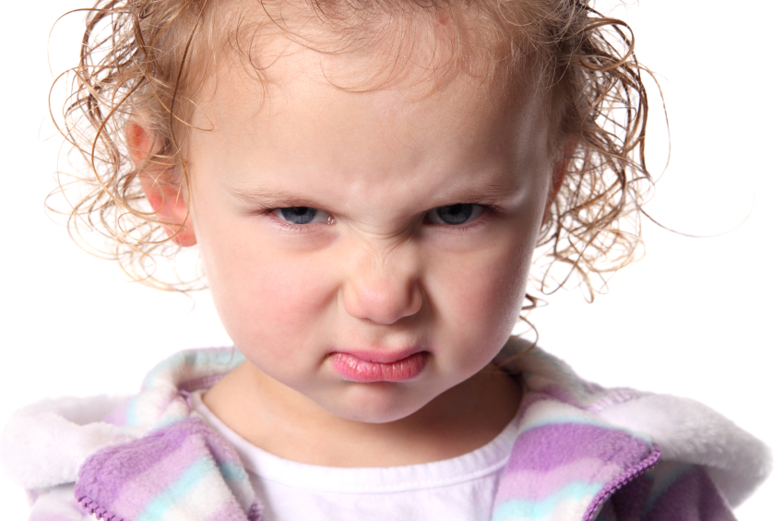
Angry

Slide 6
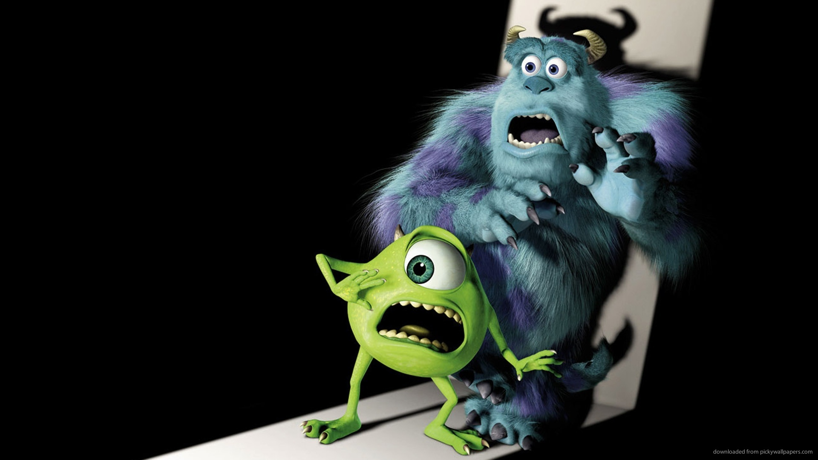
Scared

Slide 7
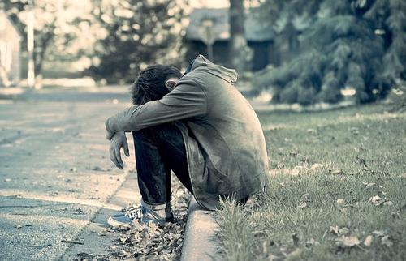
Sad

Slide 8
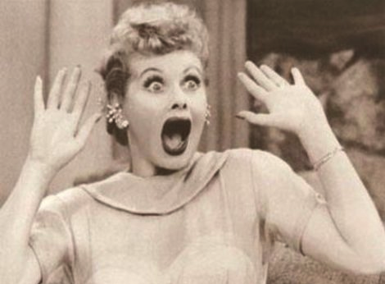
Surprised

Slide 9
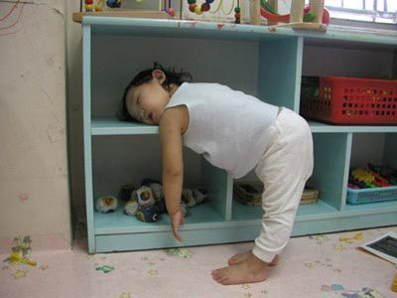
Tired

Slide 10
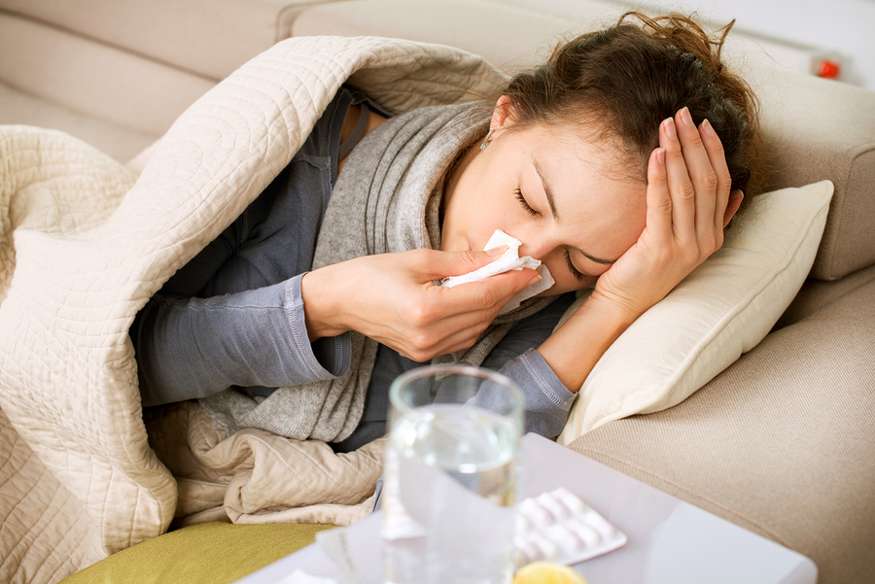
Sick

Slide 11
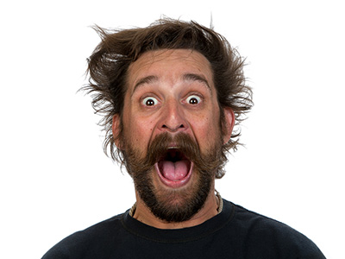
Excited

Slide 12
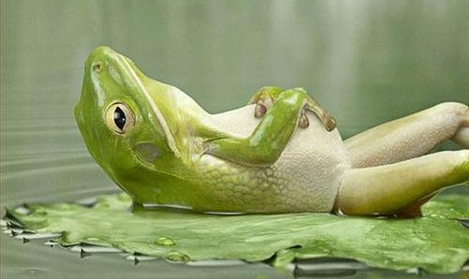
Relaxed

Slide 13
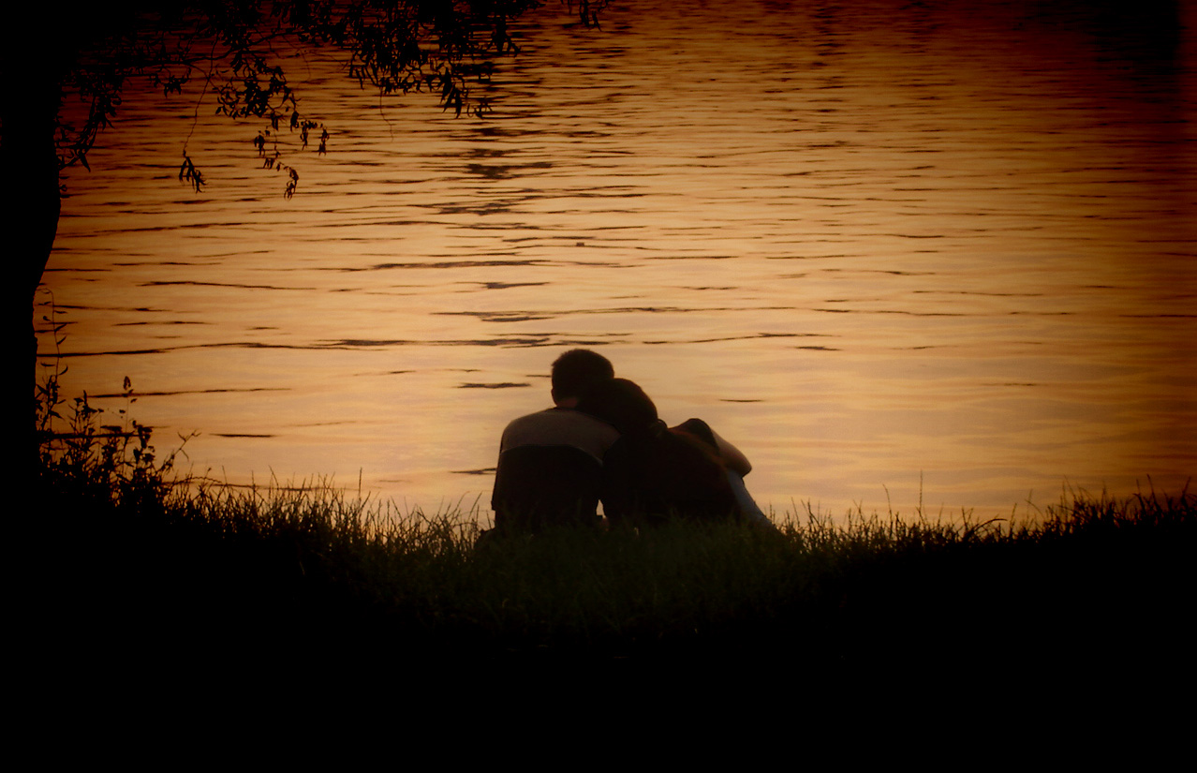
In love

Slide 14
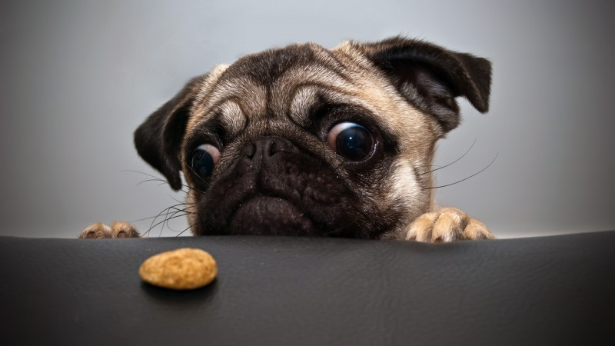
Hungry

Slide 15
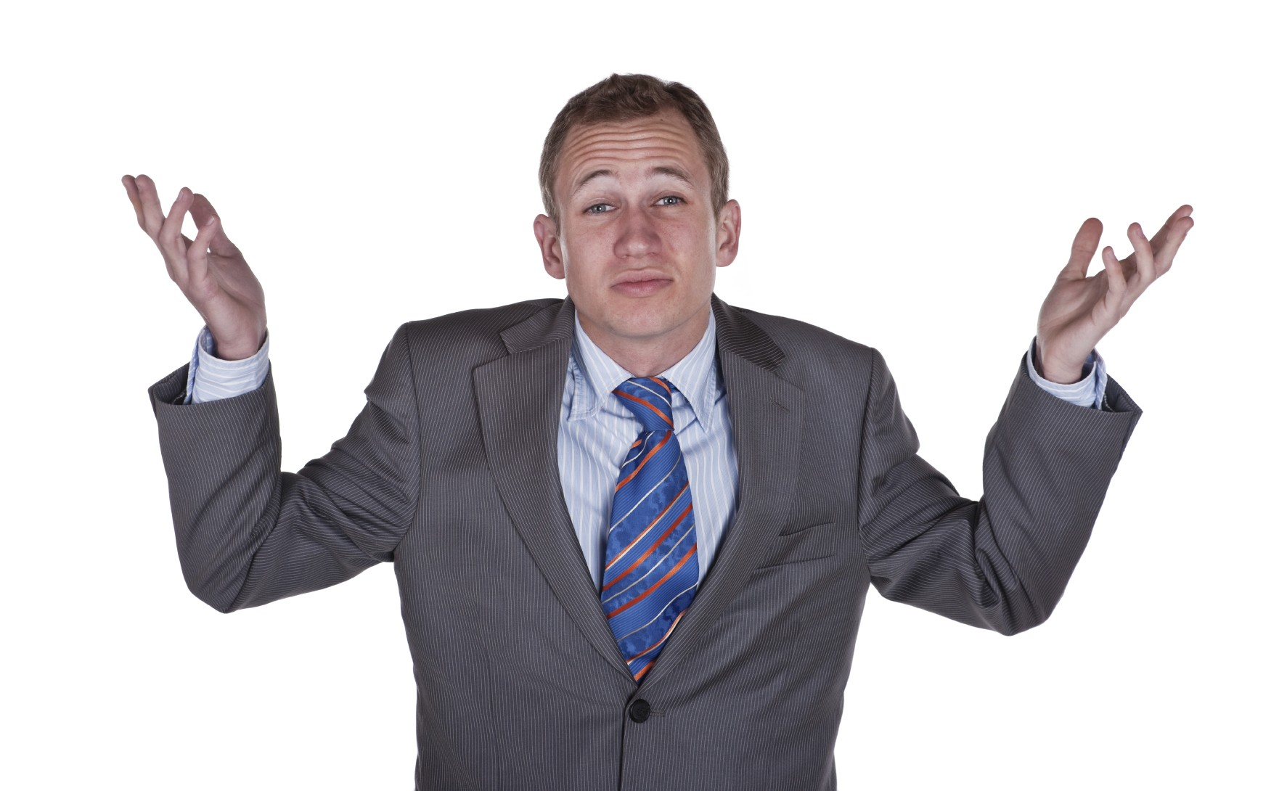
So-so

Slide 16
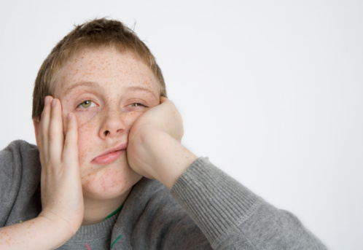
Bored

Slide 17
Happy
Fine
How are you feeling?
Bad
Good
Weather
Cold

Slide 18
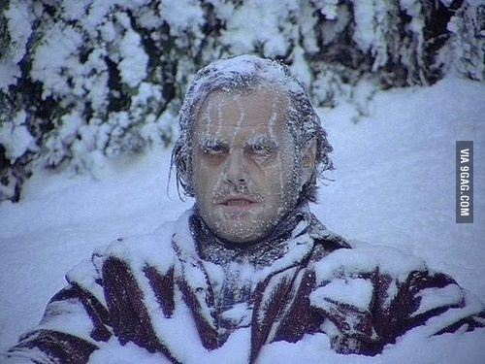
Cold

Slide 19
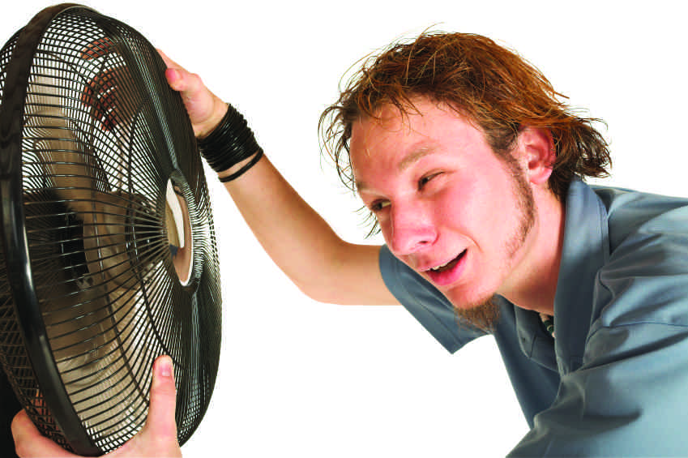
Hot

Slide 20
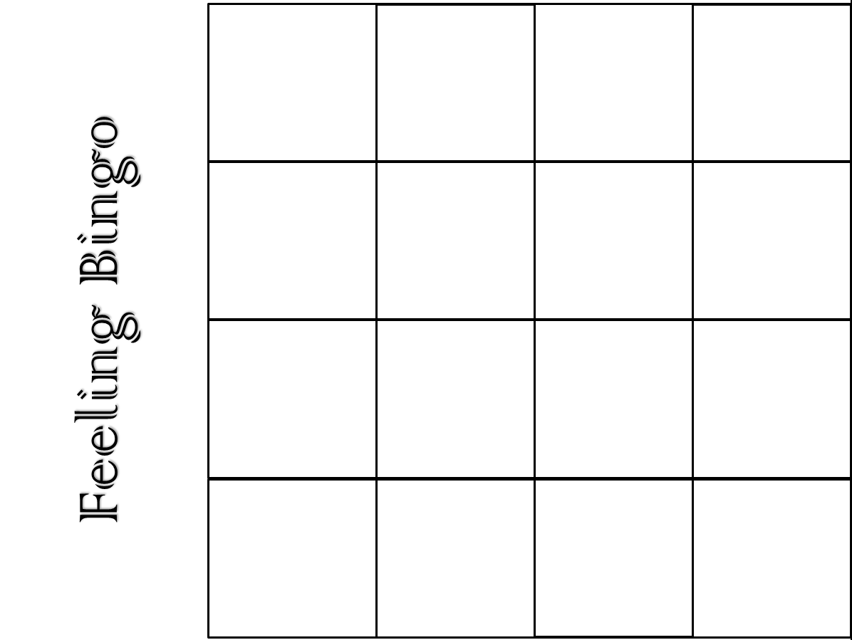

Slide 21
Bingo Game:
Student: Hello, my name is ___________.
Class: Good (morning / afternoon). How are you?
Student: I’m __________
Cross out the word on your bingo card.

Slide 22
Feeling Bingo

