Slide 1
Don’t do it
Warm up for the activity

Slide 2
What color is it?

Slide 3

Make a sentence:

Slide 4


Slide 5


Slide 6


Slide 7


Slide 8


Slide 9


Slide 10


Slide 11


Slide 12


Slide 13


Slide 14


Slide 15

Make a rule:

Slide 16

Make a rule:

Slide 17
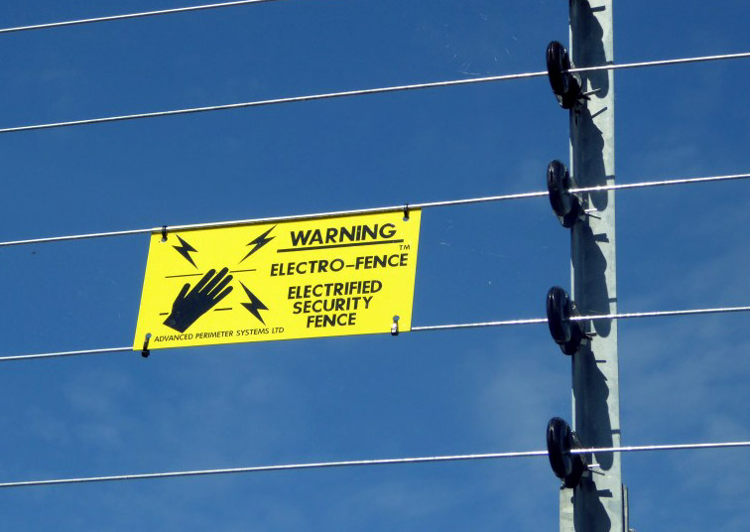
Make a rule:

Slide 18
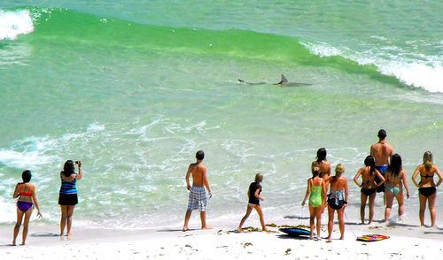
Make a rule:

Slide 19
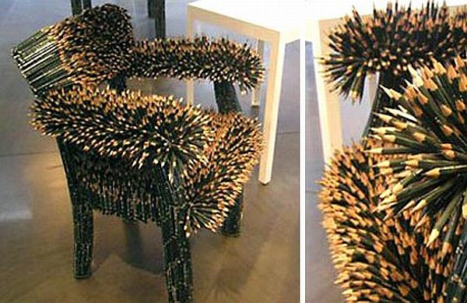
Make a rule:

Slide 20
Make a Sign

Slide 21
Make a Sign
Print the worksheet
Have the students complete the sentence, “Don’t _______.”
Then have the students draw a matching picture.
With about 5 minutes left in class, have the students present their work.
It also makes students feel proud if you tape the presented ones on the wall.

