Slide 1
Lesson 10 – Find the Items
Game

Slide 2
How to Play
The teacher will make a sentence, “Where is the _______.”
When you find it, make a sentence, “It’s ______________”
The fastest to say the sentence is the winner (touching doesn’t count)

Slide 3
Practice
All students

Slide 4
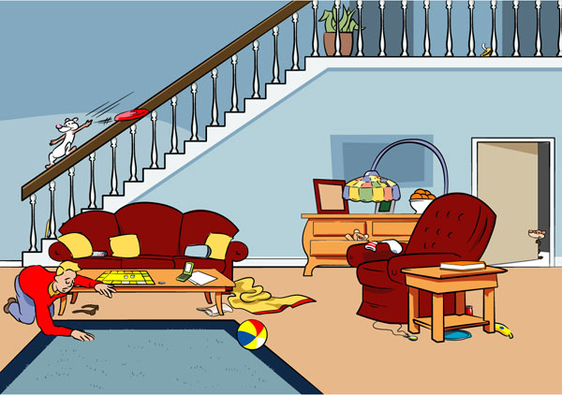

Slide 5
Let’s Play
Pass out the Sheets and a marker to keep score.

Slide 6
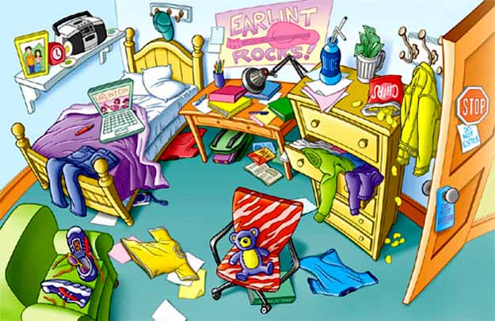
Player 1: Player 2:

Slide 7
Tournament
The winners
(two or three at a time)
Come to the front.
Race to touch the item

Slide 8
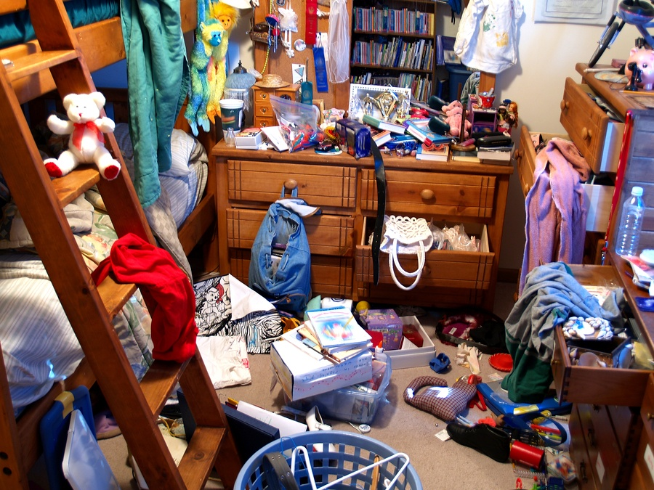

Slide 9
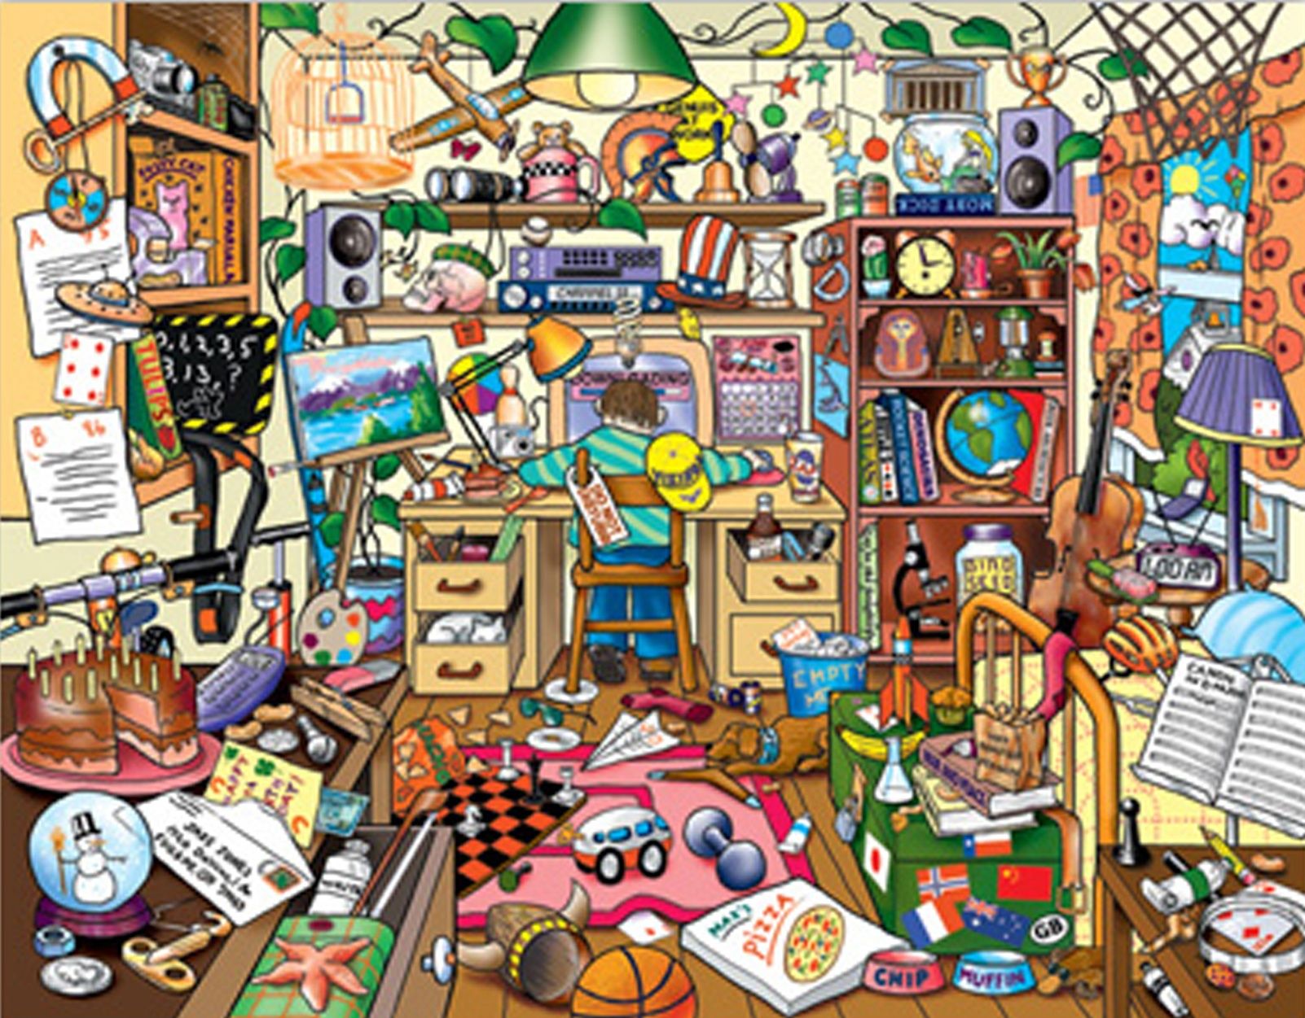

Slide 10
Where’s Waldo?

Slide 11
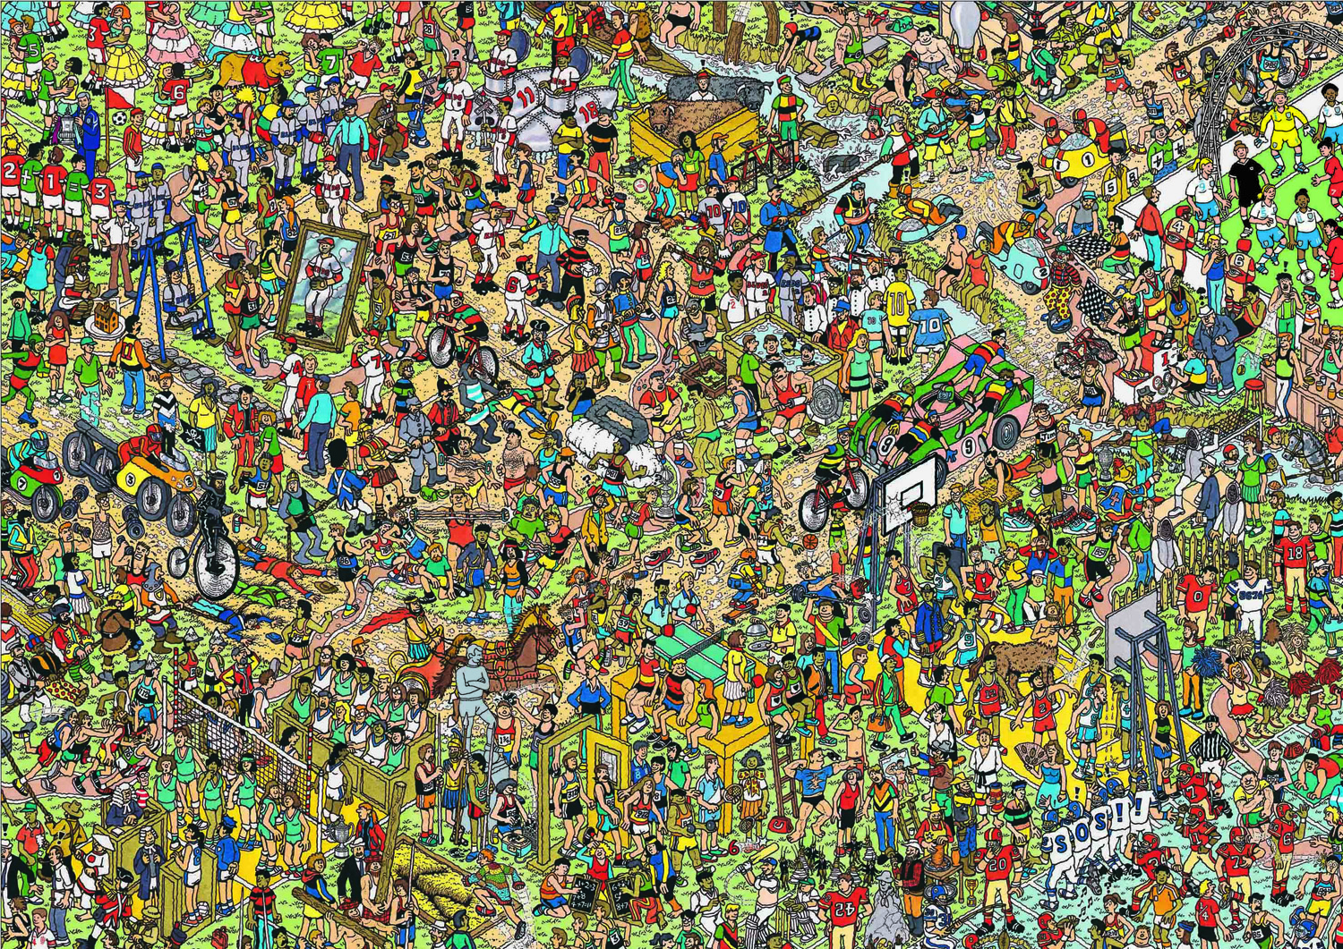

Slide 12
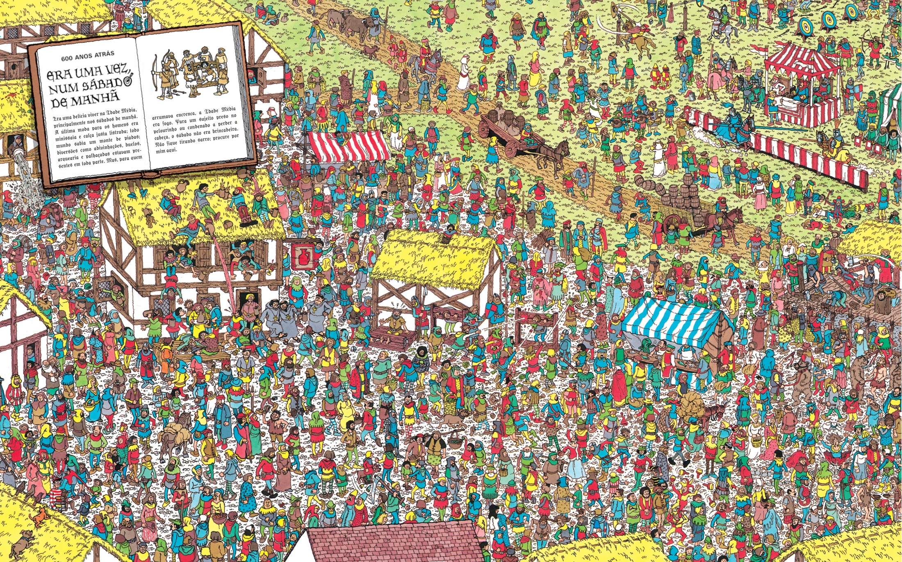

Slide 13
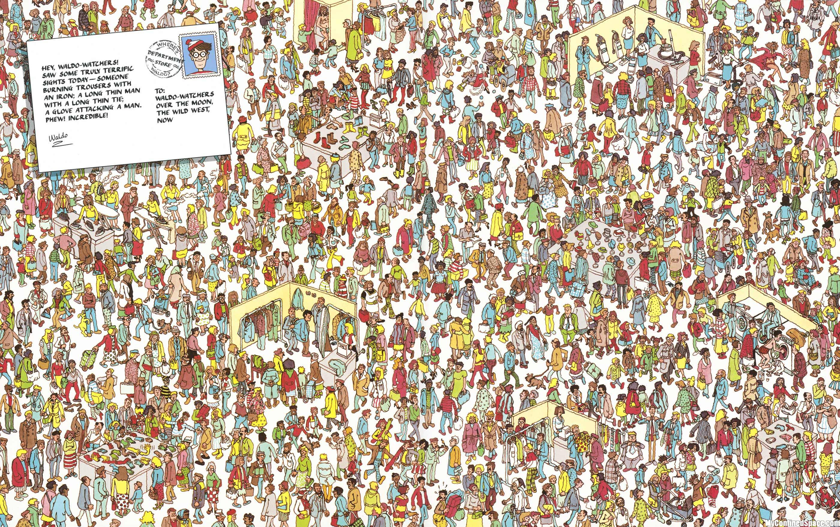

Slide 14
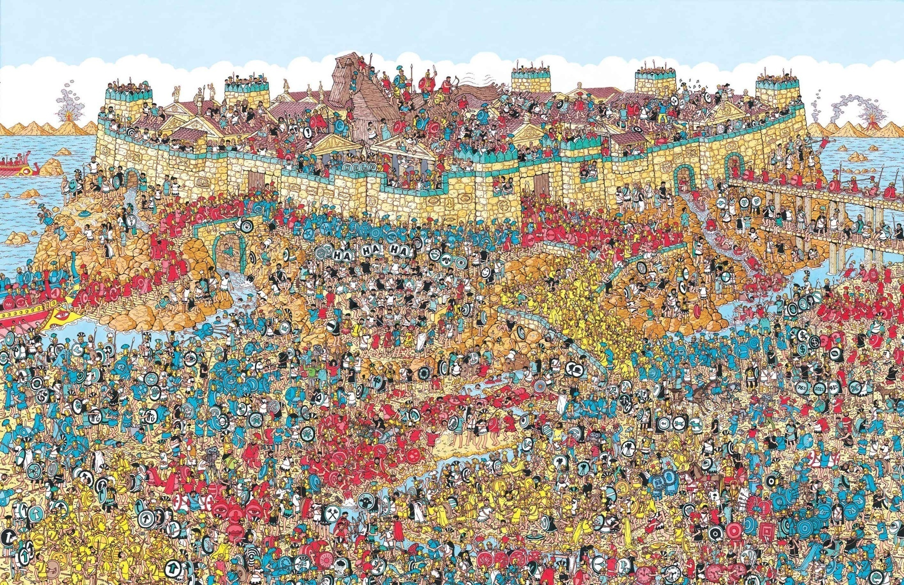

Slide 15
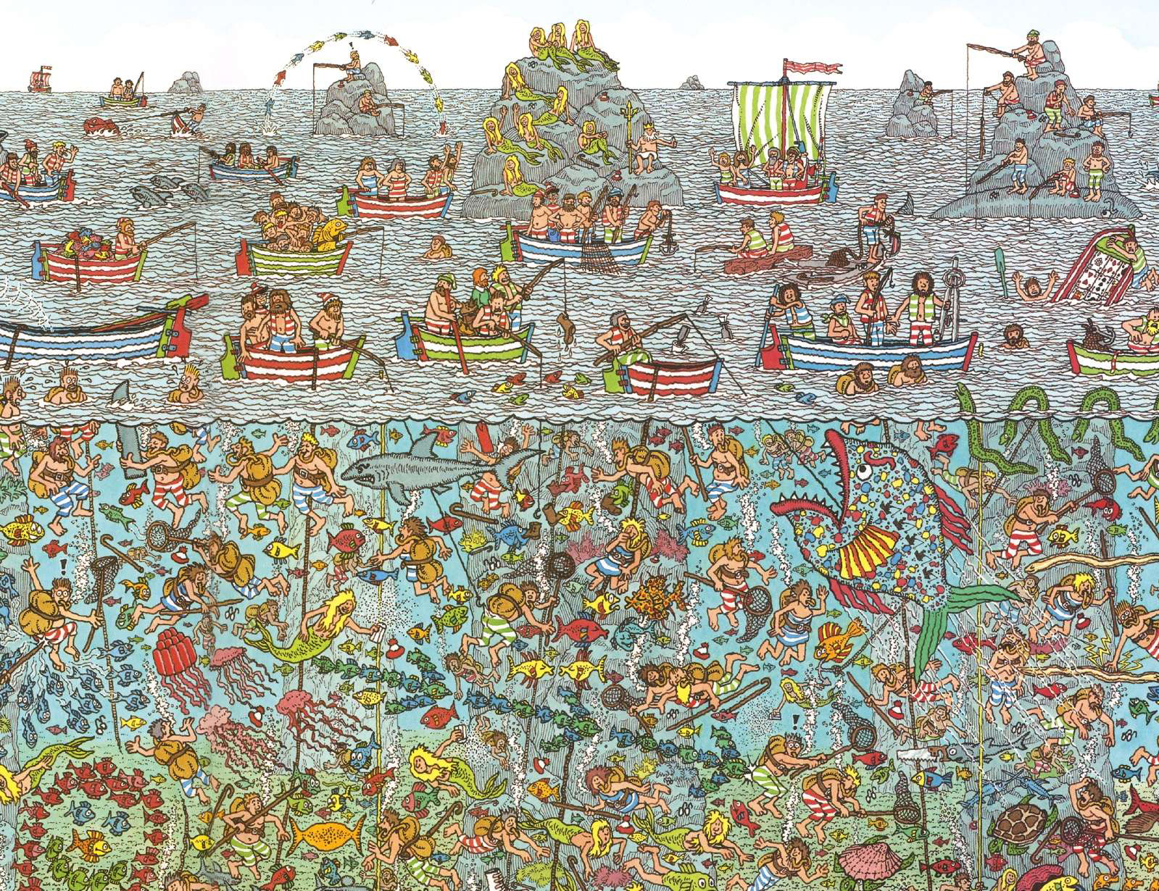

Slide 16
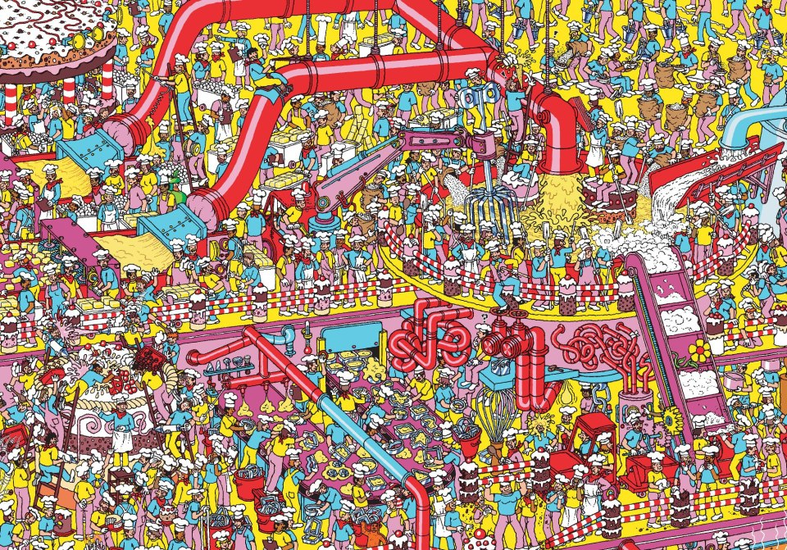

Slide 17
