Slide 1
Liar Liar
Liar, liar pants on fire…

Slide 2
How to Play
One student (leader) will start by making a statement.
Example: “I have 2 pencils”
Any of the other students can say, “Liar, Liar! Pants on fire!”
If the leader was lying, the student can steal 1 of the pants.
If the leader was not lying, the leader gets 1 pants
If no student says, “Liar, Liar! Pants on fire!”, the lead student can make a new sentence.
Whoever said, “Liar, Liar!” gets to go next.

Slide 3
Give everyone 4 pants

Slide 4
Put the cards in the middle of the table

Slide 5
The leader takes one card

Slide 6
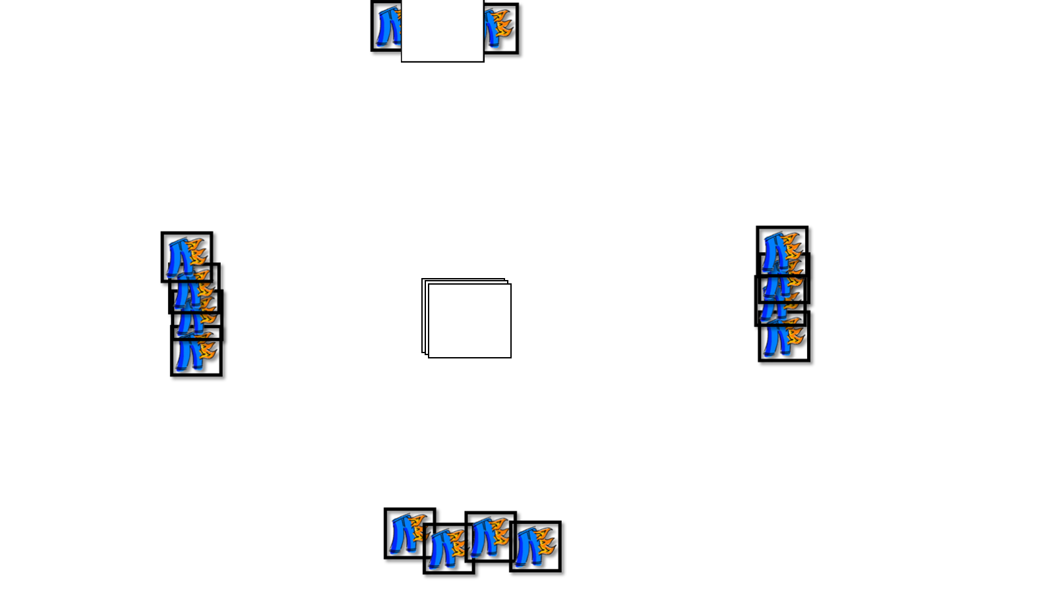
The leader makes a sentence.
If no one talks, the leader must make a new sentence.
I have 2 books.
…
…
…

Slide 7
After someone says, “Liar, liar…”, show the card.
I have 1 ruler.
Lie
…
…
Liar, liar. Pants on fire!

Slide 8
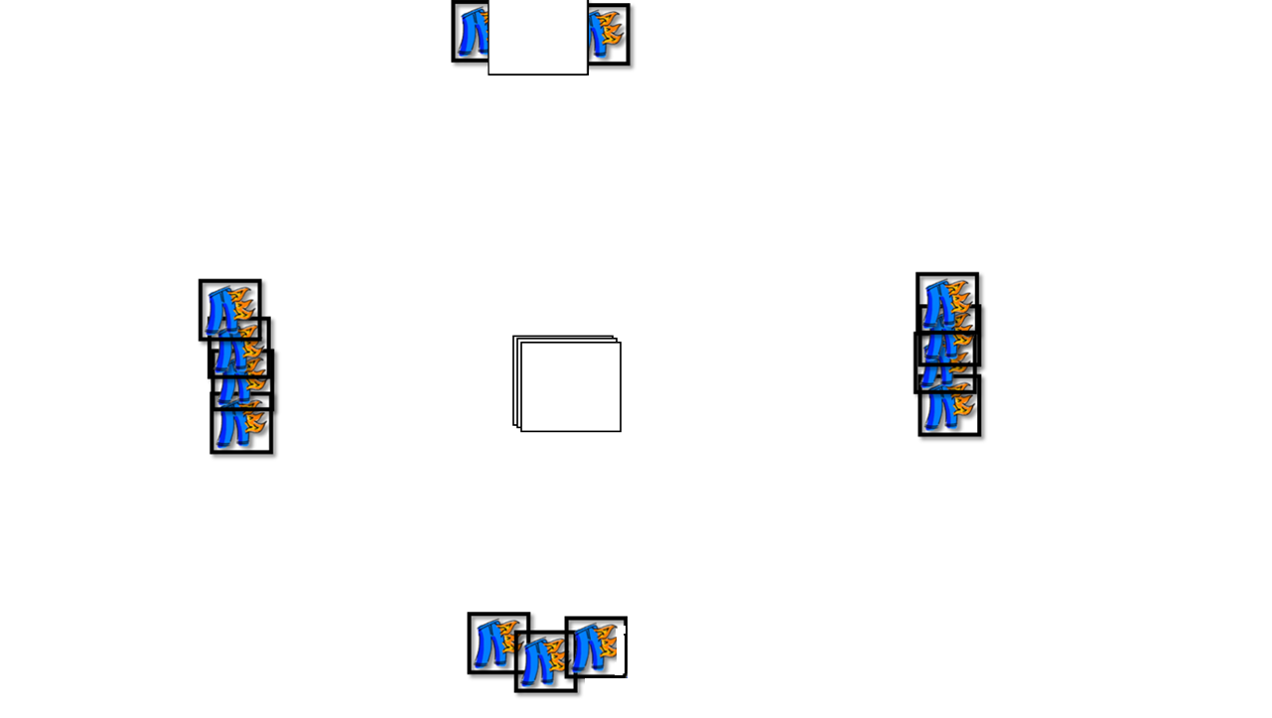
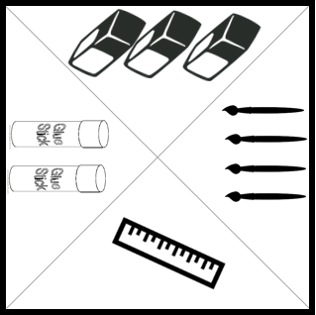
After someone says, “Liar, liar…”, show the card.
I have 1 ruler.
Truth
…
…
Liar, liar. Pants on fire!

Slide 9
I have ___ ________.
Liar, liar. Pants on fire!
…
Truth
Lie
Whoever says, “Liar, liar…” will be the next leader.
Take the leader’s pants
Take the
talker’s pants

Slide 13
Version 2
(This has not been play tested)

Slide 14
How to Play
One student (leader) will start by secretly taking a card.
Students take turns asking questions, “Do you have a book?”
The leader will answer,
“Yes, I do.”
“No, I don’t.”
At any time, a student may say, “Liar, Liar! Pants on fire!”
If the leader was lying, the student can steal 1 of the pants.
If the leader was not lying, the leader steals 1 of the pants.
After each student asks a question, the round is over
Go to the next player.

