Slide 1
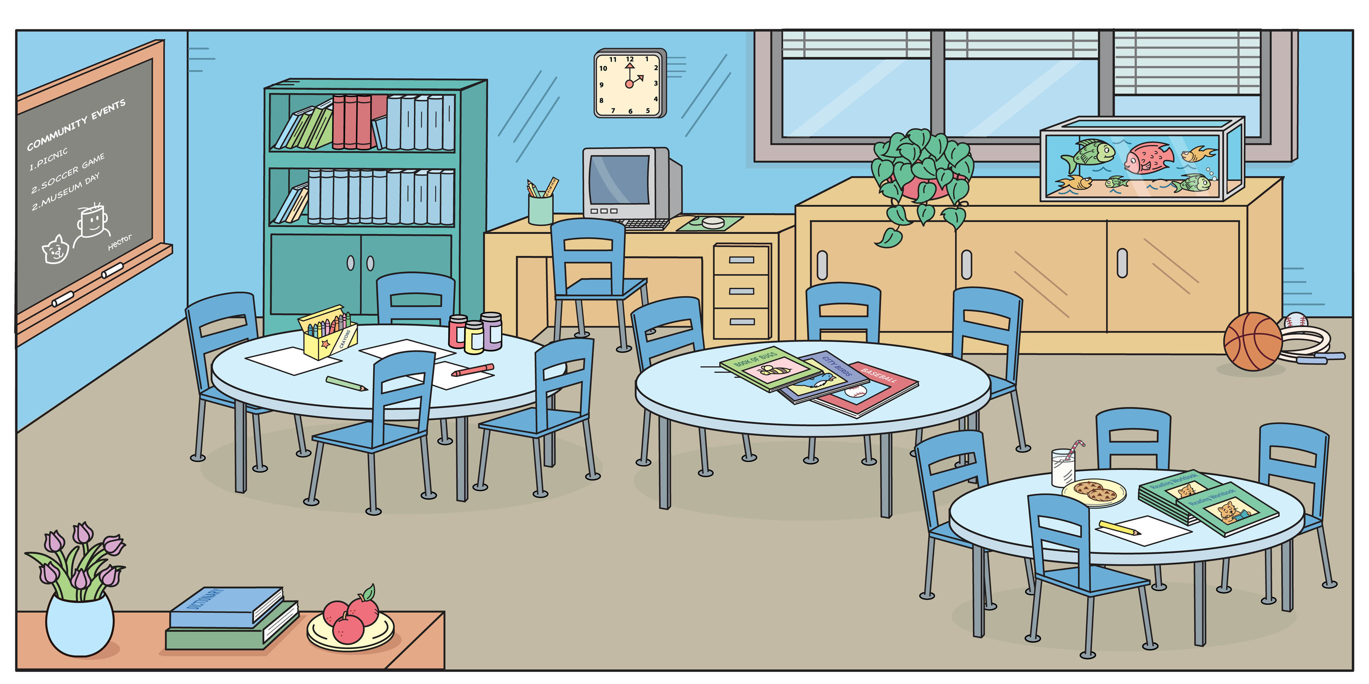
Player 1
Player 2

Slide 2


Slide 3
Prepare:
Print the above pictures (Front and Back side) and laminate
There should be enough for each pair of students.
Give each pair a game board and dry erase marker (for keeping score)

Slide 4
How to Play:
One student asks, “What’s this?” and points to an item.
The other student will answer, “It’s a ________.”
(The first student can check if it is true.)
  True = 1 point
  False = 0 points
Then switch the roles.

