Slide 1
Sorry. Why?
The GIF game

Slide 2
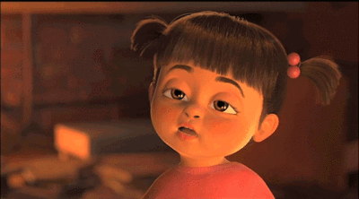
Sorry, I can’t. I’m ________.
tired.

Slide 3
Complete the Sentences:
Practice:
  “Let’s _________”
  “Ok. Sounds good.”
  “Sorry, I can’t. I’m ________”
Dive the class in half.
One side will make a question. The other will make an answer.

Slide 4

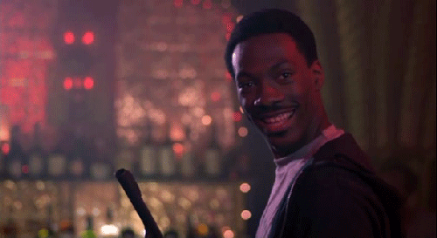
Ok. Sounds good.
Lets ___________.

Slide 5

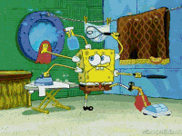
Sorry, I can’t.
I’m __________
Let’s _________
busy

Slide 6
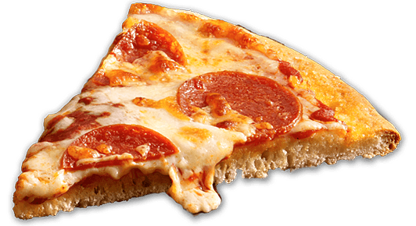
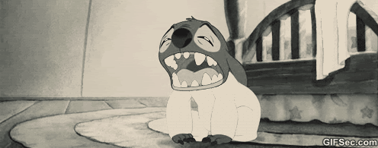
Lets ___________.
Sorry, I can’t.
I’m _________
tired.

Slide 7

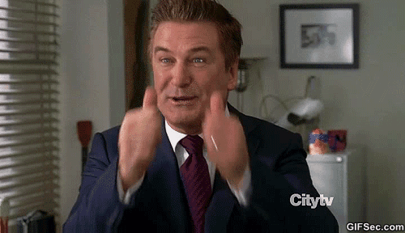
Ok. Sounds Good.
Let’s ___________

Slide 8


Lets ___________.
Sorry, I can’t.
I’m tired.

Slide 9
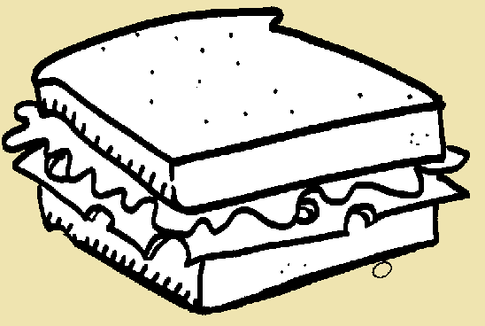

Sorry, I can’t.
I’m busy.
Let’s ___________

Slide 10


Lets ___________.
Ok. Sounds good.

Slide 11

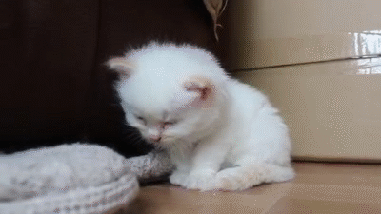
Sorry, I can’t.
I’m tired.
Let’s __________

Slide 12

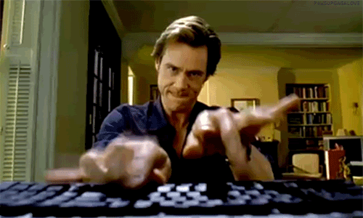
Lets ___________.
Sorry, I can’t.
I’m busy.

Slide 13

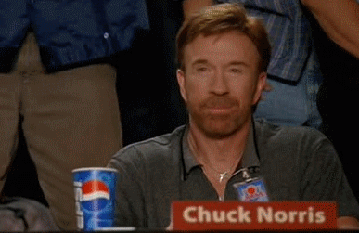
Ok. Sounds Good.
Let’s ___________

Slide 14

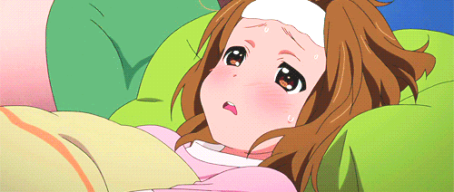
Lets ___________.
Sorry, I can’t.
I’m sick.

Slide 15

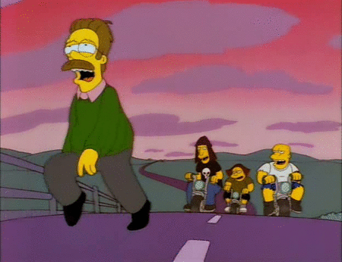
Sorry, I can’t.
I’m tired.
Let’s ___________

Slide 16


Lets ___________.
Ok. Sounds good.

Slide 17

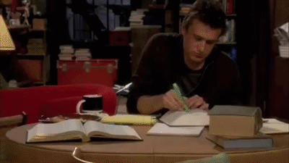
Sorry, I can’t.
I’m studying.
Let’s ___________

Slide 18


Lets ___________.
Sorry, I can’t.
I’m exercising.

Slide 19

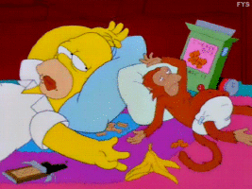
Sorry, I can’t.
I’m full.
Let’s ___________

Slide 20


Lets ___________.
Ok. Sounds good.

Slide 21

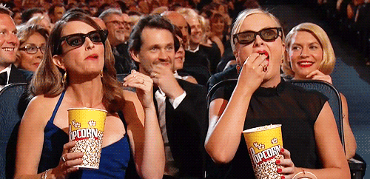
Sorry, I can’t.
I’m watching a movie.
Let’s __________.

Slide 22

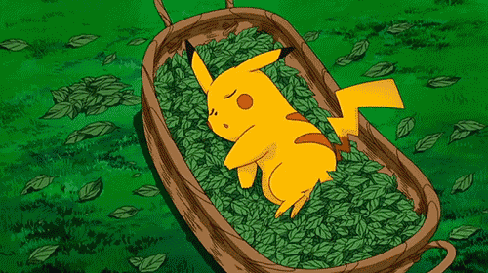
Lets ___________.
Sorry, I can’t.
I’m sleeping.

Slide 23
“Sorry, I Can’t” Game.
One student will come to the front.
They will make a suggestion.
  “Let’s ______________.”
The other students can make an excuse.
  “Sorry, I can’t. I’m ___________.”

