Slide 1
Where is it?
Find the Action

Slide 2
Prepare
Print out one set of cards.
Print a copy of the sheet for each pair of students
(laminating is a good idea)

Slide 3
Rules
Give each student 1 paper
Print a set of cards for yourself
Use the dialogue and insert the appropriate verbs
Students keep track of who finds it first.
  One point for each thing they find first.
The most points wins

Slide 4
Dialogue
Students: What is he / she doing?
Teacher: He / She is _*Card*_
*First Student to find it, is the winner.

Slide 5

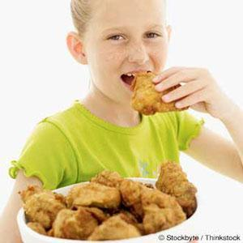
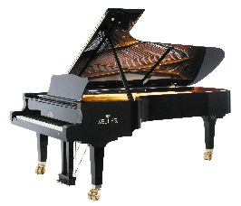


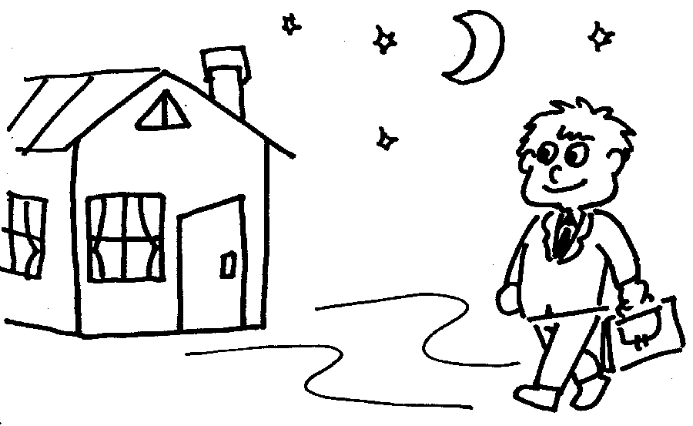

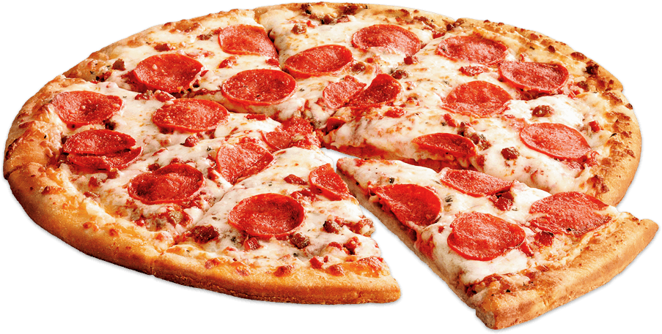








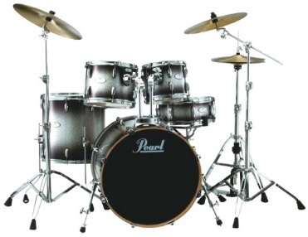
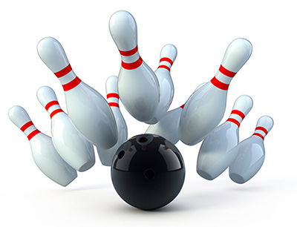


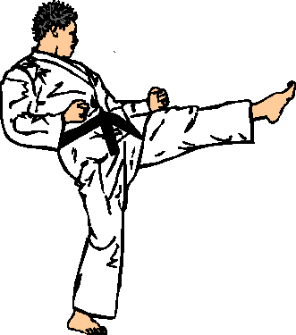

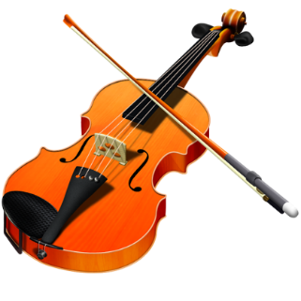
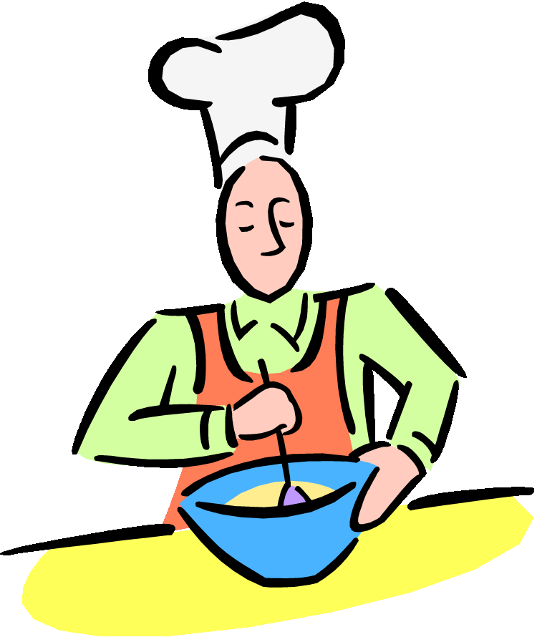


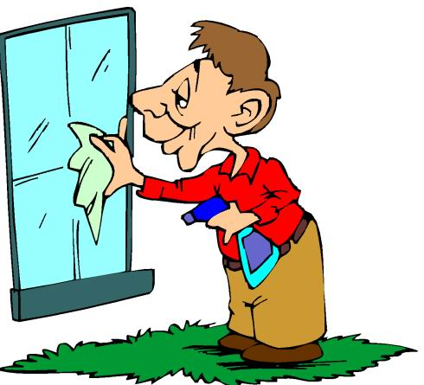






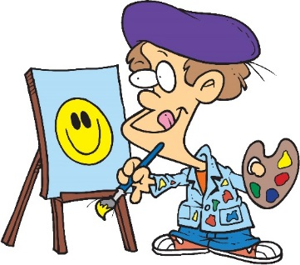
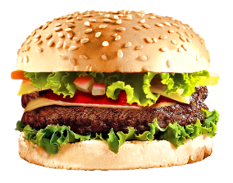

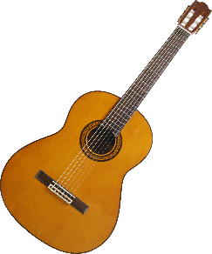




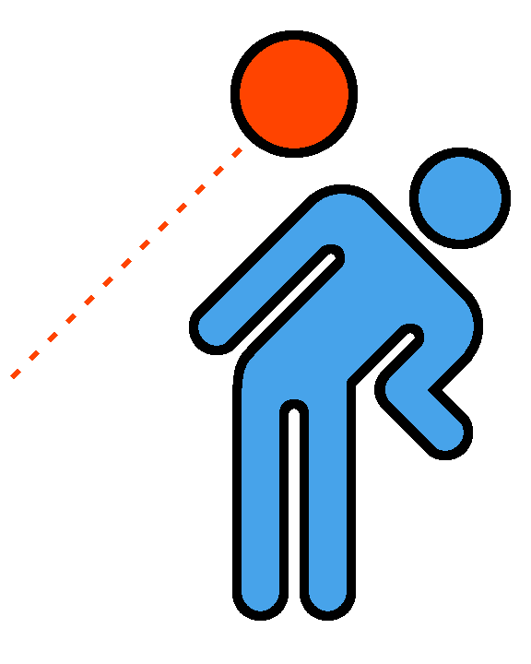






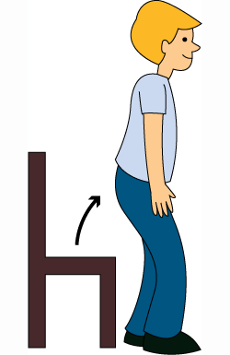



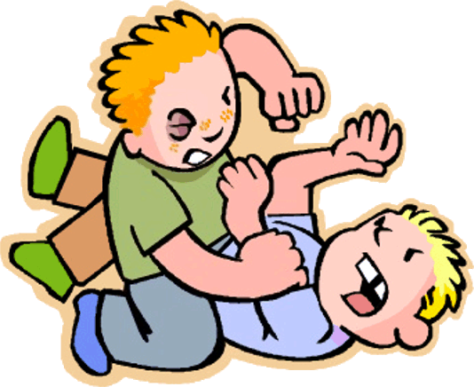
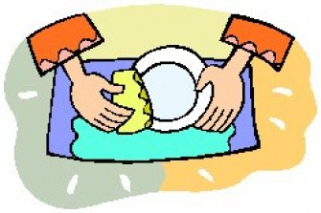
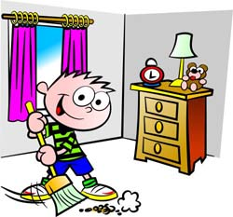


Slide 6




Writing
Reading a book
Making a Robot
Playing Piano
Running
Riding a Bike
Listening to Music
Playing Guitar

Slide 7




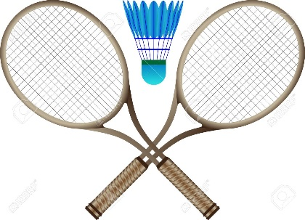

Playing Baseball
Playing Basketball
Playing Soccer
Singing
Playing Badminton
Playing Dodgeball
Playing Tennis
Walking

Slide 8

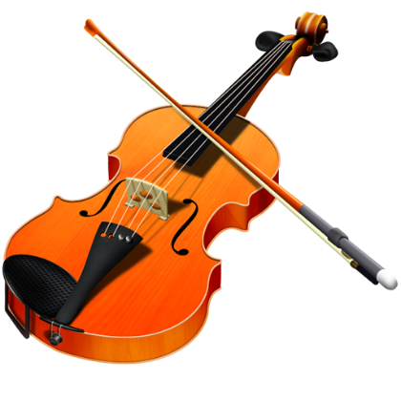

Playing Violin
Swimming
Jumping
Smiling
Sitting
Flying
Standing Up
Doing Homework

Slide 9





Eating Pizza
Eating Ice Cream
Eating Chicken
Dancing
Eating Hamburger
Eating Soup
Drinking
Talking

Slide 10


Cooking
Crying
Cleaning
Sleeping
Washing Dishes
Cleaning Bedroom
Washing the Windows
Painting

Slide 11





Driving a Car
Watching a Movie
Bowling
Brushing Teeth
Watching TV
Washing Hands
Brushing Hair
Buying

Slide 12

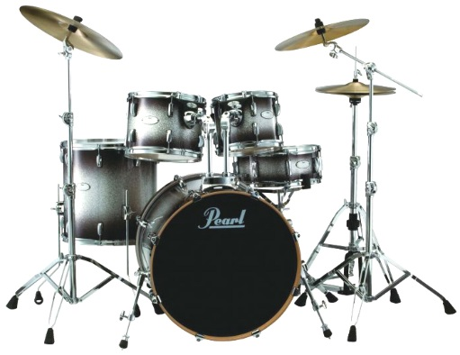


Hugging
Playing the Drums
Kicking
Going Home
Laughing
Fighting
Taking Pictures
Opening the Window

Slide 13
Bonus
These cards may also be used for charades.

