Slide 1
This is for you.

Slide 2
Rules
Each group of students gets a set of cards.
A student will secretly choose a card and put it in the gift box.
They will give the gift to the other students saying, “This is for you.”
The students receiving the gift will make a guess, by saying, “Is it a _________?”
Finally, the gift is revealed and the students that guessed correctly receive a point.

Slide 3


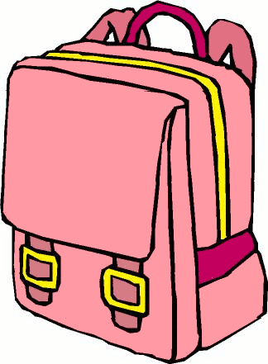








Bag
apple
Ruler
Pencil
Cap
Card
cup
book
Cake
Banana

Slide 4

Choose a Card.

Slide 5
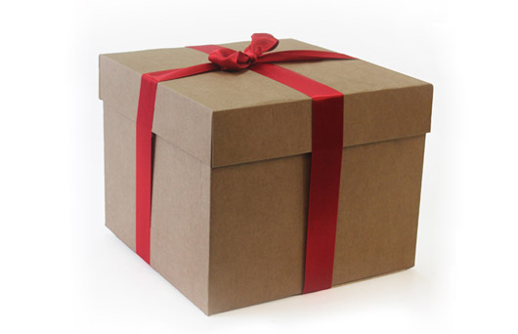
Put it in the box.

Slide 6
Give the gift
Happy birthday.
This is for you.

Slide 7
Guess…
Is it a cap?
Is it a ruler?
Is it an apple?

Slide 8

Open the gift.

Slide 9
Get points.
+1

Slide 10
Next player.

Slide 11



