Slide 1
Is it a pencil?
Guessing Game

Slide 2
How to play:
Click a box to reveal a part of the picture
Let a student take a guess, “Is it a __________?”
  “No, it isn’t.” = repeat process
  “Yes, it is.” = click, “reveal all”

Slide 3



















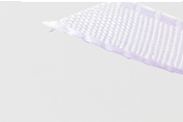
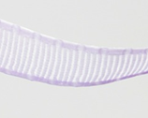









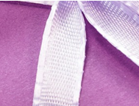







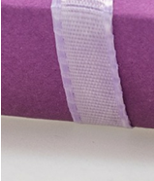
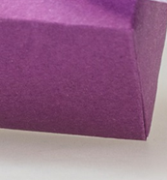

Reveal All

Slide 4

Reveal All

Slide 5

Reveal All

Slide 6

Reveal All

Slide 7

Reveal All

Slide 8
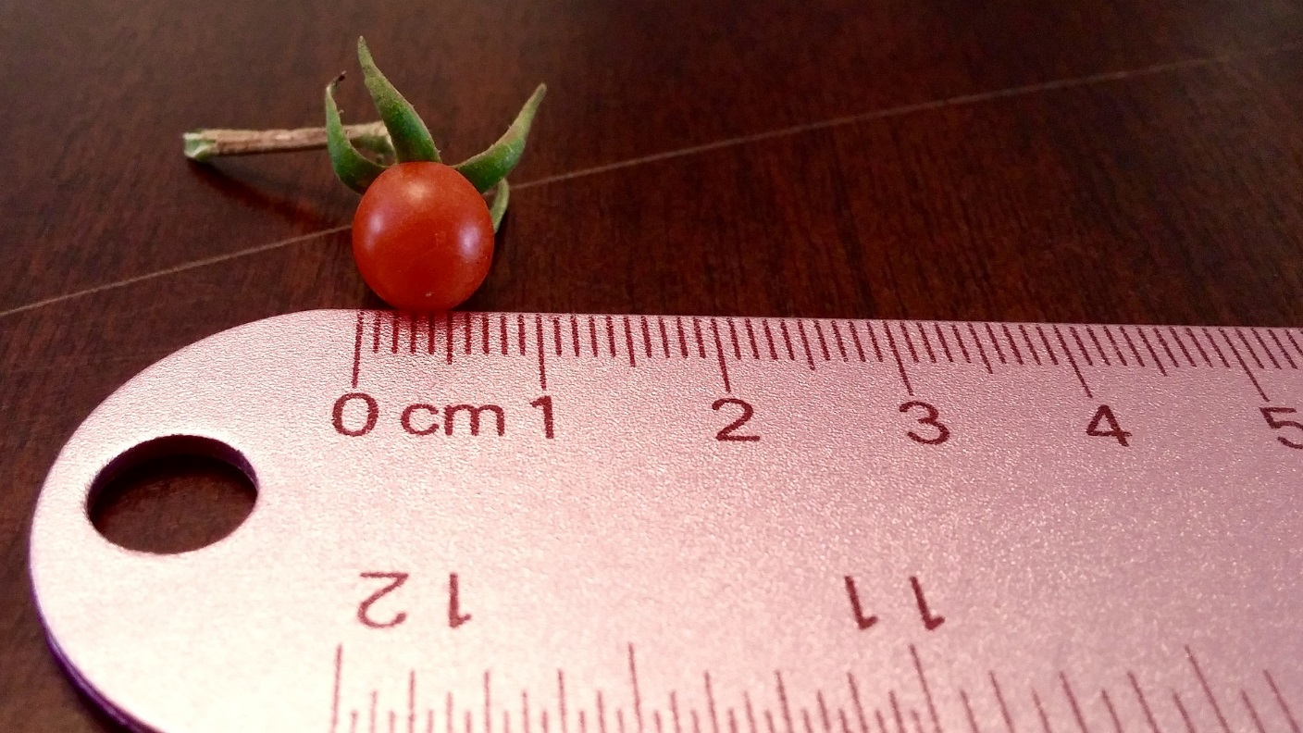
Reveal All

Slide 9

Reveal All

Slide 10

Reveal All

Slide 11

Reveal All

Slide 12

Reveal All

Slide 13

Reveal All

Slide 14

Reveal All

Slide 15

Reveal All

Slide 16

Reveal All

Slide 17

Reveal All

Slide 18
Reveal All

