Slide 1
What is she doing?

Slide 2
How to Play:
Students will answer the question with picture clues on the slides.
They must associate the question with the response.

Slide 3
I am = I’m
You are =
He is =
She is =
They are =
We are =
You’re
He’s
She’s
They’re
We’re

Slide 4
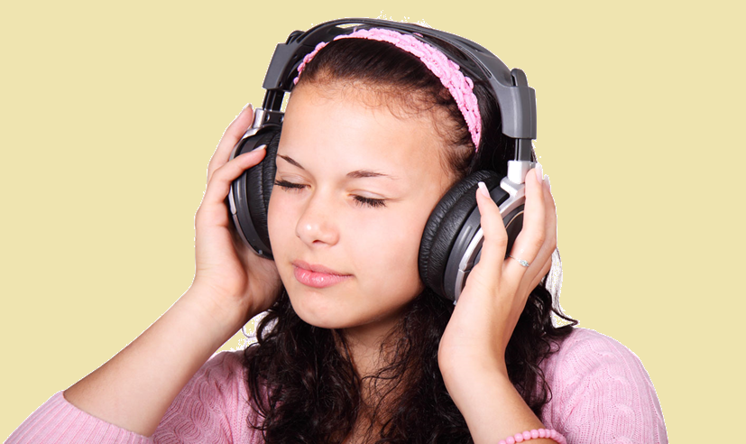
What is she doing?
She’s listening to music.

Slide 5
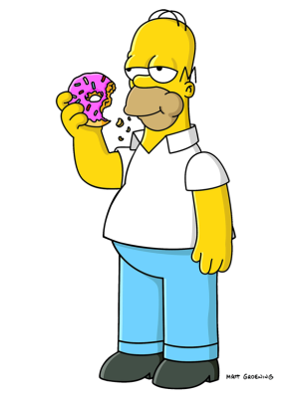
What is he doing?
He’s eating.

Slide 6
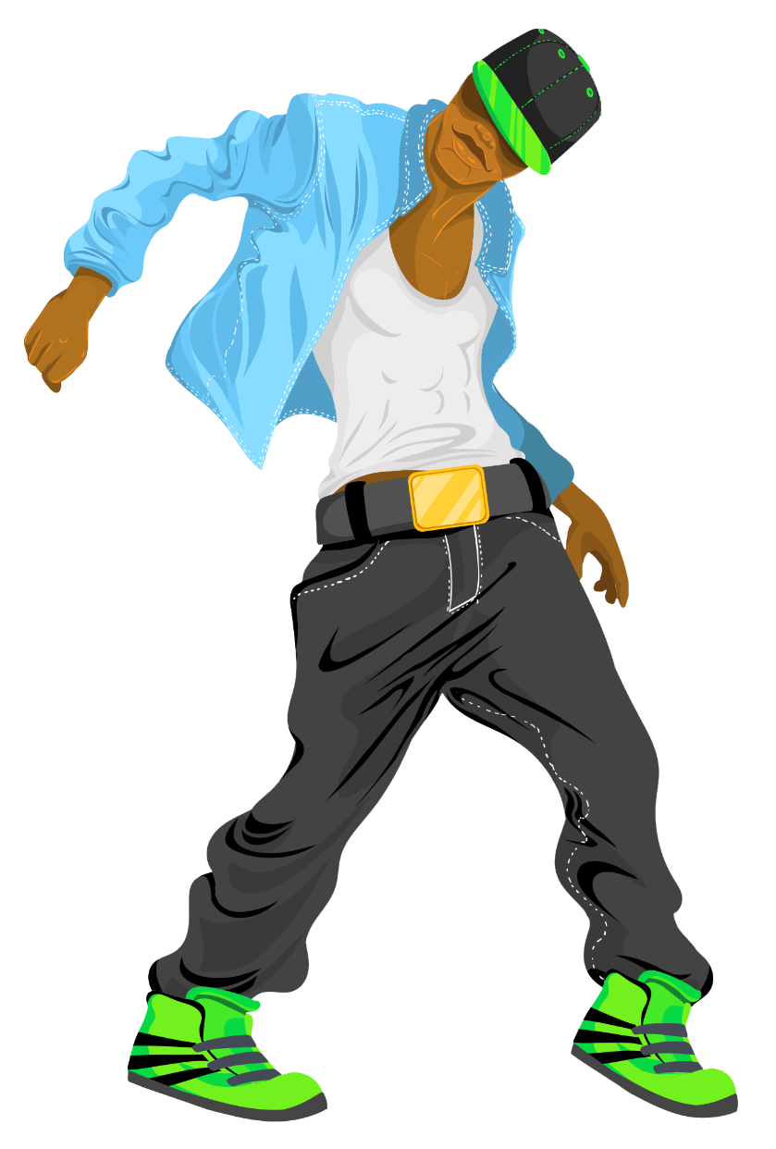
What are you doing?
I’m dancing.

Slide 7
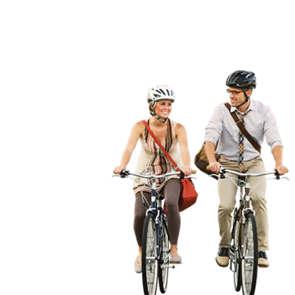
What are they doing?
They’re riding a bike.

Slide 8
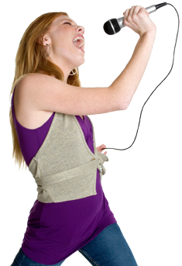
What is she doing?
She’s singing.

Slide 9
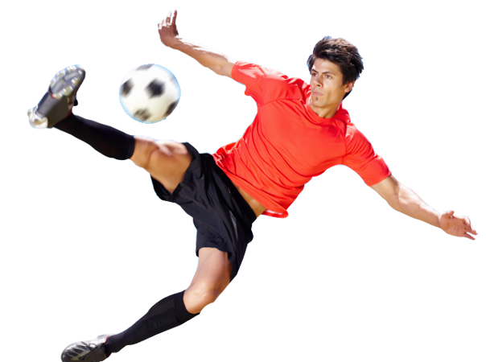
What is he doing?
He’s playing soccer.

Slide 10
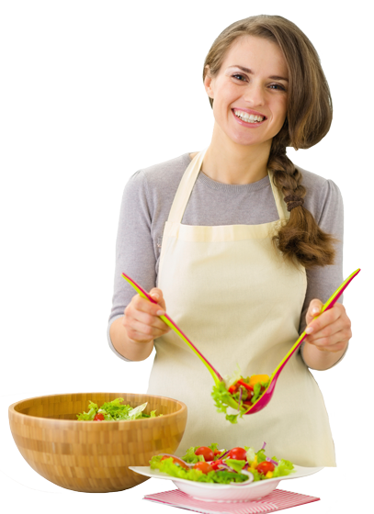
What is she doing?
She’s cooking.

Slide 11
What are we doing?
We’re reading.

Slide 12
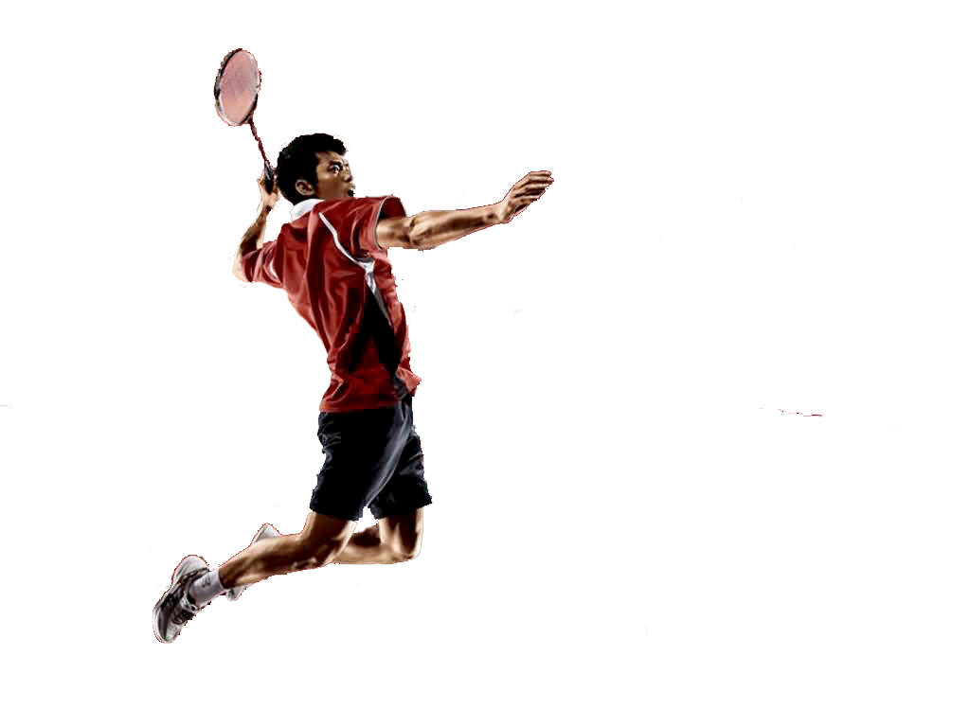
What is he doing?
He’s playing badminton.

Slide 13
What is she doing?
She’s teaching.

Slide 14
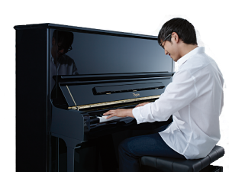
What are you doing?
He’s playing piano.

Slide 15
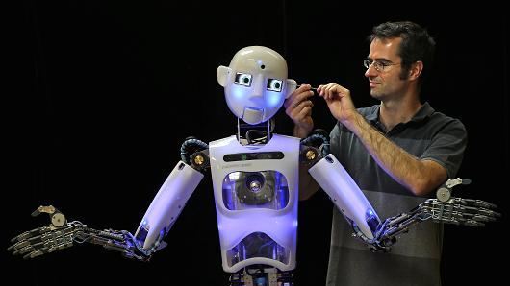
What is he doing?
He’s making a robot.

Slide 16
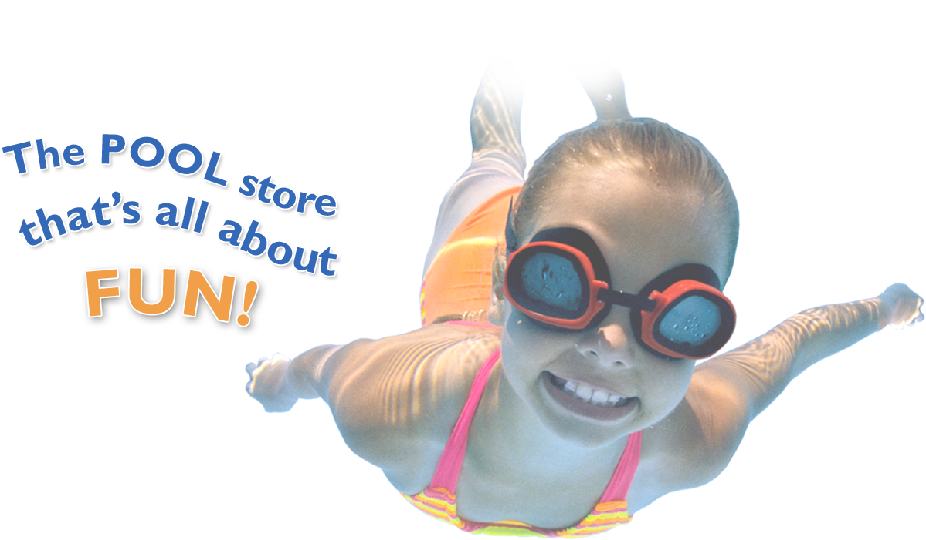
What is she doing?
She’s swimming.

Slide 17
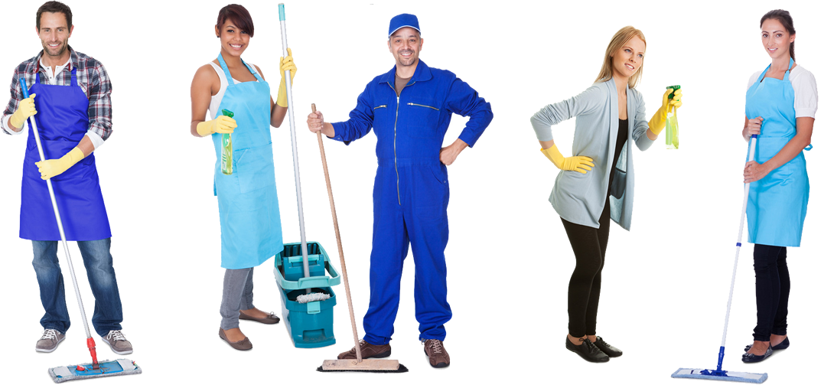
What are they doing?
They’re cleaning.

Slide 18
What are you doing?
I’m painting.

Slide 19
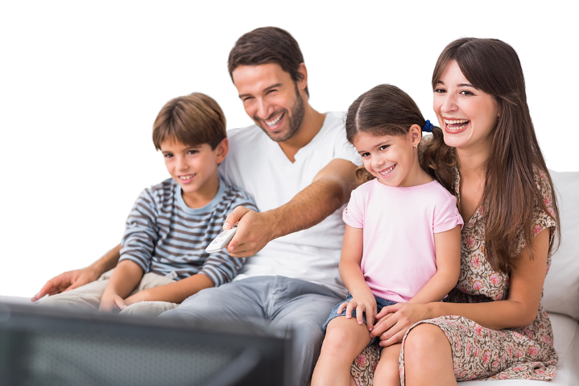
What are they doing?
They’re watching TV.

Slide 20
What are they doing?
They’re fighting.

Slide 21
What are we doing?
We’re talking.

