Slide 1
Superhero School
Loosely based on the game “Clue”

Slide 2
Ironman

Slide 3
Hulk

Slide 4
Spiderman

Slide 5
Superman

Slide 6
Wonder Woman

Slide 7
Batman

Slide 8
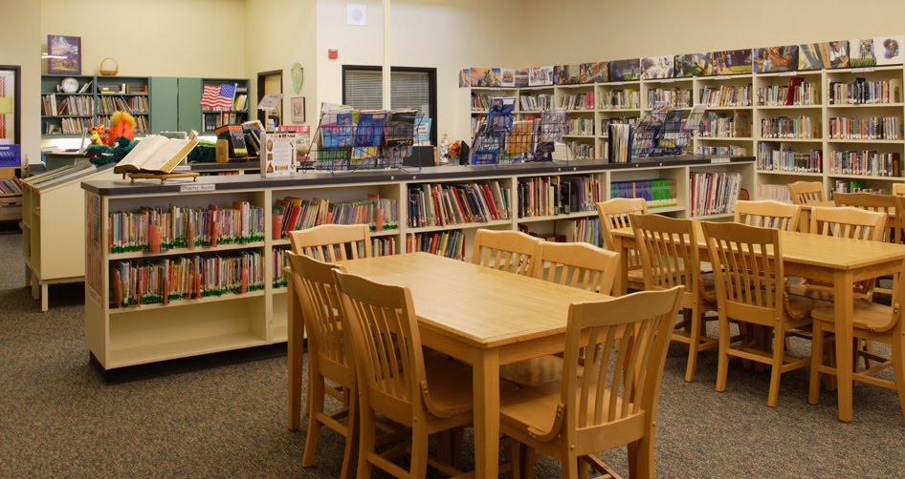
Library

Slide 9
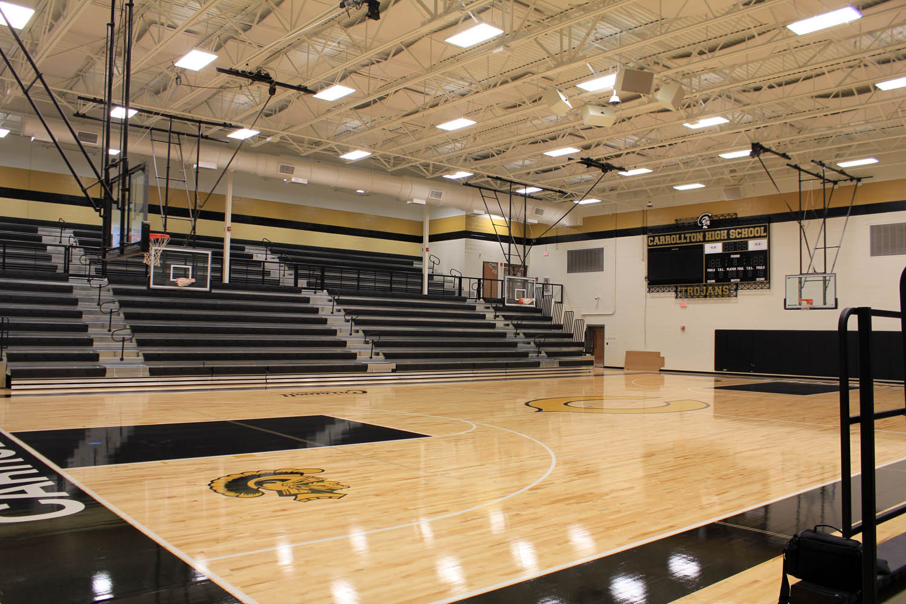
Gym

Slide 10
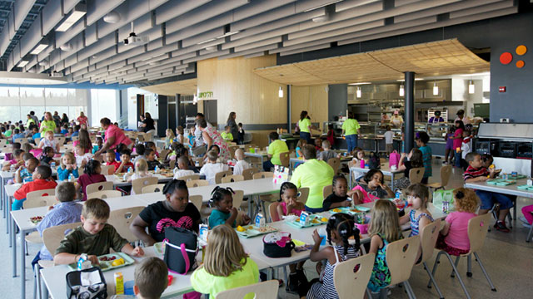
Cafeteria

Slide 11
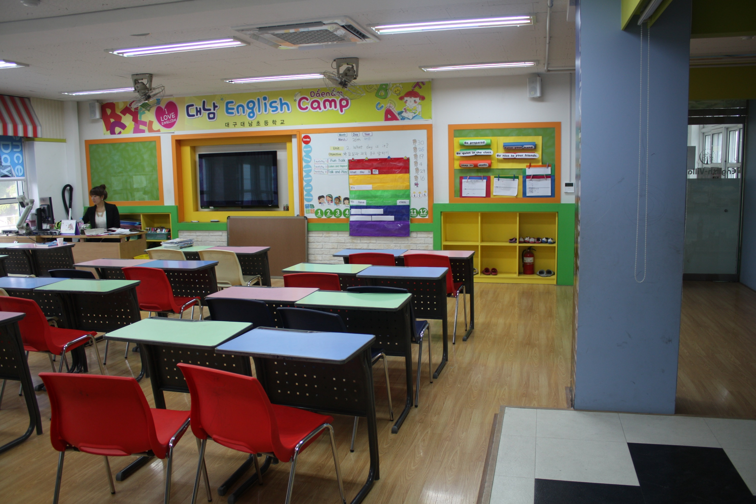
English Room

Slide 12
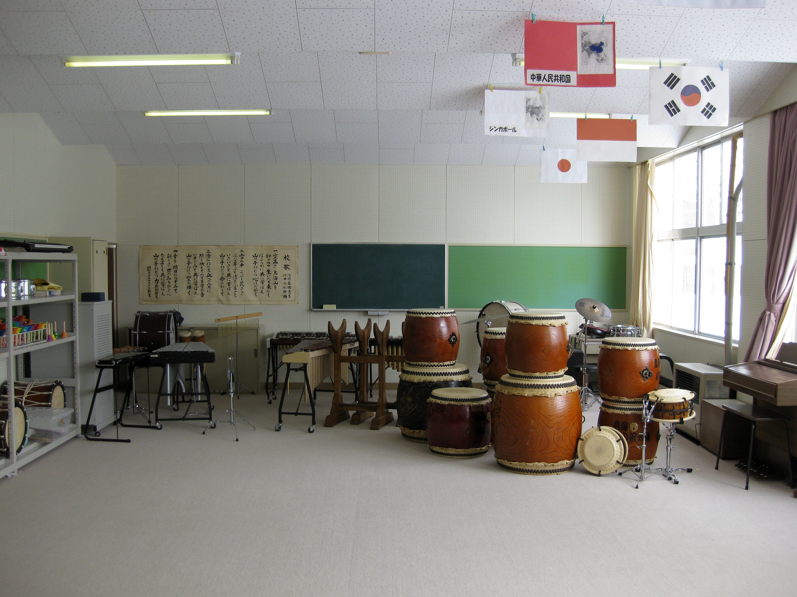
Music Room

Slide 13
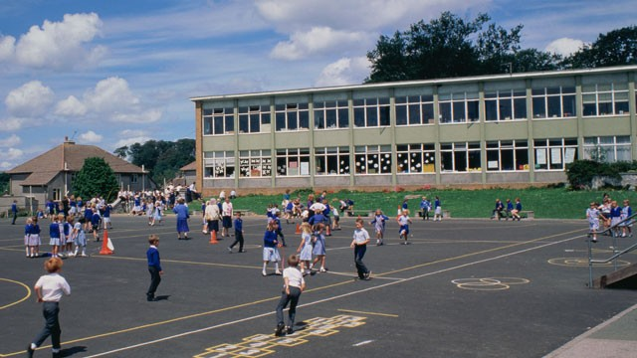
Playground

Slide 14
Reading a Book

Slide 15
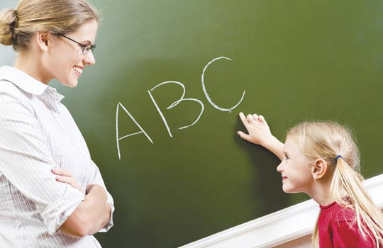
Studying English

Slide 16
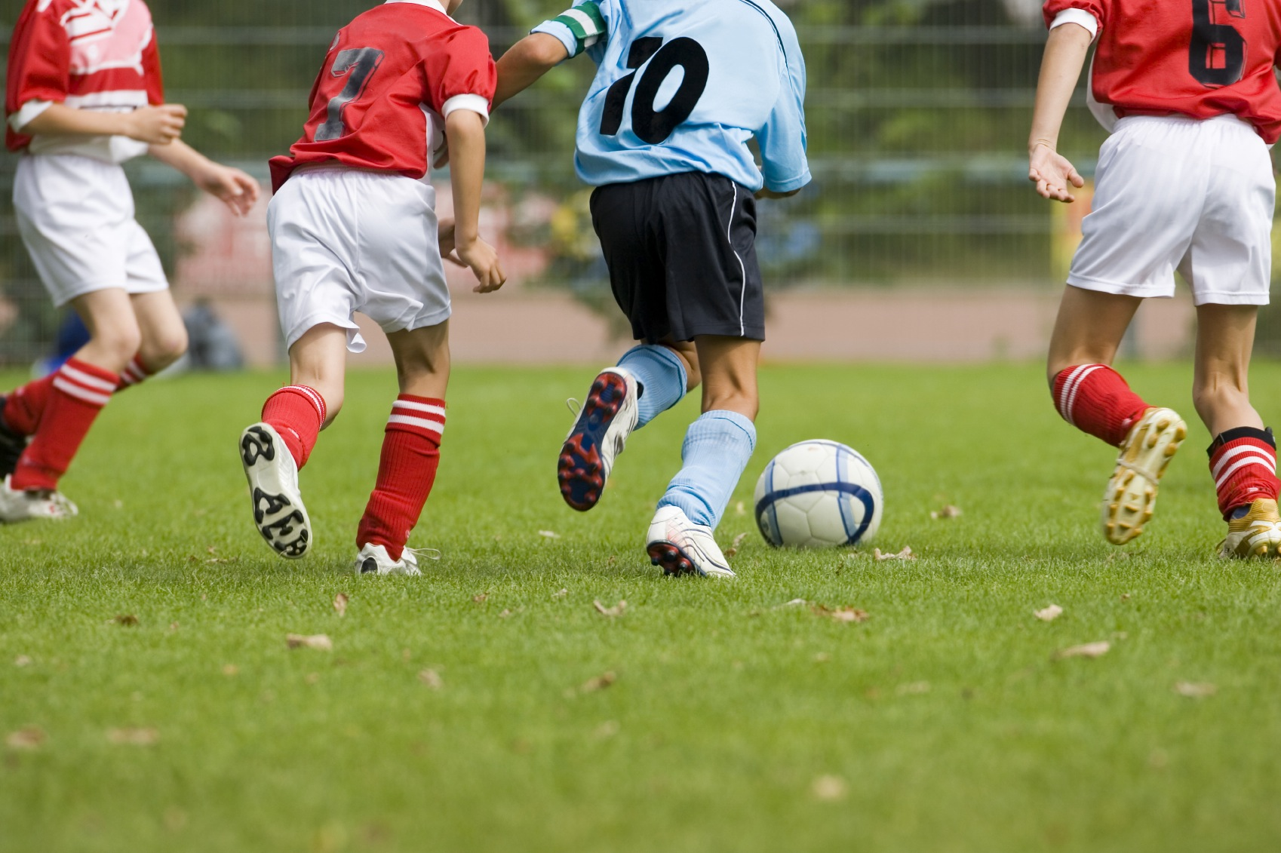
Playing Soccer

Slide 17
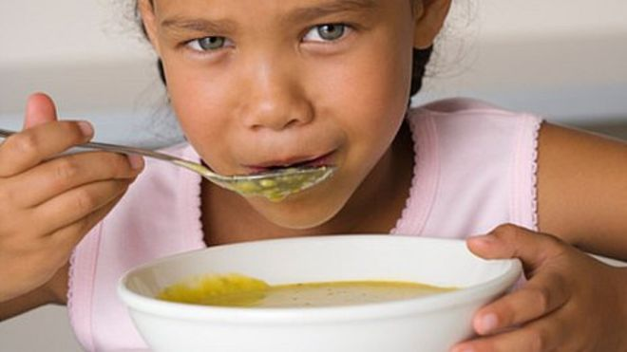
Eating Soup

Slide 18
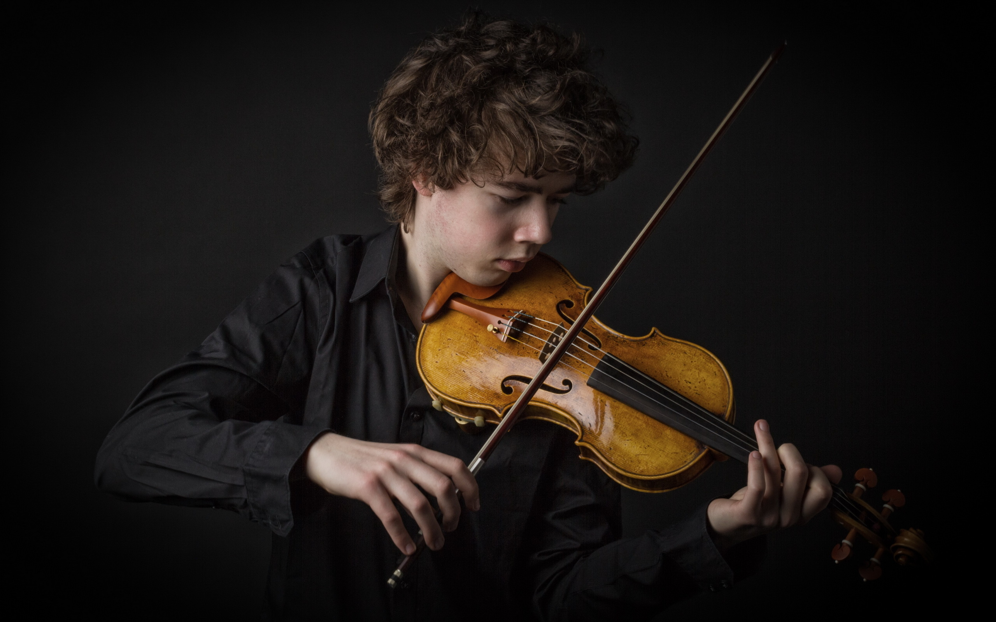
Playing Violin

Slide 19
Doing Homework

Slide 20
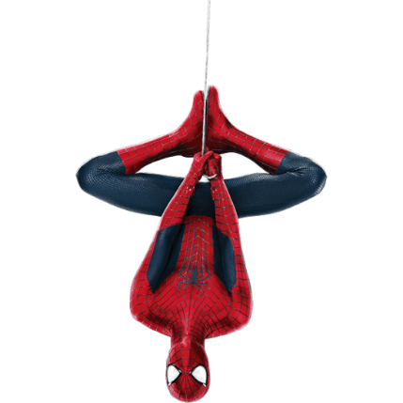
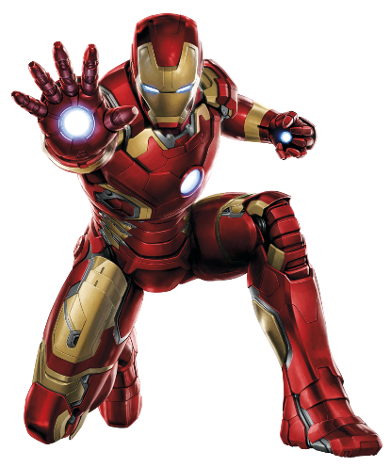
Who Where What
Library
Gym
Cafeteria
English Room
Music Room
Playground
Reading a book
Studying English
Playing Soccer
Eating Soup
Playing Violin
Doing Homework

Slide 21
Superhero School (Clue)
A ppt with rooms in a school
Have three sets of cards: People, Actions, Locations.
Choose one card from each deck (person + action + location). The students must guess who, where and what they are doing.
“Batman is in the gym. He is playing soccer.”
They can make a guess and tell them if they have any of the answers correct.
Students will use deduction to discover the answer.

Slide 22
Example:
The teacher draws three cards separately (Spiderman, Playground, Reading a book)
A student guesses, “Batman is in the playground. He is eating soup.”
The teacher informs the class that one answer is correct.
The next student guesses, “Wonder Woman is in the gym. She is playing soccer.”
The teacher informs the class that no answers are correct.
The next student guesses, “Hulk is in the playground. He is reading a book.”
The teacher informs the class that two answers are correct.

Slide 23
Batman
Wonder Woman
English Room
Doing Homework
Reading a Book
Superman
Ironman
Gym
Playing Violin
Playing Soccer
Spiderman
Playground
Cafeteria
Eating Soup
Hulk
Music Room
Library
Studying English

