Slide 1
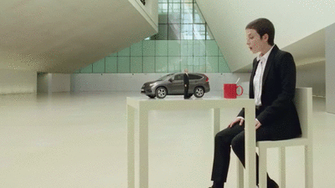
Guessing Game

Slide 2
Rules
Each slide has a noun.
Students will guess what the sentence will be:
It’s tall.
It’s big.
It’s short.
It’s long…

Slide 3
Elephant
It’s big.

Slide 4
Giraffe
It’s tall.

Slide 5
Snake
It’s long.

Slide 6
Turtle
It’s short.

Slide 7
Russia
It’s big.

Slide 8
The Pyramids
It’s big.

Slide 9
Mouse
It’s small.

Slide 10
Kimbap
It’s long.

Slide 11
Train
It’s long.

Slide 12
The Moon
It’s big.

Slide 13
Yao Ming
(Basketball Player)
He’s tall.

Slide 14
CN Tower
It’s tall.

Slide 15
Nile River
It’s long.

Slide 16
Blue Whale
It’s big.

Slide 17
Mosquito
It’s small.

Slide 18
Dachshund
It’s long.

Slide 19
Angel Falls
It’s tall.

Slide 20
Peel P50 Microcar
It’s small.

Slide 21
Oarfish
It’s long.

