Slide 1
Hot Seat

Slide 2
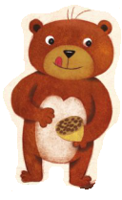
Bear

Slide 3
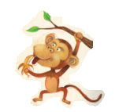
Monkey

Slide 4
Bird

Slide 5
Cat

Slide 6
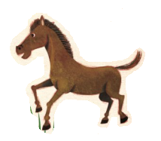
Horse

Slide 7
Pig

Slide 8
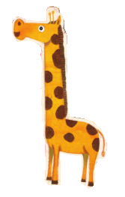
Giraffe

Slide 9
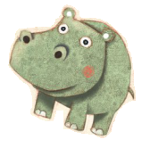
Hippo

Slide 10
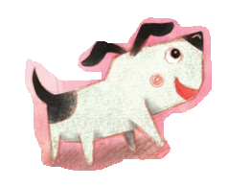
Dog

Slide 11
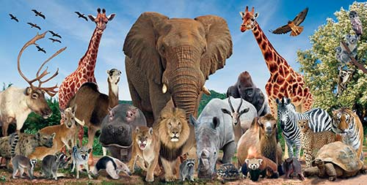
Brainstorm – Animals

Slide 12
Describing Words (color)
Red
Green
Blue
Orange
Purple
Yellow
Pink
Brown
Black
Grey

Slide 13
Describing Words (size)
Big
Small
Short
Tall
Long
Short

Slide 14
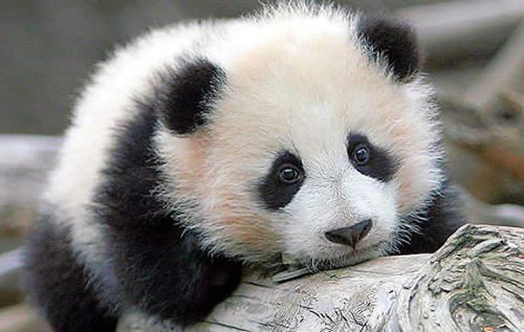
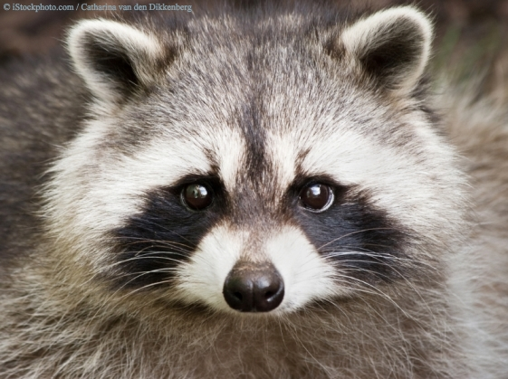
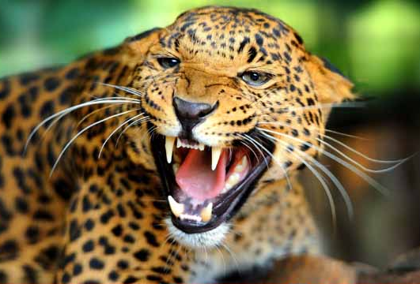
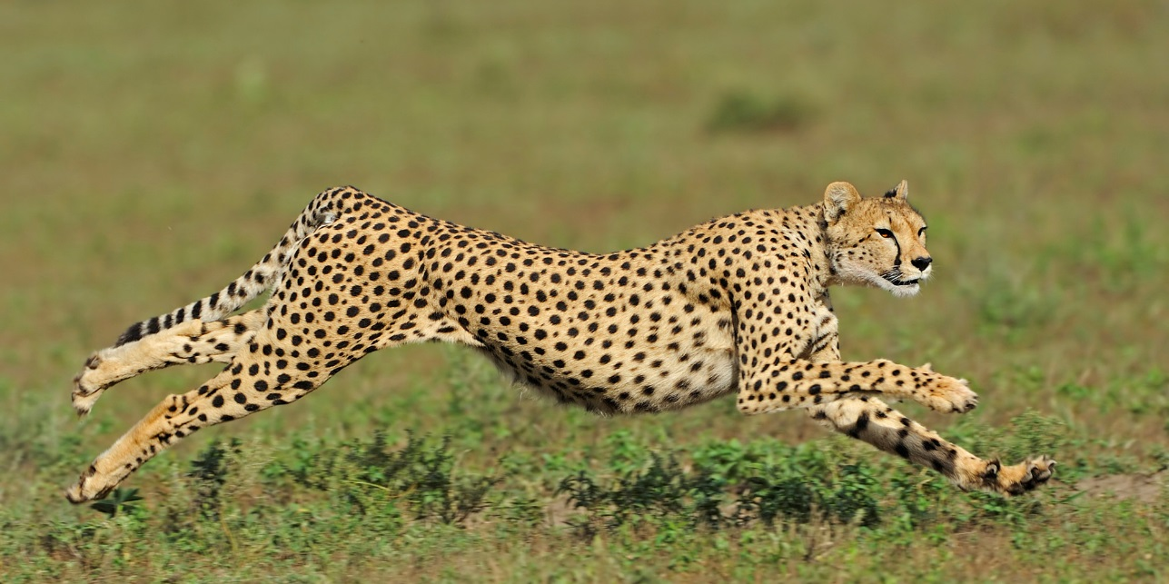
Describing Words (other)
Cute
Furry
Dangerous
Fast

Slide 15
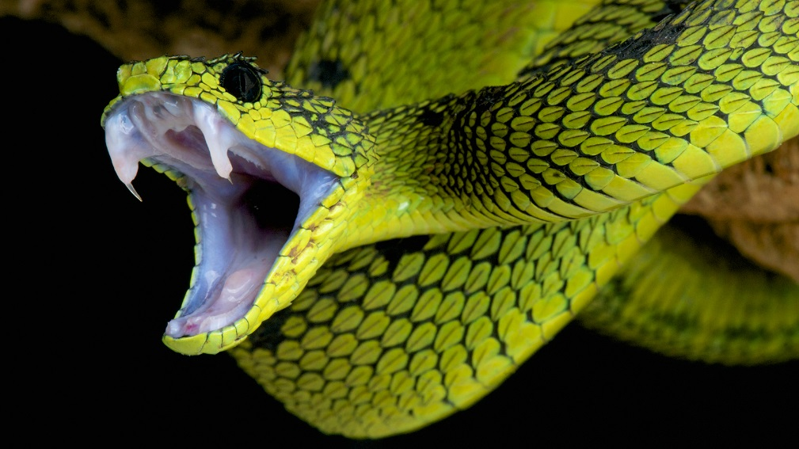
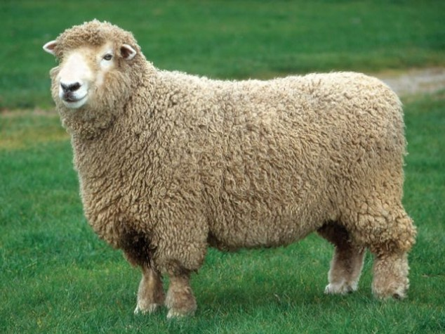
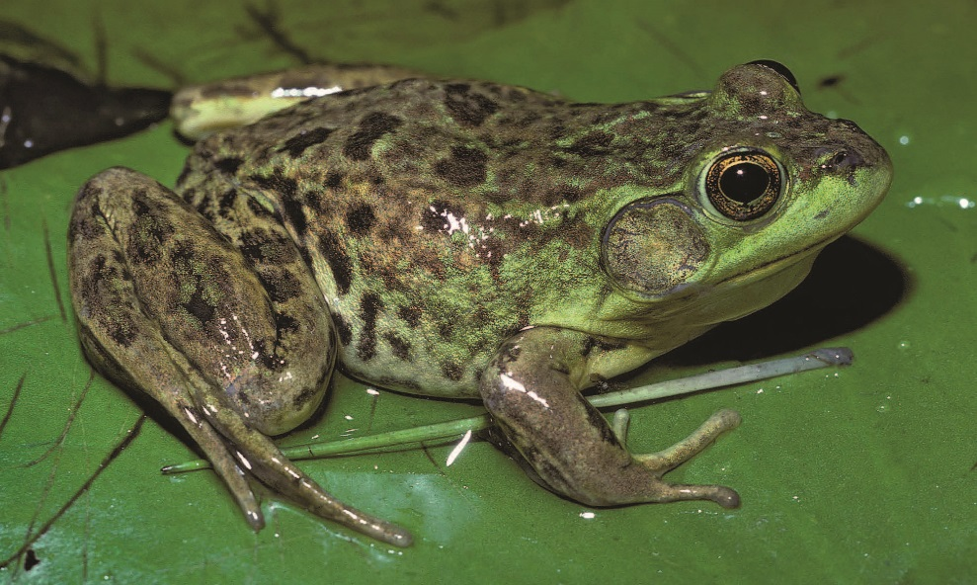
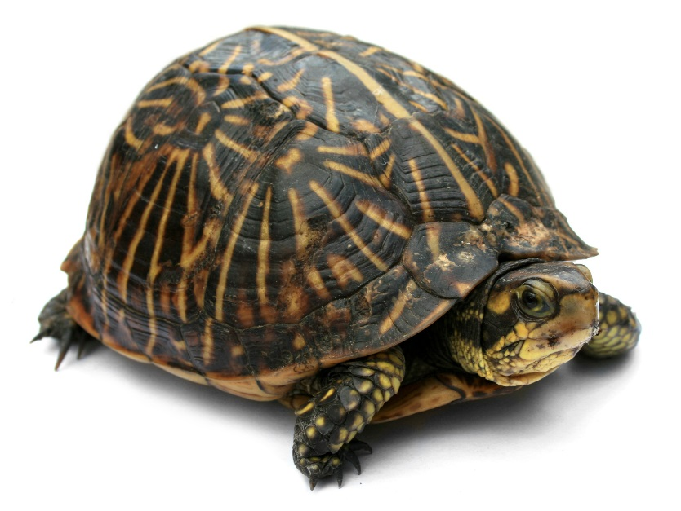
Describing Words (other)
Scary
Soft
Wet
Hard

Slide 16
Hot Seat

Slide 17
Rules
One person from your team will sit at the front
The rest of the team must describe the picture on the TV
Use the describing words
The person in the chair must guess the answer
When they are correct, say, “You’re right!”
The fastest team is the winner

Slide 18
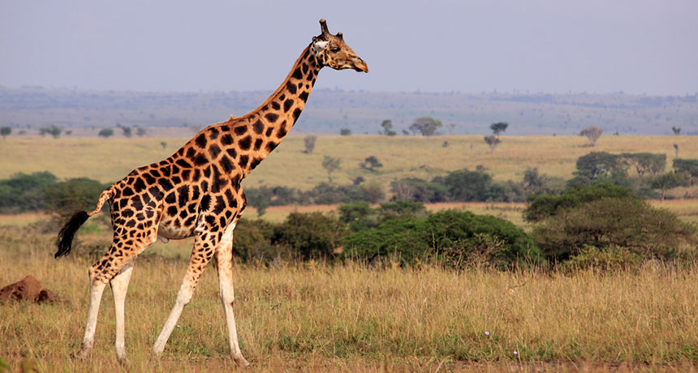
Giraffe

Slide 19
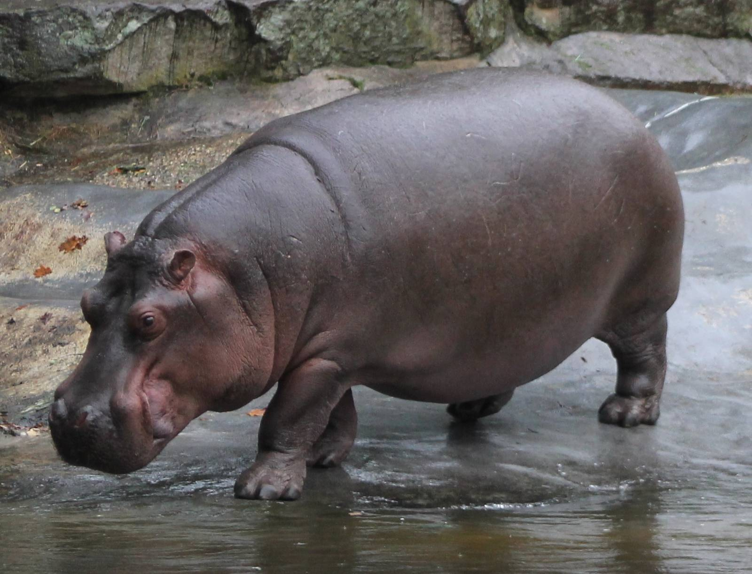
Hippo

Slide 20
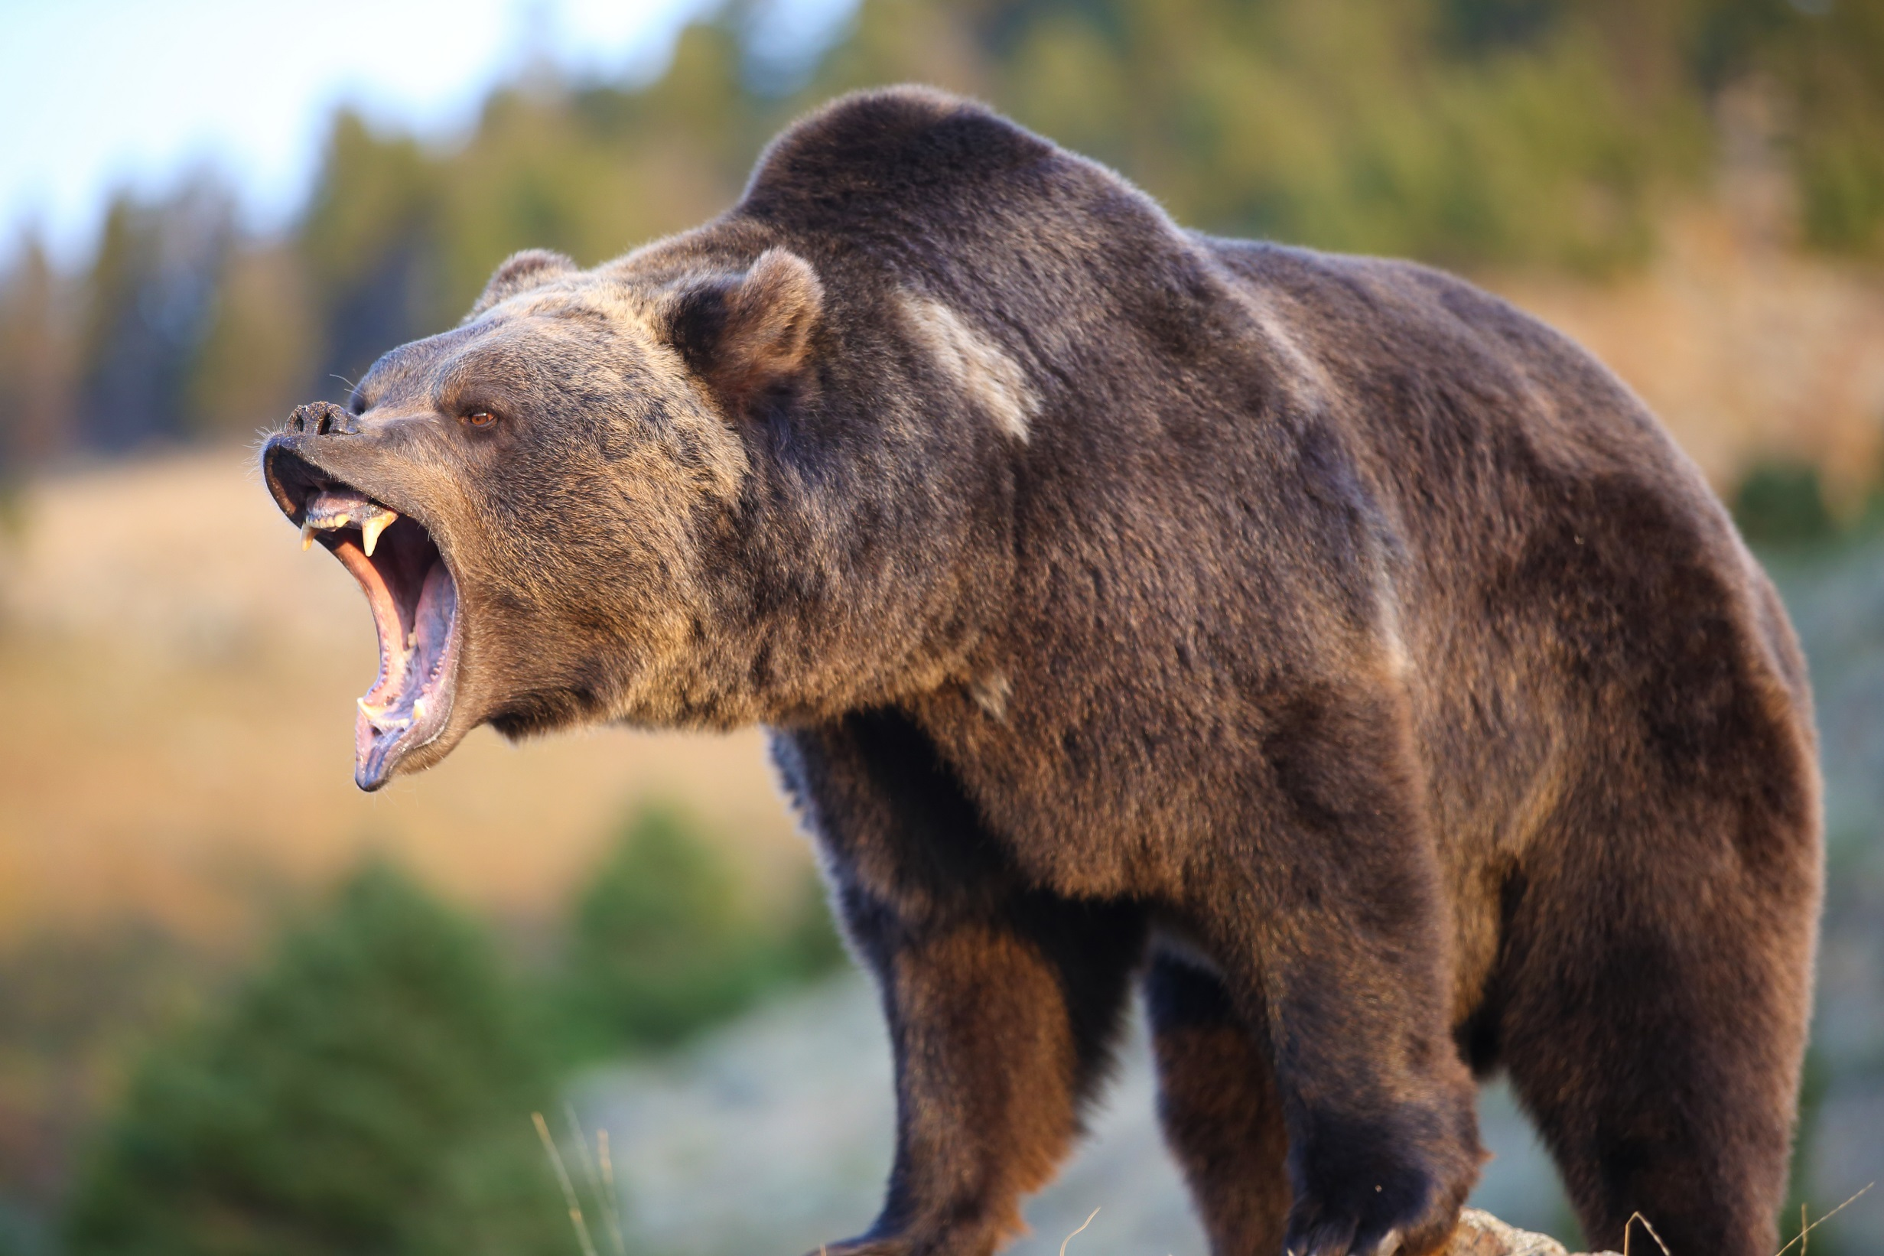
Bear

Slide 21
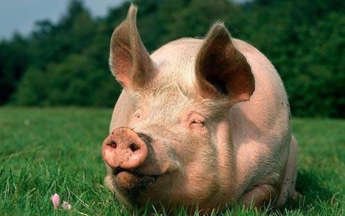
Pig

Slide 22
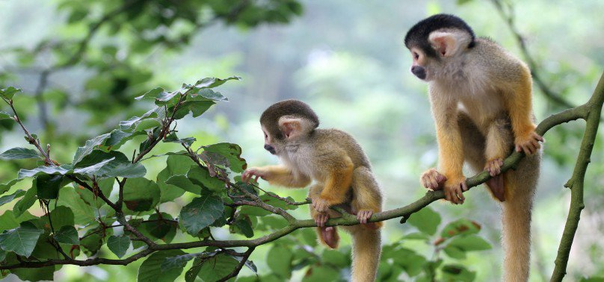
Monkey

Slide 23
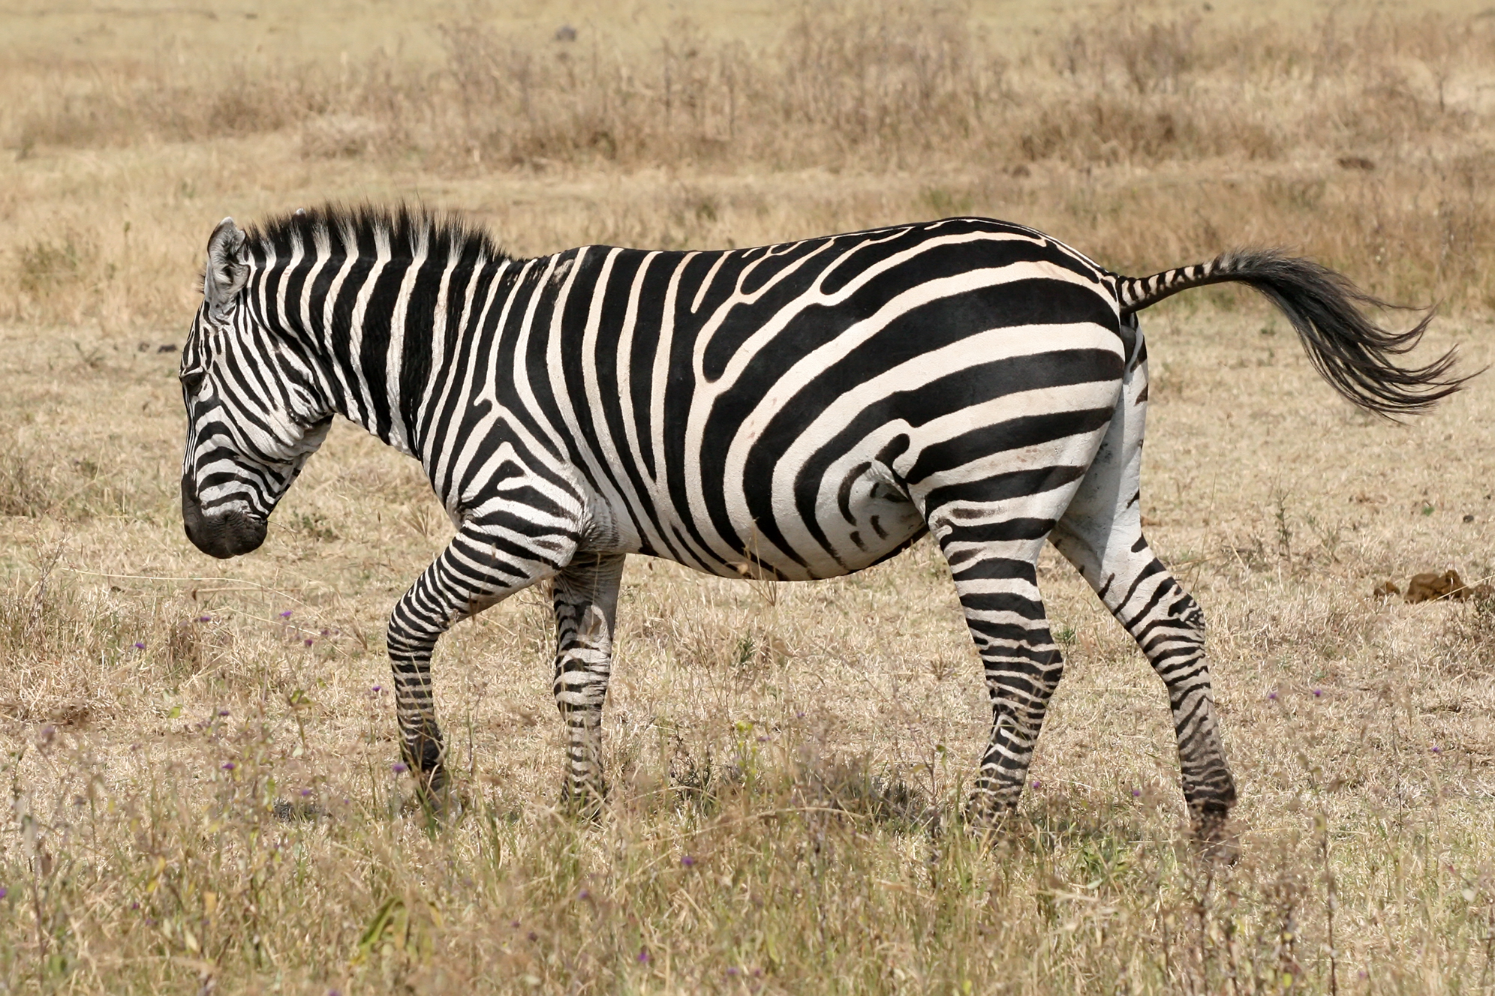
Zebra

Slide 24
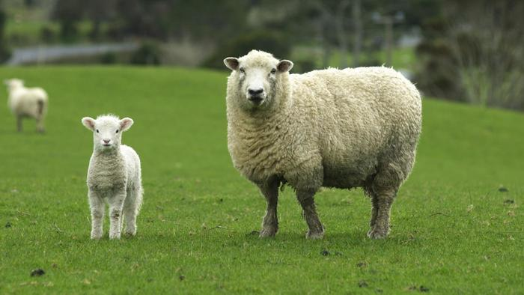
Sheep

Slide 25
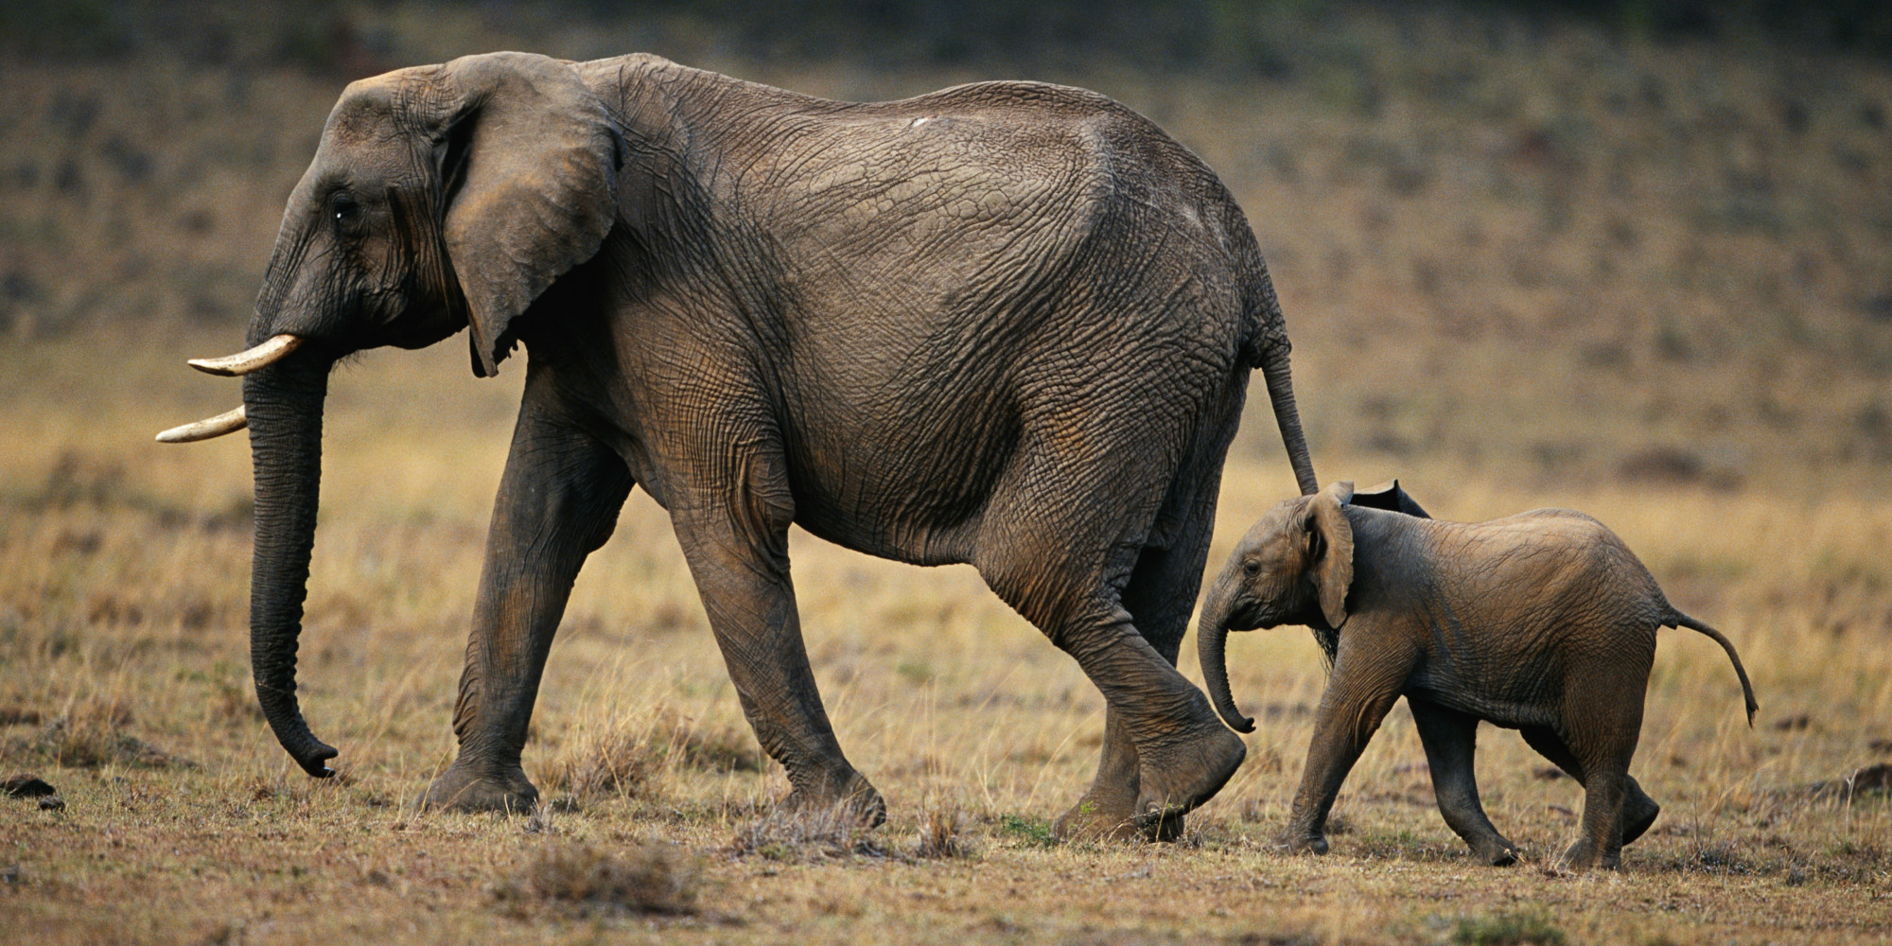
Elephant

Slide 26
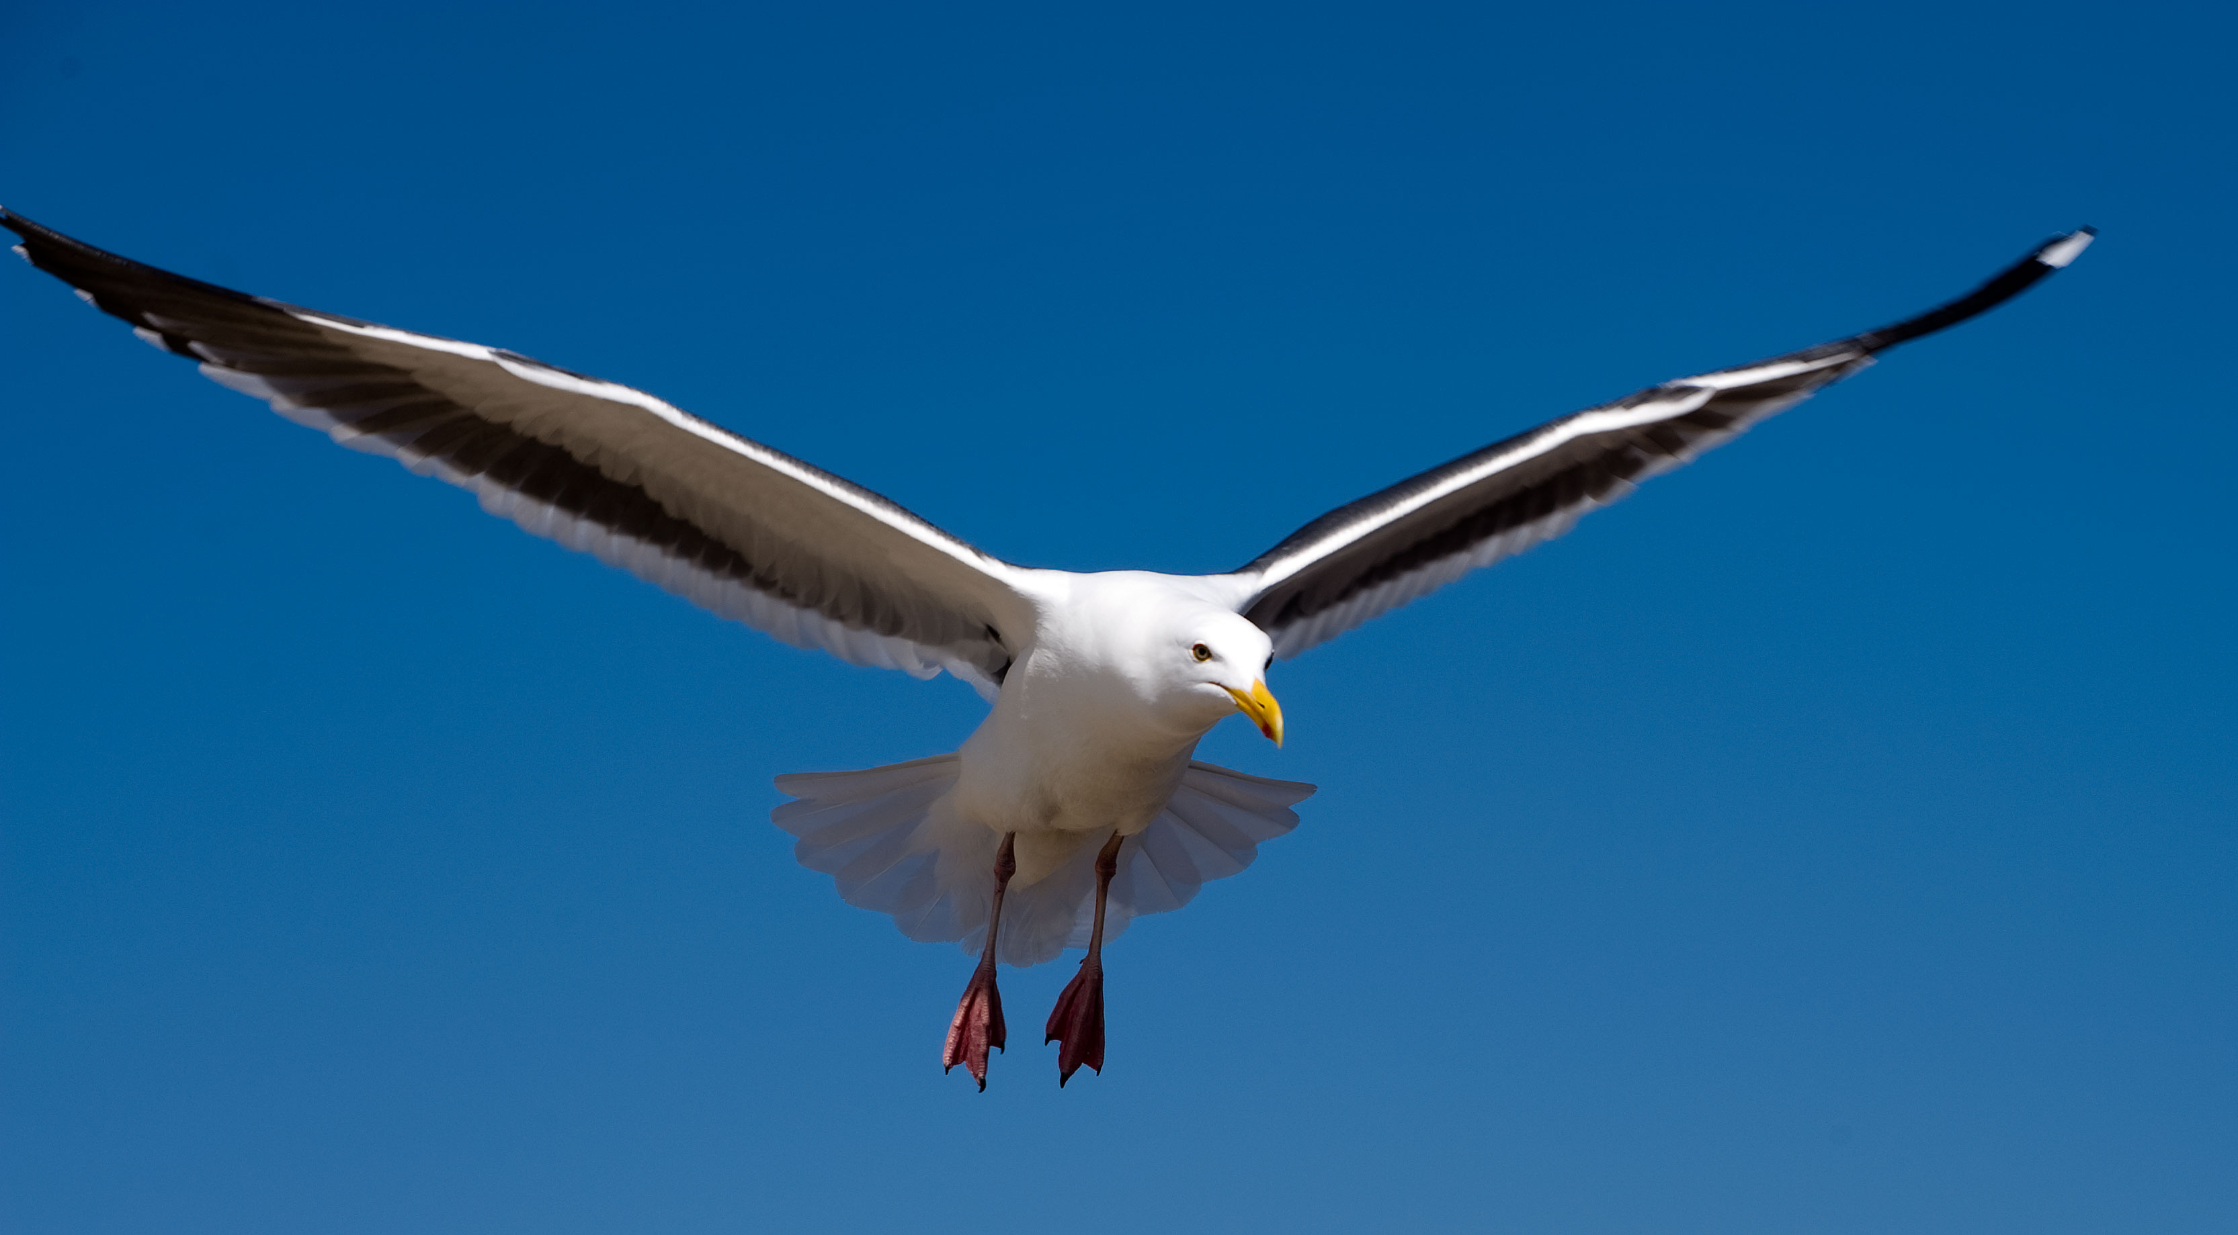
Bird

Slide 27
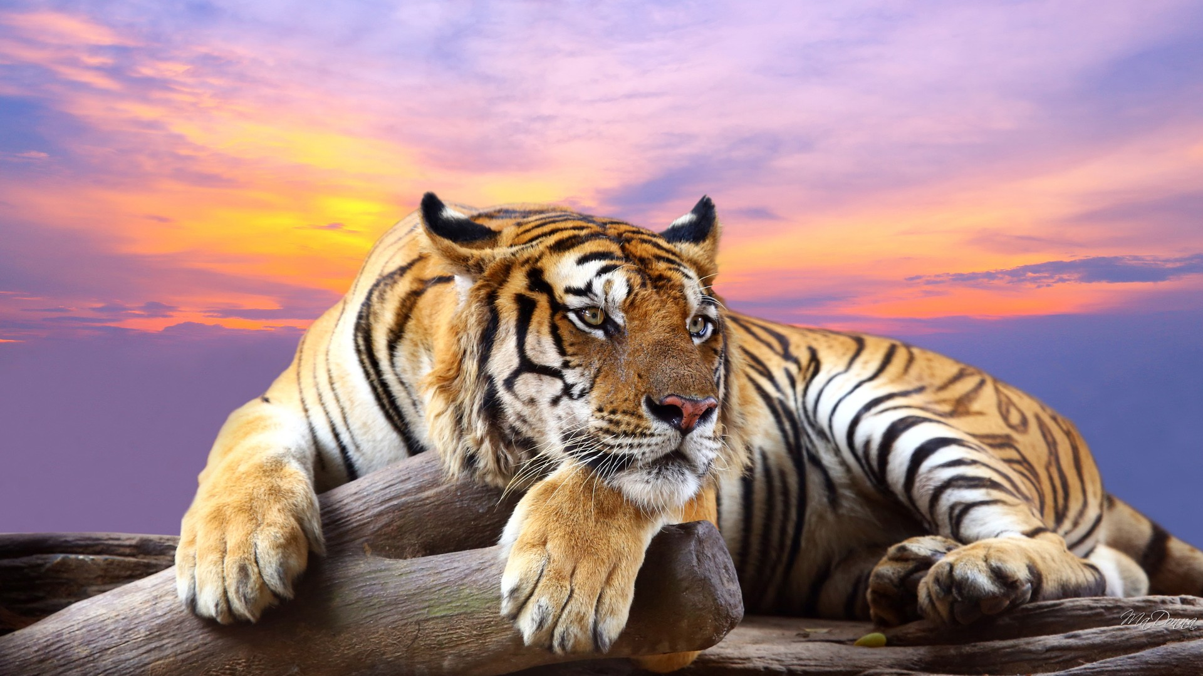
Tiger

Slide 28
Snake

Slide 29
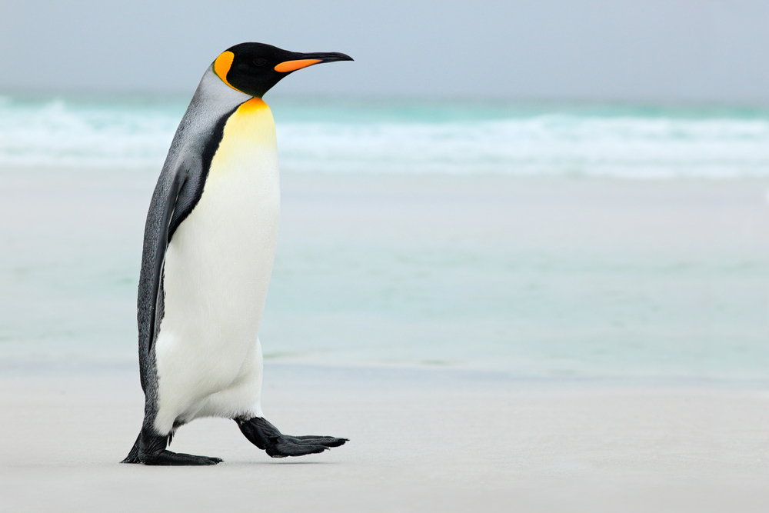
Penguin

Slide 30
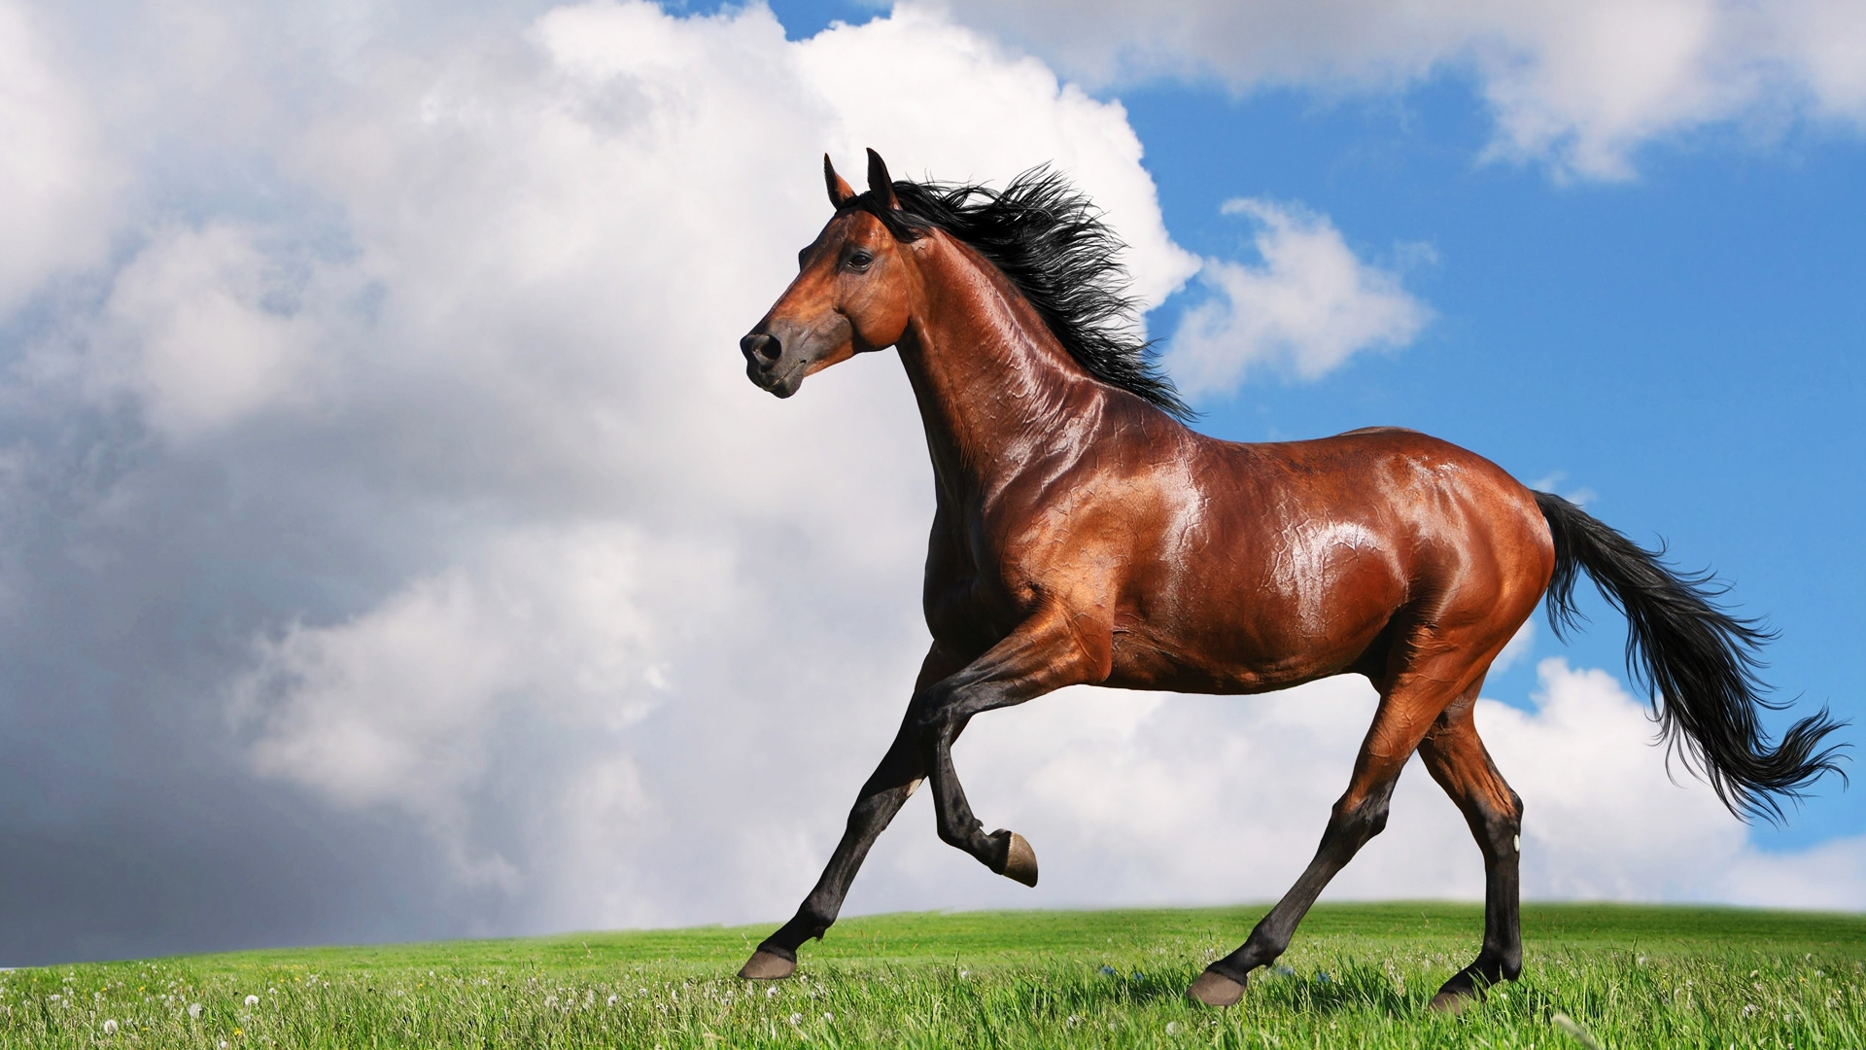
Horse

Slide 31
Cheetah

Slide 32
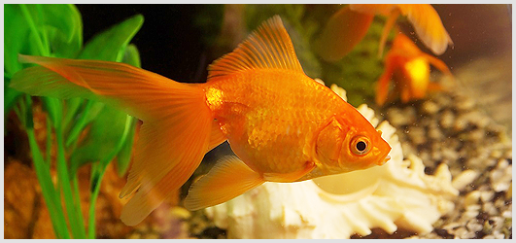
Goldfish

Slide 33
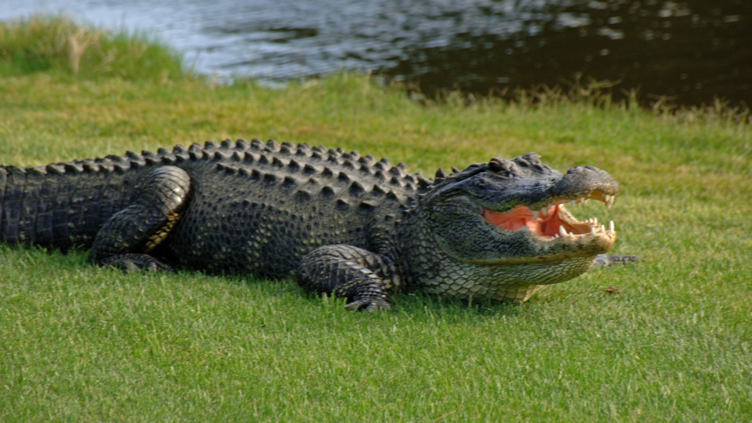
Crocodile

Slide 34
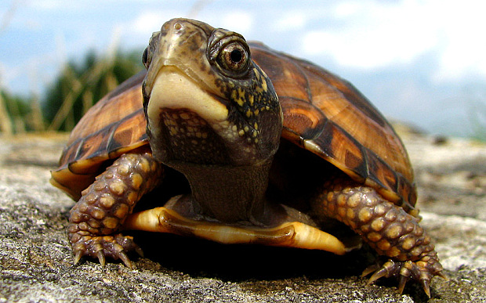
Turtle

Slide 35
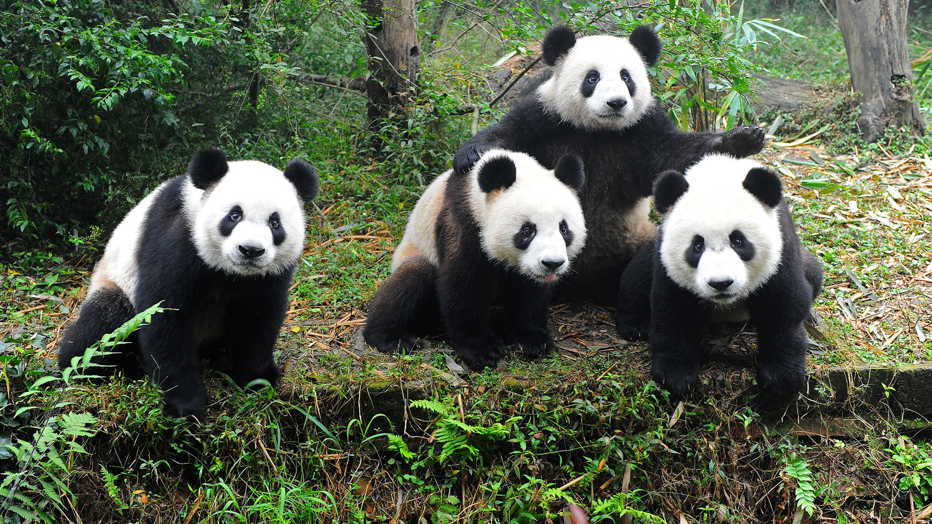
Panda

Slide 36
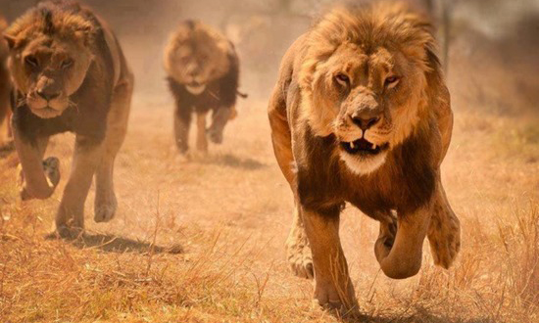
Lion

Slide 37
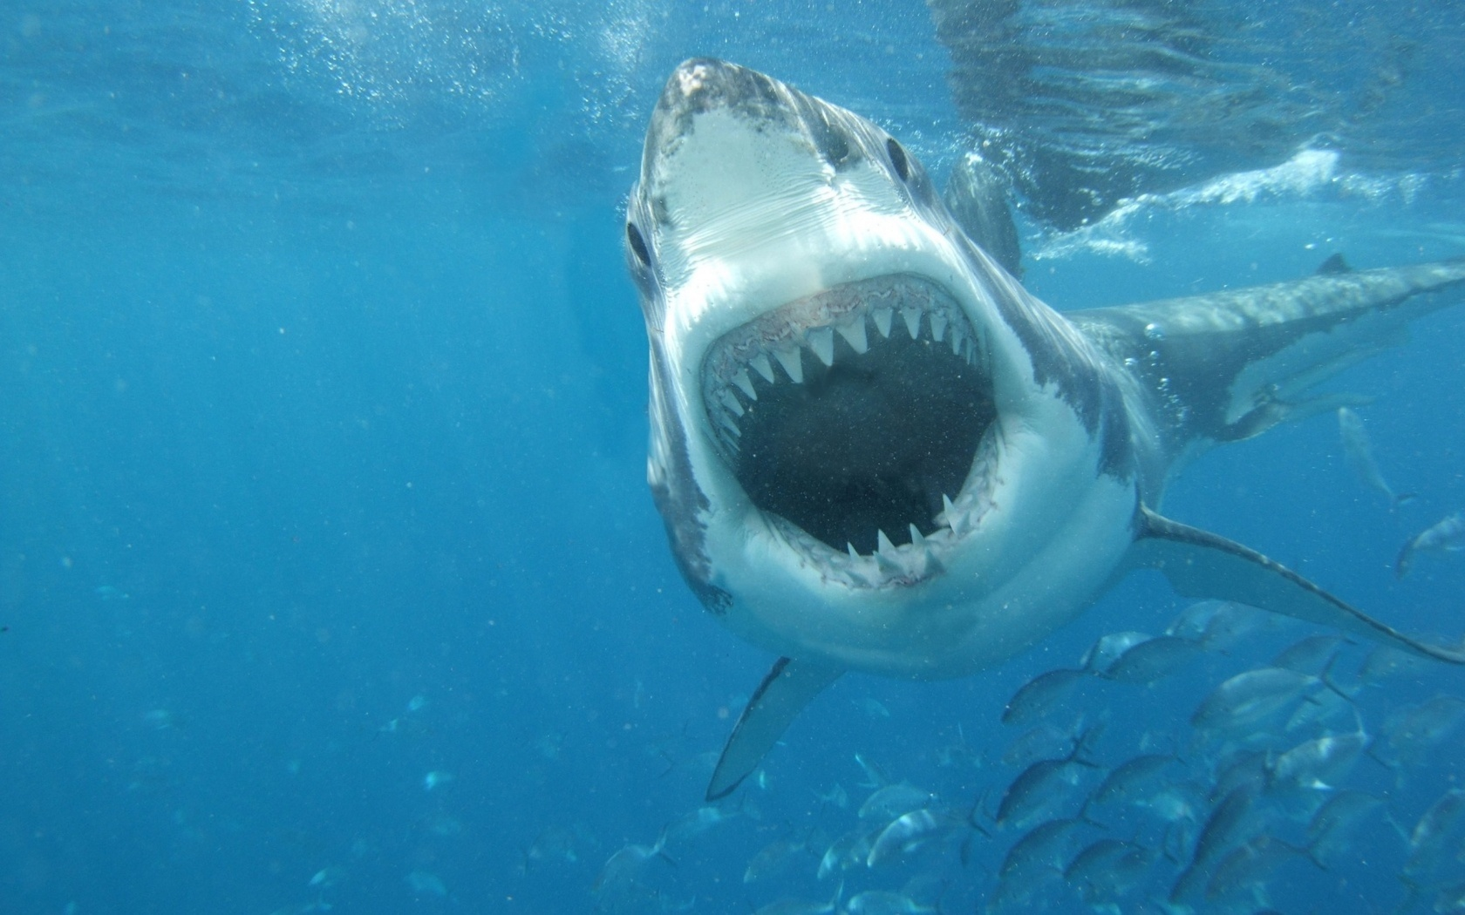
Shark

Slide 38
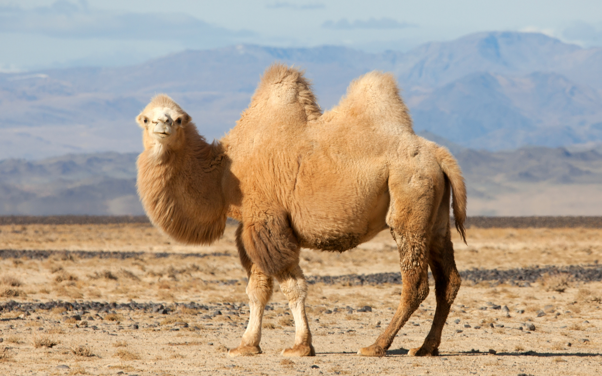
Camel

Slide 39
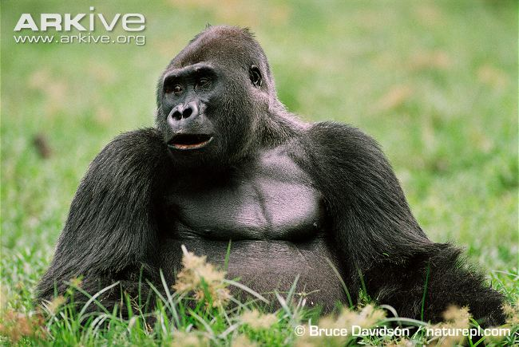
Gorilla

Slide 40
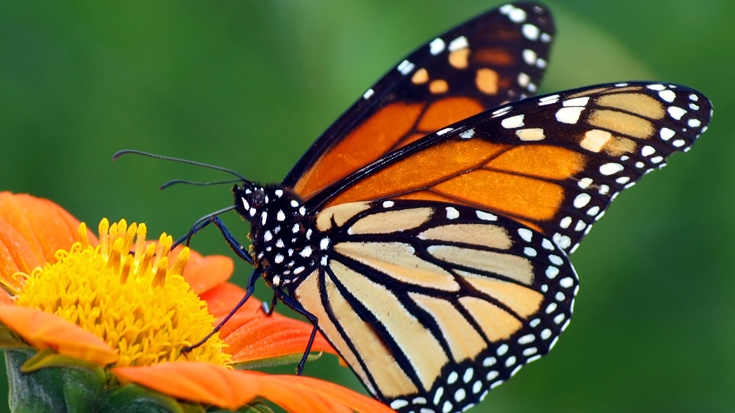
Butterfly

Slide 41
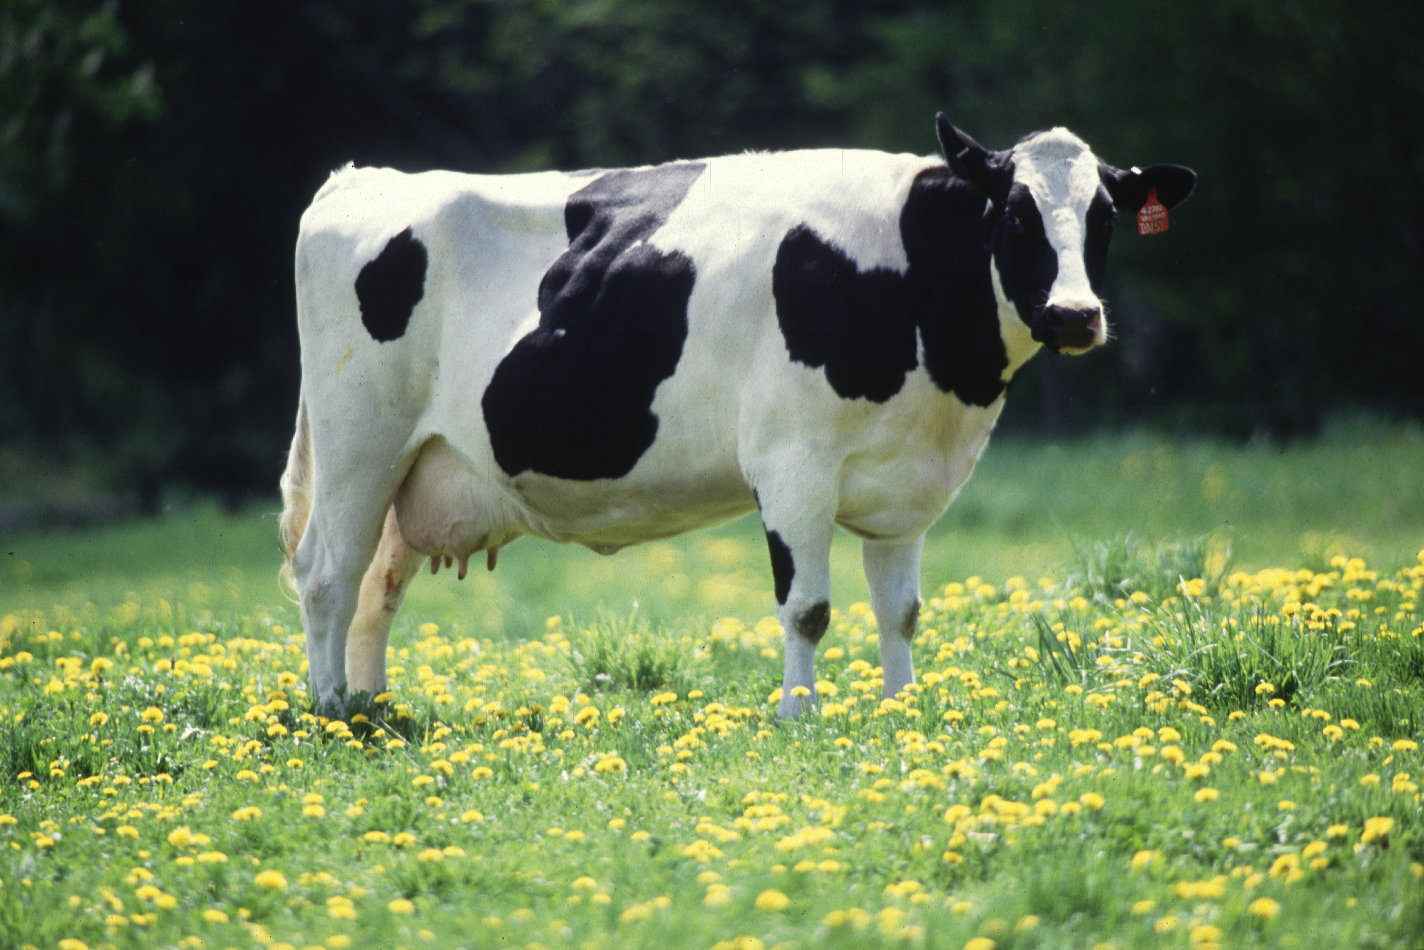
Cow

Slide 42
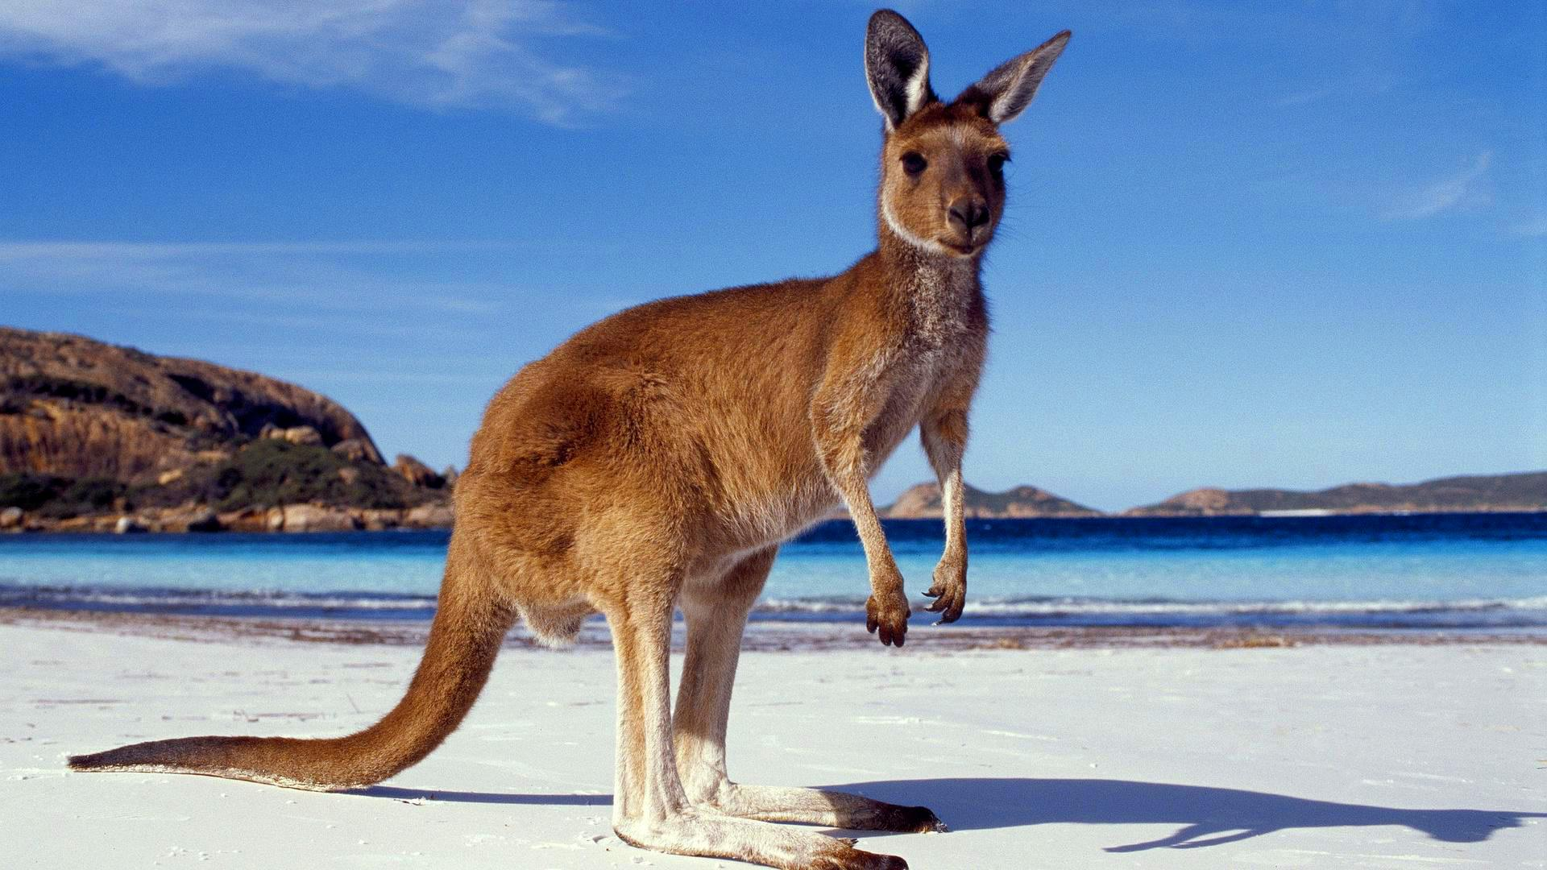
Kangaroo

Slide 43
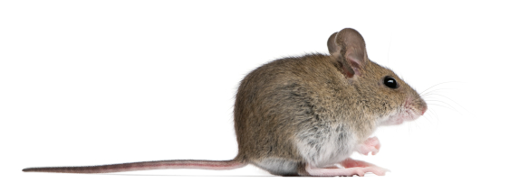
Mouse

Slide 44
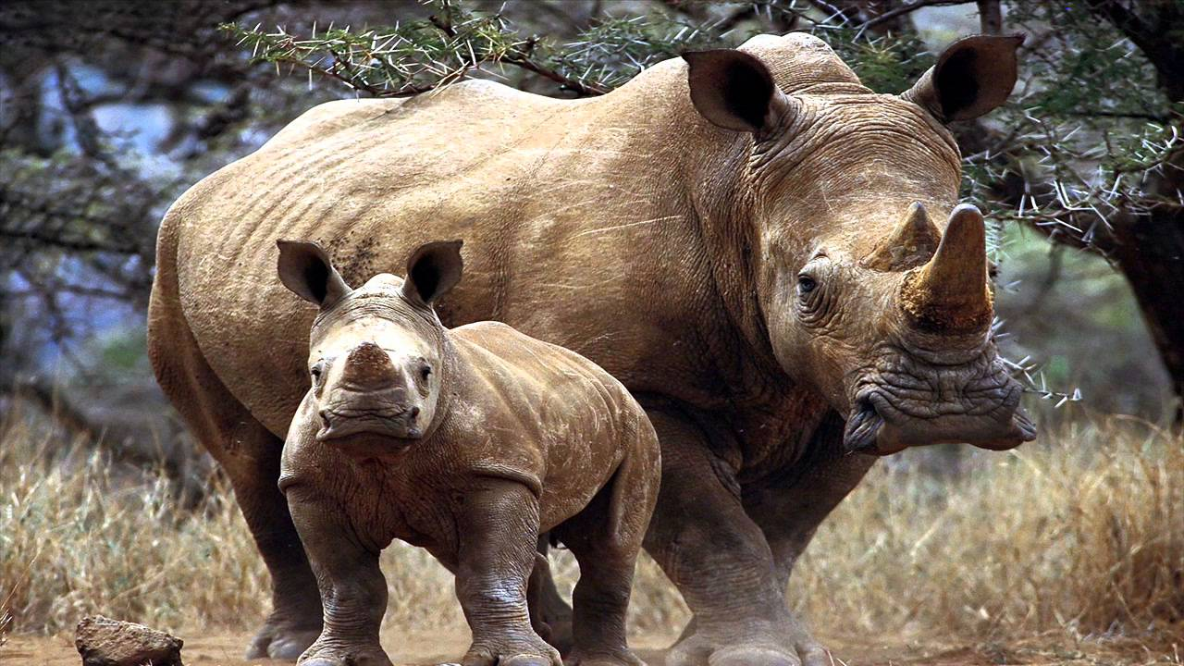
Rhino

Slide 45
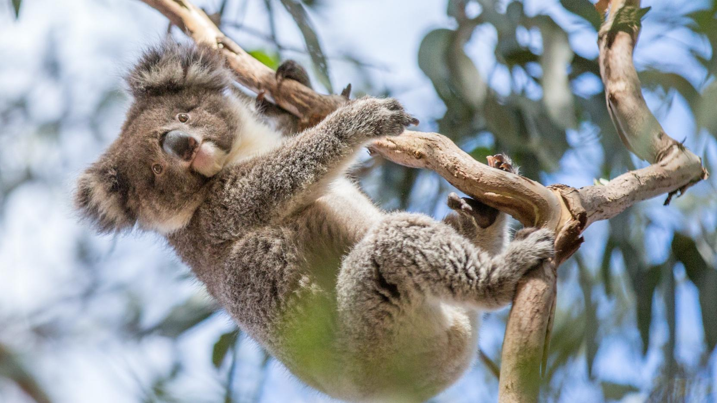
Koala

Slide 46
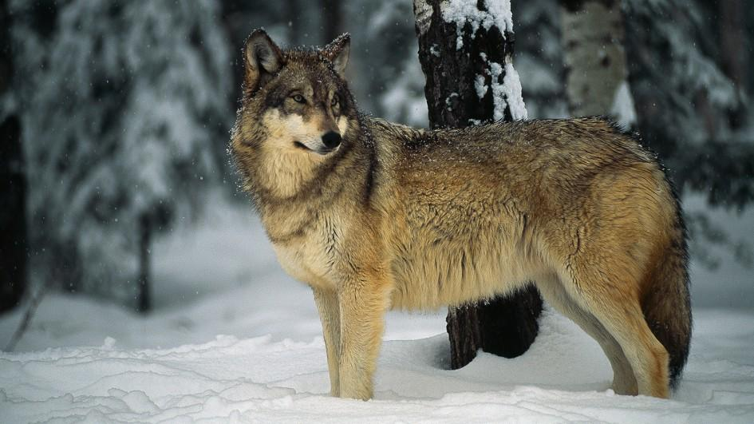
Wolf

Slide 47
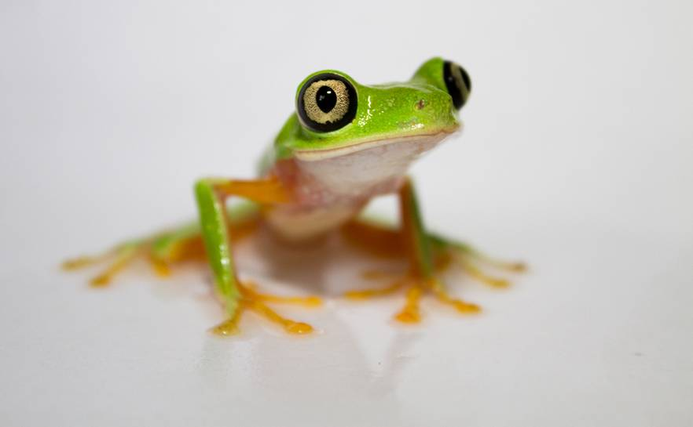
Frog

Slide 48
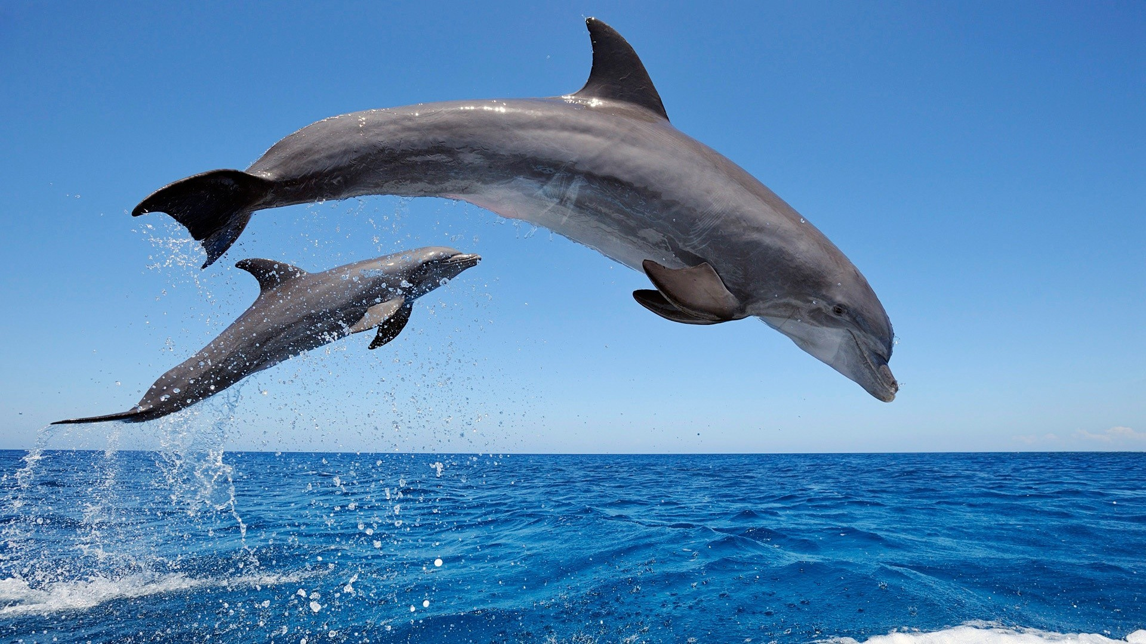
Dolphin

Slide 49
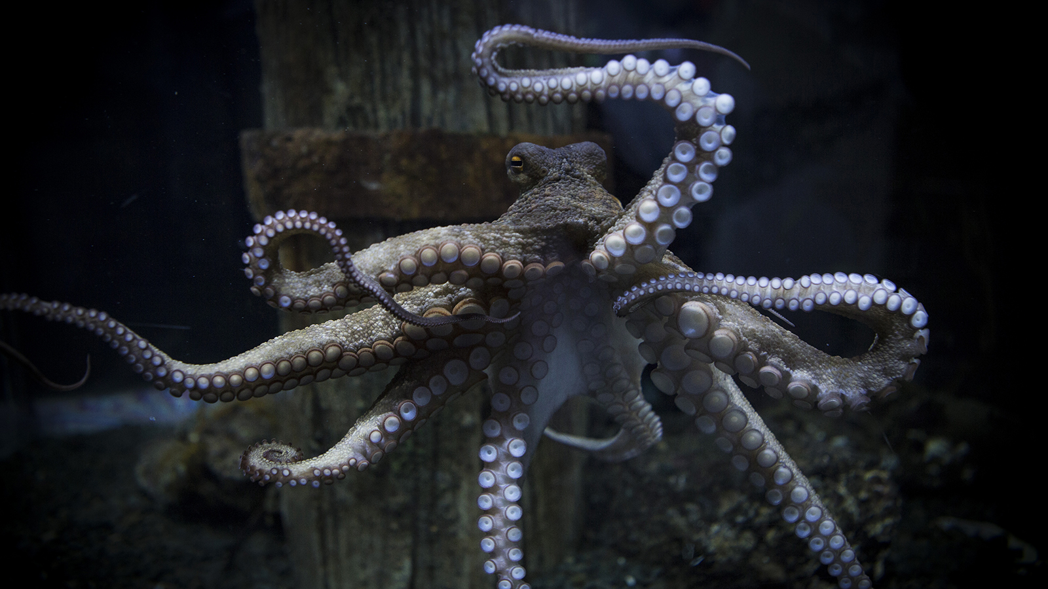
Octopus

Slide 50
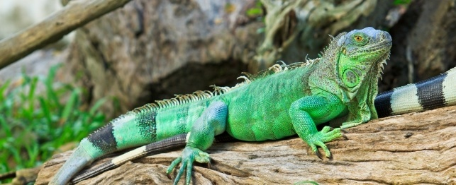
Iguana

Slide 51
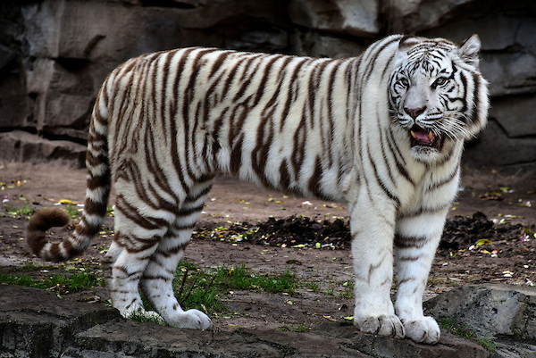
White Tiger

Slide 52
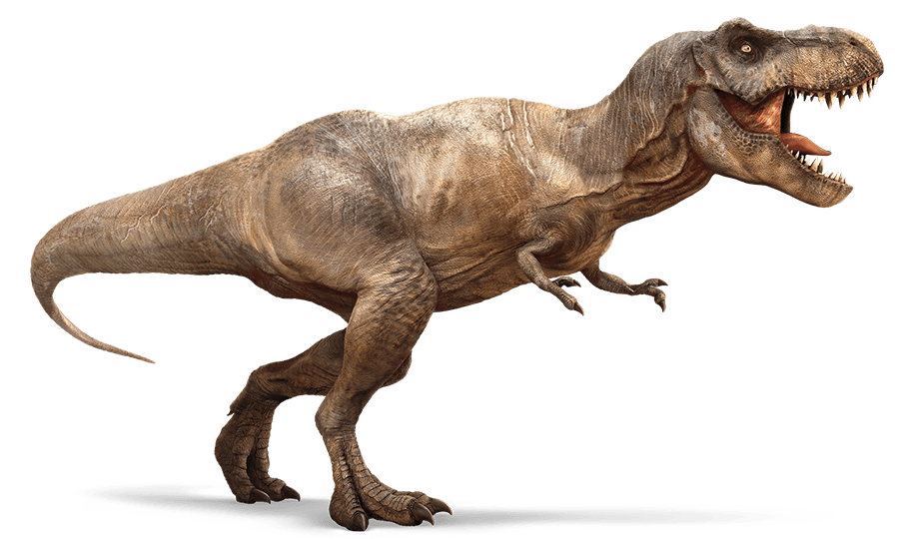
Dinosaur

Slide 53
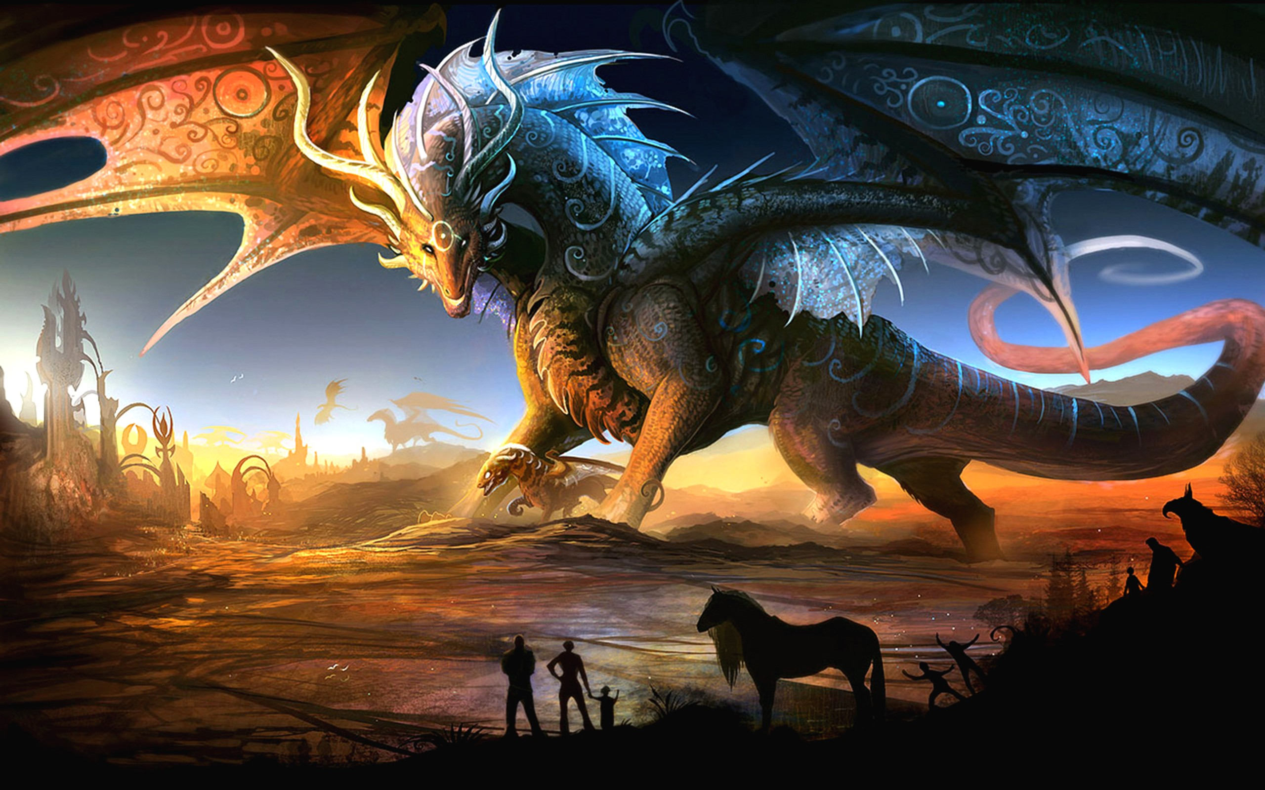
Dragon

Slide 54
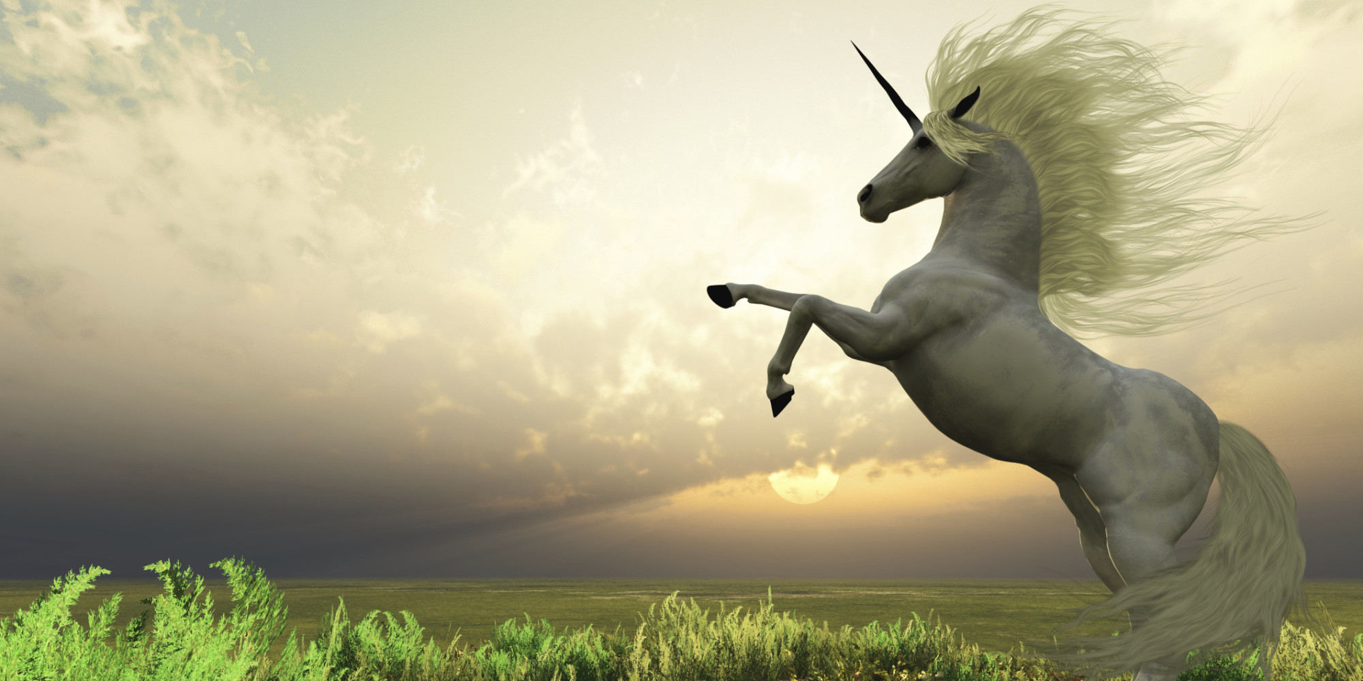
Unicorn

Slide 55
Raccoon

Slide 56
Mosquito

Slide 57
Hedgehog

Slide 58
Squirrel

