Slide 1
Rooms of a House
“Where is it?” Game

Slide 2
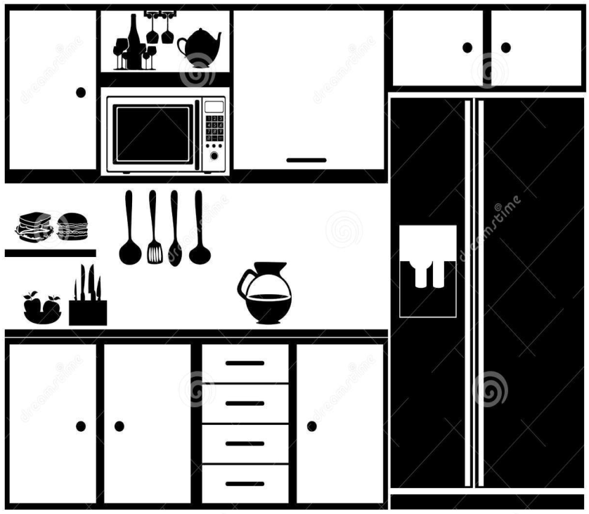
Kitchen

Slide 3
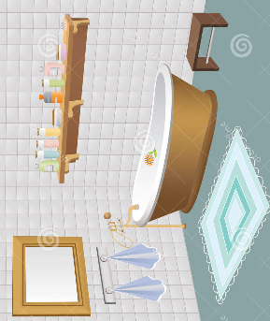
Bathroom

Slide 4
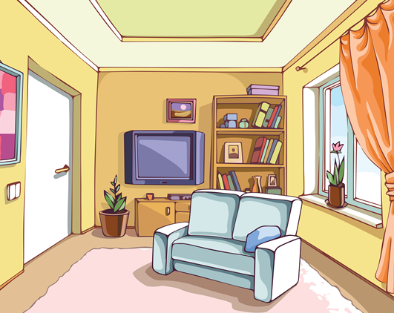
Living Room

Slide 5
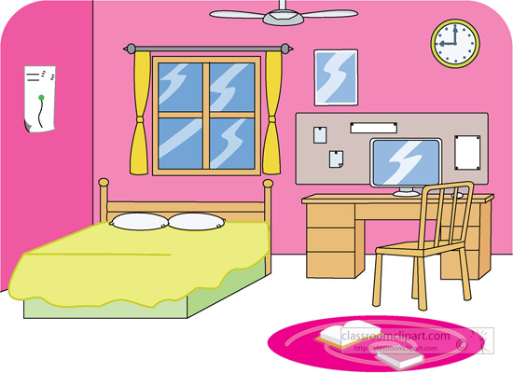
Bed Room

Slide 6
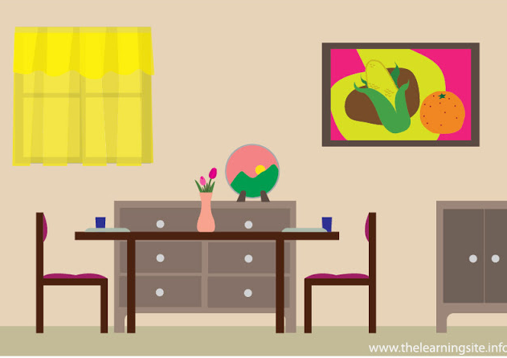
Dining Room

Slide 7
Basement

Slide 8
Kitchen, not chicken!
https://www.youtube.com/watch?v=DR5qPNPGCmY

Slide 9
Prepare
Print a copy of the game board for each pair of students (and laminate for multiple use).
Print one set of cards for you to draw from.

Slide 10
How to Play
Each pair of students shares a board and race to find the answer.
The teacher will draw one card and ask, “Where is _______?”
When the students find the character or object, they will say, “It’s in the _______”
The first student (between the two) to say the correct answer will gain one point.
Most points at the end is the winner.

Slide 11



















































Slide 12



Slide 13




Slide 14



Slide 15




Slide 16


