Slide 1
Can you do it?
Challenge Game

Slide 2
How to play:
Choose a student.
  Draw two cards and make a sentence…
  “Can you _________ ______________”
If a student thinks they can do it, they can put up their hand.
The first student chooses someone to try it.
  Success: They can choose the next two cards and the cycle continues.
  Failure: The first student will choose another student.
Shuffle the cards each time as there are many combinations. Keep the two types of cards in two separate decks.

Slide 3
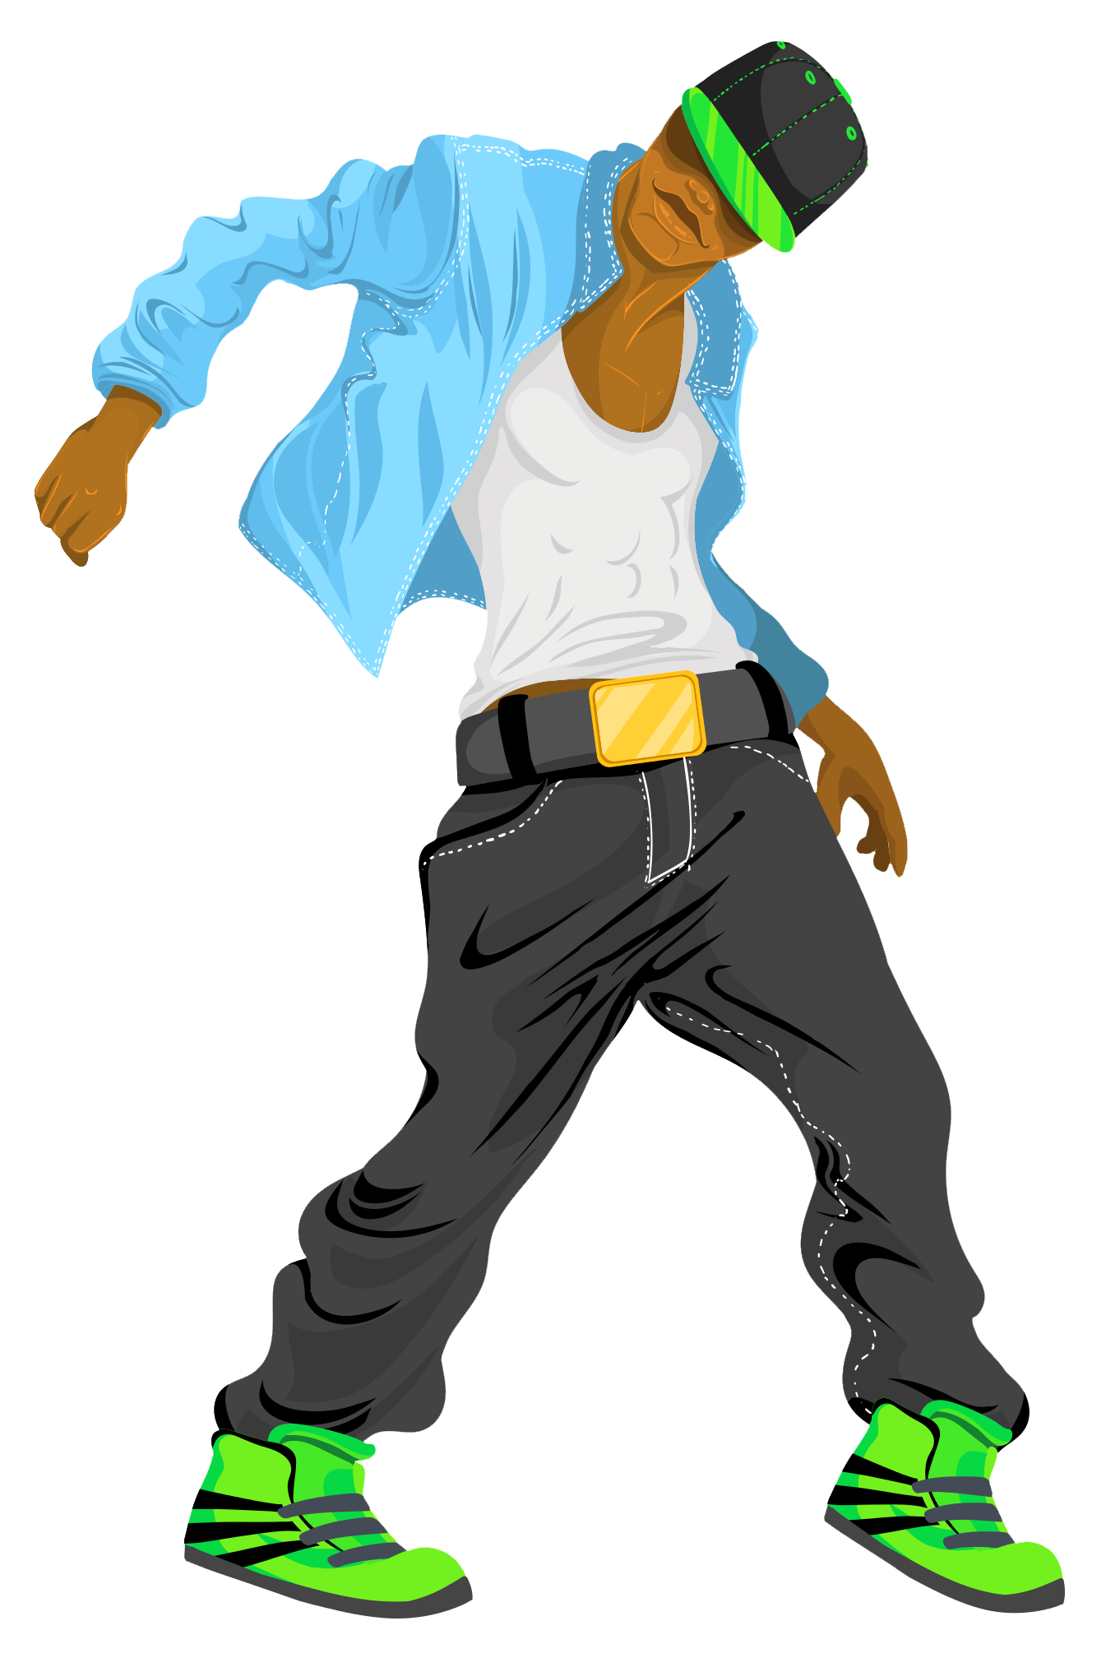




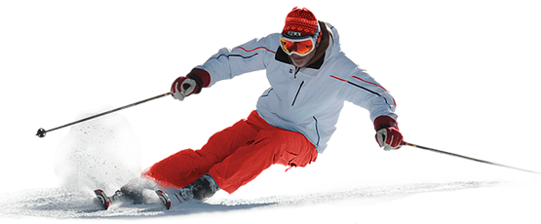

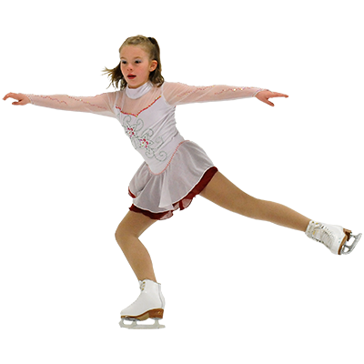
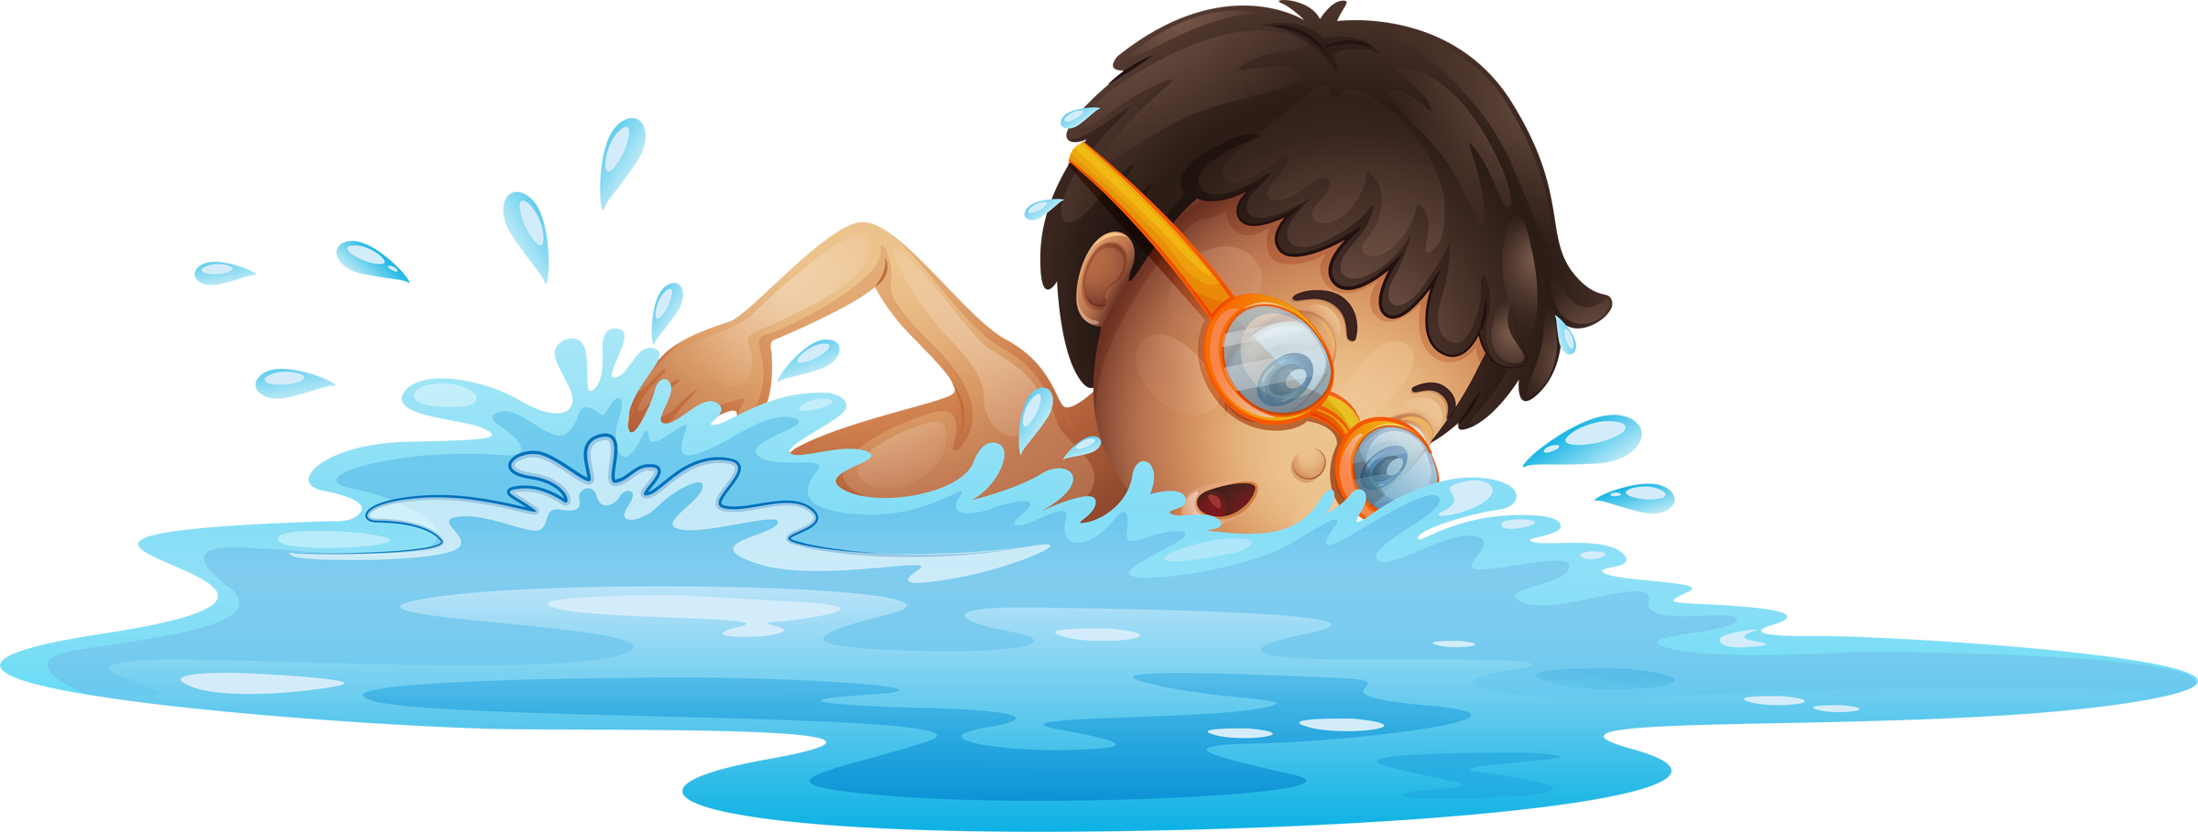
Dance
Jump
Run
Sing
Ski
Sit down
Swim
Skate
Stand up

Slide 4

With a ball on your head

Slide 5
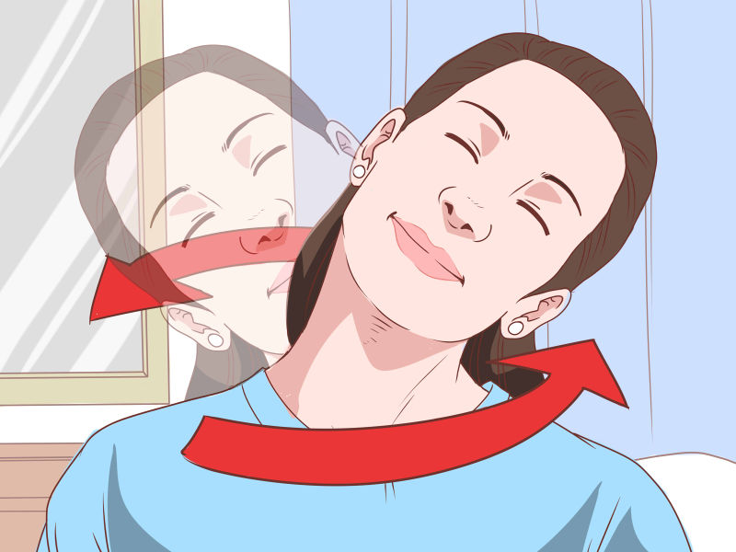

With a ball on your neck

Slide 6
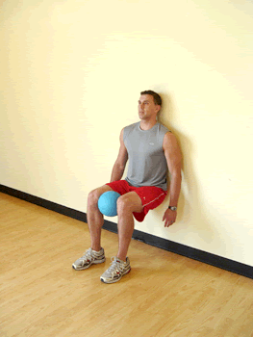
With a ball between your knees

Slide 7
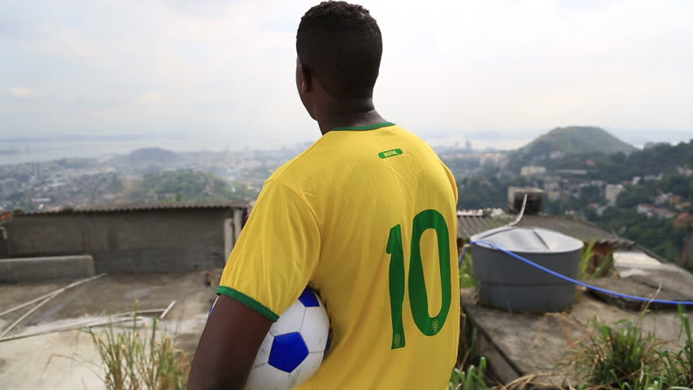
With a ball under your arm

Slide 8
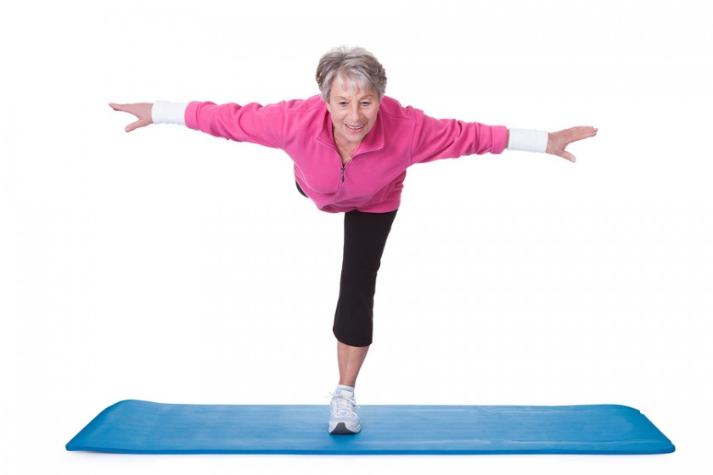
On one leg

Slide 9

With no arms

Slide 10

Wearing a blindfold

Slide 11
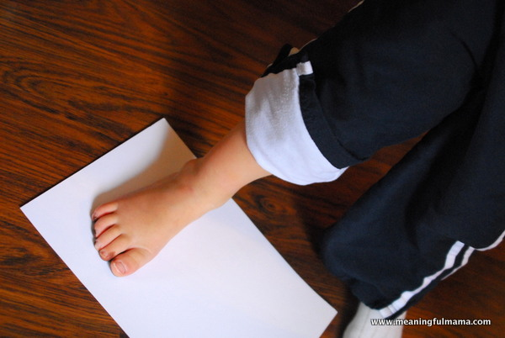
On a piece of paper.

Slide 12

With shoes on your hands.

Slide 13
Dance
Jump
Run
Sing
Ski
Sit down
Swim
Skate
Stand up

Slide 14
With a ball on your head
With a ball under your arm
Wearing a blindfold
With a ball on your neck
On one leg
On a piece of paper
With a ball between your knees
With no arms
With shoes on your hands

