Slide 1
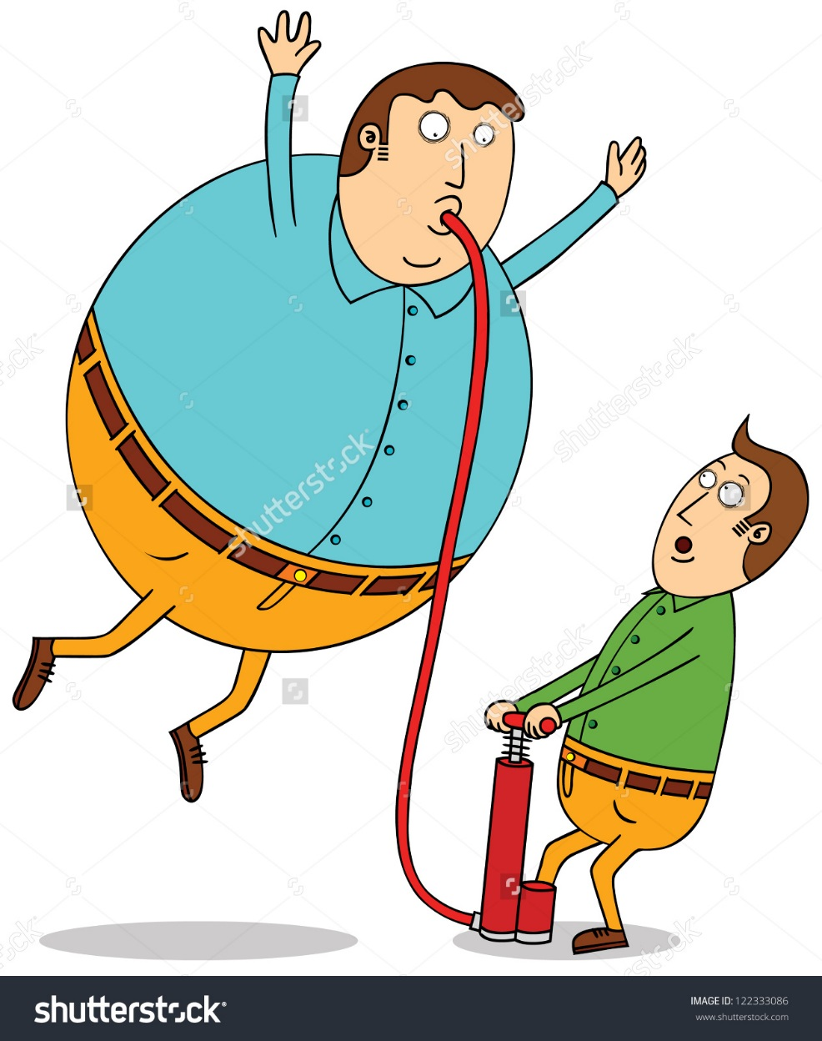
So Full !
“Would you like some ________?” “Yes, please.”
“No thanks, I’m full.”

Slide 2
Materials
A balloon pump and many balloons.
*This is a push your luck game for the whole class*

Slide 3
How to play:
One student comes to the front of the class and puts a balloon on the pump (tape helps).
They will choose a friend to ask a question.
The friend will ask, “Would you like some _______?”
The student may answer:
“Yes please”
The student must then add that many pumps (as indicated on the following slide) of air to the balloon.
If the balloon breaks, the students gets NO points and it is the next student’s turn.
If the balloon doesn’t break, they can choose a different student to ask the question.
“No thanks, I’m full.”
The students finishes their turn. Write the top score on the board.

Slide 4
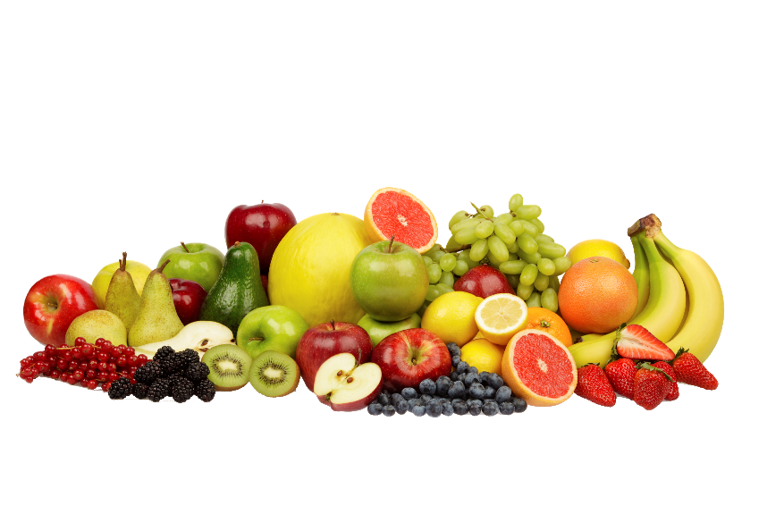
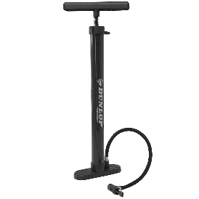
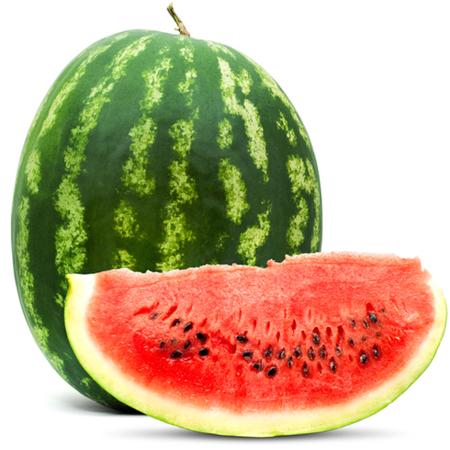
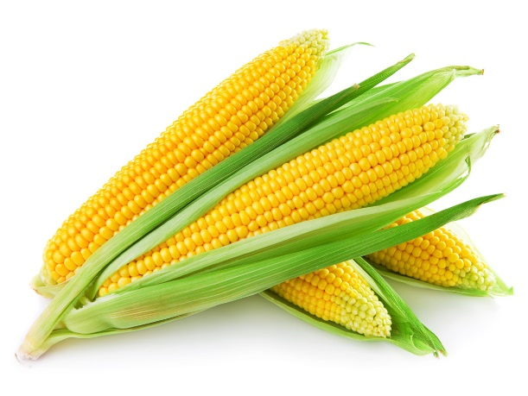
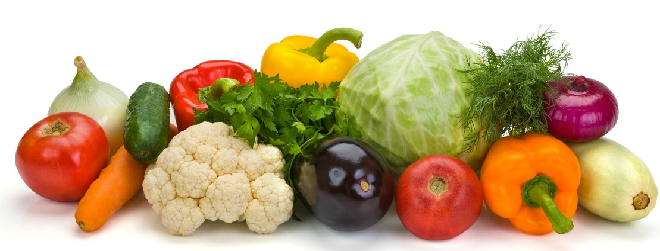
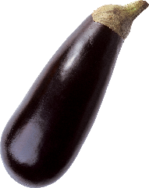
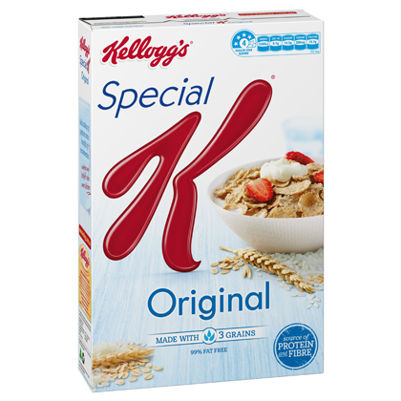
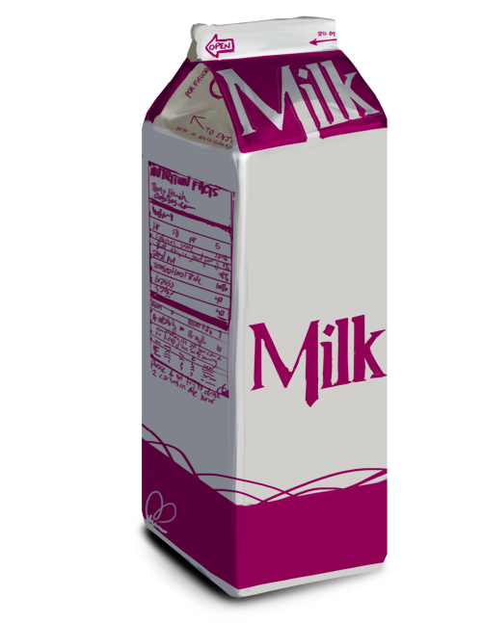
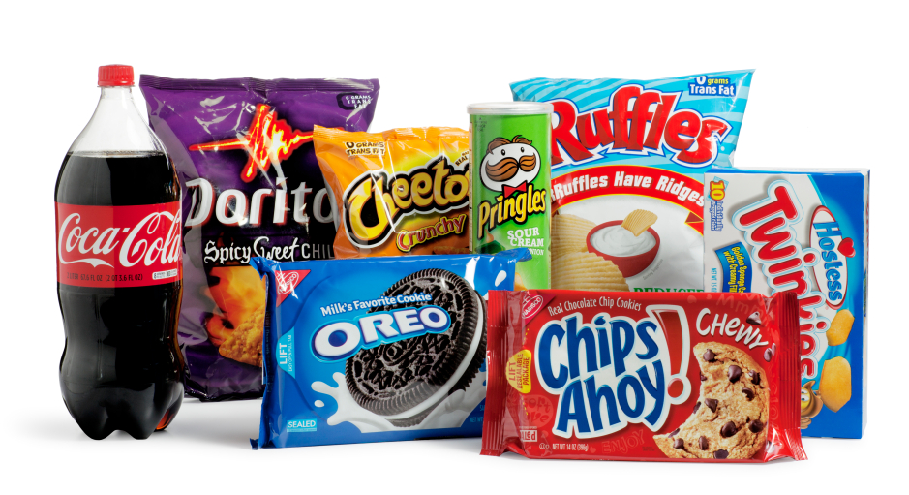
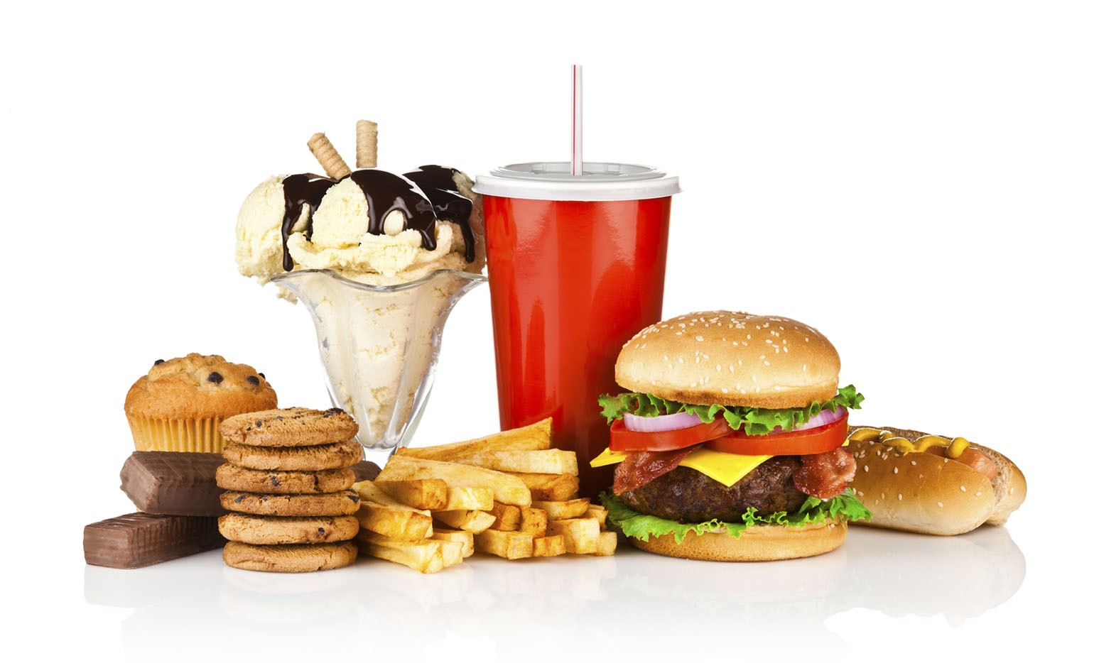
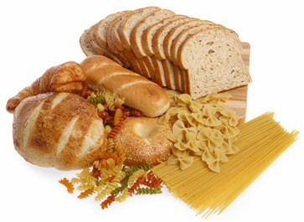
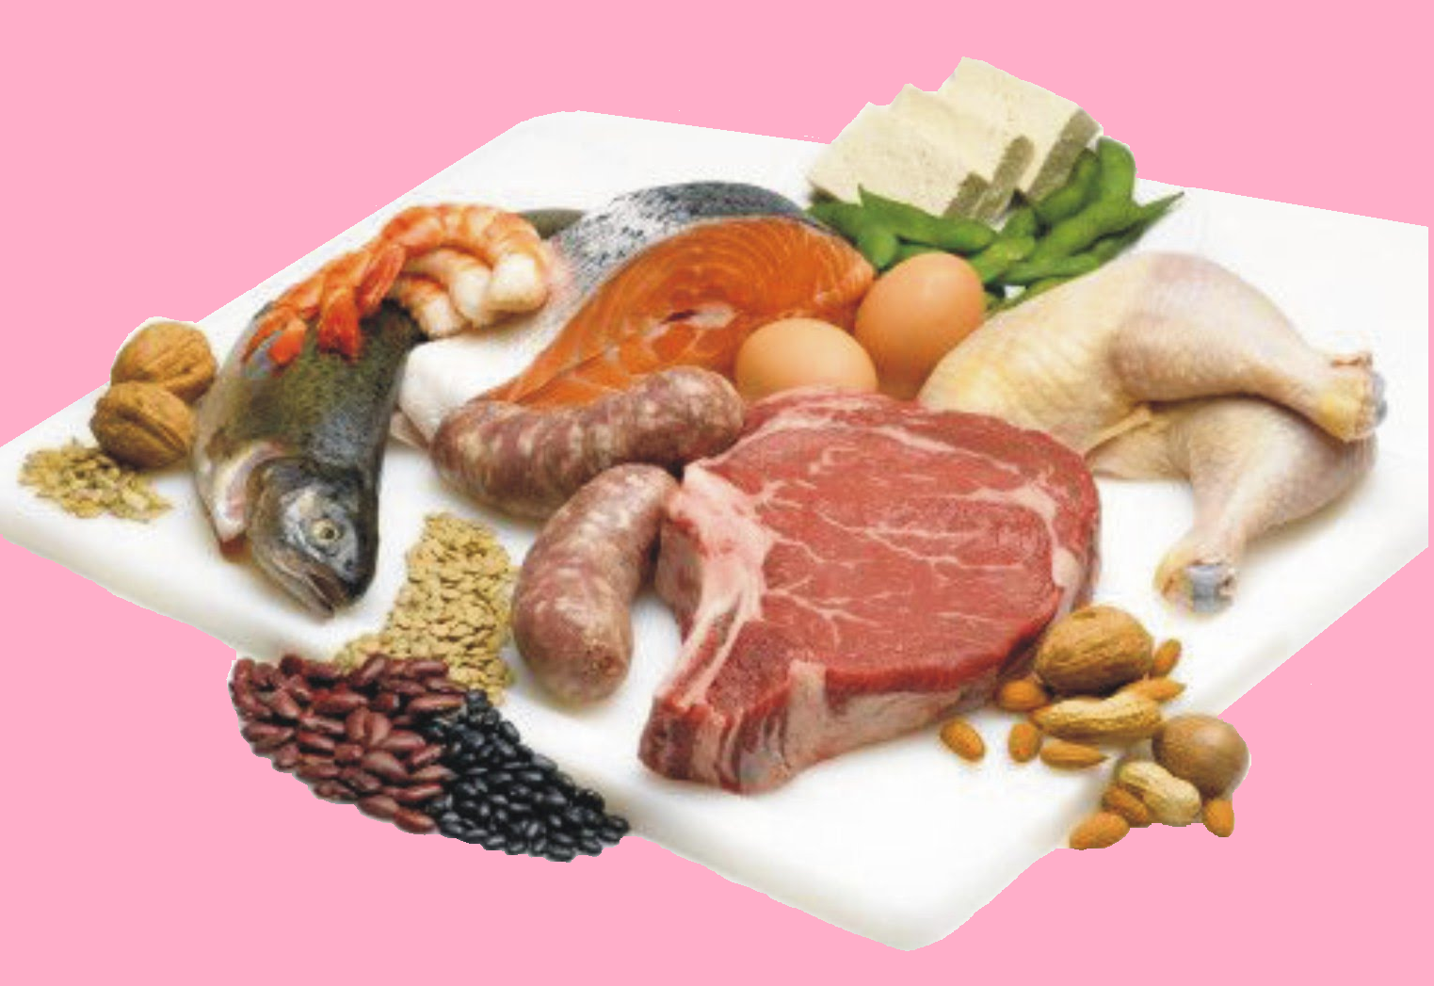

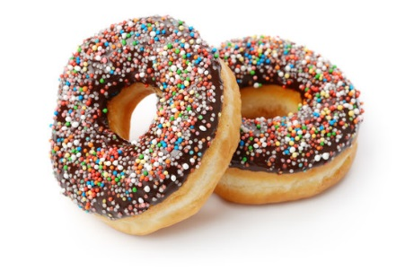
x2
x3
x5
x7

