Slide 1
Funny Fruit

Slide 2
Prepare
Print a copy of the FRUITS and a copy of the COLORS on differently colored paper.
Print a copy of the following page for each student.

Slide 3
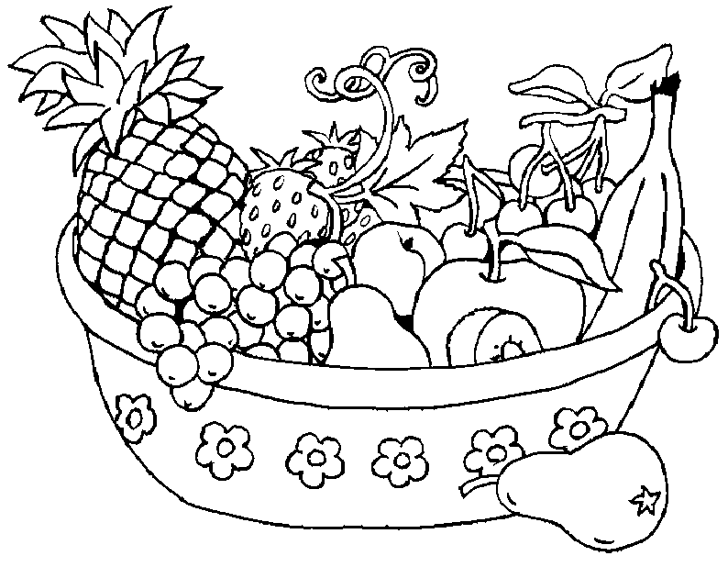
Score

Slide 4
Warm Up:
Have students name the types of fruit in the basket.

Slide 5
What fruit do you see?

Slide 6
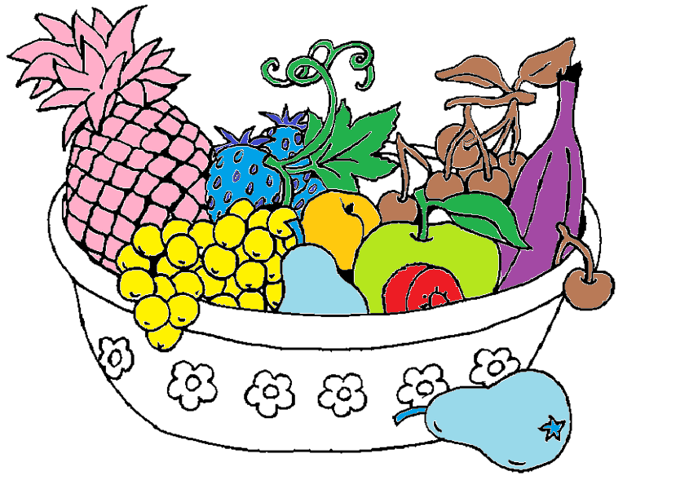
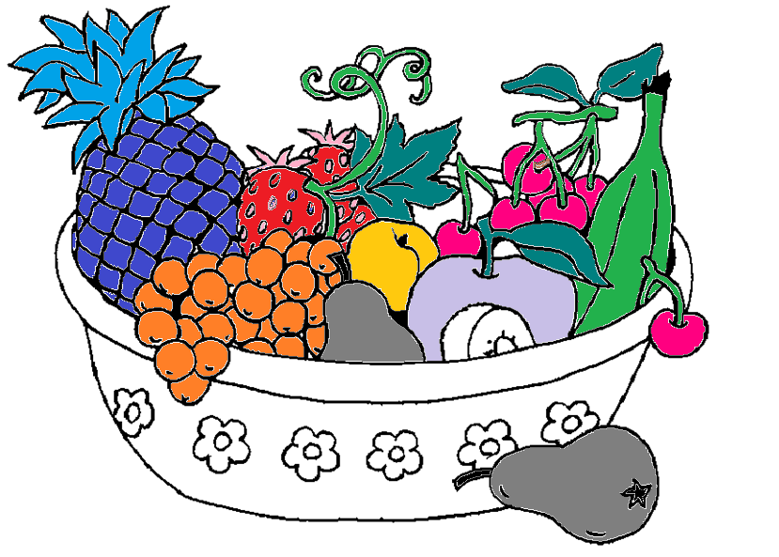
Color
Have the students color in their fruit basket using unique colors

Slide 7
Play
Choose a color and a fruit at random.
Script:
What is it?
It’s a ________.
What color is it?
It’s _________. It’s a _________ __________.

Slide 8
Score

