Slide 1
G-Market Game
How much is it?

Slide 2
How to Play
Give each group a white board and marker.
You will see an item. Guess how much it is. Write, “It’s ______ dollars” (or you can use won)
The closest answer gets a point.

Slide 3
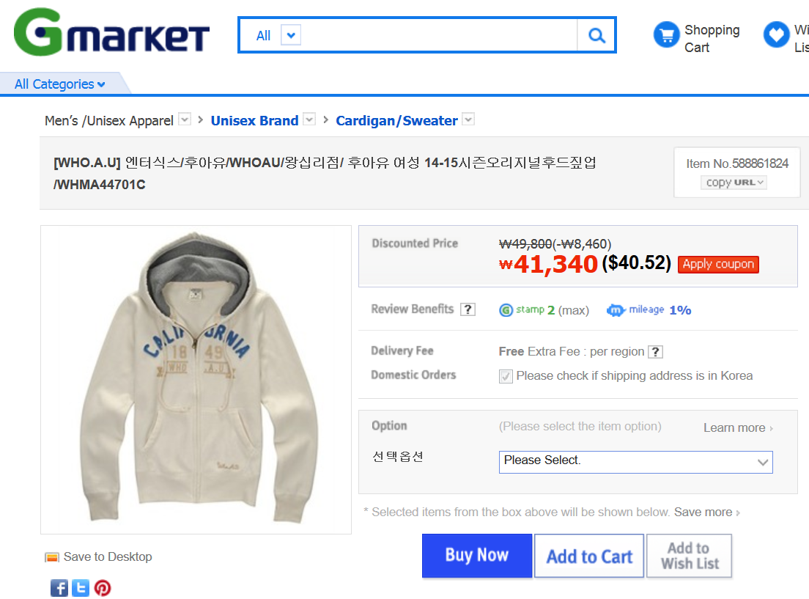

Slide 5
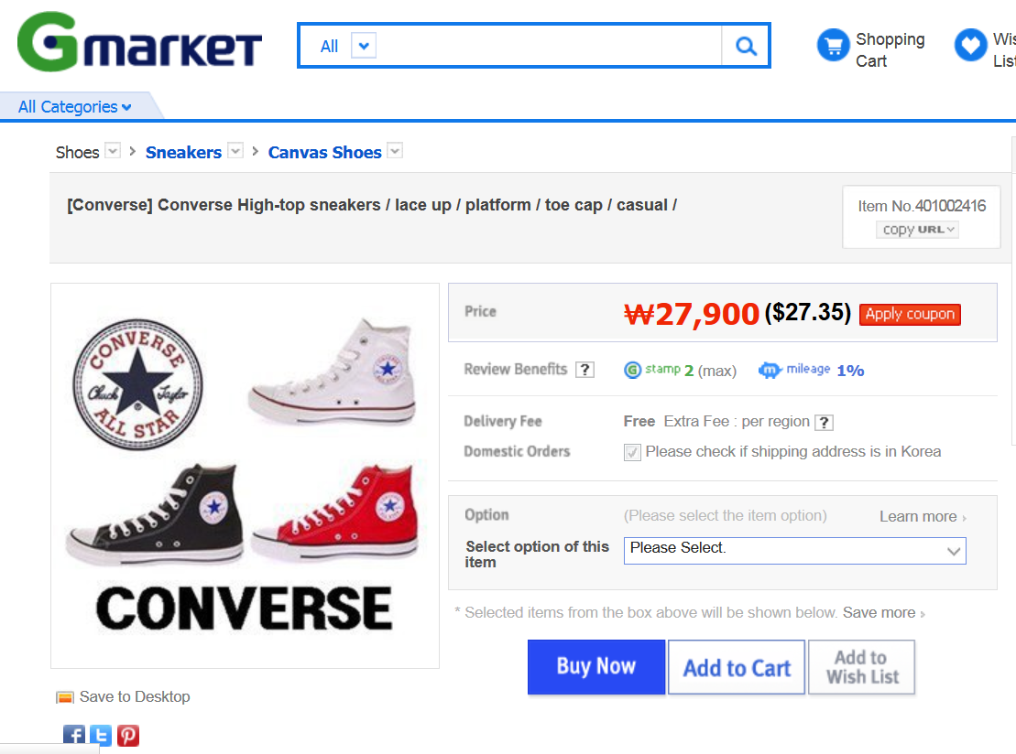

Slide 7
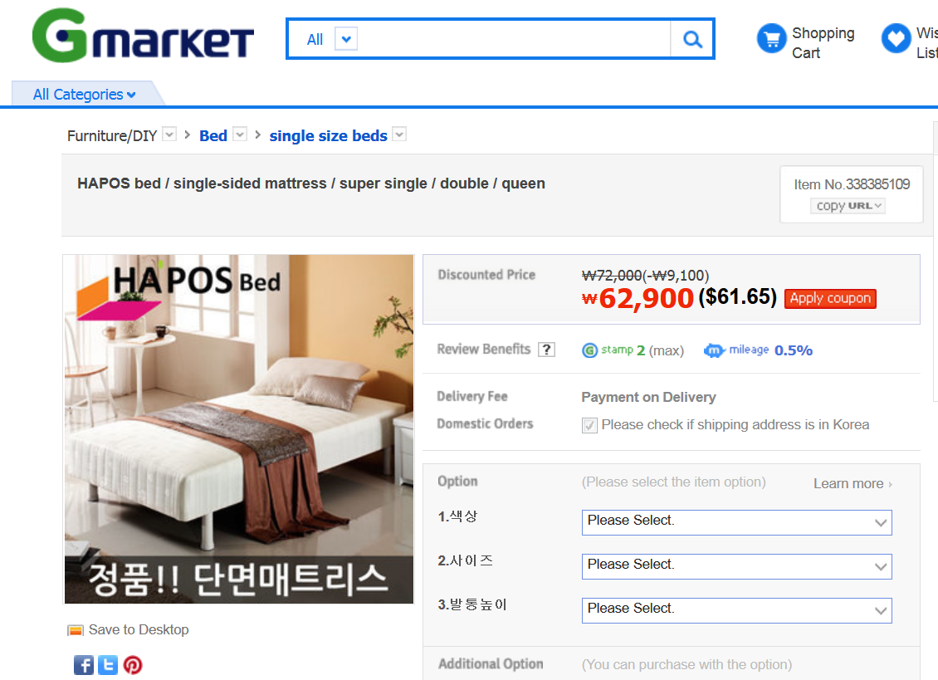

Slide 9
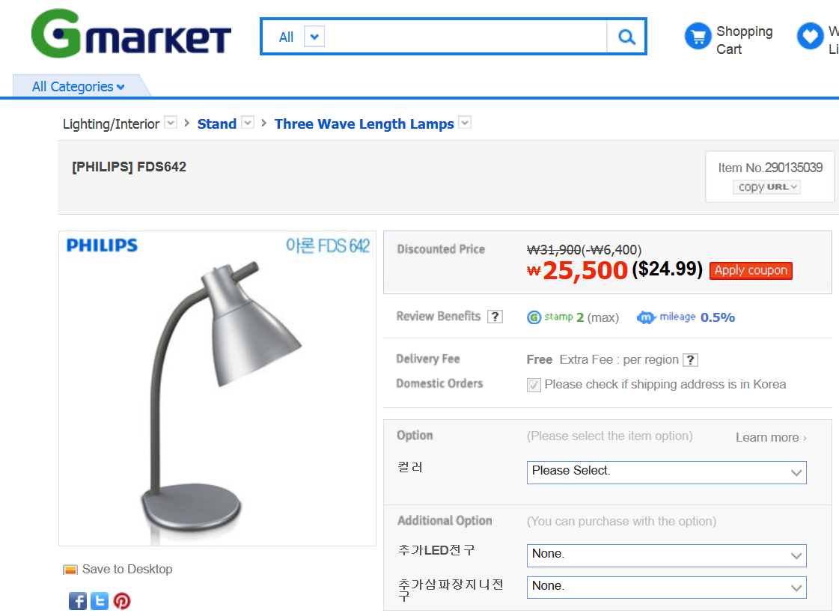

Slide 11
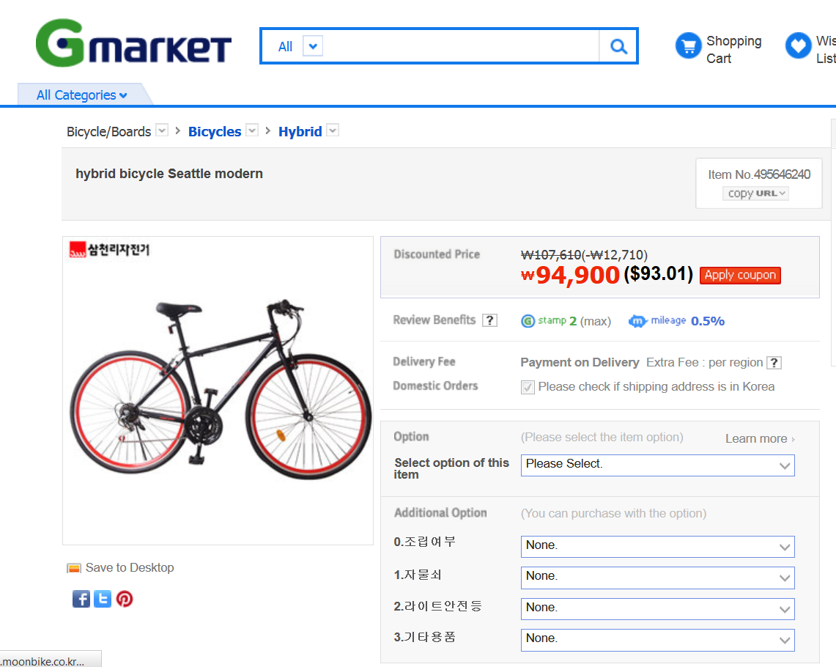

Slide 13
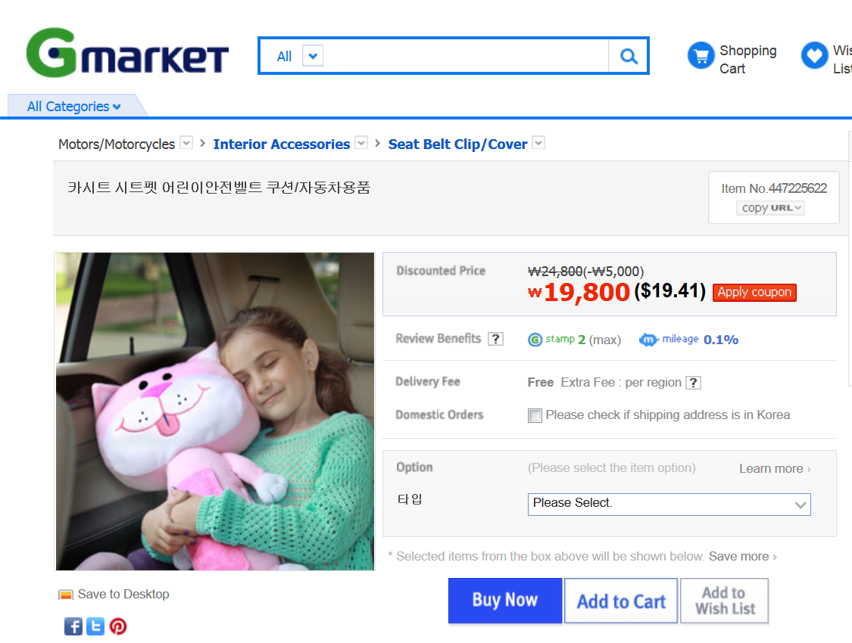

Slide 15
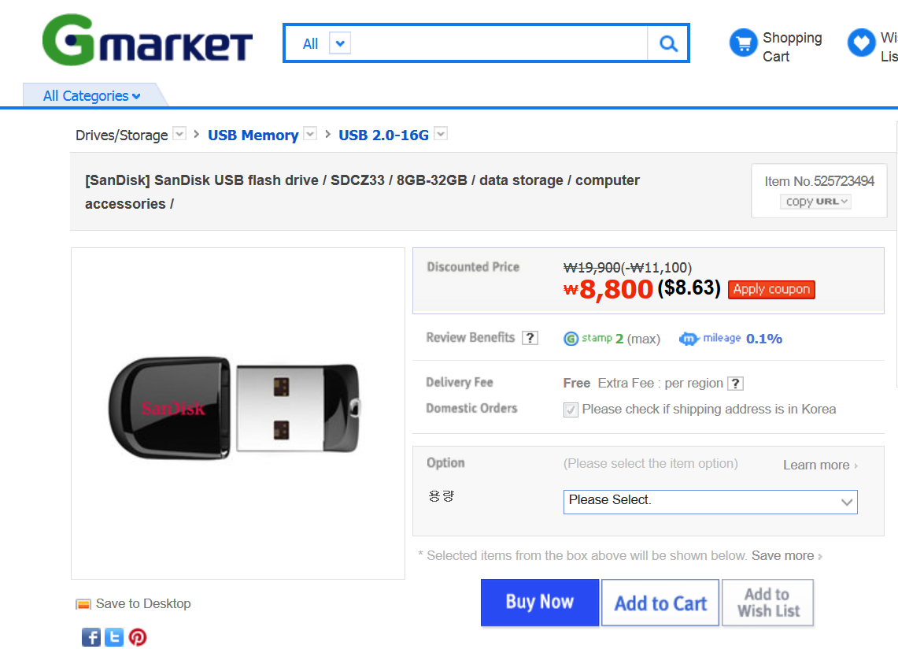

Slide 17
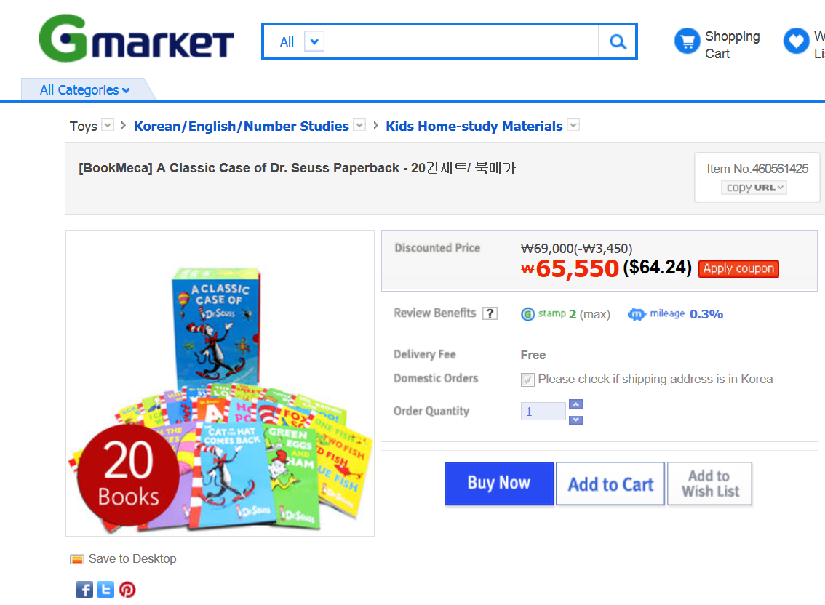

Slide 19
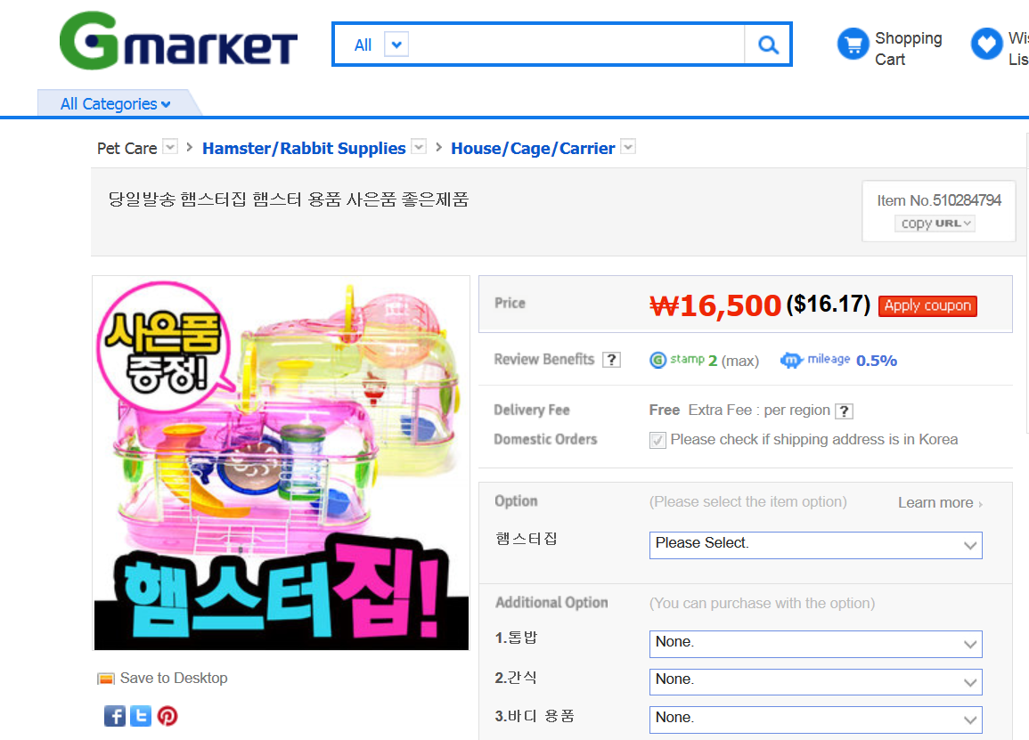

Slide 21
