Slide 1
Slap Shopping

Slide 2
Prepare:
Print out the cards (one set for each group)
Note that there are two items on each card
Divide students into groups of 3-5

Slide 3
Set Up
Place all the cards on the table face up in reach of all the students

Slide 4
How to play:
One student is the leader.
That student will ask one of the others, “Can I help you?”
Choosing a type of item, the second student can respond, “I want a _________.”
Then all the students will say, “How much is it?”
The leader will say, “It’s ________ dollars.”
The first student to put their hand on the matching card can take the card (it counts as a point)
The student with the most cards / points at the end of the game is the winner

Slide 5
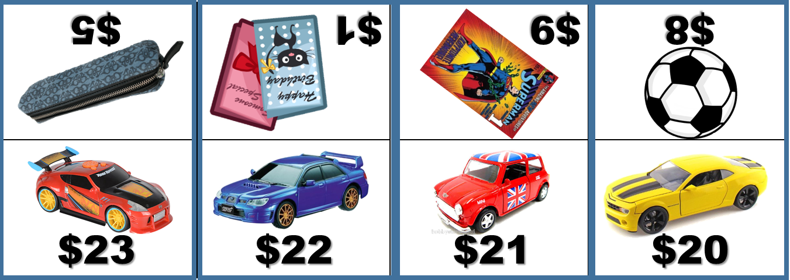
Example
Students
How much is it?
Can I help you?
I want a toy car.
It’s 21 dollars.
Leader
Student

Slide 6
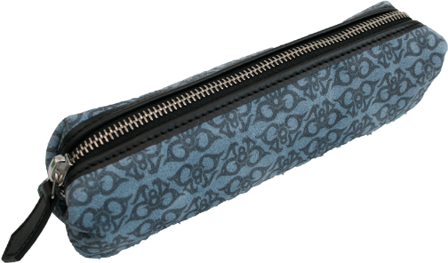
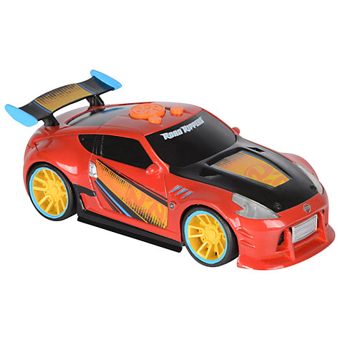
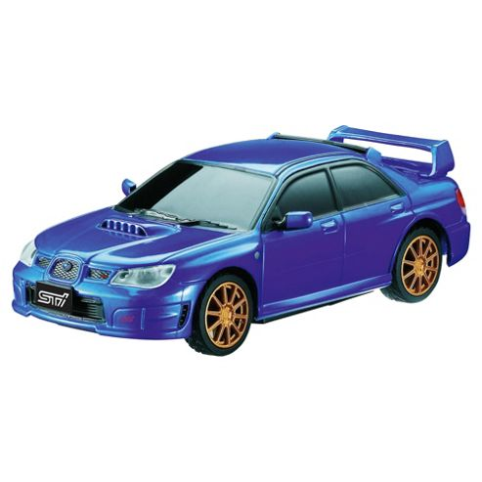
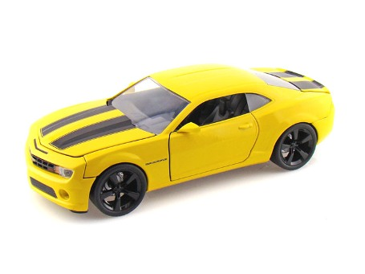
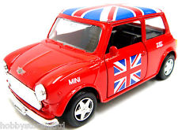
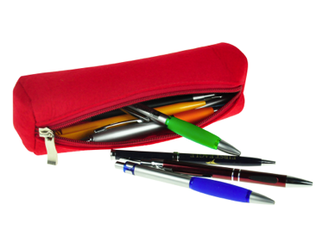
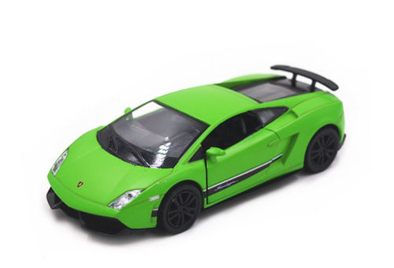
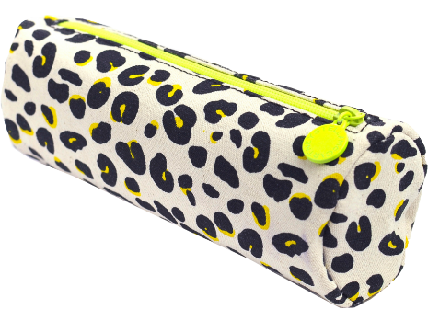
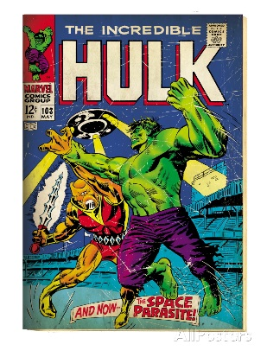
$23
$5
$1
$9
$8
$22
$21
$20
$19
$1
$2
$4
$8
$3

Slide 7
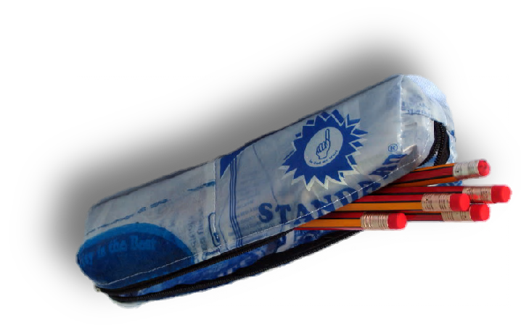
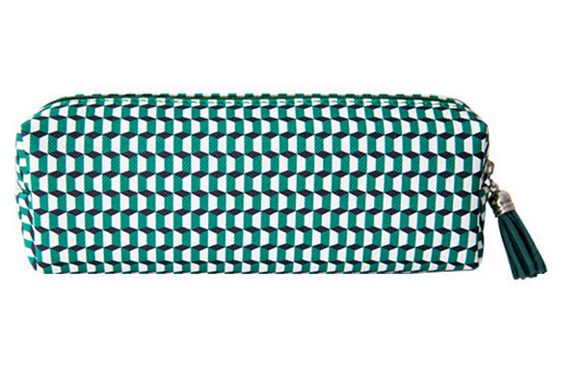
$10
$2
$6
$3
$4
$3
$7
$9
$5
$2
$11
$6
$4
$5

Slide 8
$12
$5

