Slide 1
Favorites

Slide 2
What is my favorite Korean food?

Slide 3
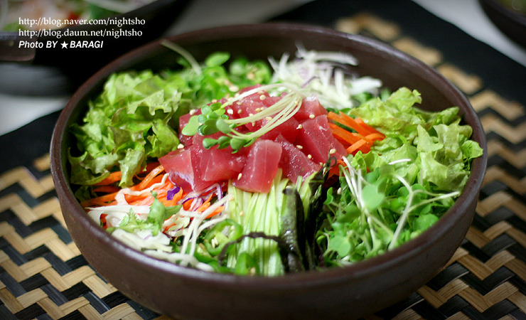
회덮밥

Slide 4
What is my favorite holiday?

Slide 5
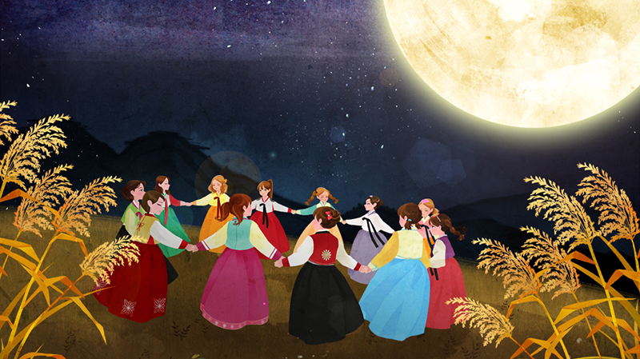
Chuseok

Slide 6
What is my favorite animal?

Slide 7
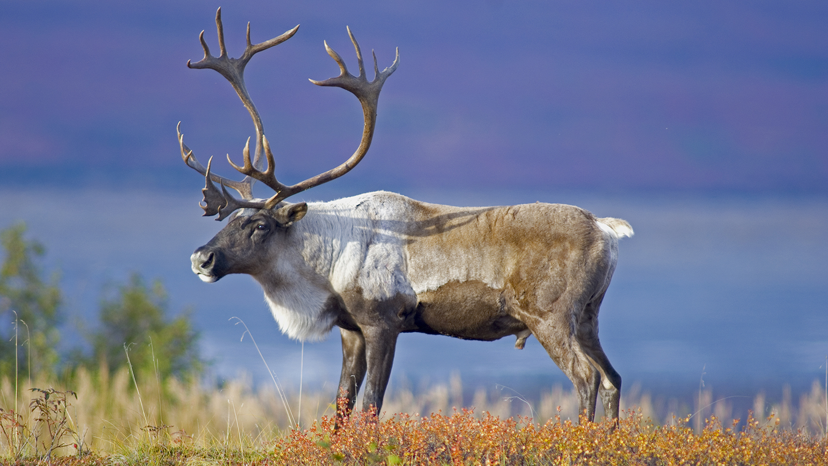
Caribou (deer)

Slide 8
What is my favorite sport?

Slide 9
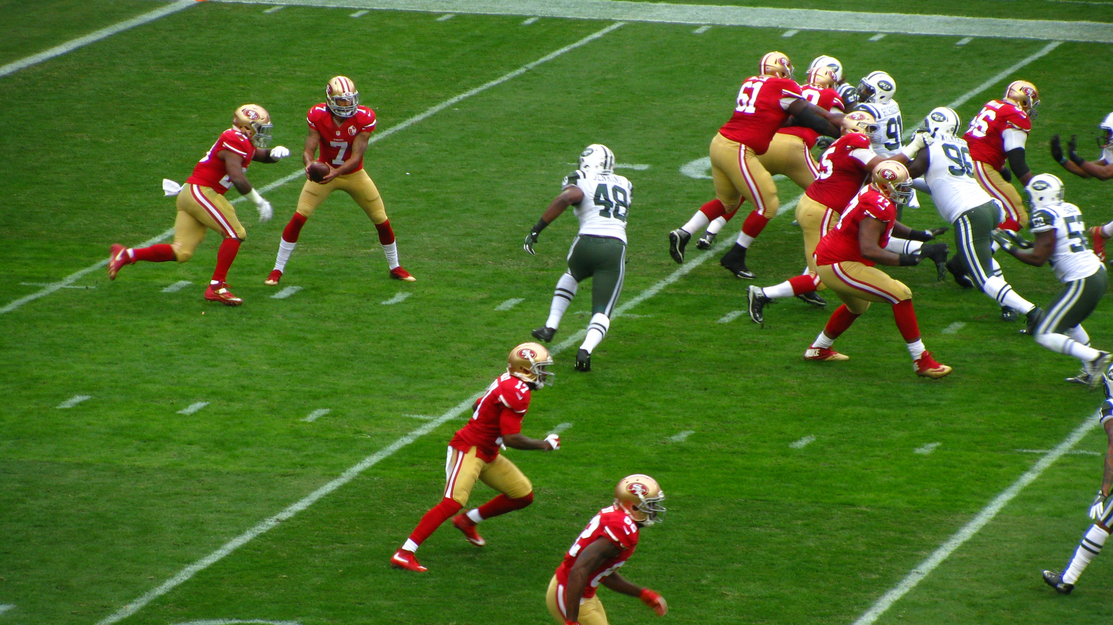
American
football

Slide 10
What is my favorite ice cream flavor?

Slide 11
chocolate

Slide 12
My favorite ______ is ______.

Slide 13
What is your favorite subject?
My favorite subject is math.

Slide 14
What is your favorite food?
My favorite food is hamburgers.

Slide 15
What is your favorite animal?
My favorite animal is a zebra.

Slide 16
SAY
anything

Slide 17
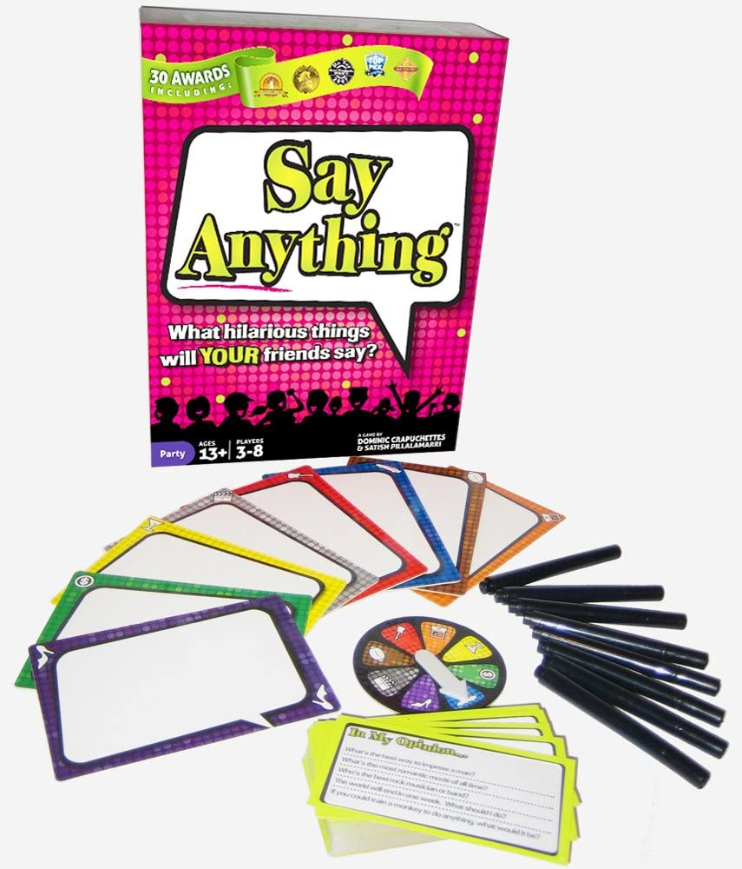
Rules
Each player gets:
Whiteboard
Marker
Eraser
2 tokens

Slide 18
Rules
Choose a judge.

Slide 19
Judge
Read a question.

Slide 20
Players
Write an answer.
dog
cat
hippo

Slide 21
Judge
Select the best answer.
dog
cat
hippo

Slide 22
Players
dog
Vote
(what you think the judge chose).
hippo
cat

Slide 23
Judge
Show your choice.

Slide 24
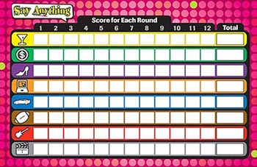
Points
Each player gets:
1 point for the correct answer
1 point for each correct vote
hippo
cat
dog

Slide 25
Points
The judge gets:
1 point for each correct vote
hippo

