Slide 1
Where Are You From?
Famous People

Slide 2
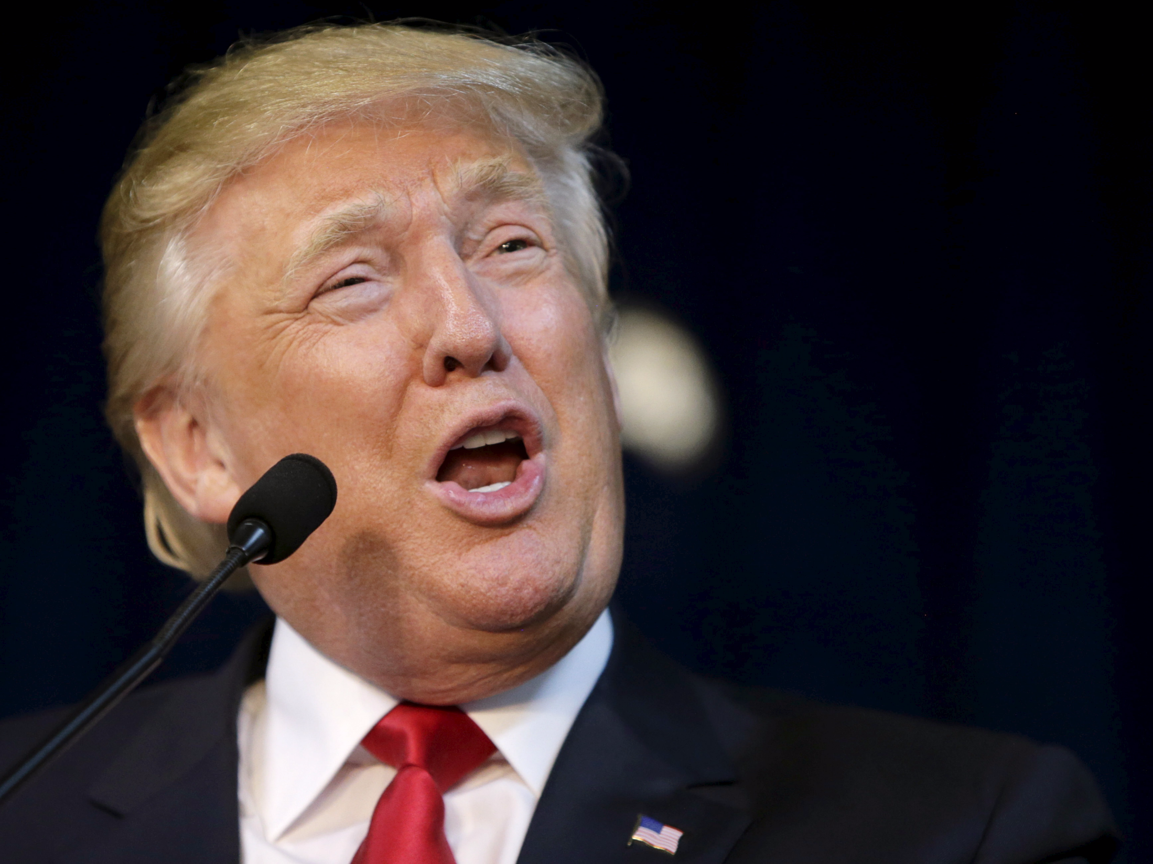
I am from
America.

Slide 3
I am from
Korea.

Slide 4
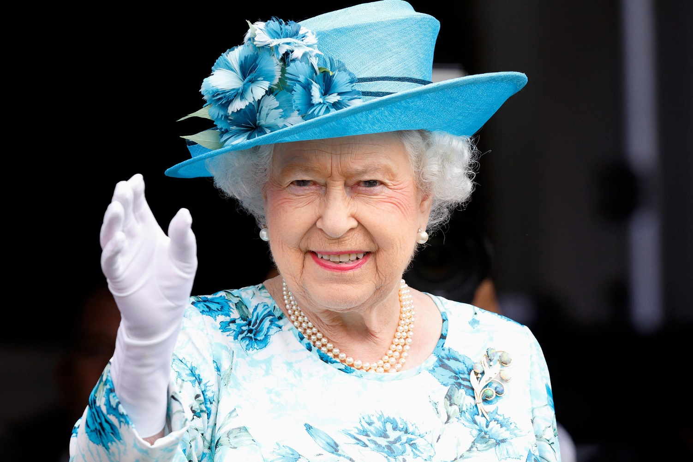
I am from
England.

Slide 5
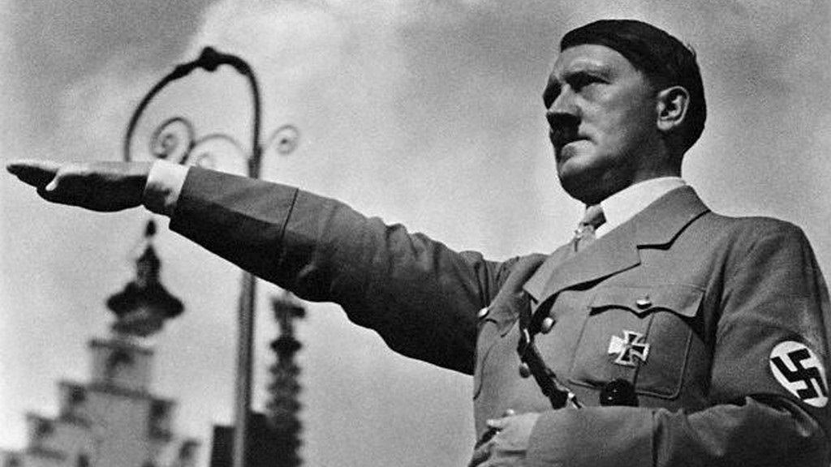
I am from
Germany

Slide 6
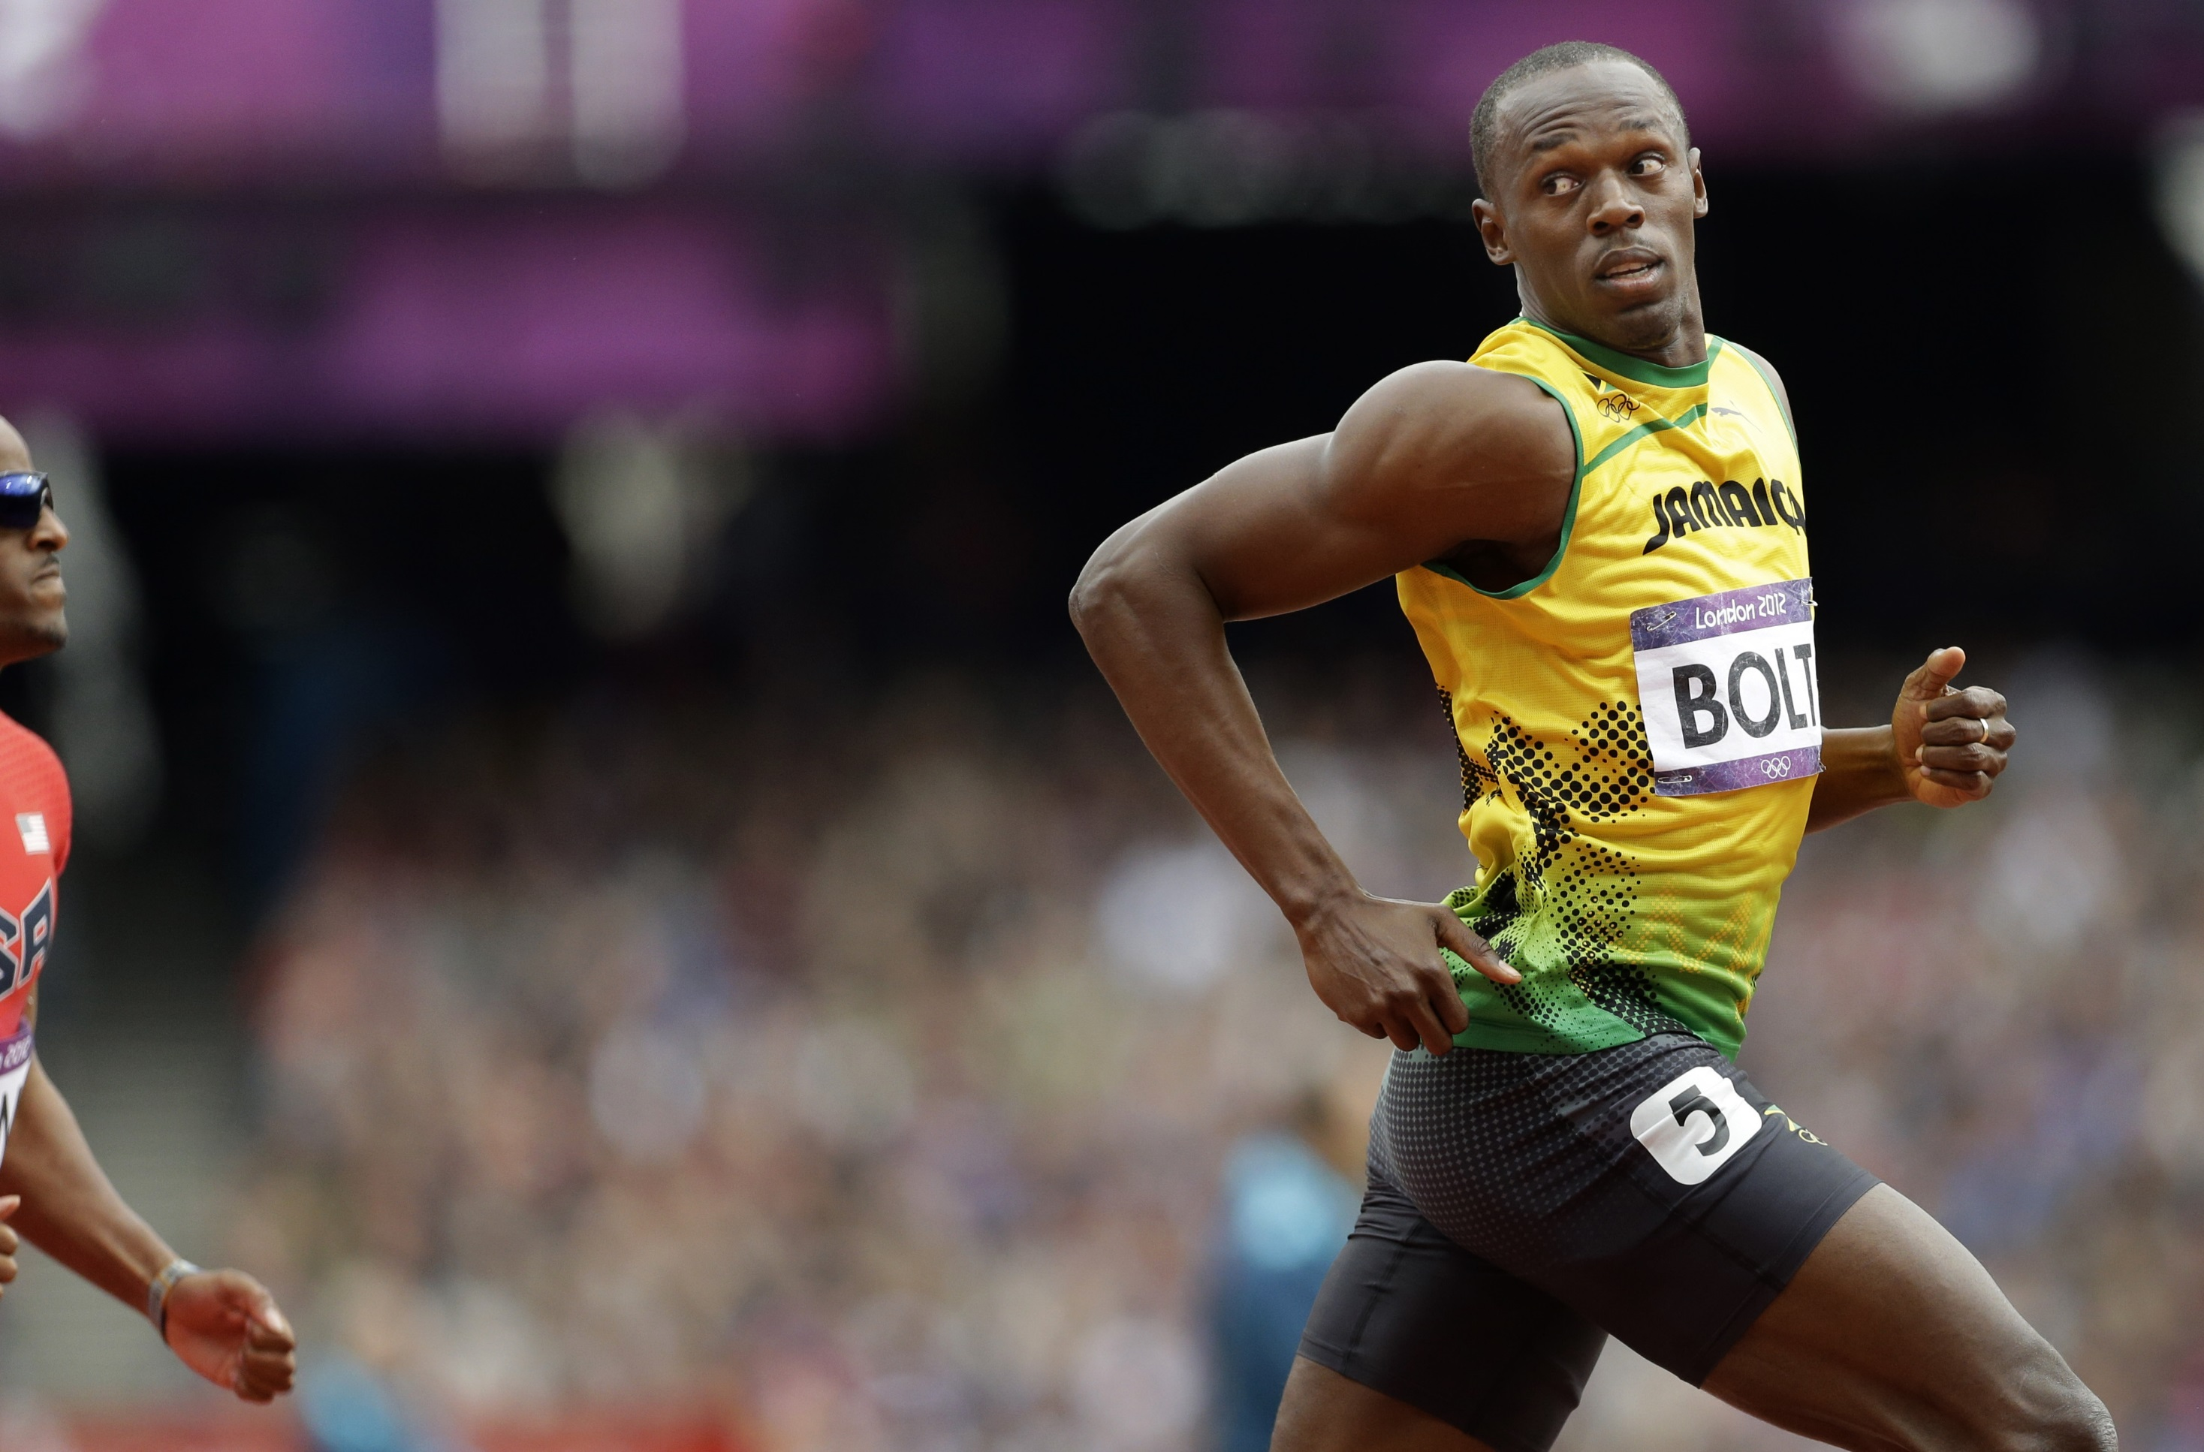
I am from
Jamaica.

Slide 7
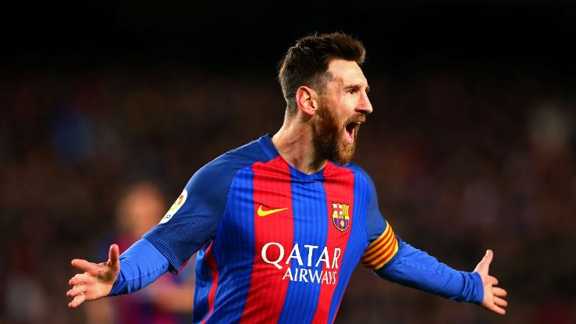
I am from
Argentina.

Slide 8
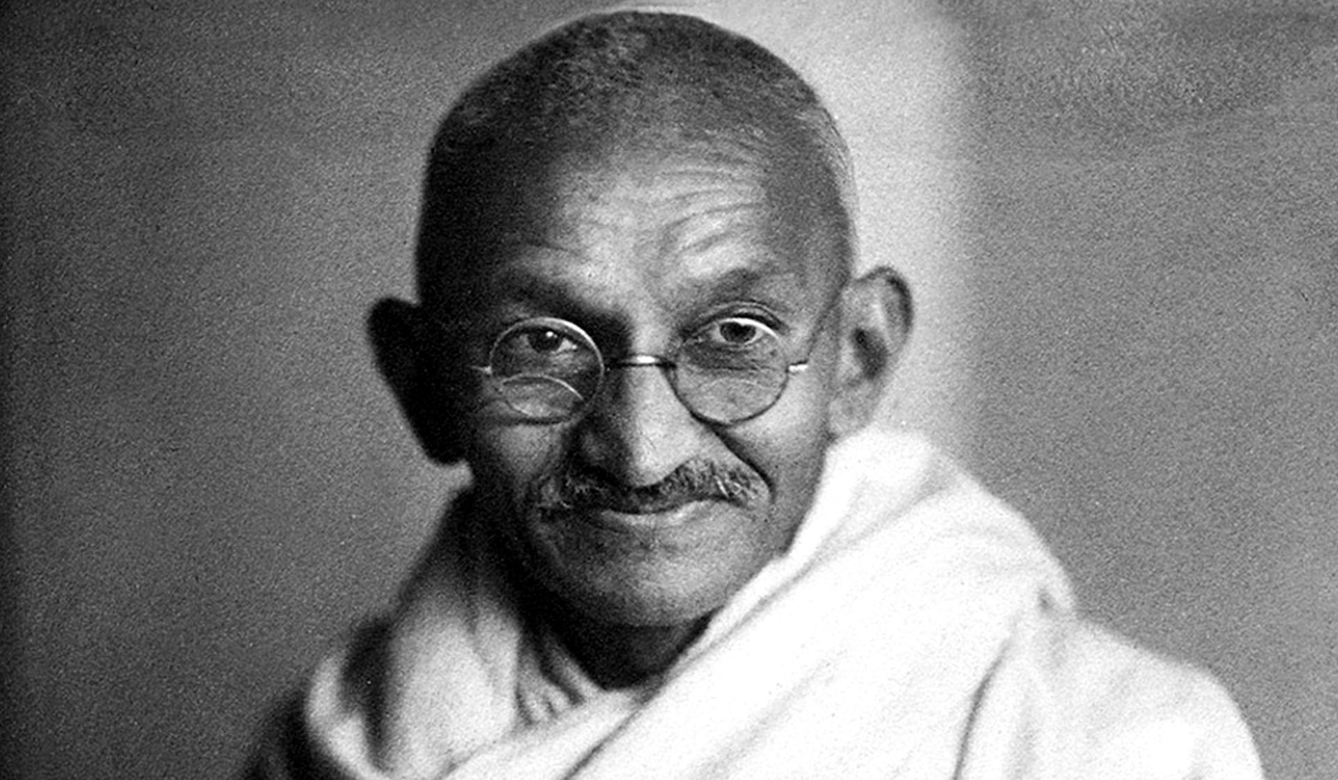
I am from
India.

Slide 9
I am from
Italy.

Slide 10
I am from
England

Slide 11
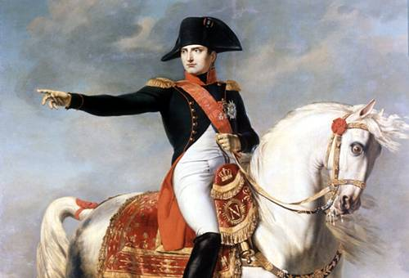
I am from
France.

Slide 12
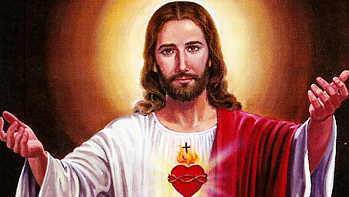
I am from
Israel (Palestine).

Slide 13
I am from
Greece.

Slide 14
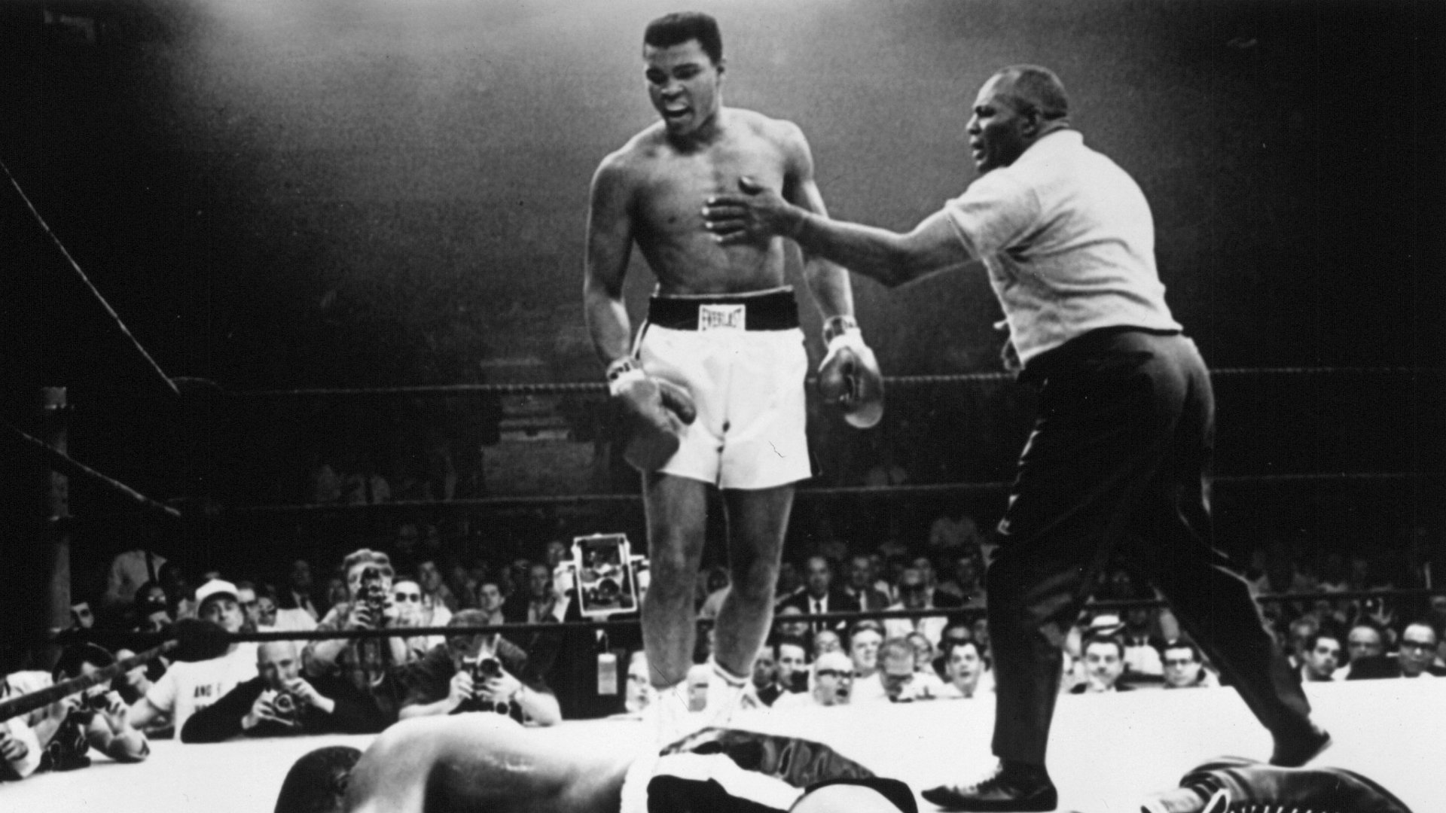
I am from
America.

Slide 15
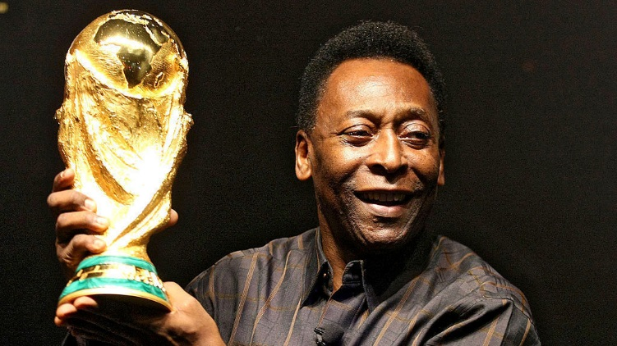
I am from
Brazil.

Slide 16
I am from
the Netherlands.

Slide 17
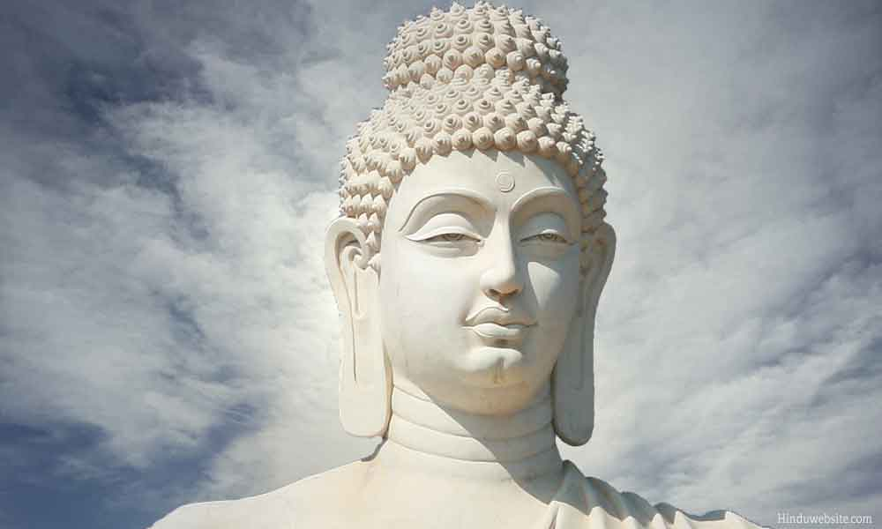
I am from
Nepal.

Slide 18
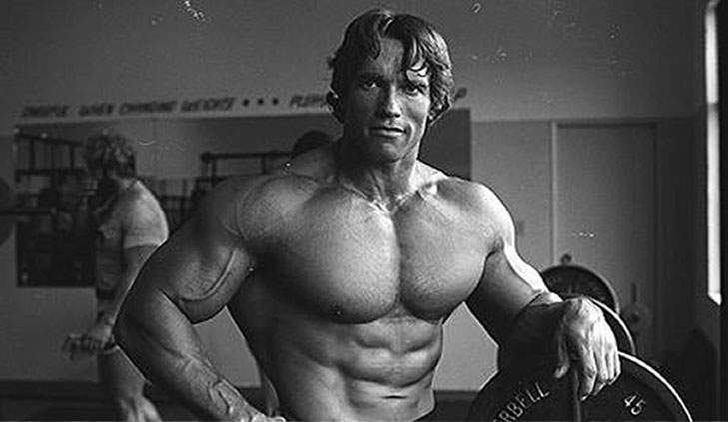
I am from
Austria.

Slide 19
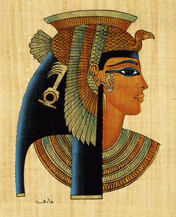
I am from
Egypt.

Slide 20
I am from
Mongolia.

Slide 21
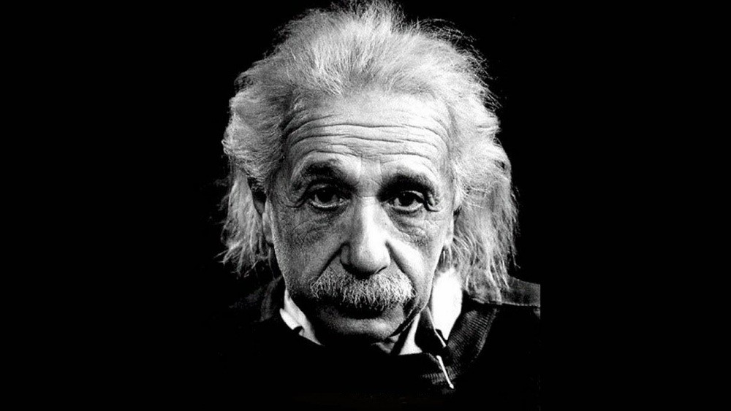
I am from
Germany.

Slide 22
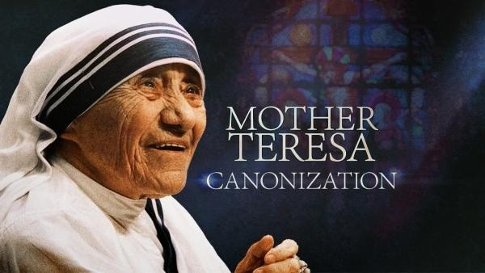
I am from
Albania.

Slide 23
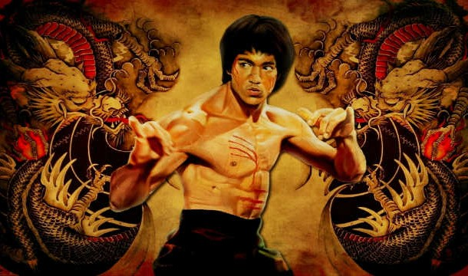
I am from
Hong Kong.

Slide 24
I am from
America.

Slide 25
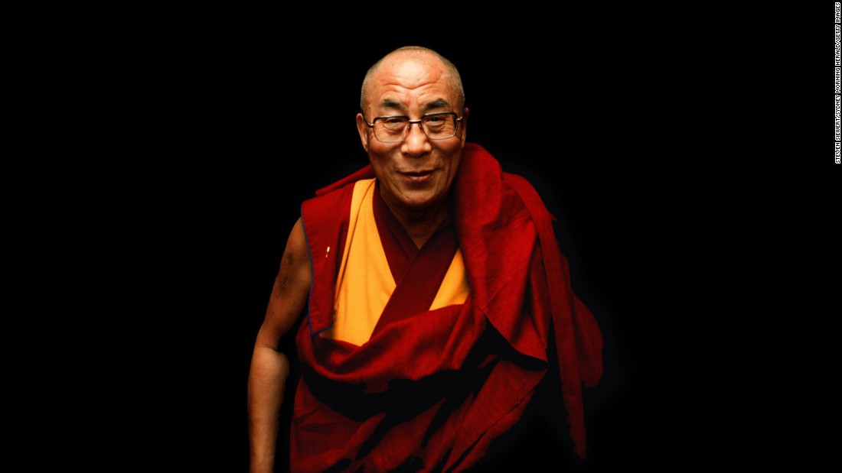
I am from
Tibet.

Slide 26
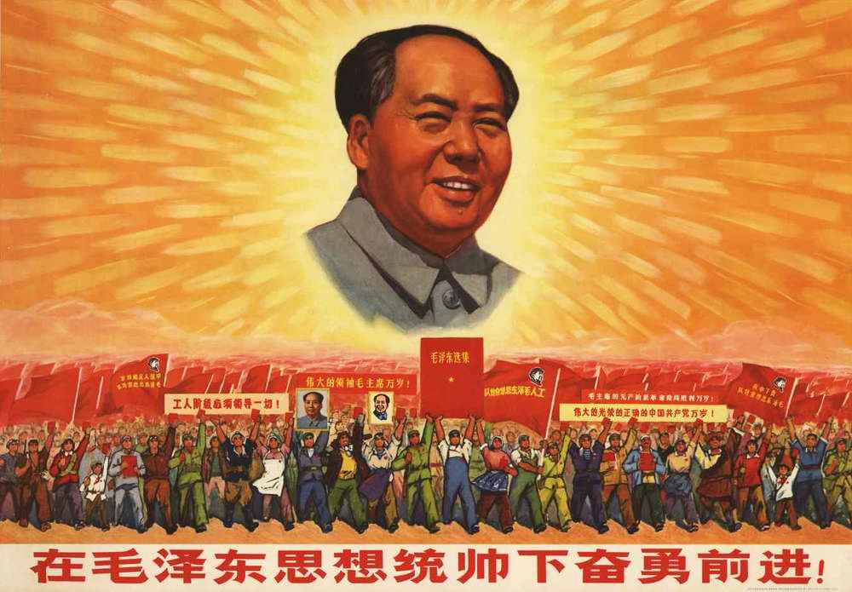
I am from
China.

Slide 27
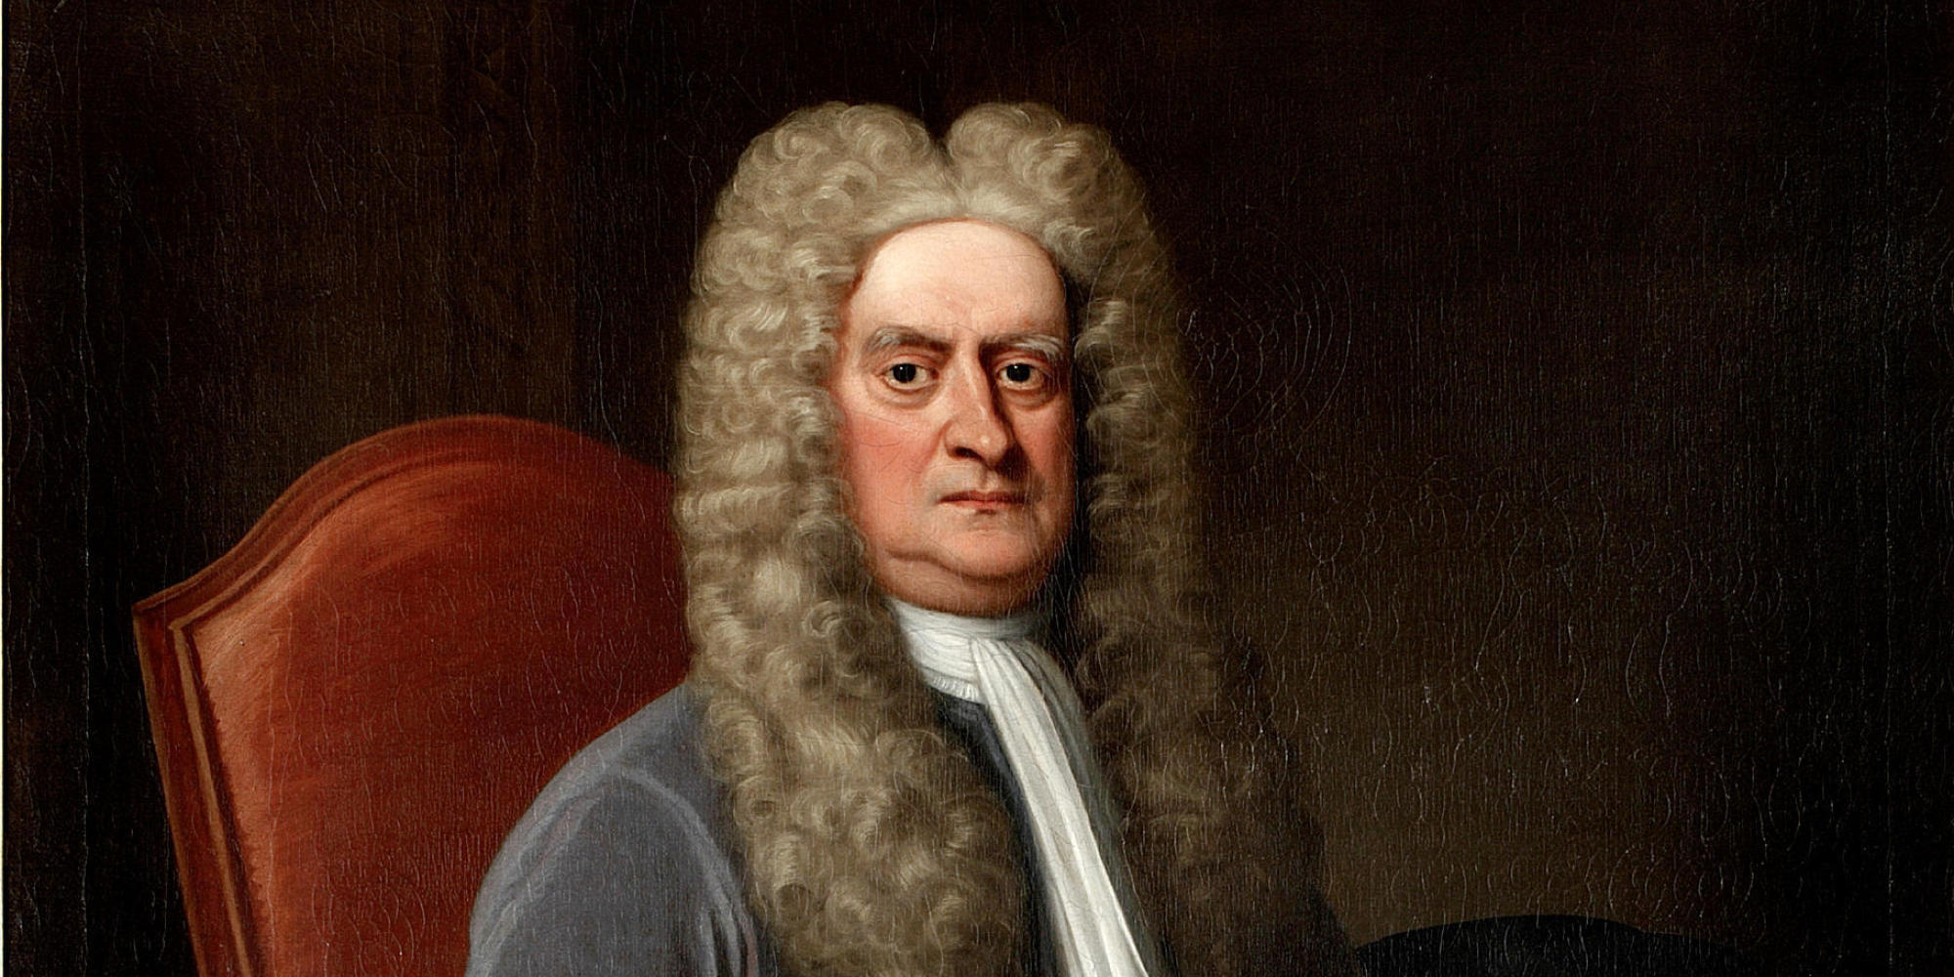
I am from
England.

Slide 28
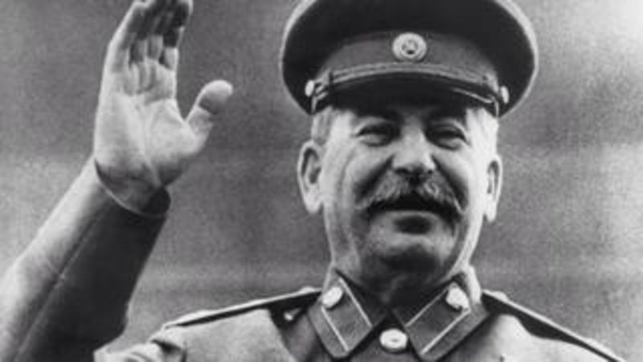
I am from
Russia.

Slide 29
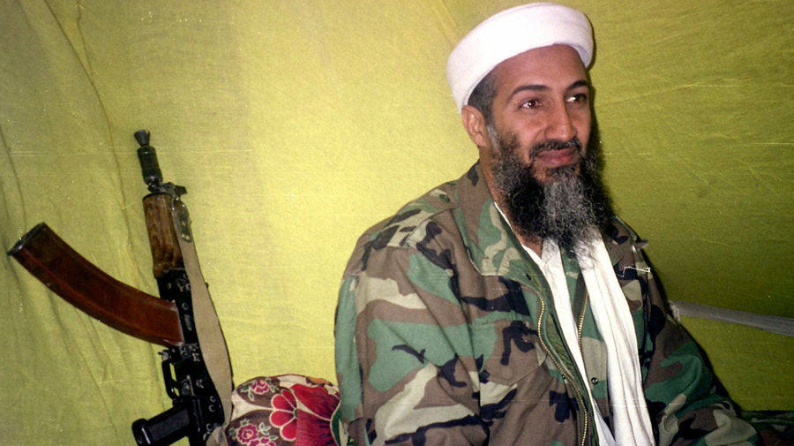
I am from
Afghanistan.

Slide 30
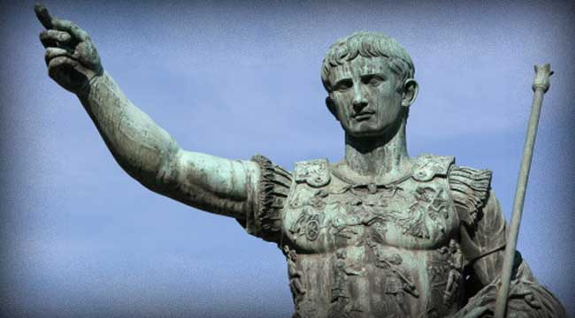
I am from
Italy.

Slide 31
I am from
South Africa.

Slide 32
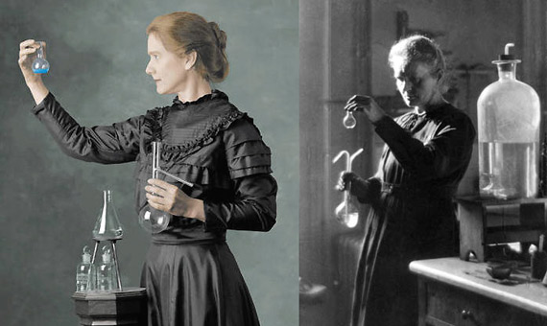
I am from
Poland.

Slide 33
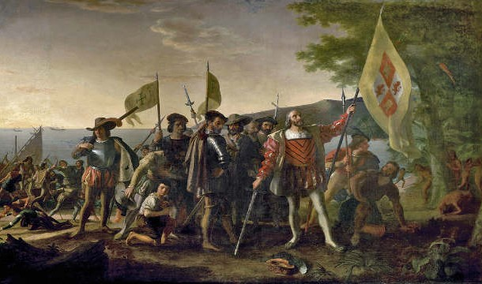
I am from
Spain.

Slide 34
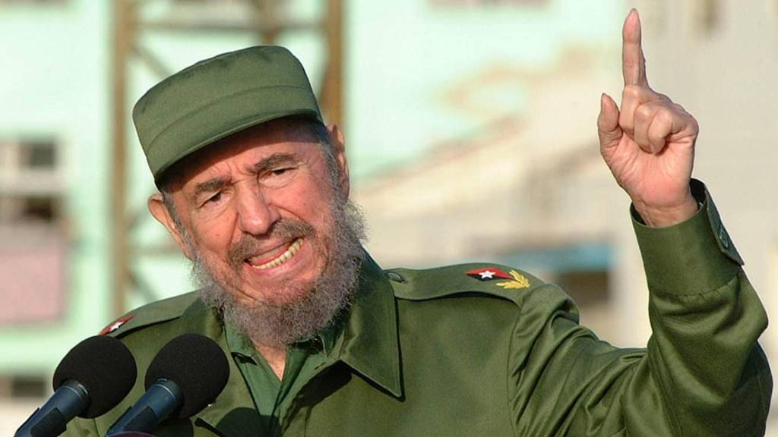
I am from
Cuba.

