Slide 1
Who am I?

Slide 2
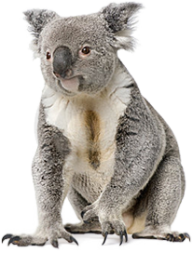
Who am I?
Hello!
I am from Australia.
I am very cute.
I am very soft.
My eyes are small and black...

Slide 3
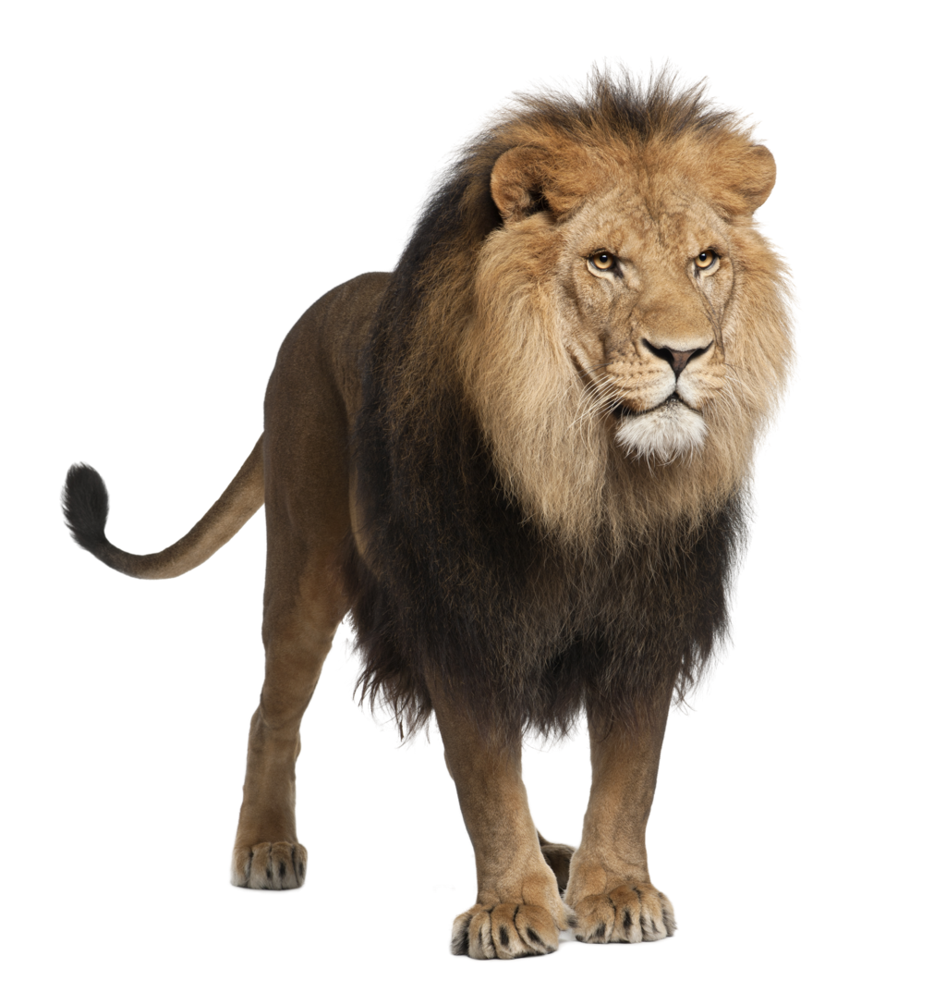
Who am I?
Hello!
I am from Africa.
I am strong and dangerous.
I am a type of cat.
I am the king of the jungle…

Slide 4
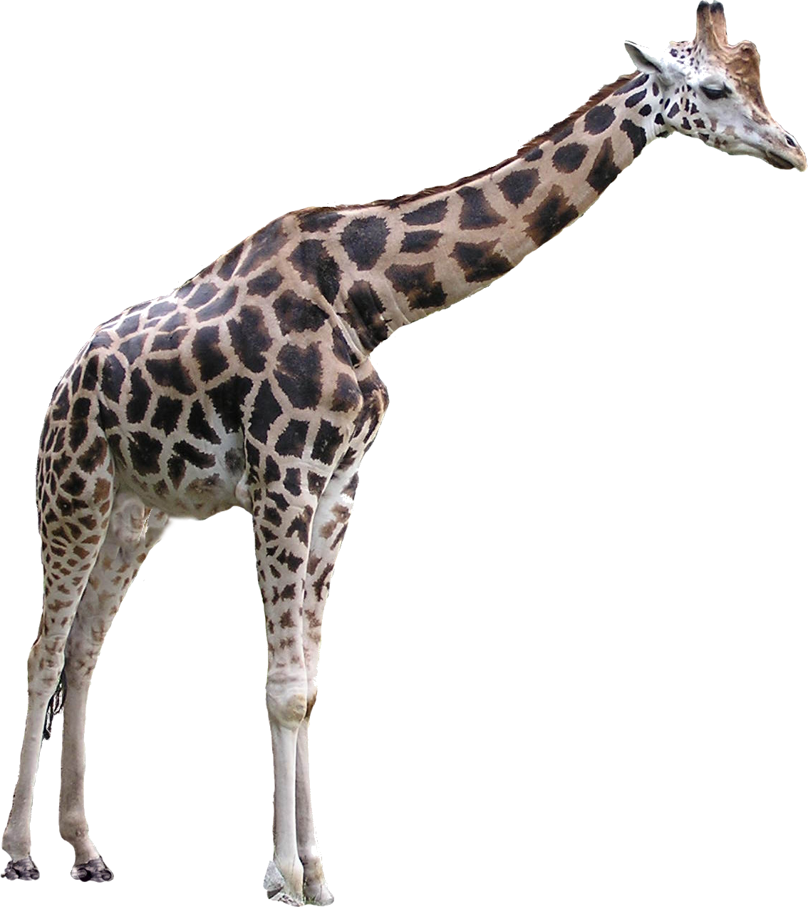
Who am I?
Hello!
I am from Africa.
I am tall.
I have a long neck…

Slide 5
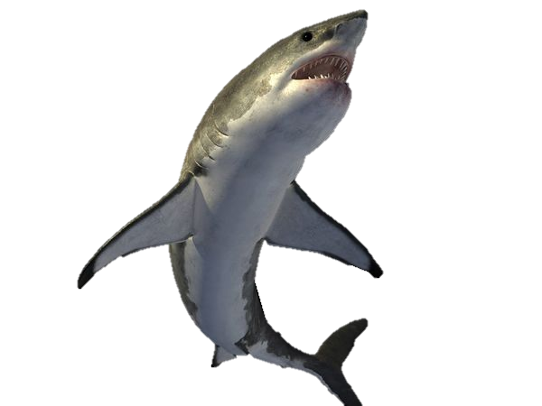
Who am I?
Hello!
I am from the ocean.
I am scary.
I have big teeth.
I like to eat fish.

Slide 6
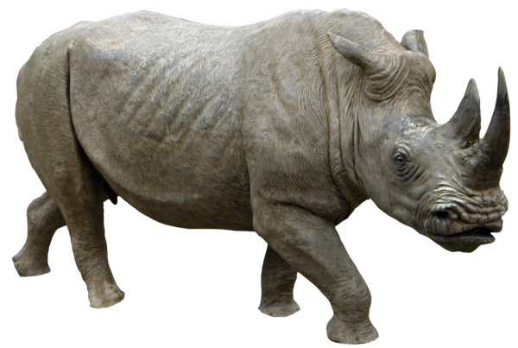
Who am I?
Hello!
I am from Africa.
I am big.
I have strong skin.
I have a large horn on my nose.

Slide 7
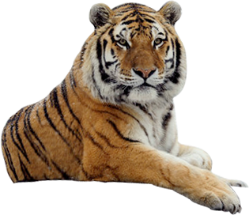
Who am I?
Hello!
I am from Asia.
I am a big carnivore.
I am orange and black…

Slide 8
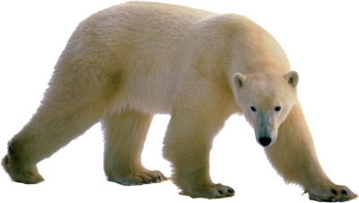
Who am I?
Hello!
I am from the north pole.
I eat fish and other animals.
I am big.
I am white…

Slide 9
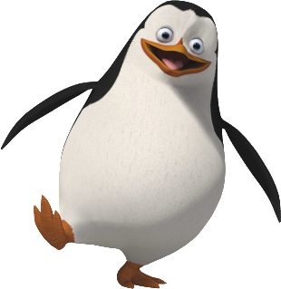
Who am I?
Hello!
I am from Antarctica.
I am a bird.
I cant fly.
I am black and white…

Slide 10
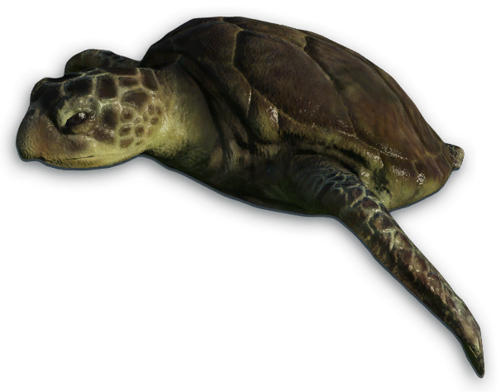
Who am I?
Hello!
I am from the Ocean.
I have 4 fins, a tail and a beak.
I have a hard shell…

Slide 11
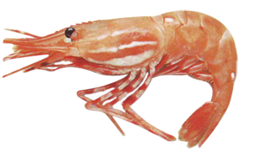
Who am I?
Hello!
I am from the ocean.
I am very small.
People eat me.
I have long feelers.
I have claws...

Slide 12
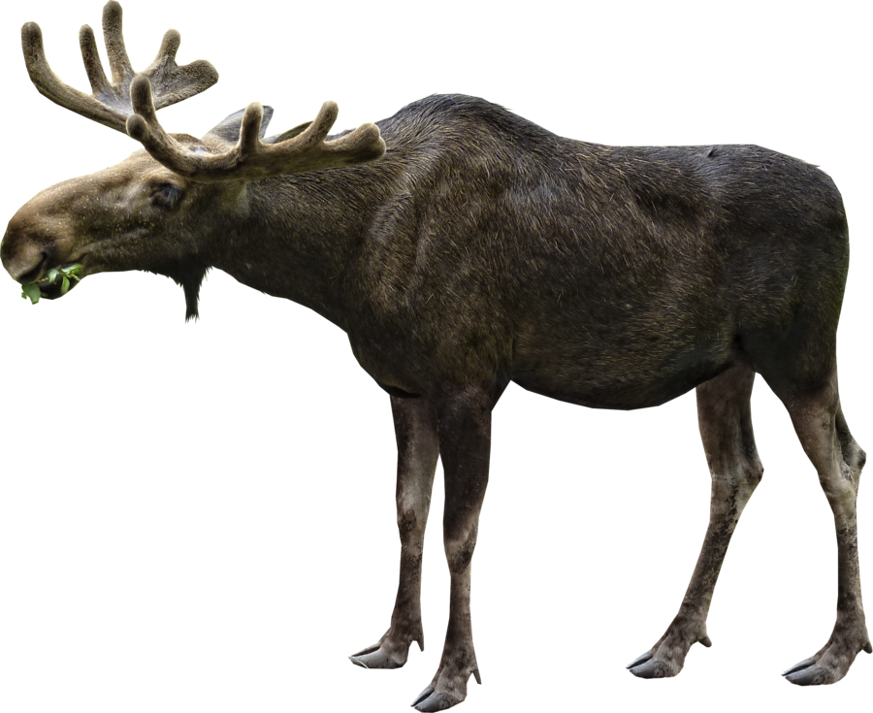
Who am I?
Hello!
I am from Canada.
I am tall.
I have big antlers…

Slide 13
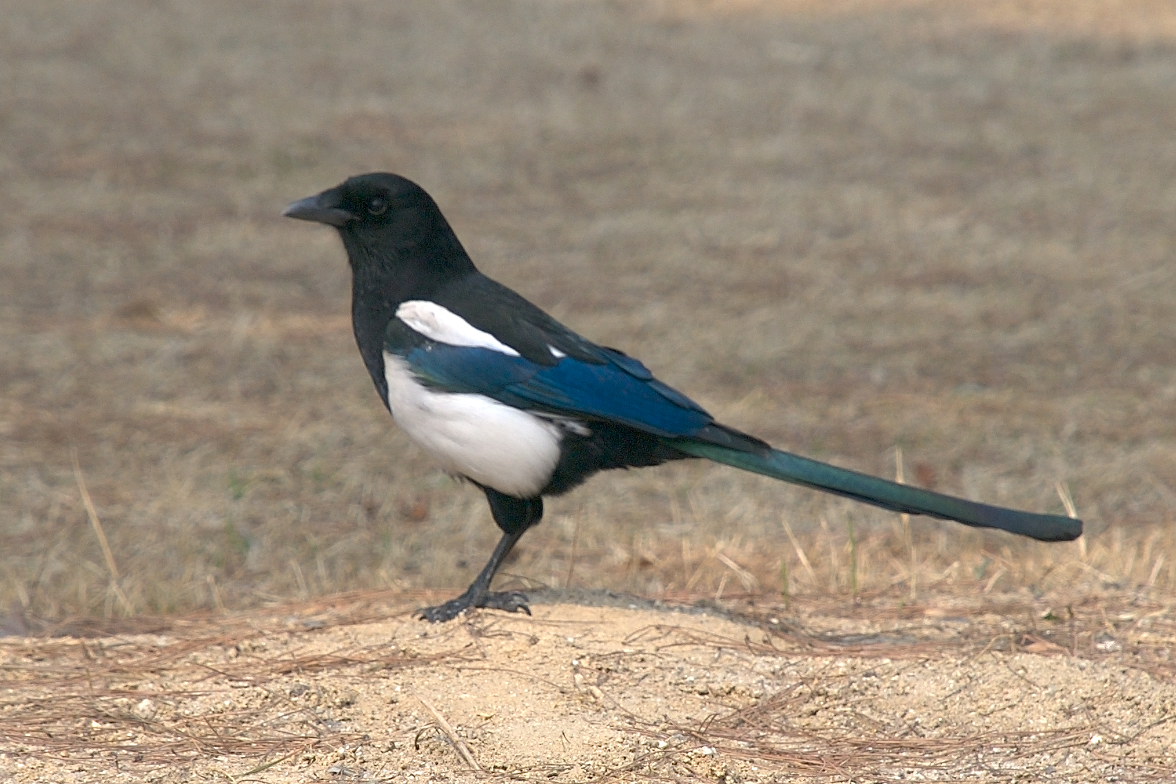
Who am I?
Hello!
I am from Korea.
I am black and white.
I can fly.
I am Korea’s national bird…

Slide 14
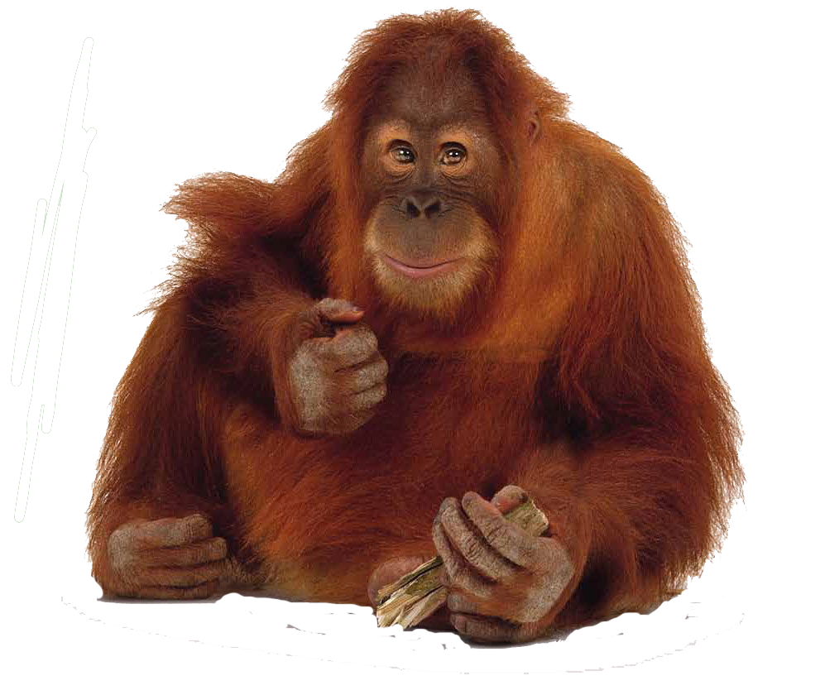
Who am I?
Hello!
I am from Borneo / Sumatra.
I have long arms.
I have red hair.
I have a wide face.
I am related to humans…

Slide 15
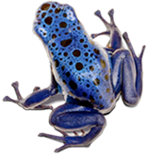
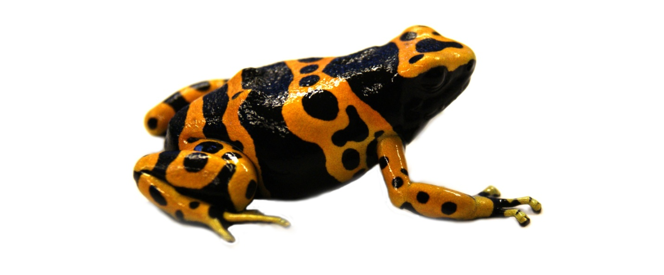
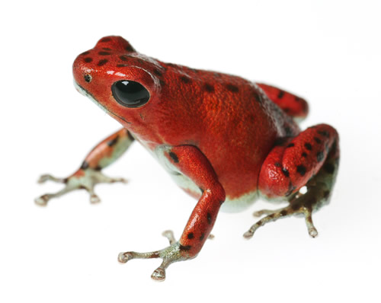
Who am I?
Hello!
I am from the Amazon.
I am small.
I am very colorful.
I am poisonous…

Slide 16
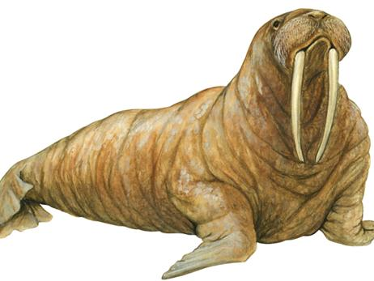
Who am I?
Hello!
I am from Antarctica.
I am very big and fat.
I make a loud noise.
I have two large tusks...

Slide 17
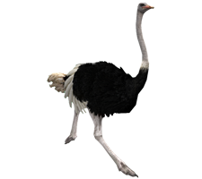
Who am I?
Hello!
I am from Africa.
I am very fast.
I am tall.
I am the biggest bird in the world.
I can’t fly…

Slide 18
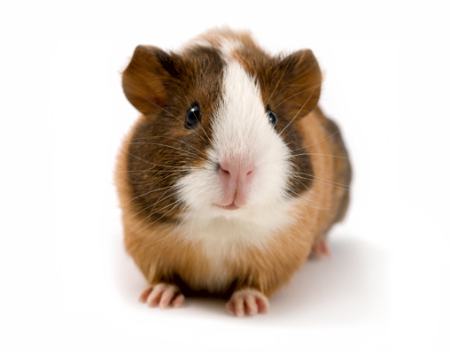
Who am I?
Hello!
I am from Peru.
I am small and furry.
People keep me as a pet (or for science)
I am not a real pig…

Slide 19

Who am I?
Hello!
I am from Canada.
I don’t have hair.
I am your teacher…

