Slide 1
The Tasty Game
Guess what I ordered.

Slide 2
How to play:
Make teams.
Take turns.
Each team can reveal one hint and make one guess (each turn)

Slide 3
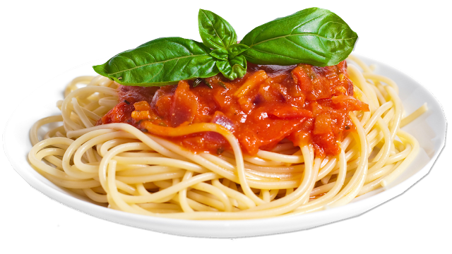
It’s spicy.
HINT 1
HINT 4
It’s long.
HINT 2
HINT 5
HINT 3
It’s Italian.
ANSWER
It’s red and yellow

Slide 4
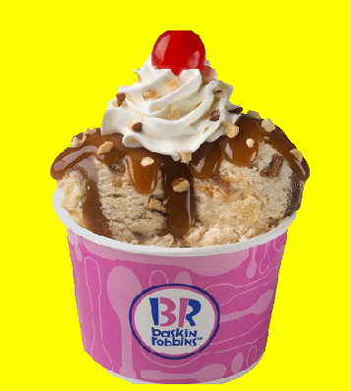
It’s sweet.
HINT 1
HINT 4
It’s cold.
HINT 2
HINT 5
HINT 3
It’s a summer food
ANSWER
There are many (31) flavors

Slide 5
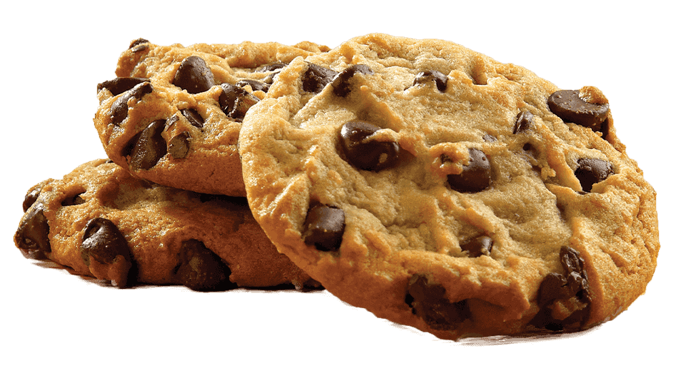
It’s sweet.
HINT 1
HINT 4
It’s round.
HINT 2
HINT 5
HINT 3
It’s crunchy.
ANSWER
It’s black and brown

Slide 6
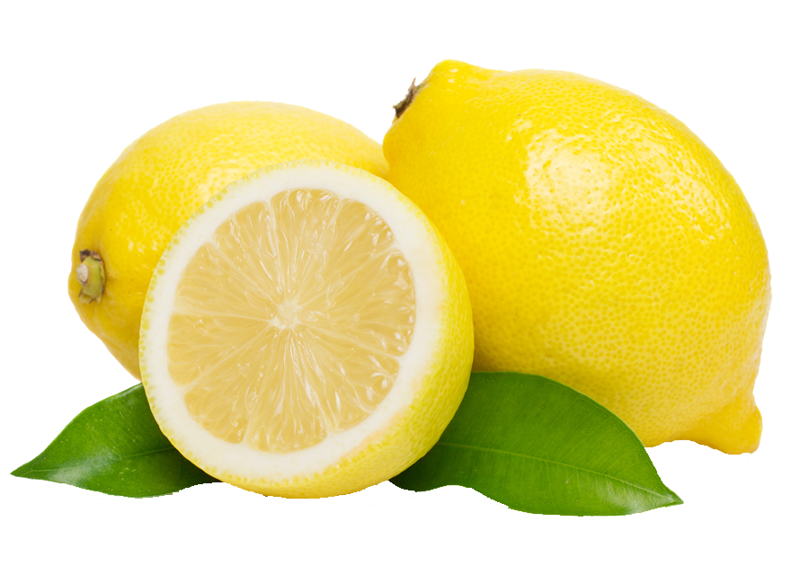
It’s sour.
HINT 1
HINT 4
It’s round.
HINT 2
HINT 5
HINT 3
It grows on trees.
ANSWER
It’s yellow

Slide 7
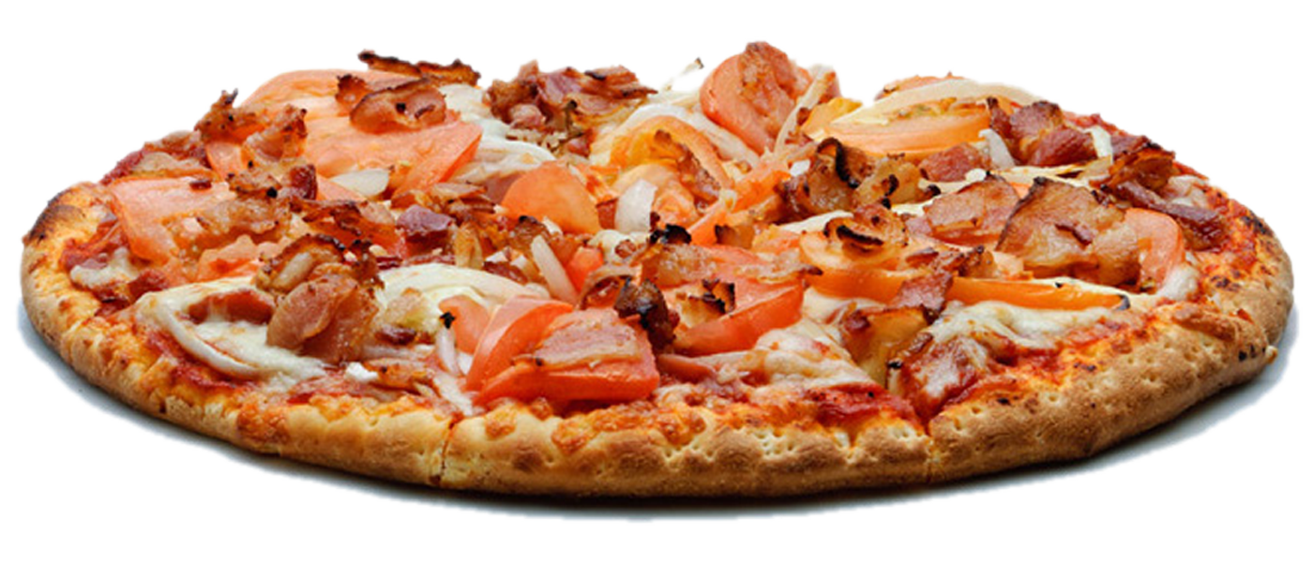
It’s delicious.
HINT 1
HINT 4
It’s round.
HINT 2
HINT 5
HINT 3
It’s Italian.
ANSWER
Each one is different

Slide 8
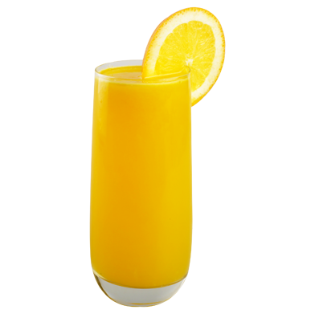
It’s sour.
HINT 1
HINT 4
It’s mostly water.
HINT 2
HINT 5
HINT 3
It’s from fruit.
ANSWER
It’s healthy.

Slide 9
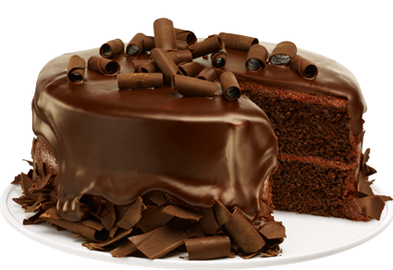
It’s sweet.
HINT 1
HINT 4
It’s brown.
HINT 2
HINT 5
HINT 3
It’s for birthdays.
ANSWER
The outside is sweeter

Slide 10
It’s tasteless.
HINT 1
HINT 4
It’s wet.
HINT 2
HINT 5
HINT 3
It’s clear.
ANSWER
You can drink it.

Slide 11
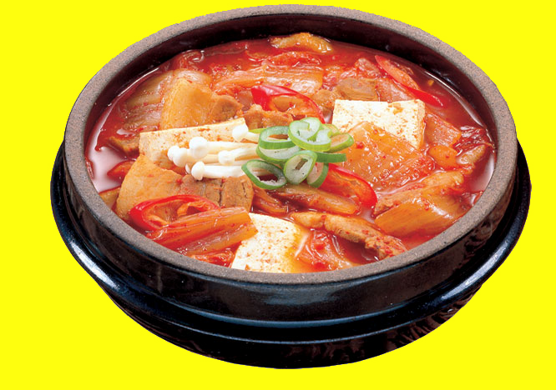
It’s spicy.
HINT 1
HINT 4
It’s Korean.
HINT 2
HINT 5
HINT 3
It’s hot.
ANSWER
It’s a type of soup.

Slide 12
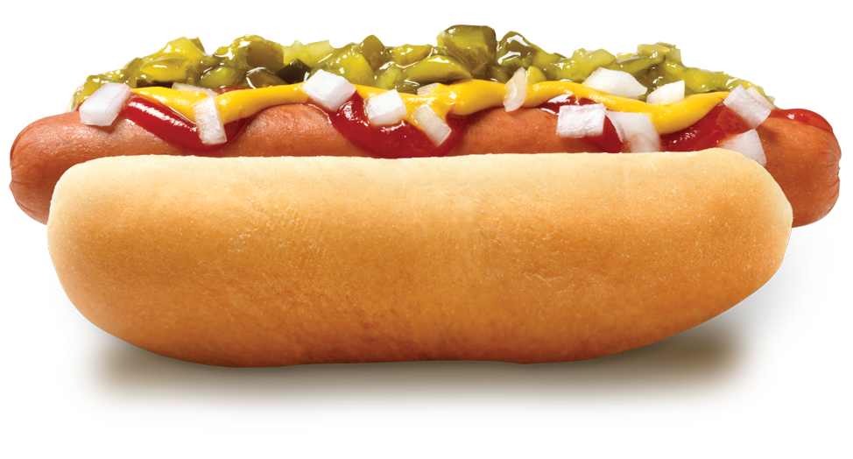
It’s delicious.
HINT 1
HINT 4
It has meat and bread.
HINT 2
HINT 5
HINT 3
It’s famous in America.
ANSWER
You can put ketchup on it.

Slide 13
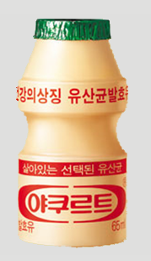
It’s sour.
HINT 1
HINT 4
You can drink it.
HINT 2
HINT 5
HINT 3
You can eat it.
ANSWER
It’s wet.

Slide 14
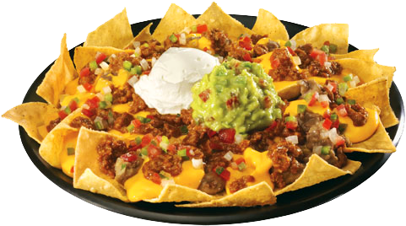
It’s spicy.
HINT 1
HINT 4
It’s triangle shaped.
HINT 2
HINT 5
HINT 3
It’s crunchy.
ANSWER
It’s Mexican.

Slide 15
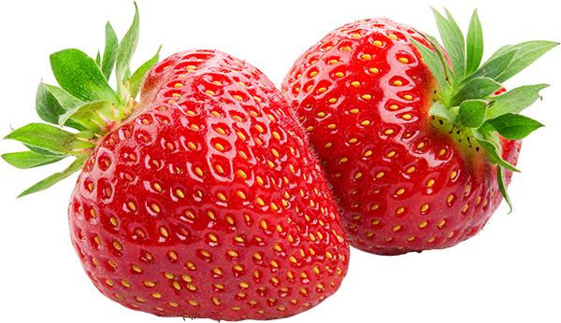
It’s sweet.
HINT 1
HINT 4
It’s a common flavor.
HINT 2
HINT 5
HINT 3
It’s red.
ANSWER
Its seeds are on the outside.

Slide 16
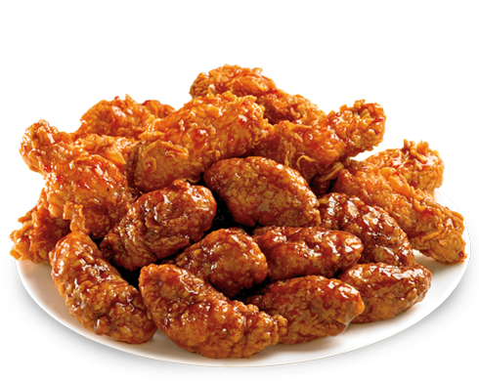
It’s spicy.
HINT 1
HINT 4
It’s meat.
HINT 2
HINT 5
HINT 3
It’s popular in Korea.
ANSWER
It’s sticky.

Slide 17
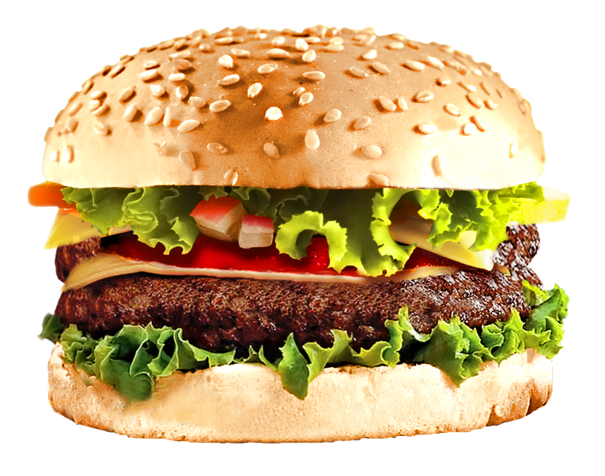
It’s delicious.
HINT 1
HINT 4
It has meat, bread and vegetables.
HINT 2
HINT 5
HINT 3
It’s fast food.
ANSWER
You can add cheese.

