Slide 1
https://www.youtube.com/watch?v=Z-9SCeFU7k8

Slide 2
Flags
http://www.triviaplaza.com/world-flags-1-quiz/#

Slide 4
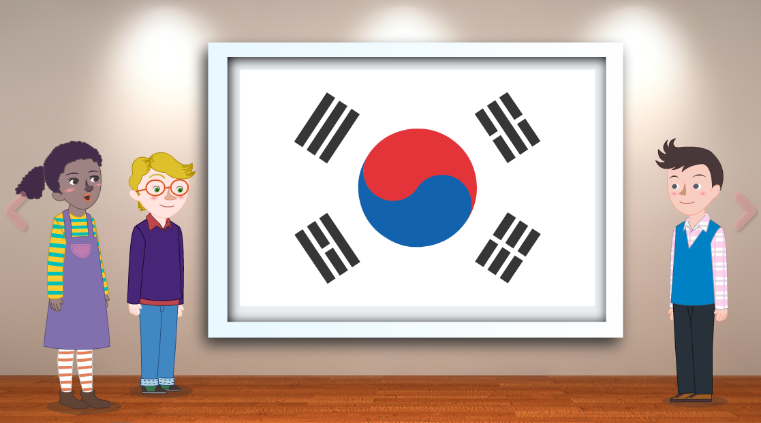

Slide 5
Old Korean Flag

Slide 7
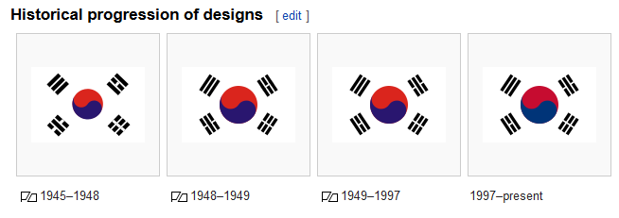

Slide 8
What does it mean?

Slide 9
What does it mean?

Slide 10
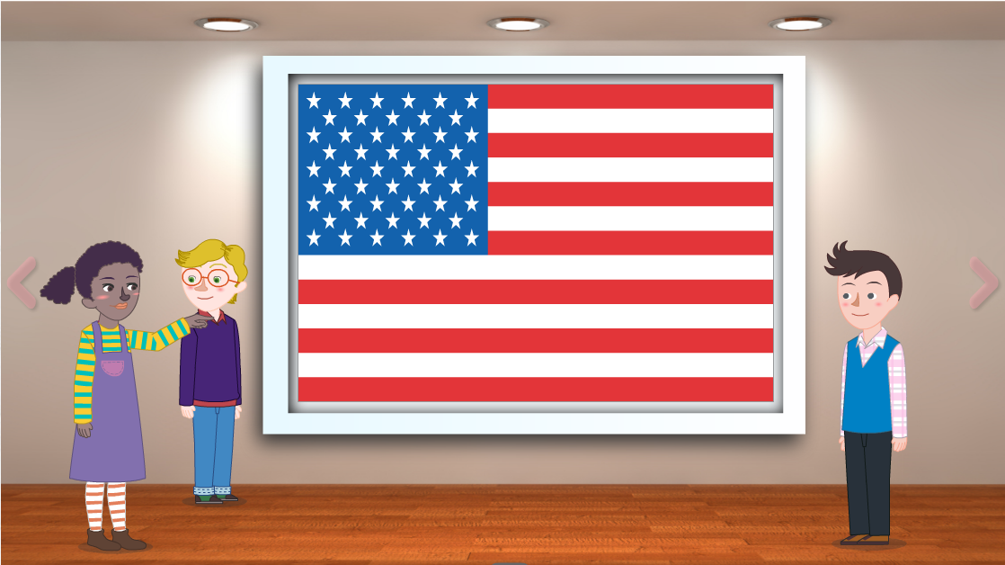

Slide 11
How many stars are there?

Slide 12
Why are there 13 stripes?

Slide 14
What can you tell me about the flag?

Slide 15
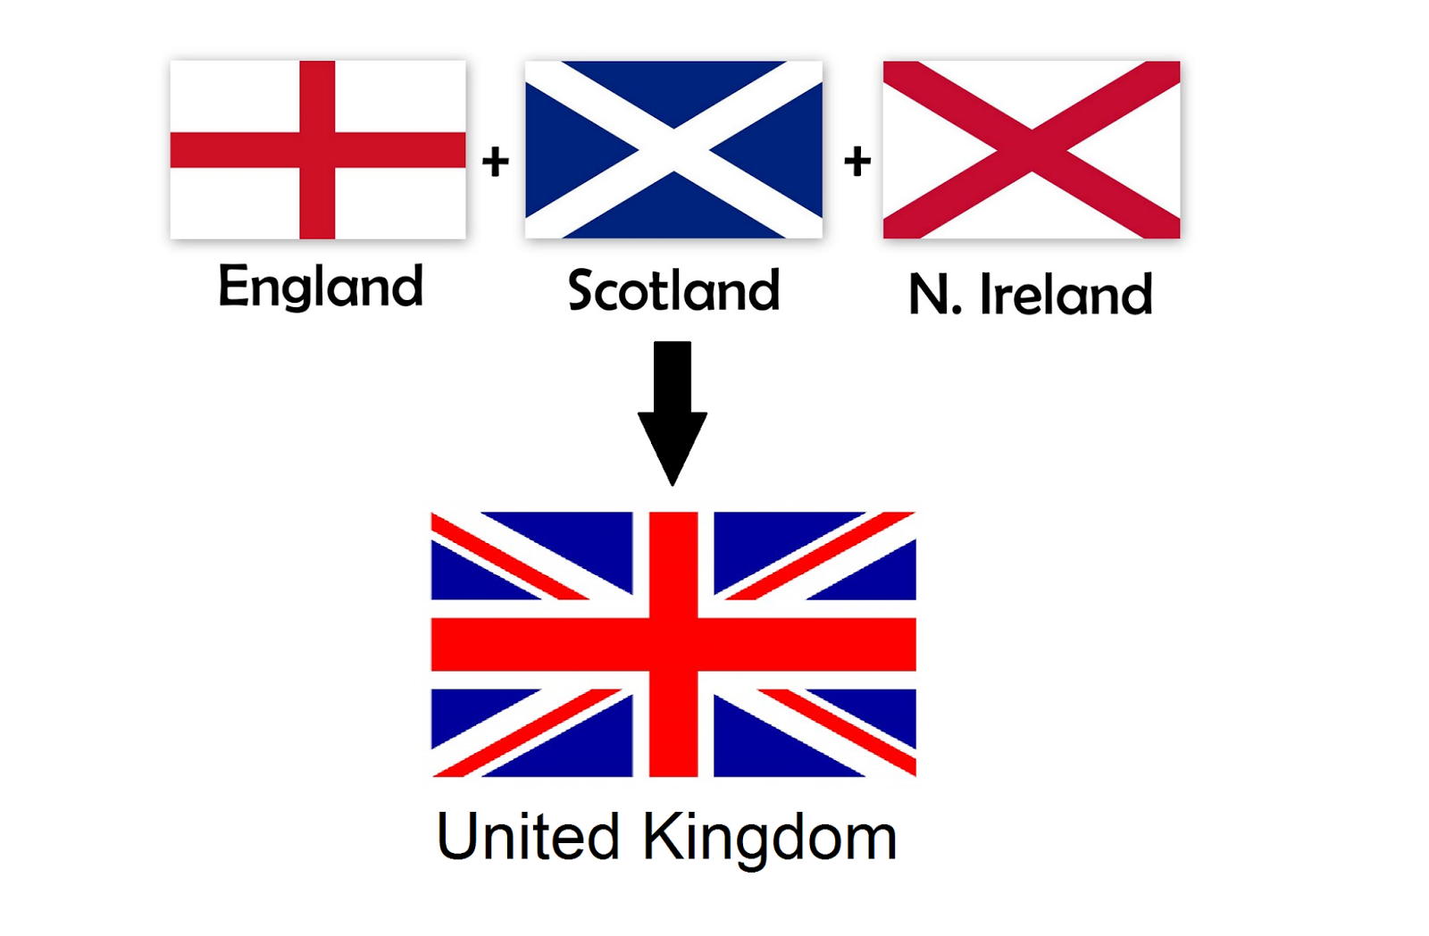

Slide 16
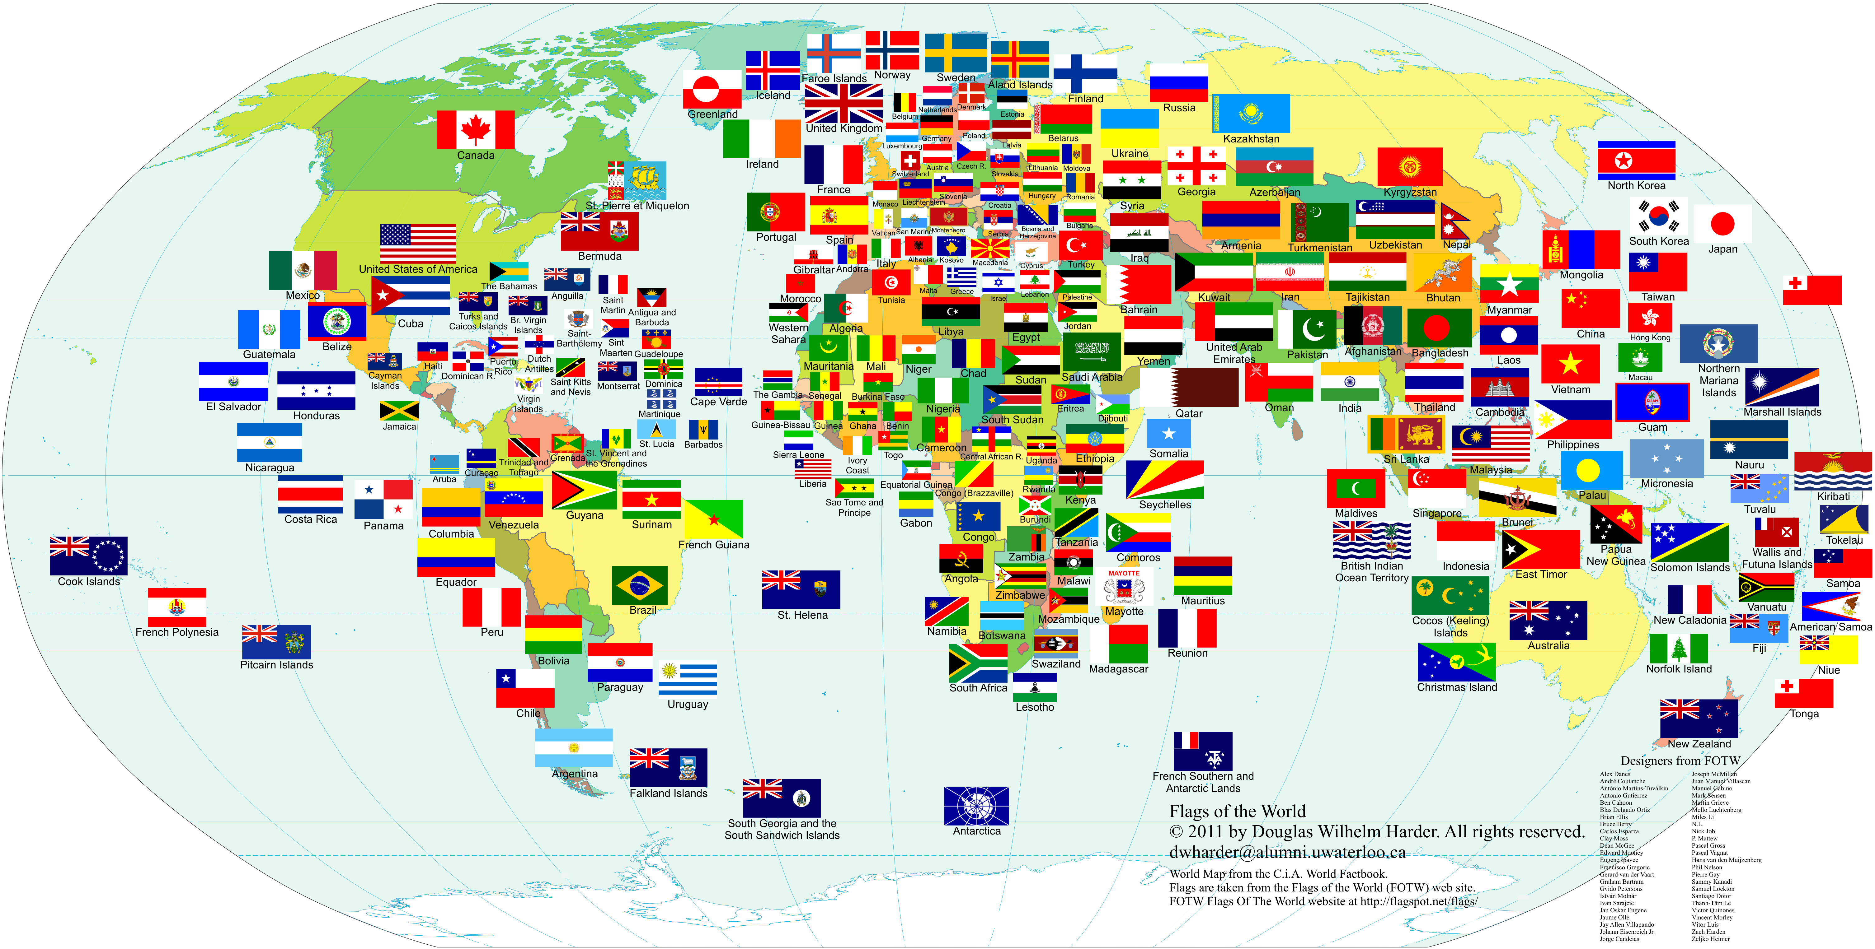
Where am I from?

Slide 18
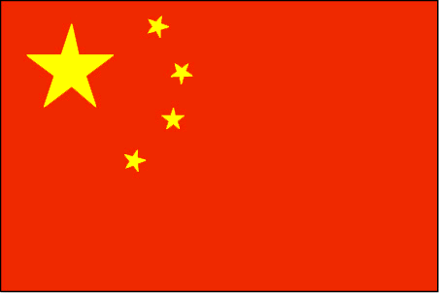
Which flags do you know?

Slide 19
What flags do you know?
http://www.jetpunk.com/quizzes/country-flag-1.php

Slide 20
Design your own flag:
What does the flag mean?
What is the name of your country?
Why is your country special?

Slide 21
