Slide 1
My Schedule

Slide 2
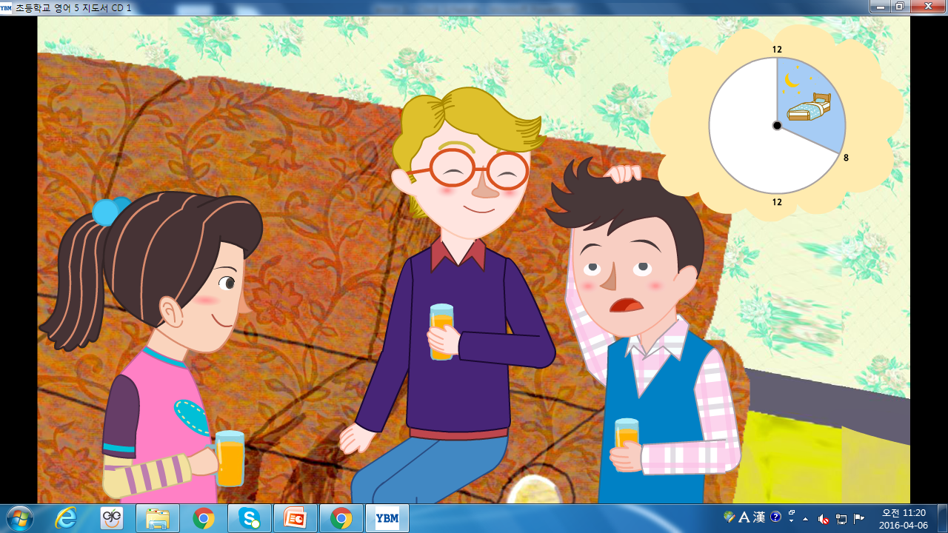

Slide 3
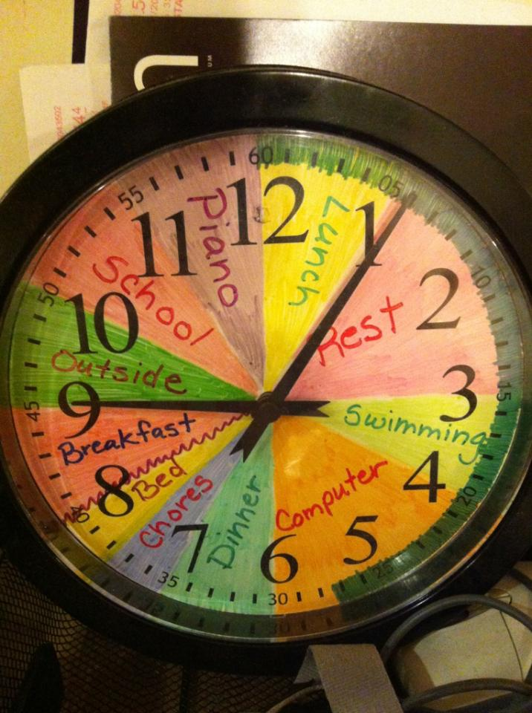
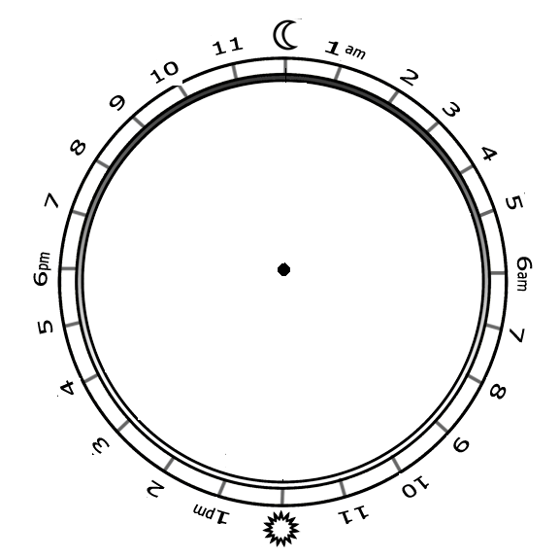

Slide 4
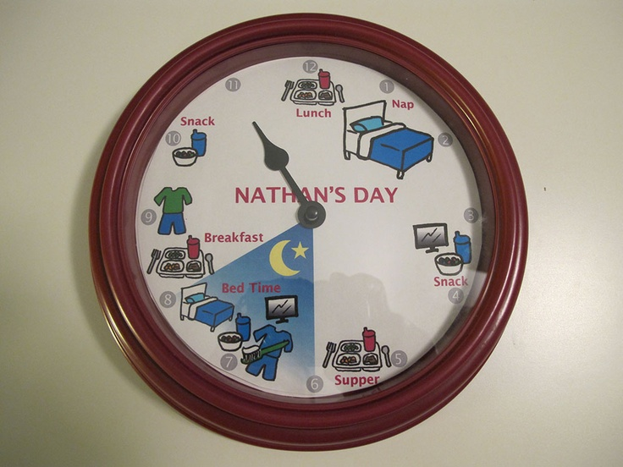

Slide 5
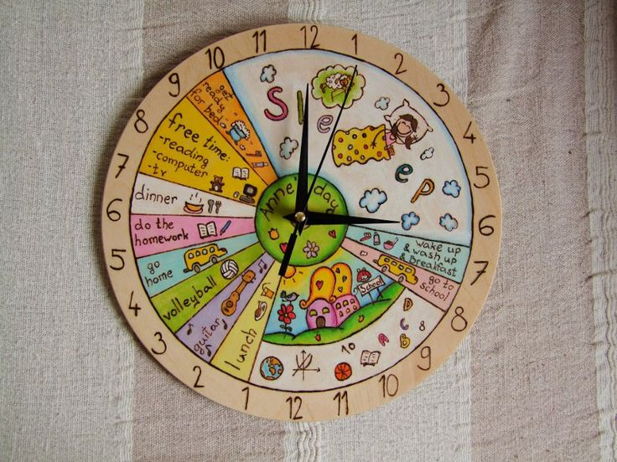

Slide 6
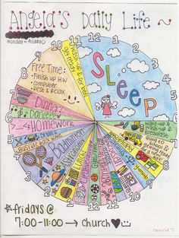

Slide 7
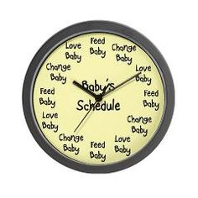
Baby Schedule

Slide 8
Make Your Schedule
Draw a line (use a ruler)
Write in English
If there is time, you can draw a picture
After 10 minutes, we will do presentations. (have students ask questions like, “What will you do at 10am)

Slide 9
When do you…
Wake up
Eat breakfast
Go to school
Eat lunch
Go home
Go to academy
Eat dinner
Go to sleep

