Slide 1
Instructions
Print these cards
Lamination is a good idea
You probably won’t need all these cards ( ~ one card type per student)
Shuffle and handout all the cards equally
Students must get 4 of the same card to win.
To do this, students will ask, “May I…” )
If the student has the card, they should respond with, “Sure, you can”
If the student doesn’t have the card, they can say, “Sorry, you can’t”
I play that the first three winners get a prize.

Slide 2
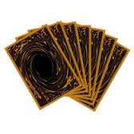
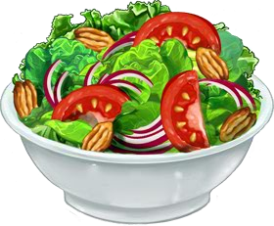
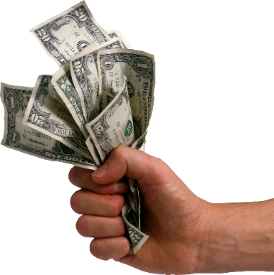
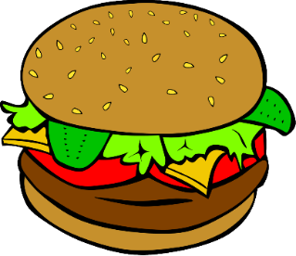
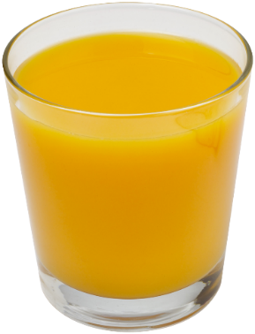
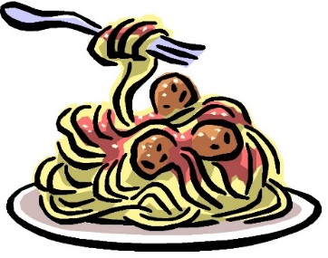
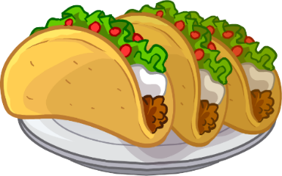
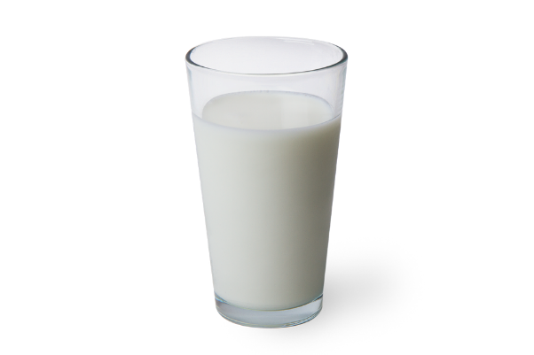
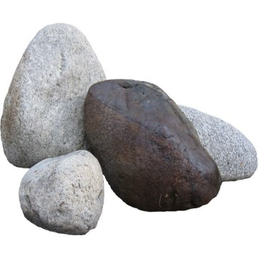
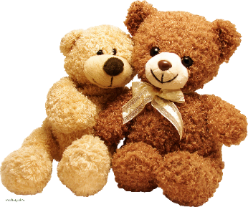
May I play games?
May I have some cake?
May I have some candy?
May I have some Yugioh cards?
May I play with toys?
May I have some milk?
May I have some chicken?
May I go to the washroom?
May I have some money?
May I have some orange juice?
May I have some cola?
May I have some watermelon?
May I have some rocks?
May I have some strawberries?
May I have some ice cream?
May I have some pizza?
May I have some carrots?
May I take your picture?
May I have some bananas?
May I have some salad?
May I have some cookies?
May I have some apples?
May I have some tacos?
May I have some spaghetti?
May I have some fries?
May I have some donuts?
May I have some coffee?
May I have some hamburgers?
May I have some shrimp?
May I have some water?

Slide 3
Water
Water
Water
Water
Juice
Juice
Juice
Juice

Slide 4
Washroom
Washroom
Washroom
Washroom
Pizza
Pizza
Pizza
Pizza

Slide 5
Cookies
Cookies
Cookies
Cookies
Apple
Apple
Apple
Apple

Slide 6
Spaghetti
Spaghetti
Spaghetti
Spaghetti
Hamburger
Hamburger
Hamburger
Hamburger

Slide 7
Strawberry
Strawberry
Strawberry
Strawberry
Cake
Cake
Cake
Cake

Slide 8
French Fries
French Fries
French Fries
French Fries
Milk
Milk
Milk
Milk

Slide 9
Money
Money
Money
Money
Rocks
Rocks
Rocks
Rocks

Slide 10
Picture
Picture
Picture
Picture
Cola
Cola
Cola
Cola

Slide 11
Yugioh Cards
Yugioh Cards
Yugioh Cards
Yugioh Cards
Candy
Candy
Candy
Candy

Slide 12
Salad
Salad
Salad
Salad
Chicken
Chicken
Chicken
Chicken

Slide 13
Banana
Banana
Banana
Banana
Taco
Taco
Taco
Taco

Slide 14
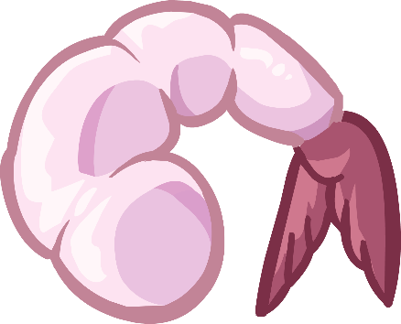
Shrimp
Shrimp
Shrimp
Shrimp
Ice Cream
Ice Cream
Ice Cream
Ice Cream

Slide 15
Carrot
Carrot
Carrot
Carrot
Watermelon
Watermelon
Watermelon
Watermelon

Slide 16
Doughnut
Doughnut
Doughnut
Doughnut
Toys
Toys
Toys
Toys

Slide 17
Games
Games
Games
Games
Coffee
Coffee
Coffee
Coffee

