Slide 1
Would you like some more?

Slide 2
How to play
This is a push your luck game.
A student (or group) will ask for something
  “May I have some ____________”
  Click the appropriate image
Then the teacher will ask, “Would you like some more?”
  “Yes, please” = repeat from step 1
  “No thanks, I’m full.” = count the points

Slide 3
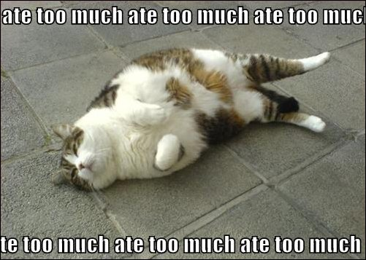
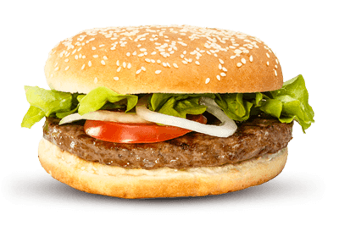




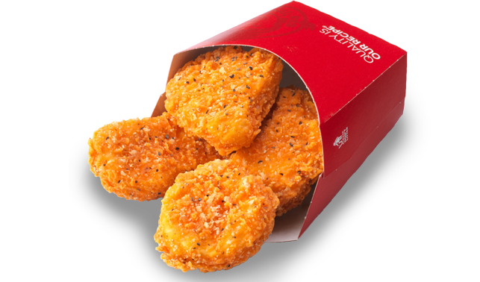
Points

Slide 4

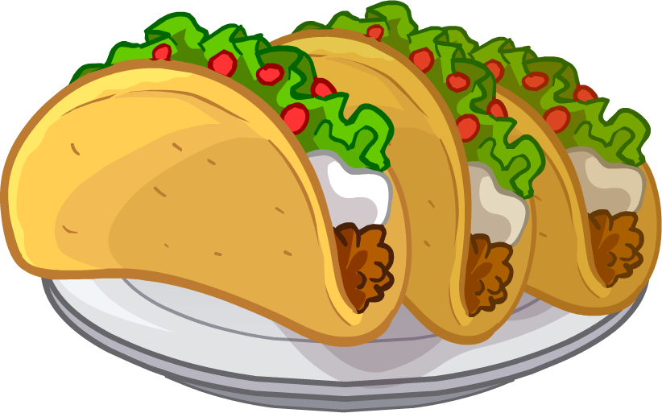
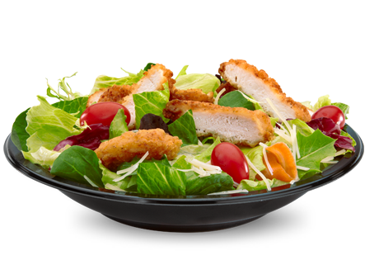
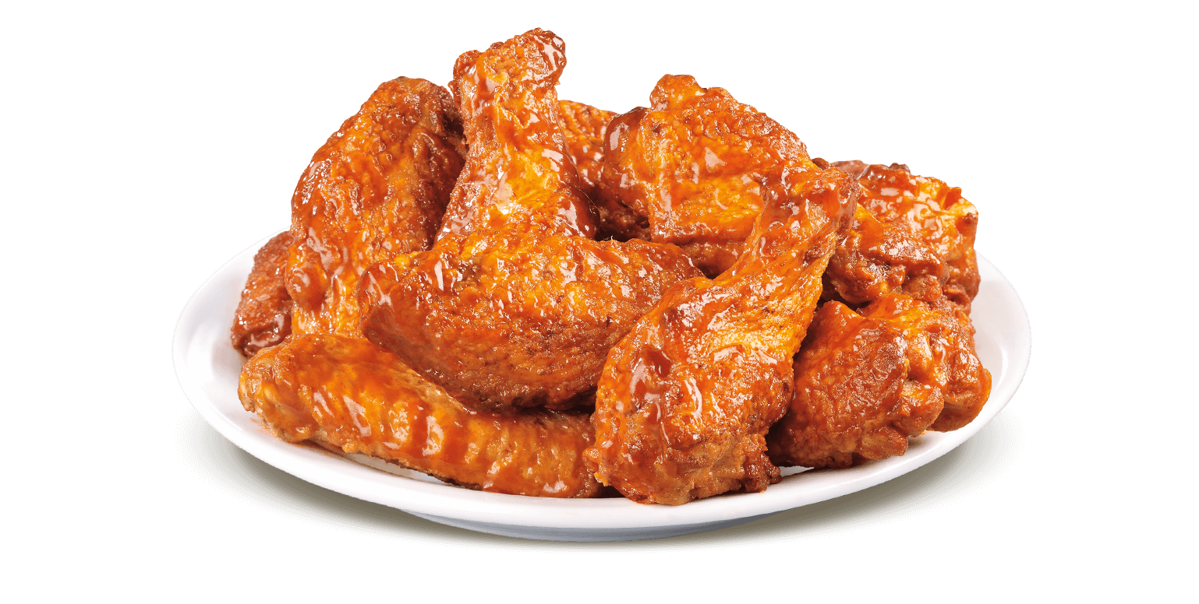
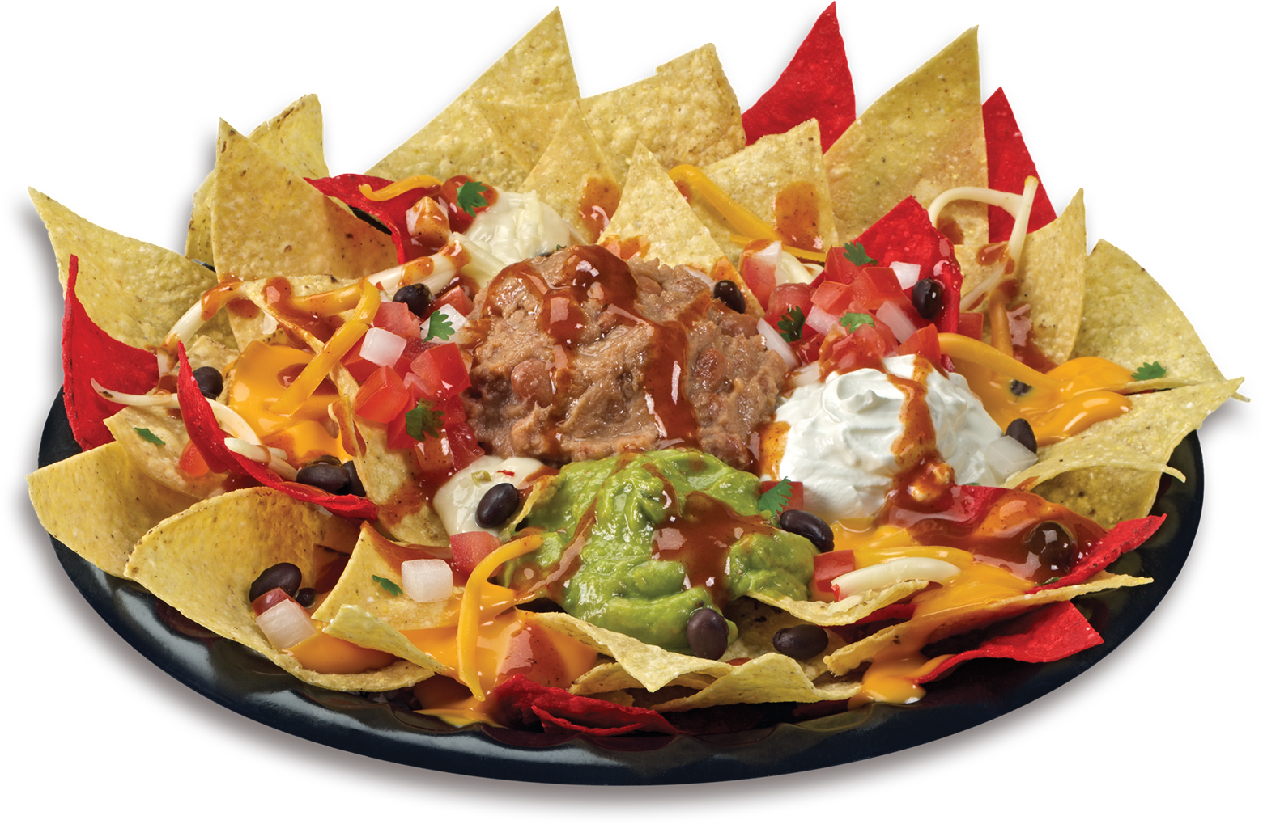
Points

Slide 5
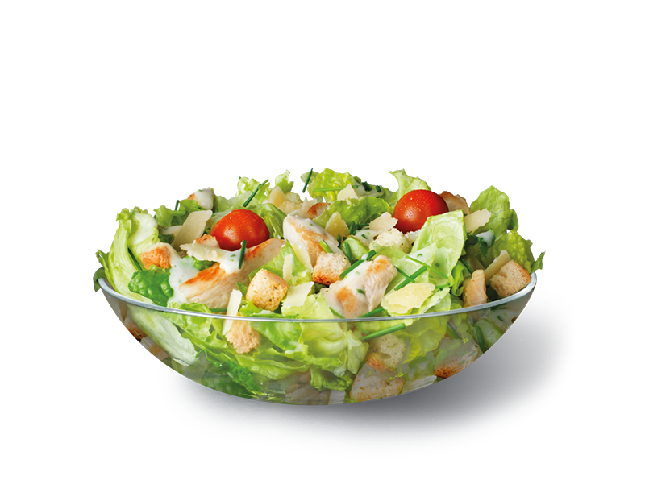
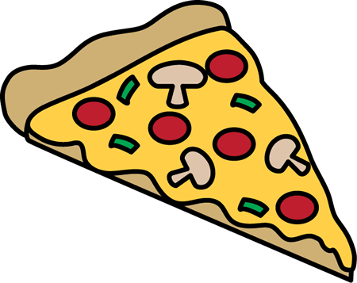
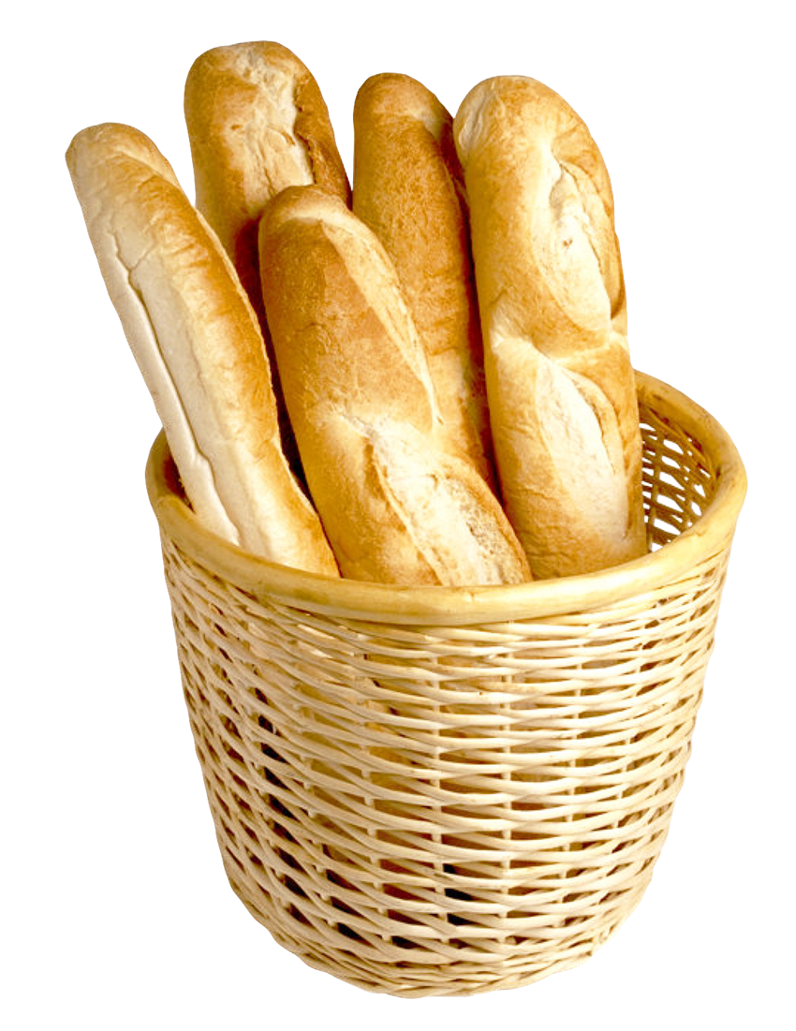
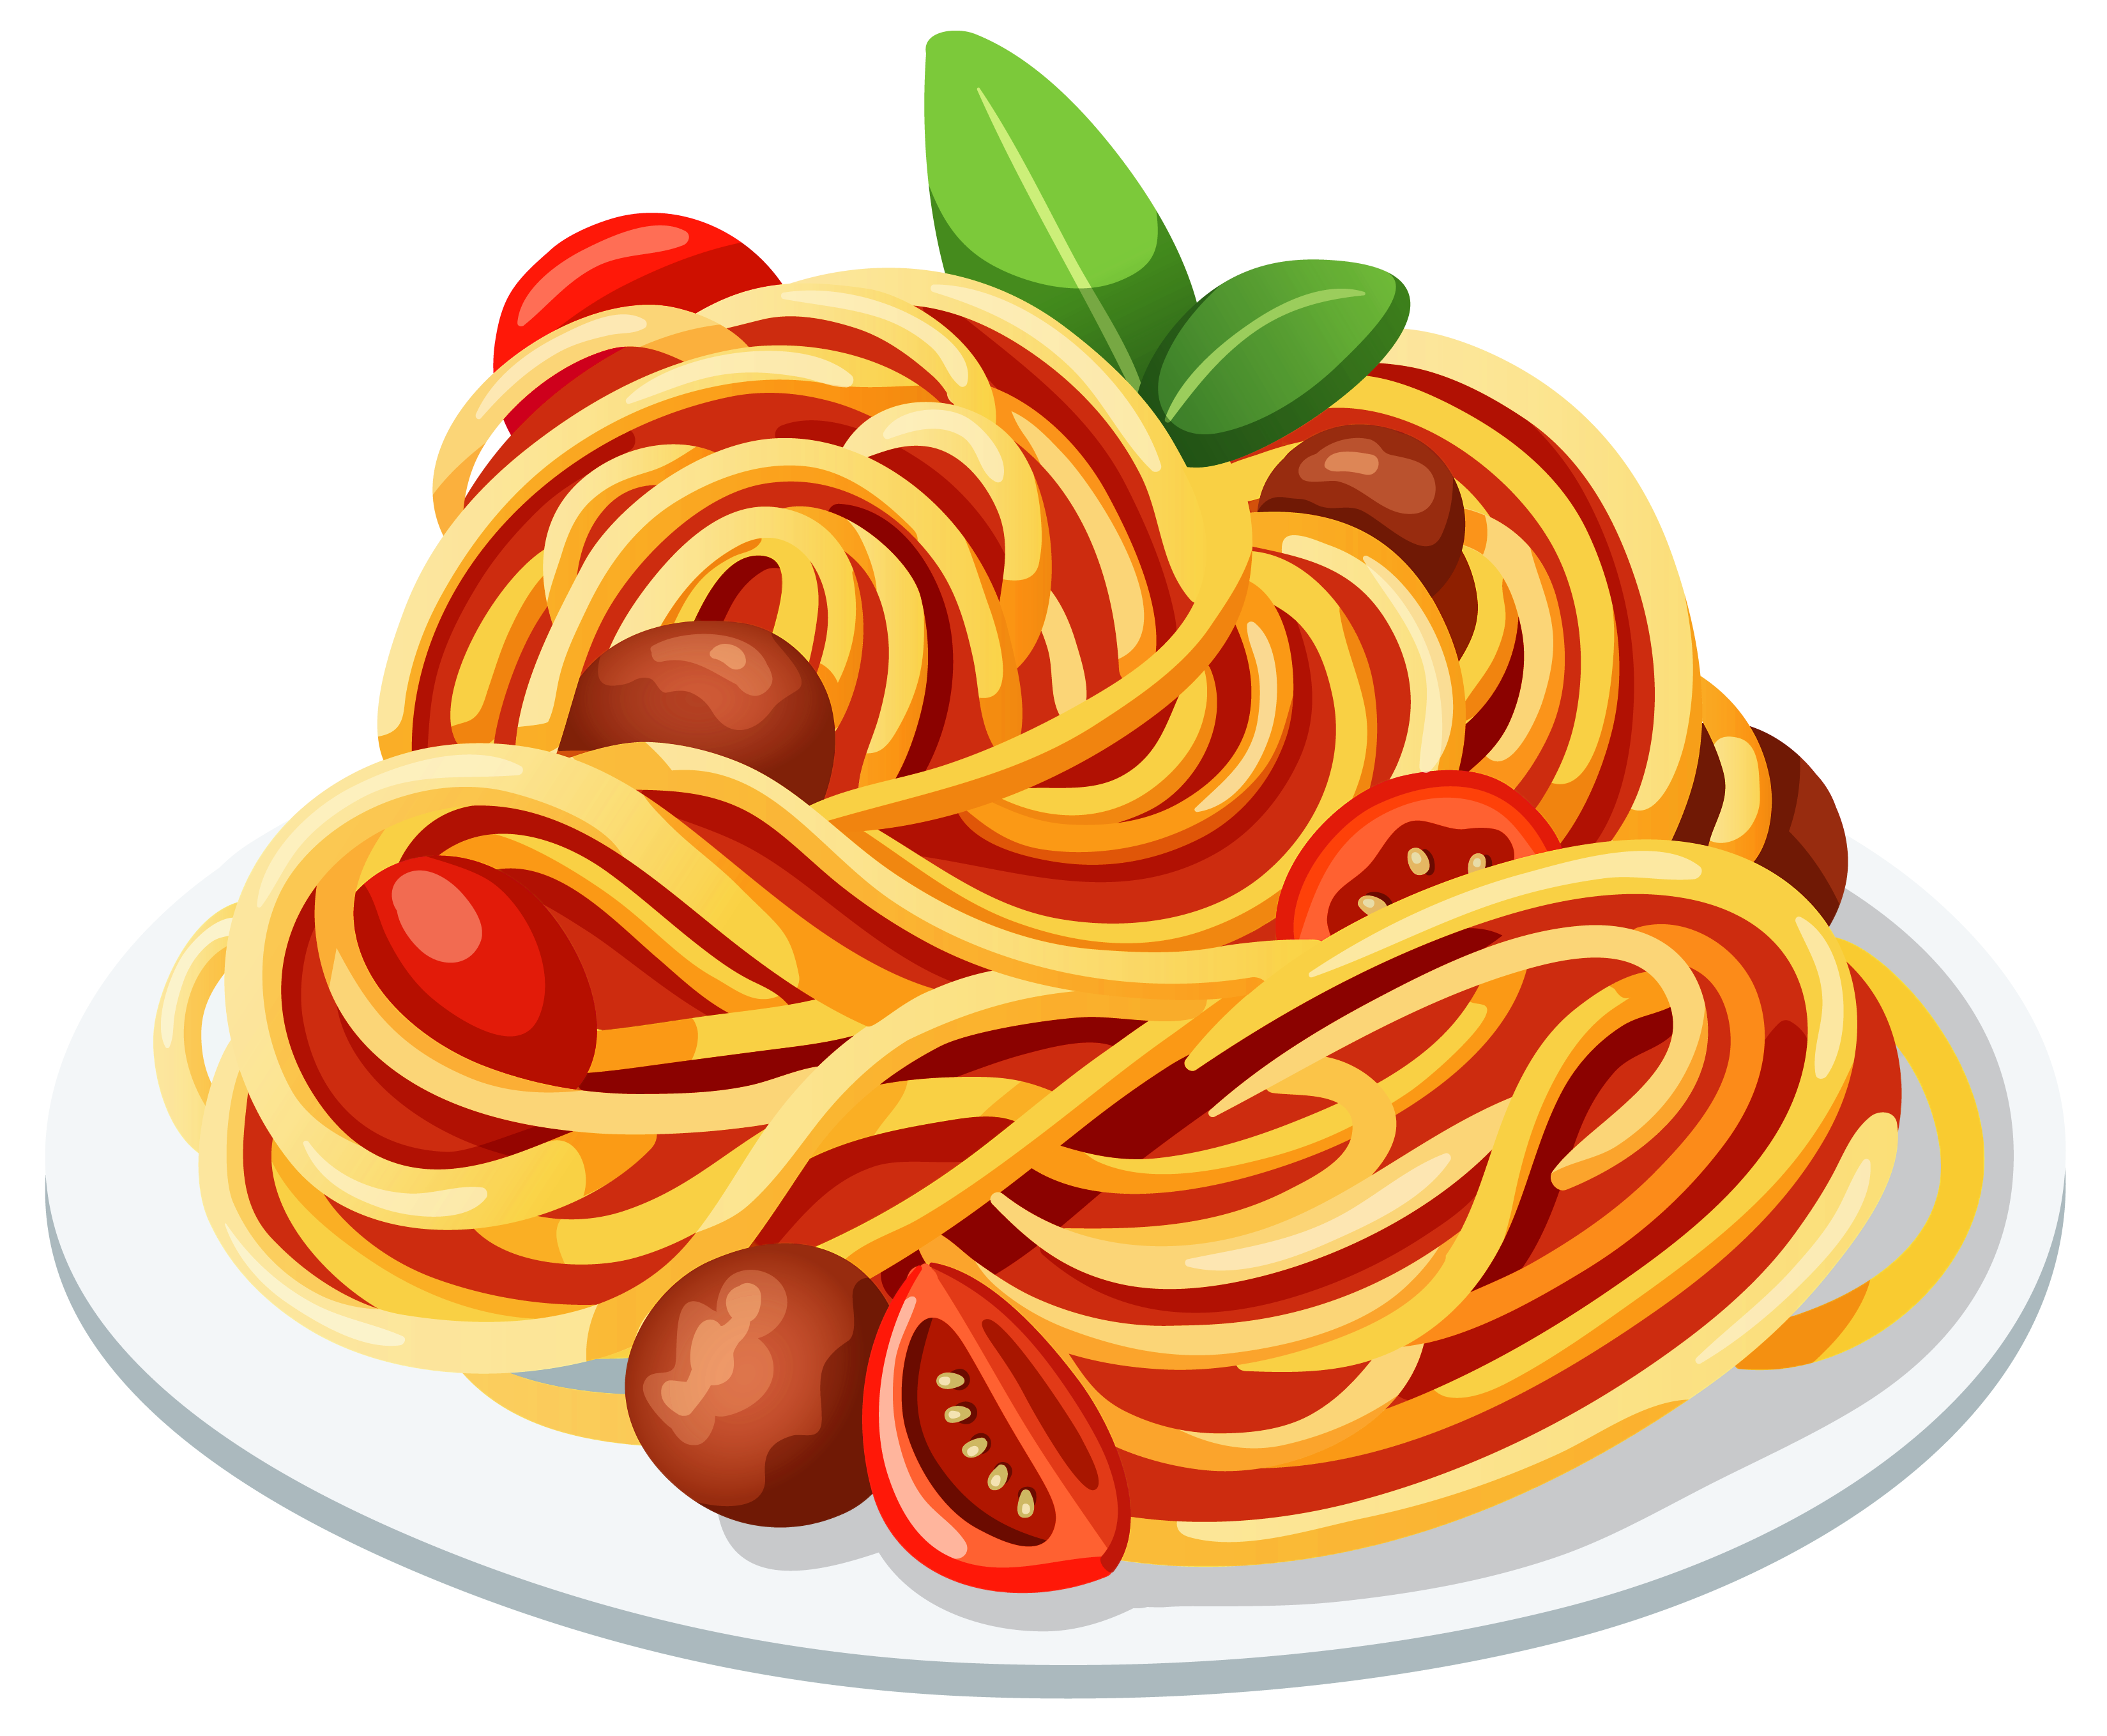

Points

Slide 6

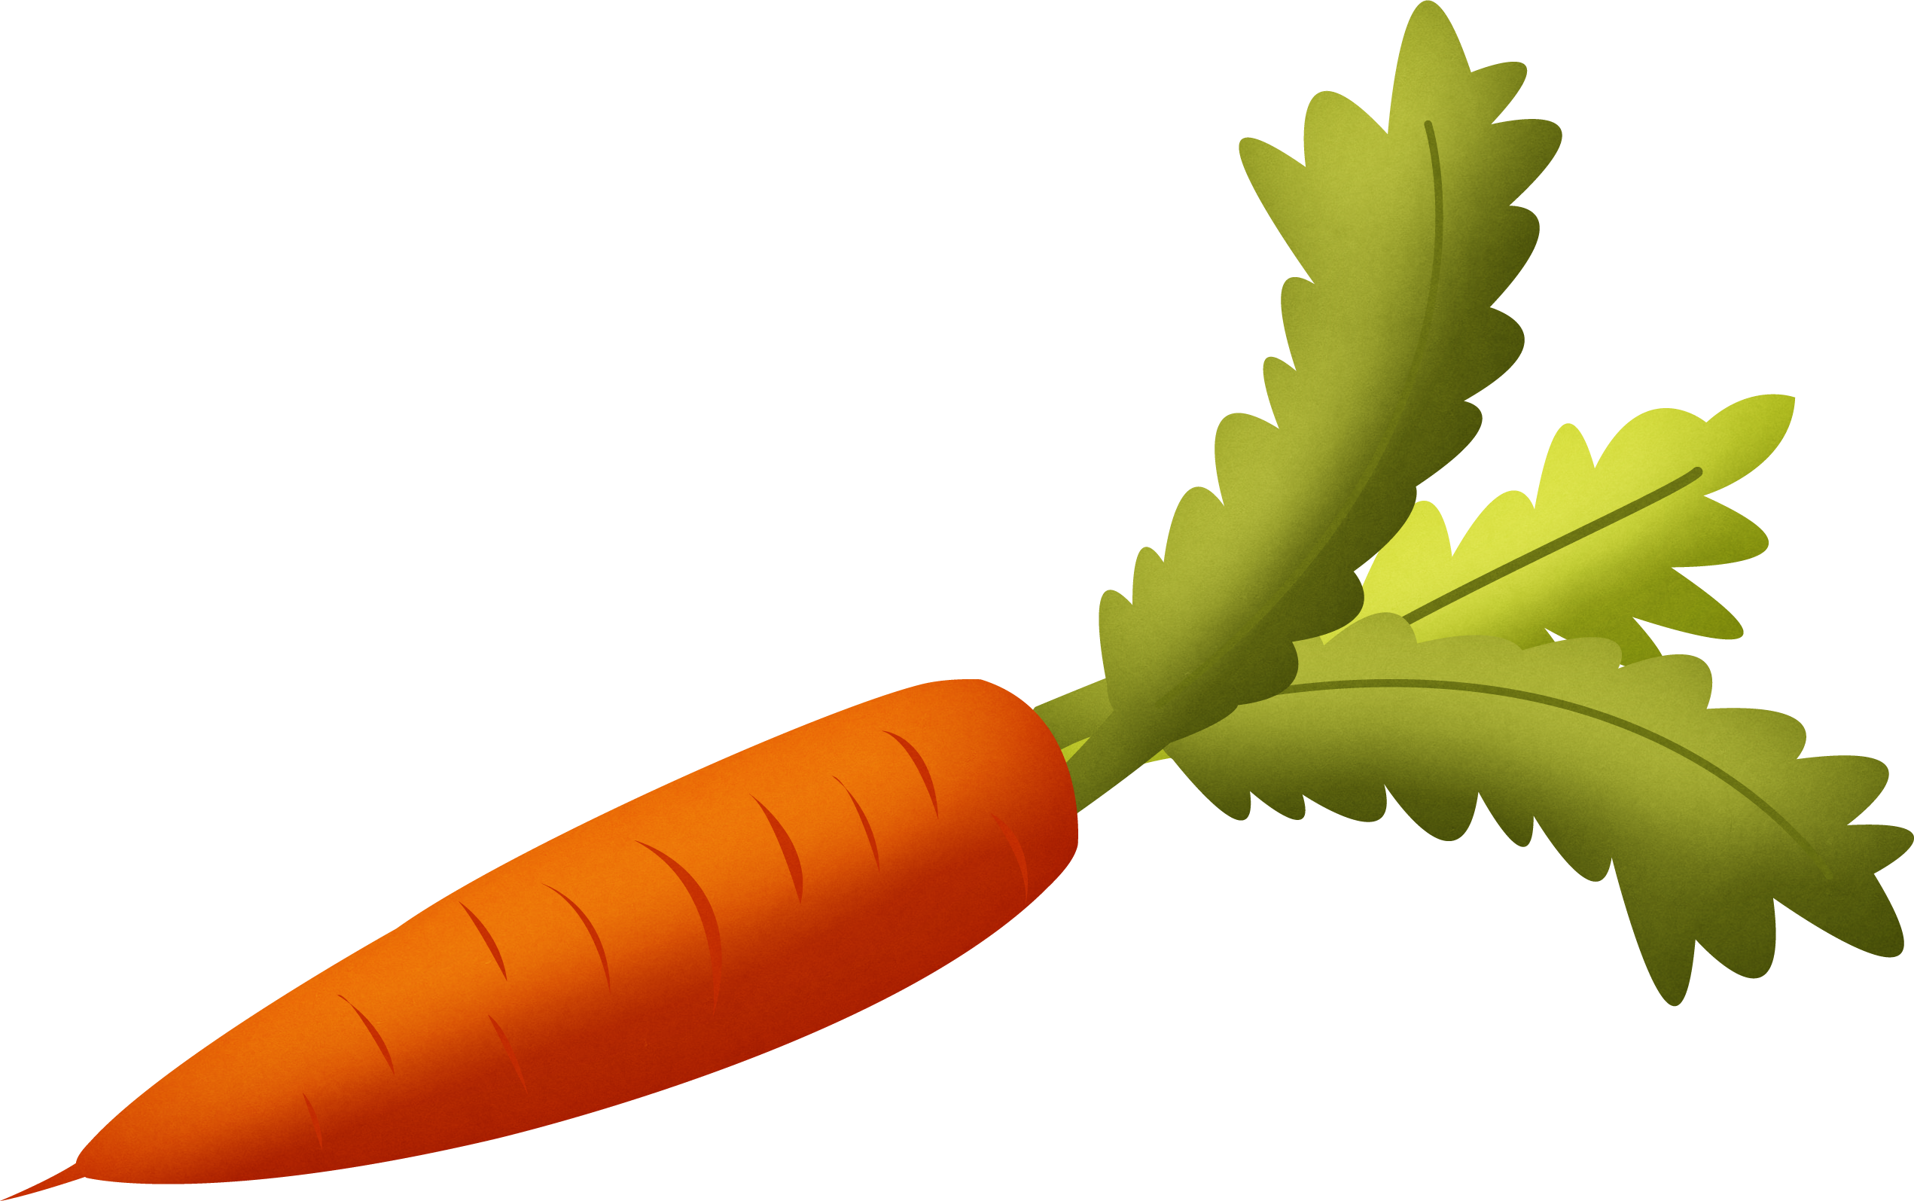


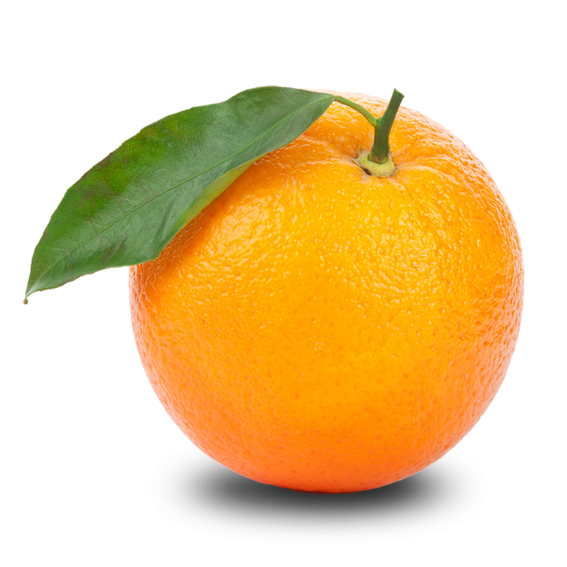
Points

Slide 7
Points

Slide 8
Points

Slide 9
Points

Slide 10
Points

Slide 11
Points

Slide 12
Points

Slide 13
Points

Slide 14
Points

Slide 15
Points

Slide 16
Points

Slide 17
Points

Slide 18
Points

