Slide 1
For Teachers:
Split the class into teams.
On a team’s turn, they will ask, “May I come in?”
Flip a coin:
Heads = “Yes, you can.” Continue to part two
Tails = “Sorry, you can’t.” Move on to the next team.
If they got a “heads”, They can choose a door number
If there is an item (s) , they can make a sentence “May I have some _______?”
Click the image
Click the door to return to the top
Some doors have other actions (ie. Zombie attack)
Apply the rule on the slide
Click the door to return to the top

Slide 2
Mr. Tree May I Come In?
The Mr. Tree Game

Slide 3
Welcome to Mr.S’ House
1
1
1
1
1
1
1
1
1
1
1
1
1
1
1
1
1
1
Ask to Come In
“Mr. Tree, may I come in?”
Then ask if you can have what is behind the door
“May I have _______”
1
1
1
1
1
1
1
1
1

Slide 4
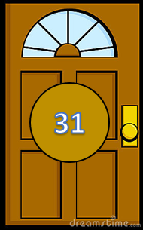
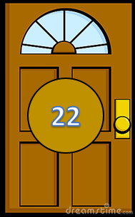
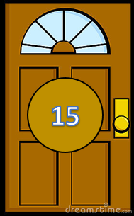

Slide 5
11
Water
1 POINT

Slide 6
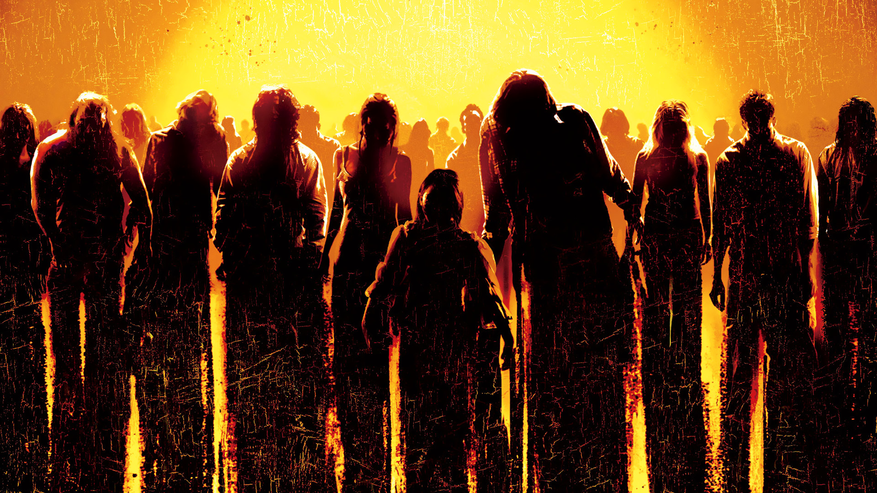
12
ZOMBIE ATTACK
Lose 2 Points

Slide 7
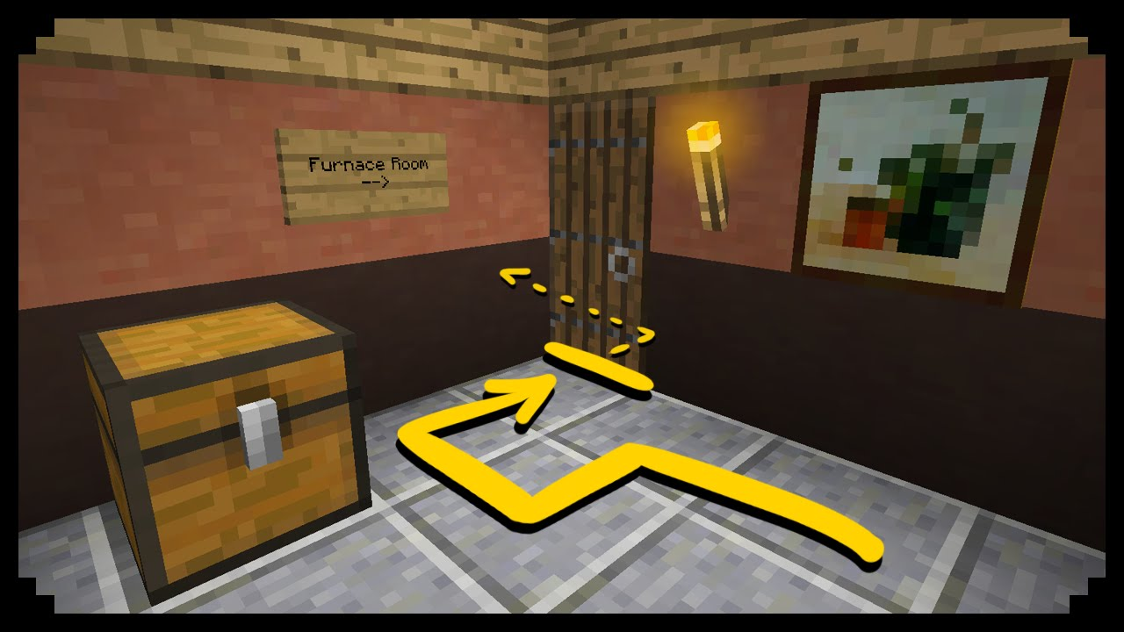
Secret Passage
Steal 3 points
13

Slide 8
14
Money
5 POINTS

Slide 9
15
Pictures
2 POINTS

Slide 10
16
Chocolate
1 POINT

Slide 11
17
Diamonds
4 POINTS

Slide 12
18
Medicine
3 POINTS

Slide 13
19
Eggs
1 POINT

Slide 14
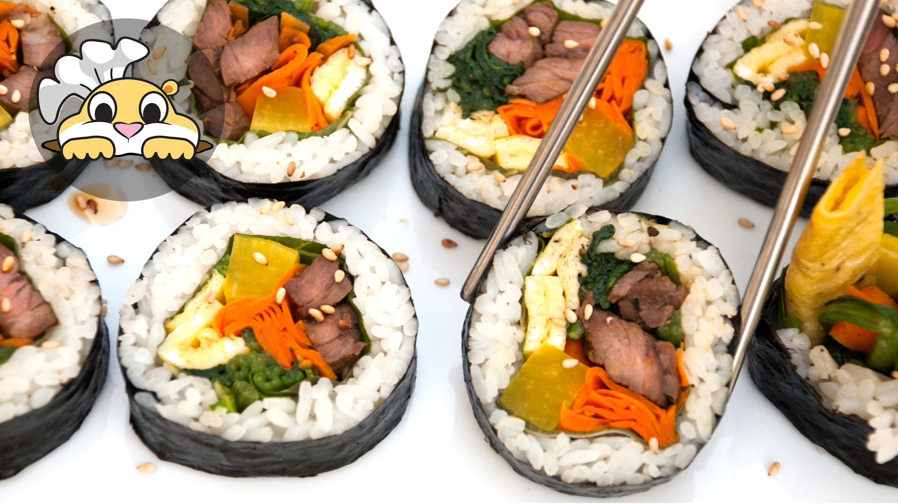
21
Kimbap
2 POINTS

Slide 15
22
Ice Cream
2 POINTS

Slide 16
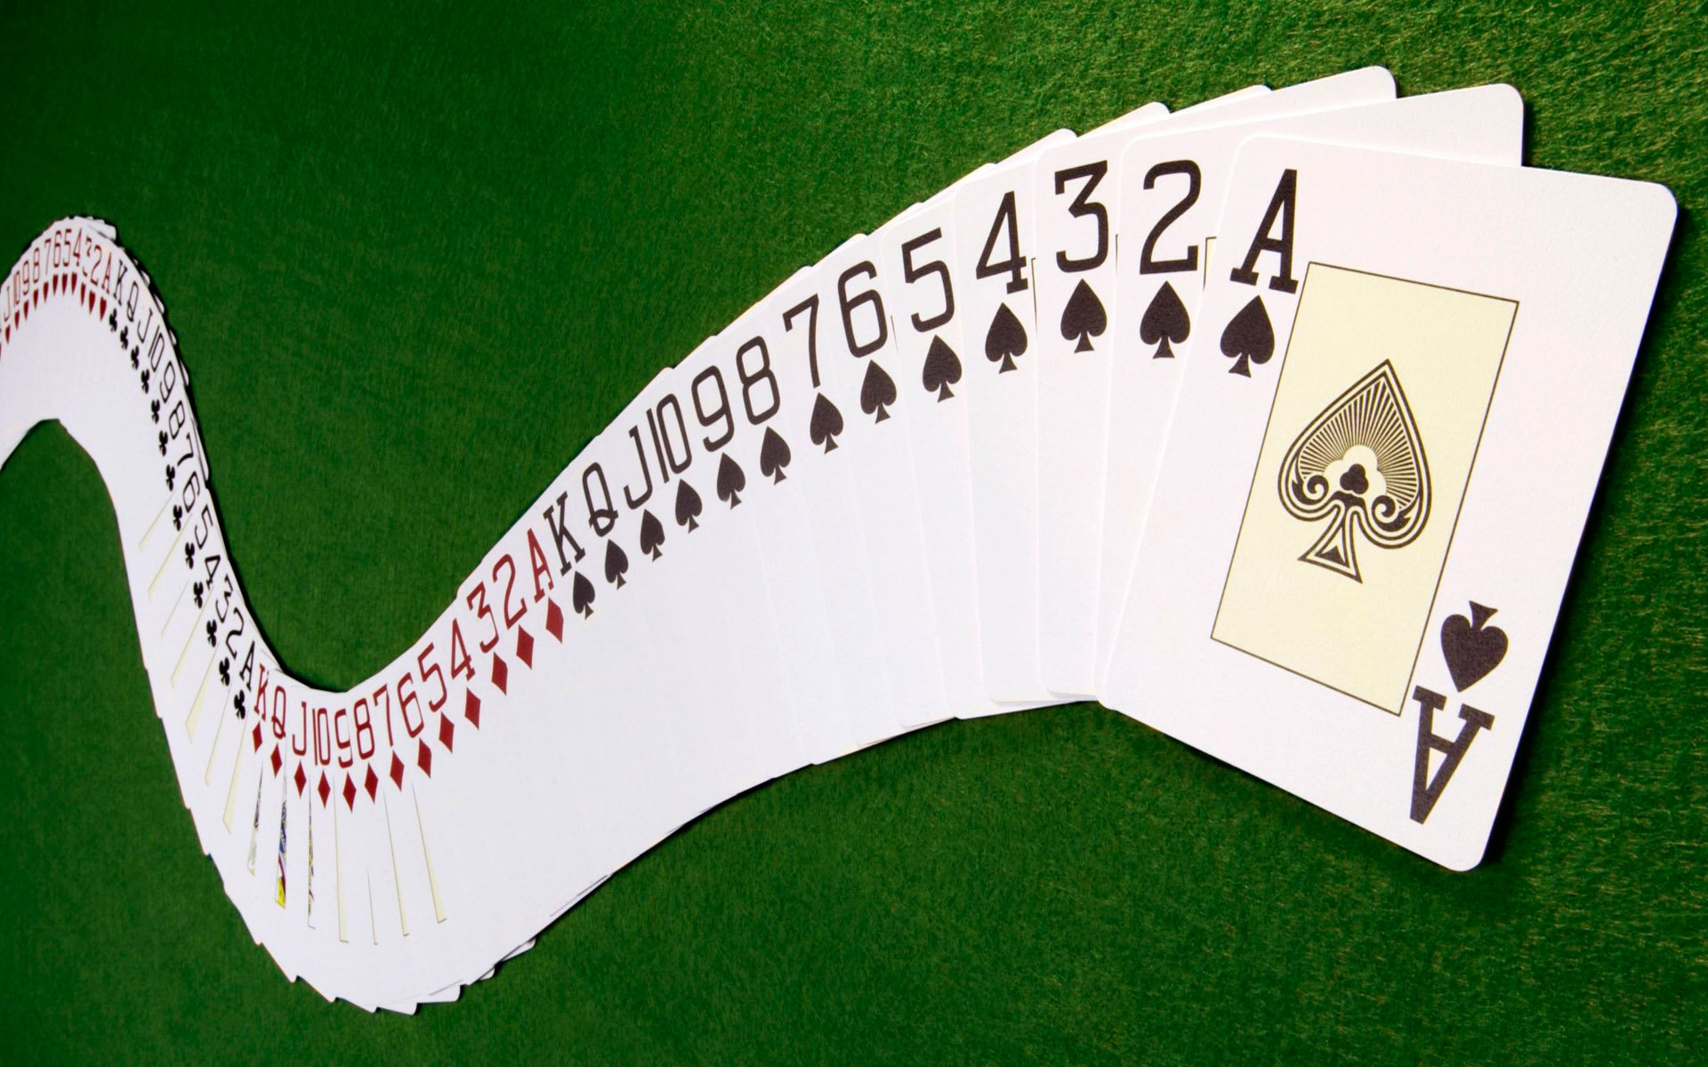
23
Cards
2 POINTS

Slide 17
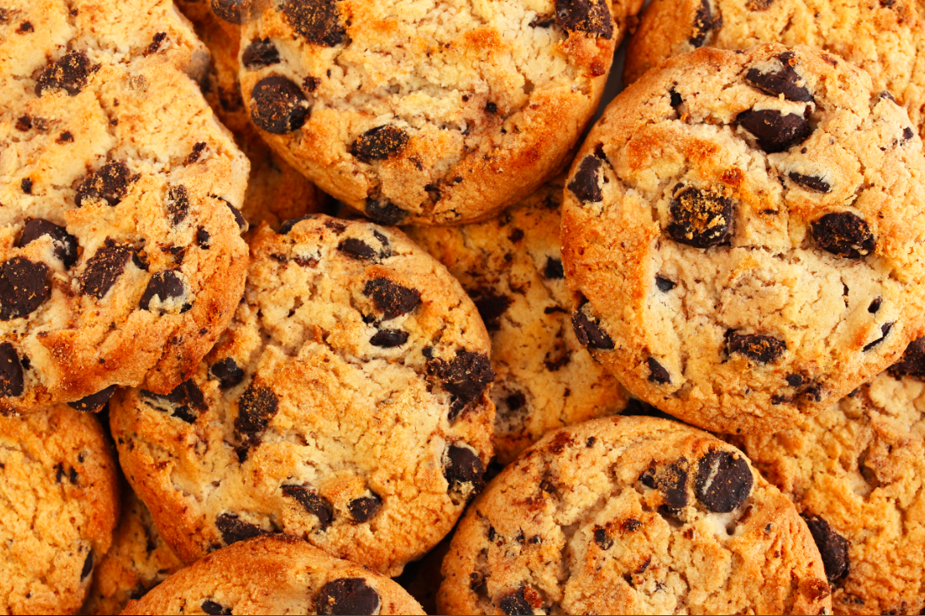
24
Cookies
3 POINTS

Slide 18
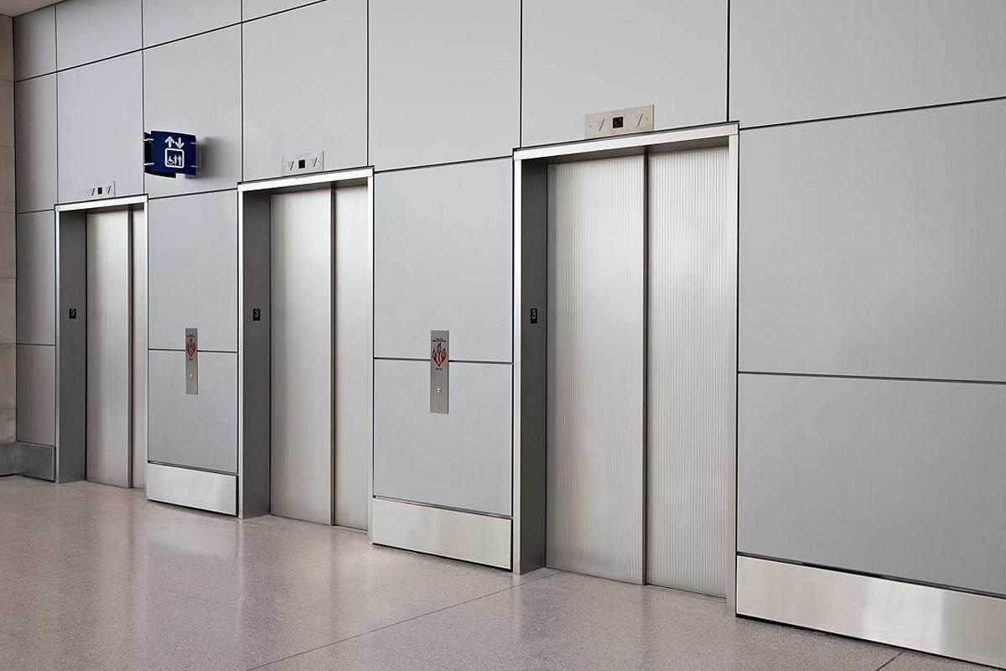
25
Elevator
Switch Points with Another Team

Slide 19
26
Doughnuts
2 POINTS

Slide 20
27
French Fries
1 POINT

Slide 21
Secret Passage
Steal 2 points
28

Slide 22
29
Money
5 POINTS

Slide 23
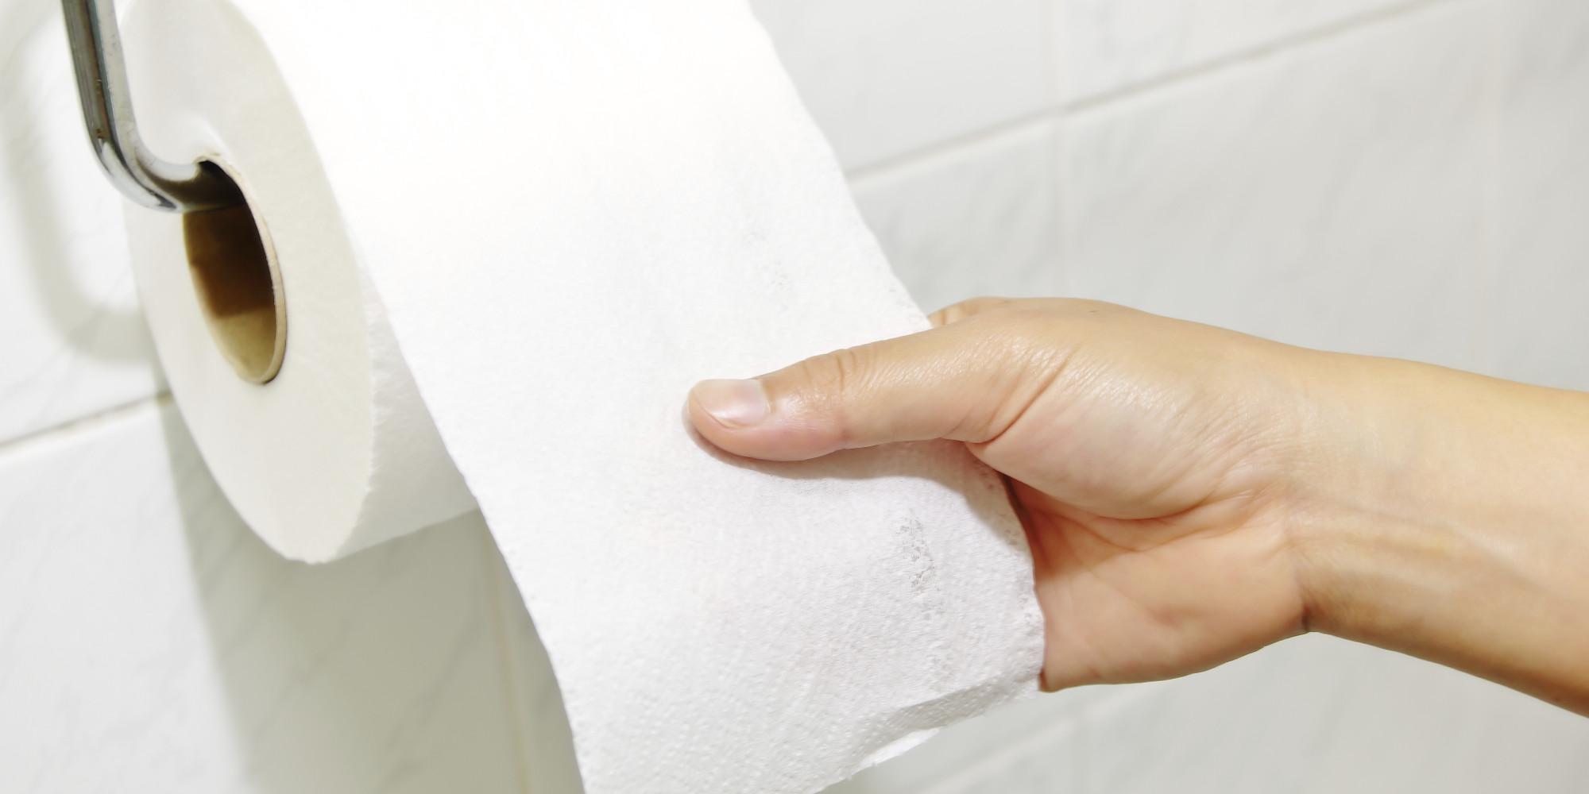
31
Toilet Paper
1 POINT

Slide 24
32
ZOMBIE ATTACK
Lose 2 Points

Slide 25
Secret Passage
Steal 3 points
33

Slide 26
34
Balloons
3 POINTS

Slide 27
35
Chocolate
1 POINT

Slide 28
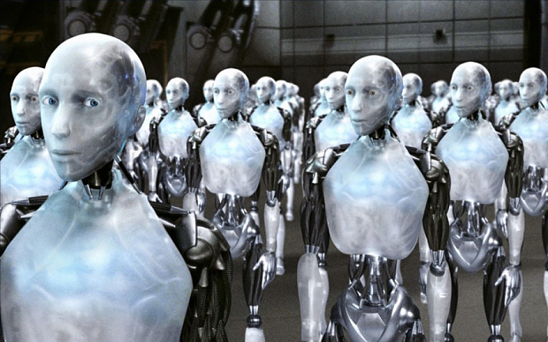
36
Robots
4 POINTS

Slide 29
37
Pizza
2 POINTS

Slide 30
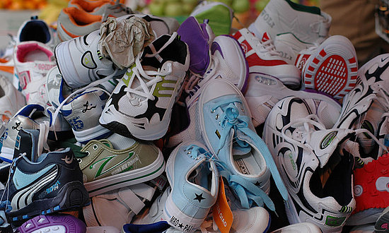
38
Shoes
3 POINTS

Slide 31
39
Elevator
Switch Points with Another Team

