Slide 1

What’s in the zoo game
Mr. S’ Zoo

Slide 2
For Teachers:
Give the students 2 minutes (or a little longer for lower levels) to brainstorm animal names.
Put down your pens and grab a different color.
Between each slide, have the students use the target language to ask you what the next animal is.
If they wrote the animal name, they can circle it (once per animal)
At the end, they can count their score to see who got the most matches.

Slide 3
What’s in the zoo game
Students write down the animals they want in their zoo (team).
*Brainstorming
Dialogue:
“What’s in the zoo?”
“There’s a ___________.”
If the students wrote the animal name, they get one point.

Slide 4

What‘s in the zoo?

Slide 5
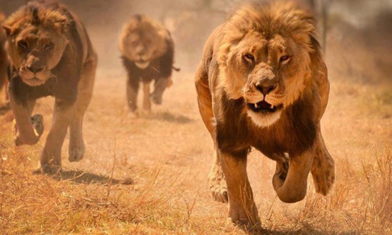
Lion

Slide 6
What‘s in the zoo?

Slide 7
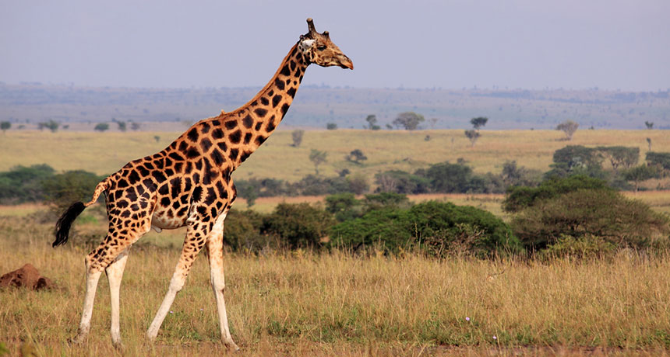
Giraffe

Slide 8
What‘s in the zoo?

Slide 9
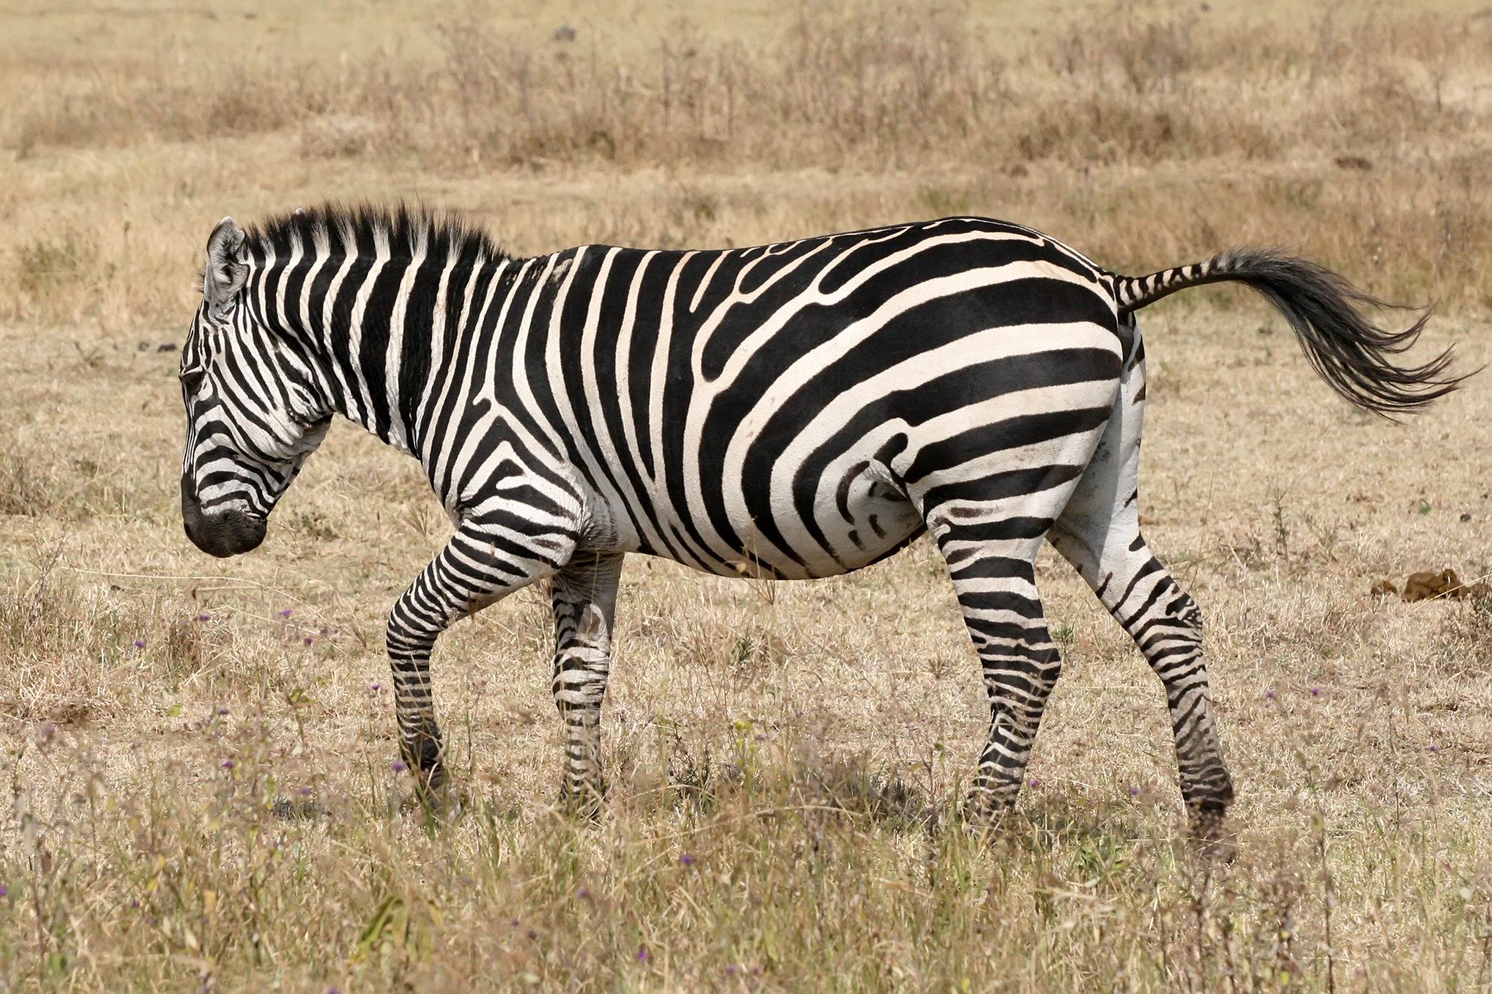
Zebra

Slide 10
What‘s in the zoo?

Slide 11
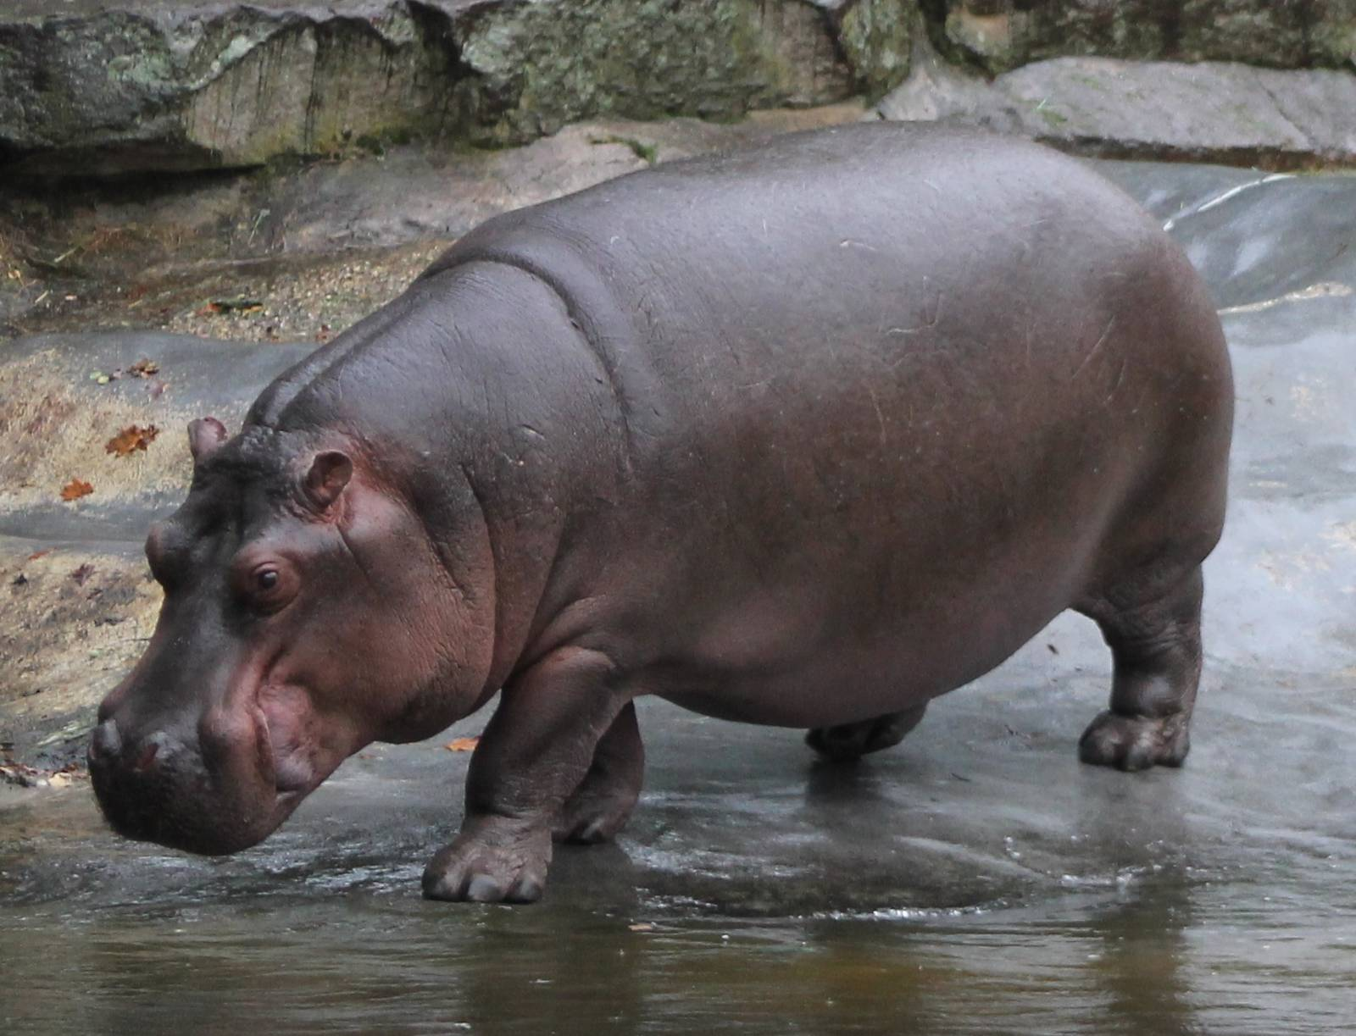
Hippo

Slide 12
What‘s in the zoo?

Slide 13
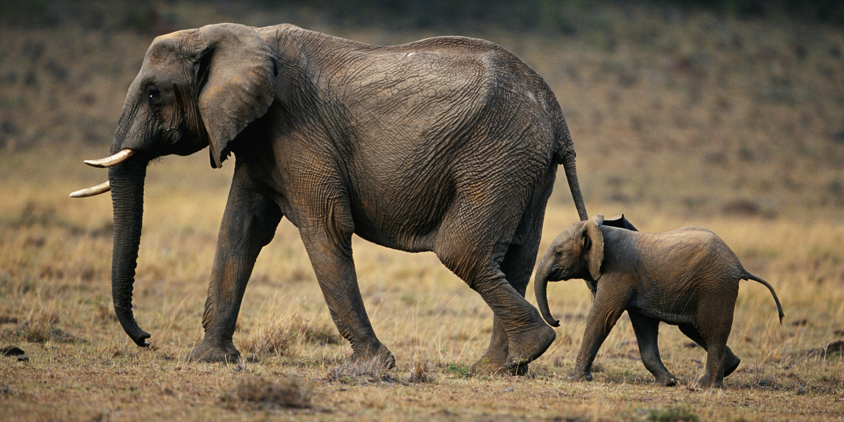
Elephant

Slide 14
What‘s in the zoo?

Slide 15
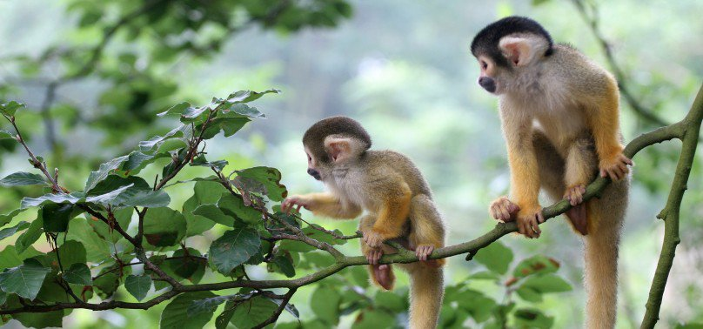
Monkey

Slide 16
What‘s in the zoo?

Slide 17
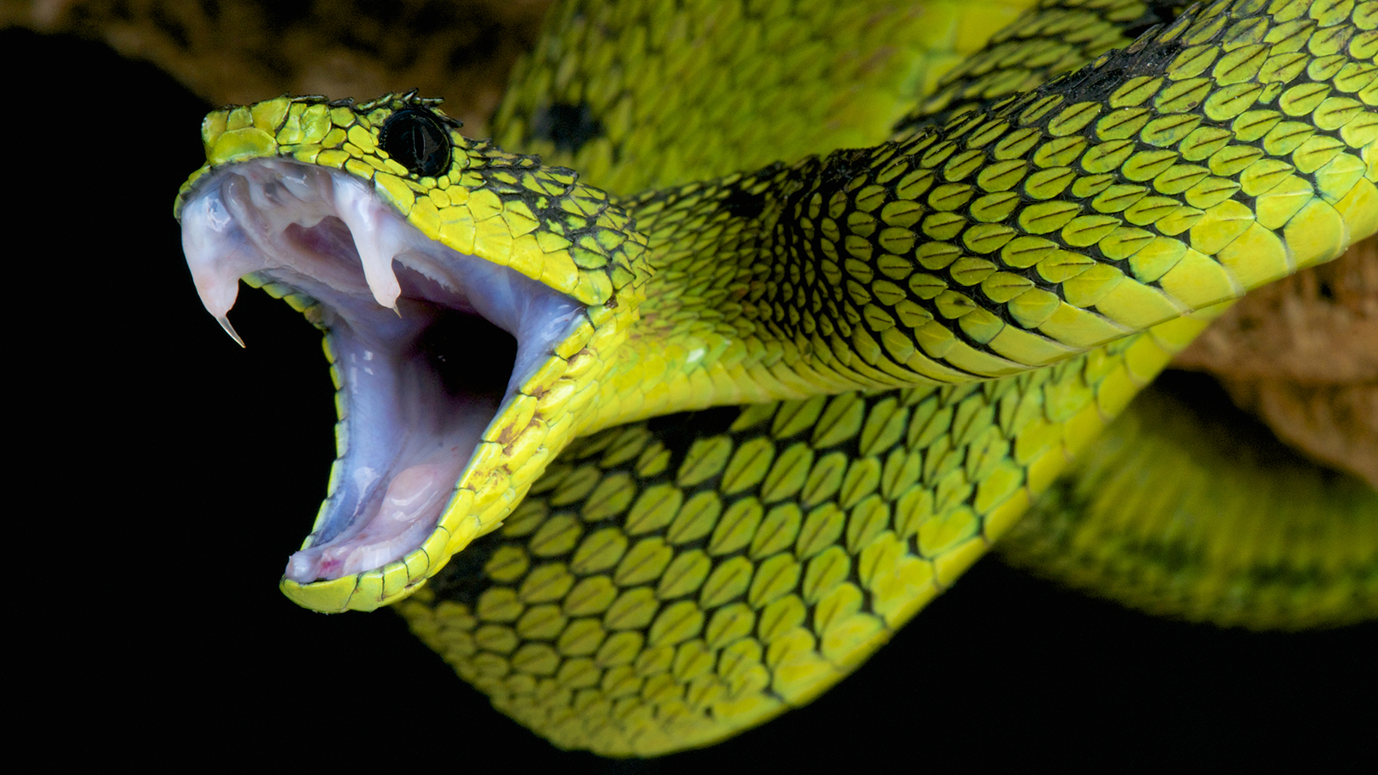
Snake

Slide 18
What‘s in the zoo?

Slide 19
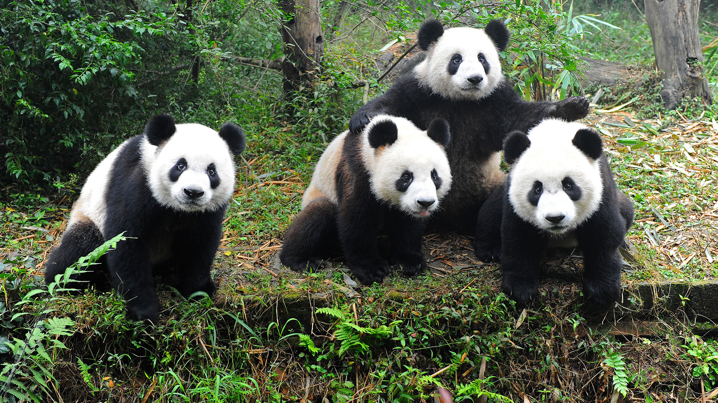
Panda

Slide 20
What‘s in the zoo?

Slide 21
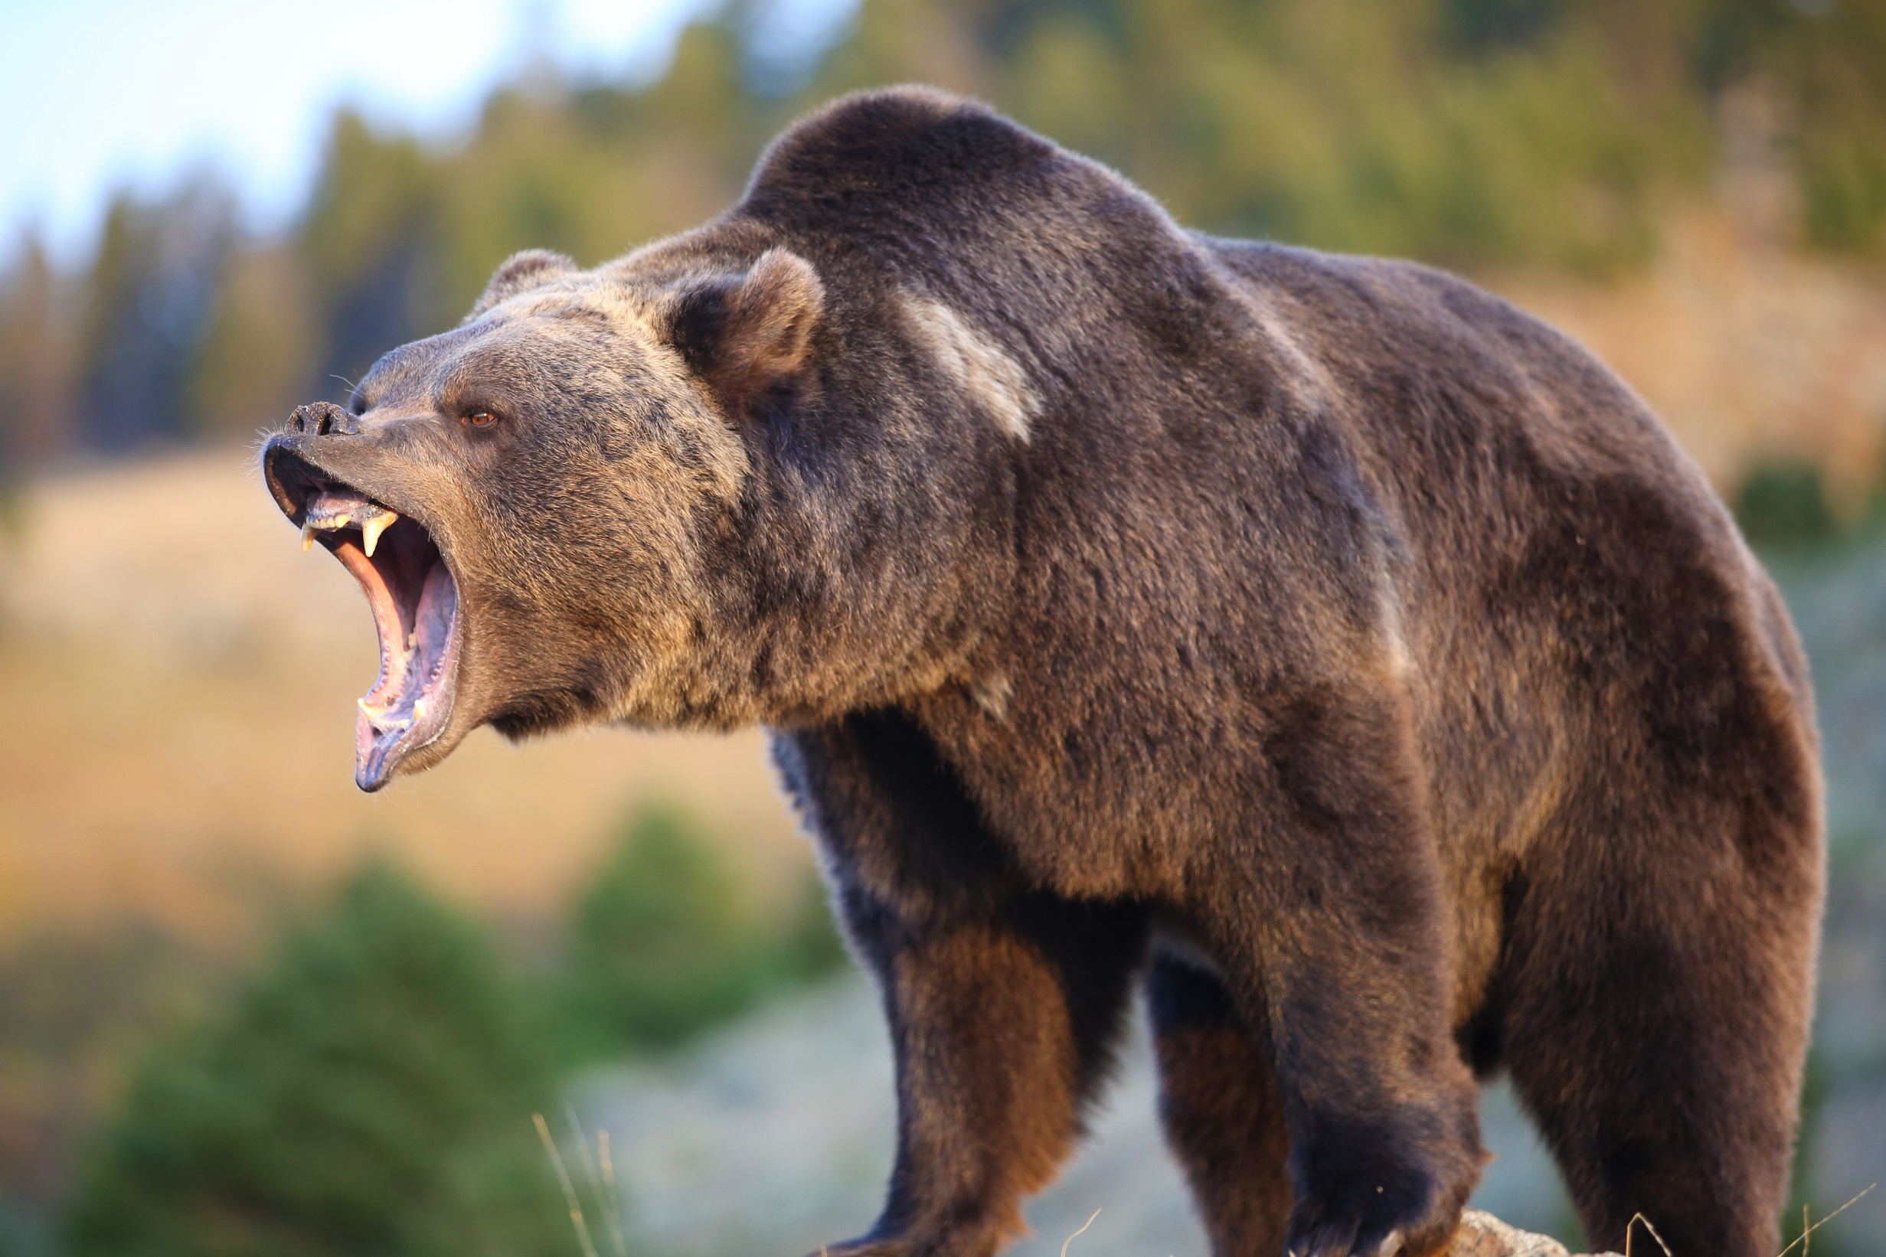
Bear

Slide 22
What‘s in the zoo?

Slide 23
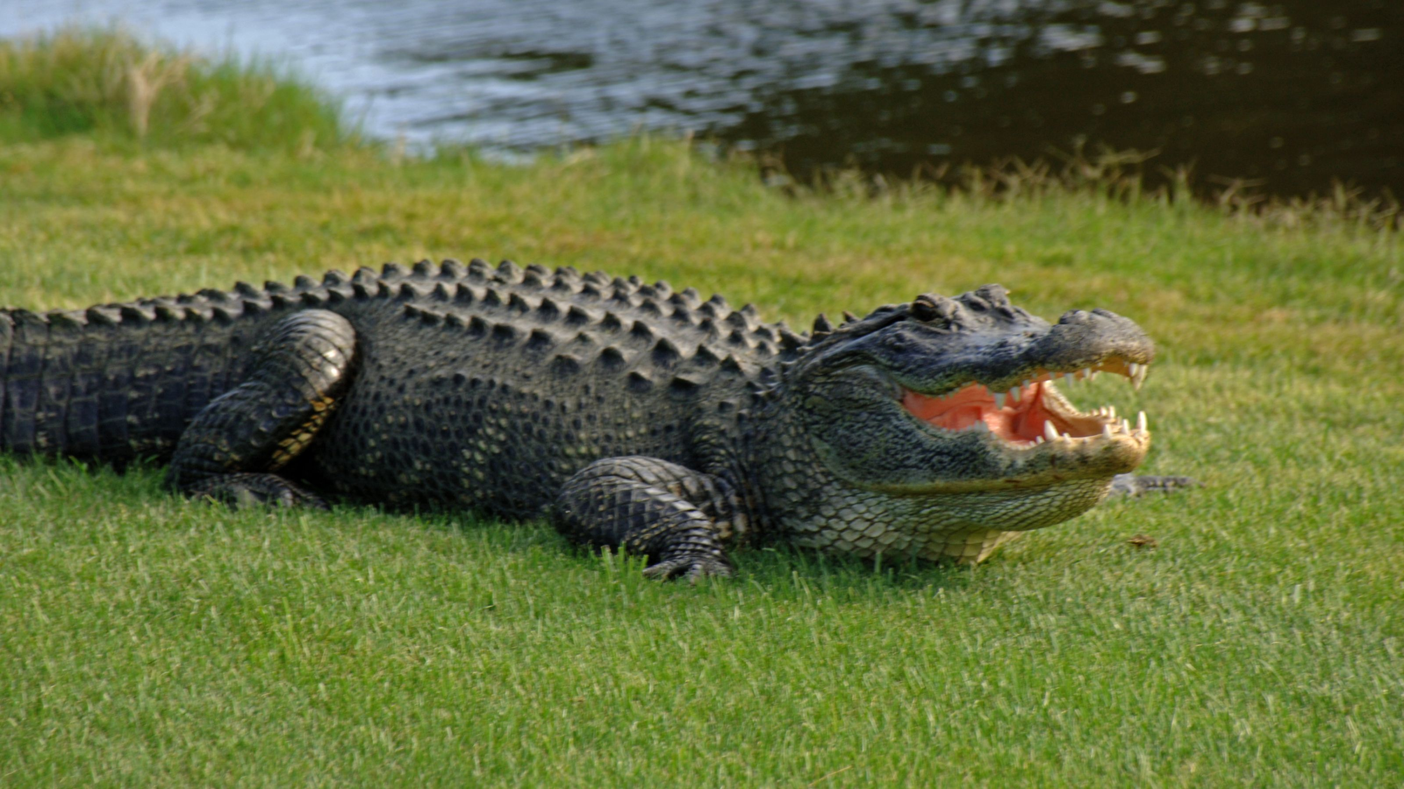
Crocodile

Slide 24
What‘s in the zoo?

Slide 25
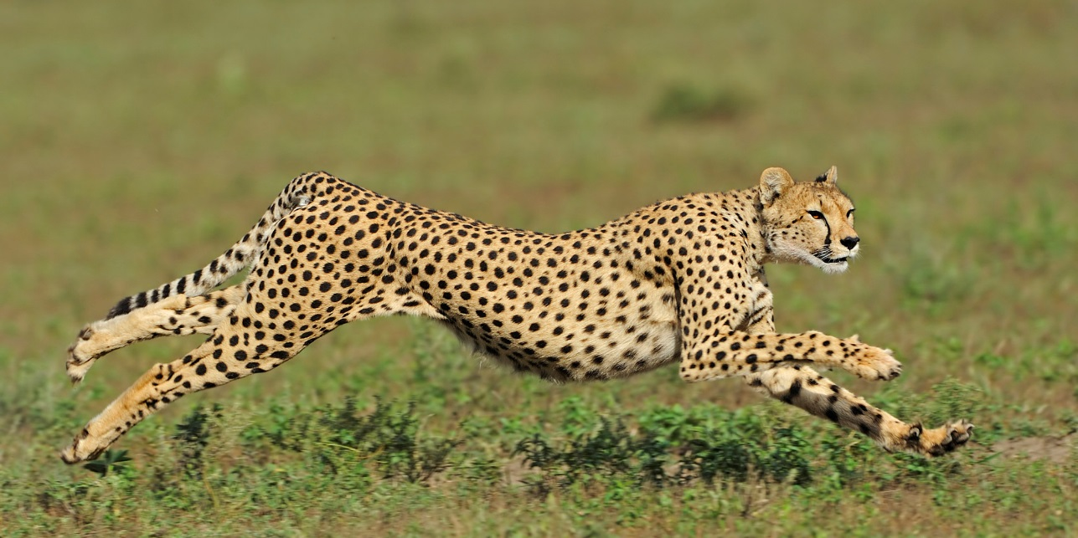
Cheetah

Slide 26
What‘s in the zoo?

Slide 27
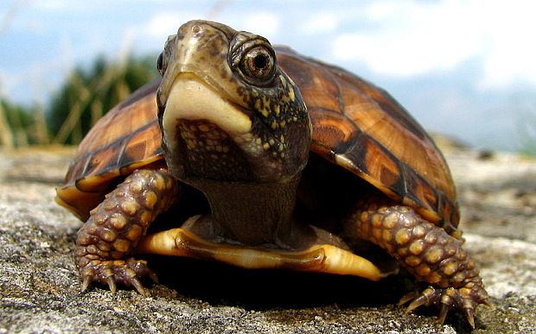
Turtle

Slide 28
What‘s in the zoo?

Slide 29
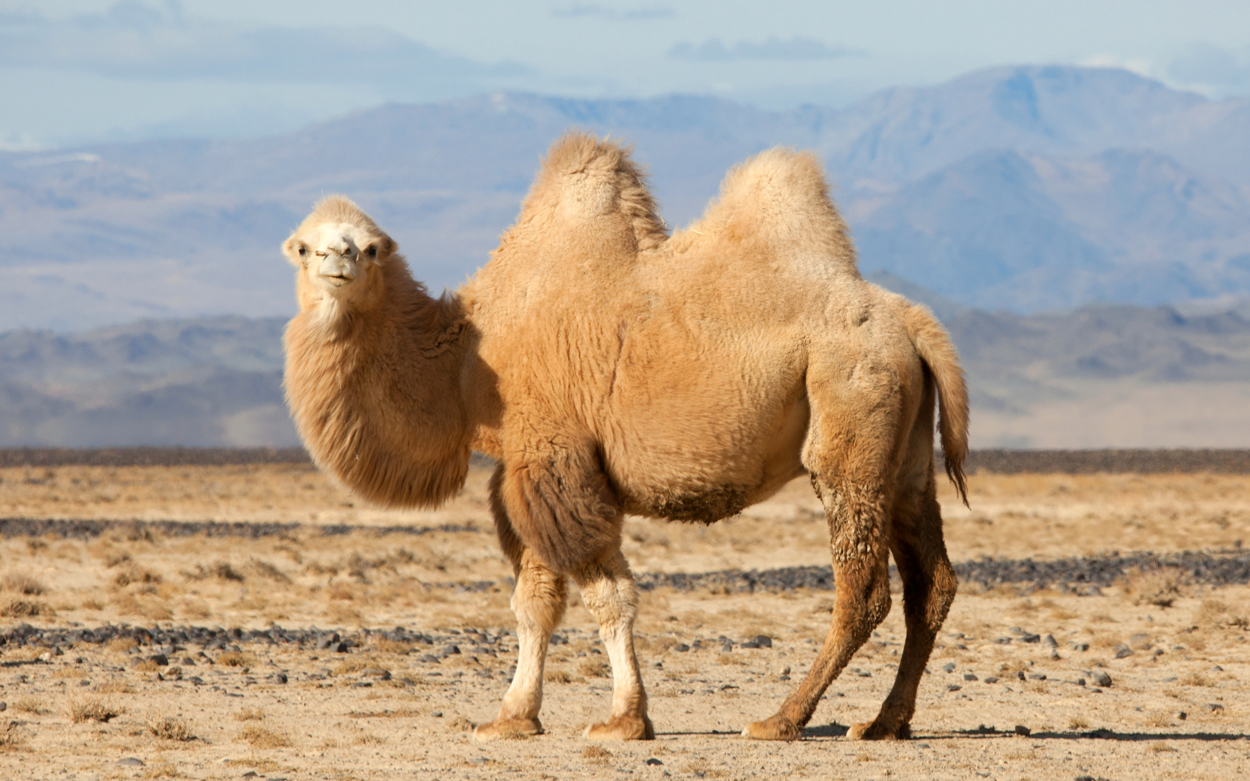
Camel

Slide 30
What‘s in the zoo?

Slide 31
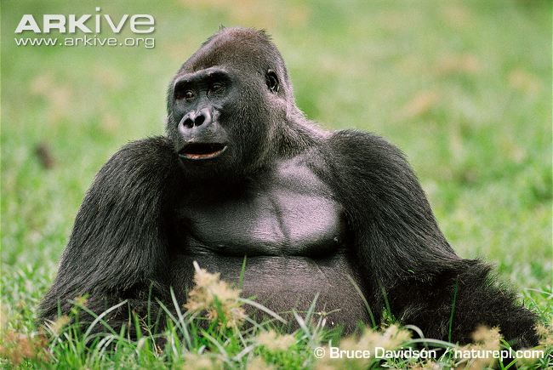
Gorilla

Slide 32
What‘s in the zoo?

Slide 33
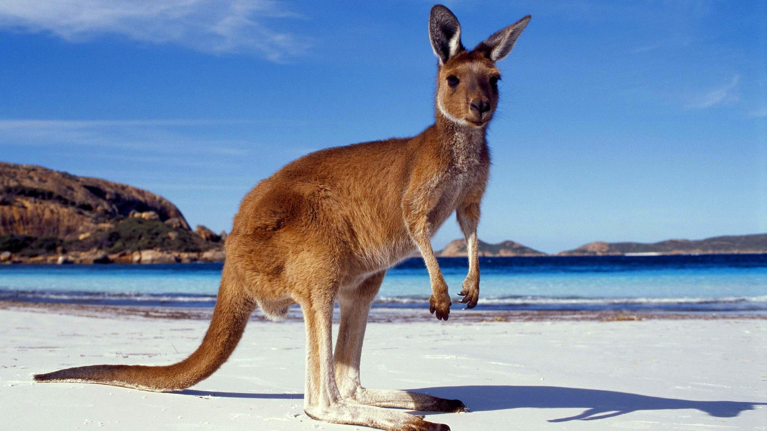
Kangaroo

Slide 34
What‘s in the zoo?

Slide 35
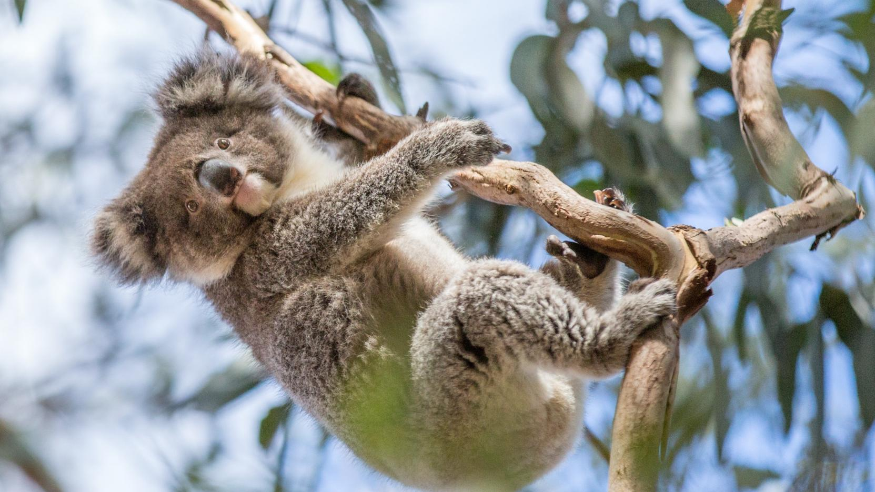
Koala

Slide 36
What‘s in the zoo?

Slide 37
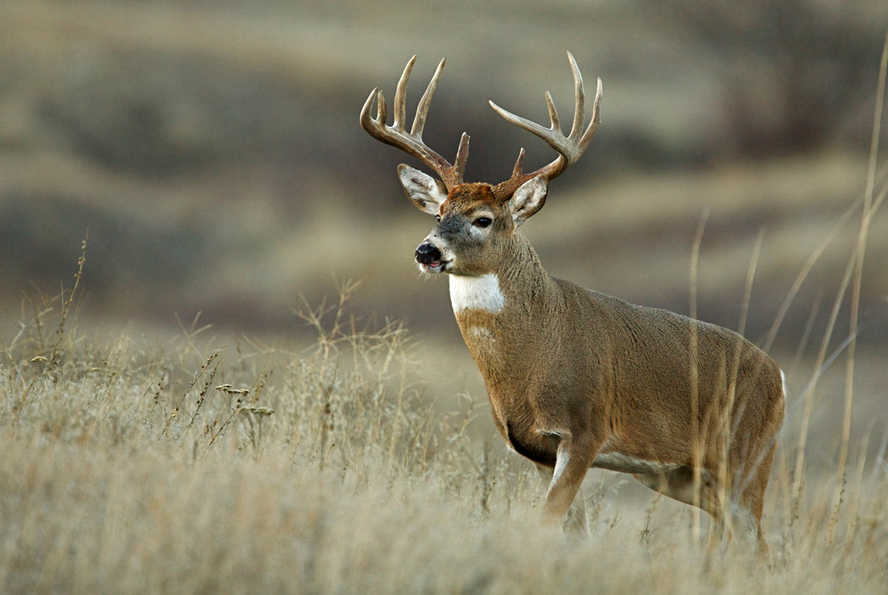
Deer

Slide 38
What‘s in the zoo?

Slide 39
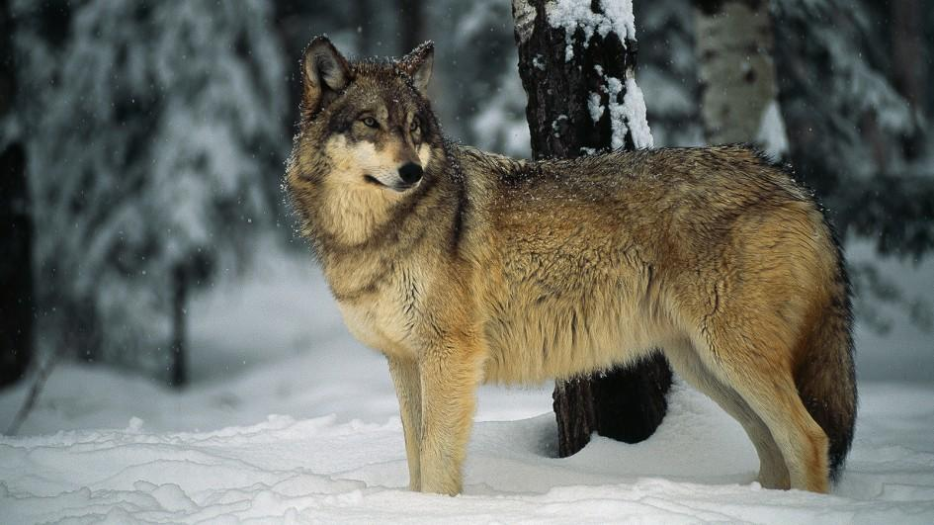
Wolf

Slide 40
What‘s in the zoo?

Slide 41
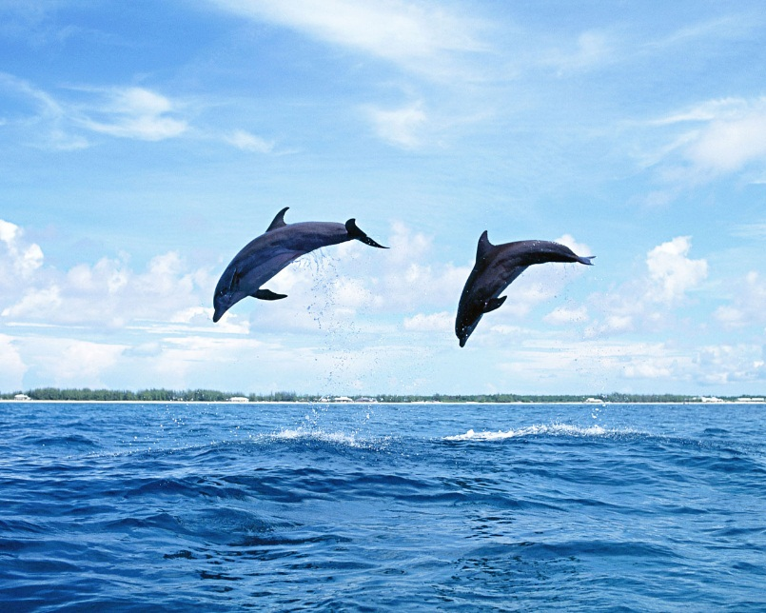
Dolphin

Slide 42
What‘s in the zoo?

Slide 43
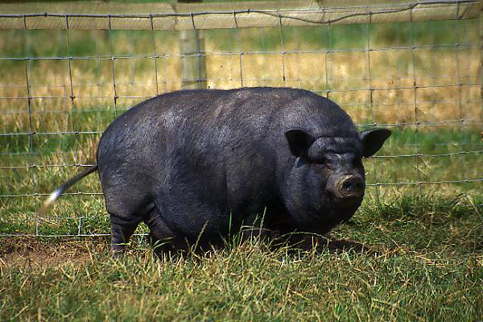
(Pot Bellied) Pig

Slide 44
What‘s in the zoo?

Slide 45
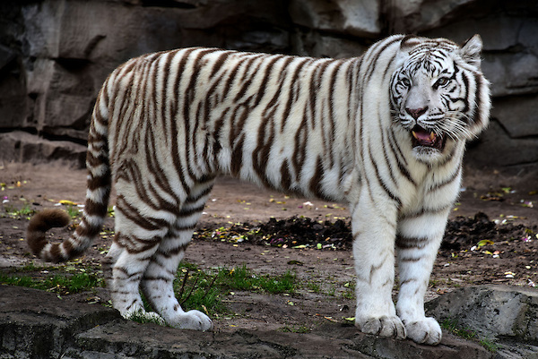
White Tiger

Slide 46
What‘s in the zoo?

Slide 47
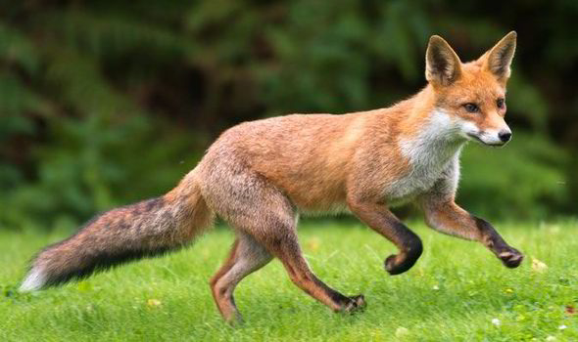
Fox

Slide 48
What‘s in the zoo?

Slide 49
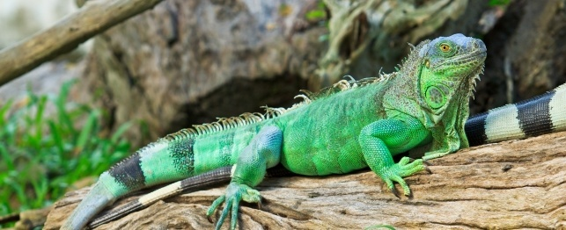
Iguana

Slide 50
What‘s in the zoo?

Slide 51
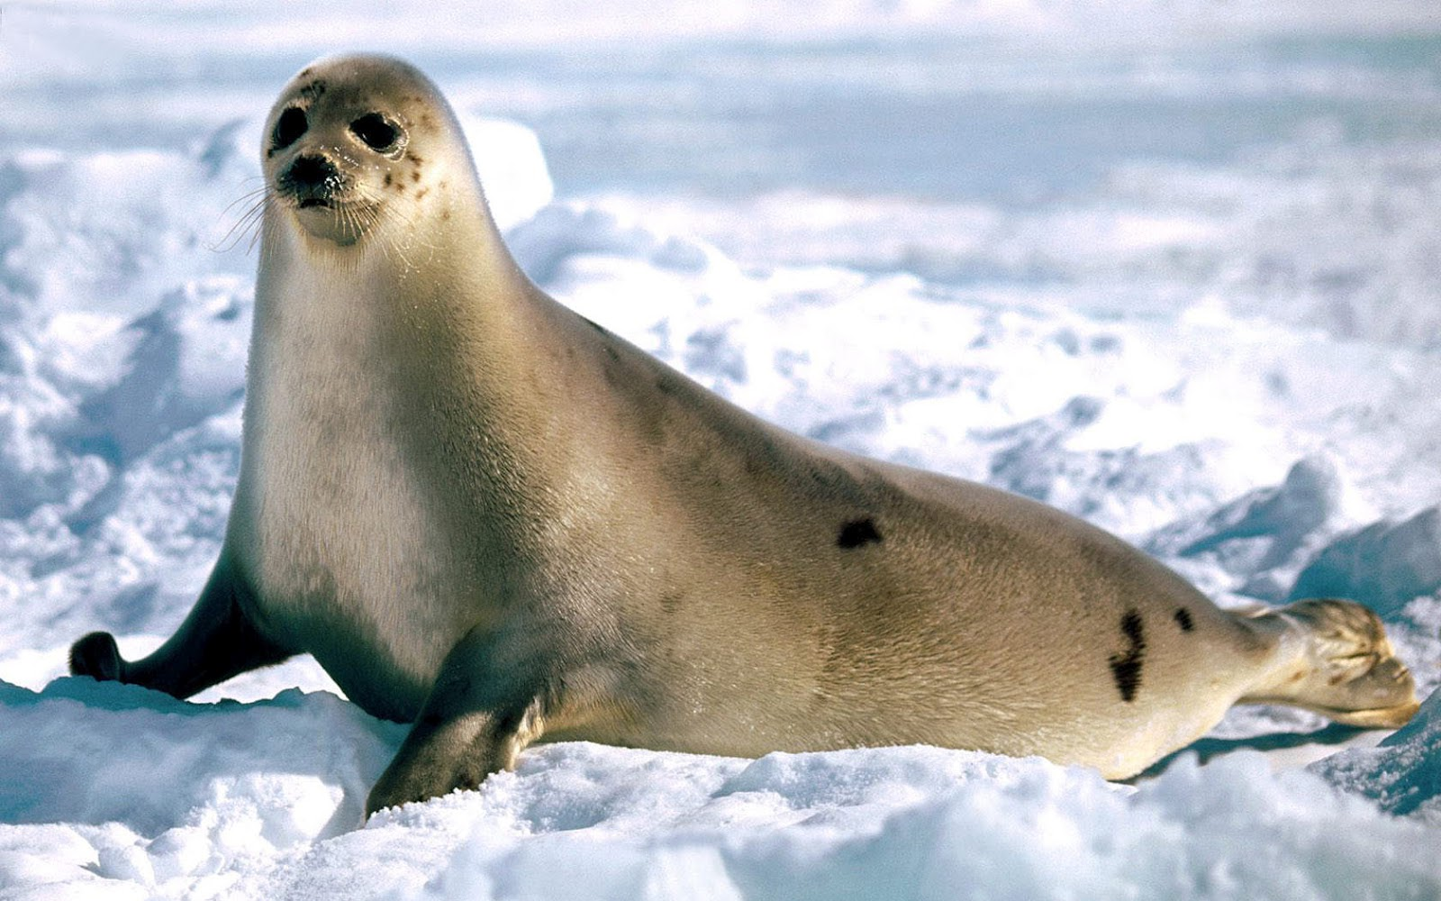
Seal

Slide 52
What‘s in the zoo?

Slide 53
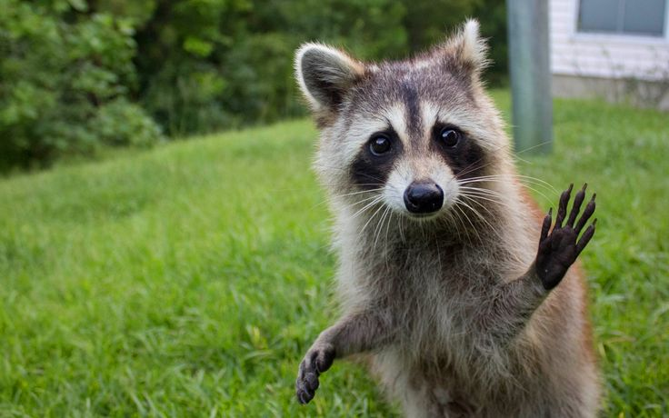
Raccoon

Slide 54
What‘s in the zoo?

Slide 55
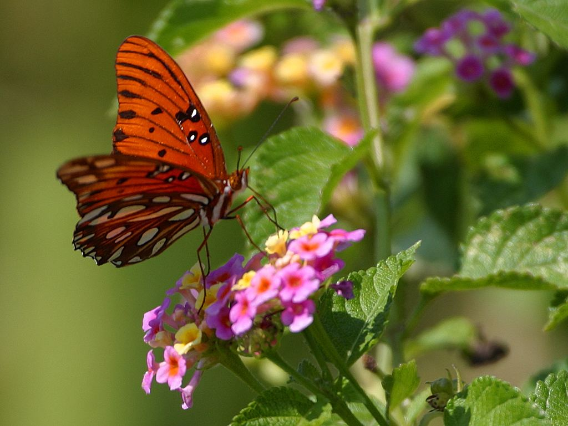
Butterfly

Slide 56
What‘s in the zoo?

Slide 57
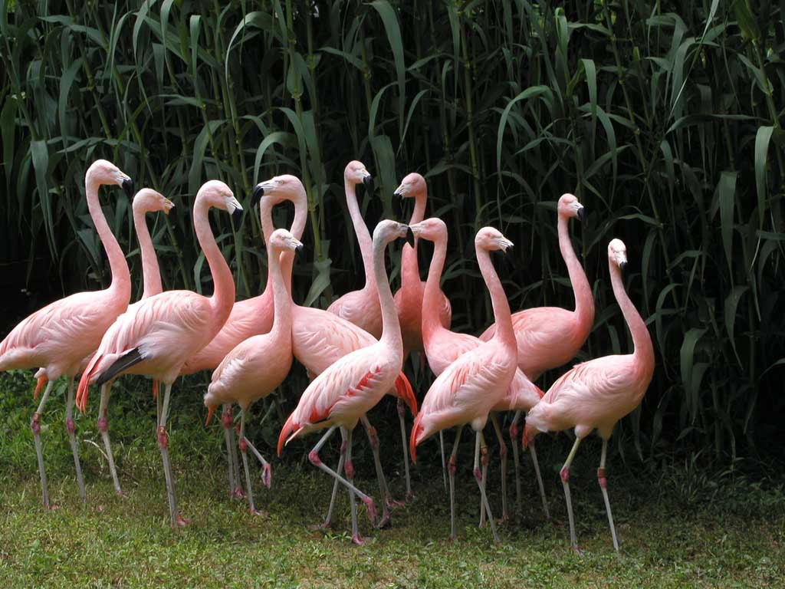
Flamingo

Slide 58
What‘s in the zoo?

Slide 59
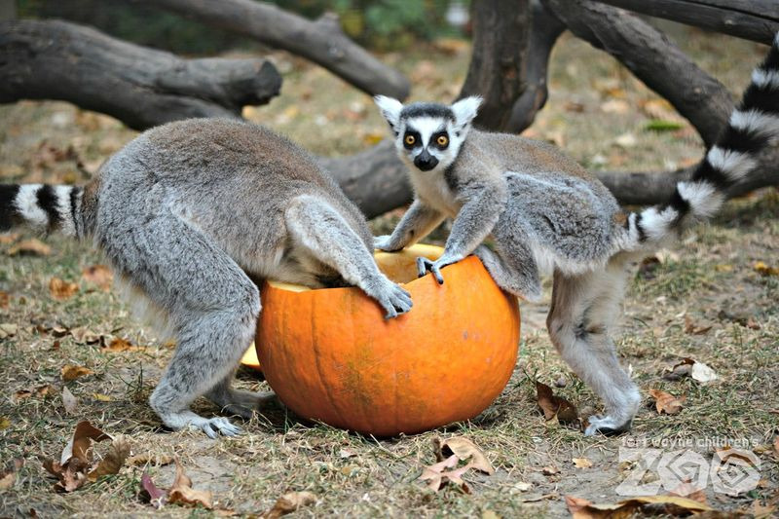
Lemur

Slide 60
What‘s in the zoo?

Slide 61
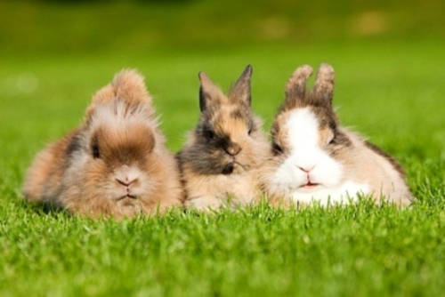
Rabbits

Slide 62
What‘s in the zoo?

Slide 63
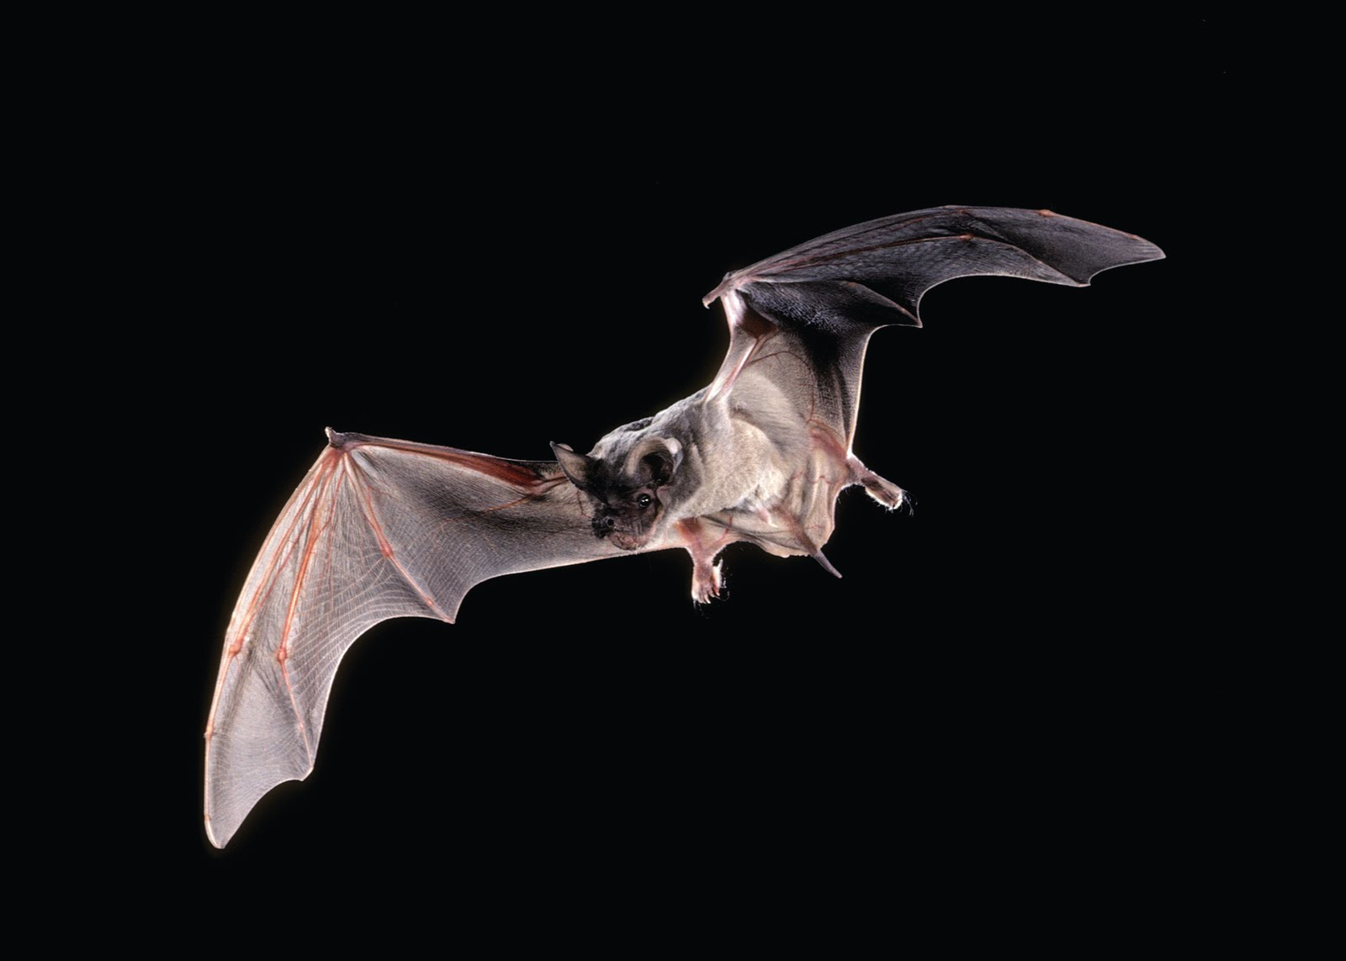
Bat

Slide 64
What‘s in the zoo?

Slide 65
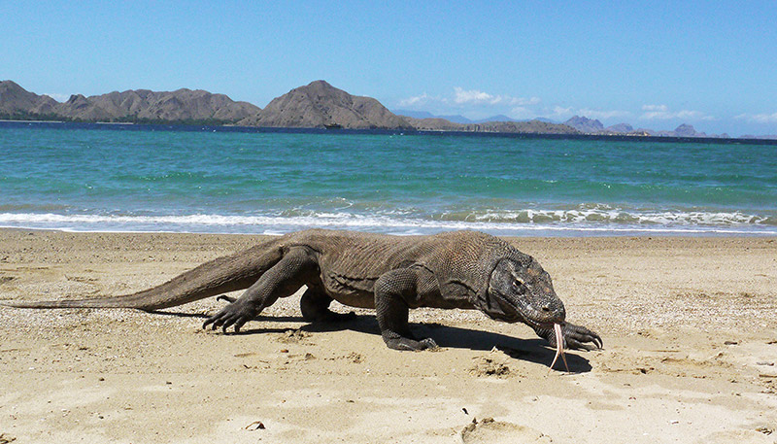
Komodo Dragon

Slide 66
What‘s in the zoo?

Slide 67
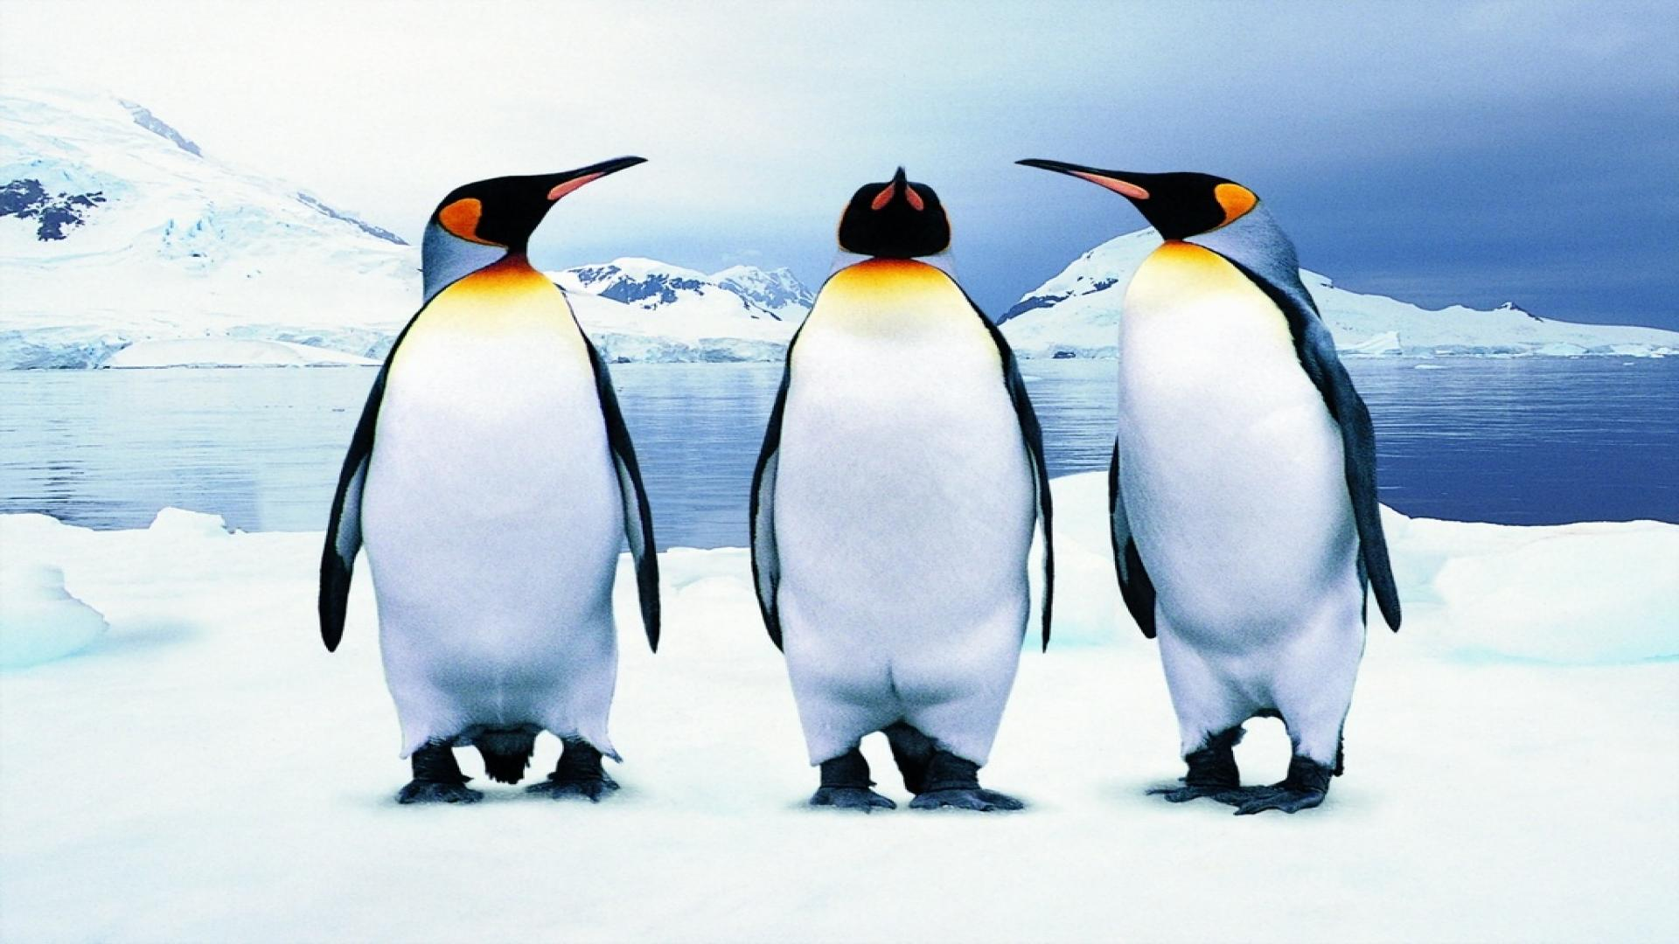
Penguin

Slide 68
What‘s in the zoo?

Slide 69
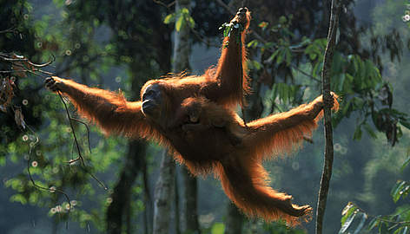
Orangutan

Slide 70
What‘s in the zoo?

Slide 71
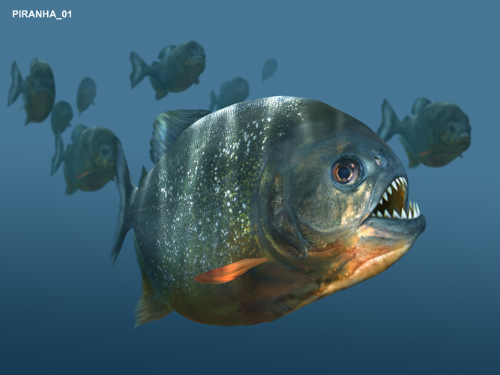
Piranha

Slide 72
What‘s in the zoo?

Slide 73
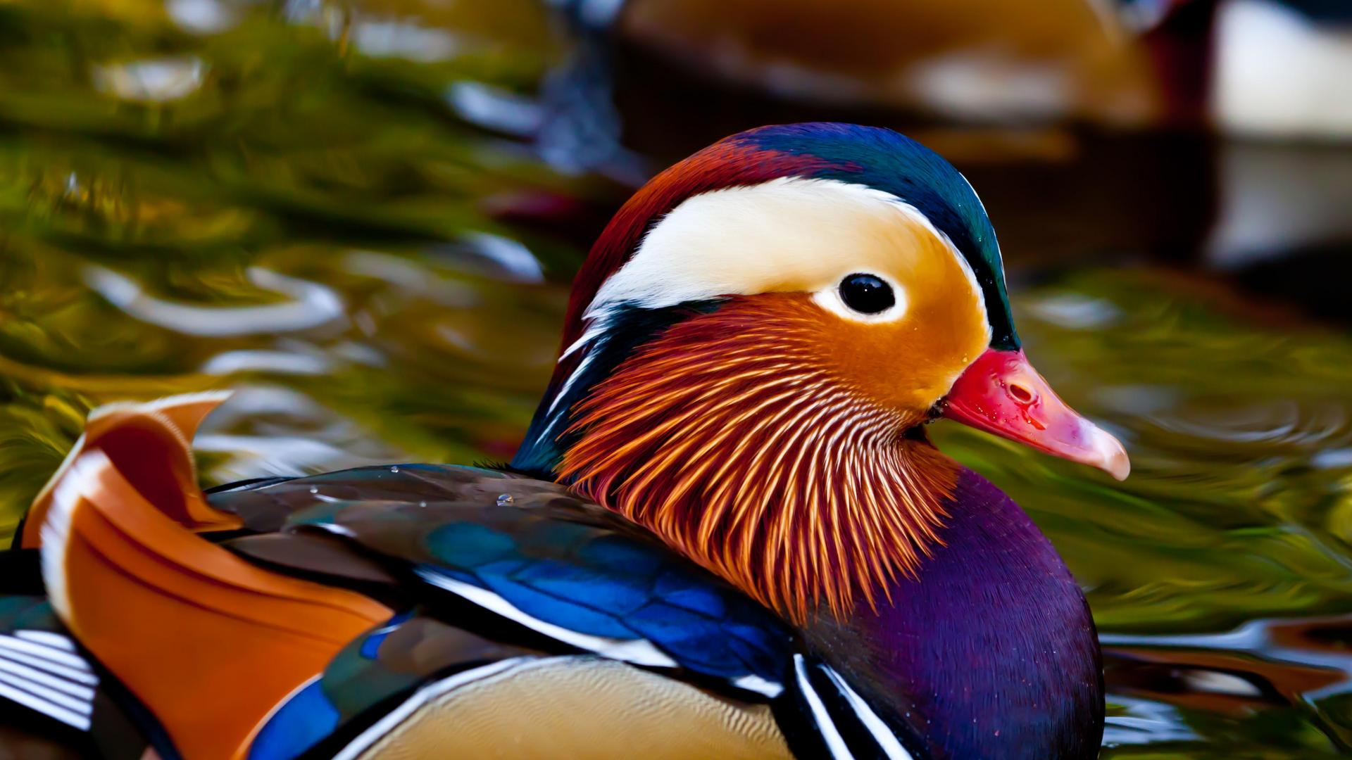
(Mandarin) Duck

Slide 74
What‘s in the zoo?

Slide 75
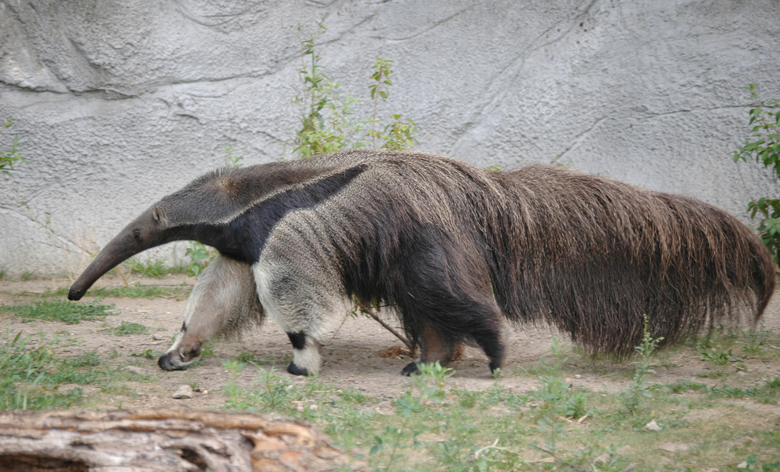
Anteater

Slide 76
What‘s in the zoo?

Slide 77
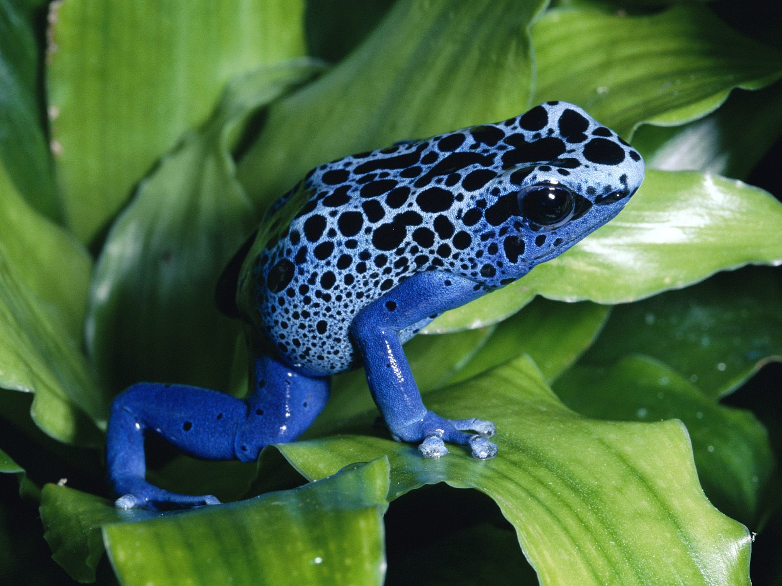
(Poison Dart) Frog

Slide 78
What‘s in the zoo?

Slide 79
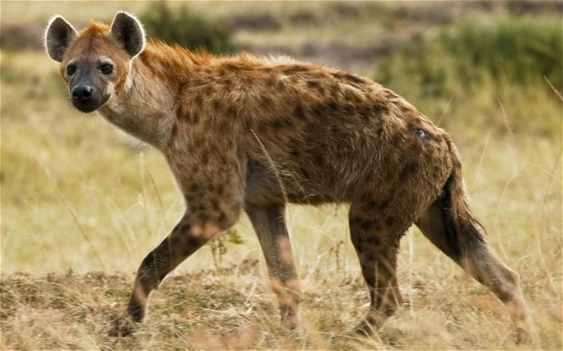
Hyena

Slide 80
What‘s in the zoo?

Slide 81
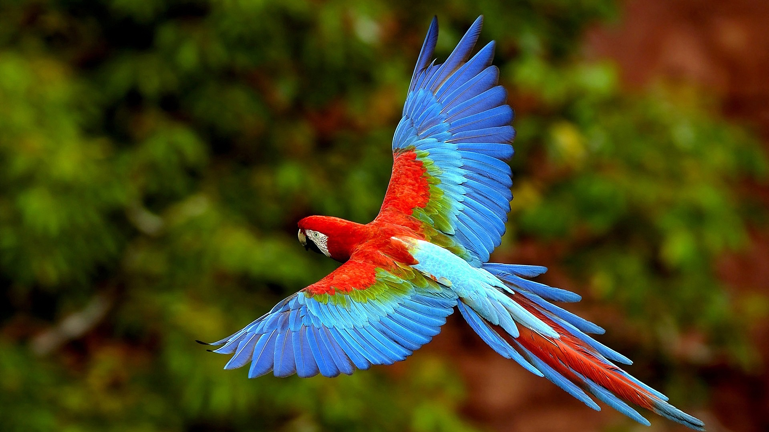
Parrot

Slide 82
What‘s in the zoo?

Slide 83
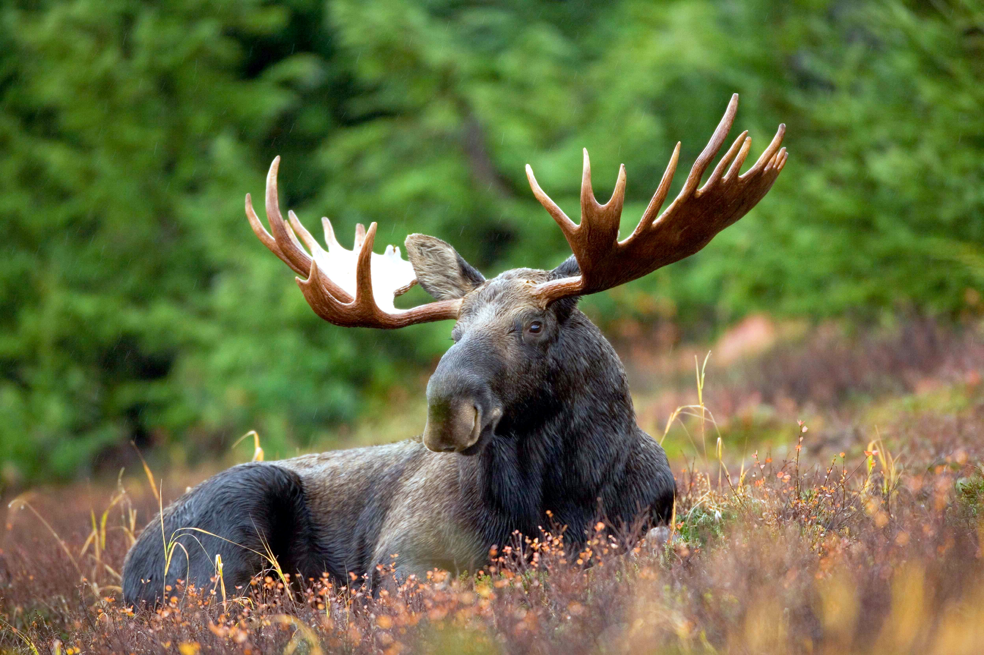
Moose

Slide 84
What‘s in the zoo?

Slide 85
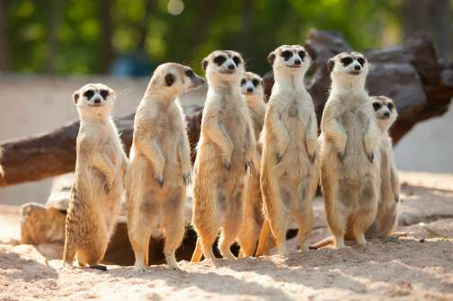
Meerkat

Slide 86
What‘s in the zoo?

Slide 87
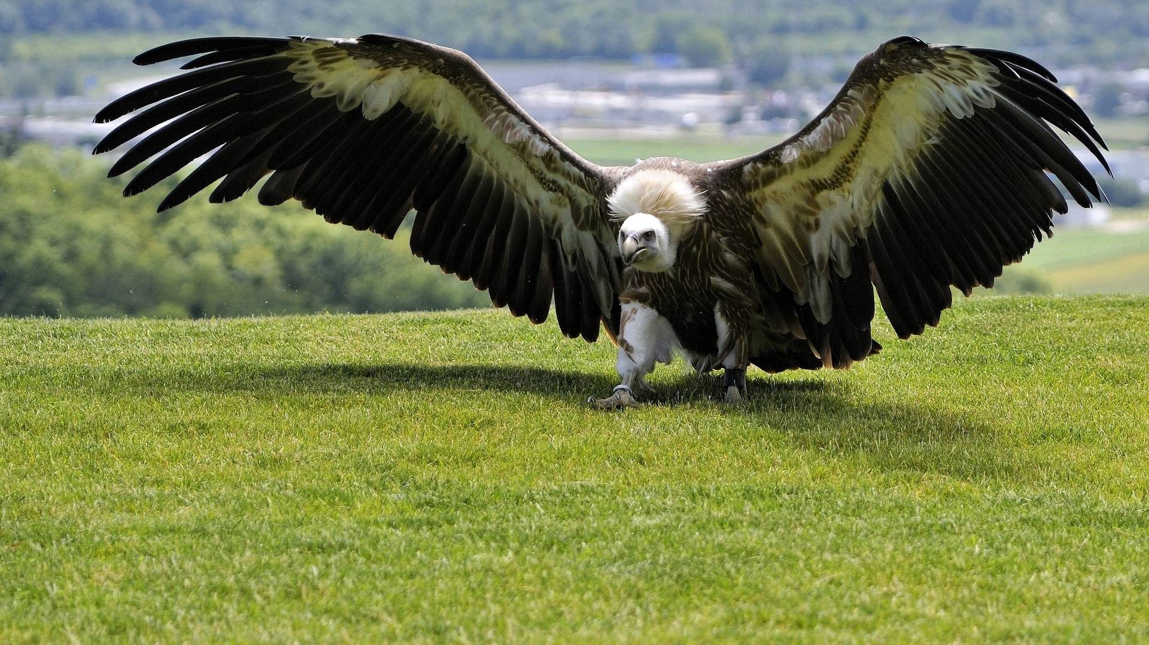
Vulture

Slide 88
What‘s in the zoo?

Slide 89
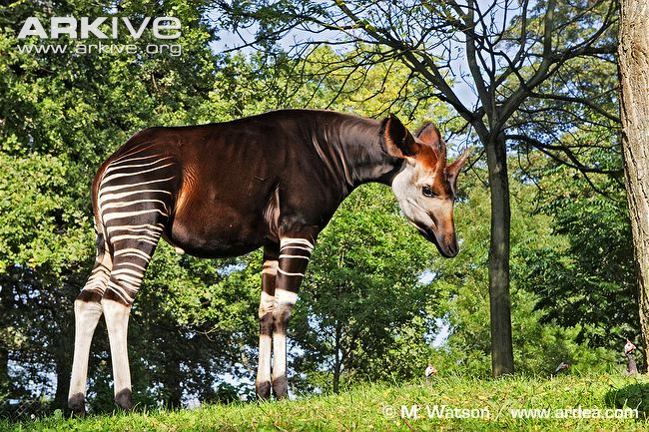
Okapi

Slide 90
What‘s in the zoo?

Slide 91
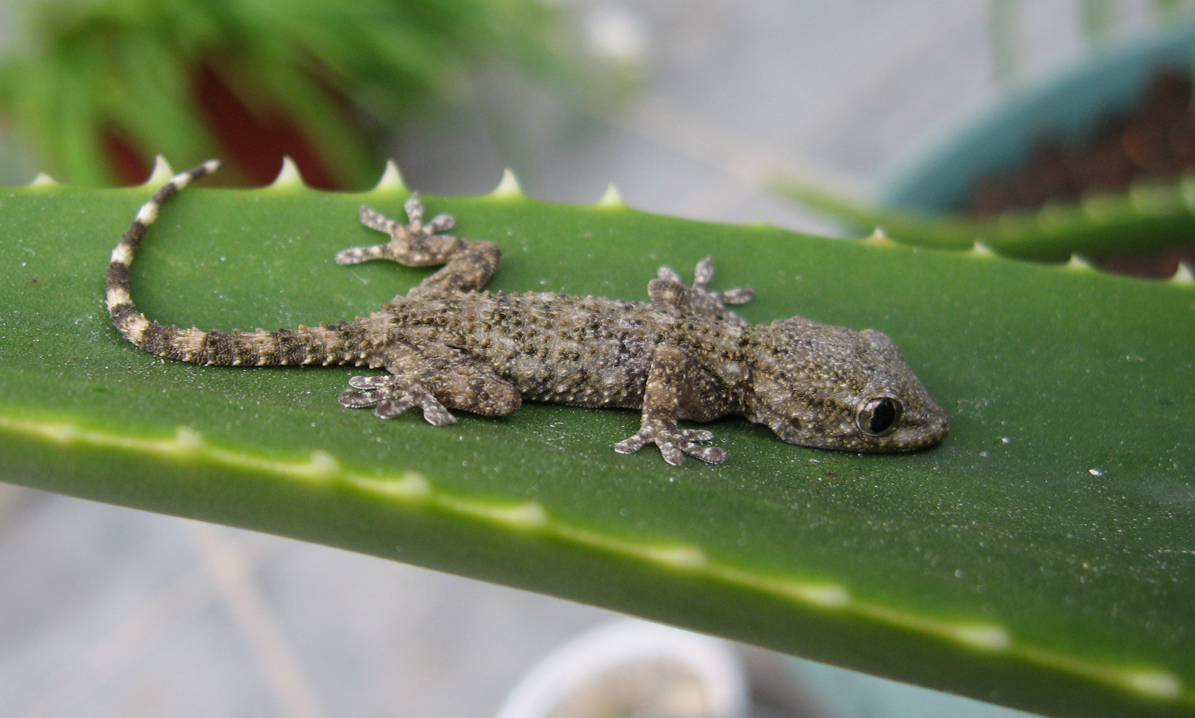
Gecko

Slide 92
What‘s in the zoo?

Slide 93
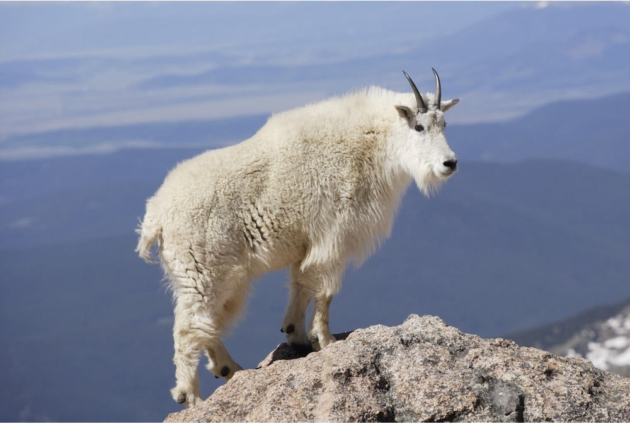
Mountain Goat

Slide 94
What‘s in the zoo?

Slide 95
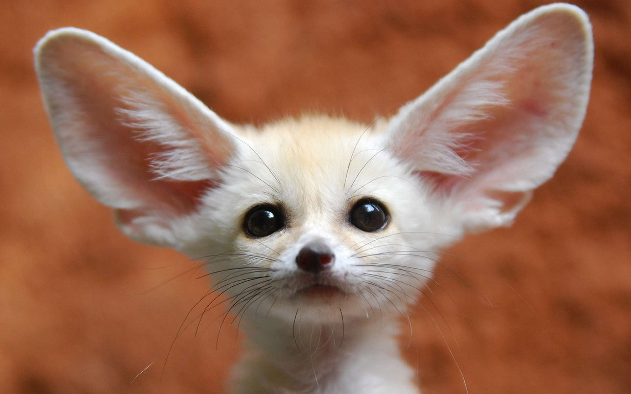
Fennec Fox

Slide 96
What‘s in the zoo?

Slide 97
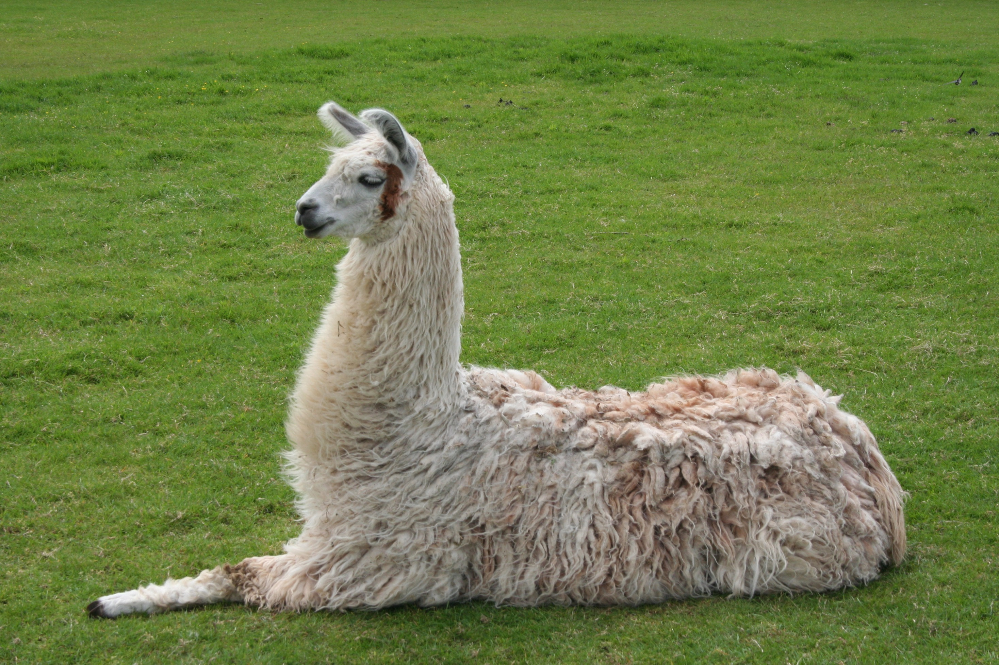
Lama

Slide 98
What‘s in the zoo?

Slide 99
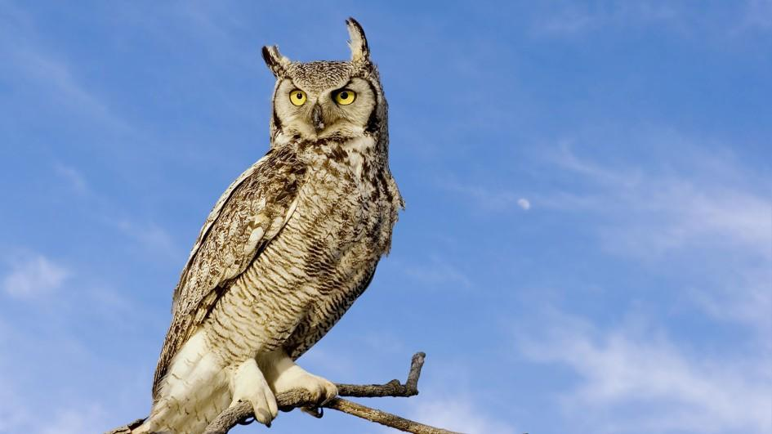
Owl

Slide 100
What‘s in the zoo?

Slide 101
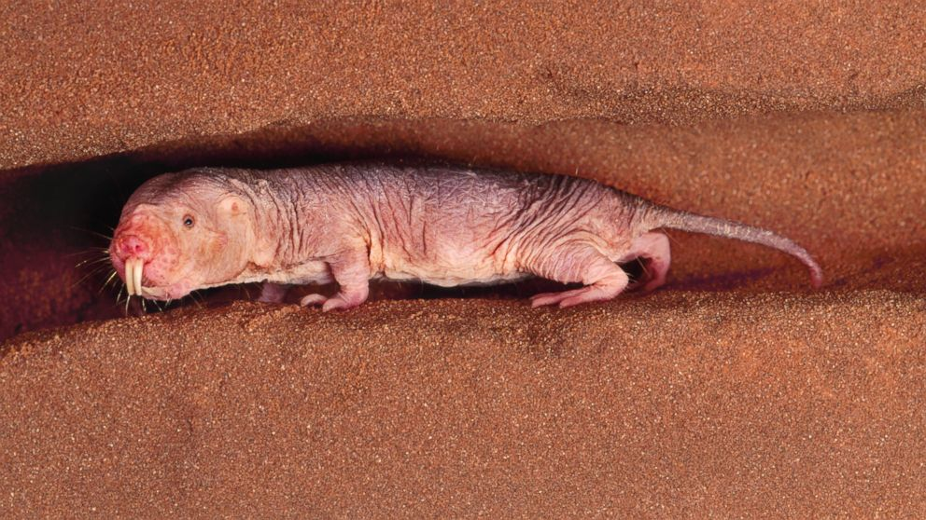
Naked Mole Rat

Slide 102
What‘s in the zoo?

Slide 103
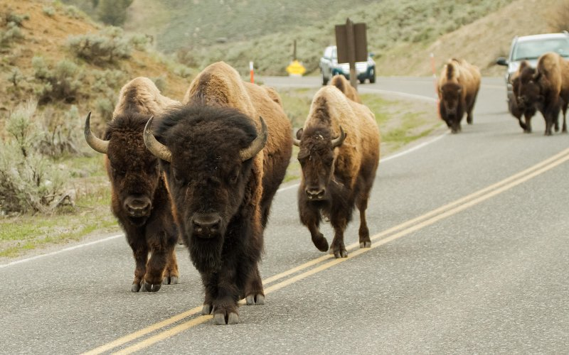
Bison

Slide 104
What‘s in the zoo?

Slide 105

Armadillo

Slide 106
What‘s in the zoo?

Slide 107

Peacock

Slide 108
What‘s in the zoo?

Slide 109

Emu

Slide 110
What‘s in the zoo?

Slide 111

Thorny Devil

Slide 112
What‘s in the zoo?

Slide 113

Beaver

Slide 114
What‘s in the zoo?

Slide 115

Warthog

Slide 116
The End

