Slide 1
____________
____________

Slide 2
For Teachers:
Use the following examples to show students how to make Venn Diagrams.
You wont need to show all of the examples.
You should personalize the second slide, or delete it from your presentation
Have the students make their own Venn Diagrams and present their work.

Slide 3
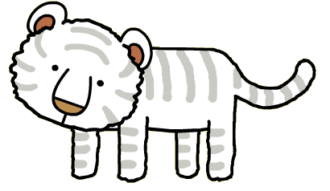
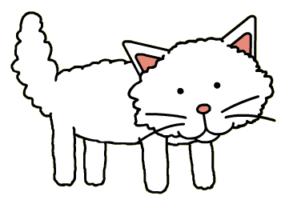
White Tiger
Coco
Black and white
White
Cute
Small
The tiger is 10 days old
She is two years old

Slide 4
_______ Teacher
Mr.S

Slide 5
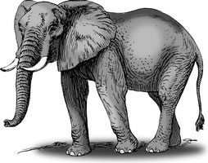
Wooly Mammoth
African Elephant

Slide 6
Hospital
School

Slide 7
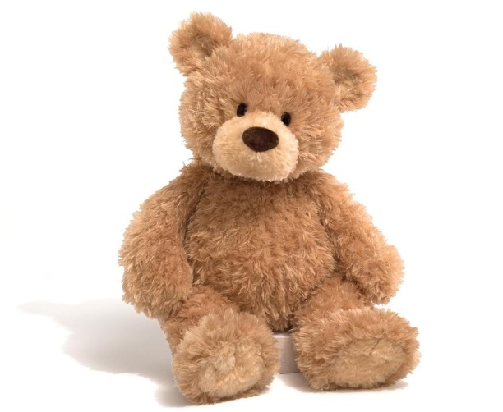
Teddy Bear
Real Bear

Slide 8
Butterfly
Fairy

Slide 9
Art
Science

Slide 10
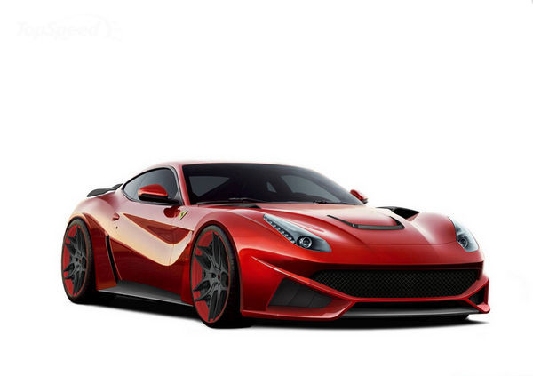
Ferrari
Jet

Slide 11
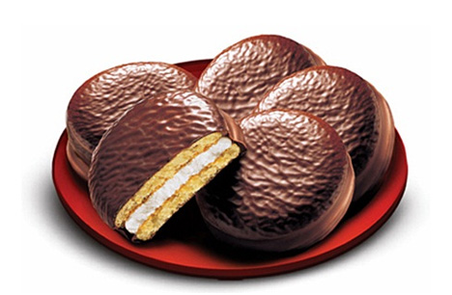
Ice Cream
Chocopie

Slide 12
Zombies
Vampires

