Slide 1
Blindfold Race
Be Careful

Slide 2
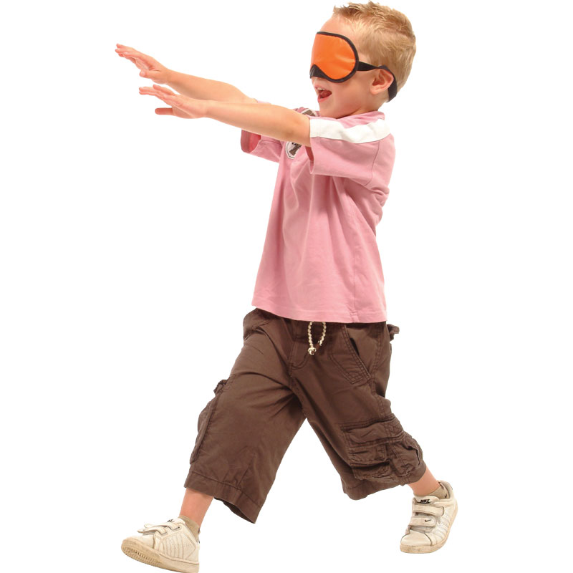
Set Up
Have the students push in their chairs and line up around the room.
Split the class into manageable groups (group size ~4)
Set Up a tournament style score sheet on the board

Slide 3
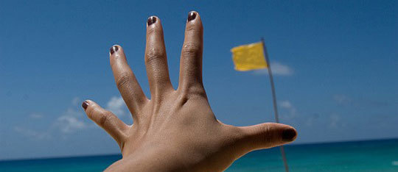
Goal
Be the first team to grab the object.

Slide 4
Rules:
Play with two groups at a time
One student from each group will put on the blindfold
The other students in the group will give (often yell) instructions to the blindfolded student.
Students may not touch the blindfolded student.
You must use the English phrases or be eliminated.
The blindfolded student should be careful and move slowly so they don’t get hurt.

Slide 5
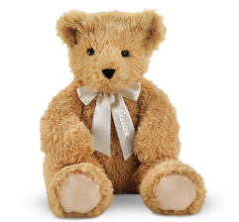
Go Straight
Turn Left
Go Straight
Turn Right
Students shout directions to their teammate.
And the blindfolded players must try to get the teddy bear.
Place the teddy bear on one of the desks.
One student from each team comes to the front.
Put on the blindfold

