Slide 1
Go Straight for __ blocks.

Slide 2
Start
Finish

Slide 3
Start
Finish

Slide 4
Start
Finish

Slide 5
Start
Finish

Slide 6
Start
Finish

Slide 7
Start
Finish

Slide 8
Start
Finish

Slide 9
Start
Finish

Slide 10
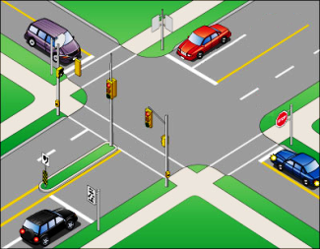
Intersection

Slide 11
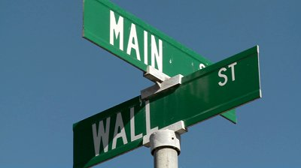
At the intersection of ________ and __________

Slide 12
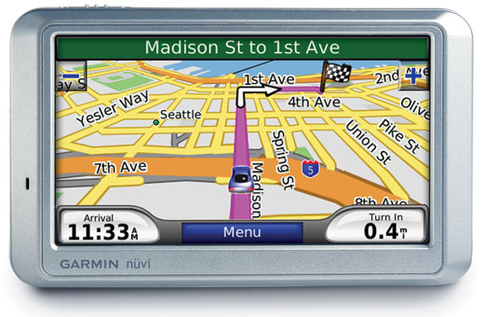
At the intersection of ________ and __________

Slide 13
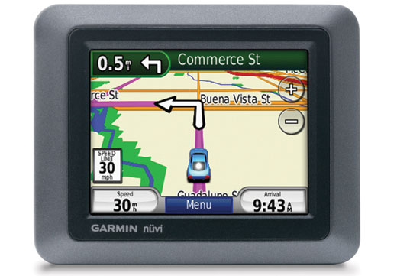
Turn ________ on _________.

Slide 14
Start
Peter St.
John St.
Annie St.
Sally St.
Mary St.
Celina St.
Finish
Alex St.

Slide 15
Start
Peter St.
John St.
Annie St.
Sally St.
Mary St.
Celina St.
Finish
Alex St.

Slide 16
Start
Peter St.
John St.
Annie St.
Sally St.
Mary St.
Celina St.
Finish
Alex St.

Slide 17
Start
Peter St.
John St.
Annie St.
Sally St.
Mary St.
Celina St.
Finish
Alex St.

Slide 18
Start
Peter St.
John St.
Annie St.
Sally St.
Mary St.
Celina St.
Finish
Alex St.

Slide 19
Start
Peter St.
John St.
Annie St.
Sally St.
Mary St.
Celina St.
Finish
Alex St.

Slide 20
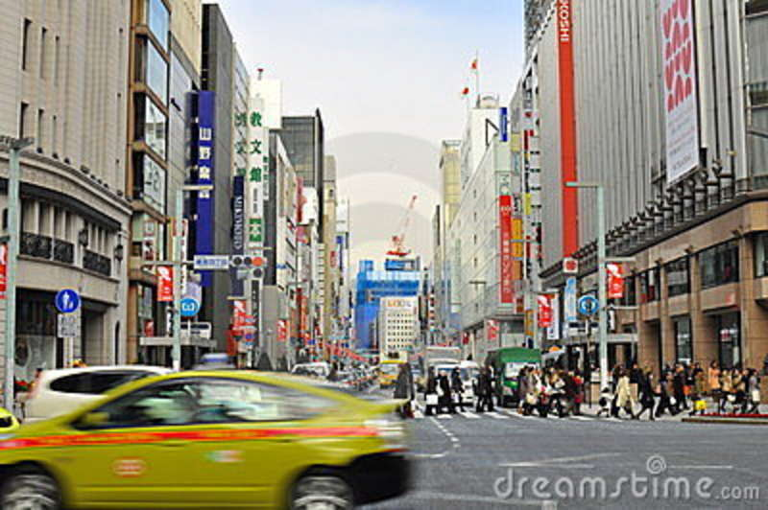
It’s on your ______.
Left
Right

Slide 21
Using these directions:
How do I get to *********?
From ______________ to _____________.

Slide 22
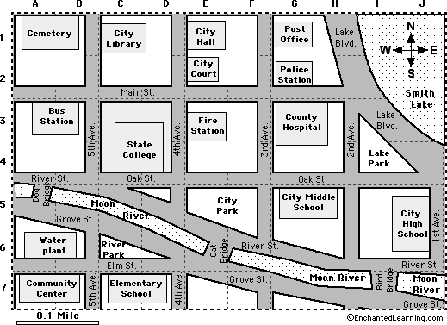

Slide 23
For Teachers:
Print out a map for pairs of students to share.
Print out and cut the list of places and place them in an opaque bag.
Draw two locations (start and finish)
Give directions for students to follow.
At the end, have the students guess where you are.
Go over the directions so the lower level students can follow and see where they went wrong.

