Slide 1
Role
play

Slide 2
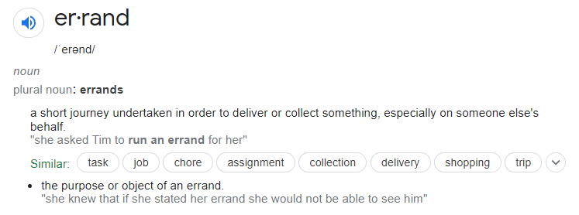
Role
play

Slide 3













Slide 4
Role Play
What is it?

Slide 5
Role Play
examples

Slide 6
Role Play
Why do we use it?

Slide 7
salesperson

Slide 8
Salesperson
Bad vs Good

Slide 9
Salesperson
A bad salesperson wants to sell you something.

Slide 10
Salesperson
A good salesperson wants to solve a problem.

Slide 11
customer

Slide 12
Customer
A customer has a problem they want to fix.

Slide 13
Customer
What do customers (you) care about?

Slide 14
Customer
Different types of customers

Slide 15
Customer
A penny pincher
doesn’t want to spend money.

Slide 16
Customer
A bargain hunter
always wants a discount.

Slide 17
Customer
An impulse buyer
will buy something unplanned.

Slide 18
Customer
Going with your gut
means with your feeling.

Slide 19
Customer
A loyal customer
will continue to buy from one vender.

Slide 20
Customer
A need-based customer
gets what they need and leaves.

Slide 21
Customer
A wandering customer
doesn’t know what they want.

Slide 22
Salesmanship

Slide 23
Salesmanship
Identify the
deeper problem.

Slide 24
Salesmanship
Offer a solution.

Slide 25
Salesmanship
Demonstrate your value.

Slide 26
Salesmanship
Negotiate price.

Slide 27
Salesmanship
Relationship > Price

Slide 28
activity

Slide 29
Activity
A customer has a errand they need help with.

Slide 30
Activity
Negotiate price.

Slide 31
Activity
RULE: no tit for tat

Slide 32
Activity
Write down how long
it will take.

Slide 33
Activity
Keep track of
income and expenses.

Slide 34
activity

Slide 35
Activity
total profit

Slide 36
Activity
net profit

Slide 37
Activity
hourly wage

Slide 38
Role
play

Slide 39

Game of Possibilities
Find as many ways to use the item as possible.

Slide 40

Grab Bag Skits
Create a play based on random items.

Slide 41

IRL
Restaurant
Hospital
Pharmacy
Hotel
Post Office
Bank

Slide 42
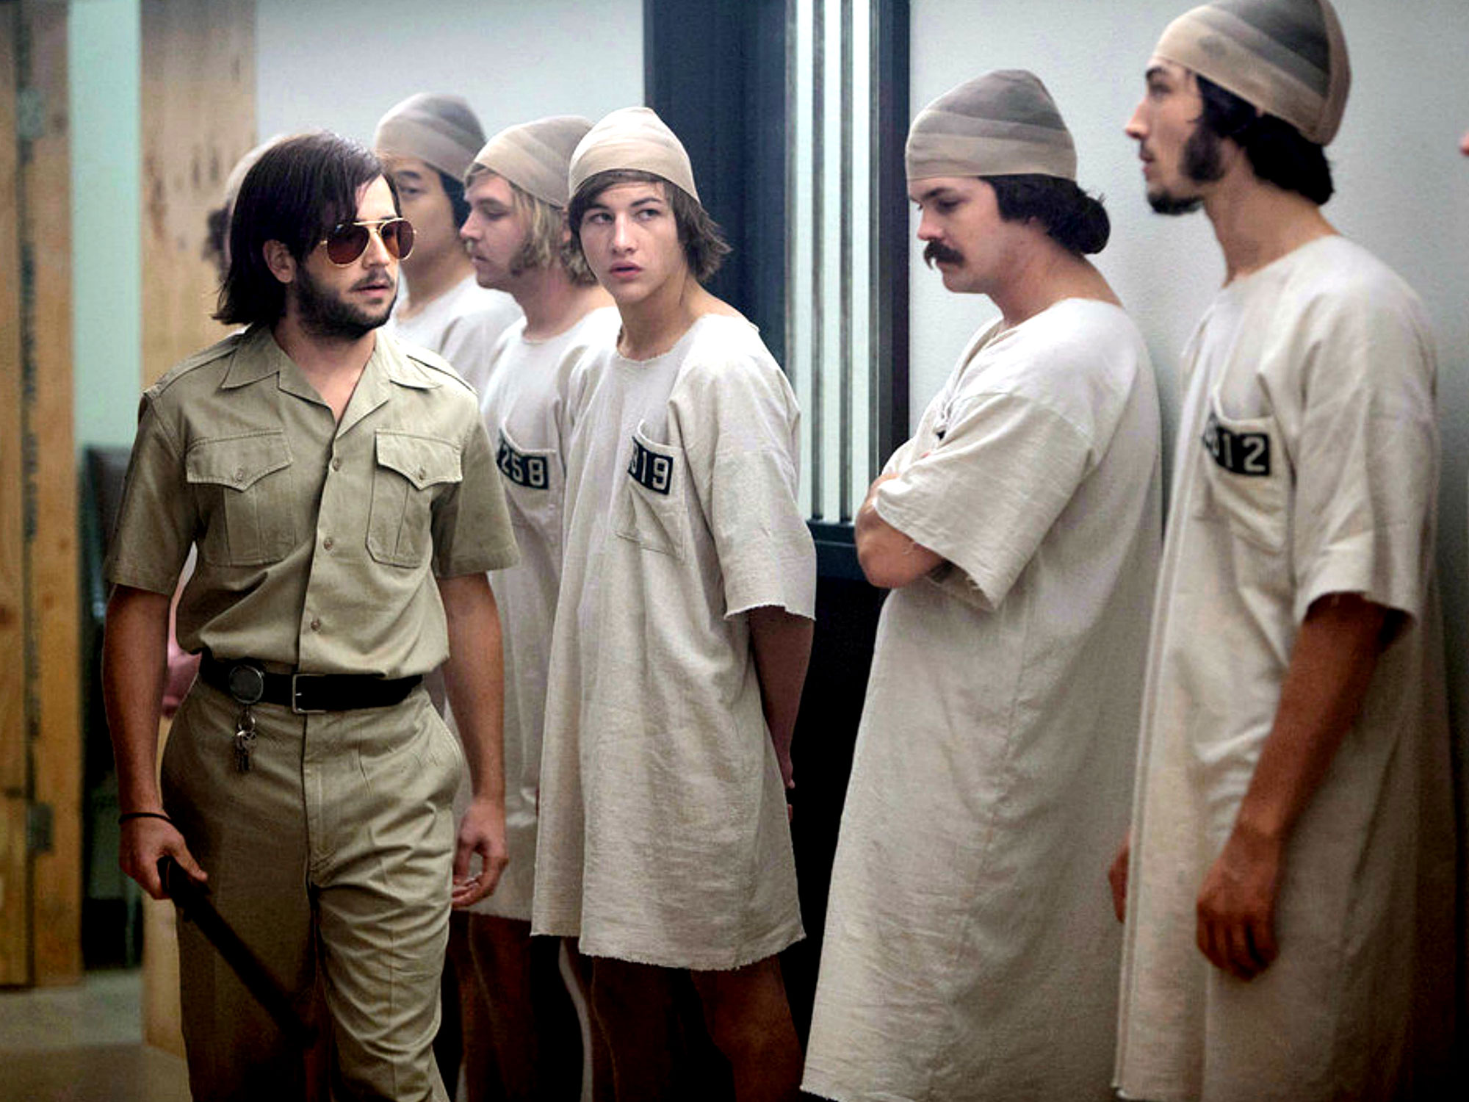
Stanford Prison
Experiments
Abuse of Power
Controversial

Slide 43
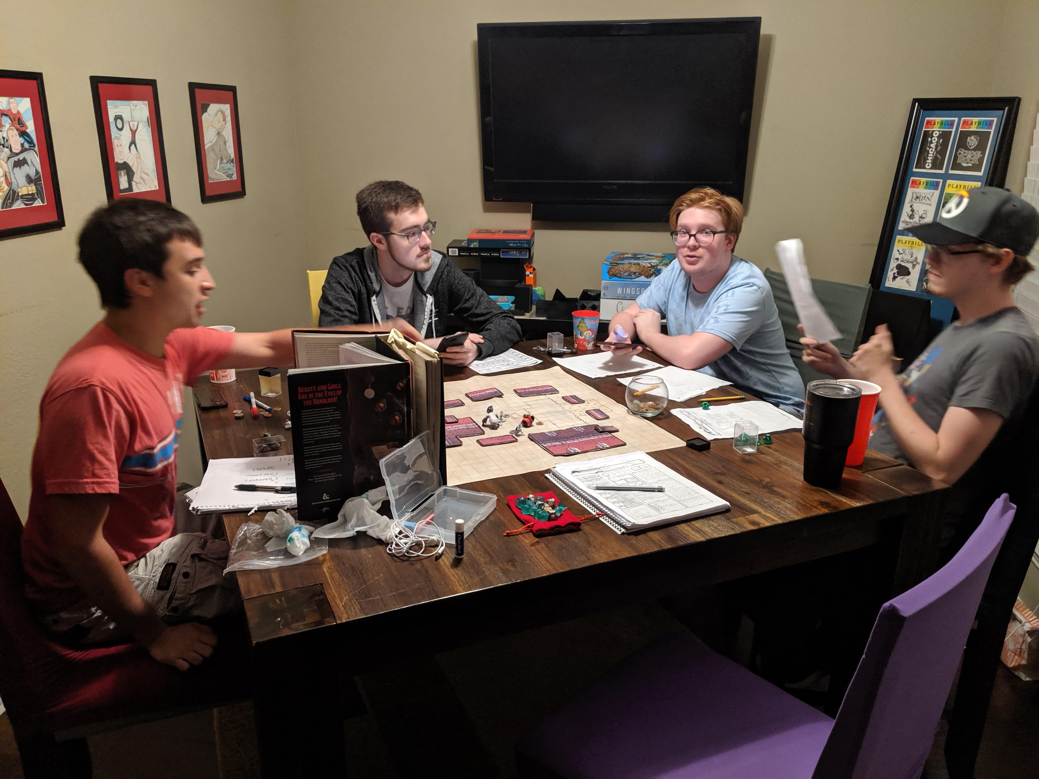
DnD
Tabletop RPG

Slide 44

Dread
DnD with Jenga

Slide 45
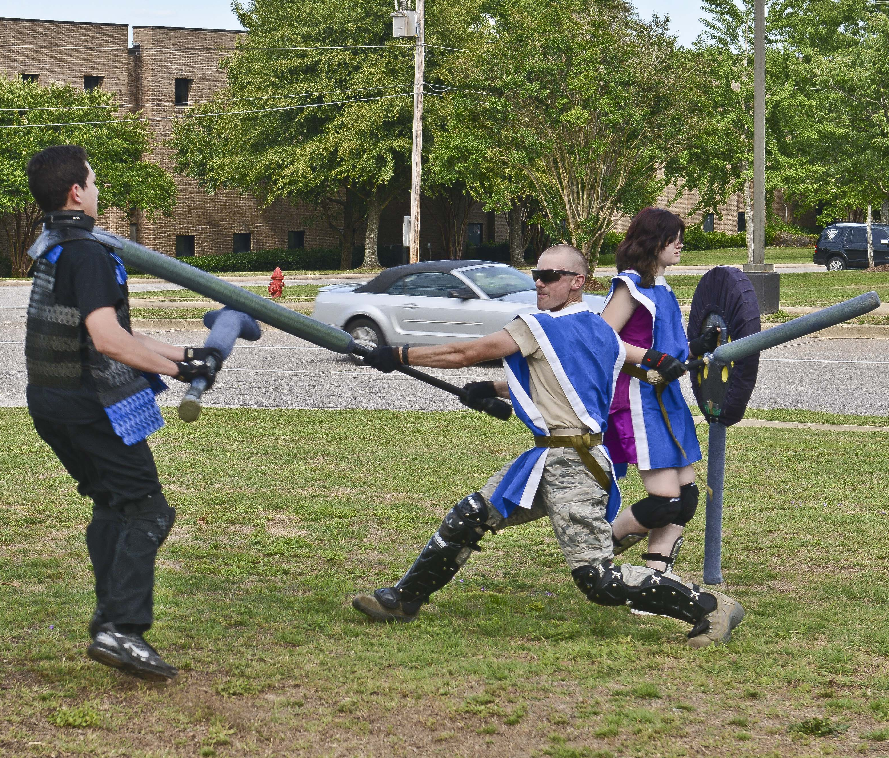
LARP
Live Action Role Play
Mad About a Boy
http://mad-about-the-boy-larp.blogspot.com/p/the-larp.html
Autonomy (LARP)
https://payhip.com/b/KvbG
Panoticorp
https://www.youtube.com/watch?v=mifzvxepjOA

Slide 46
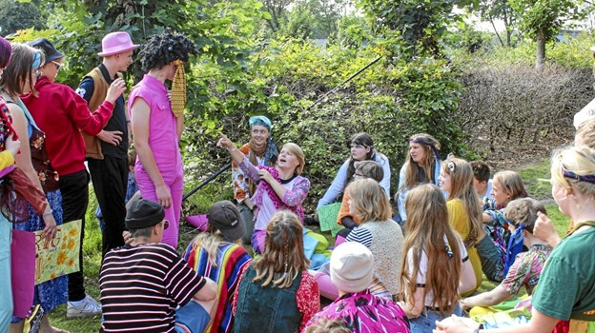
EDULarp
LARP for class
Denmark
Learning disabilities

Slide 47

Mini un
Each student represents a country
Work together to solve global issues

Slide 48
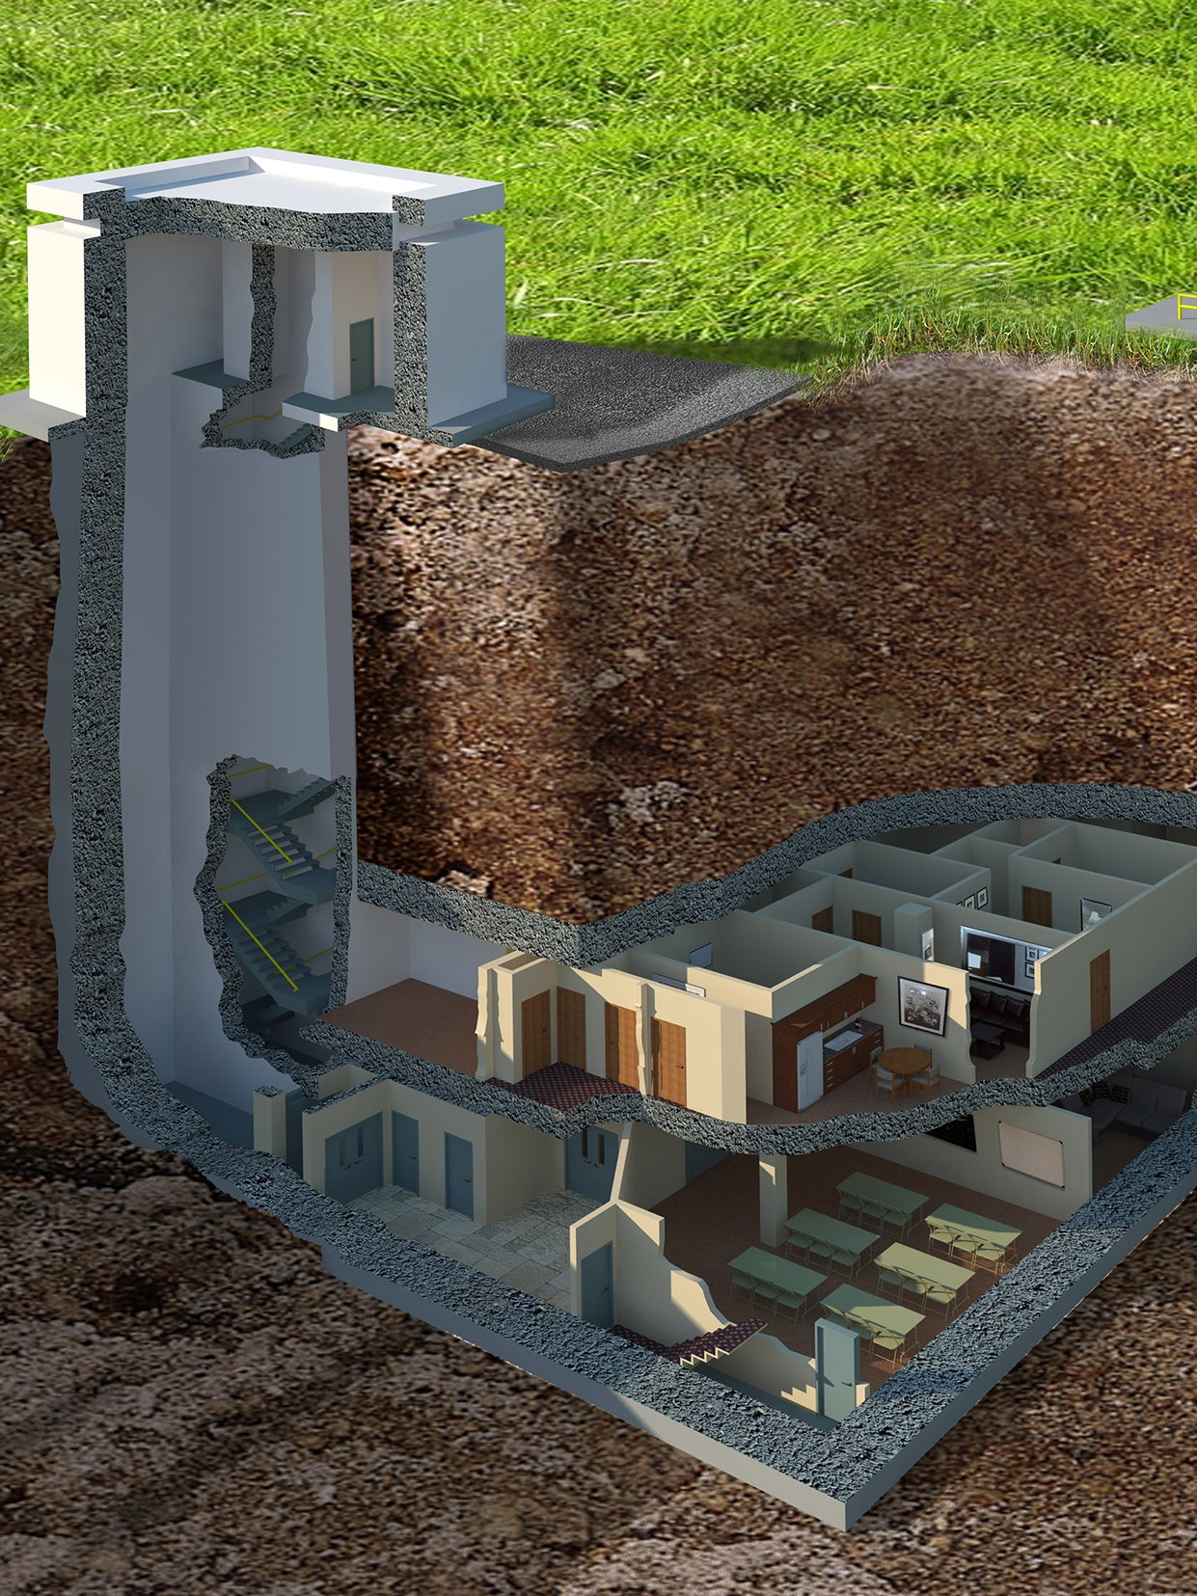
Bunker interviews
Apocalypse
Interview to get in a bunker

Slide 49

Fiasco
Role play board game

Slide 50

microscope
Create an alternate universe

Slide 51

Murder Mystery
Monday

Slide 52
ESL toybox
www.esltoybox.com

Slide 53

Gamification in the Classroom:
Rewards students with xp
Punishes students with hp
Real life consequences / power ups
Arranged into teams
Classcraft
https://www.classcraft.com/
https://www.youtube.com/watch?v=30oNjYEO4wk

Slide 54

Gamification in the Classroom:
Public schools
Uses game systems
Game designers / Teachers
Problem-Based Learning
Need to know
21st Century skills
Quest to Learn
https://www.q2l.org/
https://www.youtube.com/watch?v=kHtj6PCpyLQ

Slide 55

No Thank You, EVIL!
For elementary role plays kids

Slide 56
Types of Customers
https://corporatefinanceinstitute.com/resources/knowledge/other/types-of-customers/
Role –Playing Games Used as Educational and Therapeutic Tools for Youth and Adults
https://www.researchgate.net/publication/237074784_Role-playing_Games_Used_as_Educational_and_Therapeutic_Tools_for_Youth_and_Adults
Role –Playing Games for Common Well-Being in High School – Notes from a Study Developed in Southern Brazil
https://www.researchgate.net/publication/333755286_Role-Playing_Games_for_Common_Well-Being_in_High_School_-_Notes_from_a_Study_Developed_in_Southern_Brazil
EDULarp
https://goodjobstudios.com/animation-edu-larp/

Slide 57
Autonomy (LARP)
https://payhip.com/b/KvbG
Panoticorp
https://www.youtube.com/watch?v=mifzvxepjOA
Mad About a Boy
http://mad-about-the-boy-larp.blogspot.com/p/the-larp.html
https://www.theverge.com/2012/11/27/3609806/my-so-called-larp-living-world-without-men
More @ the Larp Library
https://library.interactiveliterature.org/

Slide 58
More @ the Drive Thru RPG
https://www.drivethrurpg.com/
FUTUR (Role Play)
https://www.youtube.com/channel/UC-b3c7kxa5vU-bnmaROgvog

