Slide 1
English
proverbs

Slide 2
Proverb
A short phrase or saying that expresses a general TRUTH or piece of ADVICE.
traditional, cultural or general use.

Slide 3
Honesty is the best policy.

Slide 4
Proverb
Get a proverb.
Research the proverb.

Slide 5
Teaching
vs
telling

Slide 6
Teaching vs Telling
Show in context
Real life examples
Explain in an understandable way
CCQ

Slide 7
Teaching vs Telling
Use the vocabulary
In other words
Games and activities
Review

Slide 8
Give a man a fish and he eats for a day.
Teach a man to fish and you feed him for a lifetime.

Slide 9
Proverb
Teach the proverb.

Slide 10
He tried paddling the canoe alone, but it was too difficult.
No man is an island.

Slide 11
Even though the trip was cancelled, now I can spend more time with my family.
Every cloud has a silver lining.

Slide 12
I helped him fix his car, but I just made it worse.
The road to hell is paved with good intentions.

Slide 13
I had the same problem as Mary, but she complained so much, they fixed her computer and not mine!
The squeaky wheel gets the grease.

Slide 14
Our team has 5 managers but only 2 laborers.
Too many cooks ruin the broth.

Slide 15
I told him about the job opportunity, but he didn’t apply.
You can lead a horse to water, but you can’t make them drink.

Slide 16
He has always been sarcastic even after I asked him to stop.
A leopard can’t change its spots.

Slide 17
The Sentinelese never learned about Covid-19.
Ignorance is bliss.

Slide 18
It is strange that he accused her of cheating because I caught him cheating last year.
People in glass houses shouldn’t throw rocks.

Slide 19
The company decided to fire him, so he started his own business.
When one door shuts, another opens.

Slide 20
She said she would help him move his furniture, but now she wants him to buy her lunch.
There’s no such thing as a free lunch.

Slide 21
AGREE
to
DISAGREE

Slide 23
Agree to Disagree
A polite way to end an argument.

Slide 24
Agree to Disagree
Used in situations where the participants can’t agree, but wish to stay friends.

Slide 25
Agree to Disagree
I’m not sure (about that / that’s true).
Yes, but… (Maybe, but…, I understand, but..)
Not necessarily

Slide 26
Rules
Read the proverb.
Move your cup (agree/disagree)
Discuss the proverb.

Slide 27
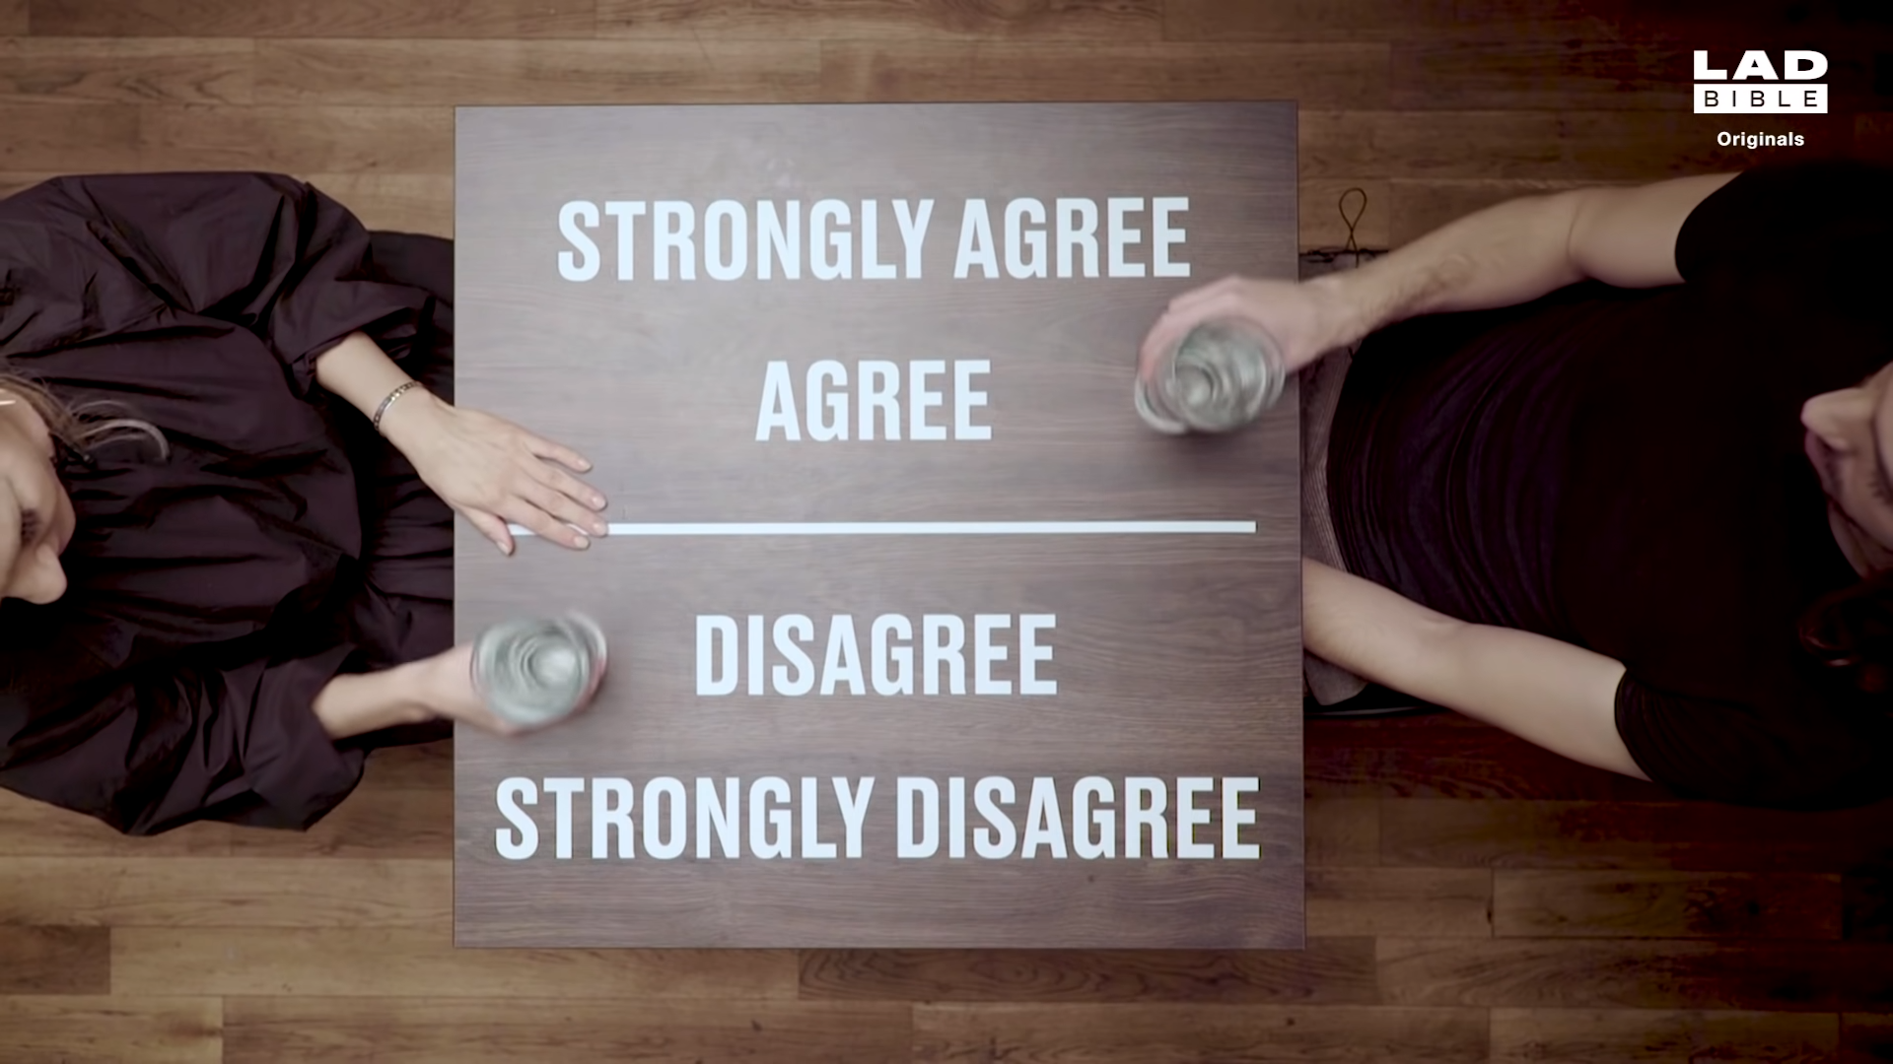

Slide 28
Honesty is always the best policy.

Slide 29
A leopard can’t change its spots.

Slide 30
Ignorance is bliss.

Slide 31
People in glass houses shouldn’t throw stones.

Slide 32
The squeaky wheel gets the
grease.

Slide 33
You can lead a horse to water, but you can’t make them drink.

Slide 34
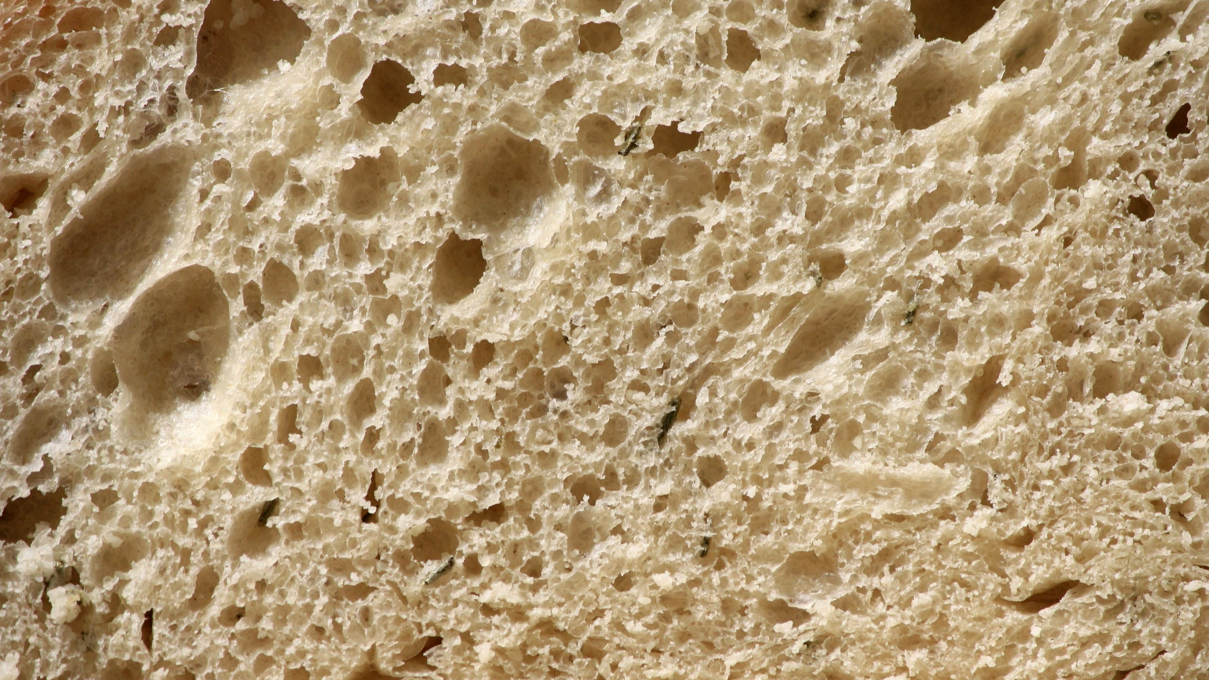
There’s no such thing as a free lunch.

Slide 35
When one door shuts, another opens.

Slide 36
No man is an island.

Slide 37
Every cloud has a silver lining.

Slide 38
The road to hell is paved with
good intentions.

Slide 39
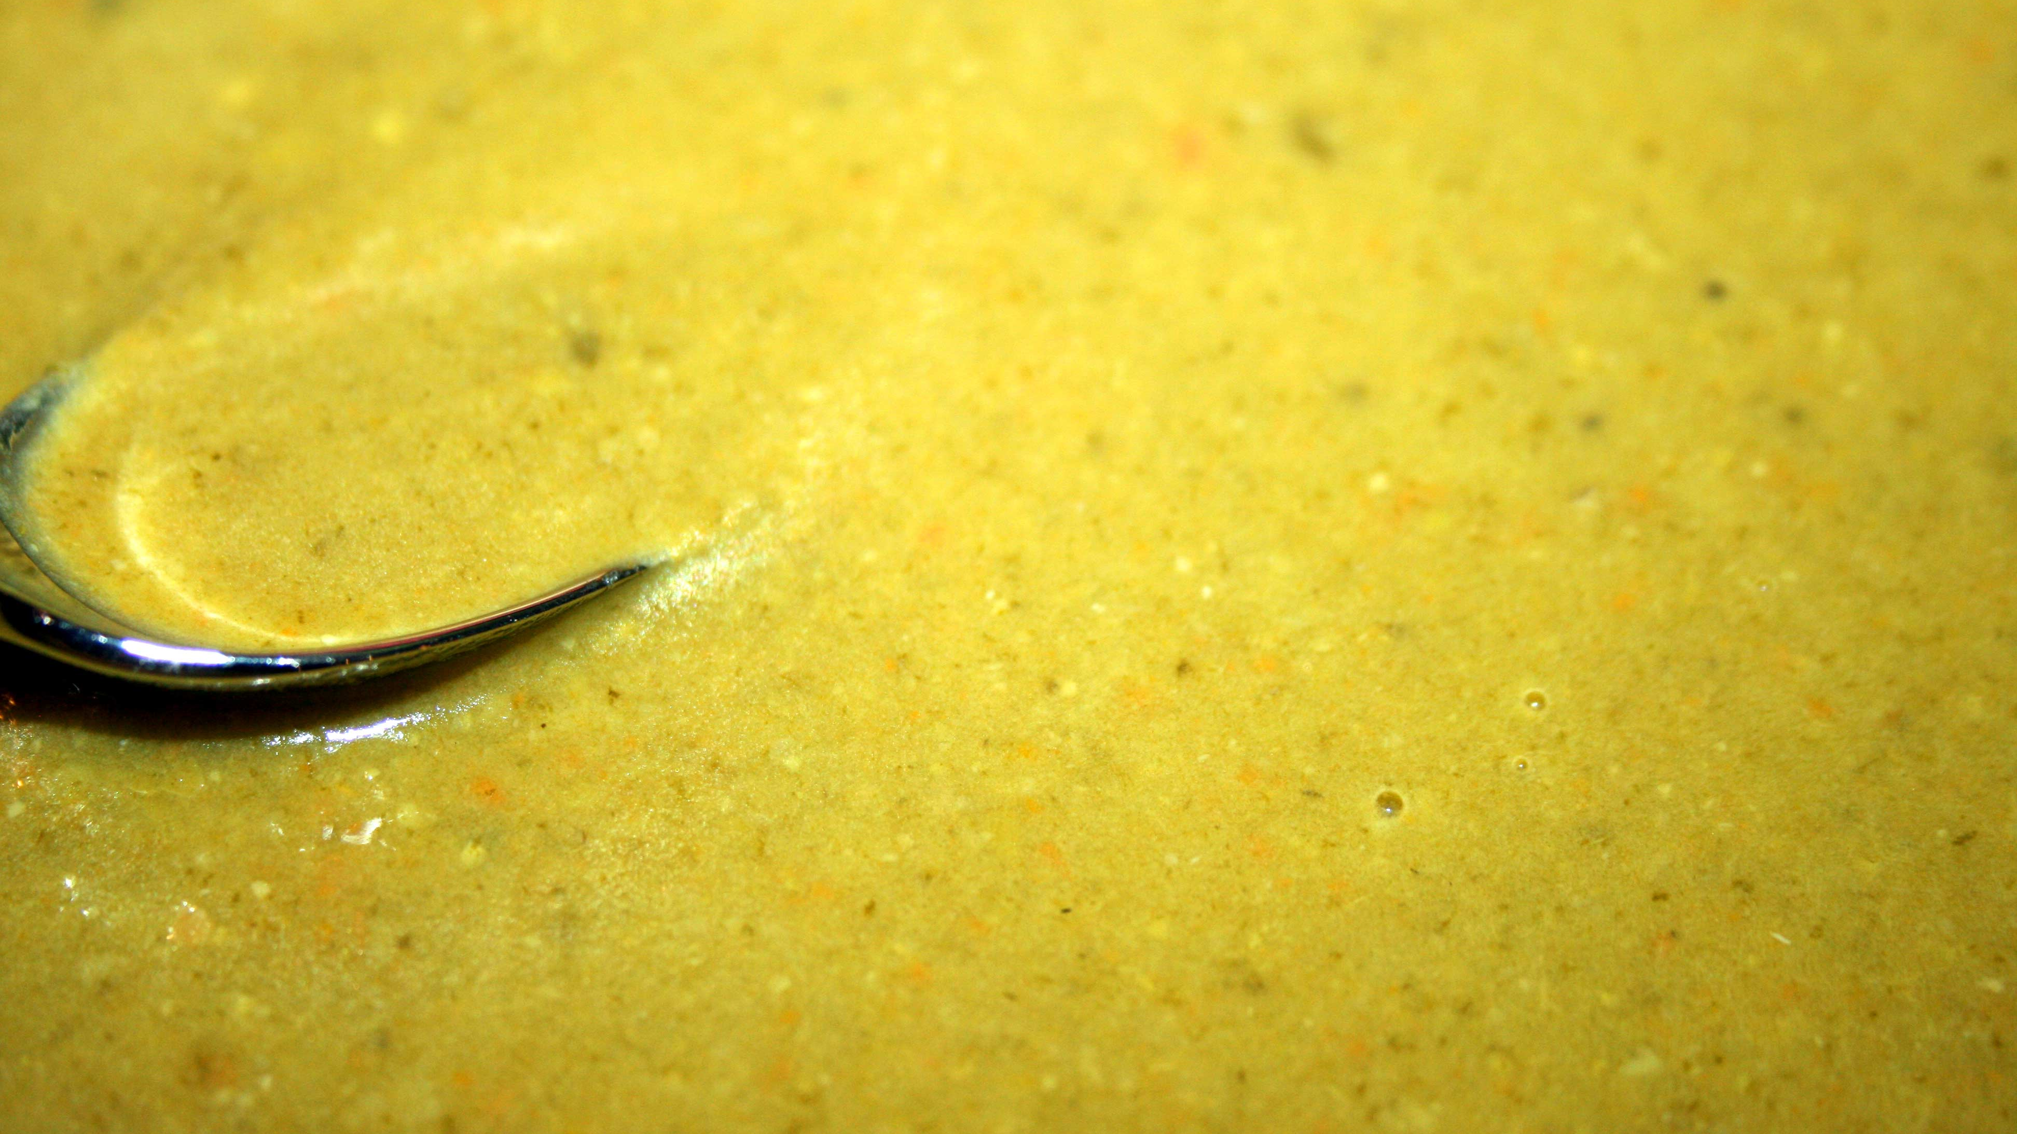
Too many
cooks
ruin the broth.

Slide 40
The end always justifies the means.

Slide 41
What doesn’t KILL you makes you stronger.

Slide 42
Still waters run DEEP.

Slide 43
Don’t count your chickens before they hatch.

Slide 44
Actions speak louder than words.

Slide 45
You can’t teach an old dog new tricks.

Slide 46
Cleanliness
is next to godliness.

Slide 47
Beauty
is in the eye of the beholder.

Slide 48
A chain is only as strong as its weakest link.

Slide 49
The pen is mightier than the sword.

Slide 50
If you want something done right, you have to do it yourself.

Slide 51
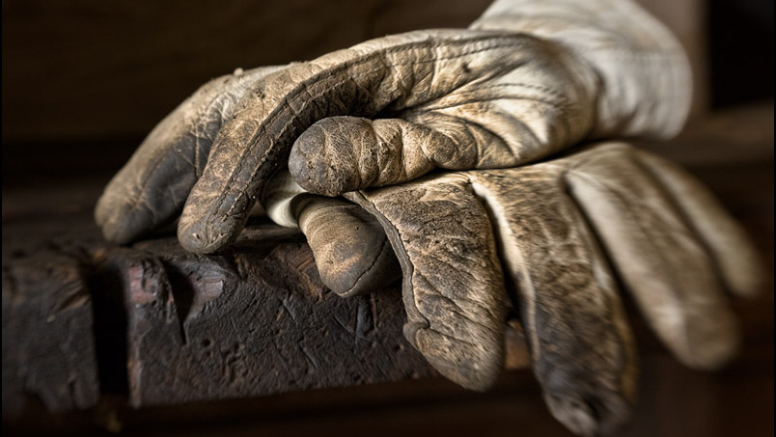
Work smart,
not hard.

Slide 52
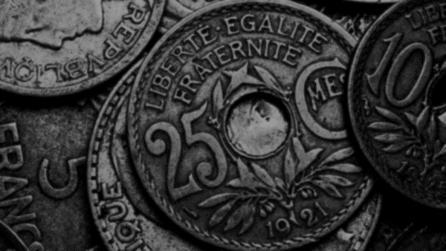
Money can’t buy happiness.

Slide 53
All’s fair in love and war.

Slide 54
The best things in life are free.

Slide 55
Life
40.
starts at

Slide 56
When in Rome, do as the romans do.

Slide 57
No pain, no gain.

Slide 58
Familiarity breeds contempt.

Slide 59
Once bitten, twice shy

Slide 60
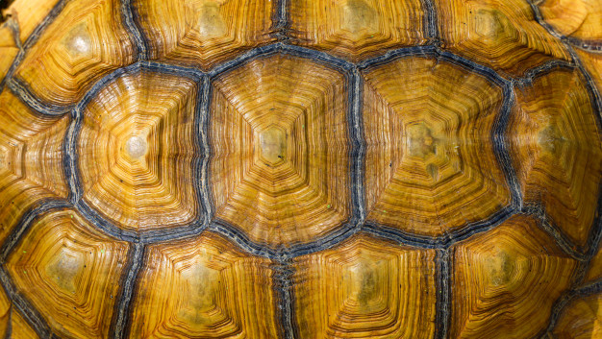
Slow and steady wins the race.

Slide 61
When the going gets tough, the tough get going.

Slide 62
The early bird catches the worm.

Slide 63
Where there’s a will, there’s a way.

Slide 64
The proof is in the pudding.

Slide 65
You can’t make an omelet without cracking a few eggs.

Slide 66
Good things come to those that wait.

Slide 67
Rome wasn’t built in a day.

Slide 68
the bad times make the good times better.

Slide 69
When life gives you lemons, make lemonade.

Slide 70
The
best things
in life
are free.

Slide 71
https://lemongrad.com/proverbs-with-meanings-and-examples/?fbclid=IwAR1Q2spMtqVuBRFF3oKJhBpwkAOgbQUEF2xyBi4sTnPvXndpkdLwpnWX4dI
https://www.phrasemix.com/collections/the-50-most-important-english-proverbs
https://youtu.be/rST26W31EPs

Slide 72
ESL toybox
www.esltoybox.com

