Slide 1
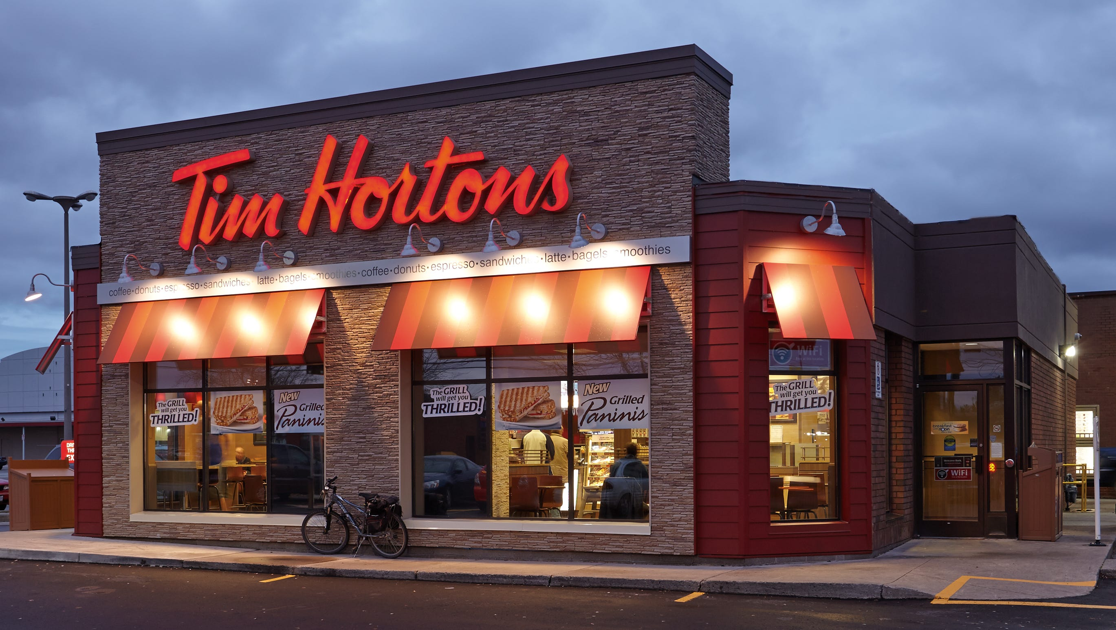

Slide 2
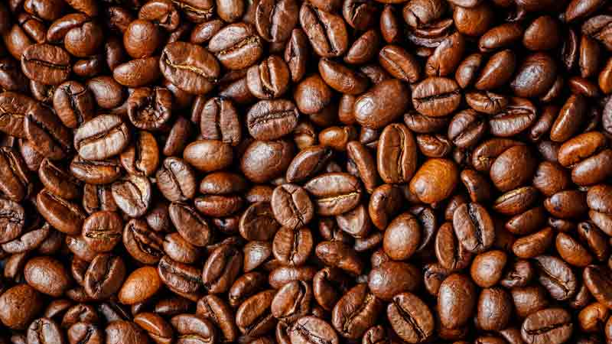

Can I get a double-double?

Slide 3
Tim Horton
24 seasons
top 100 player
strong, tough
1964 – Donut Shop
1974 – Car Crash, DUI

Slide 4


Slide 5
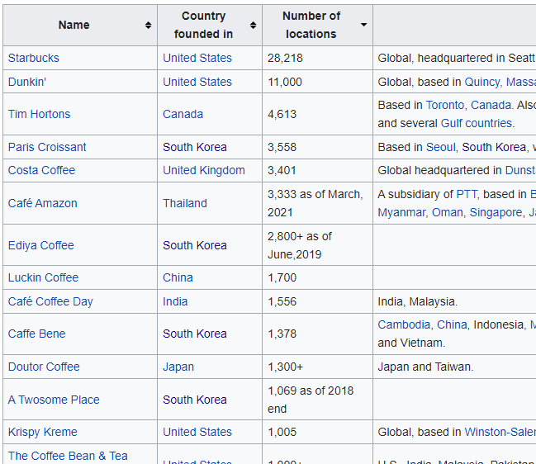
Largest Coffee Chain (Canada)
3rd Largest Coffee Chain (World)
Largest Fast-Food Chain (Canada)
2014 – Burger King buys
Roll up the rim to win
Timbits Hockey
Tim Horton Children Foundation

Slide 6

Doughnuts
Donuts

Slide 7
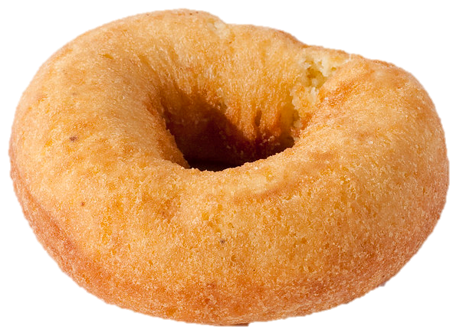
Old-fashion

Slide 8
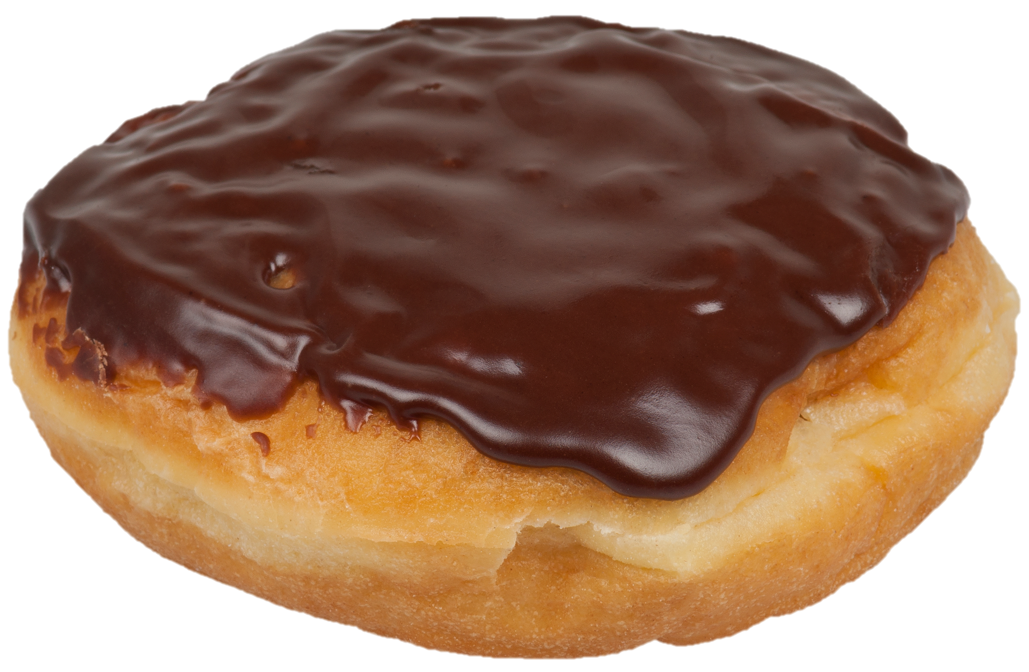
Boston Cream

Slide 9
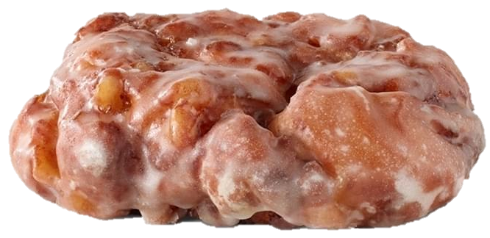
Apple Fritter

Slide 10
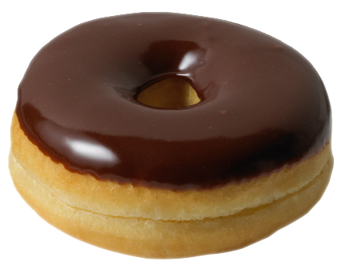
Chocolate Dip

Slide 11
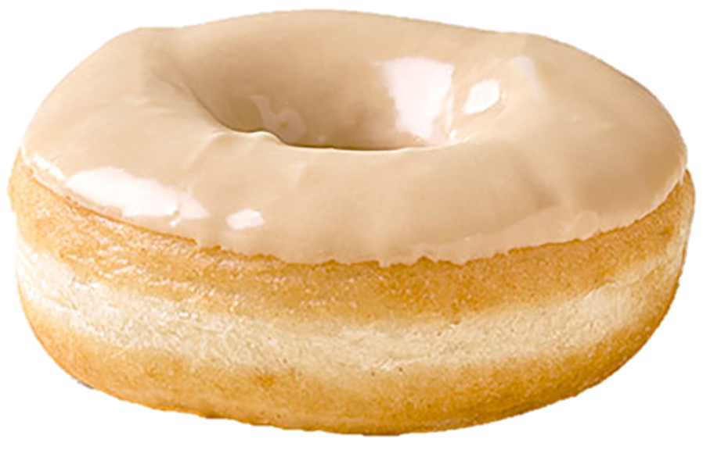
Maple Dip

Slide 12
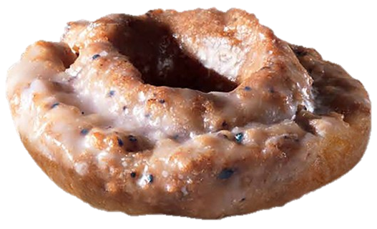
Blueberry

Slide 13
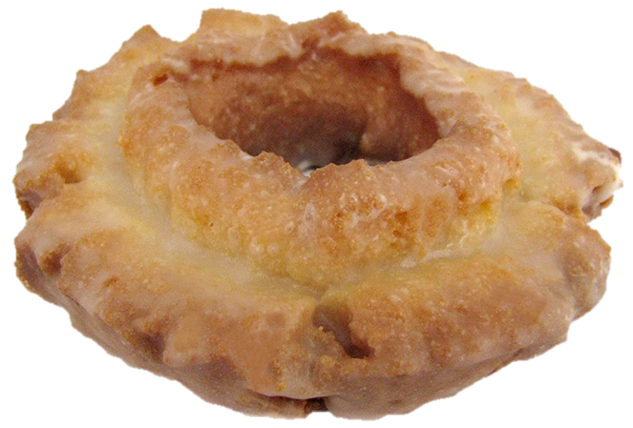
Maple glazed

Slide 14
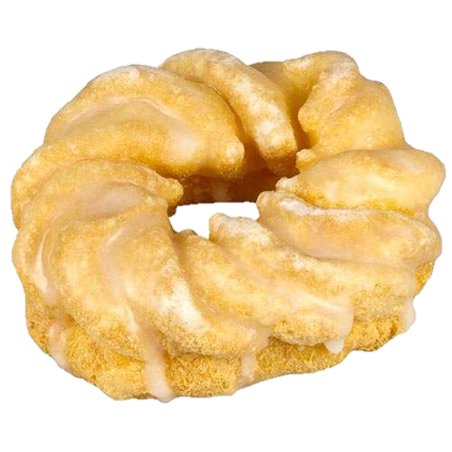
Cruller

Slide 15
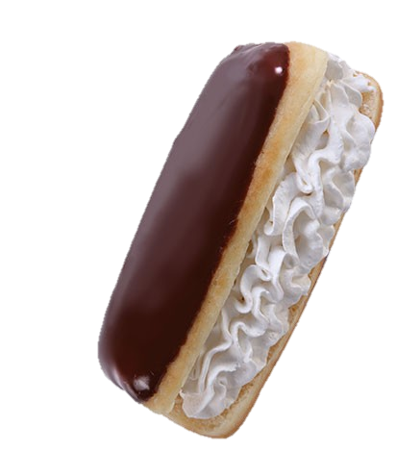
Éclair

Slide 16
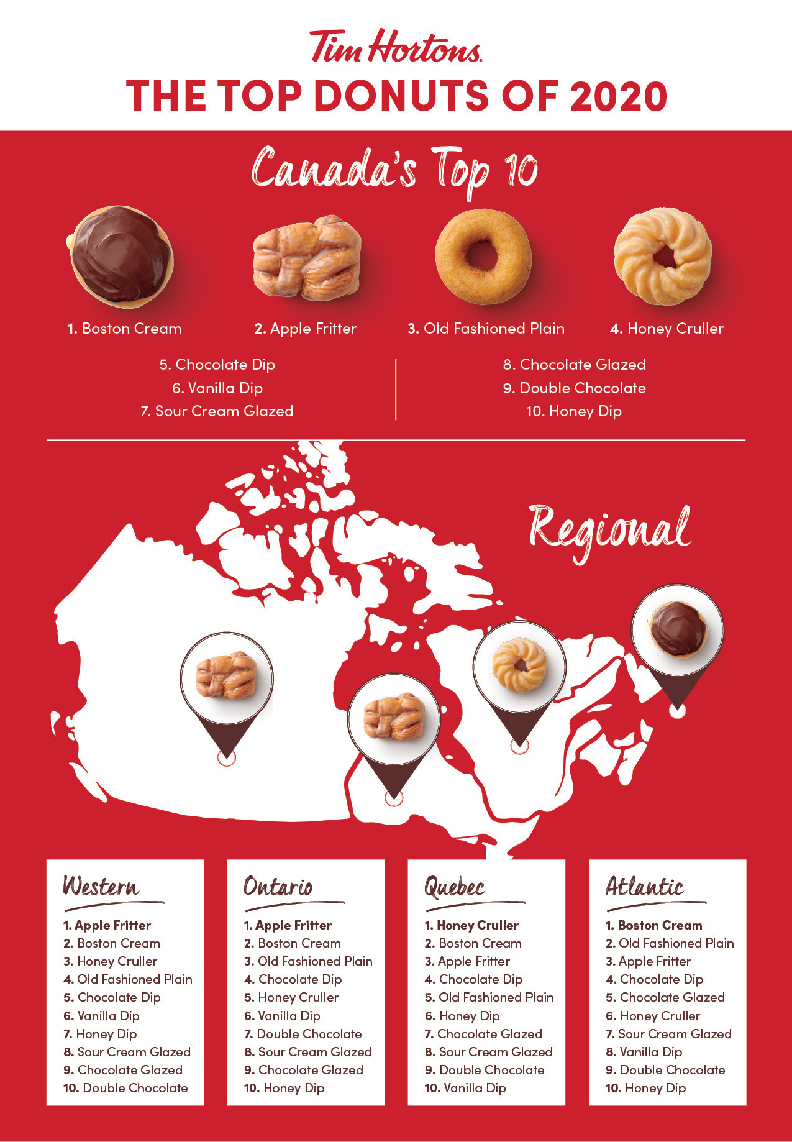
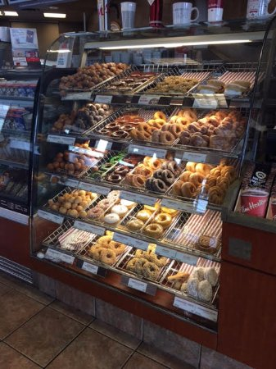

Slide 17
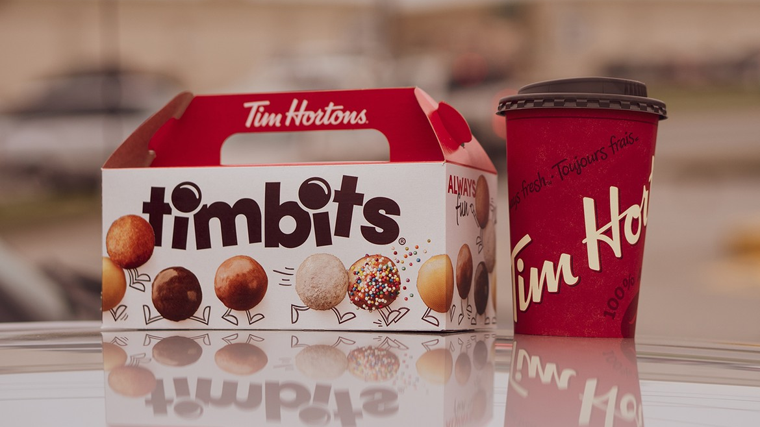

Slide 18
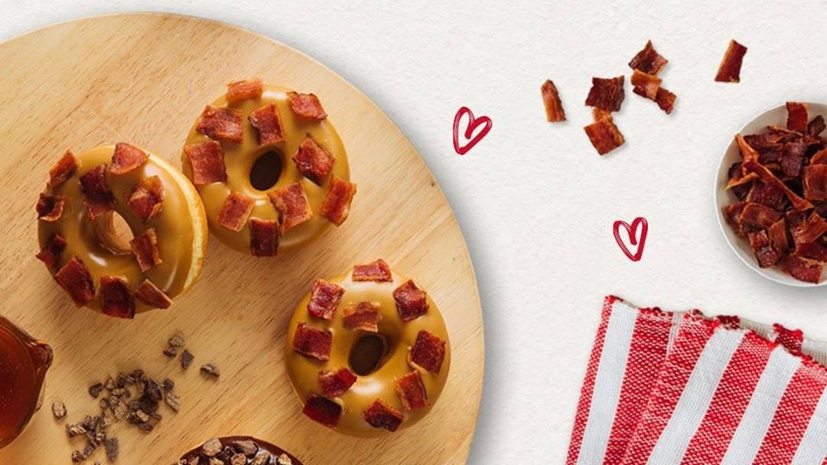


Slide 19
Hi, can I help you?

Slide 20
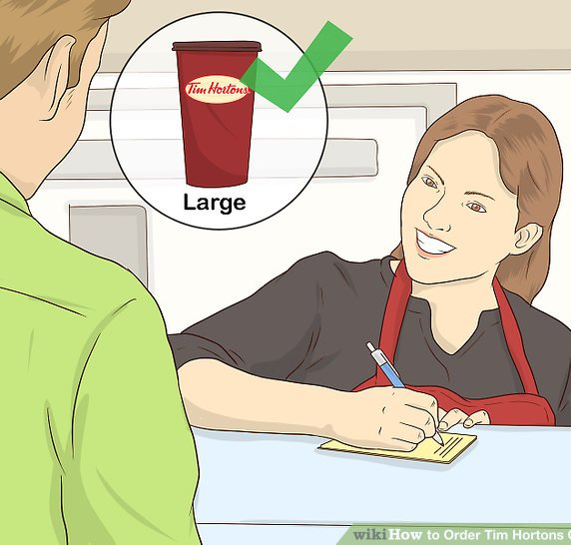
Size
S
M
L
XL

Slide 21
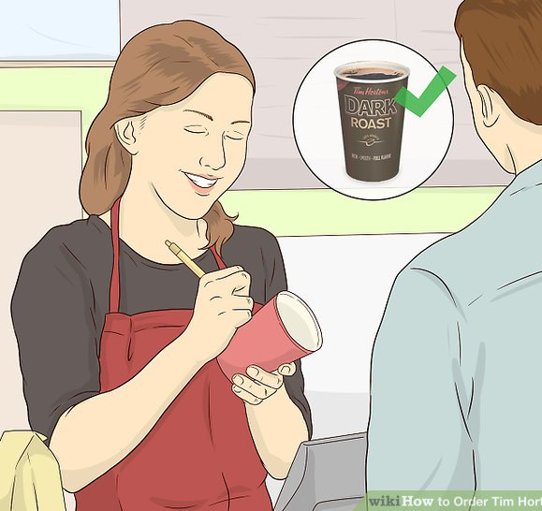
Blend
original
dark roast
decaf
French vanilla

Slide 22
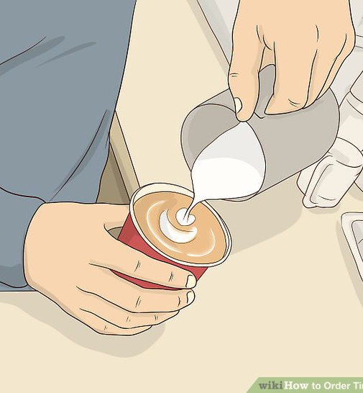
Additives
milk
cream
sugar
sweetener

Slide 23
Size
1 milk = 15mL

Slide 24
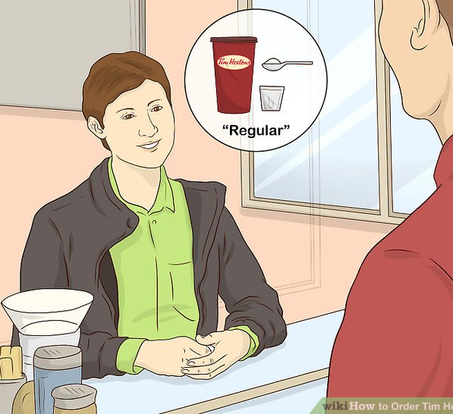
Regular
1 milk
1 sugar

Slide 25
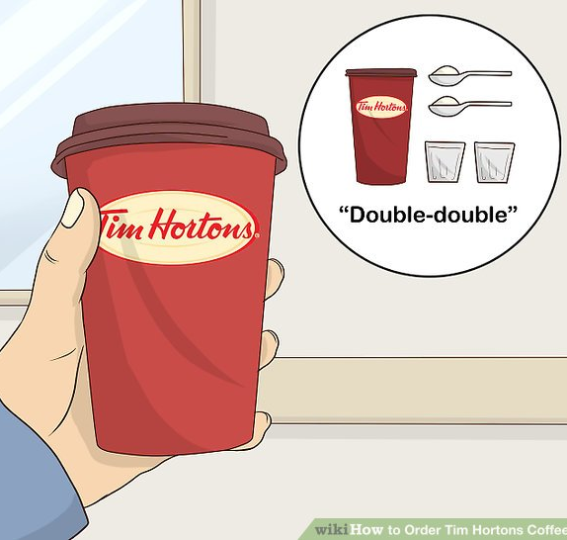
Double-double
2 cream
2 sugar

Slide 26
Triple-triple
3 cream
3 sugar

Slide 27
Four by Four
4 cream / milk
4 sugar / sweetener

Slide 28
Three cream, Two sugars
3 cream
2 sugar

Slide 29
Black
0 cream
0 sugar

Slide 30
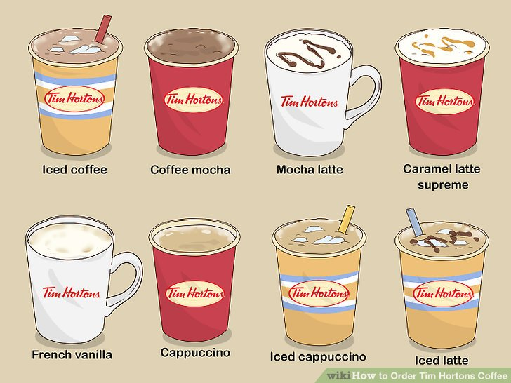

Slide 31
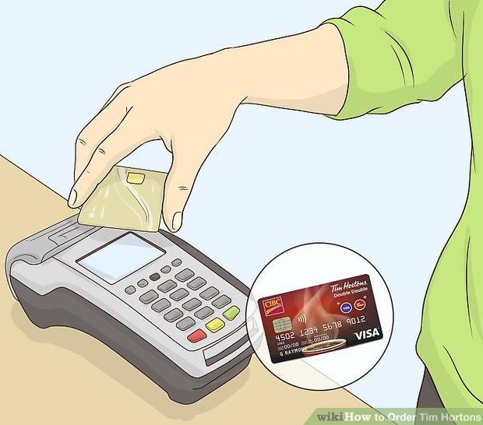
Credit or Debit?
credit card
debit card

Slide 32
For here
or
To go

Slide 33
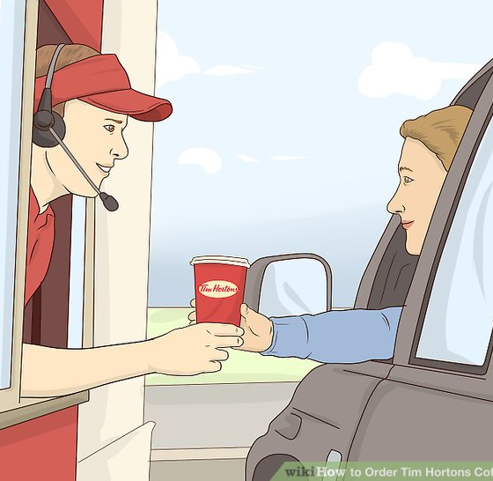

Slide 34
Role Play
Hi, can I help you?
May I have a large original double-double and a cruller?
Sure. Will you be paying with cash or credit card?
Debit, please.
For here or to go?
For here please.

Slide 35


Slide 36
Size
Blend
Additives
S
M
L
XL
original
dark roast
bold roast
Columbian
French vanilla
regular
double-double
triple-triple
four by four
etc.

Slide 37
https://www.wikihow.com/Order-Tim-Hortons-Coffee
https://wendihiebert.com/2009/08/04/how-to-order-and-behave-at-tim-hortons-to-make-the-world-a-better-place/#:~:text=Ordering%20coffee%20and%20tea%3A,is%20called%20a%20Triple%20Triple
https://youtu.be/yJ0HZam3UJo
https://www.reddit.com/r/TimHortons/comments/e7m1zy/i_heard_tim_hortons_counts_1_cream_as_more/
https://www.thestar.com/opinion/contributors/2020/01/29/your-double-double-coffee-has-more-sugar-than-you-think-and-thats-a-problem.html

Slide 38
ESL toybox
www.esltoybox.com

