Slide 1

Human
library

Slide 2
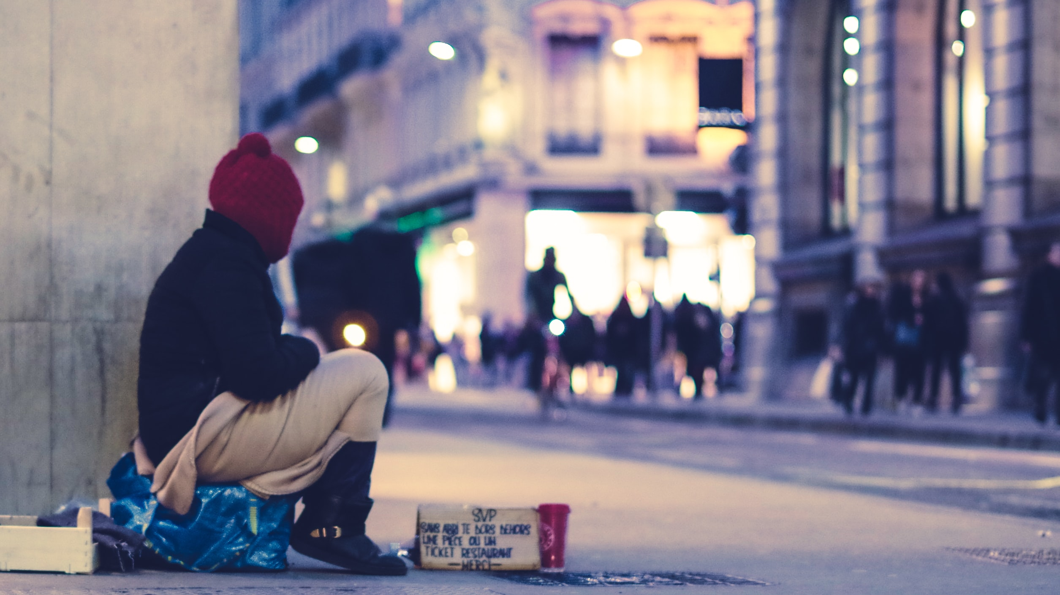


Slide 3
Challenge prejudice,
reduce discrimination,
discuss taboo topics openly.

Slide 4
How it
works

Slide 5
Who are the books?

Slide 6
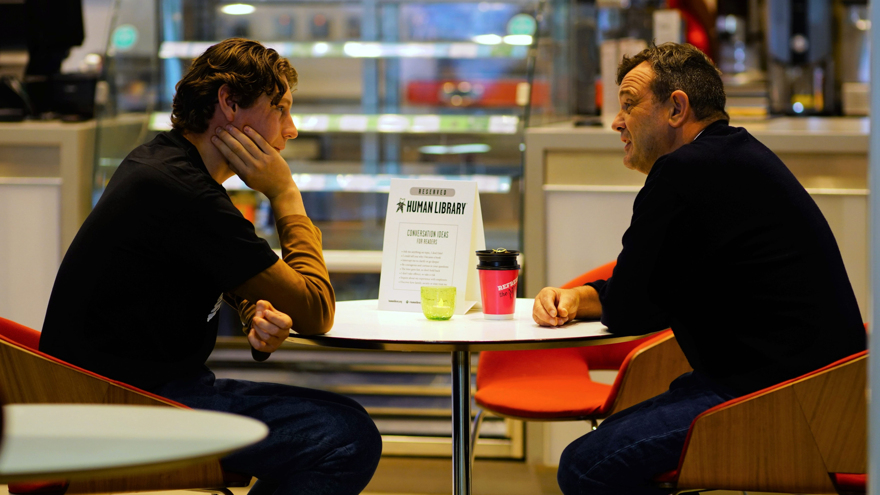
People are books.
Notes:
https://humanlibrary.org/new-human-library-book-depot-open-in-edinburgh/

Slide 7
How can you read a book?
Notes:
https://humanlibrary.org/new-human-library-book-depot-open-in-edinburgh/

Slide 8
Notes:
https://humanlibrary.org/new-human-library-book-depot-open-in-edinburgh/

Slide 9

Human
library

Slide 10
Greatest
Canadian

Slide 11
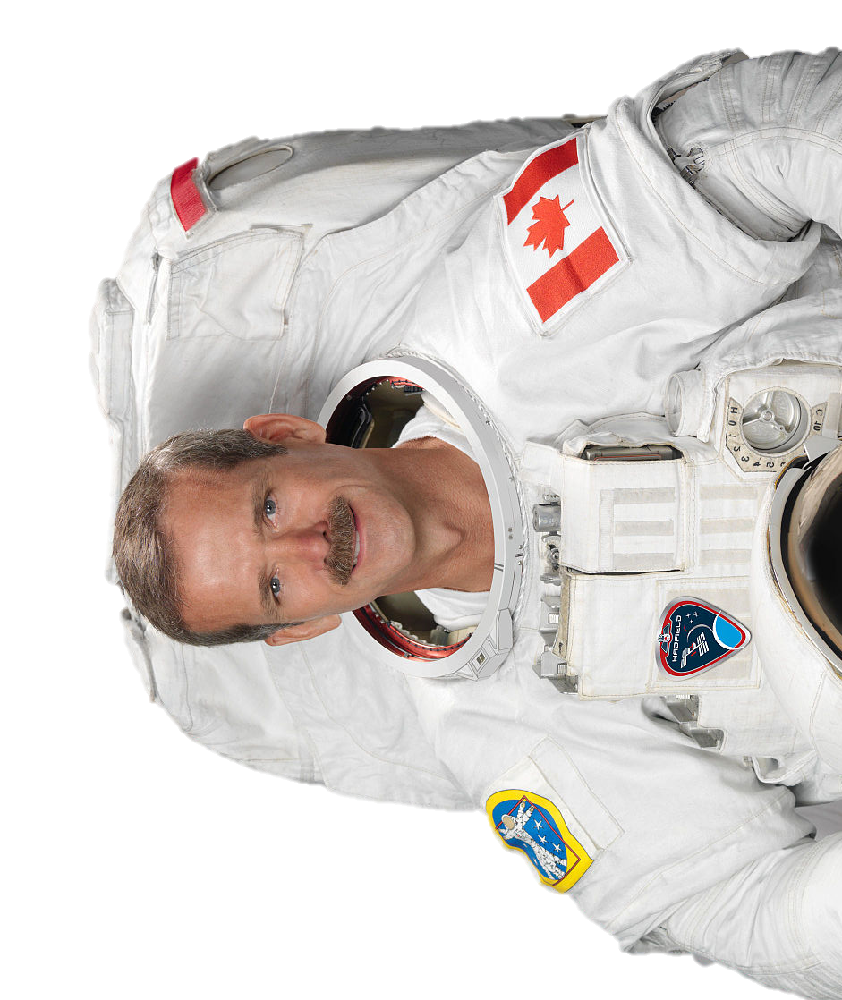
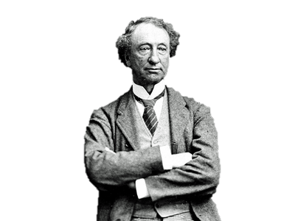
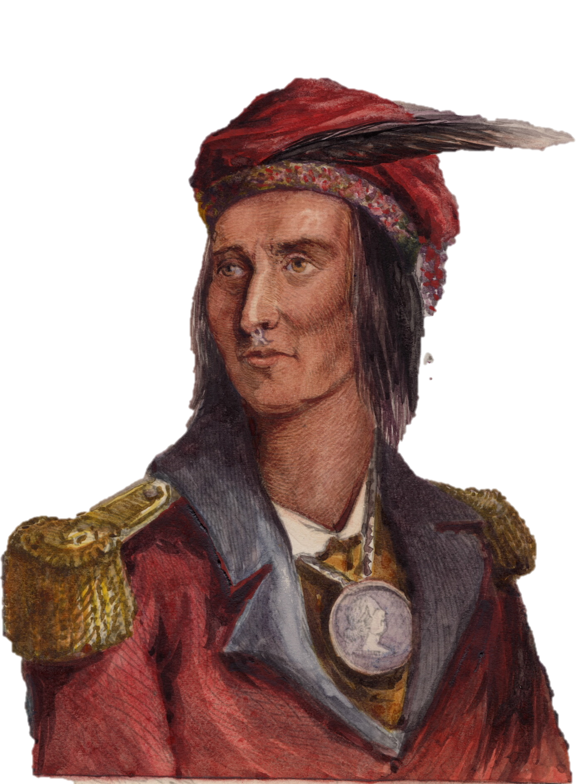
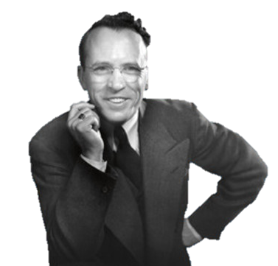


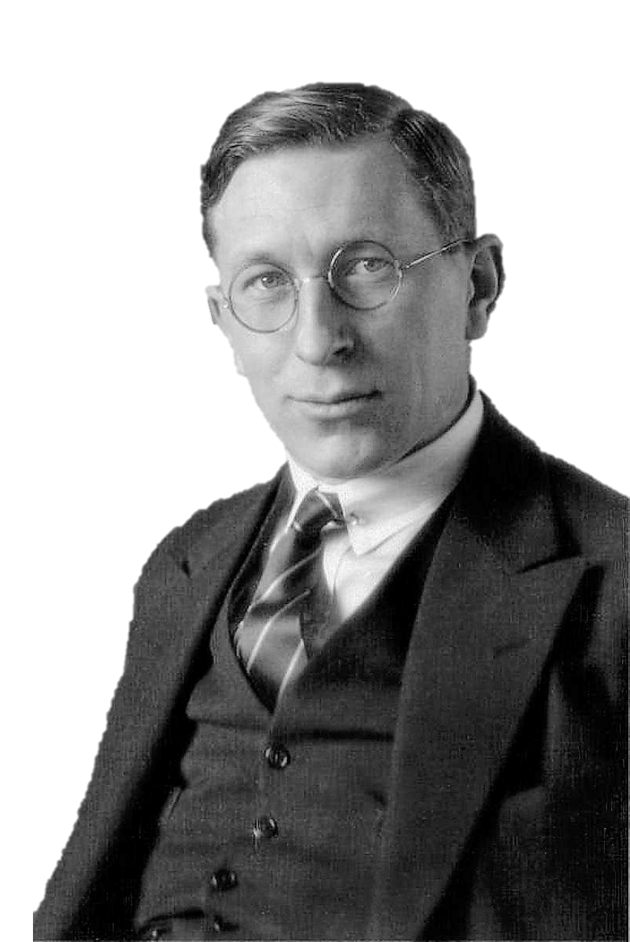
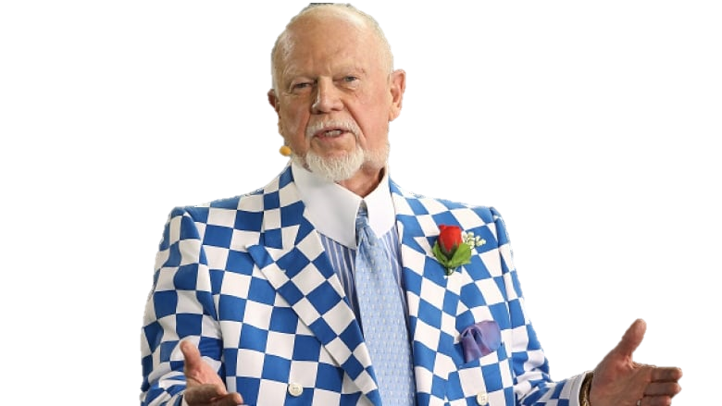
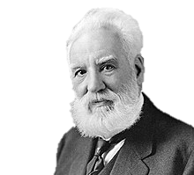
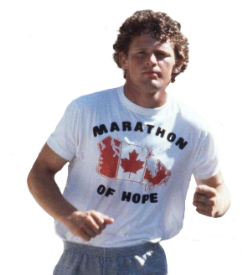
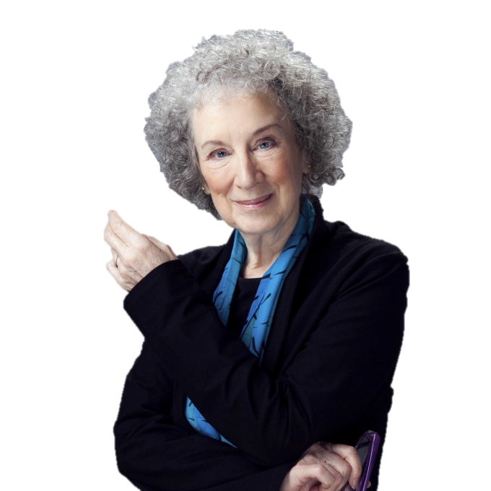
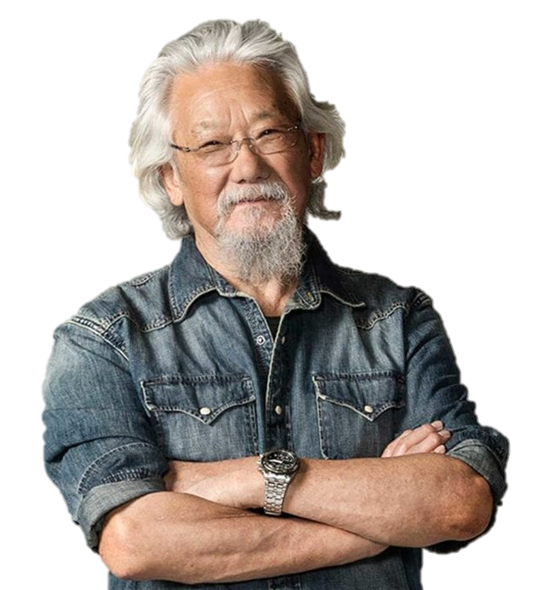
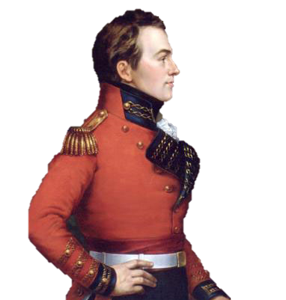
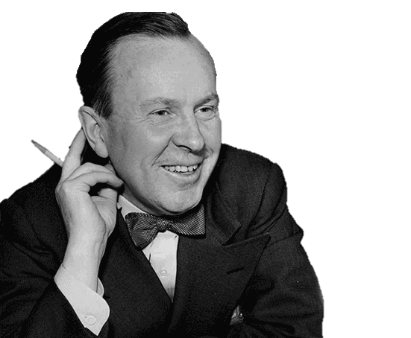
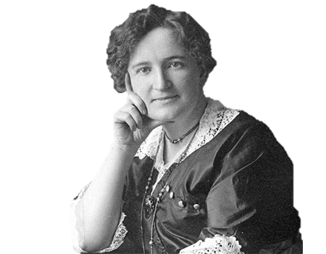


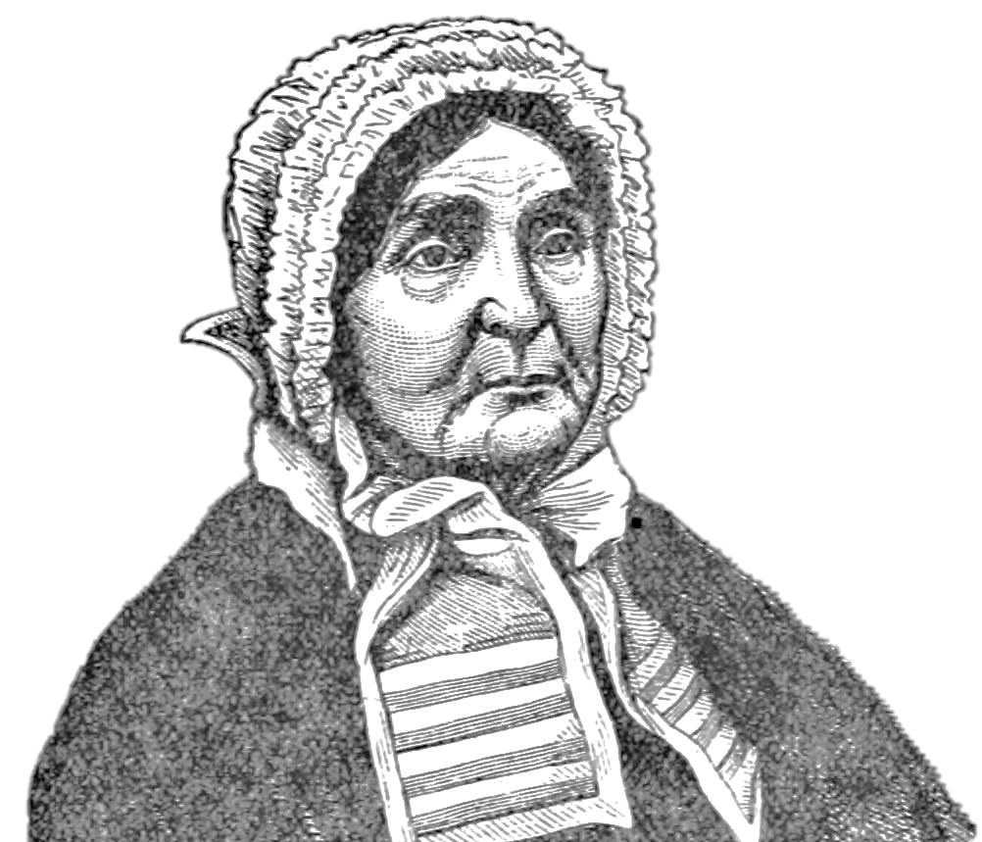
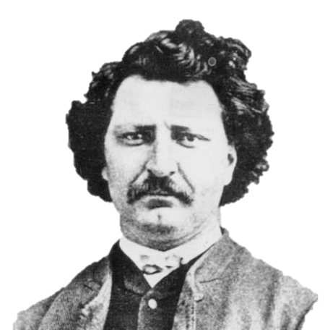
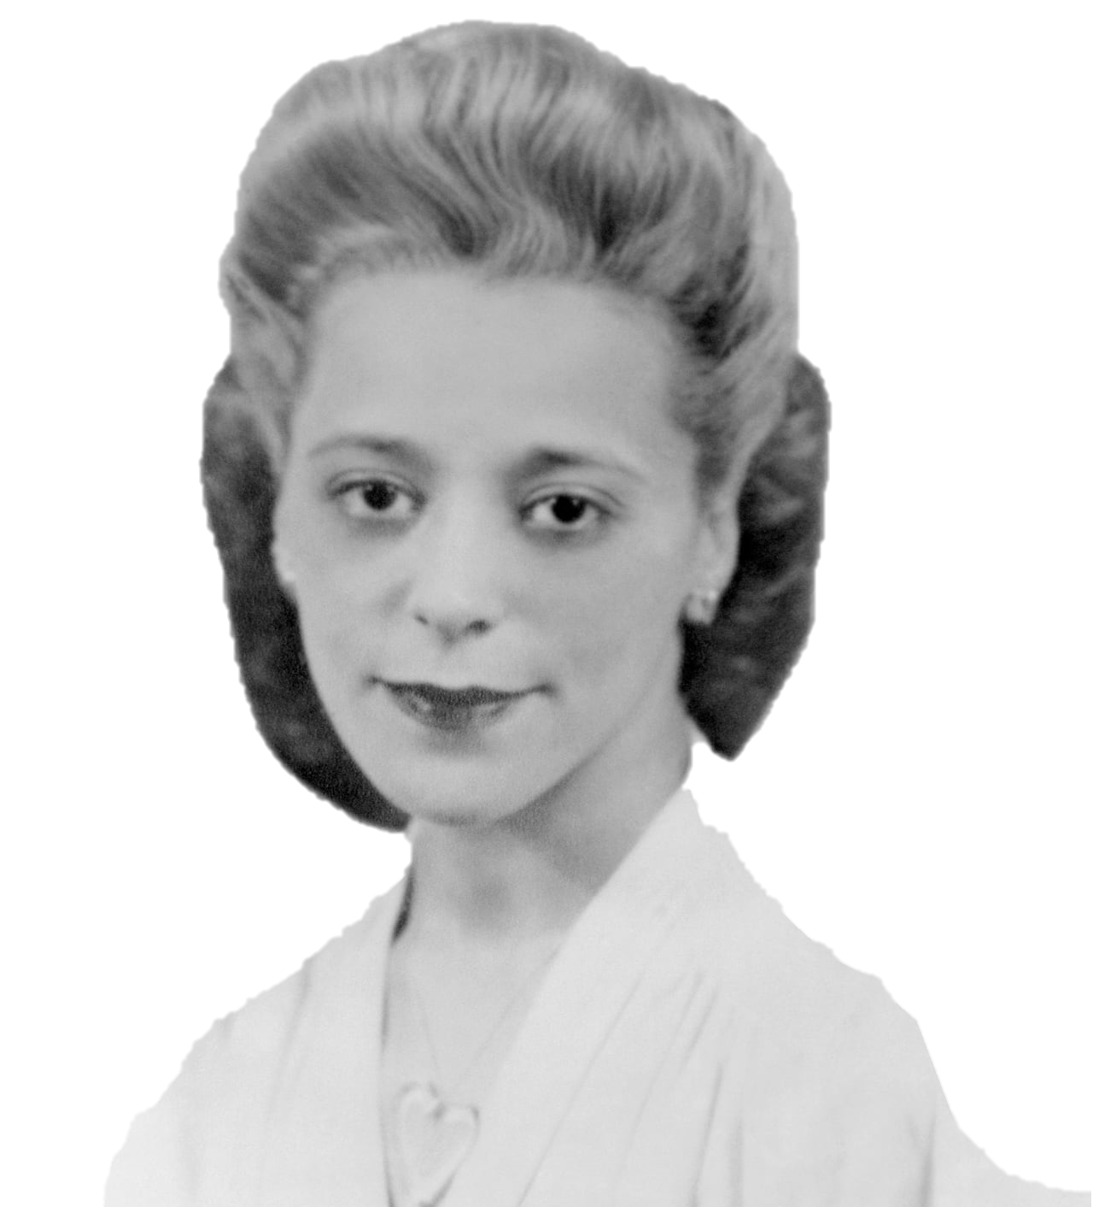
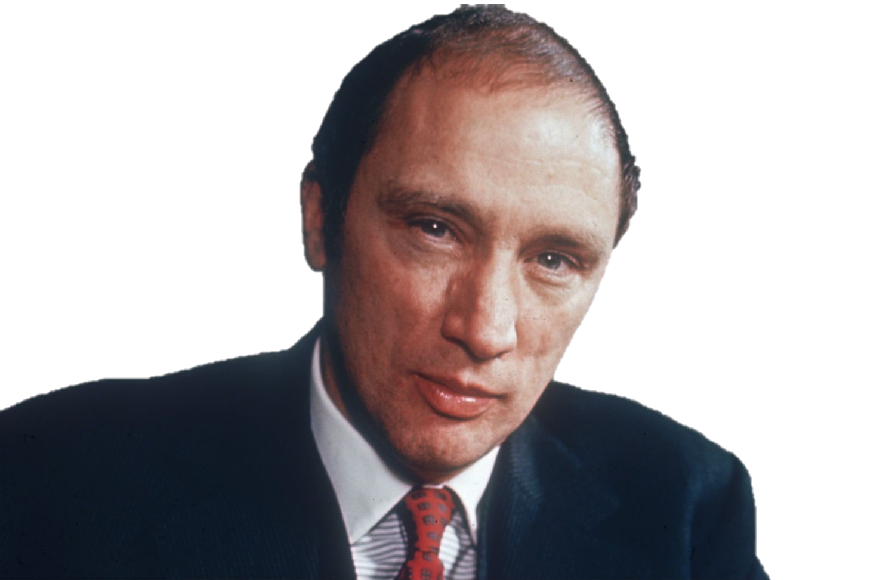
Choose a Canadian.

Slide 12
Step 1
Vocabulary
prepare for reading

Slide 13
Step 2
Reading
general understanding

Slide 14
Step 3
Questions
dig deeper

Slide 15
Step 4
Re-Read
with acquired knowledge

Slide 16
Step 5
Research
more information

Slide 17
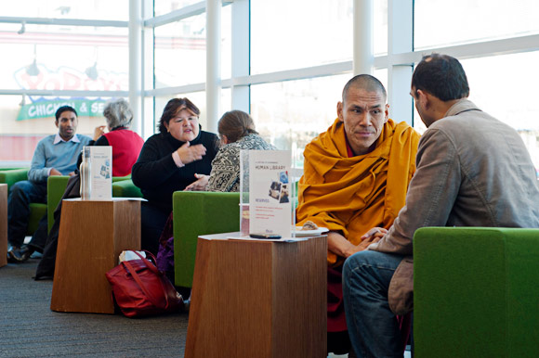
Represent your Canadian.
Notes:
https://boundinjapan.files.wordpress.com/2011/12/human-lib-3.jpg

Slide 19
ESL toybox
www.esltoybox.com

