Slide 1
Smartphones
Listening with apps

Slide 2






Improve English:
Word Games
Duolingo
Busuu
LingQ
Memrise
Babbel

Slide 3






Rosetta
Stone
LearnEnglish
Grammar
LingoDeer
Beelinguapp
ELSA Speak
Speak English
Conversation

Slide 4

Spaceteam ESL
http://spaceteamesl.ca/

Slide 5


Slide 6
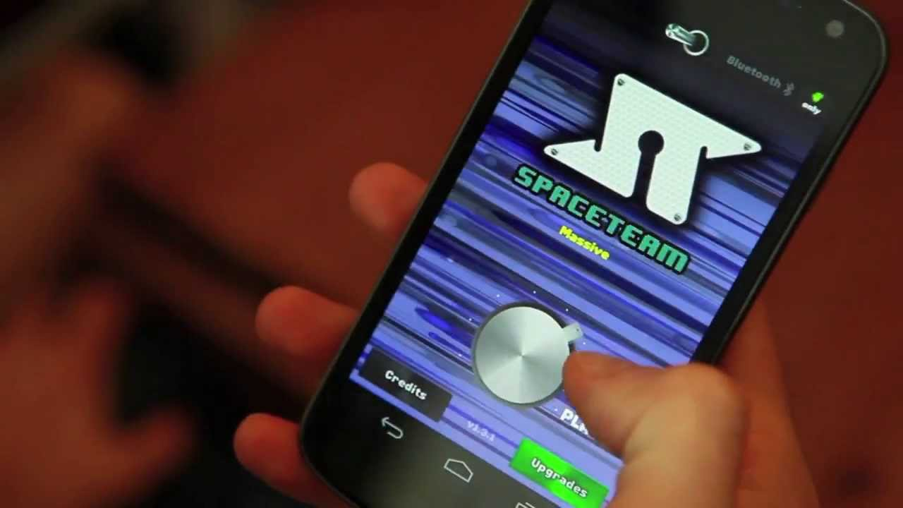

Slide 7


Slide 8
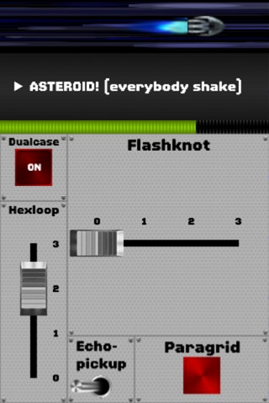

Slide 9
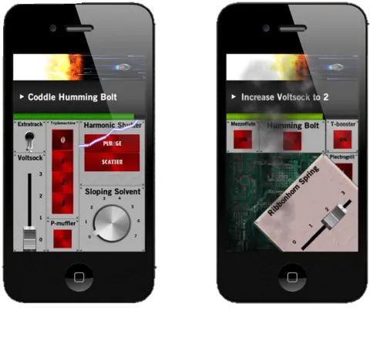

Slide 10


Slide 11

Spyfall

Slide 12


Slide 13
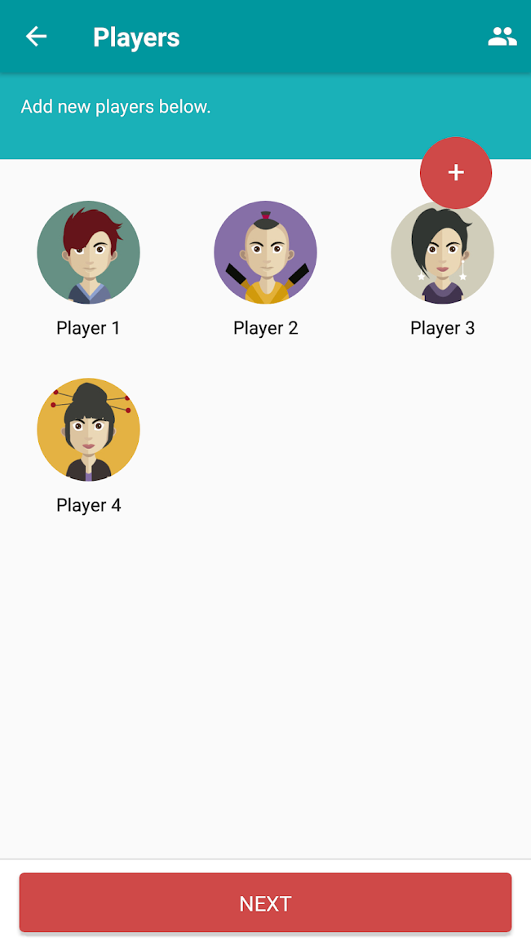

Slide 14
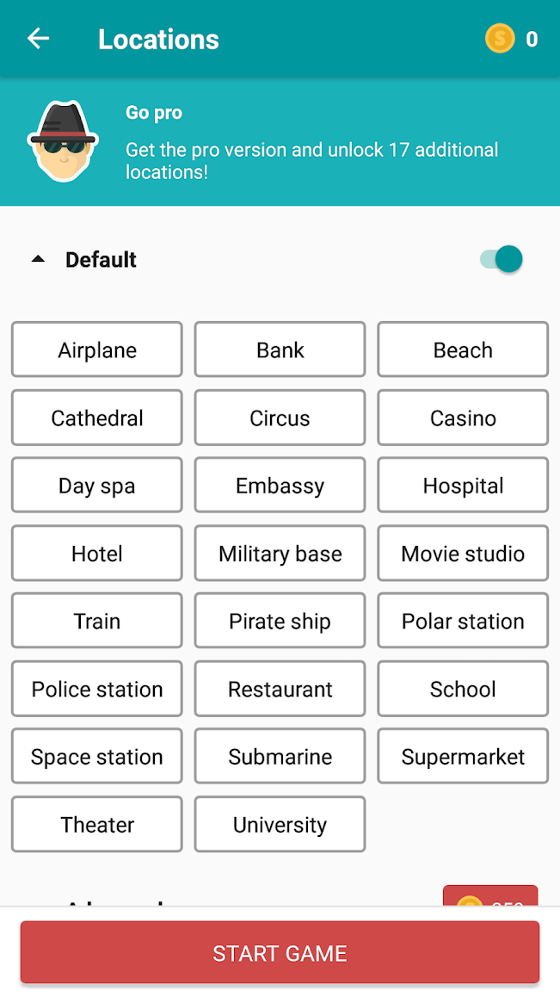

Slide 15

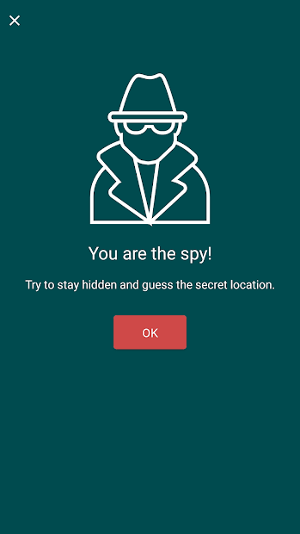

Slide 16
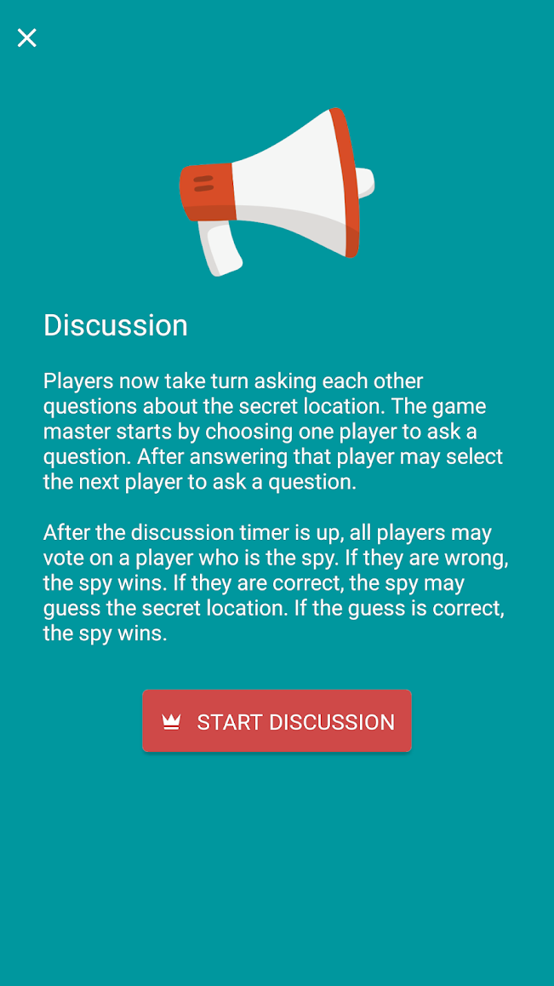

Slide 17
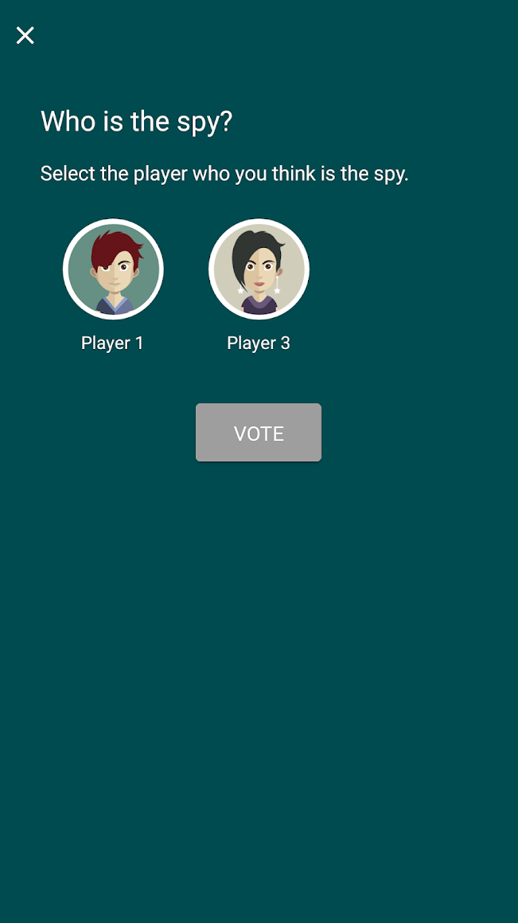

Slide 18

Mafia Online

Slide 19
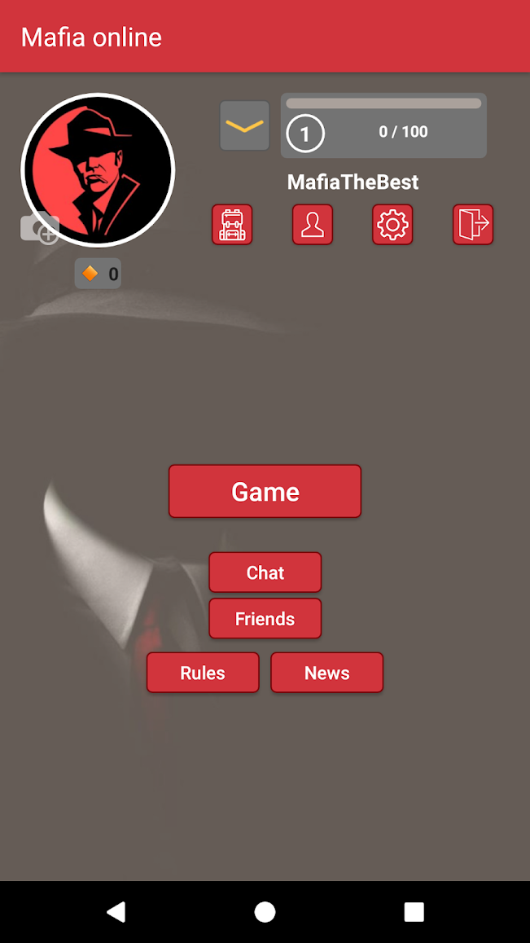

Slide 20
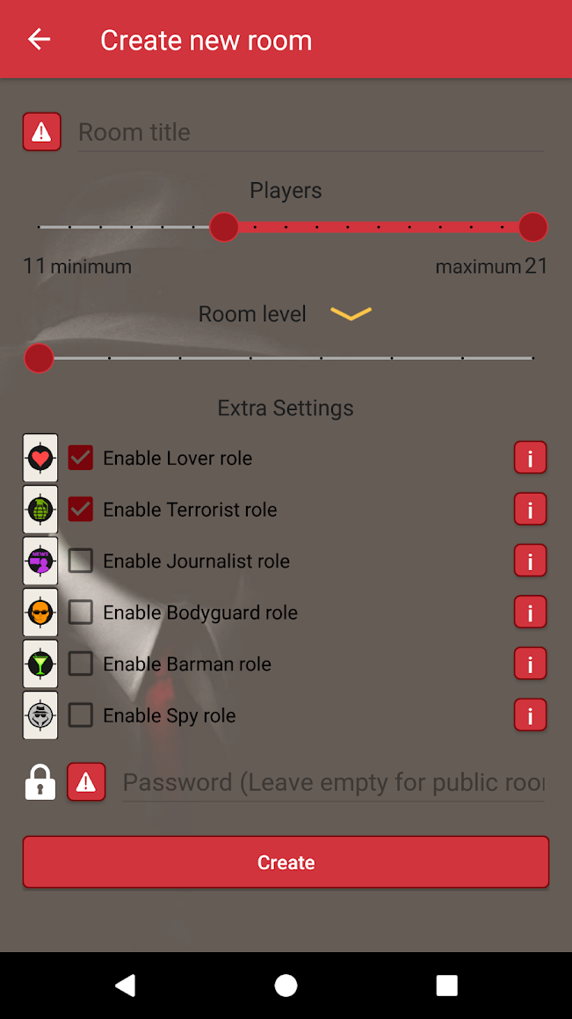

Slide 21
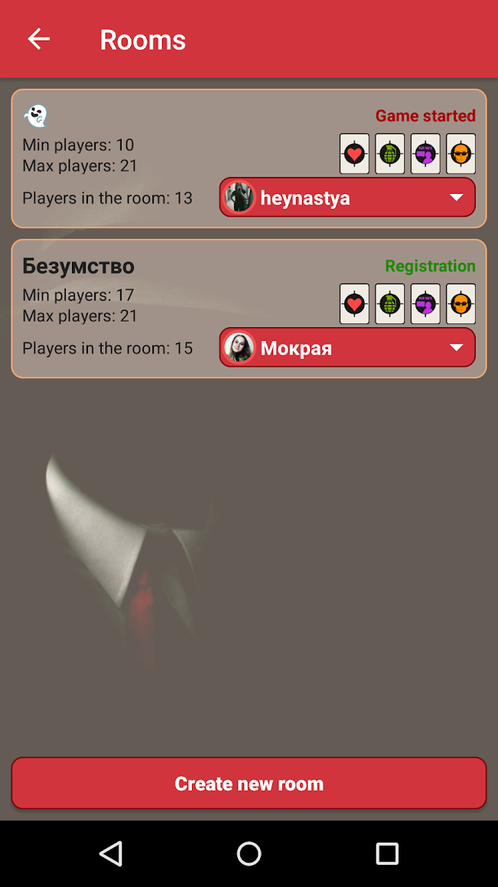

Slide 22
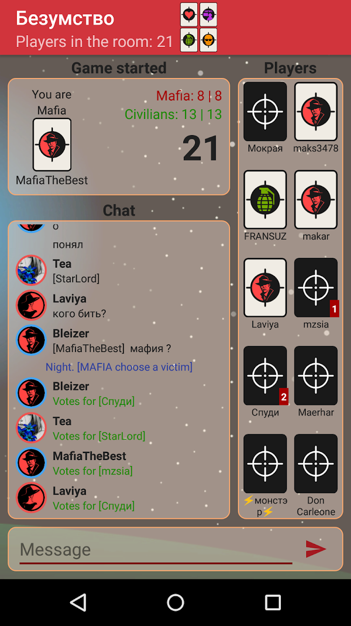

Slide 23
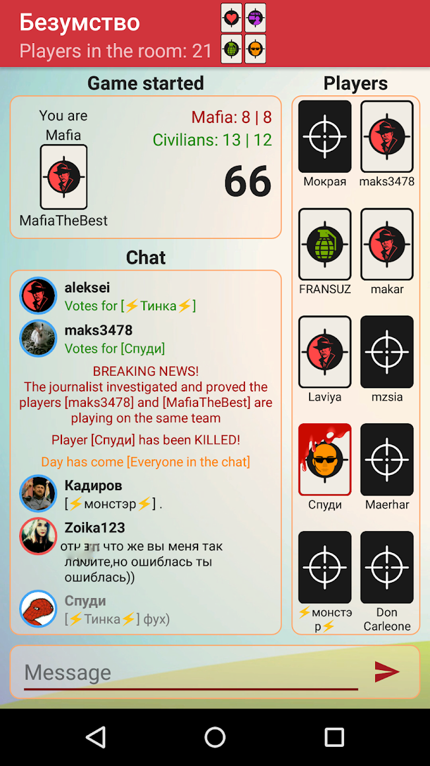

Slide 24

Heads Up!

Slide 25

Guess Up

Slide 26

Charades

Slide 27

Psych! Outwit Your Friends

Slide 28

Words with Friends 2

Slide 29

Draw It

Slide 30

Coup

Slide 31

Battle Text

Slide 32

Scattegories

Slide 33

Taboo

Slide 34

Would You Rather?

Slide 35

Hangman Free

Slide 36

Scrabble

Slide 37

Boggle with Friends

Slide 38

2 Pictures 1 Word

Slide 39

Word Search Online

Slide 40

Just Riddles

Slide 41

Match-UP Learn English

Slide 42

Wheel of Fortune

Slide 43

Epic!

Slide 44

Draw a Stickman EPIC

Slide 45

Selfie Games: Group TV Party
Game (draw and guess)

Slide 46

FarFaria

Slide 47

Curious World*

Slide 48

Triple Agent

Slide 49

Escape Team

Slide 50
…and many
hidden objects apps

Slide 51
ESL toybox
www.esltoybox.com

