Slide 1
Greatest
Canadian

Slide 2
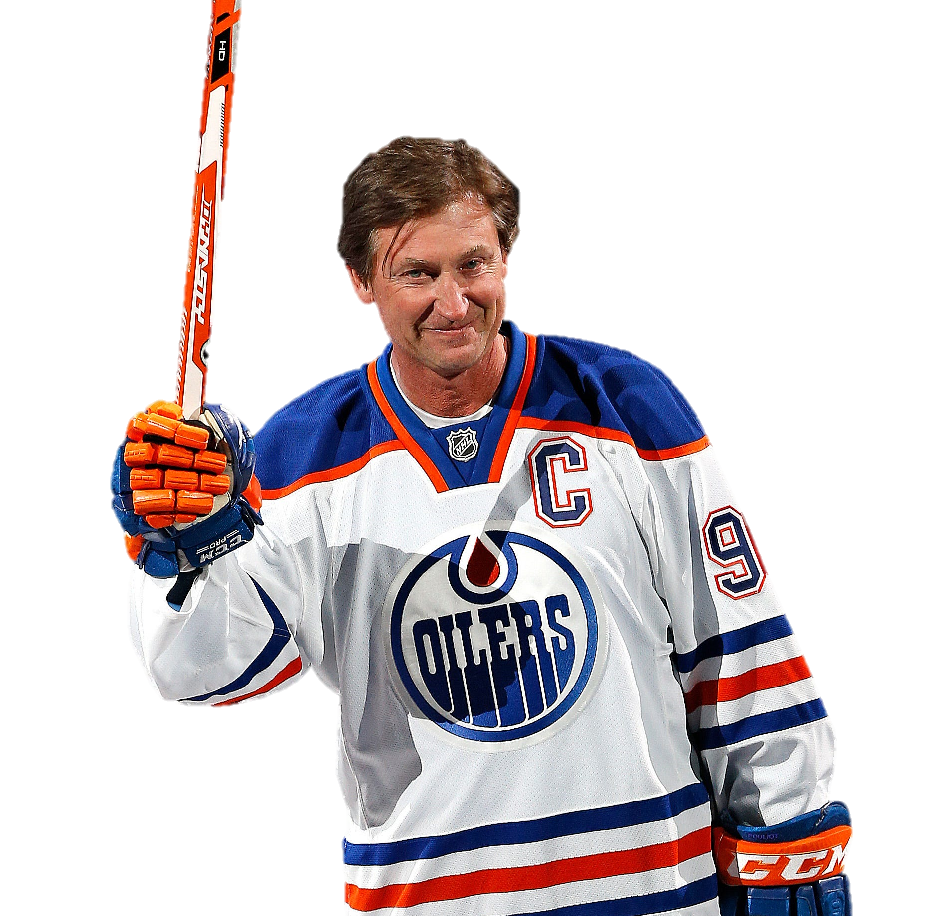
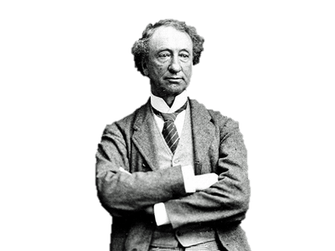
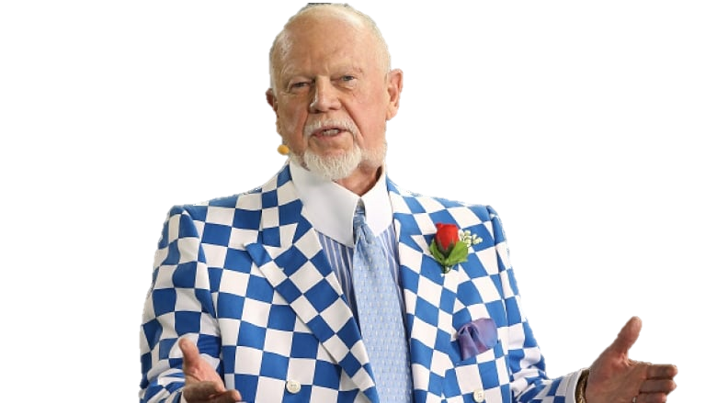
Hockey Player
Wayne
Gretzky
Prime Minister
John a.
MacDonald
Hockey Commentator
Don Cherry

Slide 3
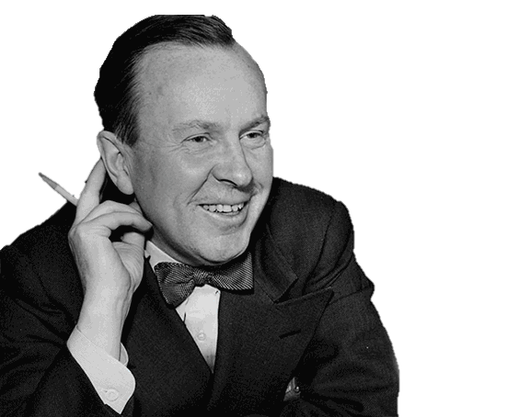
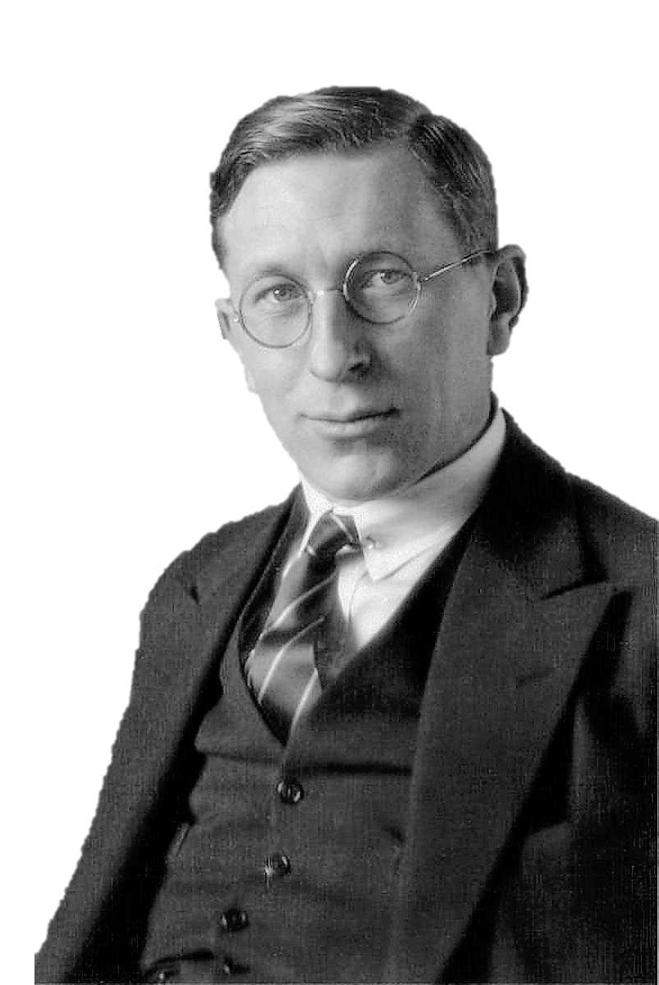
Prime Minister
Lester B.
Pearson
Environmentalist
David
Suzuki
Scientist
Sir Frederick
Banting

Slide 4
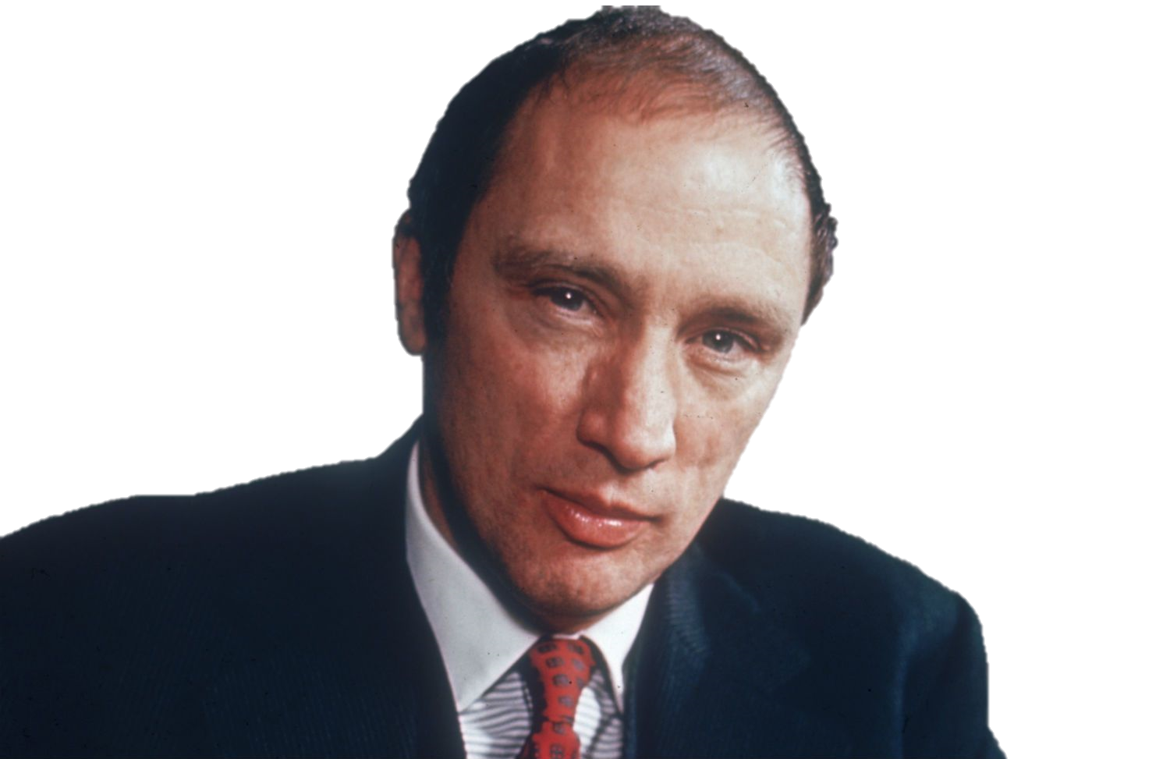
Prime Minister
Pierre Elliot
Trudeau
Athlete
Terry fox
Premier of Saskatchewan
Tommy
Douglas

Slide 5
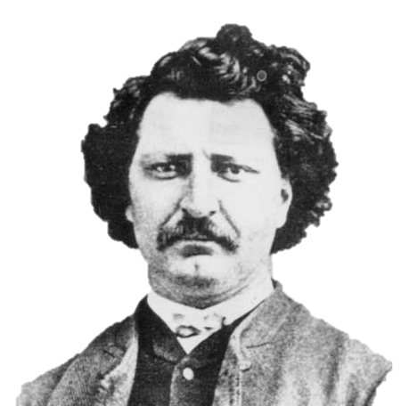
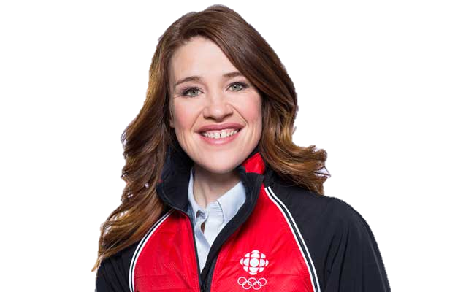
Leader of Metis
Louis riel
Singer
Gord Downie
Athlete / Advocate
Clara
Hughes

Slide 6
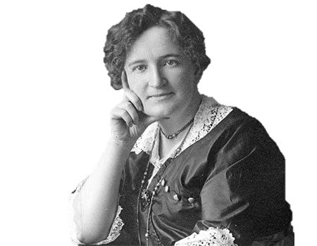
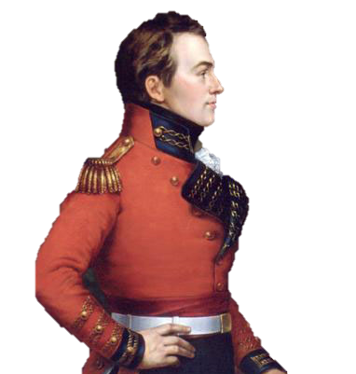
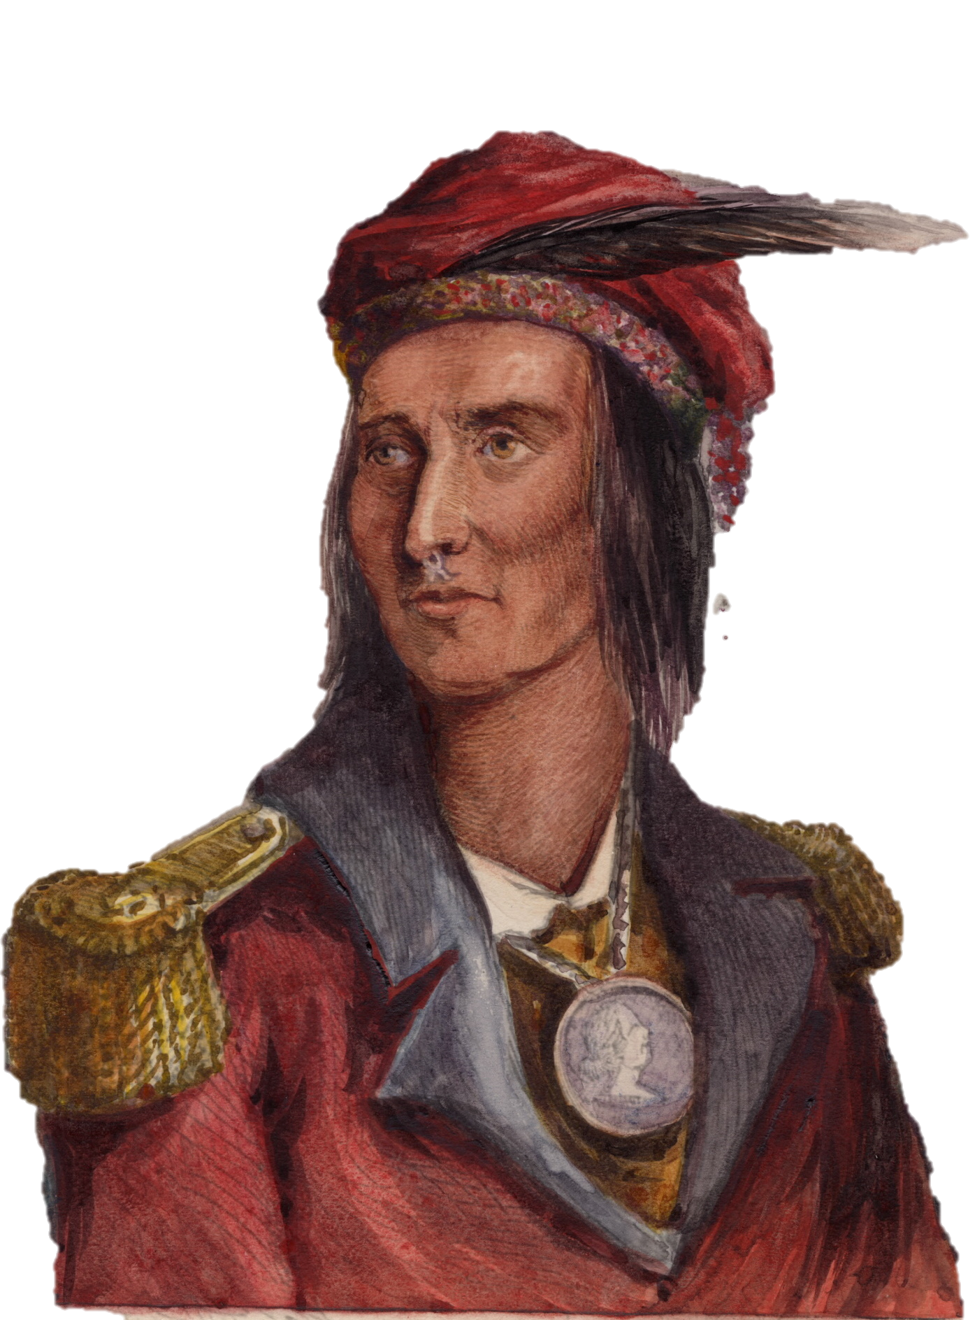
Activist
Nellie
McClung
Major-General
Isaac Brock
Chief
Tecumseh

Slide 7
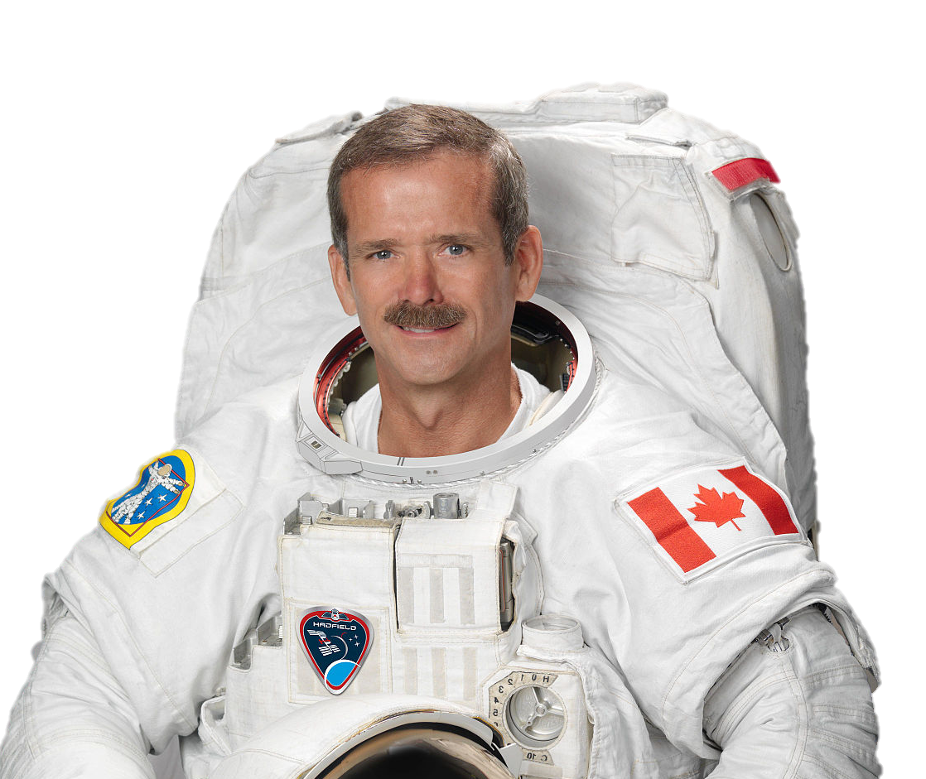
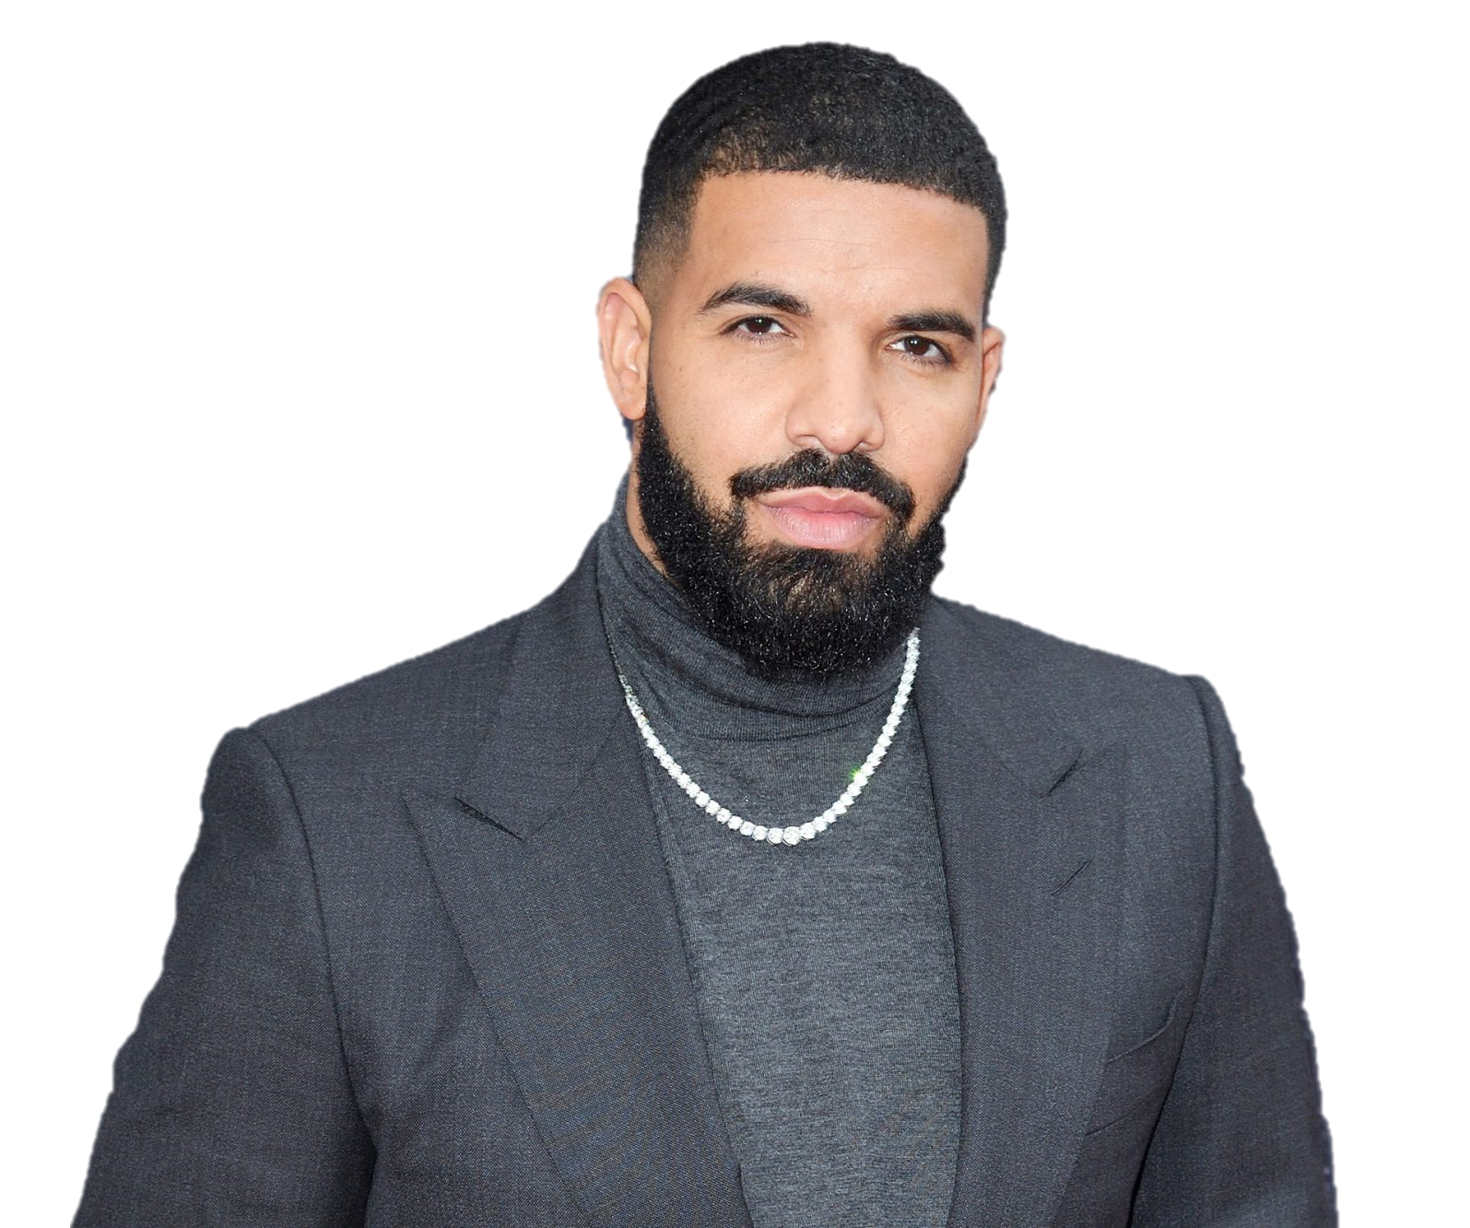
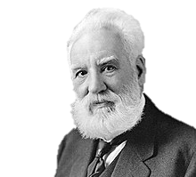
Astronaut
Chris
Hadfield
Singer
drake
Inventor
Alexander
Graham bell

Slide 8
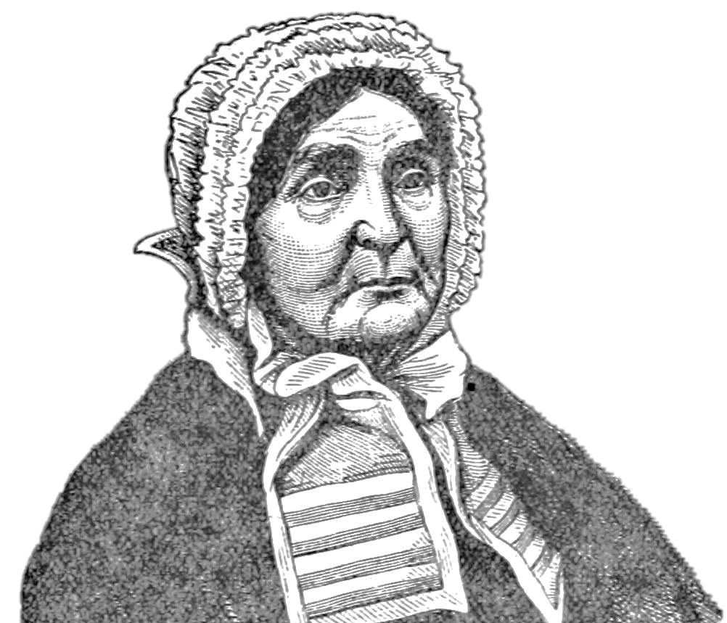
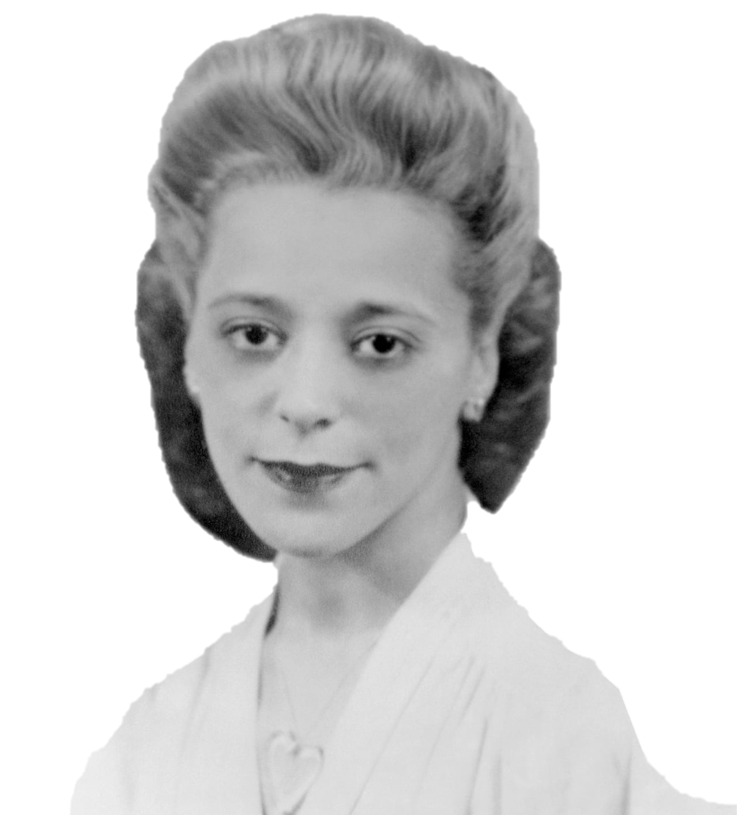
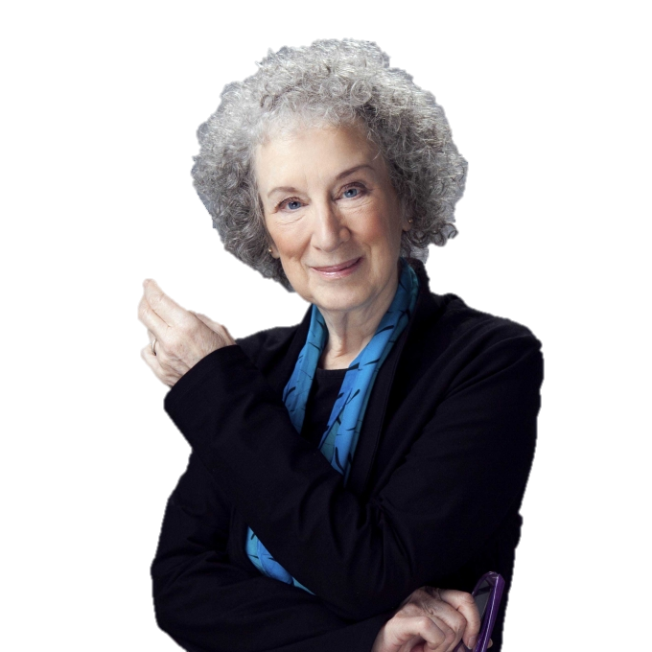
Heroine
Laura Secord
Activist
Viola Desmond
Writer
Margaret
Atwood

