Slide 1
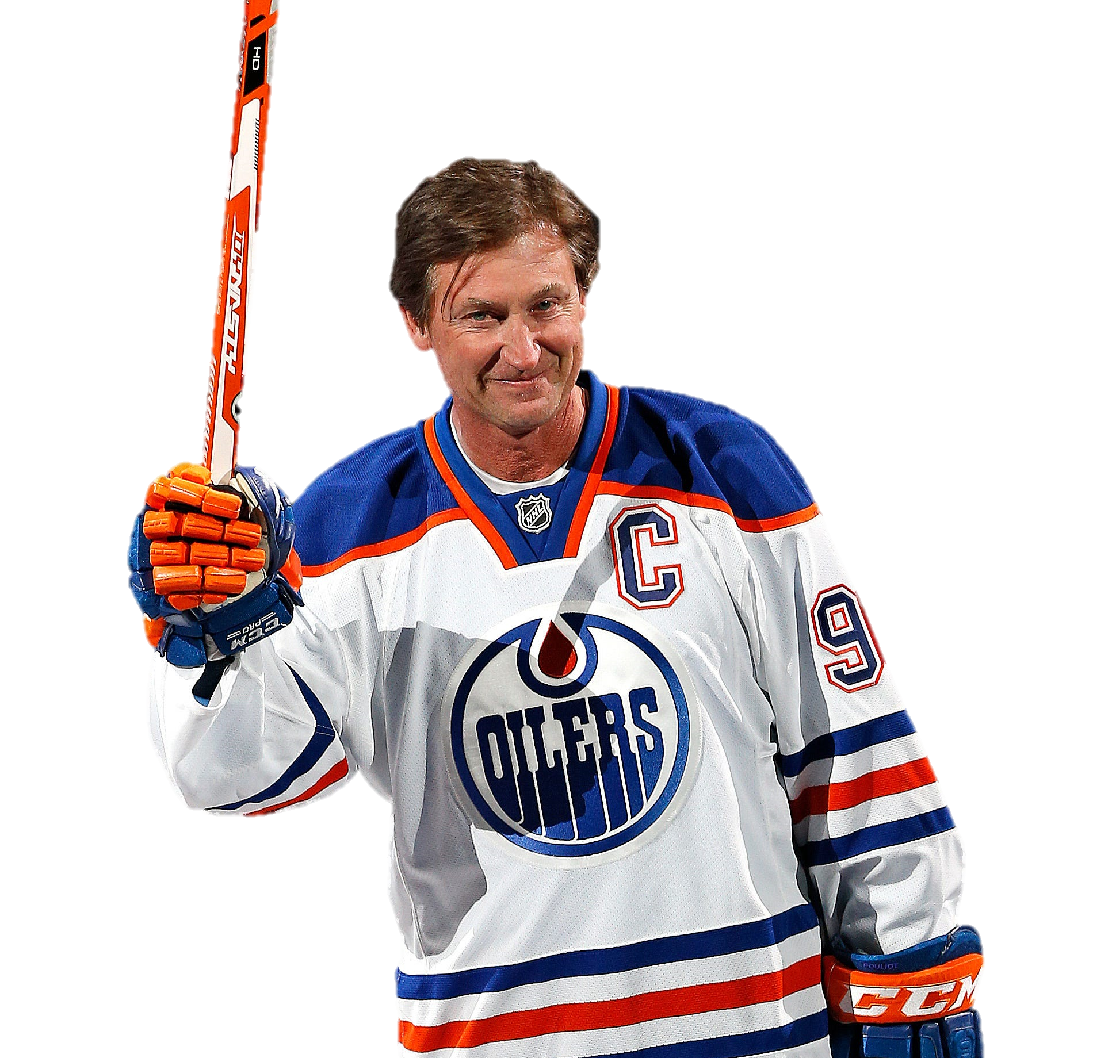
Wayne
Gretzky
Hockey
Player

Slide 2
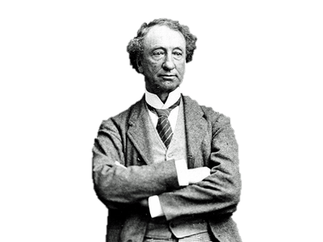
John A.
MacDonald
Prime
Minister

Slide 3
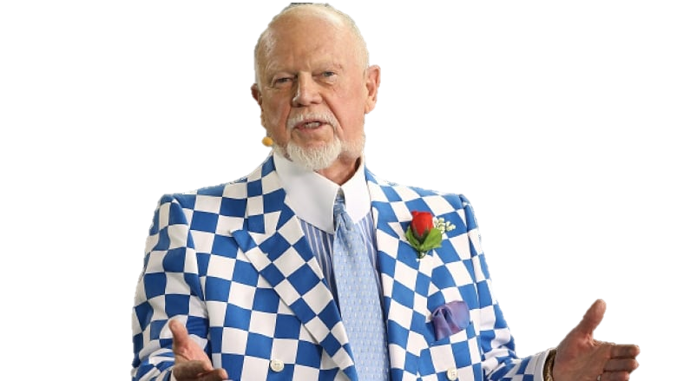
Don
Cherry
Hockey
Commentator

Slide 4
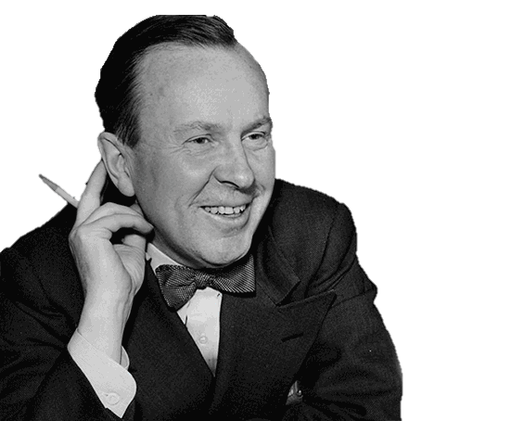
Lester B.
Pearson
Prime Minister

Slide 5
David
Suzuki
Environmentalist

Slide 6
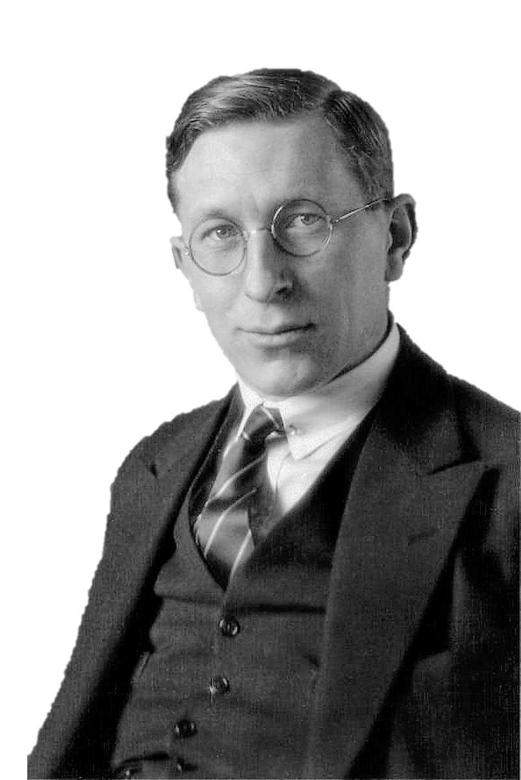
Frederick
Banting
Scientist

Slide 7
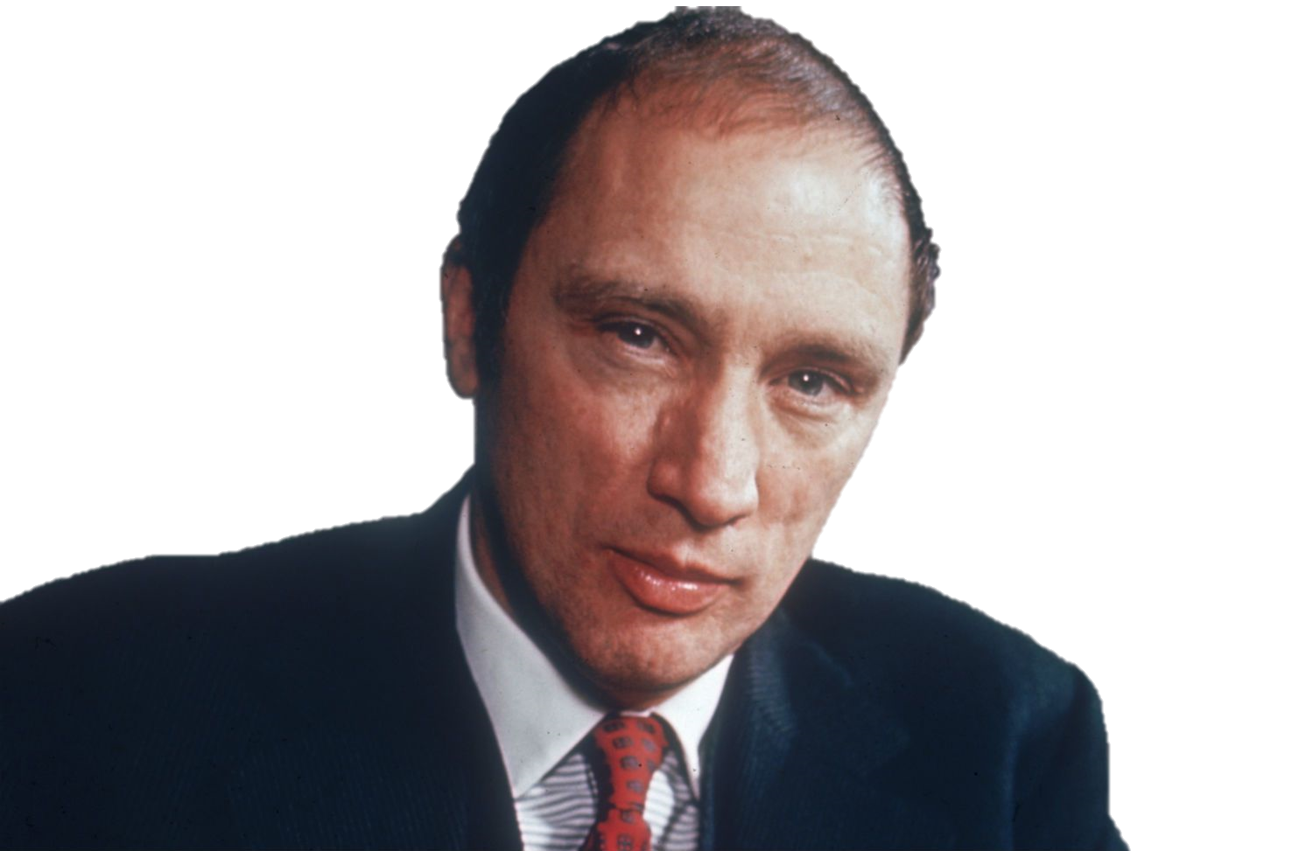
Pierre Elliot
Trudeau
Prime
Minister

Slide 8
Terry Fox
Athlete

Slide 9
Tommy
Douglas
Premier of
Saskatchewan

Slide 10
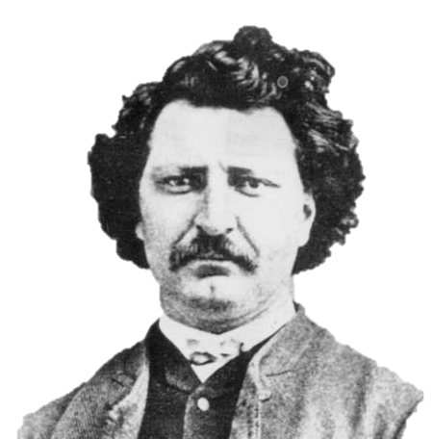
Louis Riel
Metis Leader

Slide 11
Gord
Downie
Singer

Slide 12
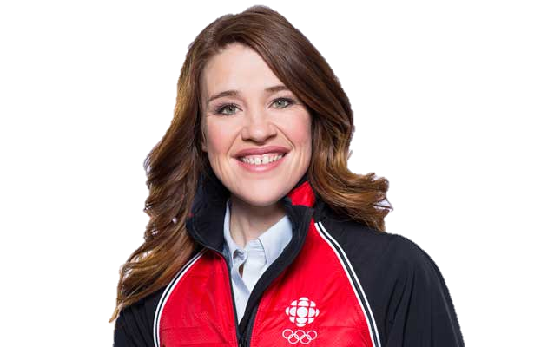
Clara
Hughes
Athlete

Slide 13
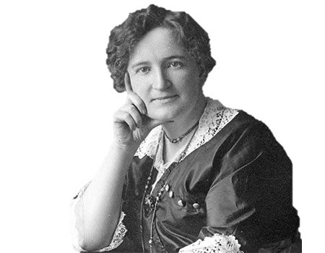
Nellie
McClung
Activist

Slide 14
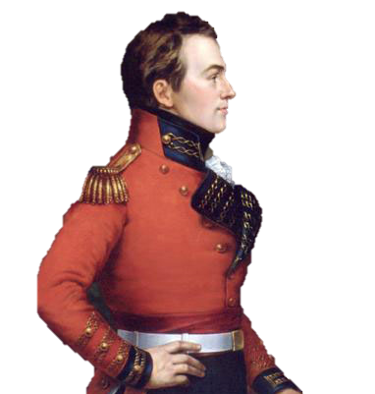
Isaac
Brock
Major-General

Slide 15
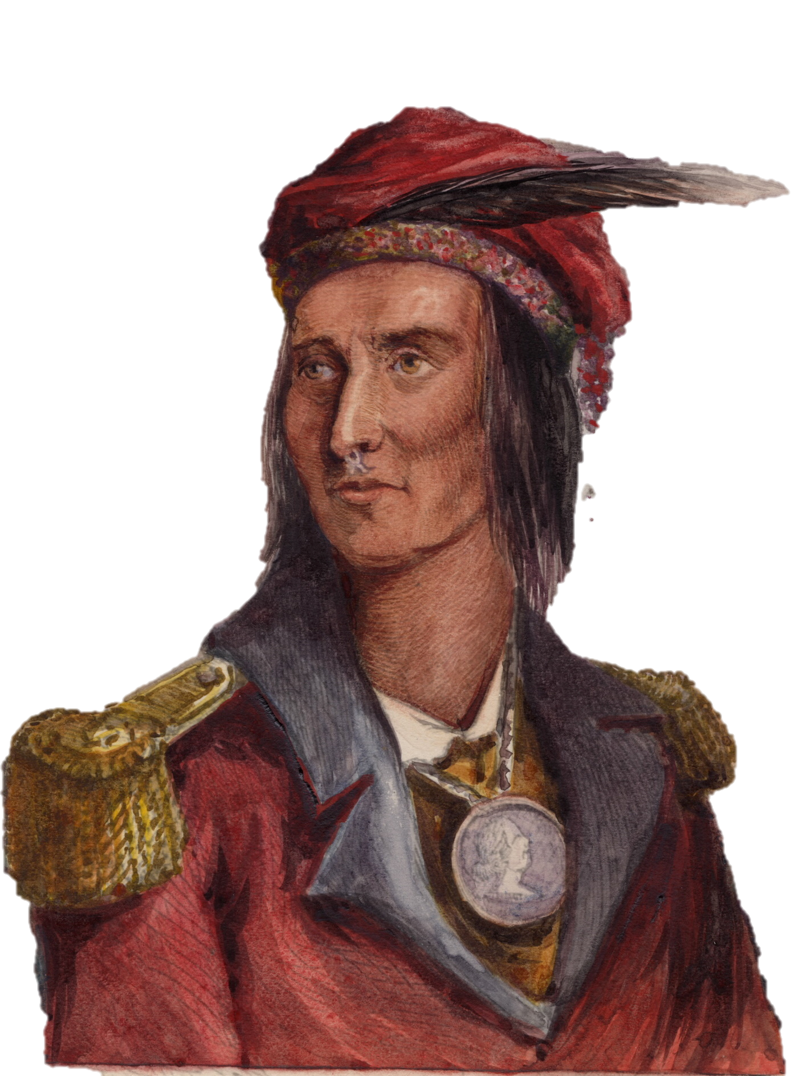
Tecumseh
Chief

Slide 16
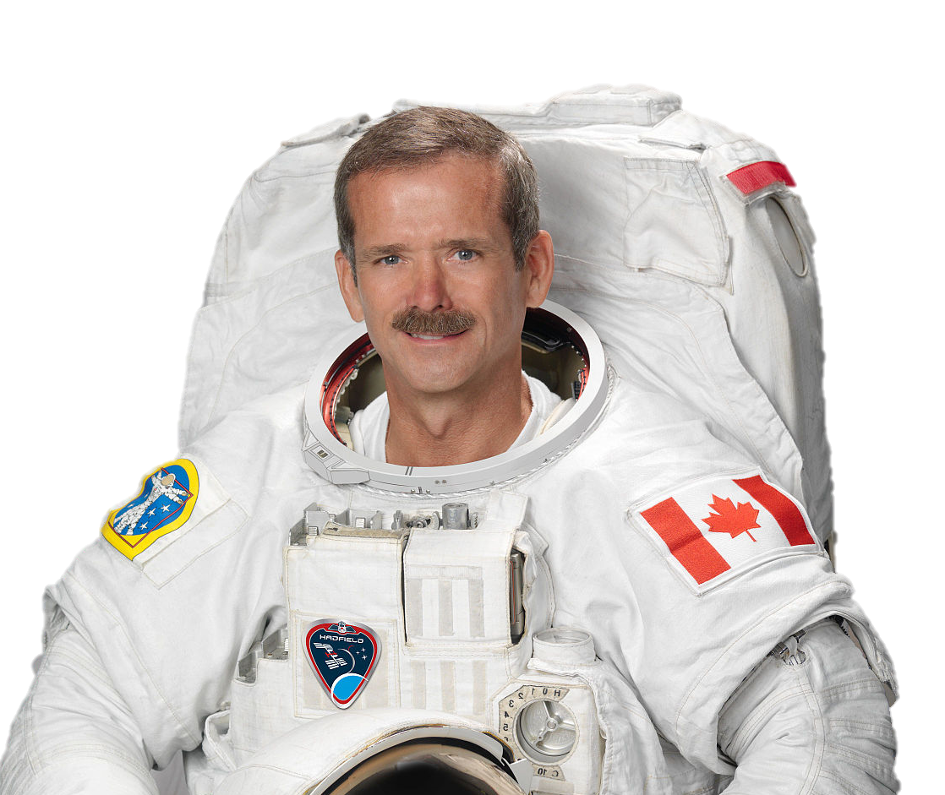
Chris
Hadfield
Astronaut

Slide 17
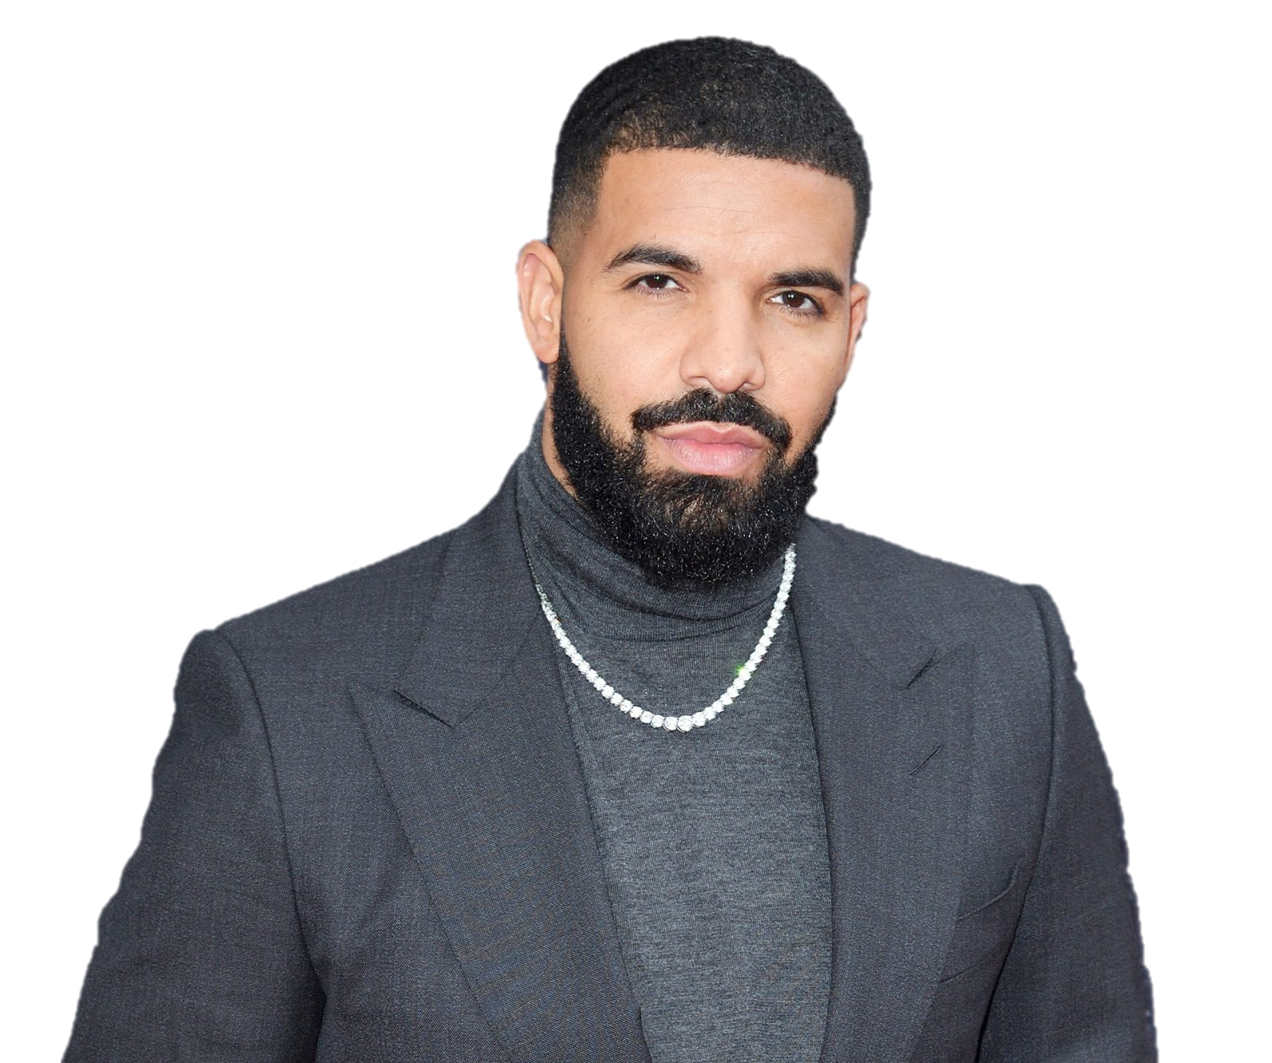
Drake
Singer

Slide 18
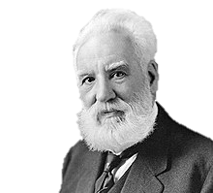
Alexander
Graham Bell
Inventor

Slide 19
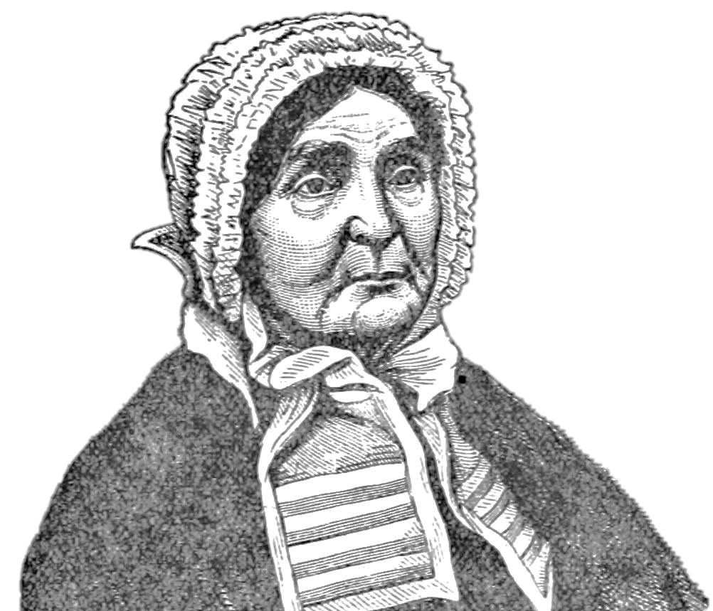
Laura
Secord
Heroine

Slide 20
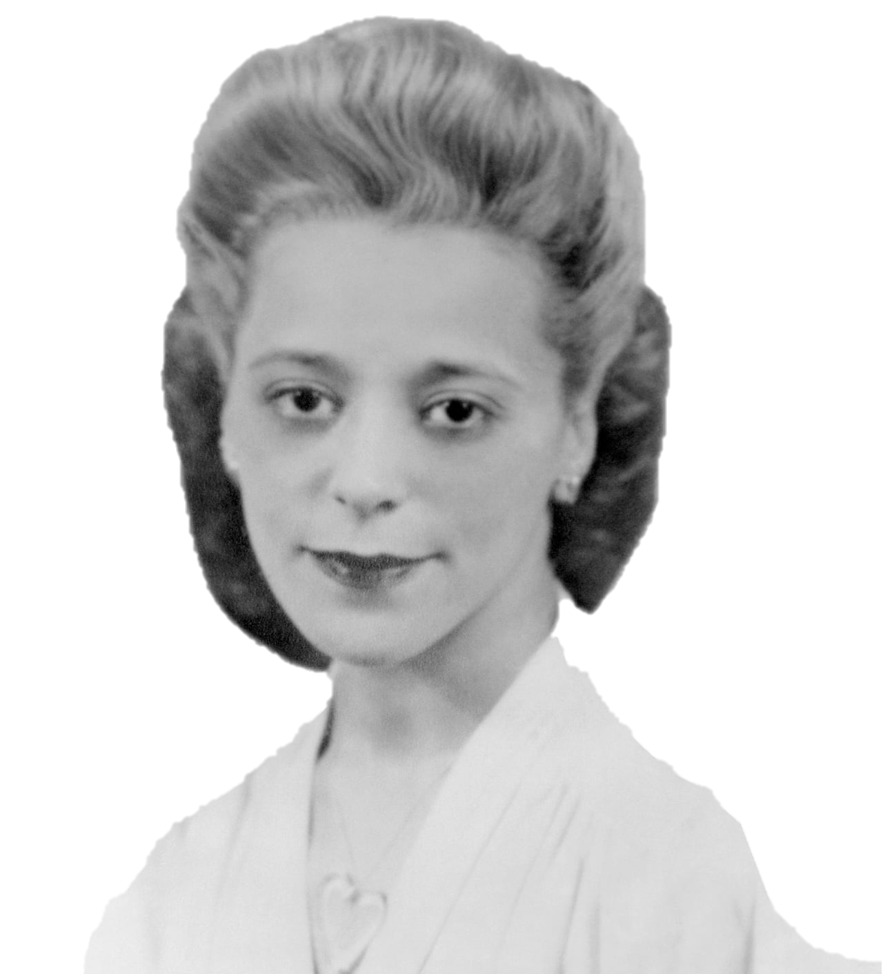
Viola
Desmond
Activist

Slide 21
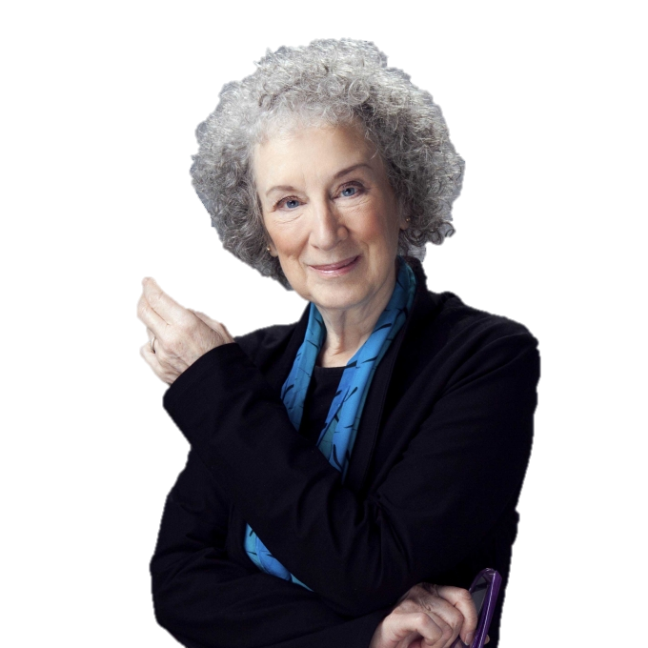
Margaret
Atwood
Writer

