Slide 1
Communication Games

Slide 2
Types of Communication based games
Group Work
Quizlet
Pennies
SpaceTeam
1 vs Class
Keep Talking and No One Explodes
Hot Seat
WikiRace
Independent
Drawing Evolution
Process of Elimination

Slide 3
Notes:
ID: findbgj Pw: Shim1975

Slide 4
www.quizlet.live
Notes:
ID: findbgj Pw: Shim1975

Slide 5
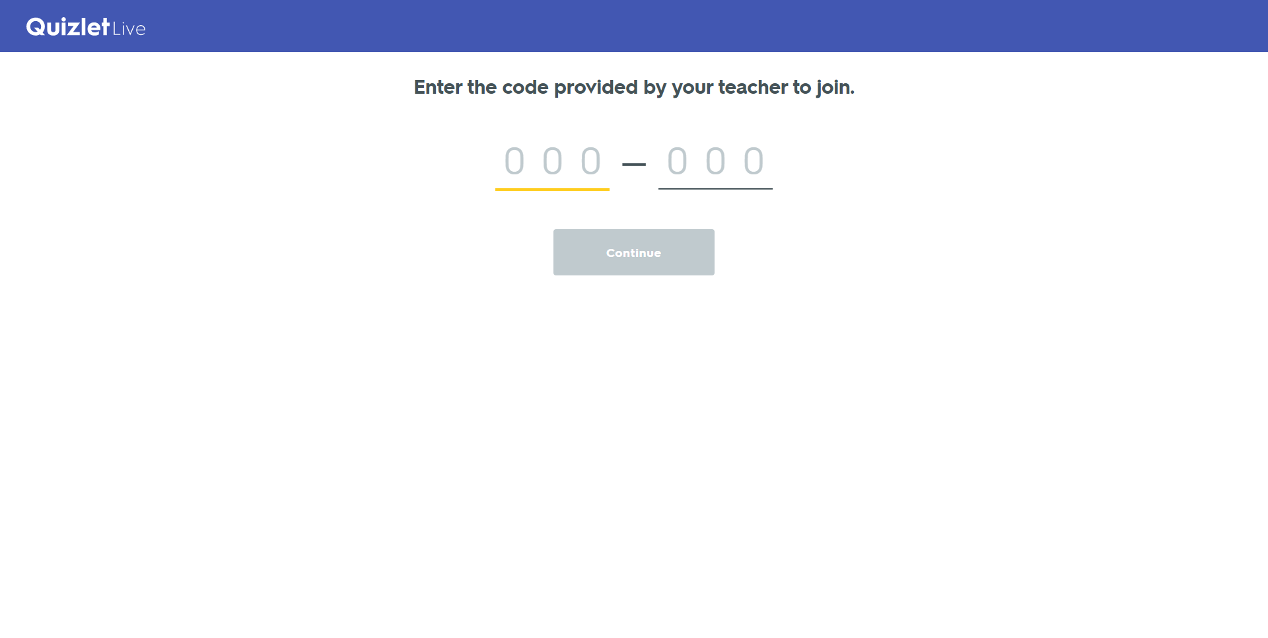
Notes:
ID: findbgj Pw: Shim1975

Slide 6
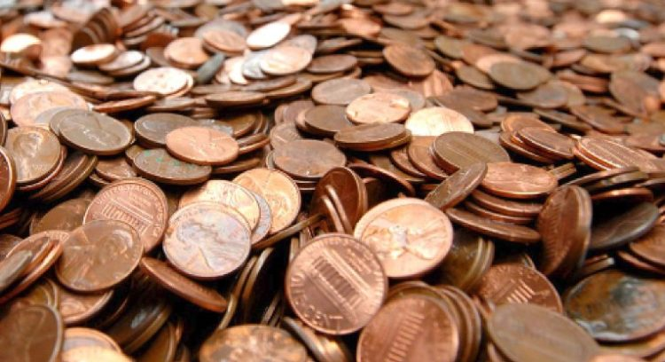
Pennies

Slide 7
Which is correct?
A.
B.
C.
D.
E.
F.
2008
한국은행
2008
한국은행
100
100
100
100
한국은행
2008
대한민국
2008
G.
H.
I.
J.
K.
L.
2008
2008
2008
대한민국
100원
100
100
100원
한국은행
대한민국
한국은행
2008

Slide 8
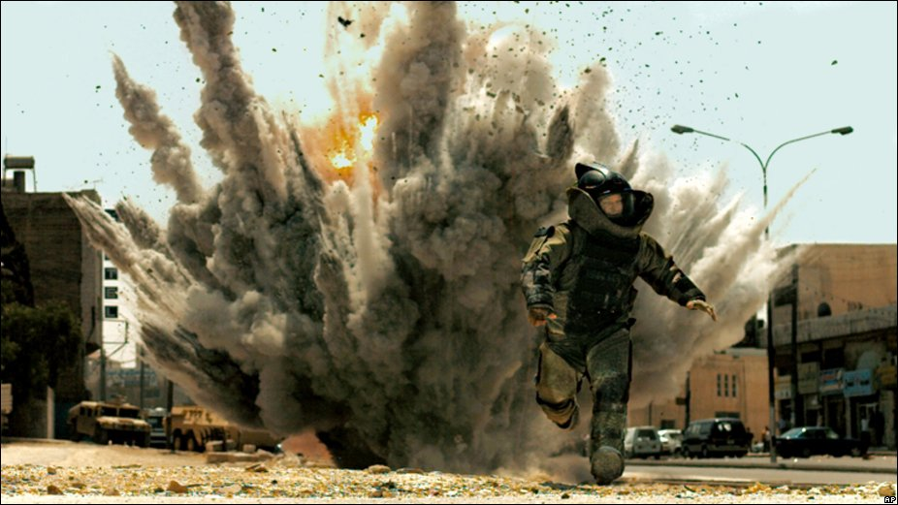
Keep Talking and No One Explodes
https://www.youtube.com/watch?v=BYunaBkn9Ng

Slide 9
Your job is to disarm the bombs.
Work together
Use the Manuals

Slide 10
How to Play
One person can see the bomb.
They must describe the bomb
The other students must work together to tell them how to disarm the bomb.
(First game will all see it.)

Slide 11
The Bomb
Handle
Animals
Symbols
Letters
Numbers
Lights
Clock
Wires
Barcode

Slide 12
https://www.youtube.com/watch?v=ymwSbxUDtTw

Slide 15
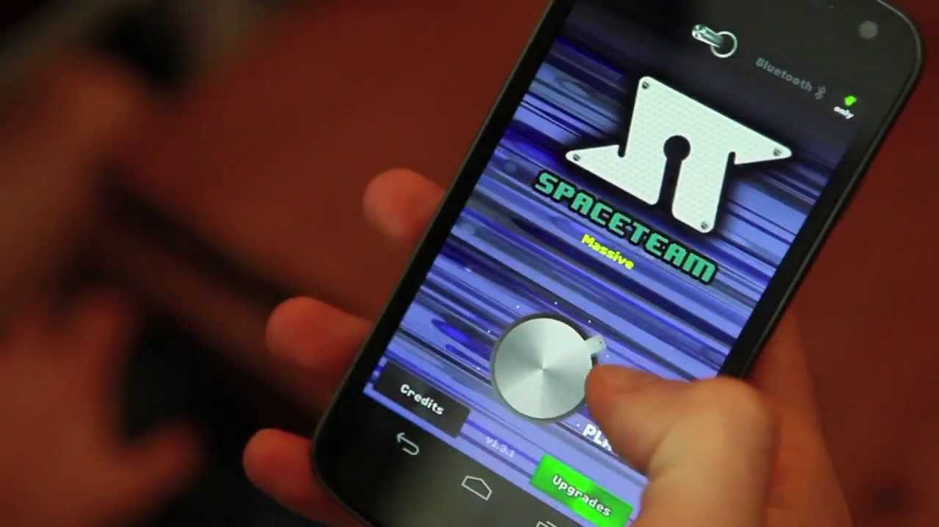

Slide 16
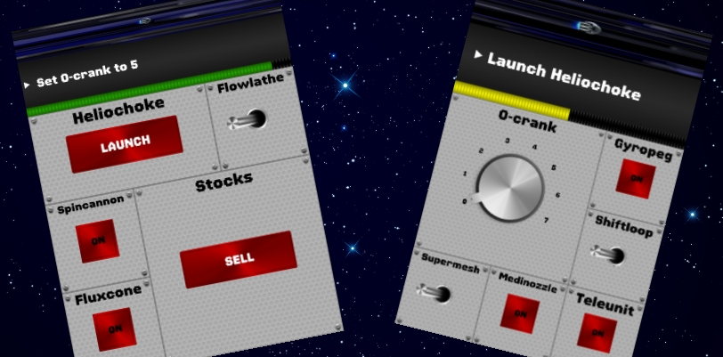

Slide 17
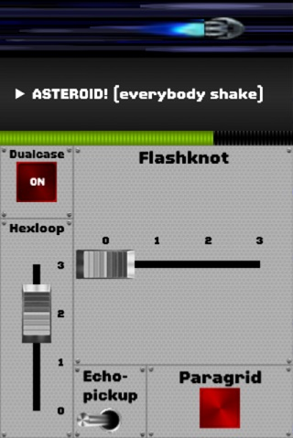

Slide 18
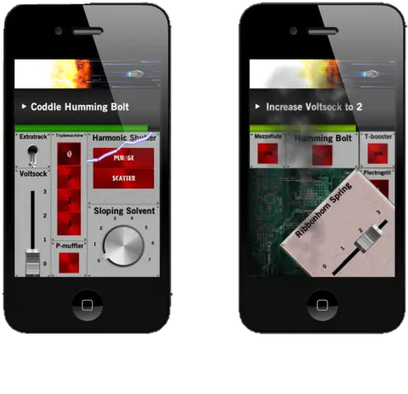

Slide 22
https://www.youtube.com/watch?v=cDIQhJH2ahY

Slide 23
How to Play
Choose a starting a ending word that are not related.
Using only the links in the Wikipedia article, can you get to the ending word?
Don’t use “references” or “see also”

Slide 25
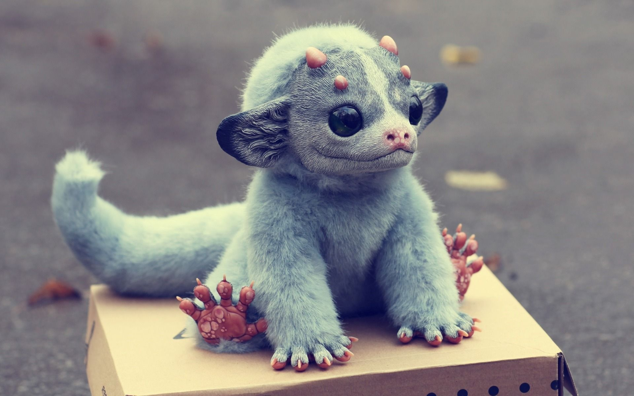
Drawing Evolution

Slide 26
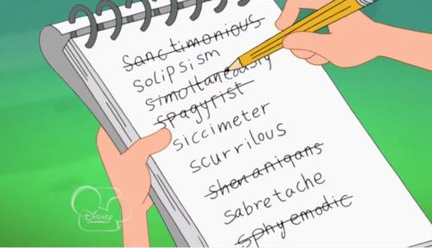
Process of Elimination

