Slide 1
Fluency vs Accuracy
..and how language is taught

Slide 2
Fluency
Fluency is the ability to produce language in a coherent, effortless way.

Slide 3
Accuracy
Accuracy is the ability to produce grammatically and lexically accurate English sentences.

Slide 4
Flingledobe and Pribin (Lavoie, 1989)
Last Serny, Flingledobe and Pribin were in the Berdlink treppening gloopy caples and cleaming burly greps. Suddenly, a ditty strezzle boofed into Flingledobe’s tresk. Pribin glaped. “Oh Flingledobe,” he chifed, “that ditty strezzle is tunning in your grep!”
Lavoie, R.D. Understanding Learning Disabilities - How Difficult Can It Be? PBS Video. Alexandria, VA. 1989
Notes:
https://www.youtube.com/watch?v=Q3UNdbxk3xs

Slide 5
Flingledobe and Pribin (Lavoie, 1989)
Last Serny, Flingledobe and Pribin were in the Berdlink treppening gloopy caples and cleaming burly greps. Suddenly, a ditty strezzle boofed into Flingledobe’s tresk. Pribin glaped. “Oh Flingledobe,” he chifed, “that ditty strezzle is tunning in your grep!”
When did they go to Berdlink?

Slide 6
Flingledobe and Pribin (Lavoie, 1989)
Last Serny, Flingledobe and Pribin were in the Berdlink treppening gloopy caples and cleaming burly greps. Suddenly, a ditty strezzle boofed into Flingledobe’s tresk. Pribin glaped. “Oh Flingledobe,” he chifed, “that ditty strezzle is tunning in your grep!”
Where did Flingledobe and Pribin treppen?

Slide 7
Flingledobe and Pribin (Lavoie, 1989)
Last Serny, Flingledobe and Pribin were in the Berdlink treppening gloopy caples and cleaming burly greps. Suddenly, a ditty strezzle boofed into Flingledobe’s tresk. Pribin glaped. “Oh Flingledobe,” he chifed, “that ditty strezzle is tunning in your grep!”
What boofed into Flingledobe’s tresk?

Slide 8
Flingledobe and Pribin (Lavoie, 1989)
Last Serny, Flingledobe and Pribin were in the Berdlink treppening gloopy caples and cleaming burly greps. Suddenly, a ditty strezzle boofed into Flingledobe’s tresk. Pribin glaped. “Oh Flingledobe,” he chifed, “that ditty strezzle is tunning in your grep!”
What kind of caples did Flingledobe and Pribin treppen?

Slide 9
Flingledobe and Pribin (Lavoie, 1989)
Last Serny, Flingledobe and Pribin were in the Berdlink treppening gloopy caples and cleaming burly greps. Suddenly, a ditty strezzle boofed into Flingledobe’s tresk. Pribin glaped. “Oh Flingledobe,” he chifed, “that ditty strezzle is tunning in your grep!”
What did the ditty strezzle do to Flingledobe’s tresk?

Slide 10
Flingledobe and Pribin (Lavoie, 1989)
Last Serny, Flingledobe and Pribin were in the Berdlink treppening gloopy caples and cleaming burly greps. Suddenly, a ditty strezzle boofed into Flingledobe’s tresk. Pribin glaped. “Oh Flingledobe,” he chifed, “that ditty strezzle is tunning in your grep!”
What was Pribin’s reaction at that point?

Slide 11
Flingledobe and Pribin (Lavoie, 1989)
Last Serny, Flingledobe and Pribin were in the Berdlink treppening gloopy caples and cleaming burly greps. Suddenly, a ditty strezzle boofed into Flingledobe’s tresk. Pribin glaped. “Oh Flingledobe,” he chifed, “that ditty strezzle is tunning in your grep!”
What do you think happened next?

Slide 12
Flingledobe and Pribin (Lavoie, 1989)
Last Serny, Flingledobe and Pribin were in the Berdlink treppening gloopy caples and cleaming burly greps. Suddenly, a ditty strezzle boofed into Flingledobe’s tresk. Pribin glaped. “Oh Flingledobe,” he chifed, “that ditty strezzle is tunning in your grep!”
Why do you think Flingledobe and Pribin went to Berlink.
Are they likely to return? Why? Why not?

Slide 13
Flingledobe and Pribin (Lavoie, 1989)
There is no meaning.
It’s easy to think you are learning something when you really are not.
Students have opinions. Ask questions that make students think about the language and use it creatively. Develops a deeper understanding of the material

Slide 14
Flingledobe and Pribin (Lavoie, 1989)
Fluency vs Accuracy
Meaning vs Grammar

Slide 15
Fluency
When teaching for fluency, there is less emphasis on being correct and more emphasis on using the language. The goal of fluency-based teaching is comprehension. Students are better able to understand meaning through this approach. Fluency-based teaching has been shown to be more useful for learning a language, but it might not always be the best technique for teaching Korean high school students.

Slide 16
Fluency
When we focus on fluency activities we: * reflect natural language use * deal with grammar implicitly. * encourage free production of the language. * reflect automatic performance. * produce language that is not always predictable. * require the use of improvising, paraphrasing, repair and reorganization. * require real communication.

Slide 17
Accuracy
In accuracy-based teaching, the emphasis is on being correct. Proper grammar and sentence structure is prioritized over understanding. Accuracy-based teaching is quite common in Korea as students prepare to take the SATs. It is also much easier to make test questions for accuracy rather than fluency.

Slide 18
Accuracy
When we focus on accuracy activities we: * focus on forming correct examples of language use. * produce language in a controlled way. * deal with grammar explicitly. * insist on receiving grammatically correct and complete sentences. * practice language out of context. * practice small samples of language. * do not require authentic communication.

Slide 19
Discussion:
What is more important in learning a foreign language?
Fluency or accuracy?

Slide 20
Fluency or Accuracy
Grammar exercises
Conversation
Role-play
Drills
Debate
Spelling Quizzes
Comprehension Check Questions

Slide 21
Suneung Question
By the early 1990s, gray wolves (A) had begun / have begun to disappear from Yellowstone National Park in the US, and this resulted in a growing elk population. The elk ate too many leaves from the trees, which reduced shade along the rivers and creeks. This caused water temperatures to increase and the populations of many fish species in the park (B) declined / had declined. To restore balance to Yellowstone’s ecosystem, sixty-six gray wolves from Canada were released into the park. As a result, the number of elk quickly dropped. Now, the ecosystem has returned to its natural balance. This story shows how crucial some species are for the health of an entire ecosystem. If we (C) respect / will respect all species equally, we’ll be able to continue to enjoy the natural world.

Slide 22
Knowledge Activation
Themes
Prior knowledge
Key concepts
Reading / Listening
Teacher / Group / Independent …
Unfamiliar words
Key Phrases
Unfamiliar words
Keywords
Questions
Meaning
Grammar

Slide 23
Wolves Change Rivers
https://www.youtube.com/watch?v=ysa5OBhXz-Q

Slide 24
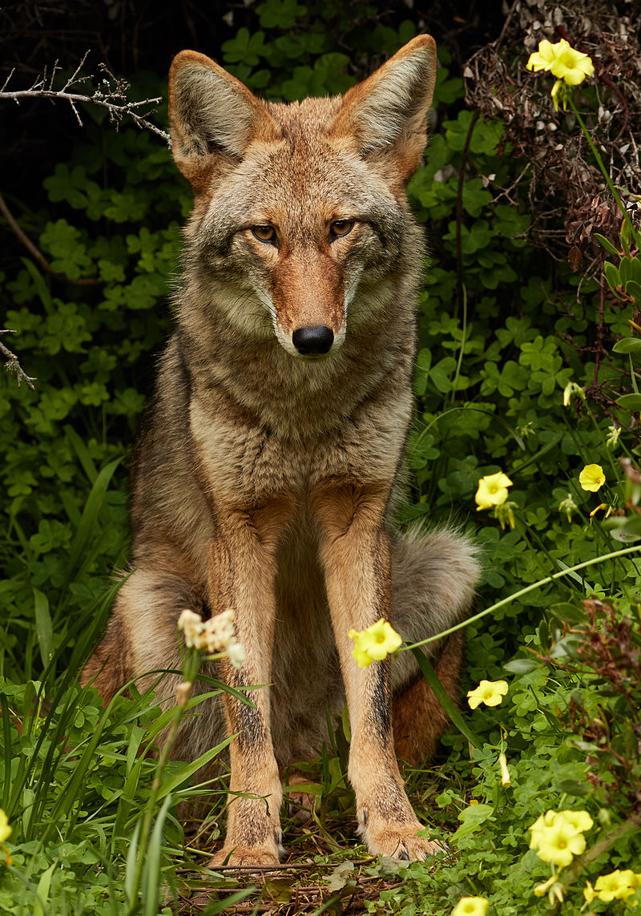
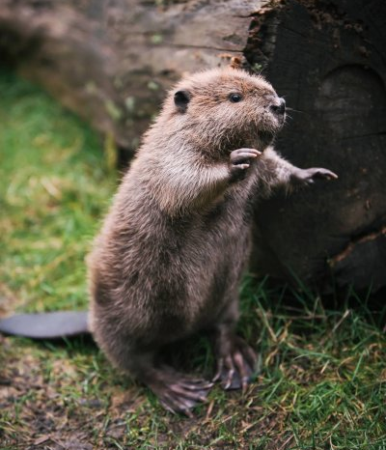
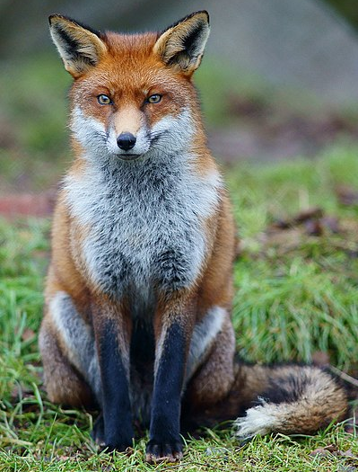
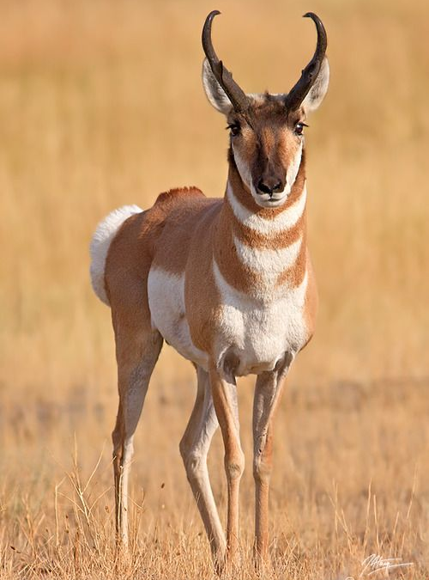
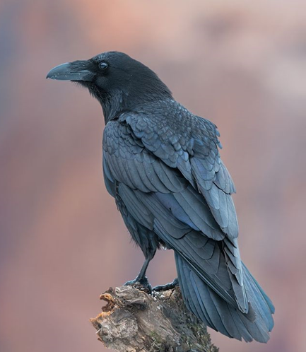
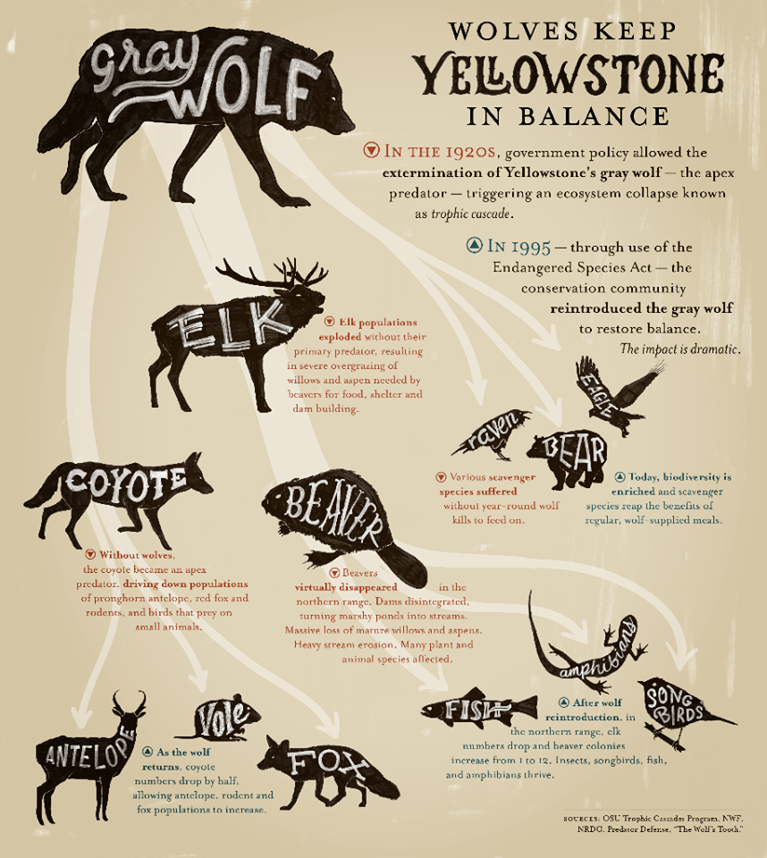
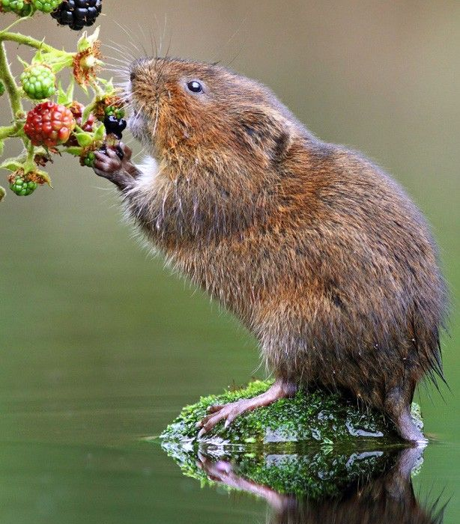
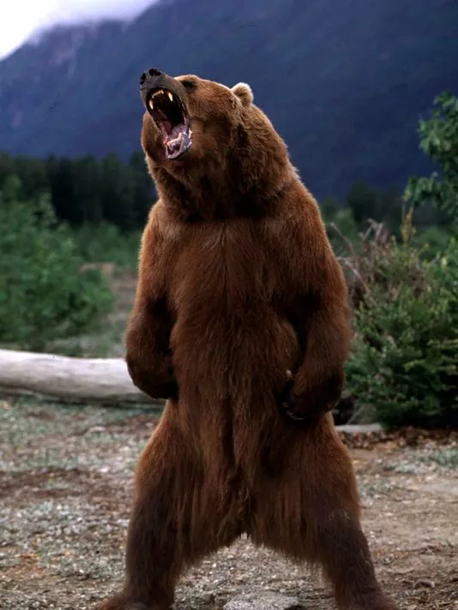
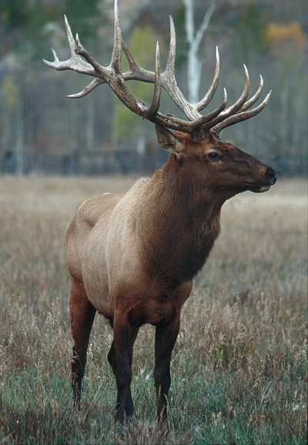
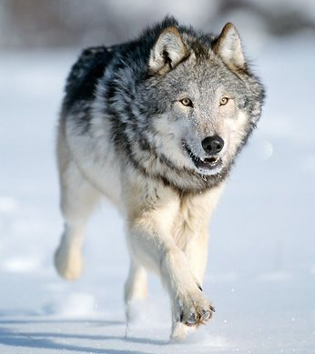

Slide 26
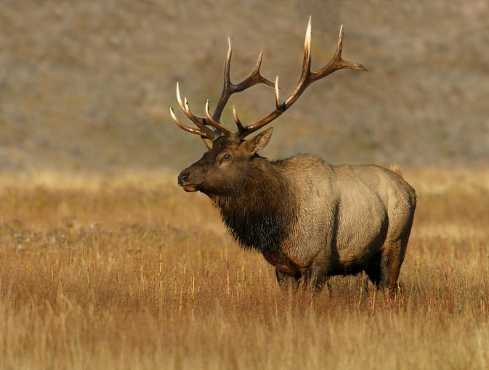
Who do you think eats elk?
Gray Wolves

Slide 27
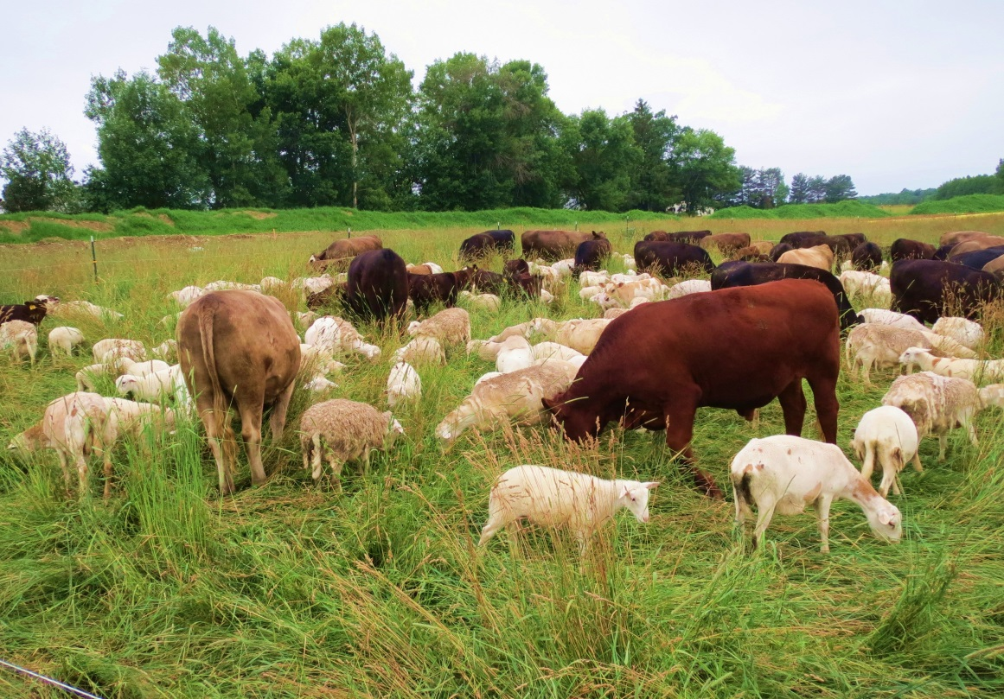
Who do you think ate farm animals?
Gray Wolves

Slide 28
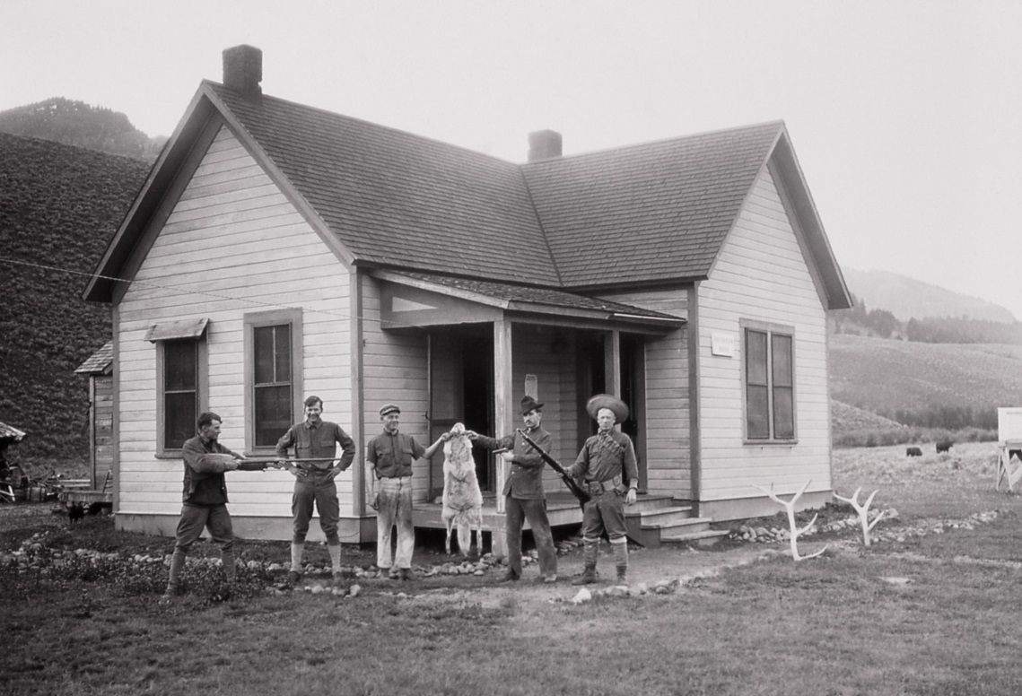
What do you think the farmers did?
They killed the Gray Wolves.

Slide 29
What would happen if the wolves disappeared?
There would be too many elk.

Slide 30
Why might that be bad?
Elk eat too much grass.

Slide 31
What would happen if we reintroduced gray wolves?

Slide 32
Wolves Change Rivers

Slide 33
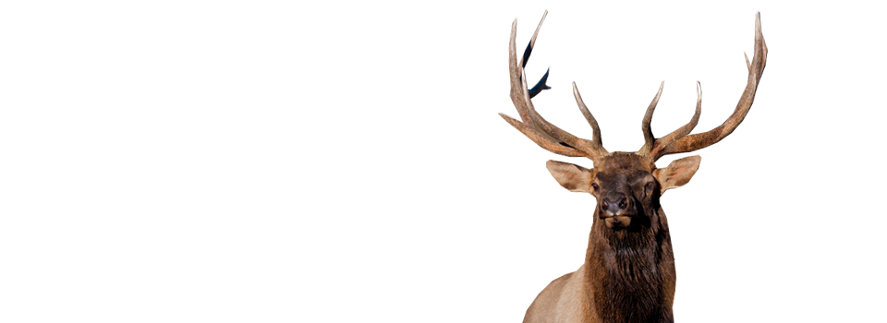
By the early 1990s, gray wolves (A) had begun / have begun to disappear from Yellowstone National Park in the US, and this resulted in a growing elk population.
By this time / Before this time…

Slide 34
What happened before the 1990s?
By the early 1990s, gray wolves (A) had begun / have begun to disappear from Yellowstone National Park in the US, and this resulted in a growing elk population.
Where?
Yellowstone National Park

Slide 35
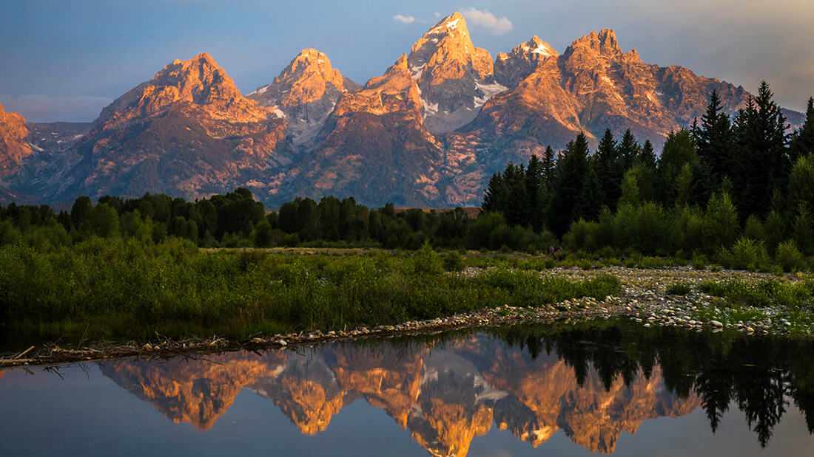

Slide 36
What was the result?
By the early 1990s, gray wolves (A) had begun / have begun to disappear from Yellowstone National Park in the US, and this resulted in a growing elk population.

Slide 37
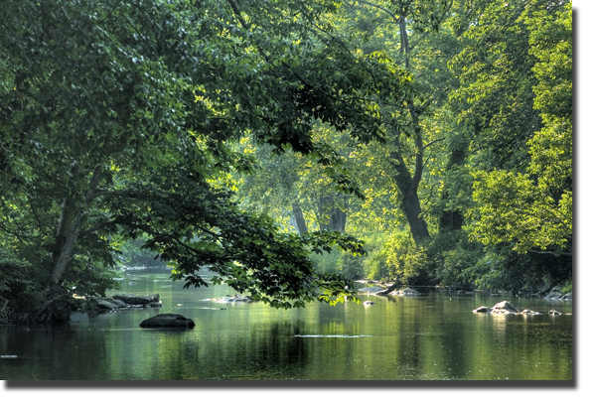
The elk ate too many leaves from the trees, which reduced shade along the rivers and creeks.

Slide 38
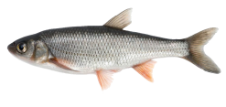
What caused it?
This caused water temperatures to increase and the populations of many fish species in the park (B) declined / had declined.
The elk ate the leaves…

Slide 39
What happened?
This caused water temperatures to increase and the populations of many fish species in the park (B) declined / had declined.

Slide 40
What happened?
This caused water temperatures to increase and the populations of many fish species in the park (B) declined / had declined.

Slide 41
What happened?
This caused water temperatures to increase and the populations of many fish species in the park (B) declined / had declined.

Slide 42
To restore balance to Yellowstone’s ecosystem, sixty-six gray wolves from Canada were released into the park.

Slide 43
To restore balance to Yellowstone’s ecosystem, sixty-six gray wolves from Canada were released into the park.
As a result, the number of elk quickly dropped.

Slide 44
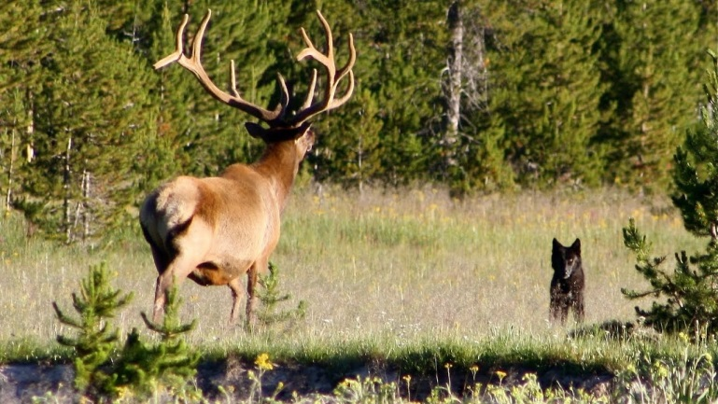
Now, the ecosystem has returned to its natural balance. This story shows how crucial some species are for the health of an entire ecosystem.

Slide 45
Now, the ecosystem has returned to its natural balance. This story shows how crucial some species are for the health of an entire ecosystem.

Slide 46
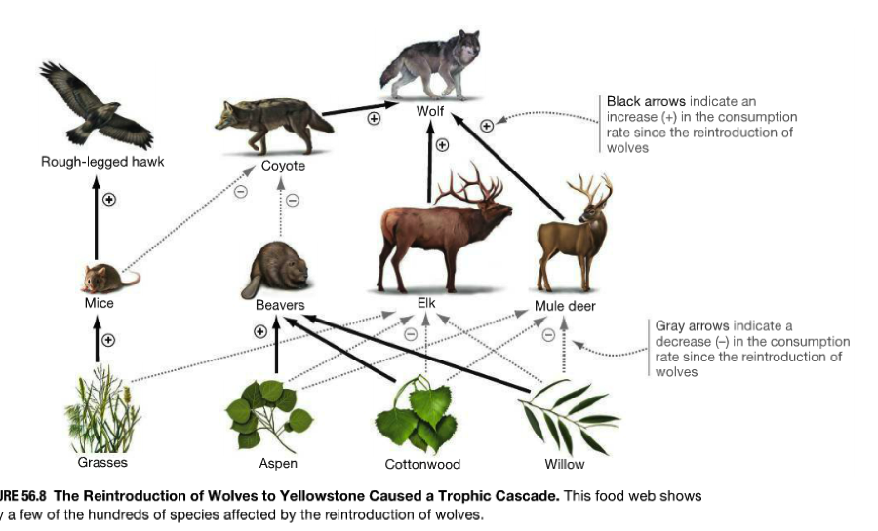
How can we respect all species?
If we (C) respect / will respect all species equally, we’ll be able to continue to enjoy the natural world.

Slide 47
Wolves Change Rivers
By the early 1990s, gray wolves (A) had begun / have begun to disappear from Yellowstone National Park in the US, and this resulted in a growing elk population. The elk ate too many leaves from the trees, which reduced shade along the rivers and creeks. This caused water temperatures to increase and the populations of many fish species in the park (B) declined / had declined. To restore balance to Yellowstone’s ecosystem, sixty-six gray wolves from Canada were released into the park. As a result, the number of elk quickly dropped. Now, the ecosystem has returned to its natural balance. This story shows how crucial some species are for the health of an entire ecosystem. If we (C) respect / will respect all species equally, we’ll be able to continue to enjoy the natural world.

Slide 48
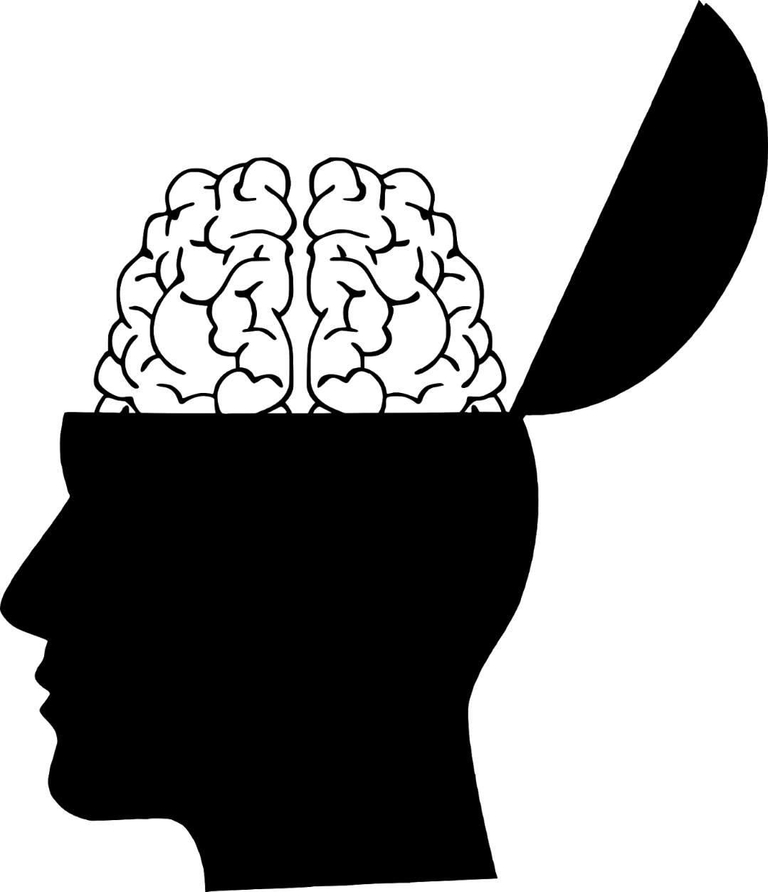
Knowledge Activation
Need information to understand and build from.

Slide 49
Reading / Listening
Comprehension check questions

Slide 50
Key Phrases
Vocabulary

Slide 51
Questions
Desirable difficulties
Bloom’s taxonomy

Slide 52
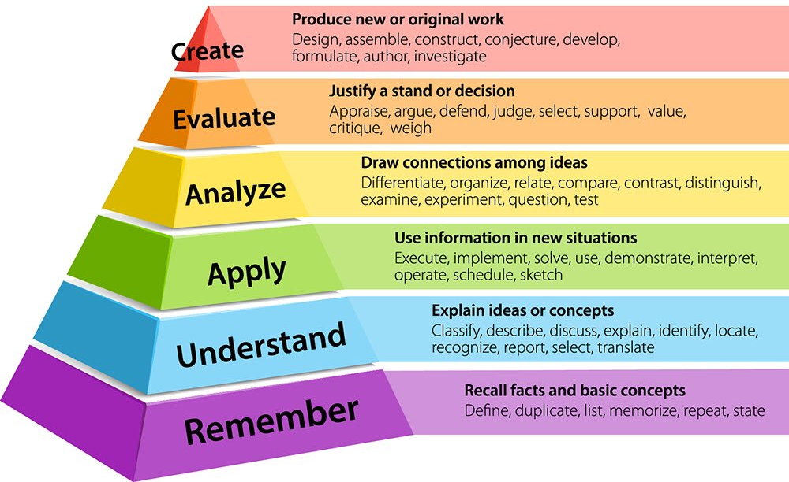

Slide 53
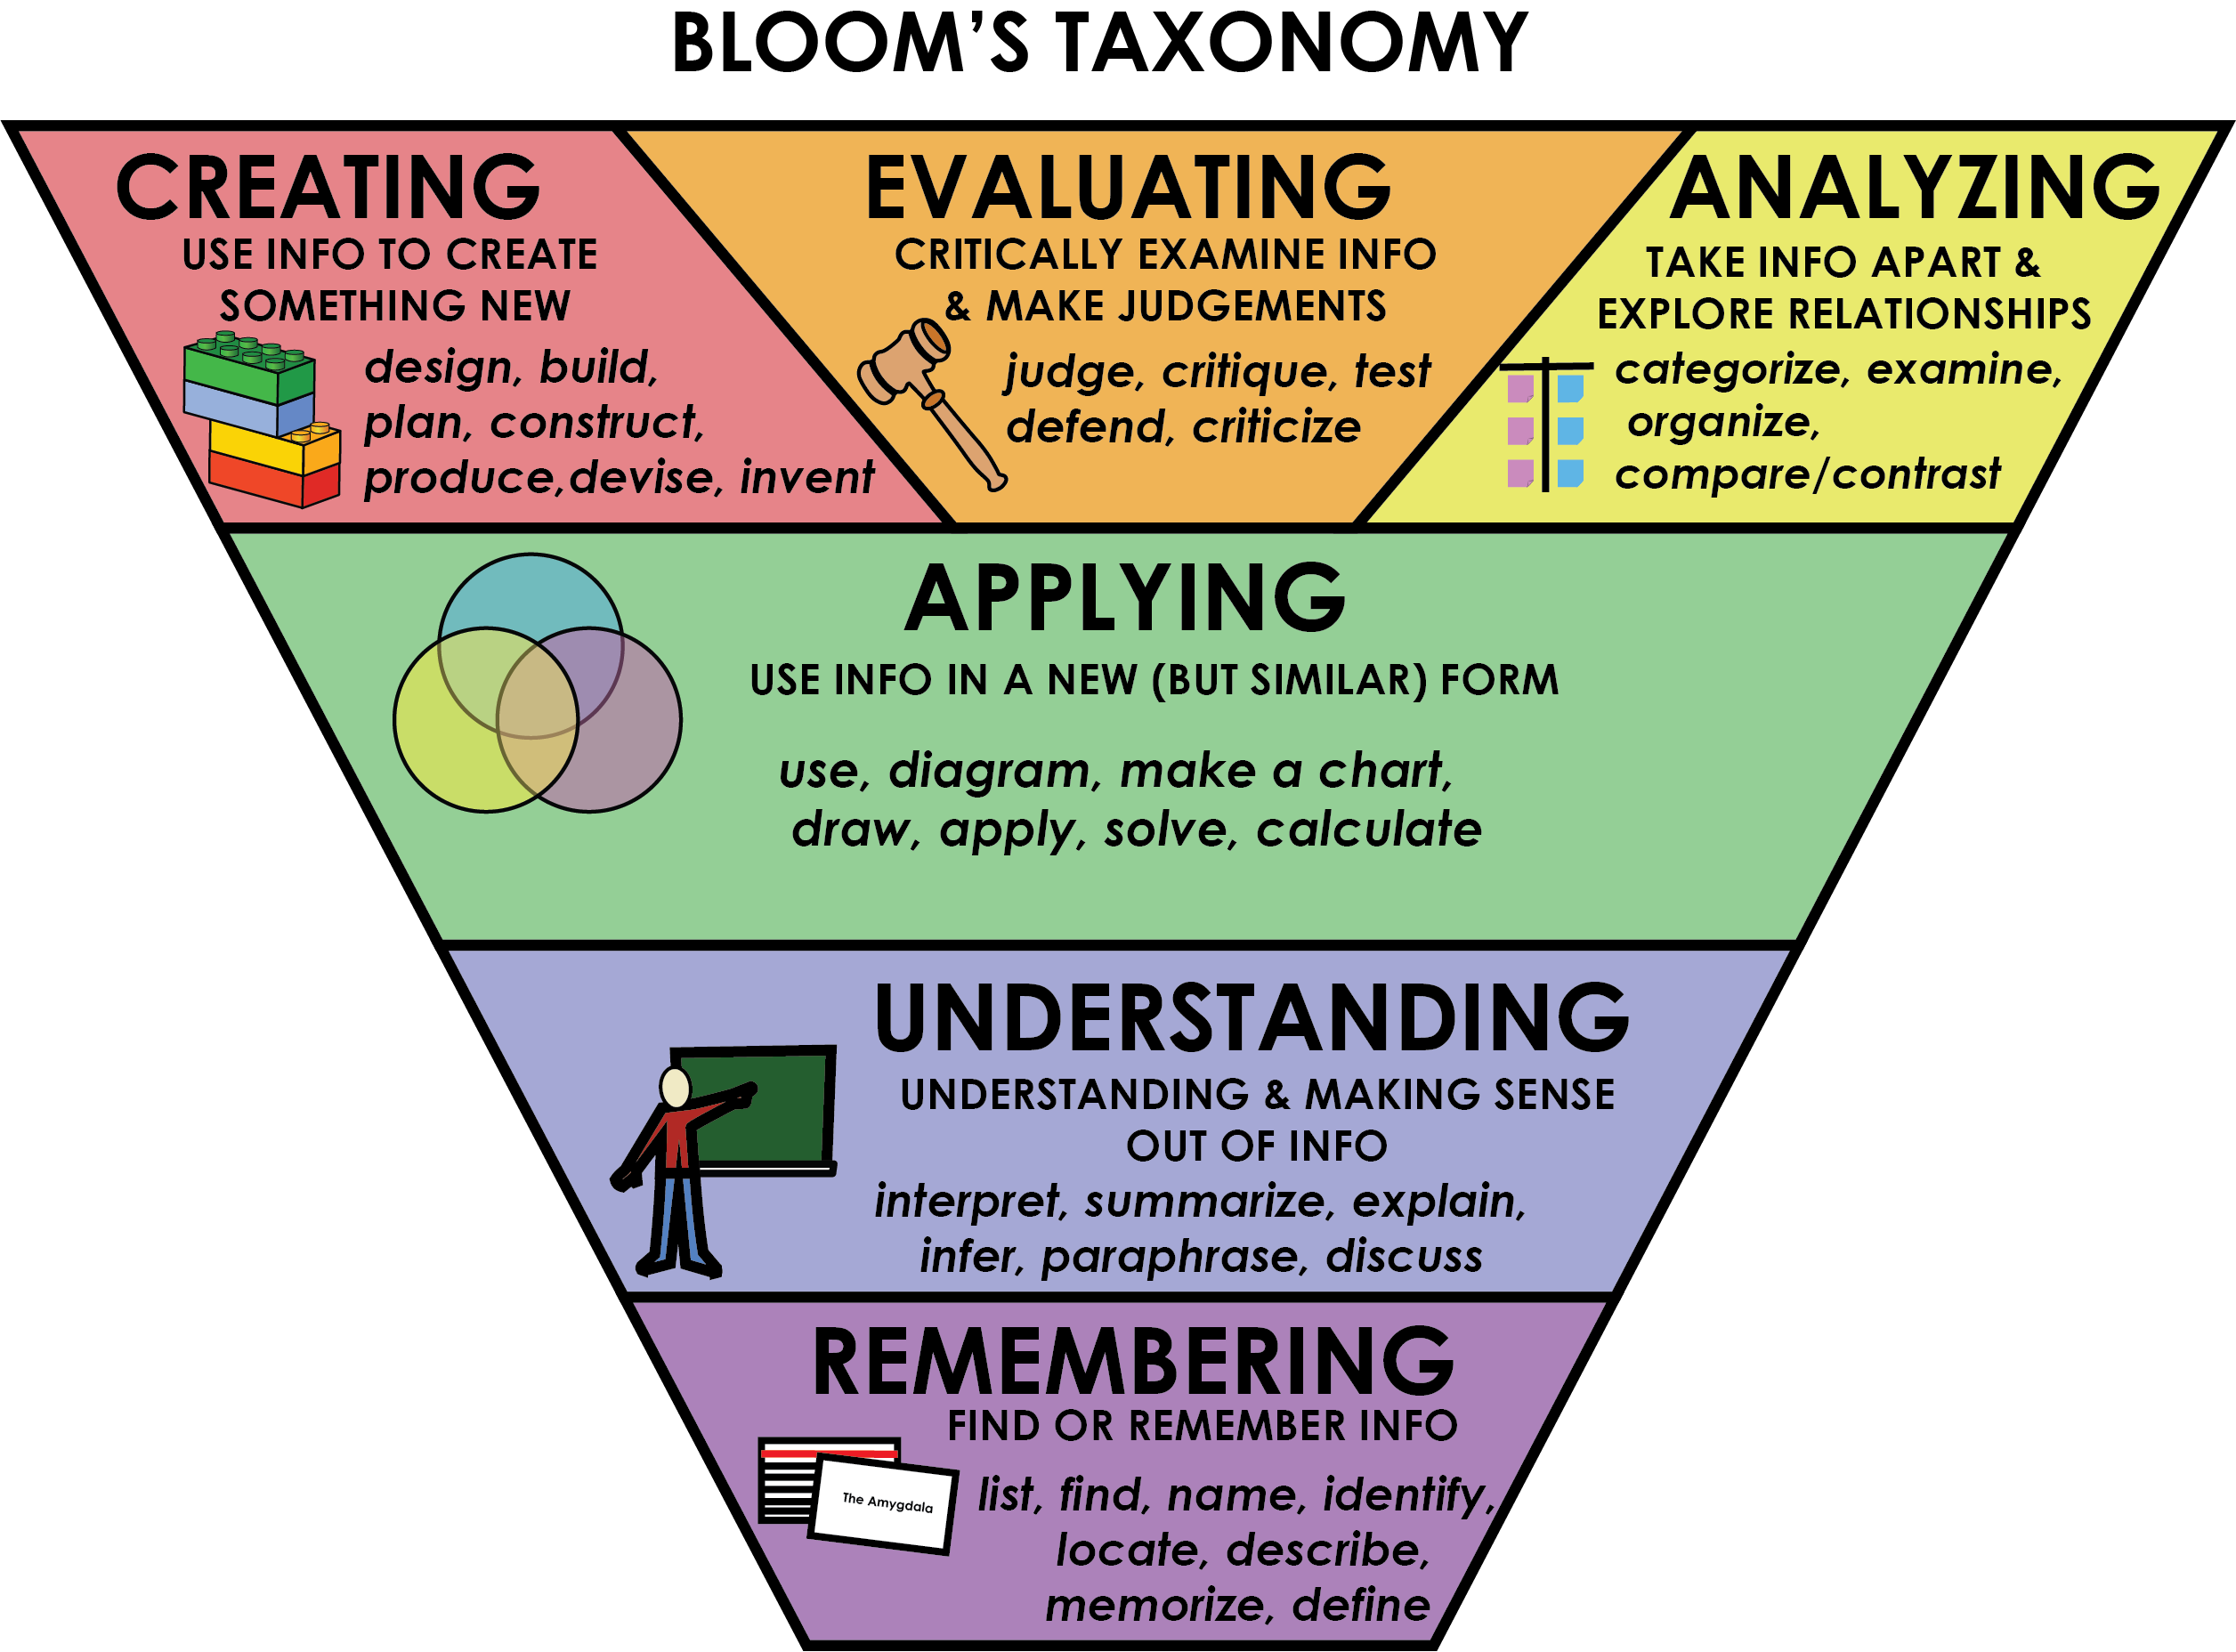

Slide 54
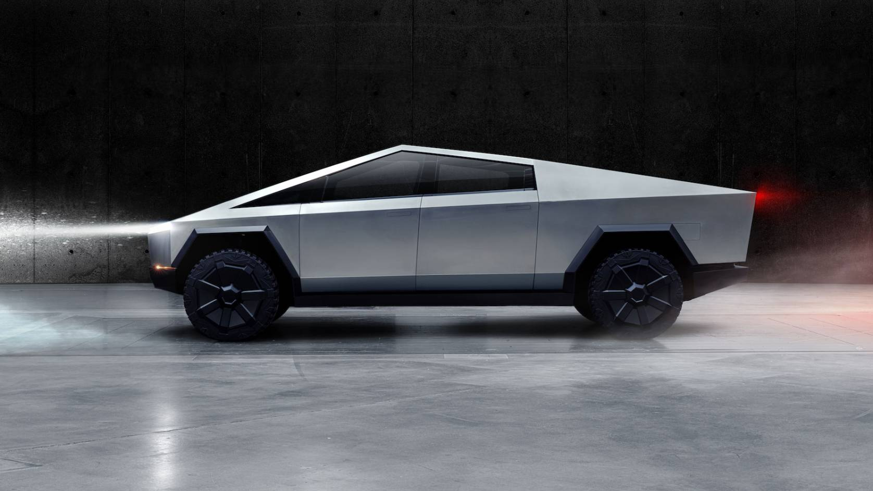
TESLA CYBERTRUCK

Slide 56
TESLA CYBERTRUCK

Slide 57
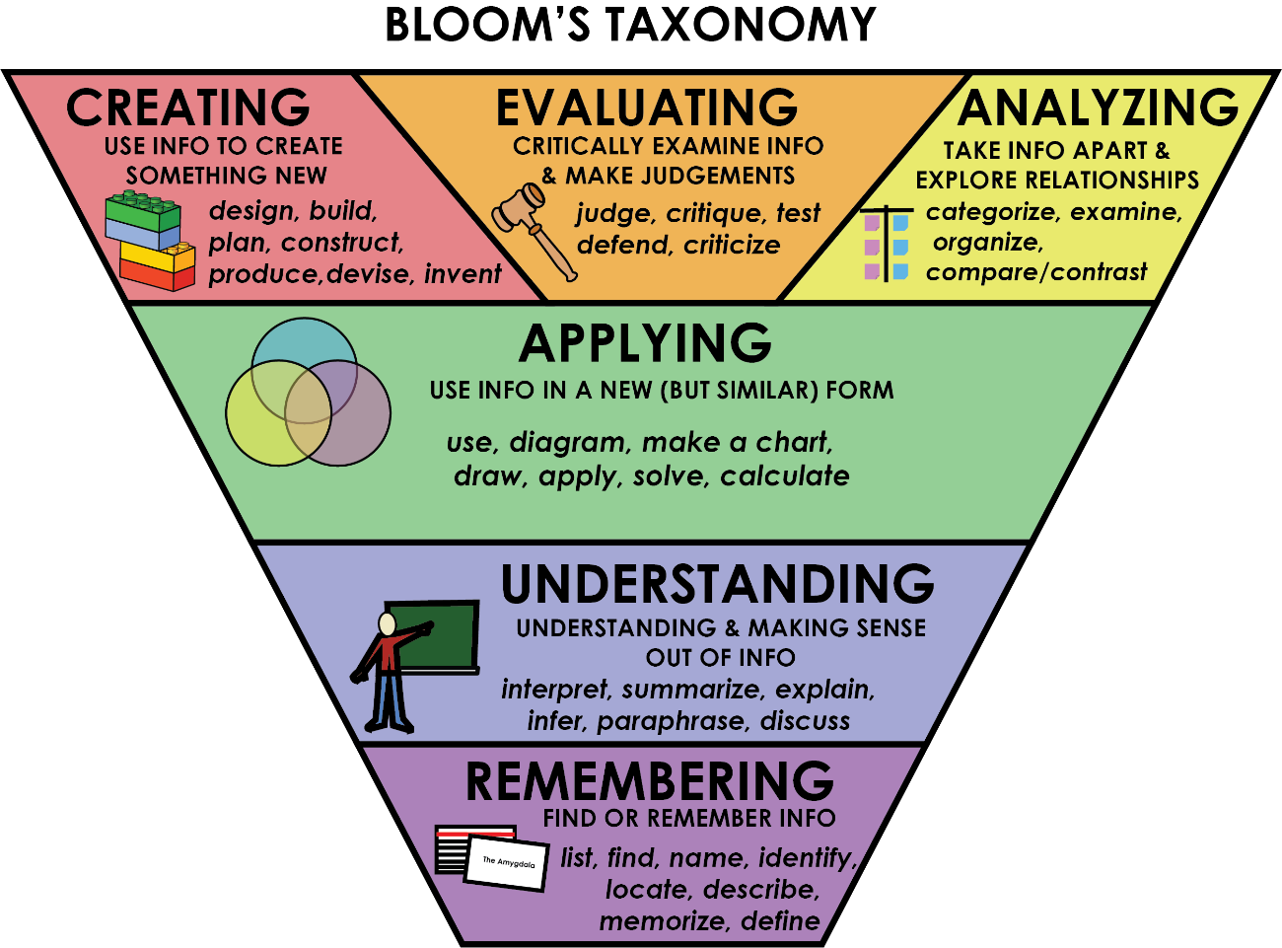
TESLA Cybertruck
Create a question for each step of Bloom’s taxonomy.

