Slide 1
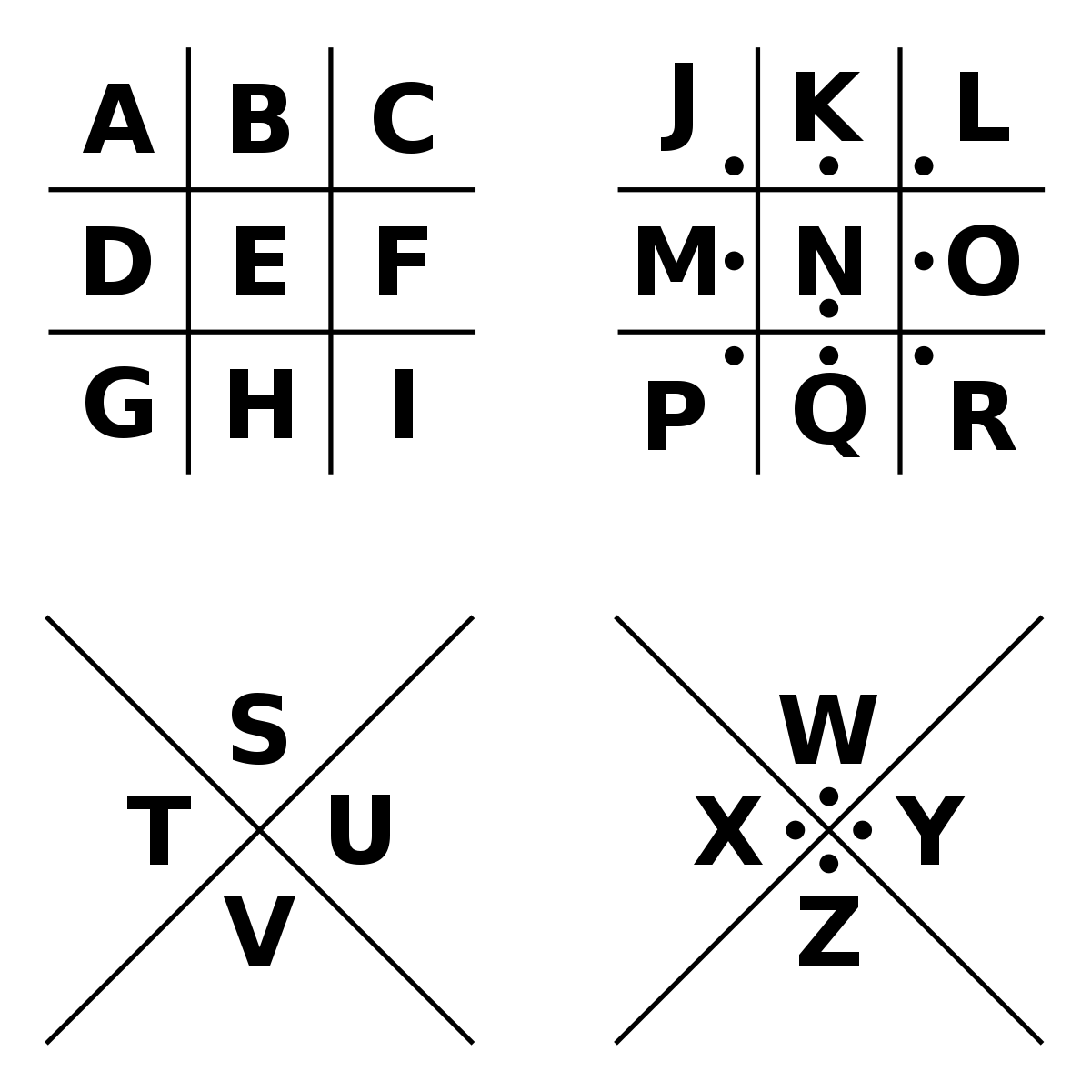
PigPen Cipher
What is the difference between Korean Valentines Day and Western Valentine’s Day?

