Slide 1
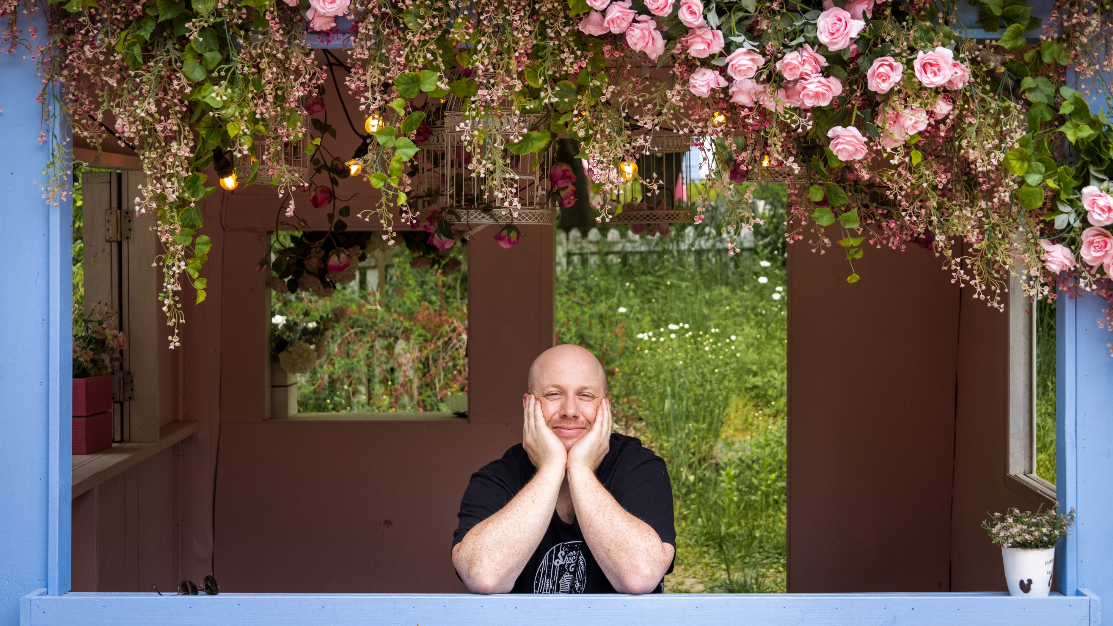

TIM
TIMOTHY JACK SCHILSTRA

Slide 2

Where am I from?

Slide 3
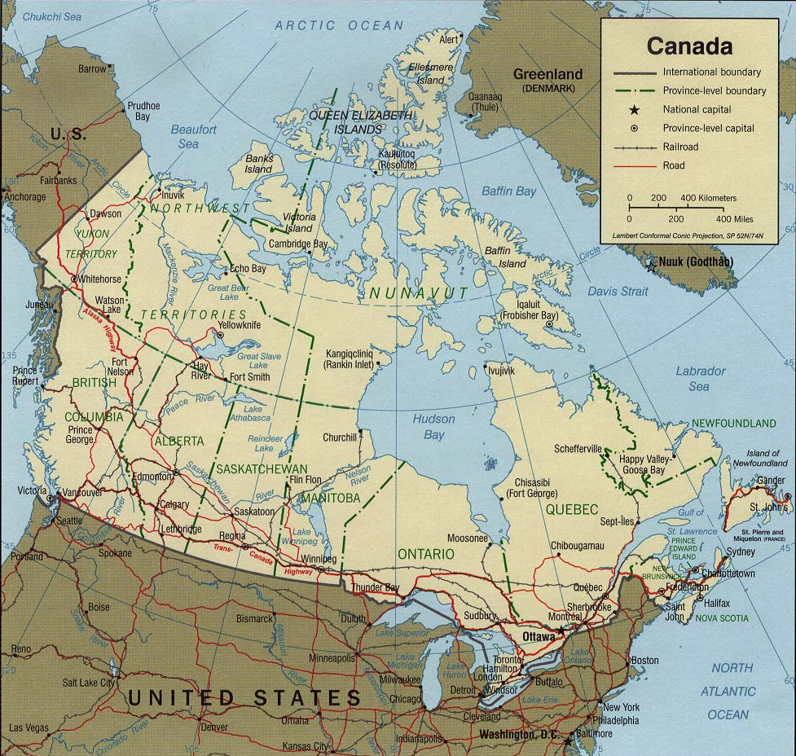
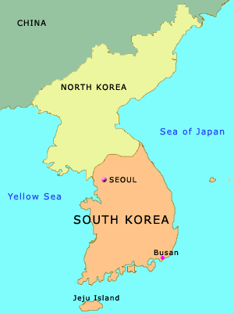

Slide 4
How many are there in my family?

Slide 5
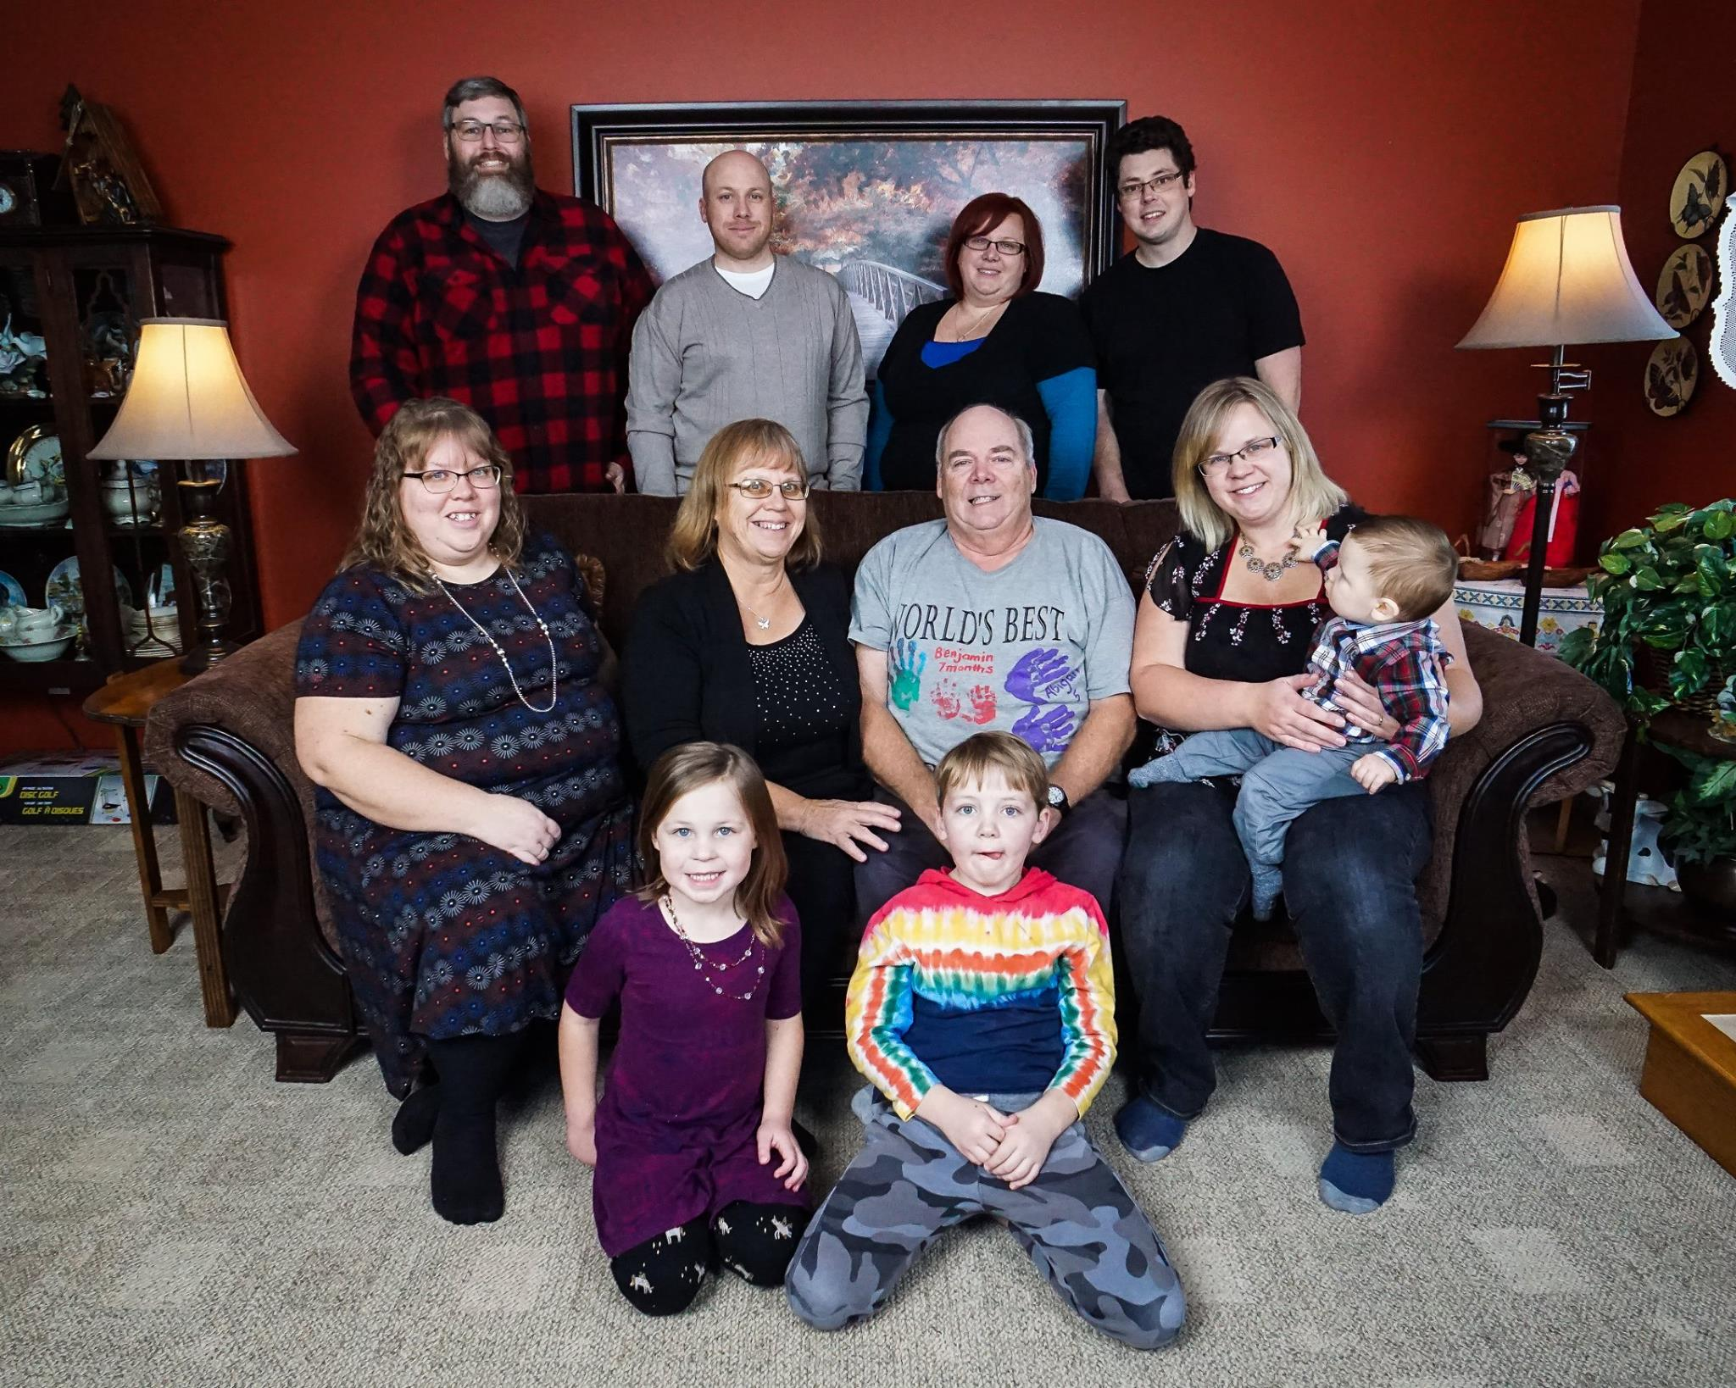
My Family

Slide 6
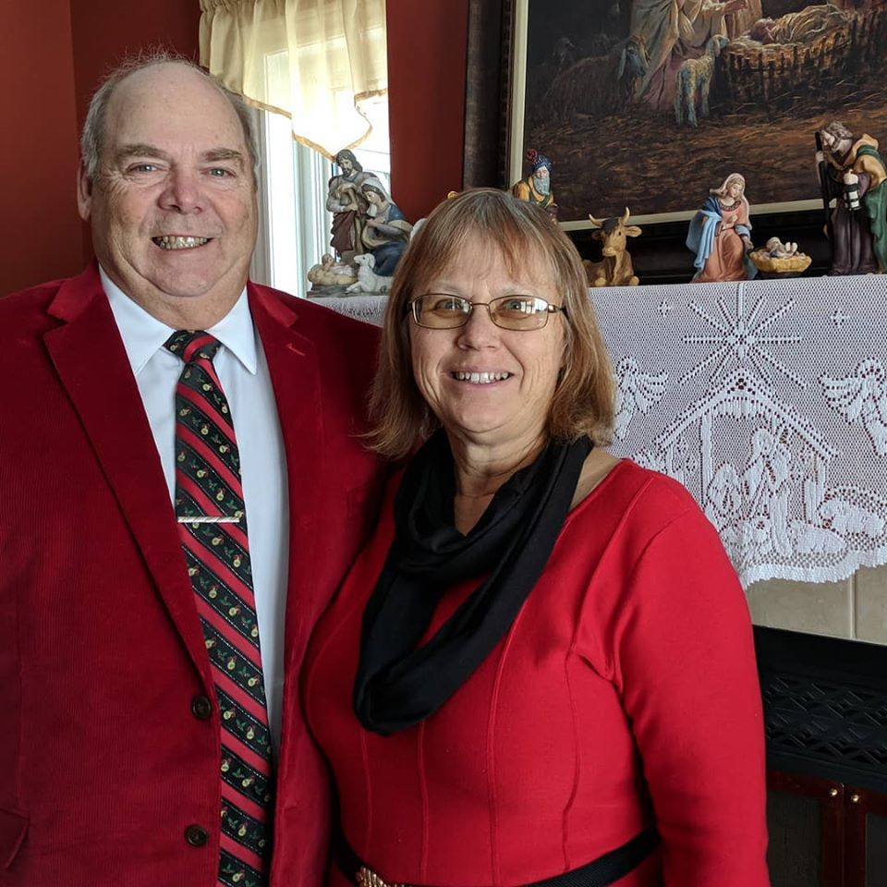
Nelly and Harold

Slide 7
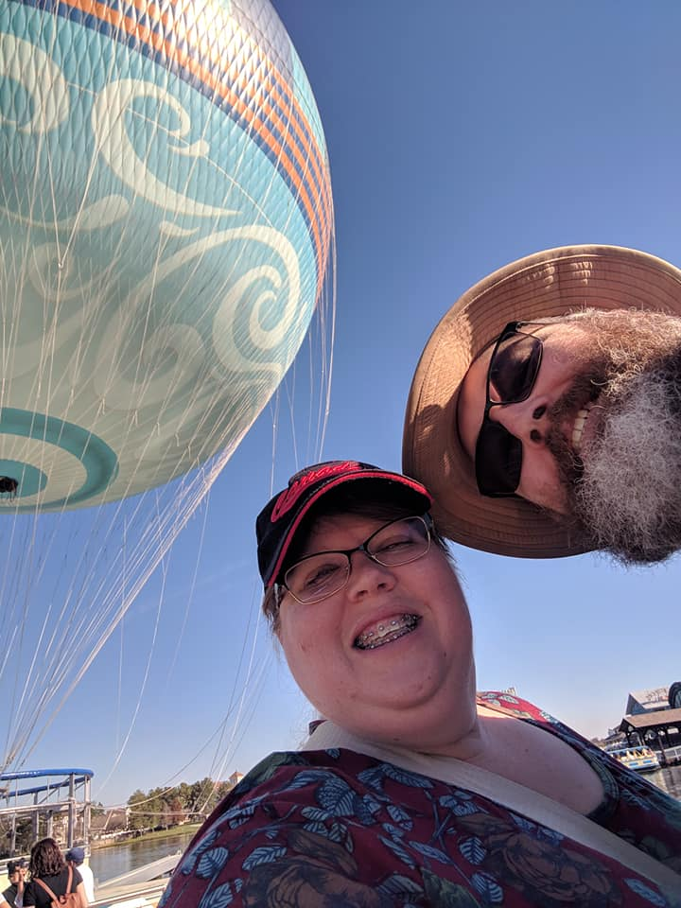
Debbie and Dave

Slide 8
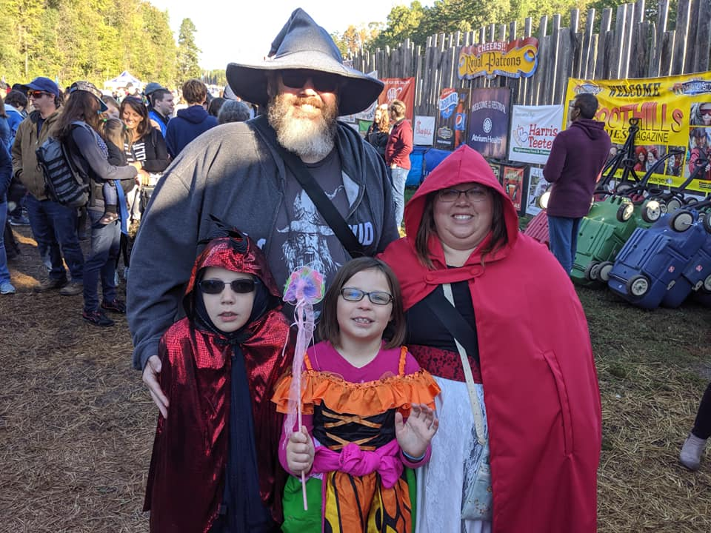
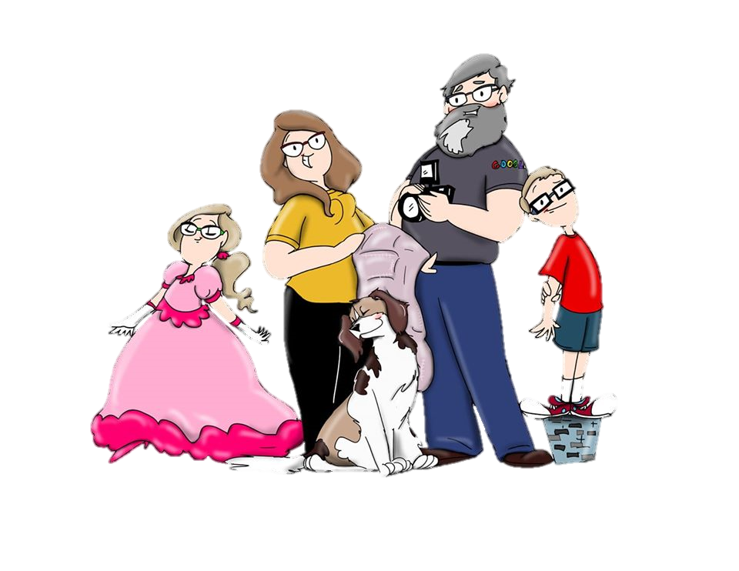
Zeke and Abigail

Slide 9
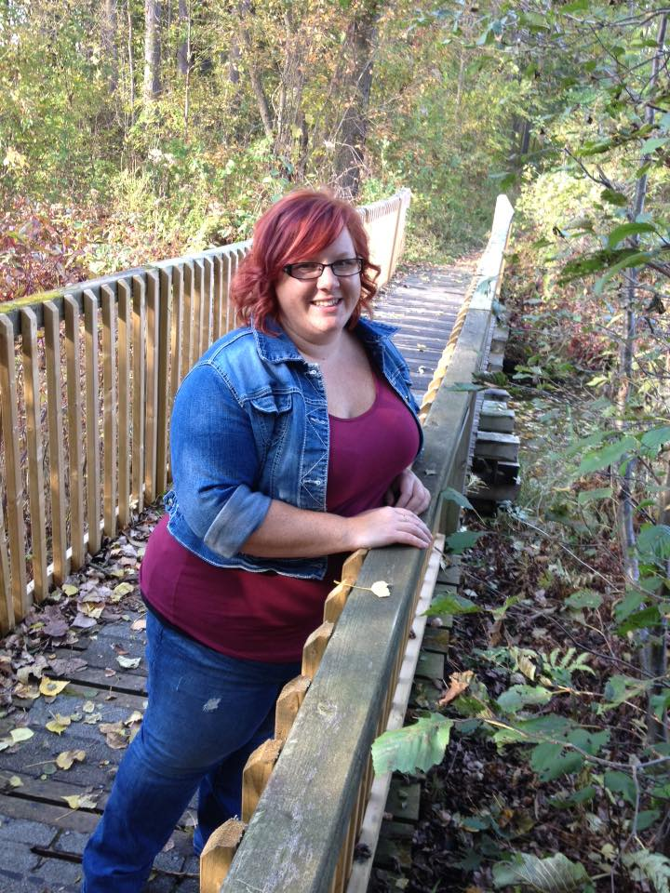
Amanda

Slide 10
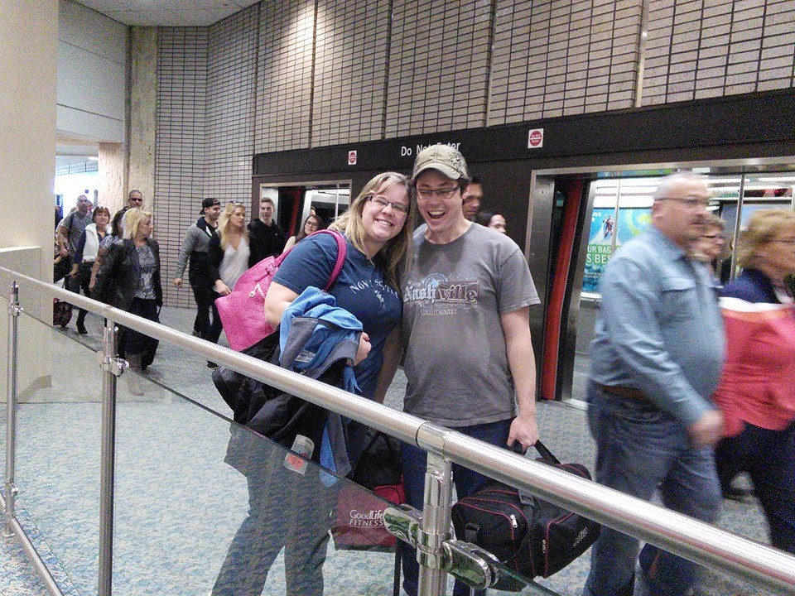
Melissa and Bob

Slide 11
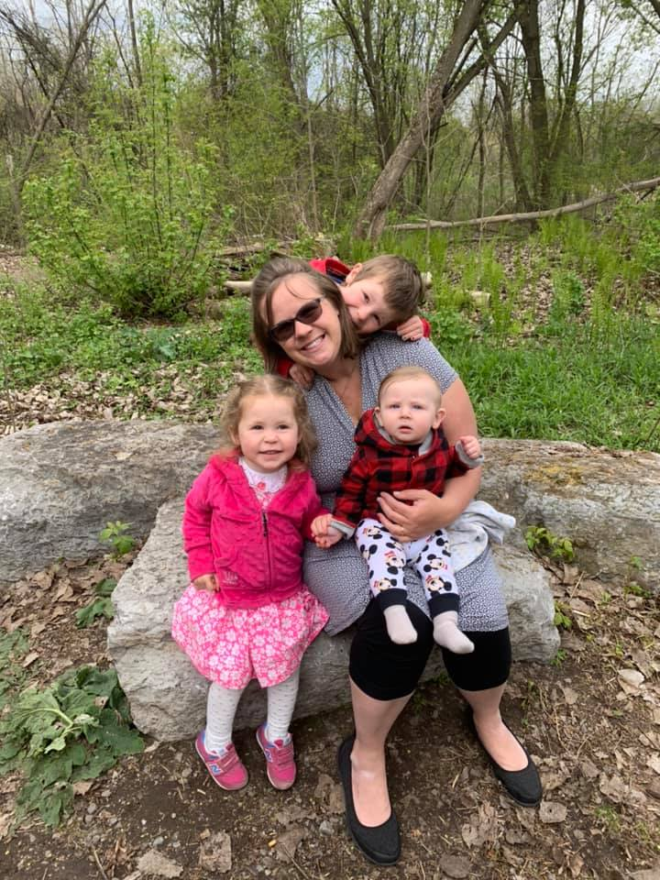
Benjamin
Lydia
Harold

Slide 12
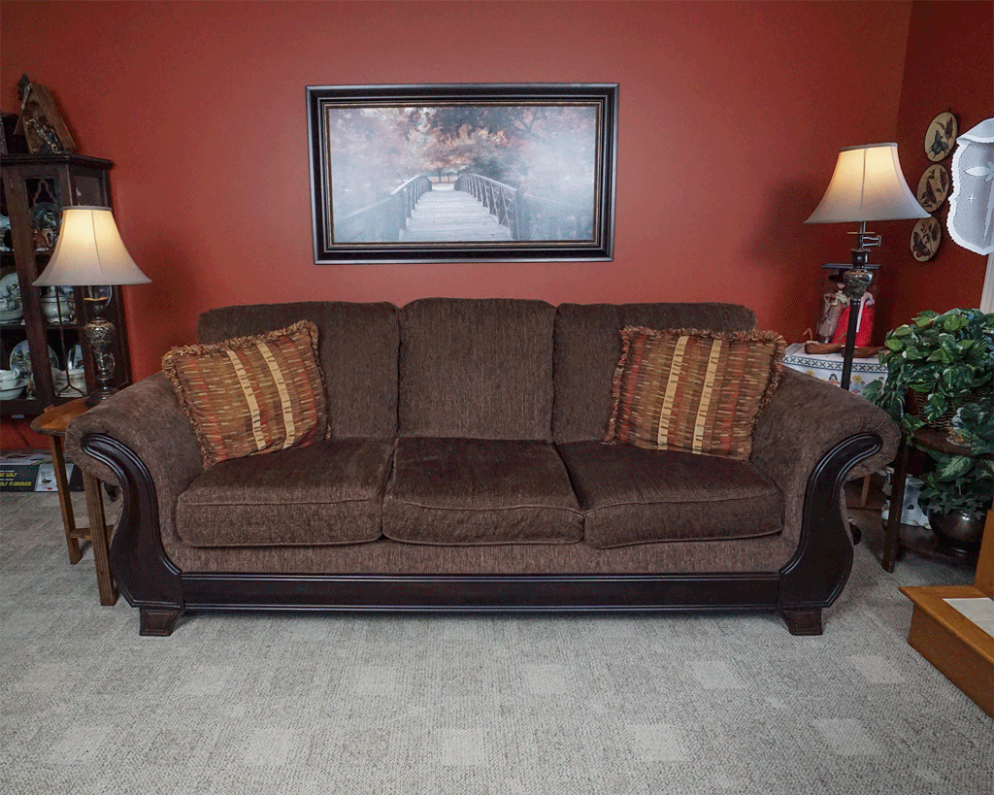

Slide 13
How long have I lived in Korea?

Slide 14
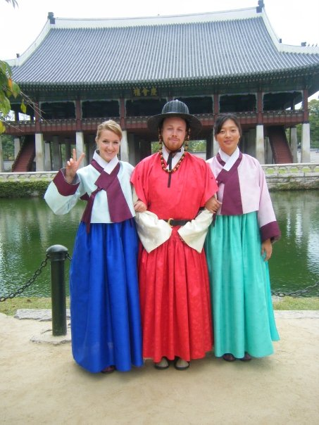
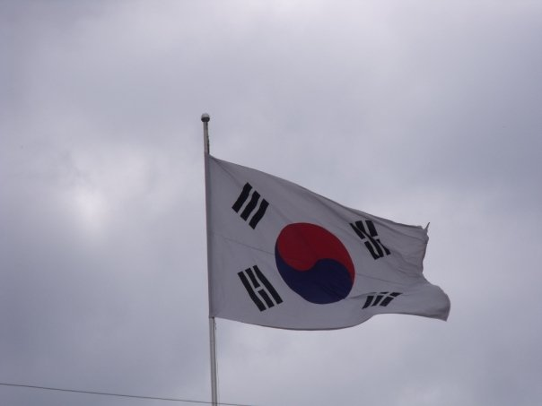
Mr.S in Korea
2009

Slide 15

Yuseong Bio-Science and Technology High School

Slide 16
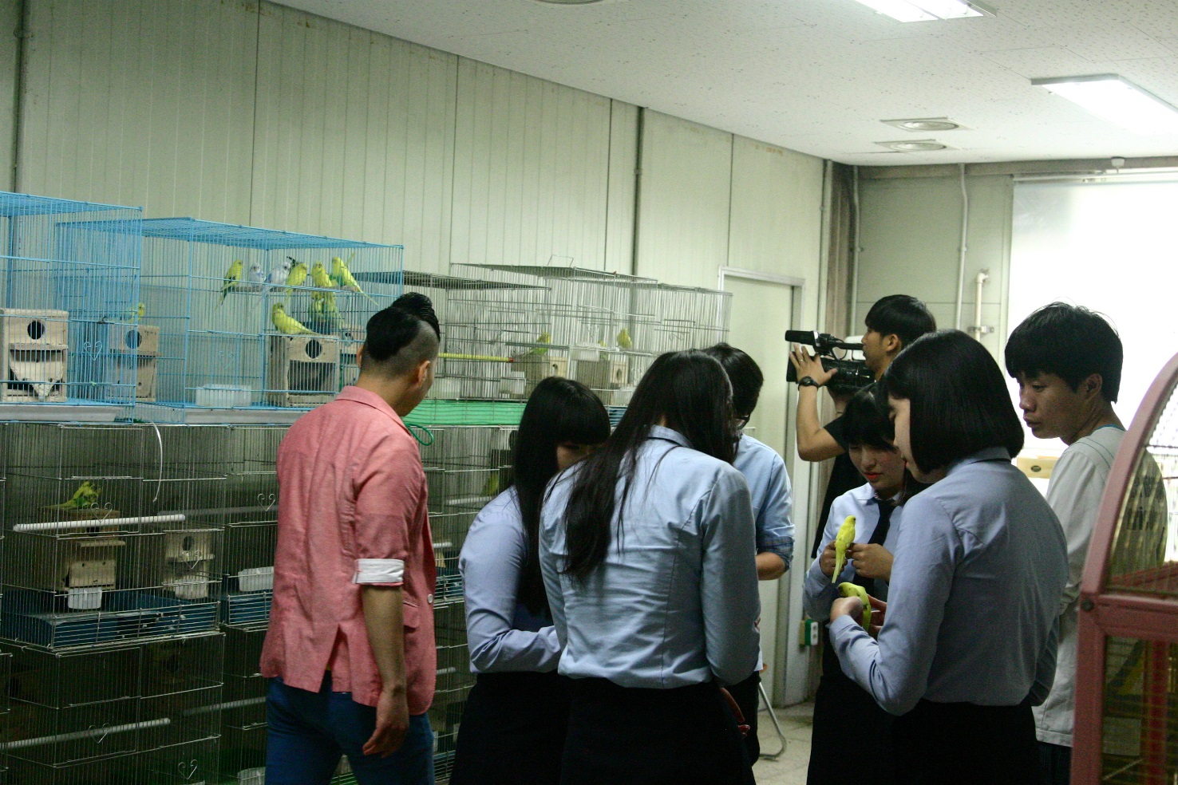
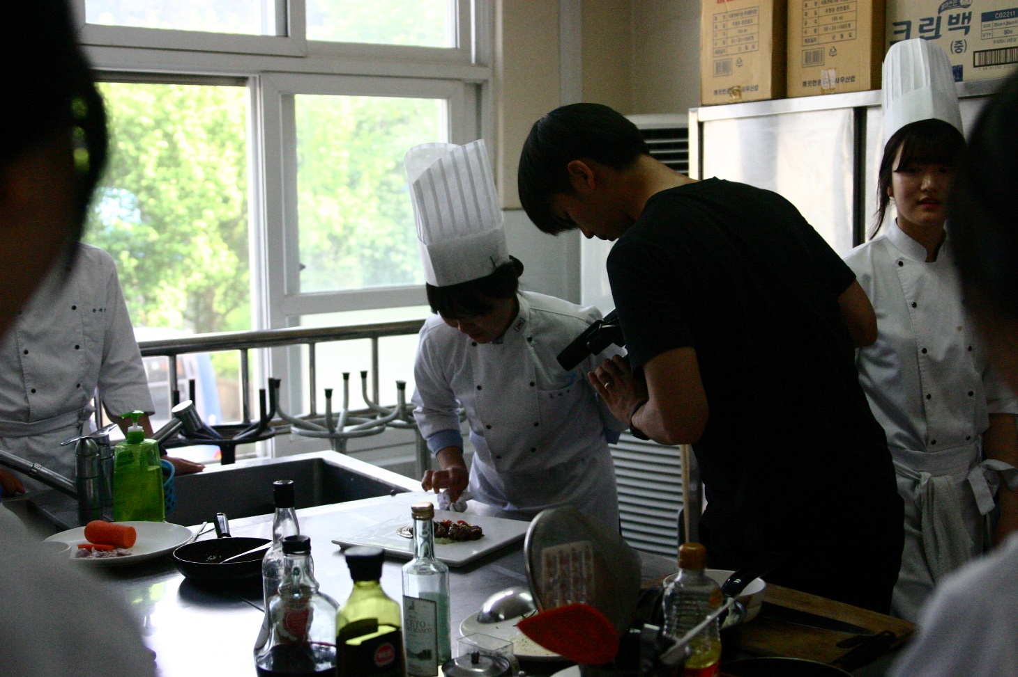
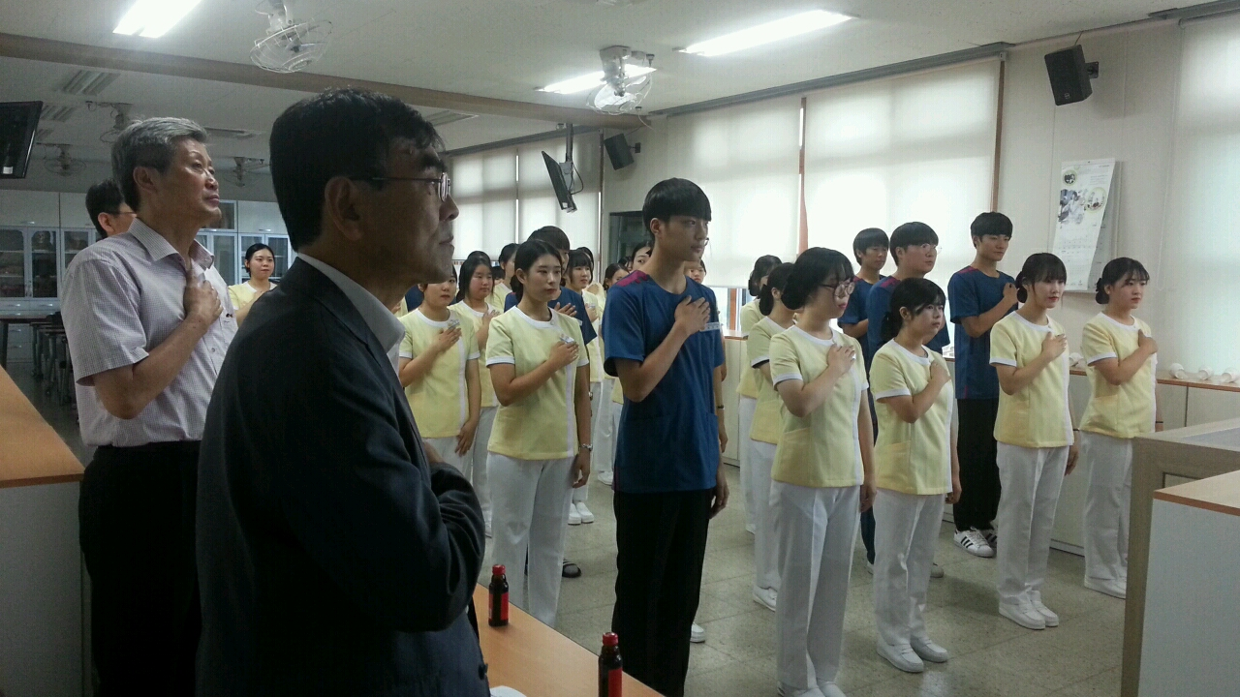
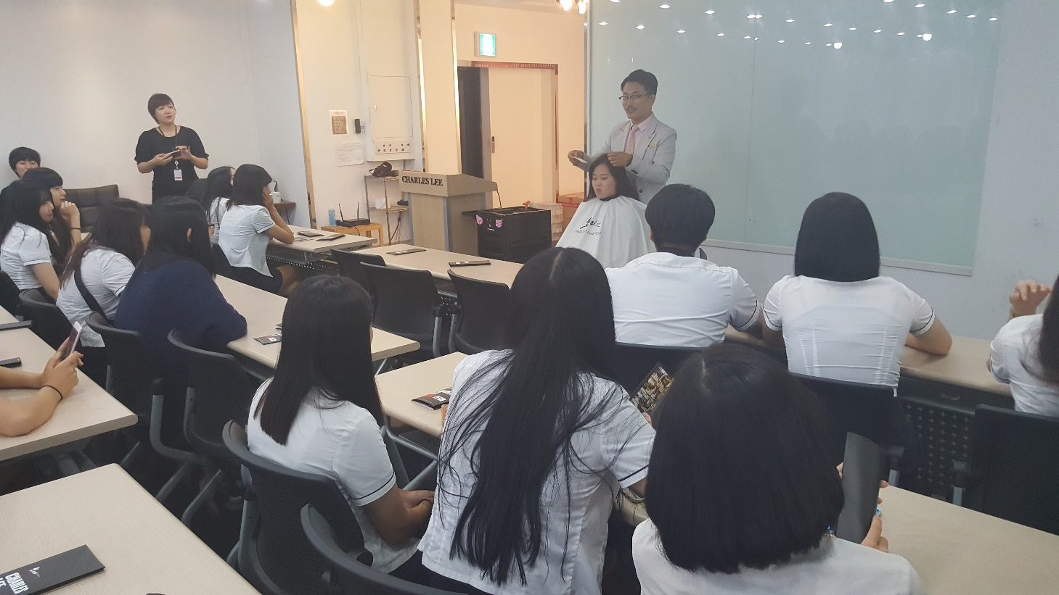

Slide 17
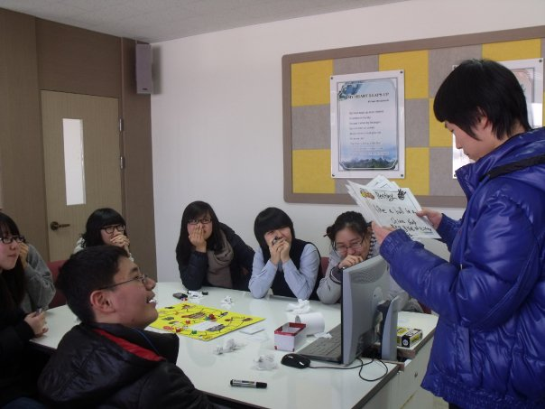
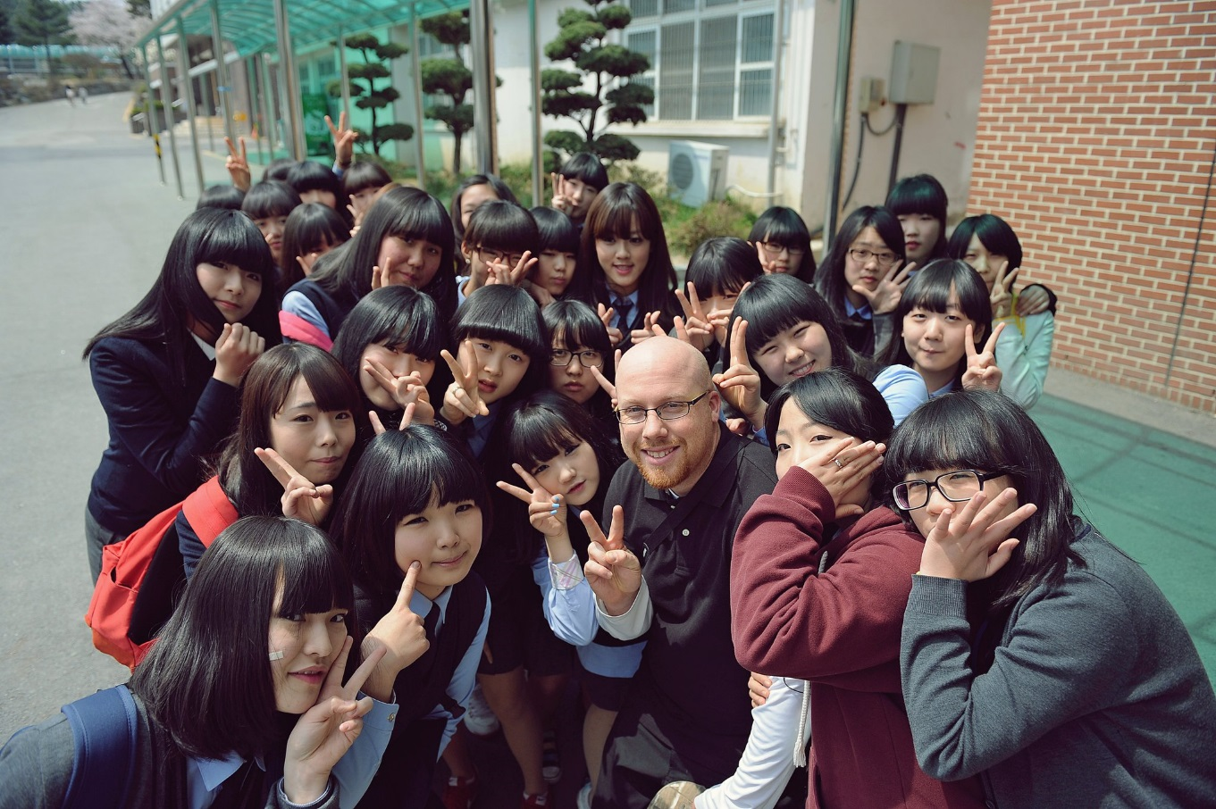

Slide 18

Eoeun Elementary School

Slide 19
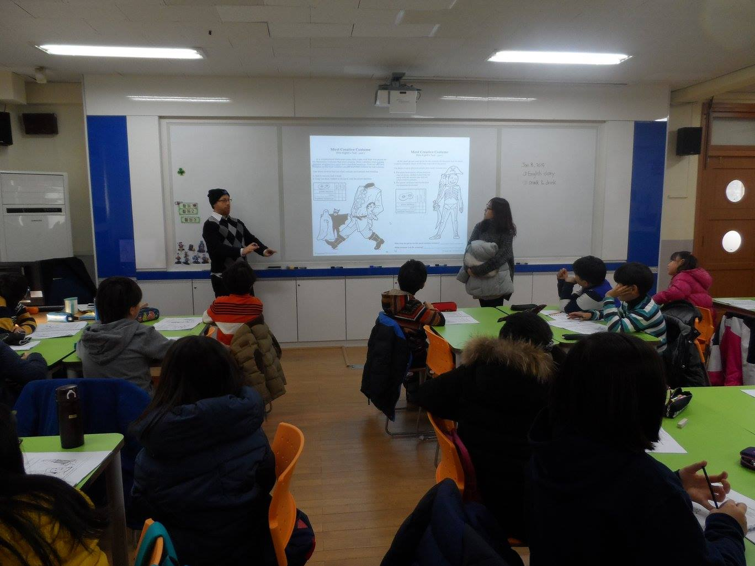
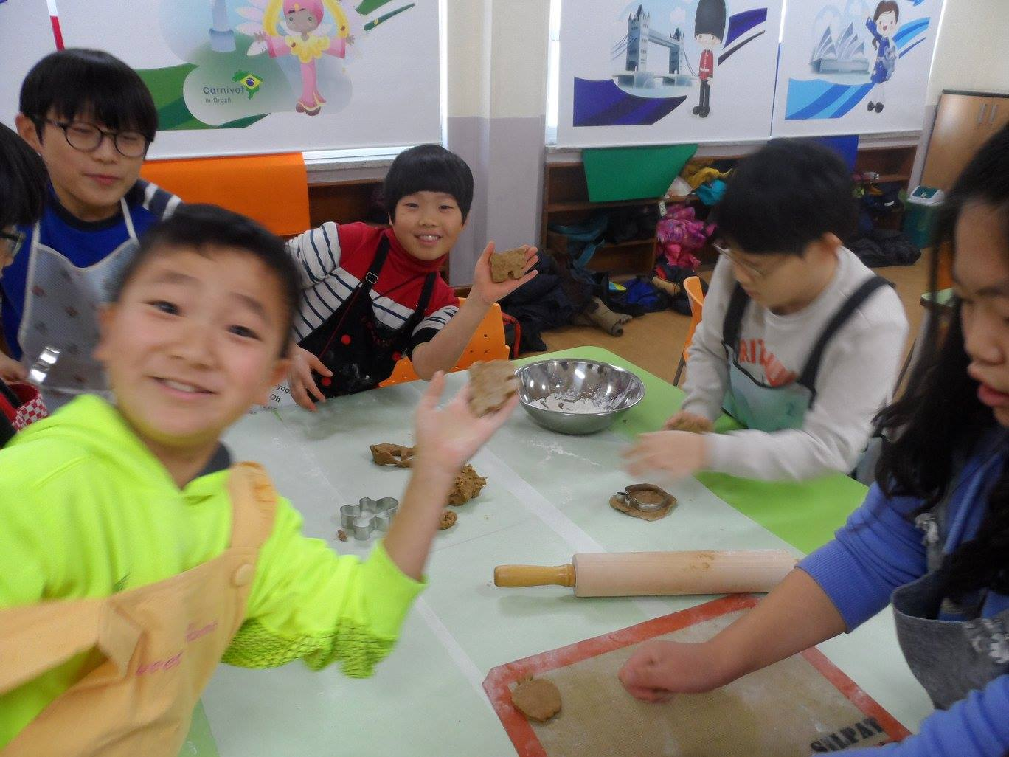

Slide 20

Shinhan High School

Slide 21
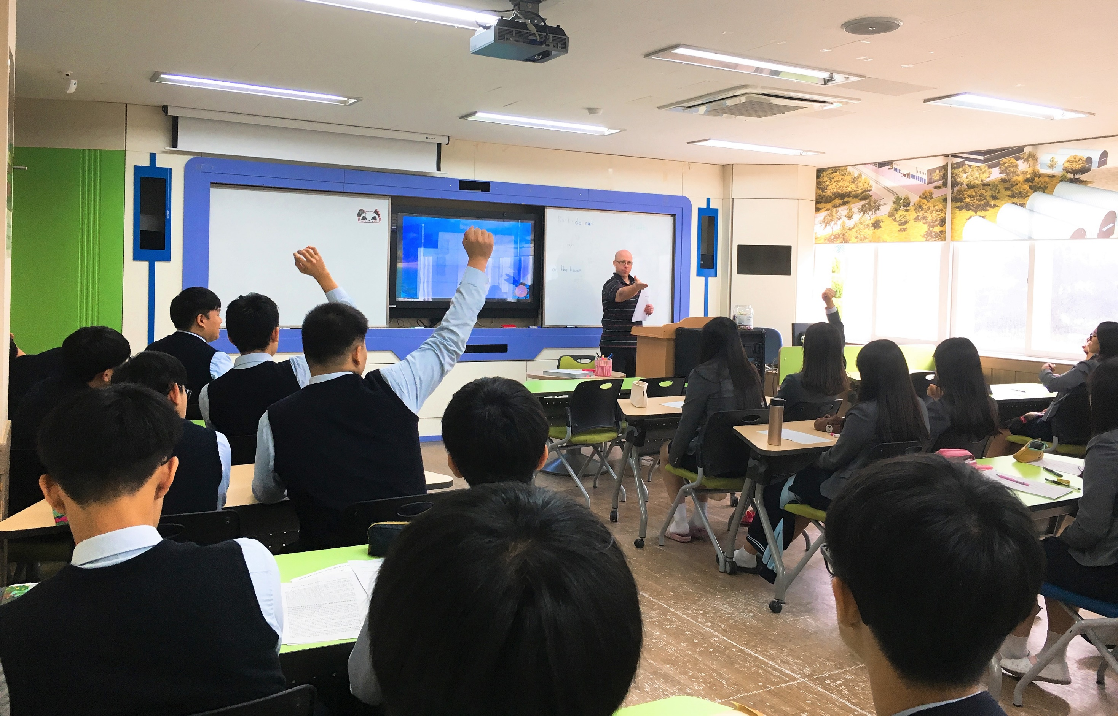
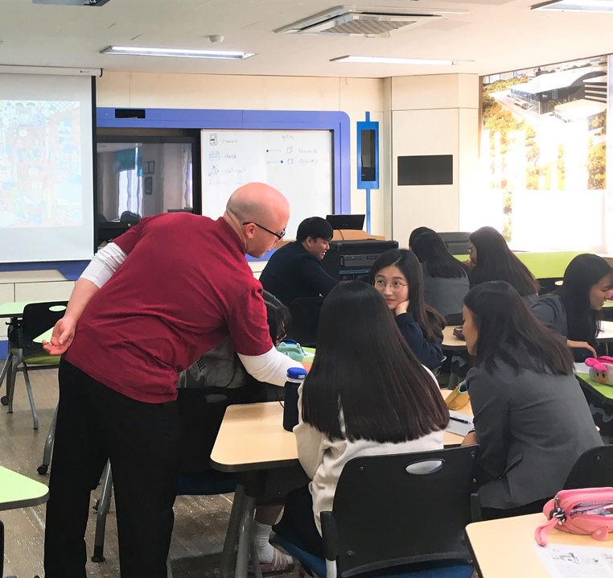

Slide 22
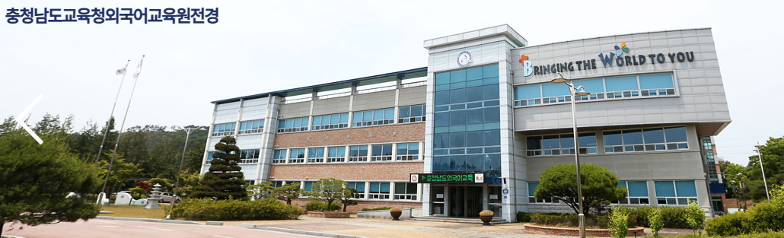
COEIEI

Slide 23
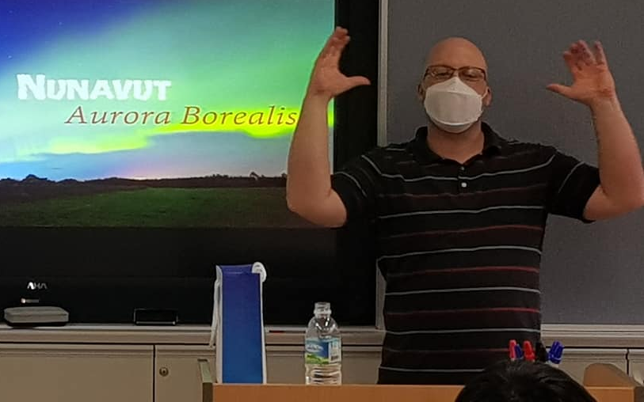
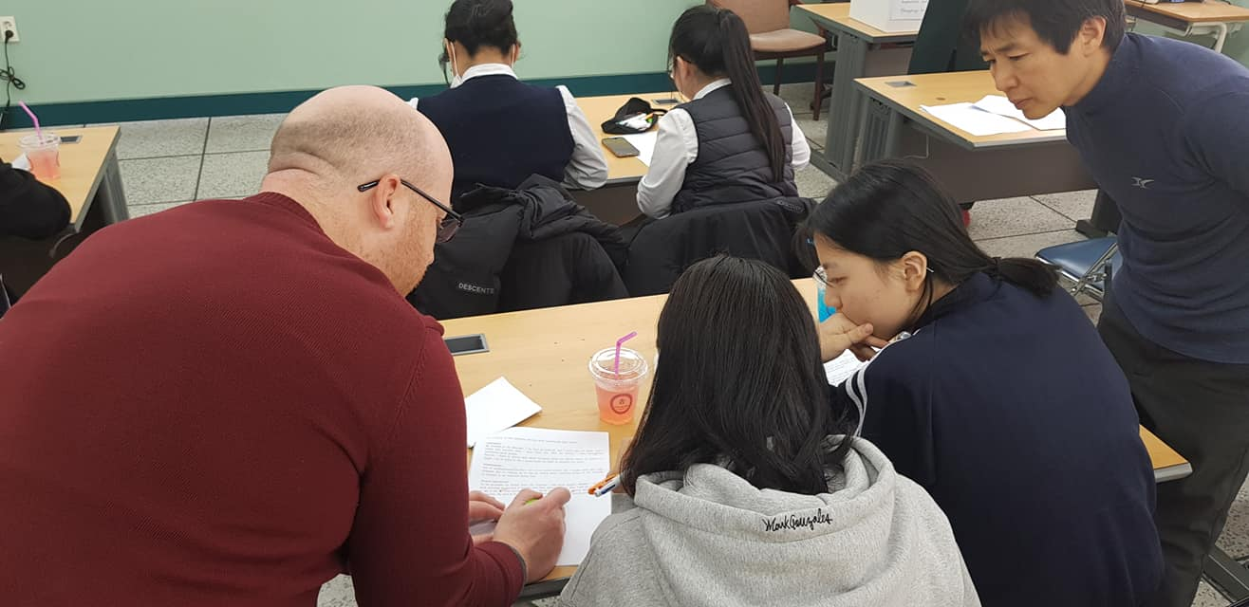
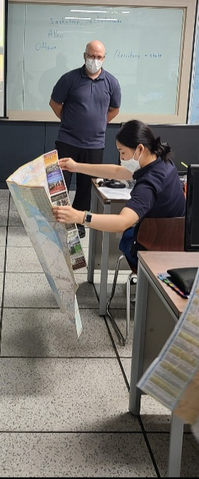
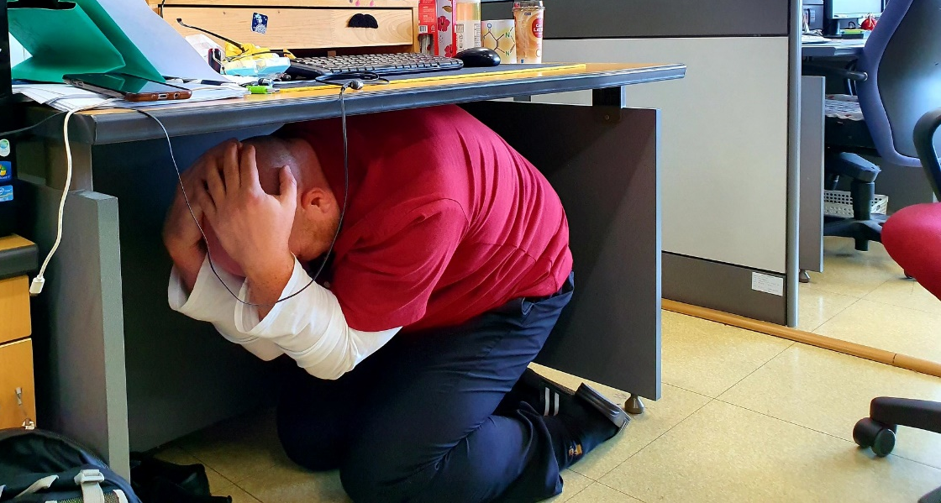
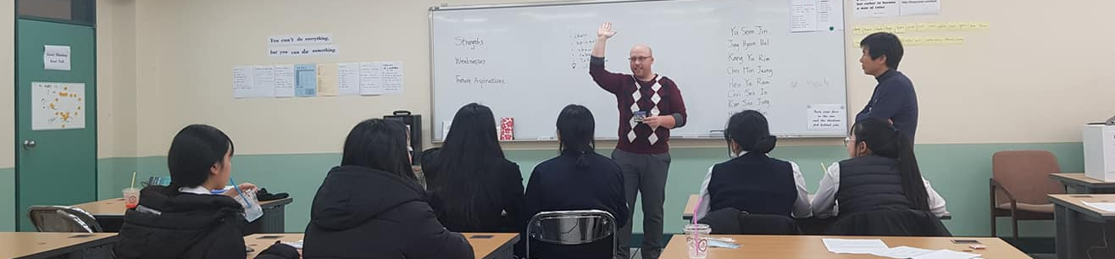

Slide 24
What kind of student do I like?

Slide 25


Slide 26
What was my major?

Slide 27
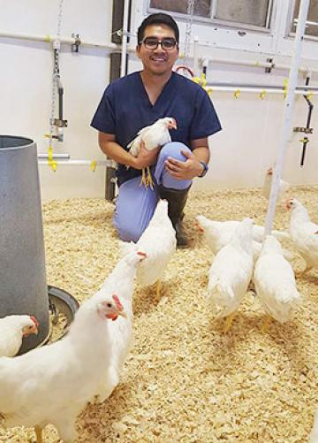


Slide 28
What was I like as a high school student?

Slide 29


Slide 30
What was my first job?

Slide 31
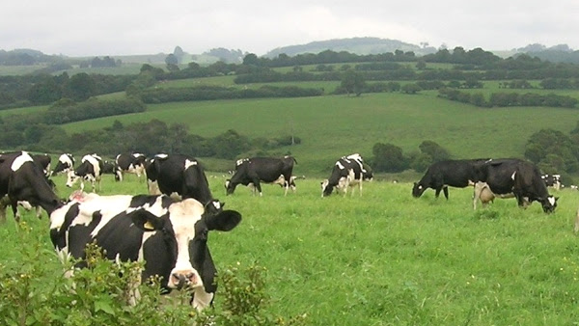
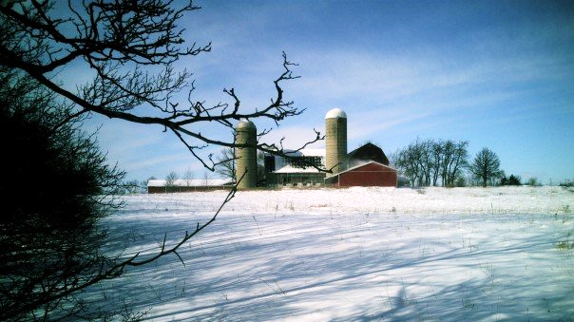

Slide 32
What is my favorite
Korean Food?

Slide 33
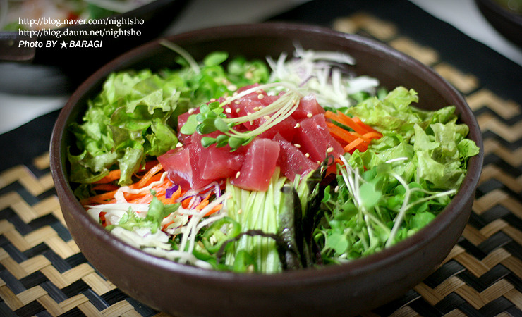
What is my favorite Korean Food?

Slide 34
What are my hobbies?

Slide 35
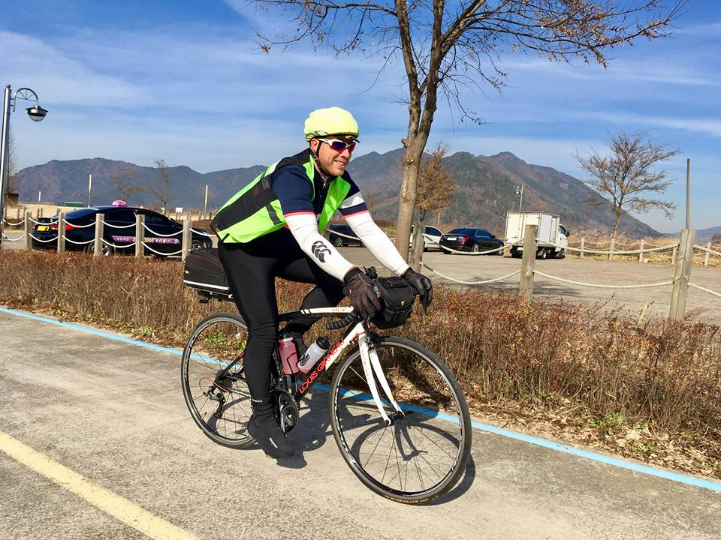

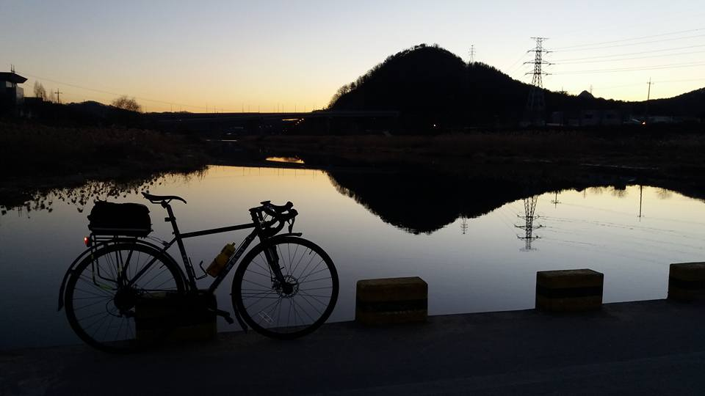

Slide 36
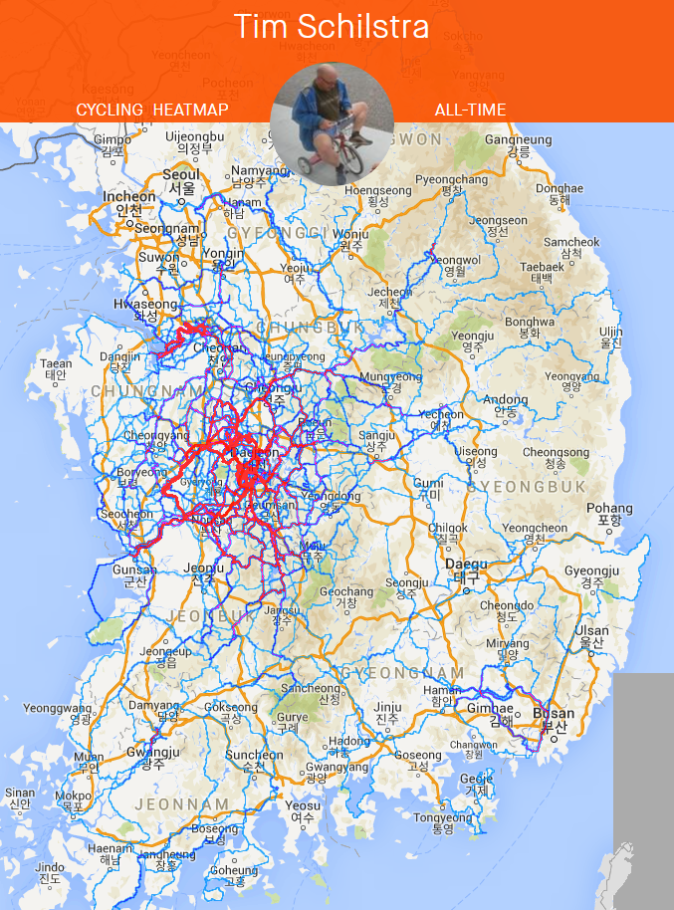

Slide 37
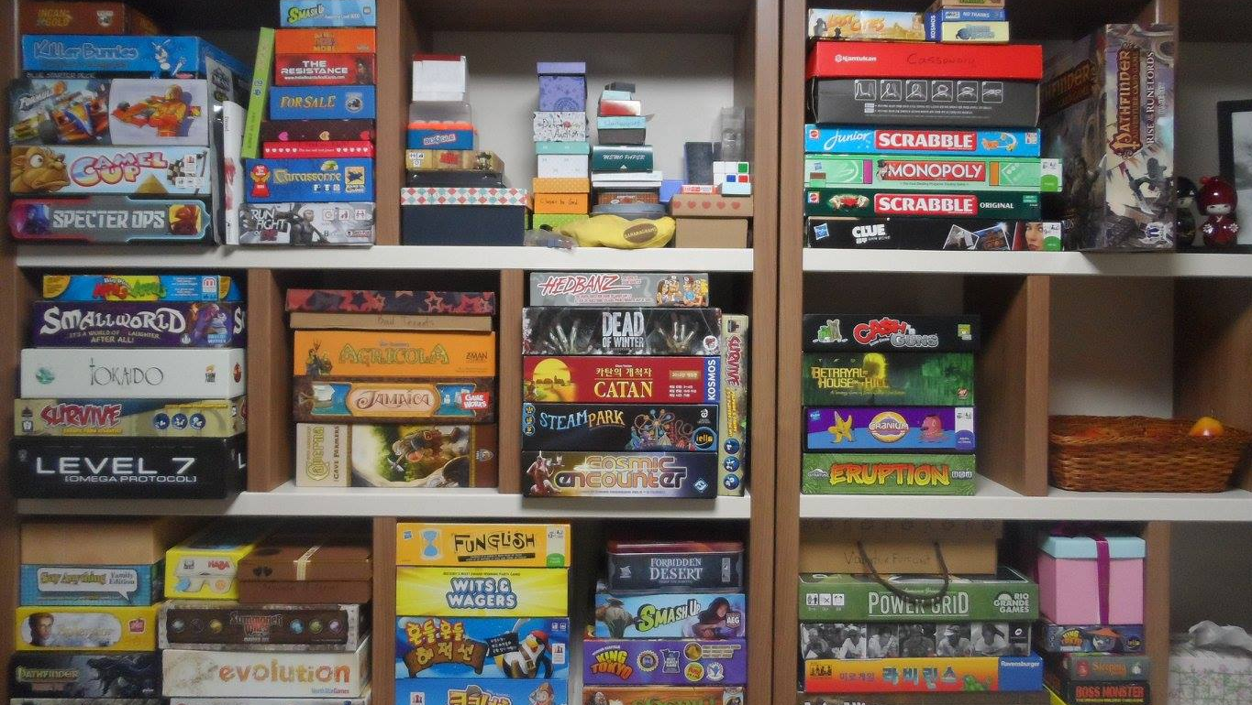

Slide 38


Slide 39
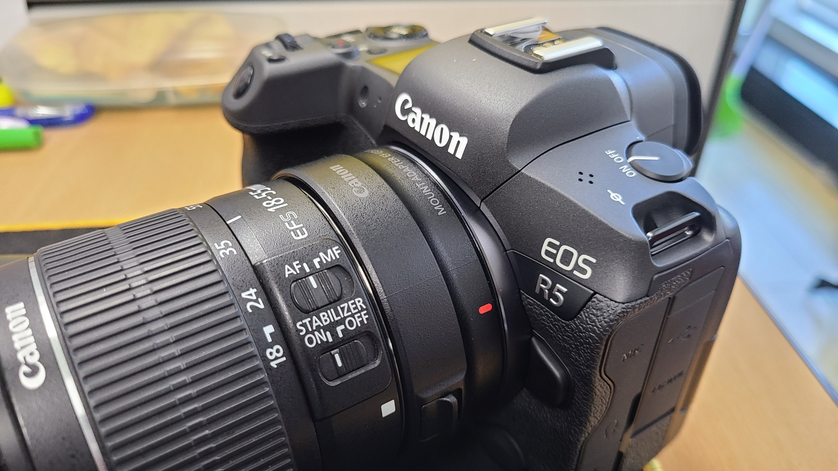

Slide 40
What is my favorite animal?

Slide 41
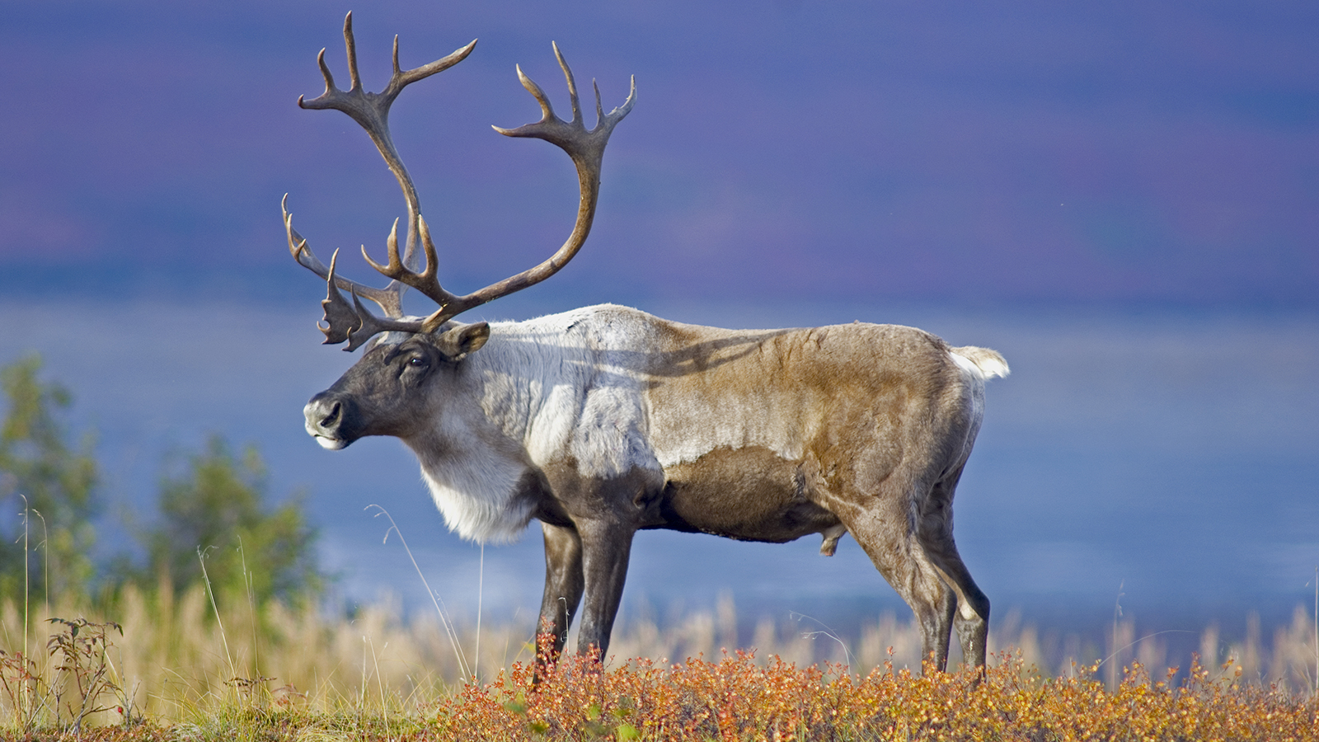
What is my favorite animal?

Slide 42
What is the strangest place I have been?

Slide 43
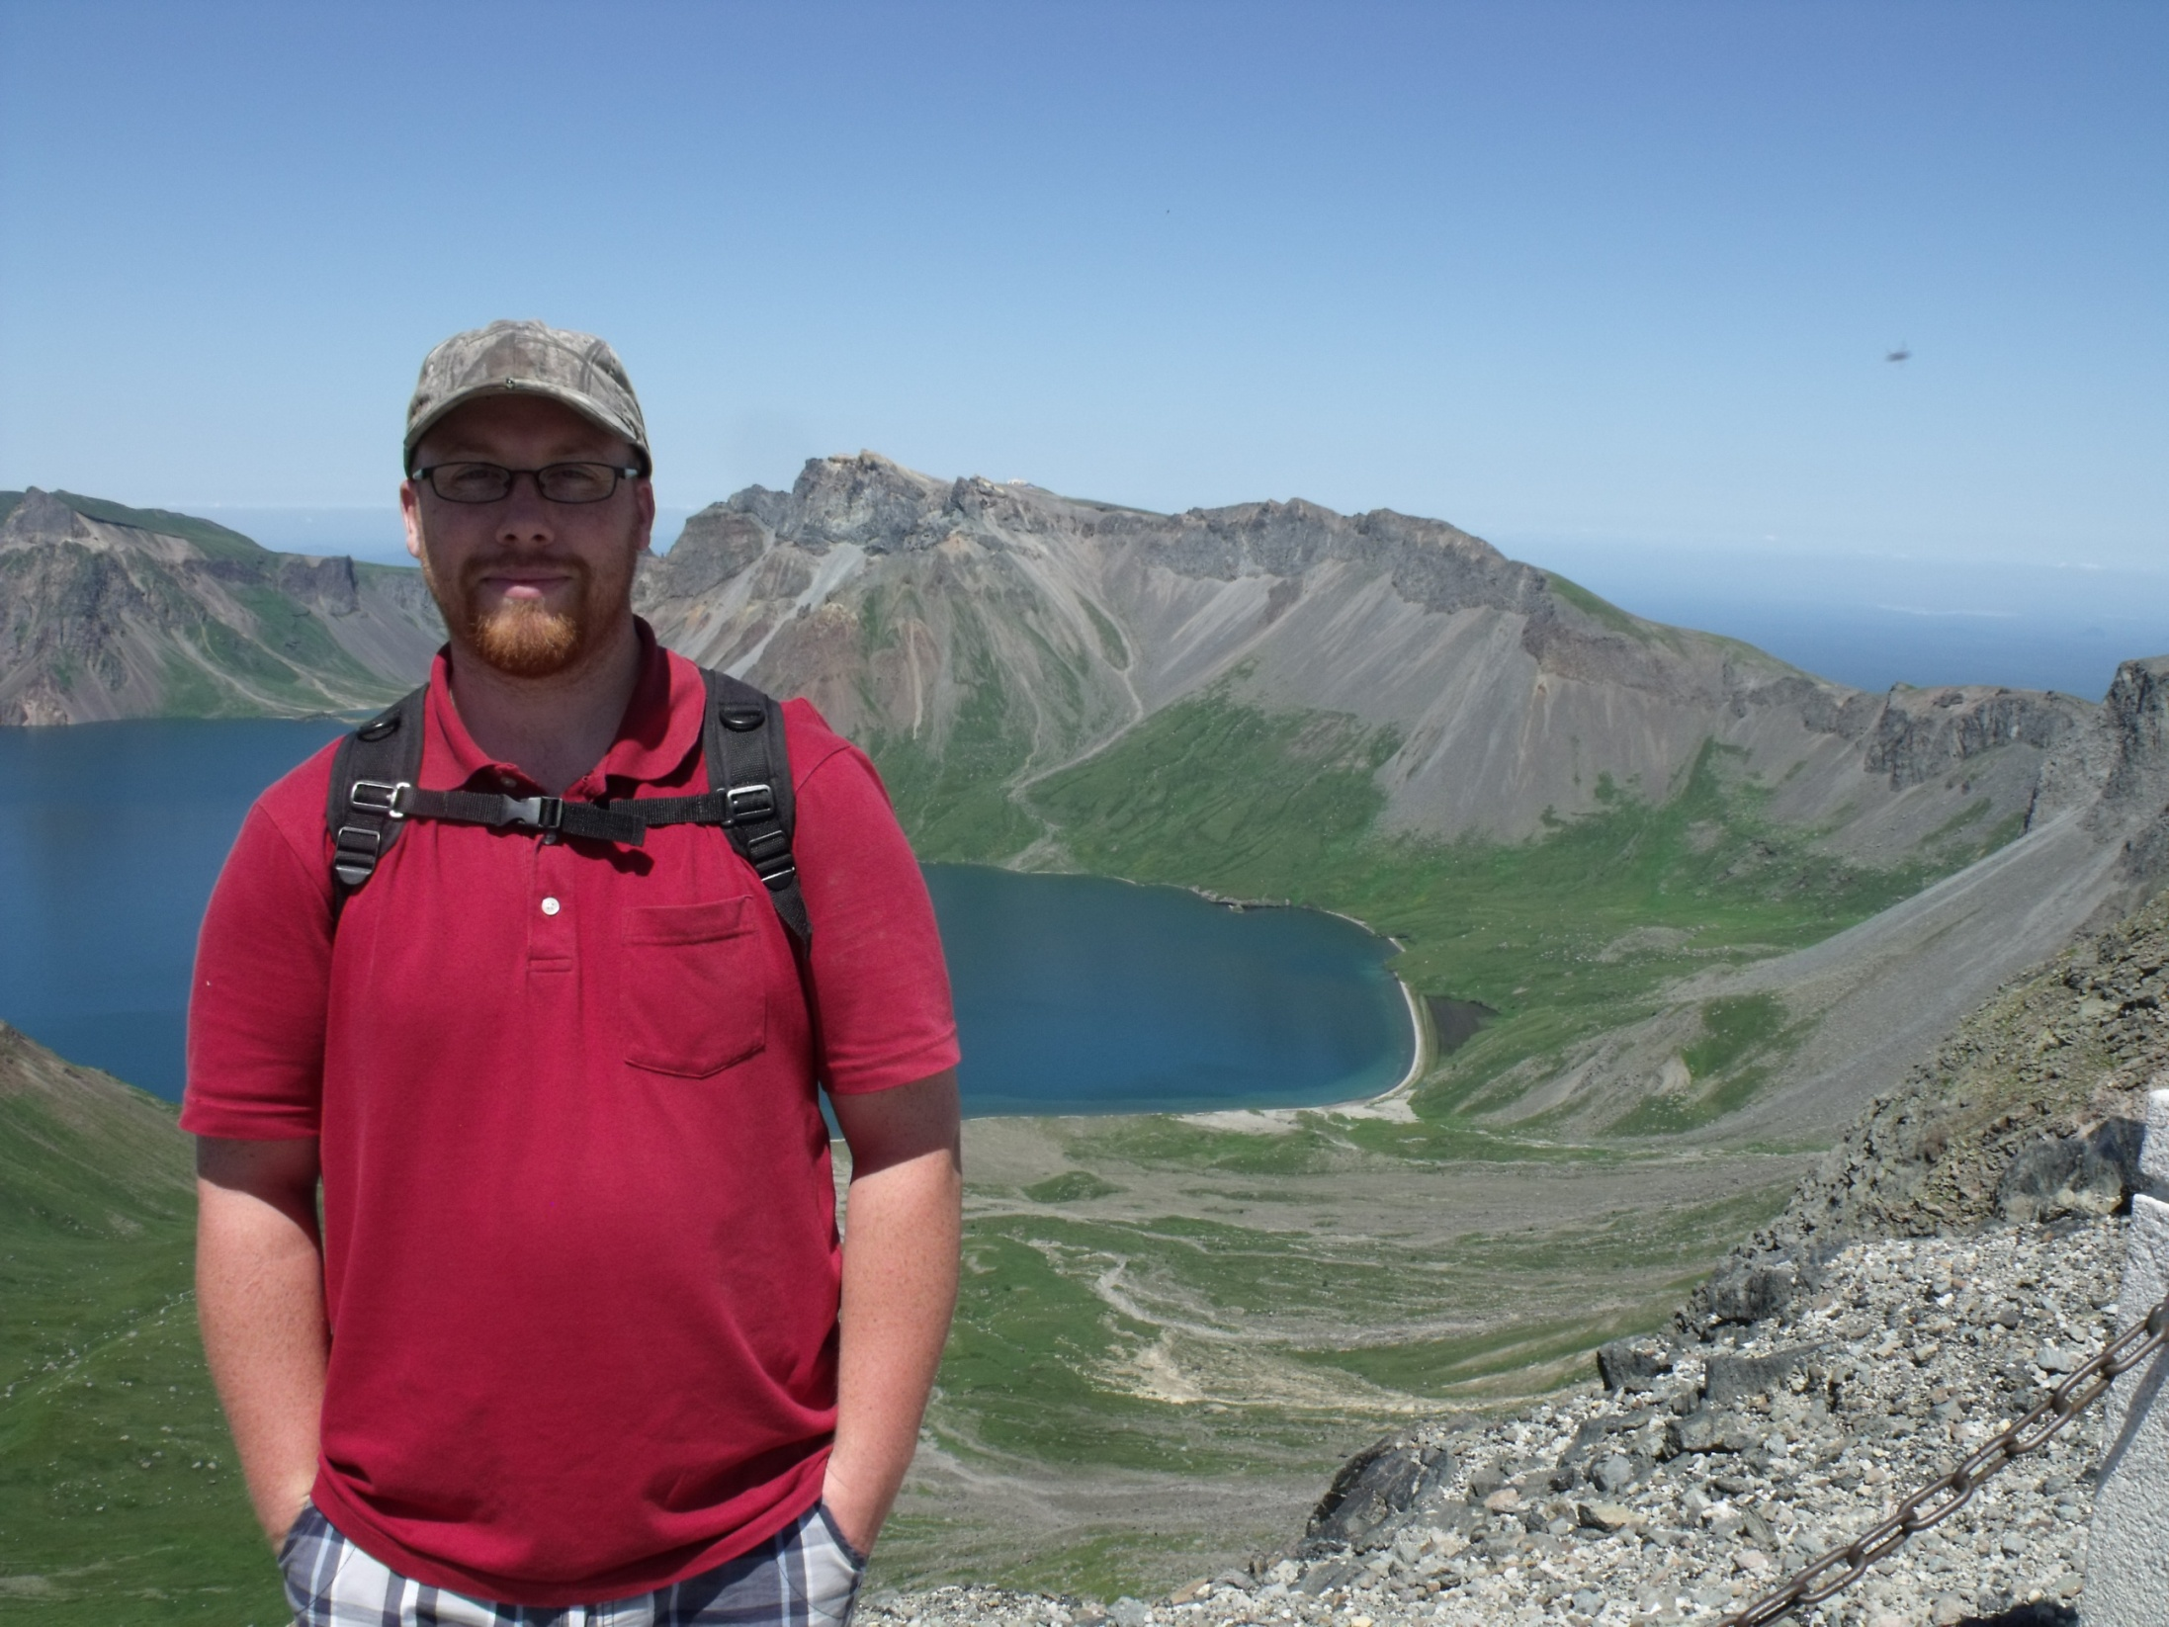

Slide 44

GOALS
SPEAKING III

Slide 45

Human Library
Unique People

Slide 46
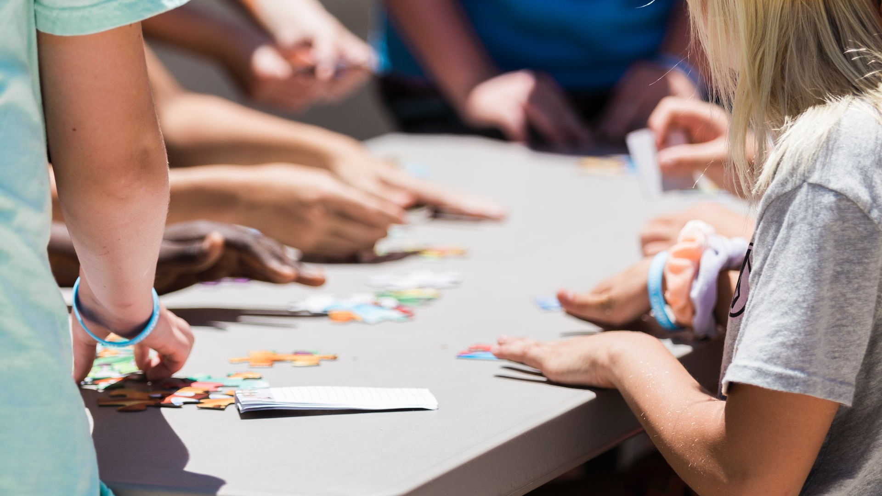
Games & activities
Board games, Apps, Challenges

Slide 47
Variety
Bartering, Maps, Mars, Role play

Slide 48
GOALS
READING

Slide 49
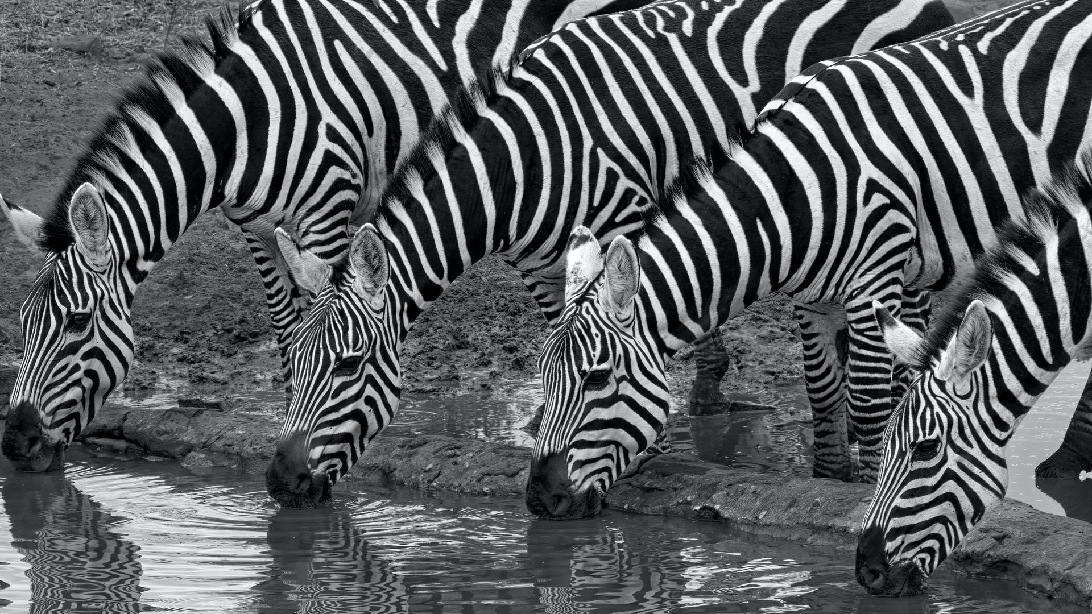
News ARTICLES
Zebra Escape, Bananas Art, Trapped in Ikea…

Slide 50
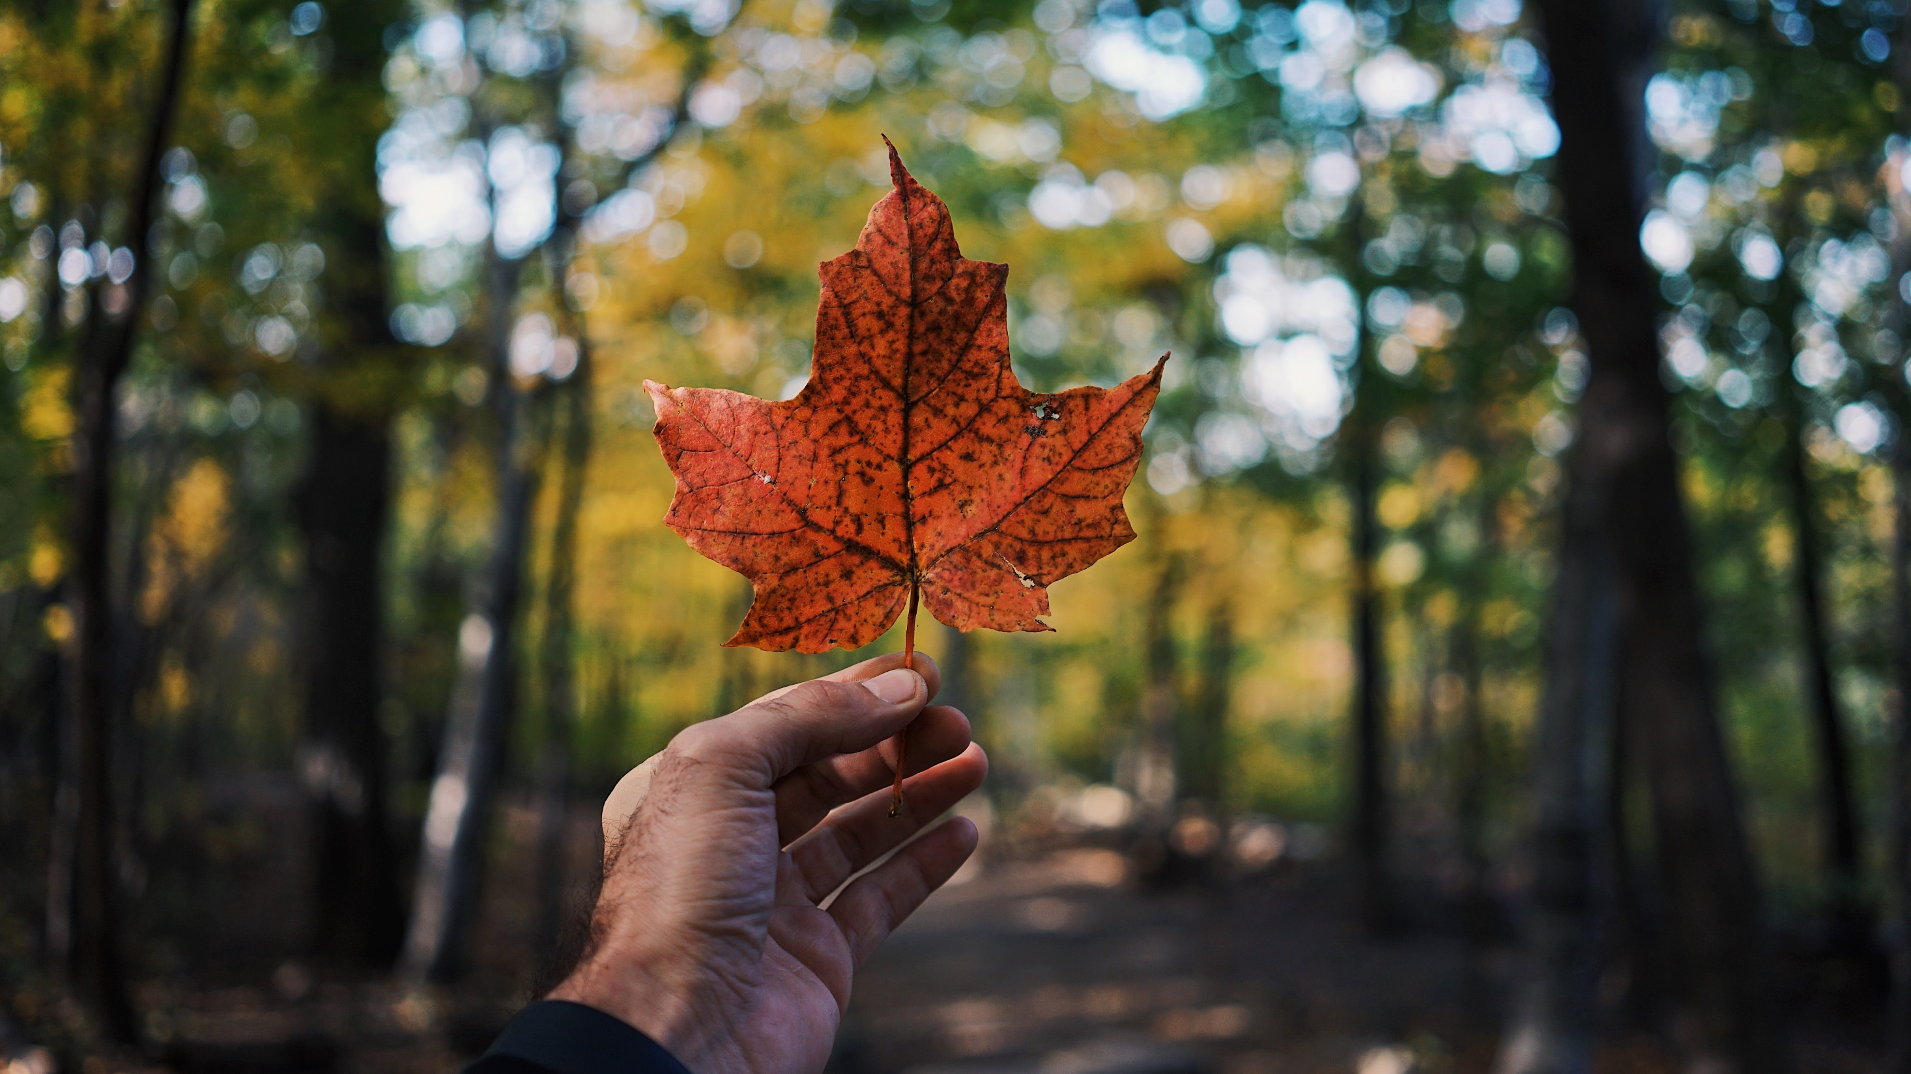
Canadian READING
Maple Syrup Heist, Canadian Goose Problem

Slide 51
GOALS
CONVERSATION

Slide 52
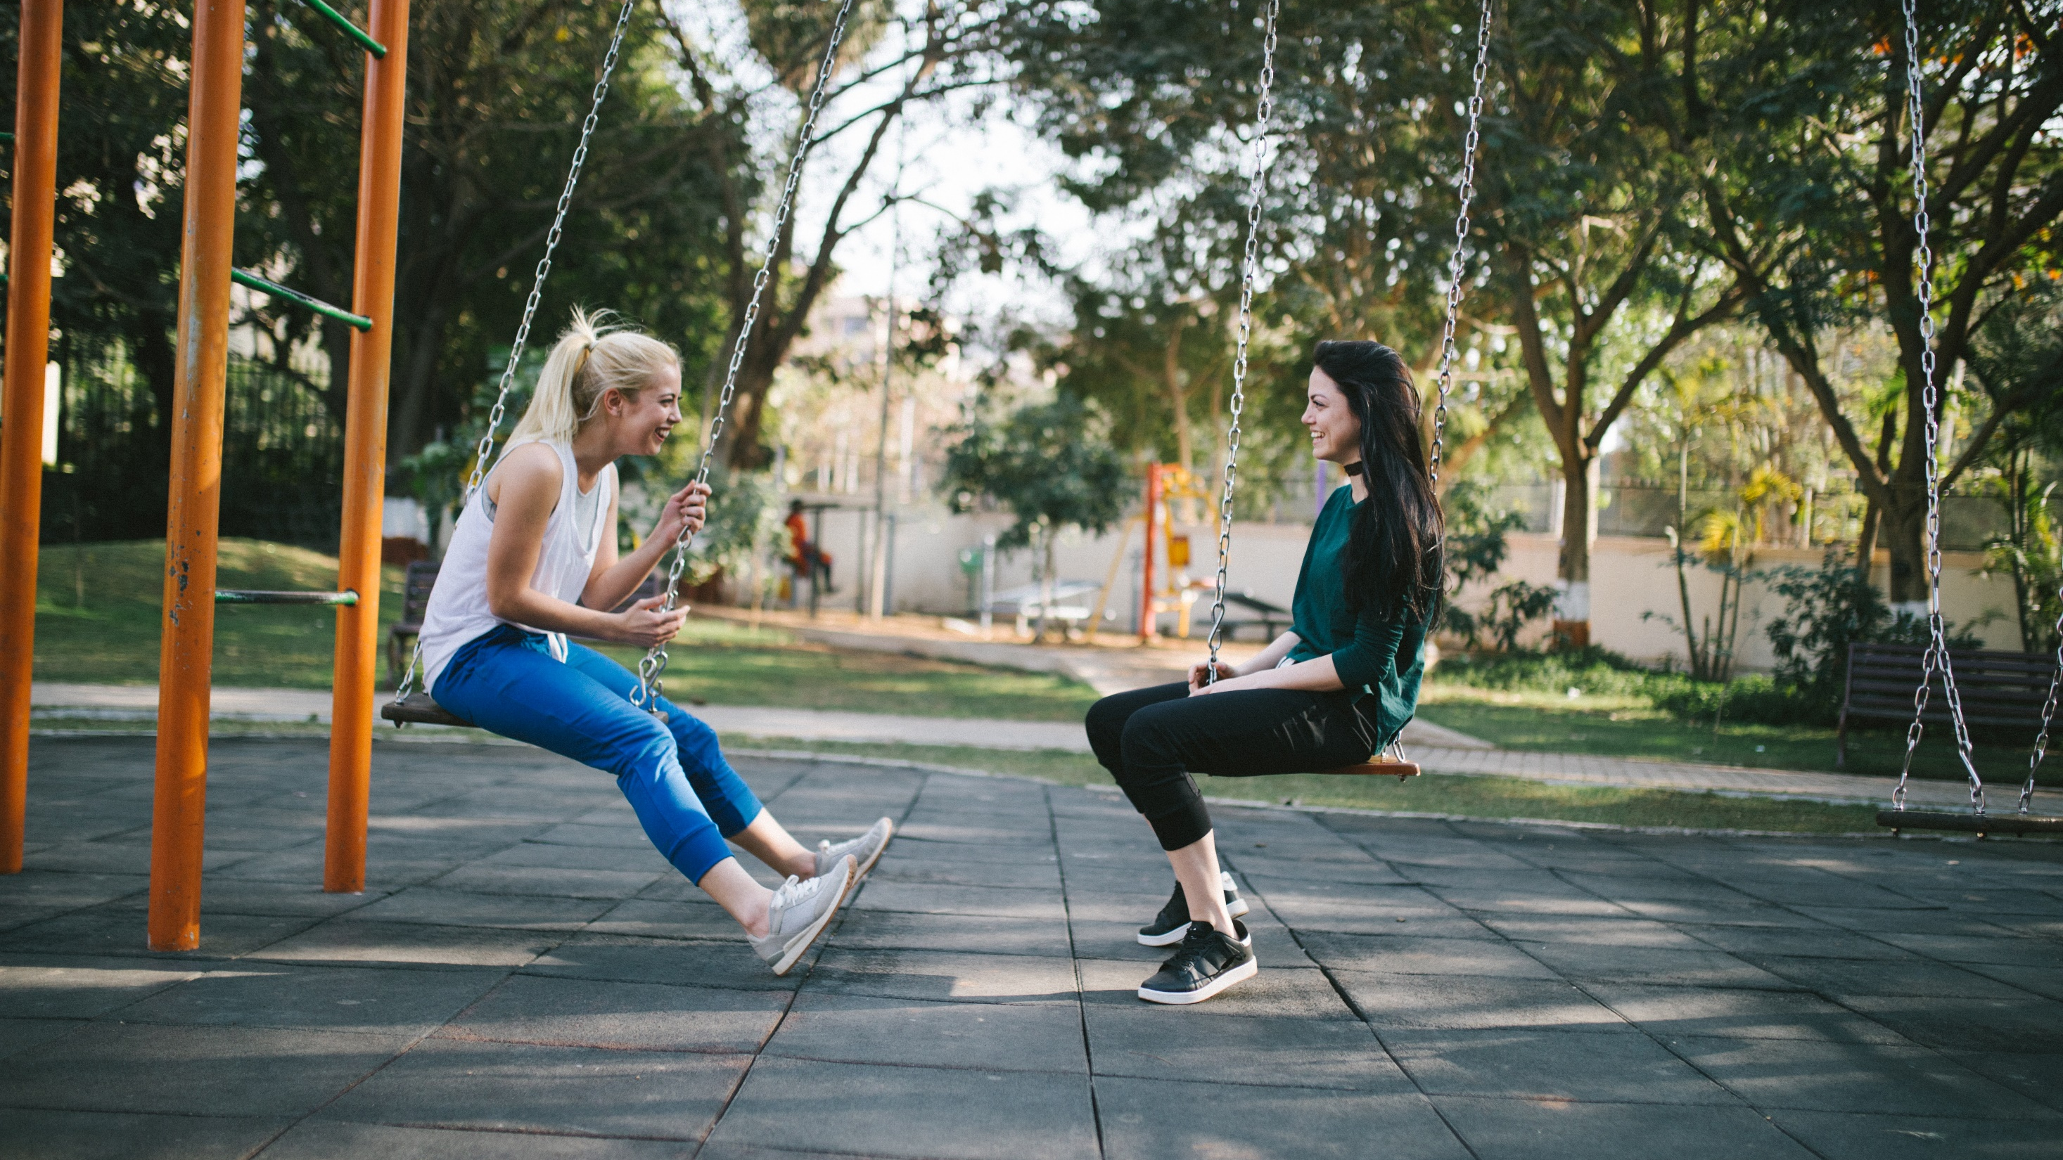
CONVERSATION
talk and games

Slide 53





ESL
ToyBox

Slide 54
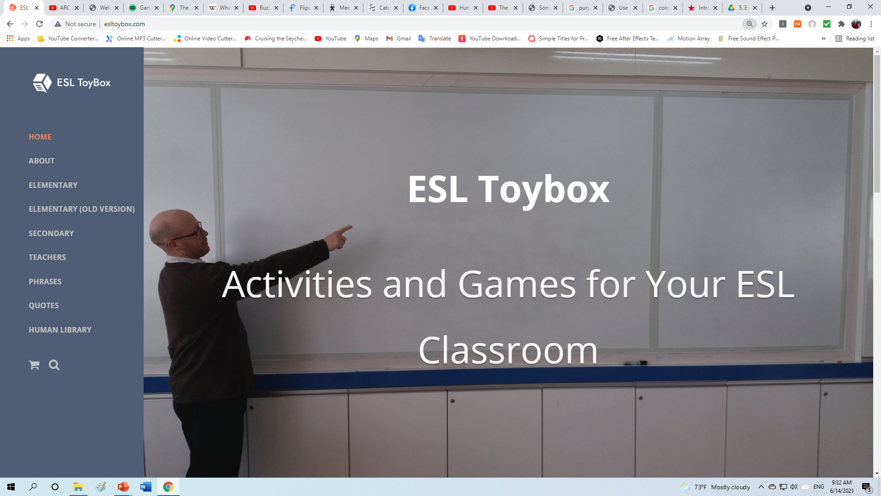

Slide 55



Slide 56
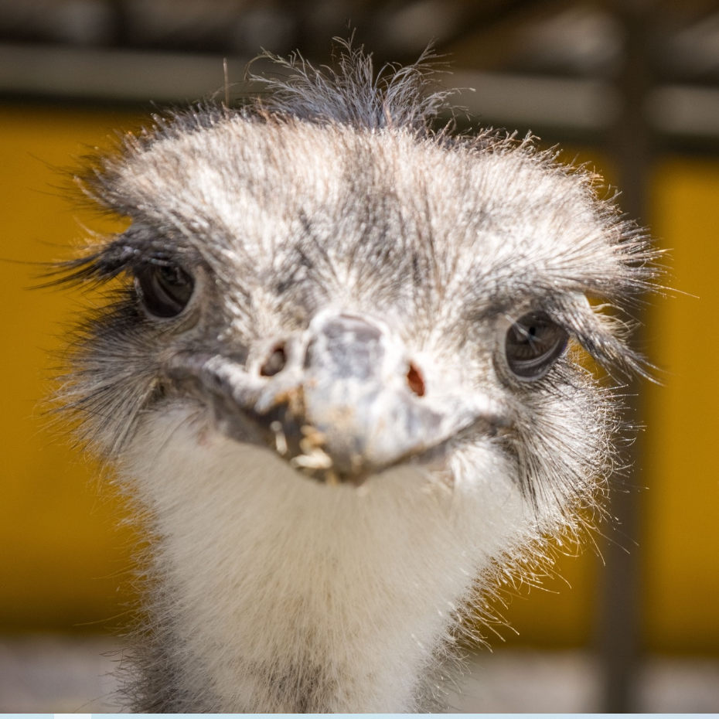
작은 마을
Small Town Korea

Slide 57

https://create.kahoot.it/share/s-iettp-2022-introduction-questions/63afef81-9c88-4fa3-93c8-6fb0bbcc91bb

